Slide 1
UTILITY VAULT
Group no 4
BY
NACHIKET BHUTA (1824015)
HIMANSHU TIGAIYA (1824024)

Slide 2
PAGES
UTILITY VAULT
CURRENCY CONVERTER
WEATHER FORECAST
SEARCH IMAGES
NEWS FEED
DICTIONARY

Slide 3
TECHNOLOGY STACK
HTML :- To display basic elements on the webpage.
CSS :- To improve design of the webpages.
JAVASCRIPT & AJAX:- To dynamically render HTML elements.
JQUERY :- To display the response received from external services.
AJAX :- To make request to external services.

Slide 4
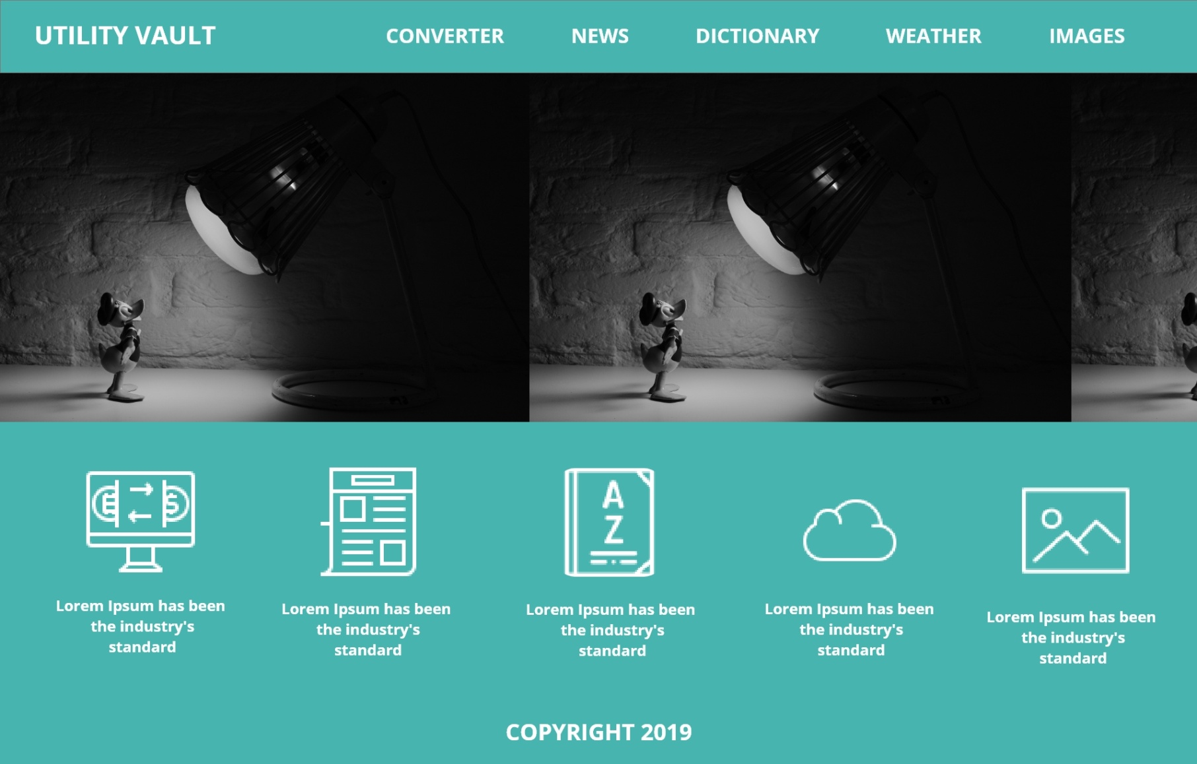
HOME PAGE

Slide 5
THANK YOU

