Slide 1

ZOMATO CLONE
A MERN Stack Web Application for Managing and Ordering Food
Student Names: Mohit Sharma Mentor Name: Mentor Aryaman Team Name: (MERN Interns)
— Technology: MongoDB · Express.js · React.js · Node.js
Zomato Clone simplifies online food ordering by discovering 50 authentic Indian restaurants across 10 cities, calculating spatial proximity distances, and managing single-kitchen checkouts.
MongoDB: Stores users, restaurants, food items, and order transactions.
Express.js: API routing, JWT validation, and business logic.
React.js: Component-driven UI and Redux state management.
Node.js: Server runtime for backend services.

Slide 2
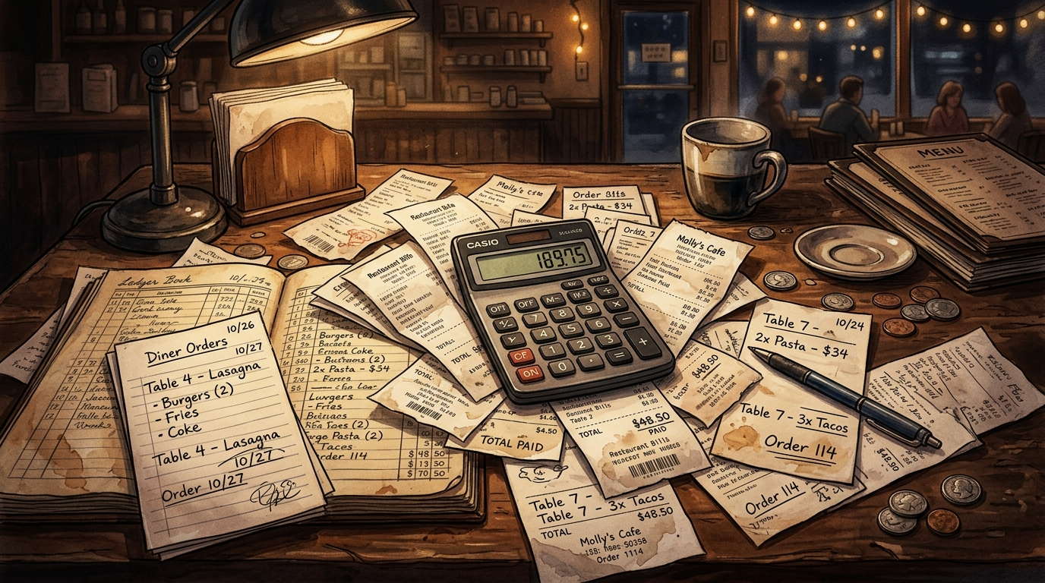
WHY ZOMATO CLONE?
Manual ordering causes confusion
Receipts, calculators, and static menus are error-prone and slow.
Lack of spatial proximity sorting
Static listings lead to delivery delays and distance disputes.
Need for a centralized system
One MERN-based application to browse, filter, and order improves transparency.
Learning opportunity
Apply full-stack MERN concepts to a practical, user-focused project.
Comparison
MANUAL: Paper Menus → Phone Calls → Manual Tracking → Confusion
With Zomato Clone
ZOMATO CLONE: Detect GPS → Sort Proximity → Filter Cuisines → Track Orders

Slide 3
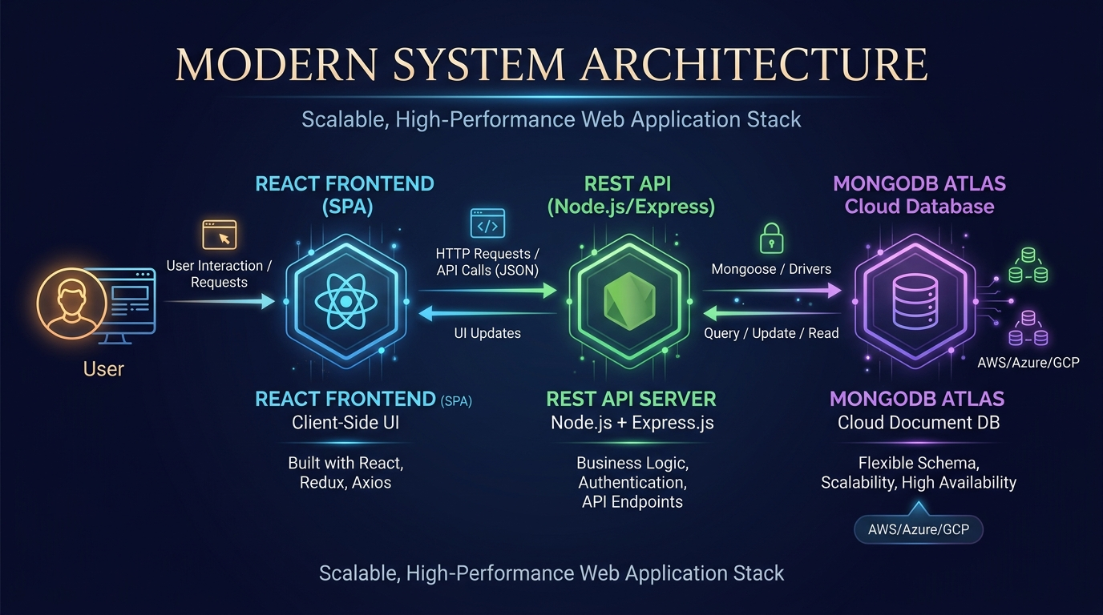
TECHNOLOGY STACK
Visual overview of core technologies and responsibilities in the application.
React.js
Interactive UI, reusable components, client-side state (Redux Toolkit/Vite).
Node.js
Server environment for Express APIs and background tasks.
Express.js
REST endpoints, validation, and authentication hooks.
MongoDB
Flexible document storage for restaurants, food items, users, and orders.
Additional: HTML5 · CSS3 · JavaScript · REST APIs · Axios · JWT · Mongoose ODM · Tailwind CSS

Slide 4
DEVELOPMENT CHALLENGES & SOLUTIONS
Concise Problem → Solution mapping encountered during development.
01 Problem 1: Mongoose buffering timeout on serverless cold starts
02 Problem 2: Cross-Origin Resource Sharing (CORS) preflight blocks
03 Problem 3: Multi-restaurant cart checkout conflicts & routing errors
04 Problem 4: External image loading flickers & fallback handling
05 Problem 5: Expired JWT tokens failing silently without redirection
Solution 1
Disabled bufferCommands, set 5s timeout, and added fallback mock dataset in controllers.
Solution 2
Configured explicit Express cors middleware with allowed Vercel frontend origins.
Solution 3
Engineered single-kitchen cart guard clearing items when switching kitchens.
Solution 4
Implemented onError fallbacks and smooth blur-to-focus load transitions.
Solution 5
Added Axios response interceptors clearing invalid tokens and redirecting to Login.

Slide 5
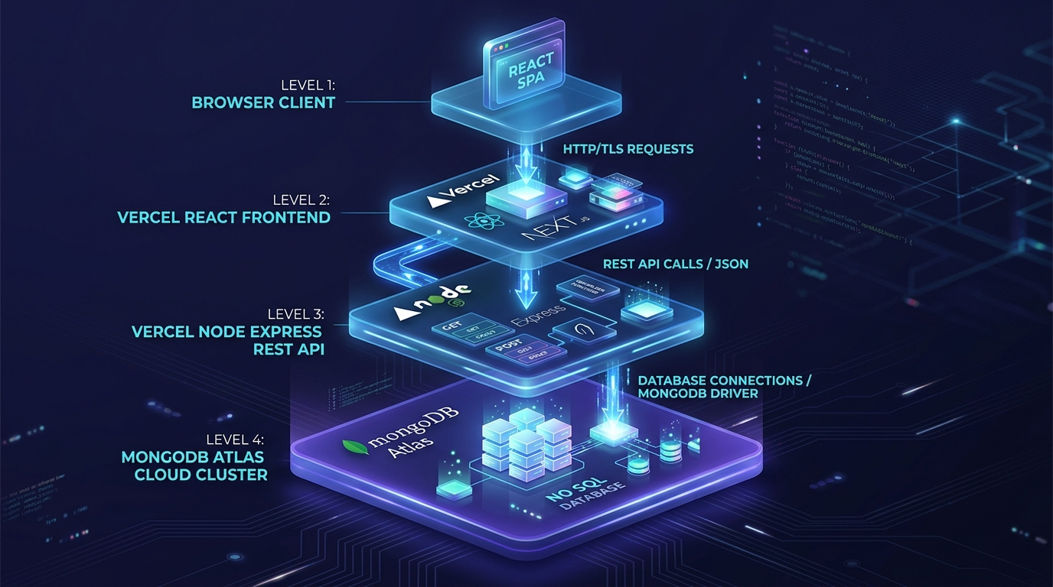
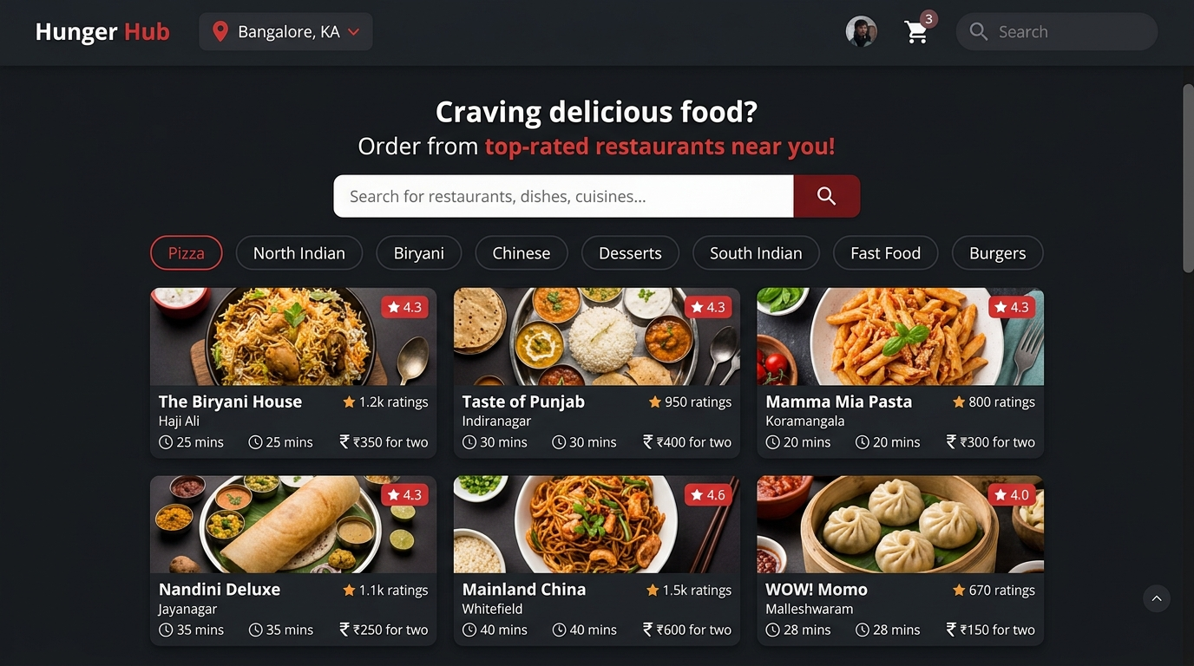
DEPLOYMENT & APPLICATION ARCHITECTURE
Deployment Configuration
• Frontend: VERCEL (https://zomato-clone-frontend.vercel.app)
• Backend: VERCEL (https://zomato-clone-backend-psi.vercel.app)
• Database: MongoDB Atlas Cloud Cluster
Caption: Decoupled serverless architecture enables independent scalability.
Screenshots of Live Web Application:
• Screenshot 1: User's Login Page & JWT Auth Interface.
• Screenshot 2: Restaurant Discovery & Spatial Proximity Dashboard.
• Screenshot 3: Categorized Menu & Promotional Badges (Bestseller, Chef Special).
• Screenshot 4: Single-Kitchen Shopping Cart & Checkout Interface.
• Screenshot 5: Order Confirmation & Live Delivery Status Tracking.

Slide 6
DEMO, KEY LEARNINGS & FUTURE SCOPE
Project Demo (walkthrough)
1. Login / Create account with JWT authentication
2. Location & GPS — Detect coordinates & sort nearby kitchens
3. Filter Cuisines — Select North Indian, South Indian, Fast Food
4. Inspect Menu — View Bestseller & Chef Special dish badges
5. Cart & Checkout — Review bill and place single-kitchen order
Key Learnings
• Practical understanding of MERN architecture and data flow
• Designing reusable React components & Redux state strategies
• Building secure, testable REST APIs with Express & JWT
• Schema design and indexing in MongoDB Atlas
• Debugging serverless cold starts & handling DB fallback edge cases
Future Improvements
• Mobile App: Develop companion React Native app with offline sync for mobile-first users.
• Notifications: Integrate Nodemailer & WebSockets for live order status and promo alerts.
• Payments: Integrate Razorpay / Stripe payment gateways for direct online checkout.
Thank You

