Slide 1

SetuAI
An offline, on-device sign-language bridge
setu (सेतु) — Hindi/Sanskrit for "bridge." Built to work where the signal doesn't.
SNAPDRAGON® AI LAB BUILD & PRESENT CHALLENGE · QUALCOMM, VIA UNSTOP · INDIVIDUAL SUBMISSION

Slide 2

01 · THE PROBLEM
A 60,000-to-1 gap
India has one certified interpreter for roughly every 60,000 deaf citizens. Most ISL apps assume a live interpreter or a data connection — both fail exactly where the gap is worst.
~18M
~300
Deaf individuals in India
Certified ISL interpreters nationwide
National Association of the Deaf
ISLRTC
63M
Indians with significant hearing loss
WHO fact sheet

Slide 3

02 · THE SOLUTION
A two-way bridge, running entirely on-device
✋ Sign → Speech / Text
⌨ Speech / Text → Sign
A camera reads the signer's hand shape. An on-device model finds 21 hand keypoints. A classifier maps the shape to a word — captioned and spoken aloud for a hearing listener.
✋ → 🔊 "Hello"
A hearing person types a message. It's displayed large and clear — legible across a room — for the deaf person to read.
⌨ "Where's the exit?" → 👁
Nothing touches the cloud. No frame, no audio, no transcript ever leaves the machine.

Slide 4
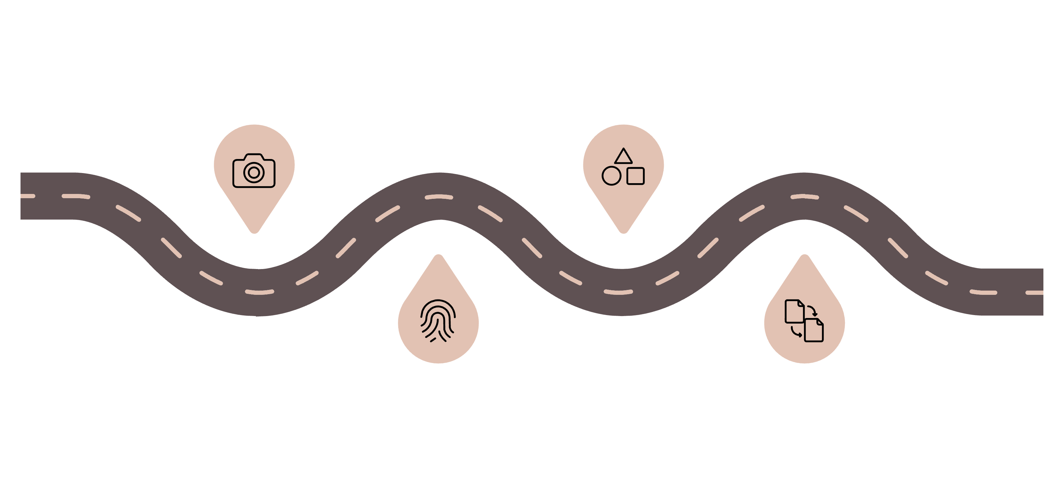
03 · HOW IT WORKS
A real pipeline, not a mockup
Every stage runs live in the browser demo — genuine on-device inference, nothing simulated.
Capture
Classify
Webcam frame grabbed locally, stays on device
Geometry of keypoints → 9-shape vocabulary
Landmarks
Stabilize
MediaPipe finds 21 hand keypoints in WASM
Sign must hold for ~8 frames before commit
From webcam capture to spoken output — every stage runs entirely on-device, with no cloud dependency at any point in the pipeline.

Slide 5
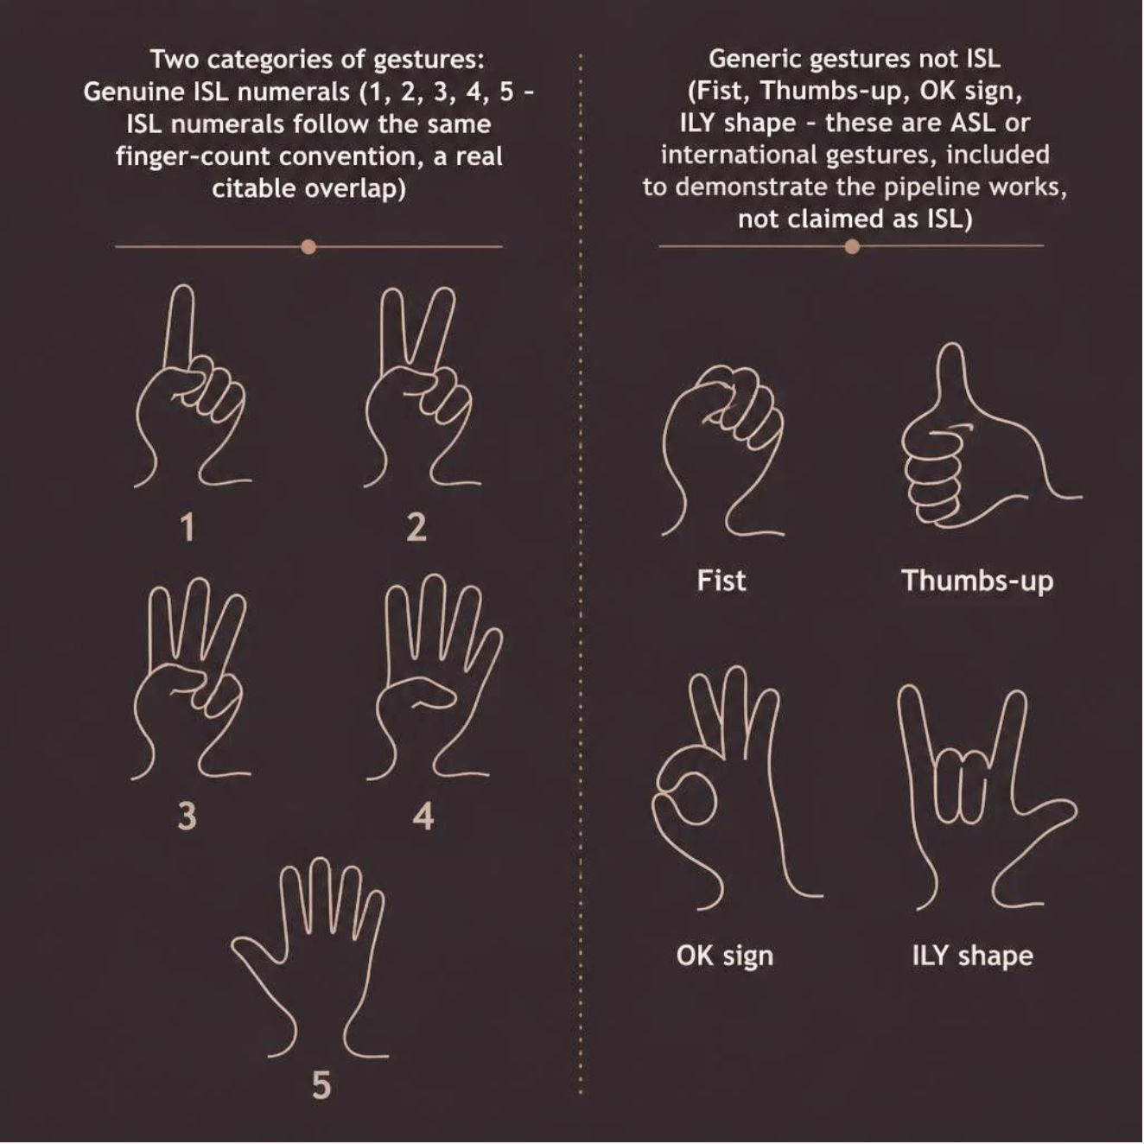
04 · SCOPE, HONESTLY
Only 5 of these 9 signs are genuine ISL
An earlier draft mislabeled some gestures as ISL. That was wrong — here's the corrected breakdown.
Why show a mistake we already fixed?
Because a submission that corrects itself openly is more credible than one that never admits scope limits.
✓ Genuine ISL numerals: 1, 2, 3, 4, 5 — ISL finger-count convention, a real citable overlap
○ Generic gestures: Fist, thumbs-up, OK, ILY — ASL/international, included to show the pipeline works

Slide 6
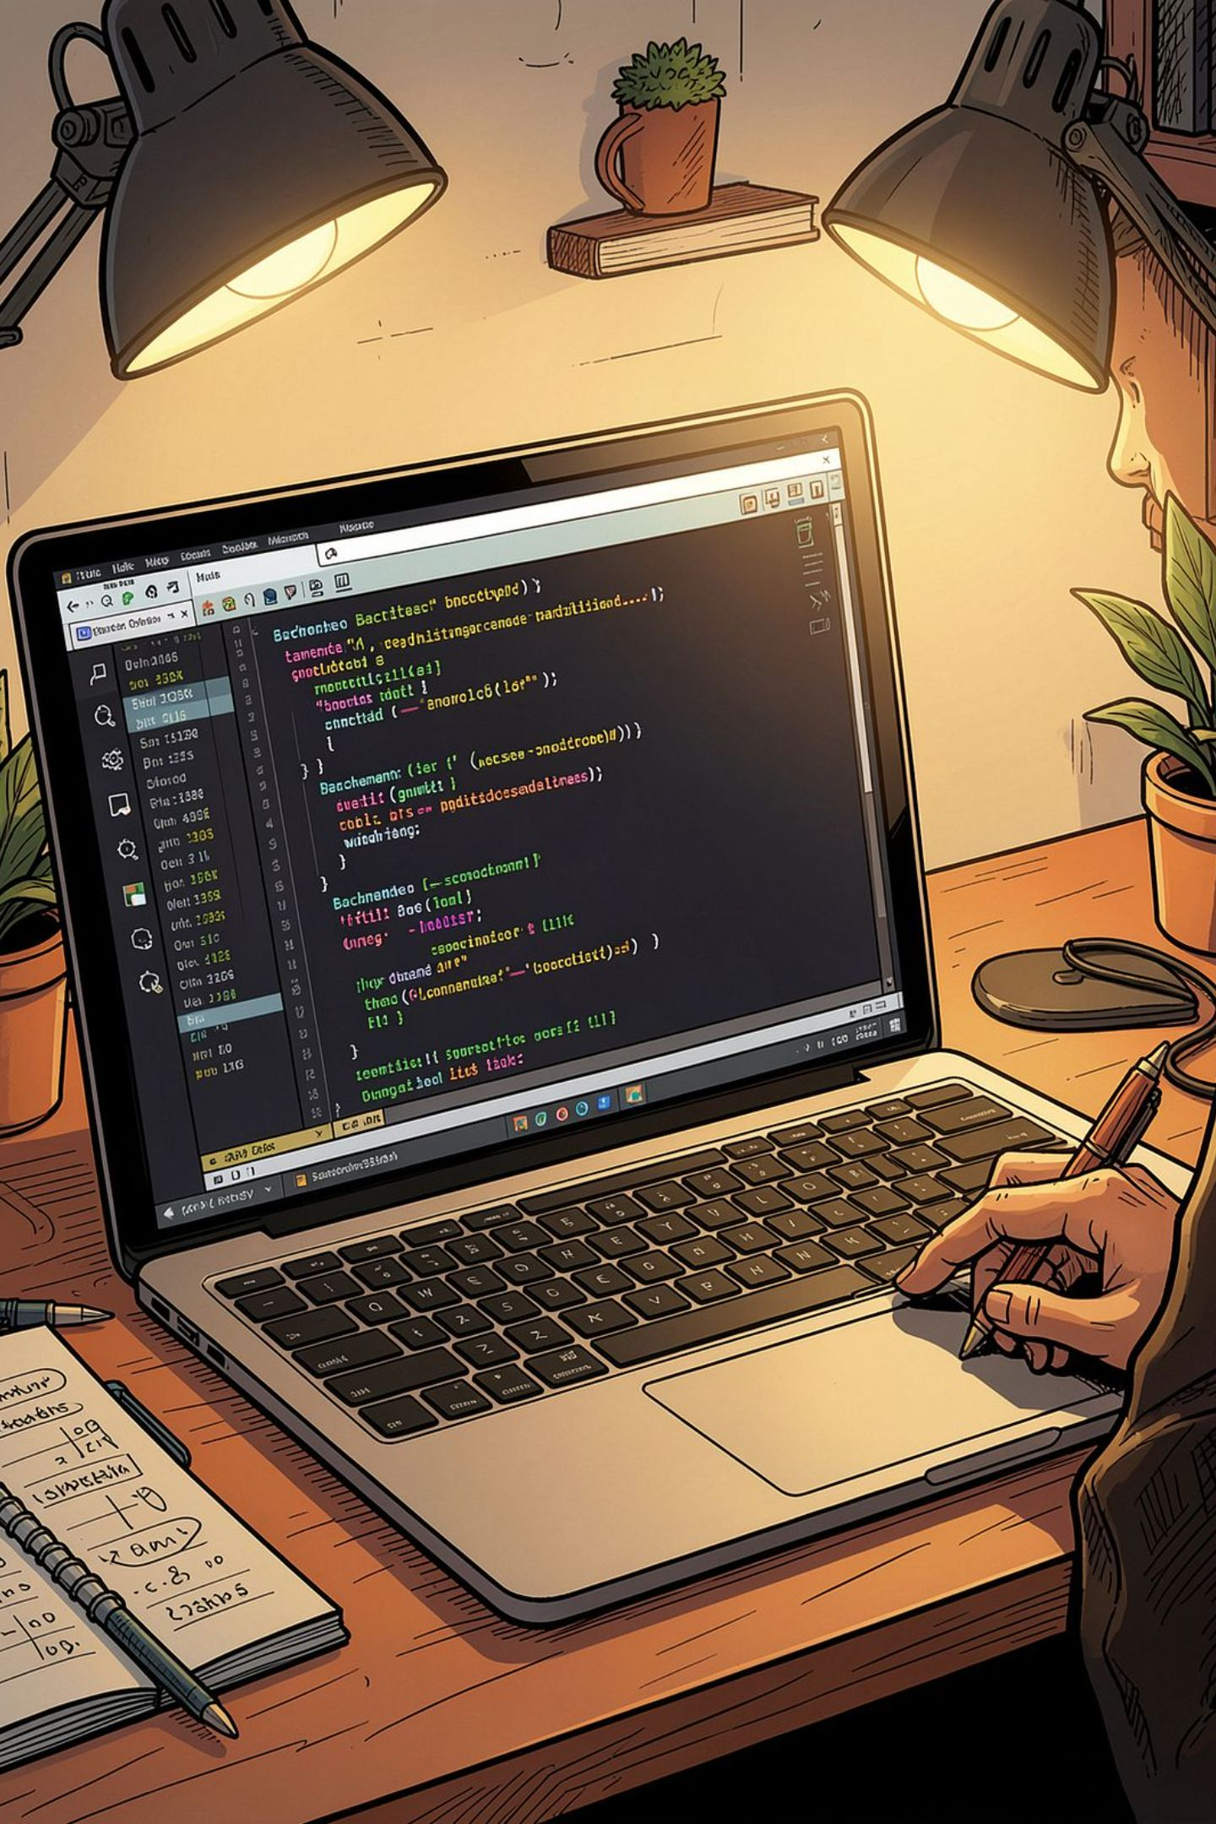



05 · REAL NUMBERS
We didn't just cite Qualcomm's number — we measured our own
Attempt 1 — qai_hub_models + PyTorch
Blocked by disk quota in the build sandbox.
Attempt 2 — Plain MediaPipe
Blocked — model weights host outside the sandbox's network allow-list.
Attempt 3 — ONNX Runtime ✓
Found a real ONNX hand-landmark model on npm, ran it with ONNX Runtime. Worked — twice, consistently.
Script + model + license included — anyone can re-run this.

Slide 7
06 · PRODUCTION PATH
From this browser demo to a Snapdragon NPU app
Stage | This browser demo | Production on Snapdragon
Hand tracking | MediaPipe Hands (WASM) | MediaPipe-Hand-Detection (Qualcomm AI Hub) on Hexagon NPU via QNN — 1.36 ms published
Gesture → word | Rule-based geometry, 9 shapes | Temporal model trained on ISLTranslate (31k pairs), compiled via AI Hub Workbench
Speech-in | Browser Speech API (often cloud) | Whisper-Base-En (Qualcomm AI Hub), fully offline
Speech-out | OS speechSynthesis | On-device neural TTS, extended to Hindi & regional languages

Slide 8
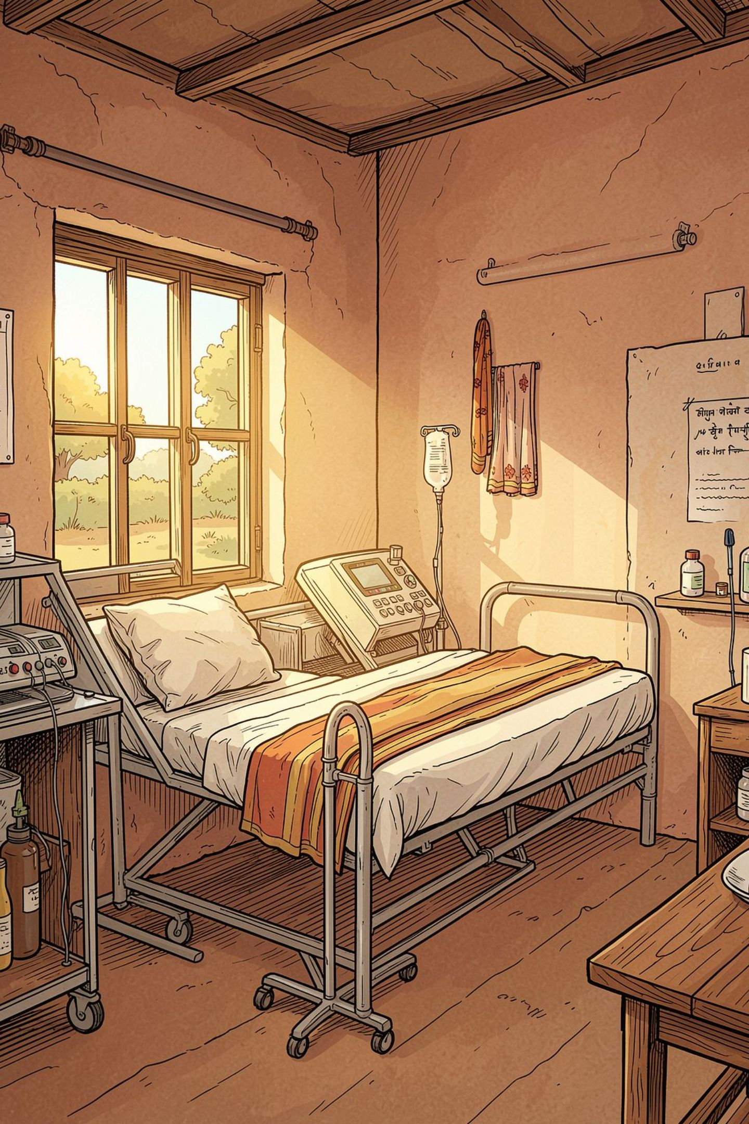




07 · WHY THE NPU MATTERS
On-device isn't a preference here — it's the requirement
No connectivity required
Works in a rural clinic, moving vehicle, or network outage — exactly where the interpreter gap is worst.
No per-query cost
A cloud API charges per call. This is used dozens of times a day — it must be free after the device is bought.
Privacy by design
A camera feed of a medical visit or bank appointment never leaves the person's device.
1.36 ms on the NPU
Qualcomm's published number for this model on Snapdragon X Elite — fast enough to feel like real conversation.

Slide 9
08 · ROADMAP
Honest scope today, a credible path forward
Phase 1 — Now
1
Static, single-hand
9 shapes, rule-based, running in-browser today.
2
Phase 2
True ISL words
Fine-tune a classifier on real ISL hand-shapes, compiled for QNN.
Phase 3
3
Two-handed, continuous
Track both hands + pose; temporal modeling via ISLTranslate corpus.
4
Phase 4
Bidirectional, multilingual
On-device Whisper in, on-device Hindi & regional TTS out.

Slide 10

09 · CRITERIA FIT
Mapped against the challenge's own evaluation
Technical Implementation
Working CV pipeline today; named AI Hub model; reproducible ONNX benchmark.
Application Use Case & Innovation
Targets a documented 63M-person gap with an offline-first approach no cloud-dependent app can match.
Deployment & Accessibility
Zero install, zero recurring cost, zero network dependency — plus an offline-cache service worker.
Presentation & Documentation
This deck, a cited README, an honest correction, and a live testable demo — together, not just slides.
setu (सेतु) — a bridge. This is a working bridge, not a promise of one.

Slide 11




Thank You
Let's build a bridge together
Live Demo
Source Code
mohit-shirke.github.io/SetuAI/
github.com/Mohit-shirke/SetuAI.git
Email
Phone
ommohitshirke@gmail.com
9321593583

