Slide 1


ELECSY
Front-end development project
Mohit [2010990463]
Mentor: Lavish arora

Slide 2


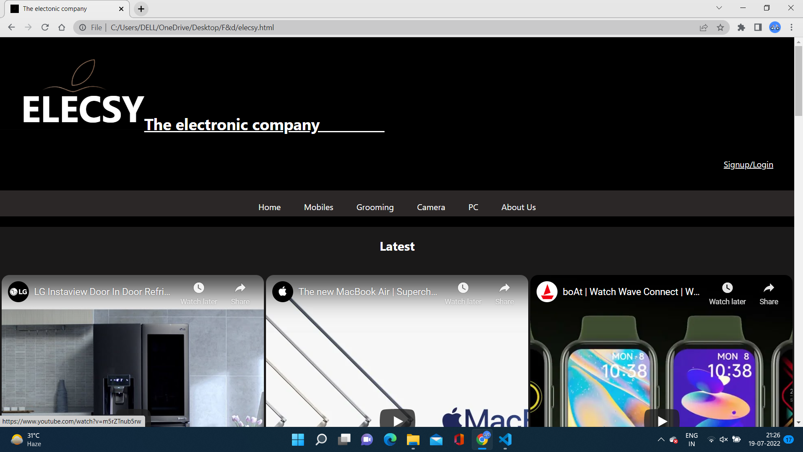
HOME page
This is the home page of the projects.
Which includes all the major features and elements of the webpage .
Also it includes the demo section for users.

Slide 3
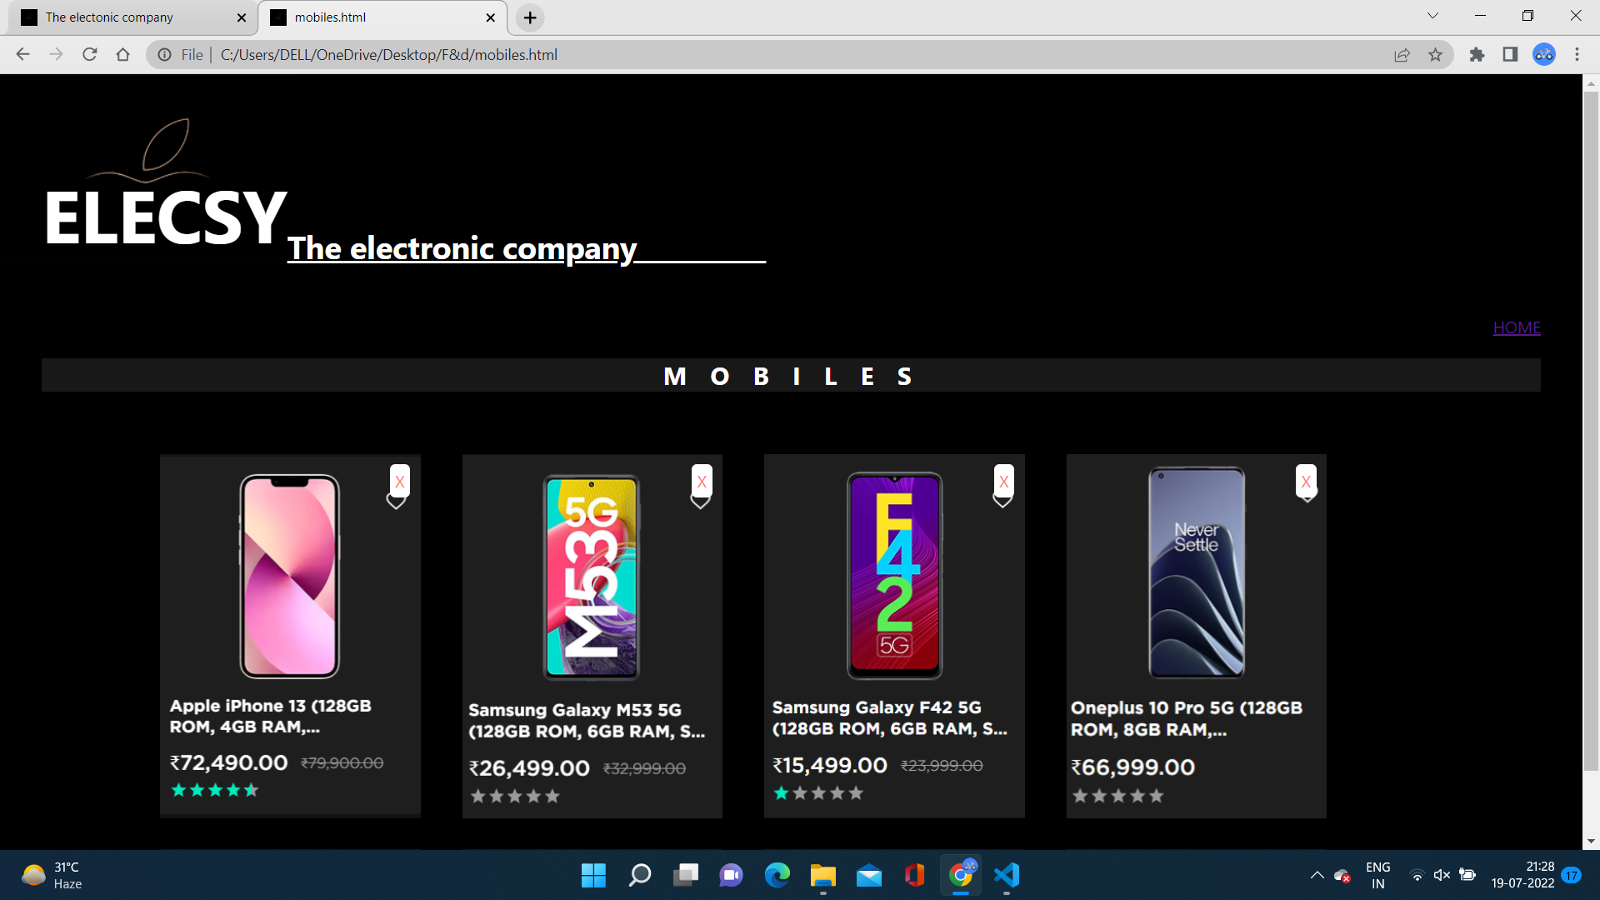
Mobiles page
This section includes a shopping
user Interface .
The user easily access all the products accordingly.

Slide 4
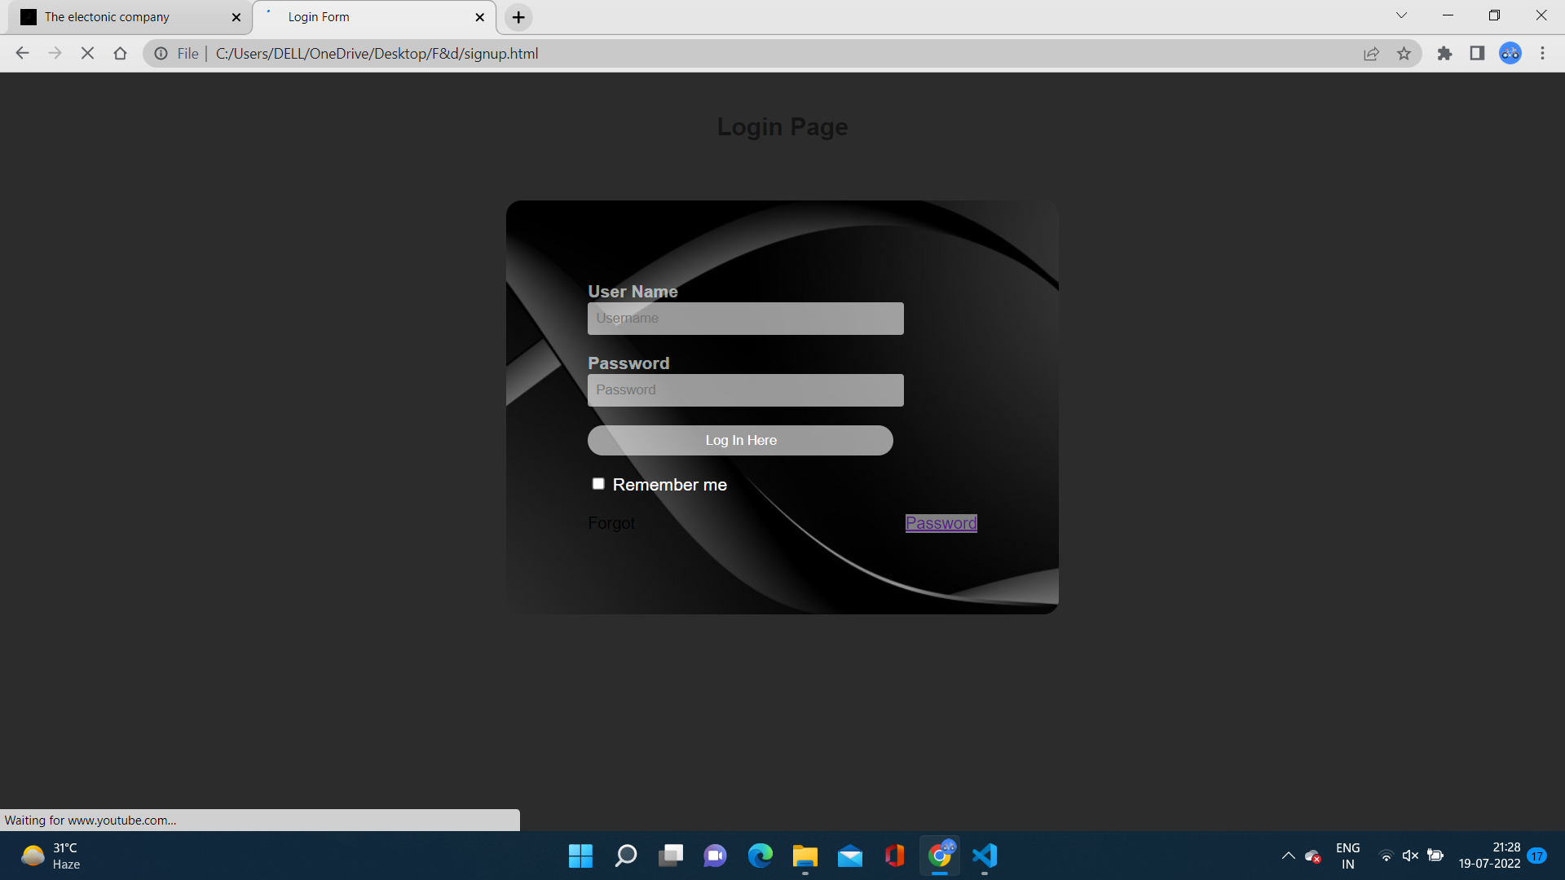
SIGNUP page
This is the signup section of the website .
Build using a html forms.
Must help user to create an account or login the preexisting accounts.

Slide 5
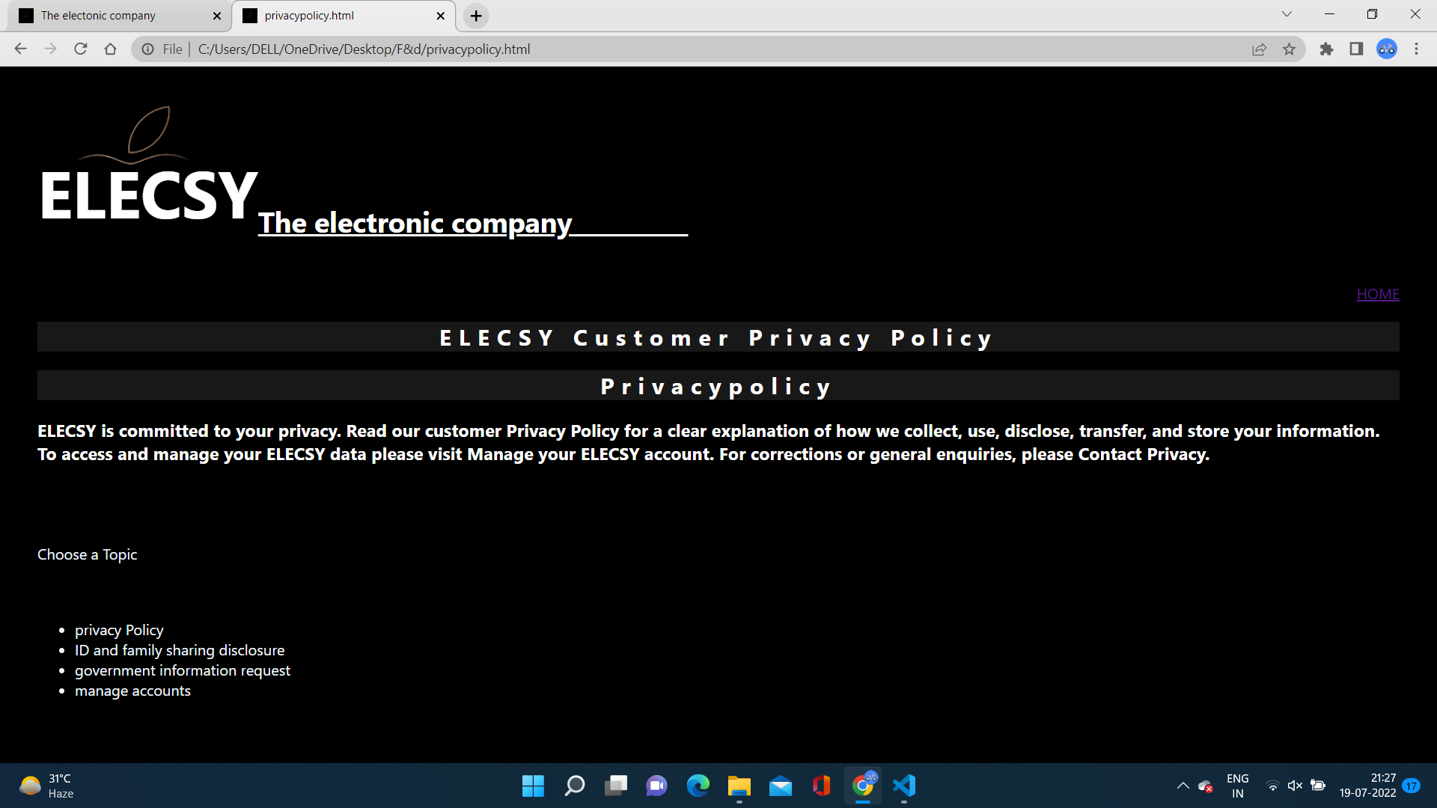
PRIVACY-POLICY page
This Is the privacy policy section the webpage.
And this must be included in the every company’s website .
This include directly approaching factors in order to help customers.

Slide 6
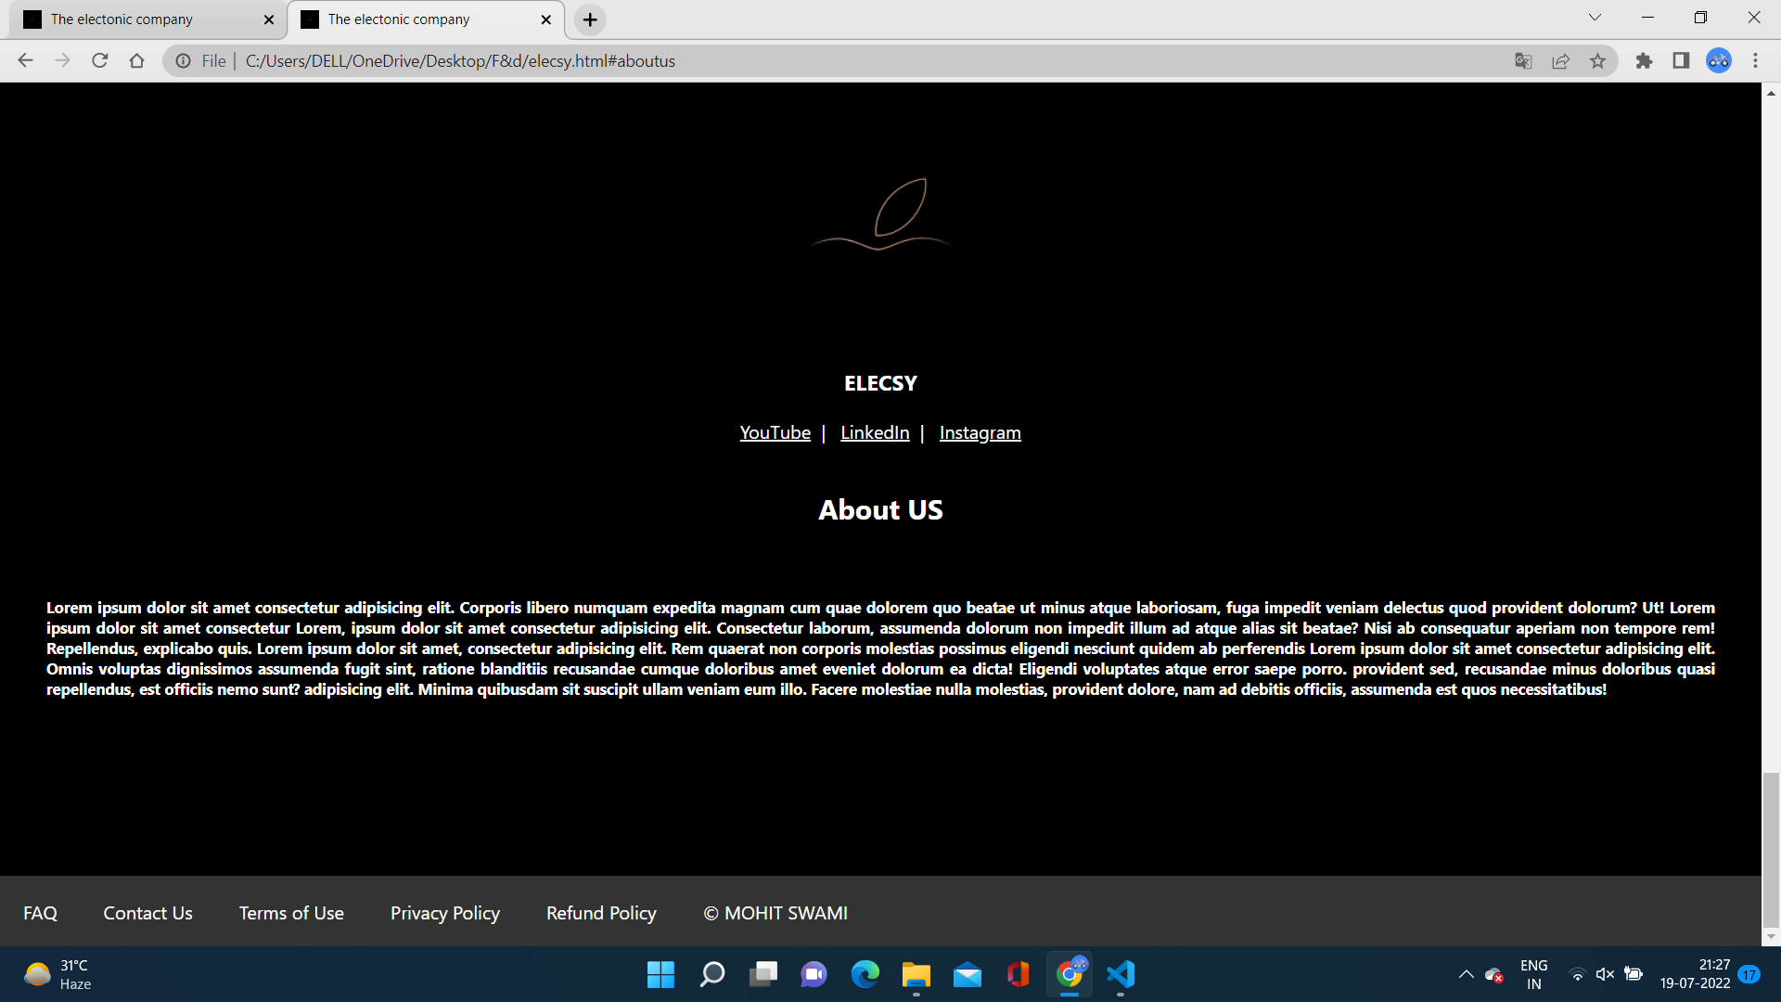
ABOUT US page
This is the about section include all policies and features of the company.
This section is the last section of the company profile
And can be accessed at the end of the webpage just as an internal linking at the end .

Slide 7
Thank you

