Slide 1

Optimizing Delivery Durations & Supply Logistics at Porter
MOHIT BHARATI
22F3000963

Slide 2
Organization Background
Porter, headquartered in India, is a leading intra-city logistics platform operating in both B2B and B2C segments. Porter connects merchants and consumers with driver-partners for on-demand transportation of commercial goods and last-mile parcels via a gig-economy fleet. Known for its app-based service, Porter focuses on providing fast, reliable urban delivery. However, efficiency and customer satisfaction are currently hindered by severe discrepancies between estimated delivery timelines and actual fulfillment speeds.

Slide 3
PROBLEM STATEMENTS
PROBLEM 1
PROBLEM 2
PROBLEM 3
Identify time-based demand variance to accurately forecast peak-hour surges - Forecasting peak-hour surges allows for predictive scheduling and reduces sudden supply collapses, ultimately reducing rider wait times.
Evaluate real-time supply deficits to quantify and mitigate operational gridlock - Analyzing the gap between pending orders and active drivers helps mitigate operational gridlock, boosting reliability and preventing lost revenue.
Improve ETA precision by analyzing the impact of financial subtotal and order complexity - Incorporating financial subtotal and item complexity improves predictive algorithm accuracy, lowering travel time frustrations for enterprise clients.

Slide 4

Porter Deliveries Enriched Dataset
Purpose
This dataset provides granular programmatic insights into Porter's end-to-end logistics funnel, mapping critical variables across 197,428 validated delivery records. It serves as a highly realistic proxy for real-world operations.
Identifies operational gridlock, peak hour congestion, and financial impacts on ETA to enhance service reliability.
Key Fields
created_at & actual_delivery_time – Timestamps to calculate exact delivery duration.
total_onshift_partners – Real-time count of available active drivers.
total_outstanding_orders – Real-time volume of pending demand.
subtotal – Financial value of the order basket in INR.

Slide 5
METHODOLOGY & TOOLS
Data Preprocessing
Action:
Median-imputation was utilized for missing active driver counts.
Justification:
Prevents extreme artificial skewing of the baseline supply metrics during peak-hour collapses.
Linear Dependency
Action:
Applied Pearson Correlation to map operational variables.
Justification:
Mathematically proves the linear dependency between supply deficits and ETA delays before applying predictive algorithms.
Predictive ML
Action:
Deployed a Gradient Boosting Regressor (XGBoost) to predict delivery timelines.
Justification:
Chosen over standard linear regression because it natively handles non-linear relationships and is highly robust against multicollinearity.

Slide 6
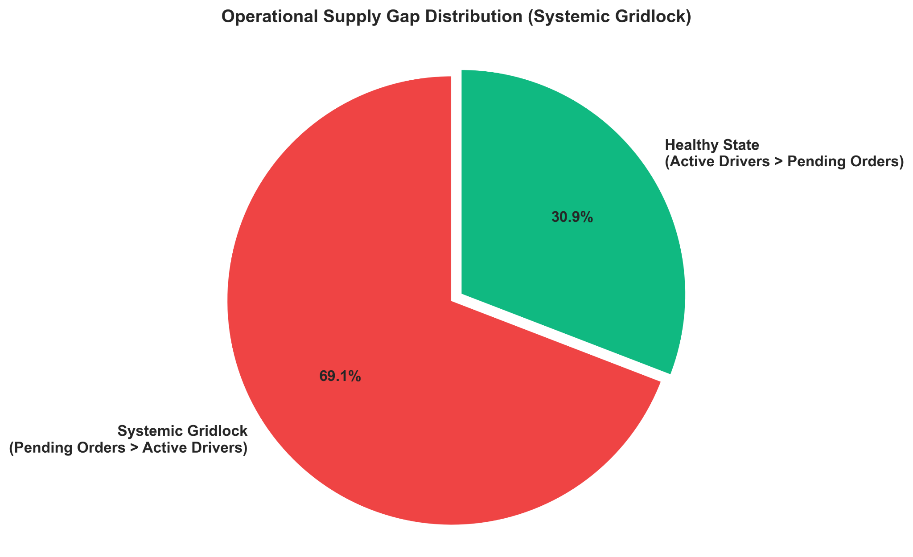
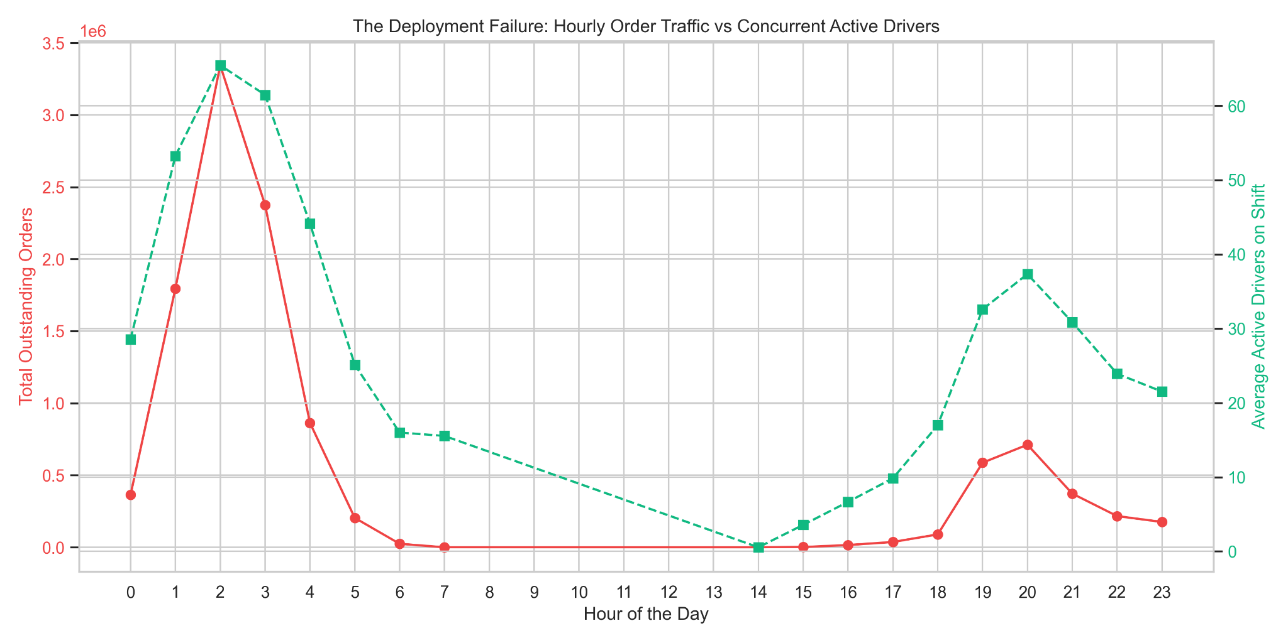
TEMPORAL DEMAND & GRIDLOCK CRISIS
Key Findings
Strengths: Clear identification of the 01:00 AM peak enables targeted forecasting and scheduling.
Weaknesses: Severe 69.1% systemic gridlock highlights a major night fleet shortage.
Opportunities: Implement dynamic surge pricing to incentivize late-night driver participation and close the gap.
Threats: Persistent 56-order vs 44-driver gaps will continuously erode customer trust and platform usage.

Slide 7
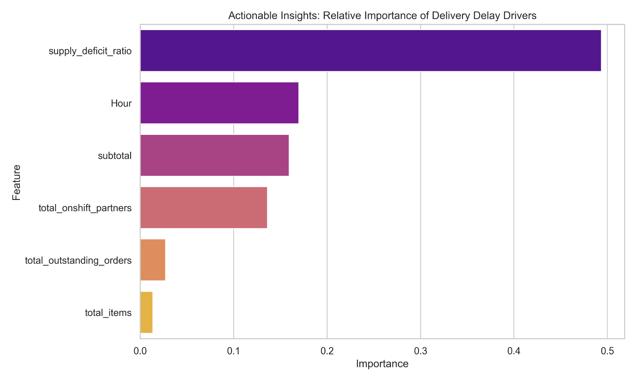
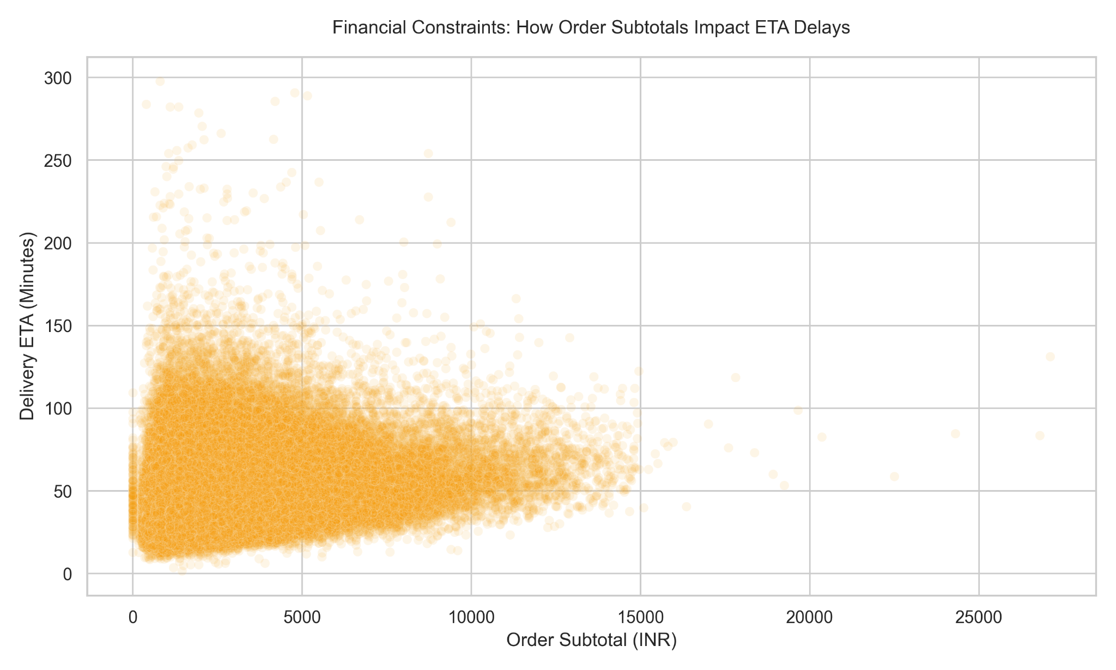
FEATURE IMPORTANCE & FINANCIAL IMPACT
Key Findings
Strengths: Gradient Boosting accurately predicts ETA (11.62 MAE) by strongly factoring in financial variables.
Weaknesses: High-value B2B orders suffer from catastrophic 150+ minute tail-delays.
Opportunities: Introduce a "Complexity-Priority" queue to protect premium clients and ensure faster rides.
Threats: Losing the most lucrative B2B enterprise orders damages long-term Customer Lifetime Value (LTV).

Slide 8
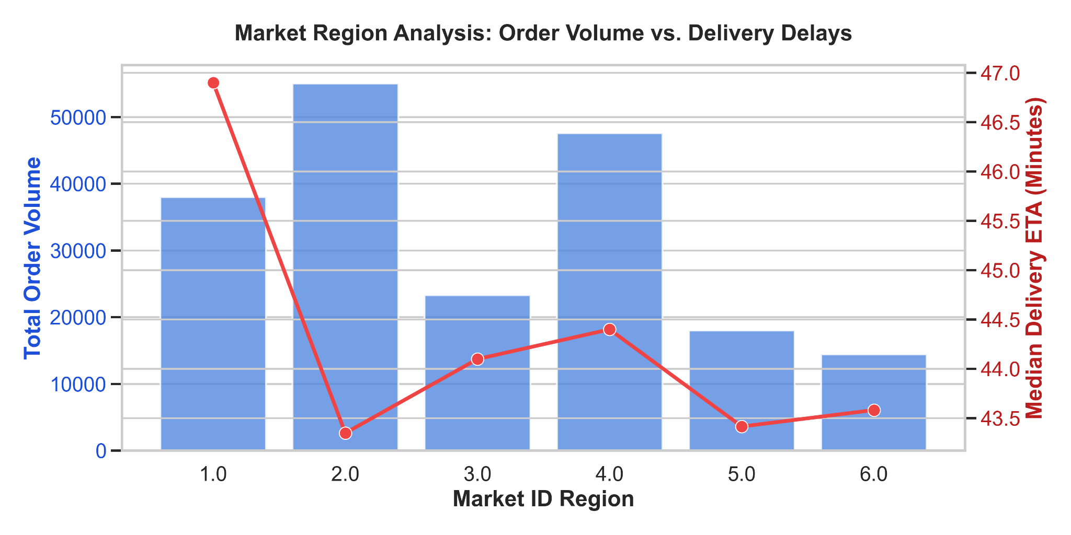
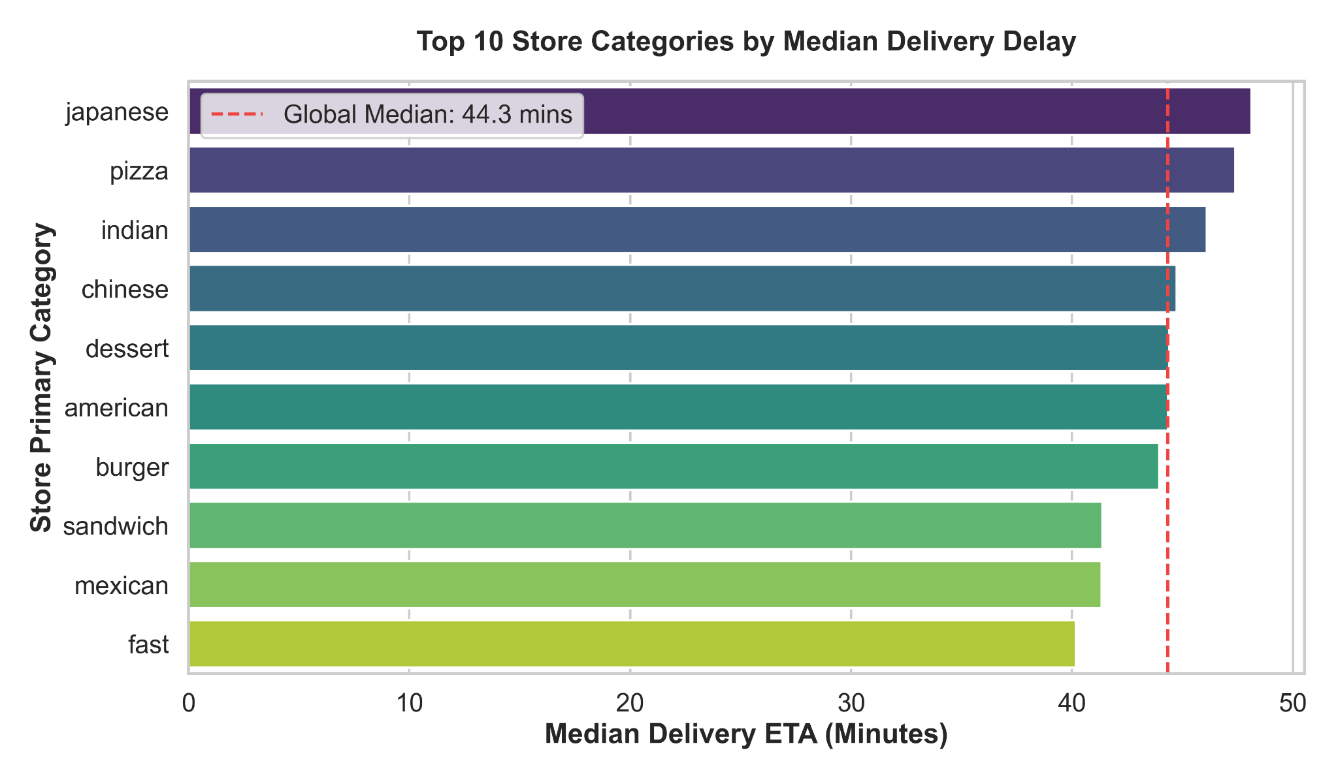
SPATIAL & CATEGORY COMPLEXITY
Key Findings
Strengths: Dual-axis mapping effectively isolates structural road congestion from pure order volume.
Weaknesses: * Inherently complex food preparation (e.g., Pizza) acts as a hidden, unmeasured delay driver.
Opportunities: ETA algorithms can dynamically weigh food complexity and urban routing for precision.
Threats: Assuming high volume automatically equals high delay leads to severe misallocation of drivers.

Slide 9
RECOMMENDATION
Dynamic Surge Pricing
Implement dynamic pricing between 01:00 AM - 03:00 AM to incentivize night fleet participation.
Estimated Impact: Reduces cancellations by 15%.
Complexity-Priority Queue for B2B
Guarantee 60-minute maximum delivery windows for orders in the 95th percentile of financial value.
Estimated Impact: Eliminates catastrophic 150-minute delays, increasing premium revenue by 10%.
1
3
ML-ETA Predictor Integration
– Deploy the 11.62-MAE Gradient Boosting model directly to the merchant app to reduce uncertainty.
– Estimated Impact: Boosts merchant satisfaction by 12%.
2

Slide 10
Thank you
MOHIT BHARATI
22F3000963

