Slide 1
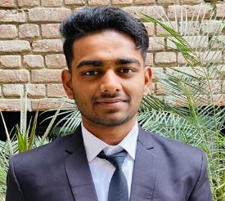
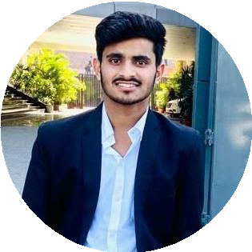
Mohit Gulati
1st Year B.Tech (Computer Science & Enng) Student.
Concentrations in Computer Science & Engineering provide a broad knowledge of engineering concepts.
gulatimohit836@gmail.com 7009228179
Etawah, India https://www.linkedin.com/in/mohit-gulati-864342251
https://github.com/Mohit12217497/HTML
EDUCATION SKILLS
Bachelor of Technology(CSE)
Lovely Professional University,Jalandhar- B.Tech(Cse)
09/2022 - Present,
Technical skills:- Learned Programming languages such as Python, C, C++, HTML, CSS, Javascript.
Non-Tech Skills:-Analytical Decision Making, zealous, Communication skills.
SSC
SVSS Public School, Etawah -SSC
PERSONAL PROJECTS
HSC
SVSS Public School, Etawah -HSC
Clock Angle Program (12/2022 - Present)
In this project, I made a python program that tells us about the angle between the minute hand and the hour hand.
Restaurant Website (12/2022 - Present)
In this, I have made a Restaurant website using HTML, CSS, and Javascript.
CERTIFICATIONS
JAVA SCRIPT INTERMEDIATE LEVEL
Online Course from UDEMY
ACHIEVEMENTS
DSA BEGINNERS LEVEL
Online course from Geeks for Geeks
2020-2021 Select for army training.
2019-2020 State level running player
2018-2019 Gold medal in maths olympiad
JOB DESCRIPTION
A Data Scientist is a professional who collects large amounts of data using analytical, statistical, and programmable skills. It is their responsibility to use data to develop solutions tailored to meet the organisation's unique needs.
LANGUAGES
English
Full Professional Proﬁciency
Hindi
Native or Bilingual Proﬁciency
French
Elementary Proﬁciency
INTERESTS
A national-level Running player in the U-19 tournament. Runner-up in State-level running championship. Also likes to do curricular activities like calisthenics, Weight lifting and something related to the tech ﬁeld in my free time.

