Slide 1
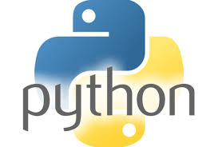
1. Introduction to Programming Fundamentals

Slide 2
1. Introduction to Programming Fundamentals
Q. What is Program?
Ans. A program is a set of instructions written in a programming language that tells a computer what to do and how to do it.
Q. What is Programming?
Ans. Programming is the process of designing and writing a set of instructions that tells a computer how to perform a specific task or solve a problem using a programming language.
Examples of Programming Languages:
C, C++, Java, Python, etc.
Q. Why is Programming Important?
Ans. Programming is important because:
1. It helps to create software and applications.
2. It is used to automate tasks, saving time and effort.
3. It helps in solving problems logically and efficiently.
4. It makes machines work according to instructions given by humans.

Slide 3
1. Introduction to Programming Fundamentals
Q. What is Software?
Ans. Software is a collection of programs that controls the working of computer hardware and helps users perform tasks. Software is a set of instructions that tells a computer or mobile device what work to do.
Example: Music player application
Works: Plays music, Pauses music, Changes songs, etc.
Types of Software
Software can be broadly classified into two main types:
System Software: System software is a type of software that runs and controls the computer hardware and provides a platform for application software to work.
example: Windows, Linux, Android, macOS
2. Application Software: Application software is designed to perform specific tasks for the user.
example: Ms. Word, Web Browser(Chrome, Firefox), Calculator, Media Player

Slide 4
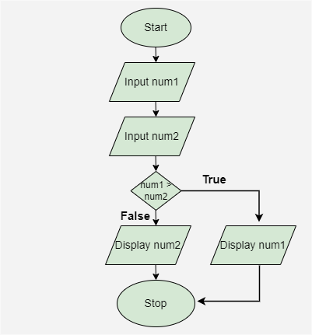
1. Introduction to Programming Fundamentals
Q. Compiler vs Interpreter
Ans. Both compiler and interpreter are used to translate program code into machine-readable language so that the computer can understand and execute it.
Compiler: A compiler translates the entire program at once into machine code before execution.
Languages Using Compiler: C/C++, Java
Interpreter: An interpreter translates and executes the program line by line.
Languages Using Interpreter: Python, JavaScript
Q. What is a Flowchart?
Ans. A flowchart represents the steps of an algorithm in a diagram form using standard symbols.
Flowchart—Steps in diagram.

Slide 5
1. Introduction to Programming Fundamentals
Q. What is an Algorithm?
Ans. An algorithm is a finite, step-by-step procedure used to solve a problem or perform a specific task.
Example: ATM Withdrawal Algorithm
Start
Insert ATM Card
Enter PIN
Select Transaction Type (Withdrawal)
Enter Amount
Collect Cash
Take Receipt
Remove Card
Stop

Slide 6


