Slide 1
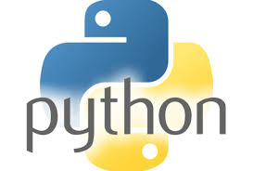
1. Introduction to Python Programming
Q. What is Python?
Ans. Python is a high-level, interpreted programming language used for general-purpose software development. It was developed by Guido van Rossum in 1991.
Q. Where is Python Used?
Ans. Python is used in many fields because of its simplicity, flexibility, and powerful library support.
Web Development
Data Science and Data Analysis
Artificial Intelligence and Machine Learning
Desktop Applications
Game Development
Cybersecurity and Networking
Q. Why is Python Popular?
Ans. Python is popular because of its:
Easy to Learn and Read
Platform Independent
High Productivity

Slide 2
1. Introduction to Python Programming
Q. Features of Python
Ans. Python has several powerful features that make it a popular and widely used programming language.
Simple and Easy to Learn
High-Level Language
Interpreted Language
Platform Independent
Object-Oriented
Dynamic Typing
Our first Program.
print(“Hello World”)

