Slide 1


Database Management System (303105203)
Unit – 1: Introduction
Ruchika Chouhan,
Assistant Professor, Computer Science & Engineering

Slide 2
Unit 1: Introductory concepts of DBMS
1)Introduction and applications of DBMS
2)Purpose of Database
3)Data Independence
4)Database System Architecture - Levels Mappings Database
5)Users
6)DBA

Slide 3
Data & Information
Data:
Raw facts which can be manipulated.
Refers to what is actually stored in the database.
Information:
Manipulation of data.
Summarization of data in a presentable form.
Meaning of the data as understood by some users.
Data comprises of raw facts, which become information when processed
Information conveys some meaning to people

Slide 4
Database
Organized collection of inter related facts.
Collection of “persistent” data.
Collection of Information arranged and presented to serve an assigned purpose.
Definition (C.J. Date):
A Database is a collection of persistent data that is used by the application systems of some given enterprise.
Ex: Dictionary

Slide 5
What is Database Management System (DBMS)?
Data - Fact that can be recorded or stored
e.g. Person Name, Age, Gender and Weight etc.
Database - Collection of logically related data
e.g. Books Database in Library, Student Database in University etc.
Management - Manipulation, Searching and Security of data
e.g. Viewing result in GTU website, Searching exam papers in GTU website
System - Programs or tools used to manage database
e.g. SQL Server Studio Express, Oracle 11g
DBMS - A Database Management System is a software for creating and managing databases. It provides a systematic way to create, retrieve, update and manage data.
e.g. MS SQL Server 2014, Oracle 11g, My SQL, MS Access, dBase etc.

Slide 6
Applications
The following are examples of database applications:
Computerized Library Systems
Automated Teller Machines
Flight Reservation Systems
Computerized parts inventory systems
Enterprise Resource Management (ERP) systems
Online Banking systems
Write down any five applications of DBMS other than above individually in chats separated by comma.

Slide 7
Disadvantages of File processing system(FPS)
Earlier database applications were built directly on top of file systems.
DBMS were developed to handle the difficulties of typical file-processing systems supported by conventional operating systems.
Database systems offer solutions to all the disadvantages of file processing systems.

Slide 8
Disadvantages of File processing system(FPS)
Data redundancy and inconsistency.
Multiple file formats.
Duplication of information.
Difficulty in accessing data.
File system exhibits structural dependency.
Need to write a new program to carry out each new task.

Slide 9
Disadvantages of File processing system(FPS)
Data isolation
Integrity problems
Hard to add new constraints or change existing ones
Atomicity of updates
Failures may leave database in an inconsistent state with partial updates carried out
Example: Transfer of funds from one account to another should either complete or not happen at all.

Slide 10
Disadvantages of File processing system(FPS)
Concurrent access by multiple users
Concurrent access is needed for performance
Uncontrolled concurrent accesses can lead to data inconsistencies
Example: Two people reading a balance and updating it at the same time

Slide 11
Disadvantages of File processing system(FPS)
Security problems.
Security features like -
effective password protection,
locking out parts of files or parts of the system itself.

Slide 12
Advantages of DBMS
Data can be shared.
Redundancy can be reduced.
Inconsistency can be avoided
Integrity can be maintained.
Security can be enforced.
Better Conflicting Management.
Standards can be enforced.

Slide 13
ANSI/SPARC THREE LEVEL ARCHITECTURE
This is in agreement with the ANSI/SPARC study group on DBMS. ANSI/SPARC is the American National Standards Institute/Standard Planning and Requirement Committee).

Slide 14
ANSI/SPARC THREE LEVEL ARCHITECTURE
The Architecture for DBMS is divided into three general levels:
External level: concerned with the way individual users see the data.
Conceptual level: can be regarded as a community user view - a formal description of data of interest to the organization, independent of any storage considerations.
Internal level: concerned with the way in which the data is actually stored.

Slide 15
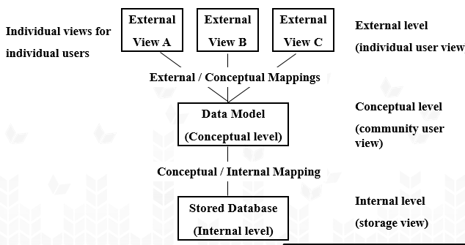
ANSI/SPARC THREE LEVEL ARCHITECTURE

Slide 16
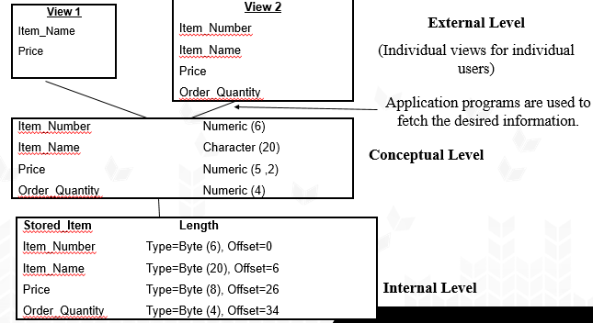
ANSI/SPARC THREE LEVEL ARCHITECTURE
What type of data
How data will be stored
Where data is stored

Slide 17
Data Abstraction
Hide irrelevant details from the users.
Three levels of data abstraction:
Physical: Lowest Level of data abstraction. It tells us where the data actually stored in memory.
Logical: Describes how the data is stored in the Database. In short, it represents SCHEMA
View: Highest level of data abstraction. It contains what type of data is to be stored in the database.

Slide 18
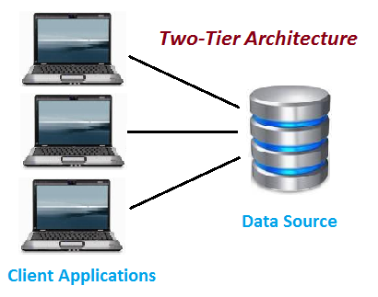
Database Application Architectures

Slide 19
Database Application Architectures
Advantages:
1)Easy to maintain
2)Modification is bit easy
3)Communication is faster
Disadvantages :
1)Performance degrades when number of users increase
2)Cost-ineffective

Slide 20
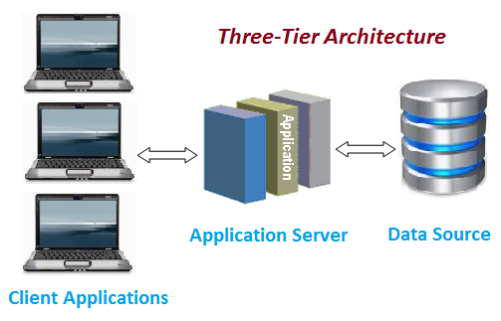
Database Application Architectures

Slide 21
Database Application Architectures
Advantages
High performance
Improve Data Integrity
Improved Security – Client has not direct access to database.
In three tier architecture application performance is good.
Disadvantages
Increase Complexity/Effort

Slide 22
Data Independence
Ability to modify a data or a structure of the database without disturbing an entire application.

Slide 23
Data Independence
Two levels of data independence:
Physical data independence
A user is allowed to enter any type of data in relevance to Database Requirement.
Logical data independence
A user can change the internal schema of the database without considering the type of data already exists in Database.

Slide 24
Users
Application programmer: writes programs in some high-level language such as Java, etc.
Specialized users: write specialized database applications that do not fit into the traditional data processing framework.
Database Administrator (DBA): controls all operations on the database.
Naive users: invoke one of the permanent application programs that have been written previously E.g. people accessing database over the web, bank tellers, clerical staff. In short, General Users (End Users).

Slide 25
Role of DBA
Schema Definition
defines the logical schema of the database.
Storage Structure and Access Method Definition
decides how the data is to be represented in the database & how to access it.
Defining Security and Integrity Constraints
decides various security and integrity constraints.
Granting of Authorization for Data Access
determines which user needs access to which part of the database.

Slide 26
Role of DBA
Liaison with Users
provide necessary data to user.
Assisting Application Programmer
provides assistance to application programmers to develop application programs.
Monitoring Performance
ensures that better performance is maintained by making change in physical or logical schema if required.
Backup and Recovery
backing up the database on some storage devices such as DVD, CD or Magnetic Tape or remote servers and recover system in case of failures, such as flood or virus attack from this backup.

Slide 27
Overall Database Architecture and Components
It comprises of 4 components:
1) Users
2)Query Processor
3)Storage Manager
4)Disk Storage

Slide 28
Overall Database Architecture and Components
Executes low level instructions generated by DML compiler.
Naive
user
Application programmer
Sophisticated
user
Database administrator
uses
write
uses
uses
Application
interfaces
Application
program
Query
tool
Administration tool
Translates DML statements into low level instructions that the query evaluation engine understands
Compiler and linker
DML queries
DDL interpreter
Interprets DDL statements into a set of tables containing metadata
Deals with execution of DDL and DML statements
Application program object code
Fetches data from disk storage to memory for being used
DML compiler and organizer
Query evaluation engine
Query processor
Transaction manager
Preserves atomicity and controls concurrency
Buffer manager
File manager
Authorization and integrity manager
Manages allocation of space on disk storage
Storage manager
Provides interface between low-level data stored and application program or queries
Indices
Data dictionary
Disk storage
To provide faster access to data items
Data
Statistical data
To store metadata
To store user data
Checks the authority of users to access data and integrity constraints
To store statistical information about the data

Slide 29
MCQs
The view of total database content is
(A) Conceptual view | B) Internal view.
(C) External view. | (D) Physical View.

Slide 30
MCQs
The security features of the database are set up by the _______.
Online Users
Database Administrator
Naive Users
Application Programmer

Slide 31
MCQs
Which of the following are the roles of the Database Administrator: a) Managing security issues b) Storage structure definition c) Develop application programs d) Take backups of the database
a
a,b,c
a,b,d
All of these

Slide 32
MCQs
Typically, a database management system is managed by a person called a _____________.
system manager
technology manager
database manager
D. database administrator

Slide 33
MCQs
The database environment has all of the following components except:
(A) users. | (B) separate files.
(C) database. | (D) database administrator.

Slide 34
References
1) Silberschatz A, Korth HF, Sudarshan S. Database system concepts. New York: McGraw-Hill; 1997 Apr.
2) Date CJ. An introduction to database systems. Pearson Education India; 1975.
3) PL/SQL Programming by Ivan Bayross.

Slide 35
Thanks

