Slide 1


Database Management System (303105203)
Unit – 3: Database Models
Dr. Rachit Adhvaryu,
Assistant Professor, Computer Science & Engineering

Slide 2
Basic concepts
Integrity constraints
Database models
E-R diagrams
Mapping cardinality
Participation Constraints
Weak entity set
Specialization
Generalization
Aggregation
E-R Diagram Example

Slide 3
Basic Concepts
Database design involves understanding operational and business needs of an organization, modeling the specified requirements, and realizing the requirements using a database.
The overall database design process has to follow a series of steps. The systematic process of designing a database is known as design methodology.
The goal of designing a database is to produce efficient, high quality, and minimum cost database.
In large organizations, database administrator (DBA) is responsible for designing an efficient database system

Slide 4
Integrity Constraint
Integrity constraints are the set of rules imposed on database to maintain quality of data.
Integrity constraints ensures that any manipulation on data does not affect the data integrity.
It secures the data management.
Various Integrity Constraints are:
Check
Not null
Unique Key
Primary key
Foreign key

Slide 5
Integrity Constraint
Check
This constraint is defined on a column of the table.
Limits the data values of variables to a specific set of values based on condition.
The constraint can be applied for a single column or a group of columns.
E.g. amount must be greater than 500.
Not null
This constraint ensures that each column of all the rows in the table has some value (data).
Any column value cannot be NULL (empty).

Slide 6
Integrity Constraint
3. Unique Key
Ensures that the data in each row for a single or group of columns is unique (distinct).
A column can have NULL values, but cannot be duplicated.
E.g. Roll Number of a student is Unique.
4. Primary Key
Ensures that a column or a group of columns identify uniquely each row in the table.
A column cannot have NULL values and cannot be duplicated.
E.g. Roll Number of a student is Unique.

Slide 7
Integrity Constraint
5. Foreign Key
Also known as Referential Integrity Constraint
Allows a table to refer a column of another table with Primary Key
For e.g.
Student (sroll, sname, std)
Result (sroll, m1, m2, m3, result)
Primary Key
Foreign Key referring to sroll column of Student table

Slide 8
Database Models
A database model describes the logical structure of a database.
It describes whether how a data can be stored, accessed and updated.
The most popular example of a database model is Relational Model
Types of Database Model are:
Hierarchical Model
Network Model
Relational Model
Object Oriented Model
Entity Relationship Model

Slide 9
Database Models (Hierarchical Model)
In this, the data is organized into a tree-like structure, where each record has a single parent or root.
Department
Manager
Worker
The data is organised into tree-like structure with one data component connected to many other data components.
For example, one department can have many managers and many workers.

Slide 10
Database Models (Network Model)
In this, the data is organized into a tree-like structure, where each record can have multiple parents or roots.
A
B
C
D
E
F
The data is organised into tree-like structure more than one data components connected to more than one other data components.

Slide 11
Database Models (Relational Model)
In this, the data is stored in the table known as Relation.
A Relation contain Rows known as Tuples and column known as Attributes
Employee
Relation
Eid | Employee Name | Salary
1 | Raj | 21
2 | Meet | 22
Attributes
Tuples

Slide 12
Database Models (Object Oriented Model)
Object oriented data model is based upon real world situations.
Objects: The real world components and situations are represented as objects
Attributes and Method:
Every object has certain characteristics. These are represented using Attributes. The behavior of the objects is represented using Methods.
Class: Similar attributes and methods are grouped together using a class. An object can be called as an instance of the class.

Slide 13
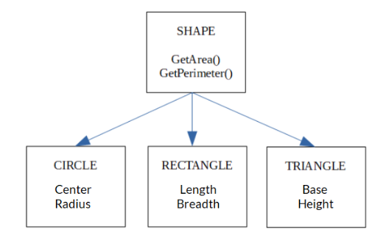
Database Models (Object Oriented Model)
Inheritance: A new class can be derived from the original class. The derived class contains attributes and methods of the original class as well as its own.
For E.g.
Shape, Circle, Rectangle and Triangle are all classes in this model.
Shape has methods as GetArea() and GetPerimeter()
Circle has the attributes Center and Radius.
Rectangle has the attributes Length and Breath
Triangle has the attributes Base and Height.
The Circle, Rectangle and Triangle classes inherit from the class Shape.

Slide 14
E-R Diagram
Stands for Entity-Relationship diagram.
It is a graphical or a pictorial representation of a database.
It uses different types of symbols to represent various instances of database

Slide 15
E-R Diagram (Entity)
An entity is a “thing” or “object” in the real world that is distinguishable from all other objects.
For example, each Employee in a firm is an entity.
An entity has a set of properties, and the values for some set of properties may uniquely identify an entity.

Slide 16
E-R Diagram (Entity)
An entity is represented by a rectangle which contains the name of an entity.
Entity Name
Symbol
Employee
Example
Write down the different entities of college database.
Write down the different entities of hotel database.

Slide 17
E-R Diagram (Entity Set)
It is a collection of different entities of same type.
Examples:
All the employees working in a firm
All persons having an account in a bank
All the students studying in a school

Slide 18
E-R Diagram (Attributes)
Each entity is described by a set of attributes/properties. In short, Attributes define details of Entity
An attribute is represented by an oval containing name of an attribute.
For e.g., Employee ID and Name are the attributes of Employee.
Attribute Name
Employee Id
Name
Employee
Symbol
Example
Write down the different attributes of college database.
Write down the different attributes of hotel database.

Slide 19
E-R Diagram (Types of Attributes)
Simple Attribute | Composite Attribute
Cannot be divided into sub attributes | Can be divided into sub attributes
E.g. Employee ID | E.g. Name (first name, middle name, last name) Address (street, road, city)
Symbol | Symbol
Name
Employee ID
First name
Last name
Middle name

Slide 20
E-R Diagram (Types of Attributes)
Single-Valued Attribute | Multi-Valued Attribute
Can have only 1 value | Can have multiple values
E.g. Employee ID | E.g. Phone Number (Can have more than 1 phone numbers) Address (street, road, city)
Symbol | Symbol
Employee ID
Phone Number

Slide 21
E-R Diagram (Types of Attributes)
Derived Attributes
It’s value is derived or calculated from other attributes.
For e.g. Age of a person can be easily known from his/her birthdate
Symbol:
Age

Slide 22
E-R Diagram (Attributes Example)
Middle Name
First Name
Last Name
Simple
Single Value
ID
Name
Composite
Apartment
Derived
Composite
Employee
Street
Age
Address
Multiple Value
Phone No
Birth Date
Area
Create E-R Diagram for college database. Use all types of Attributes
Create E-R Diagram for hotel database. Use all types of Attributes

Slide 23
E-R Diagram (Relationship Set)
Relationship is link between several entities.
It must be placed between two entities and a line linking it to an entity.
A relationship is represented by a diamond containing relationship details.
A Relationship between 2 Entities is called Binary Relationship and A Relationship between 3 Entities is called Ternary Relationship.
Relationship Detail
Example
Student
Symbol
Issue
Book

Slide 24
Mapping Cardinality
It defined number of entities of one entity set connected to number of entities of another entity set using a relationship set.
Mapping cardinalities are most useful in describing binary relationship sets.
The mapping cardinality are of following types:
One to One
One to Many
Many to One
Many to Many

Slide 25
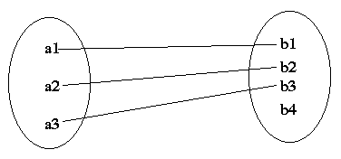
Mapping Cardinality (One to One)
An entity in entity set A is associated with at most one entity in entity set B, and an entity in entity set B is associated with at most one entity in entity set A.
Set A
Set B
For e.g.
One Customer is connected with only one Loan and One Loan is connected to only One Customer using Borrow Relationship Set.
customer
borrow
loan

Slide 26
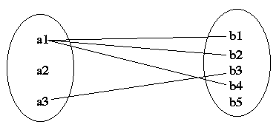
Mapping Cardinality (One to Many)
An entity in entity set A is associated with any number (more than 1) of entities in entity set B. An entity in entity set B is associated with at only one entity in entity set A.
Set A
Set B
One Customer is connected with more than one Loan; but, One Loan is connected to only One Customer using Borrow Relationship Set.
For e.g.
customer
borrow
loan

Slide 27
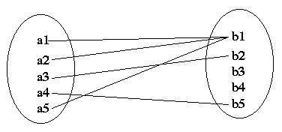
Mapping Cardinality (Many to One)
An entity in entity set A is associated with only one entity in entity set B. An entity in entity set B is associated with more than one entities in entity set A.
Set A
Set B
One Loan is connected to more than one Customers; but, One Customer is connected with only one Loan using Borrow Relationship Set.
For e.g.
customer
borrow
loan

Slide 28
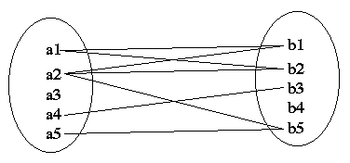
Mapping Cardinality (Many to Many)
More than one entities in entity set A is associated with more than one entities in entity set B. More than one entities in entity set B is associated with more than one entities in entity set A.
Set A
Set B
One Loan is connected to more than one Customers and One Customer is connected with more than one Loan using Borrow Relationship Set.
For e.g.
customer
borrow
loan

Slide 29
Participation Constraints
It specifies the participation of an entity set in a relationship set.
There are two types participation constraints:
Total participation:
every entity in the entity set participates in at least one relationship in the relationship set. It is denoted by Double Line
Partial participation
some entities in the entity set may not participate in any relationship in the relationship set. It is denoted by Single Line

Slide 30
Participation Constraints (Example)
Partial Participation
Total Participation
customer
borrow
loan
C1
L1
C2
L2
C3
Customers
Loan

Slide 31
Weak Entity Set
An entity set that does not have a primary key is called weak entity set.
It is denoted by double rectangle symbol.
When a weak entity set is connected with strong entity set by some relation, then the relation is known as Weak Relationship Set.
It is denoted by Double Diamond.
A Discriminator in Weak Entity Set distinguishes all other entities.
It is denoted by Dashed Line
To make Relationship stronger, the Primary Key is created by combining Discriminator of Weak Entity Set and Primary Key of Strong Entity Set.

Slide 32
Weak Entity Set (Example)
Discriminator
Payment-date
loan-no
amount
payment-no
Payment-amount
loan
L_P
payment
Strong Entity Set
Weak Entity Relationship
Weak Entity Set
In the above example, the relationship can be made stronger by creating Primary Key by combining Discriminator of Weak Entity Set and Primary Key of Strong Entity Set.
In above e.g. payment-no (Discriminator) & loan-no (Primary Key) combines to generate Composite Primary Key as
(loan-no, payment-no)

Slide 33
Extended E-R Diagram : Specialization
The process of creating sub-groups within an entity is called specialization.
Top-Down design process; designate subgroupings within an entity set that are distinctive from other entities in the set.
The process of taking a subset of higher level entity set to form a lower level entity set.
Uses a triangle component labeled as “ISA”

Slide 34
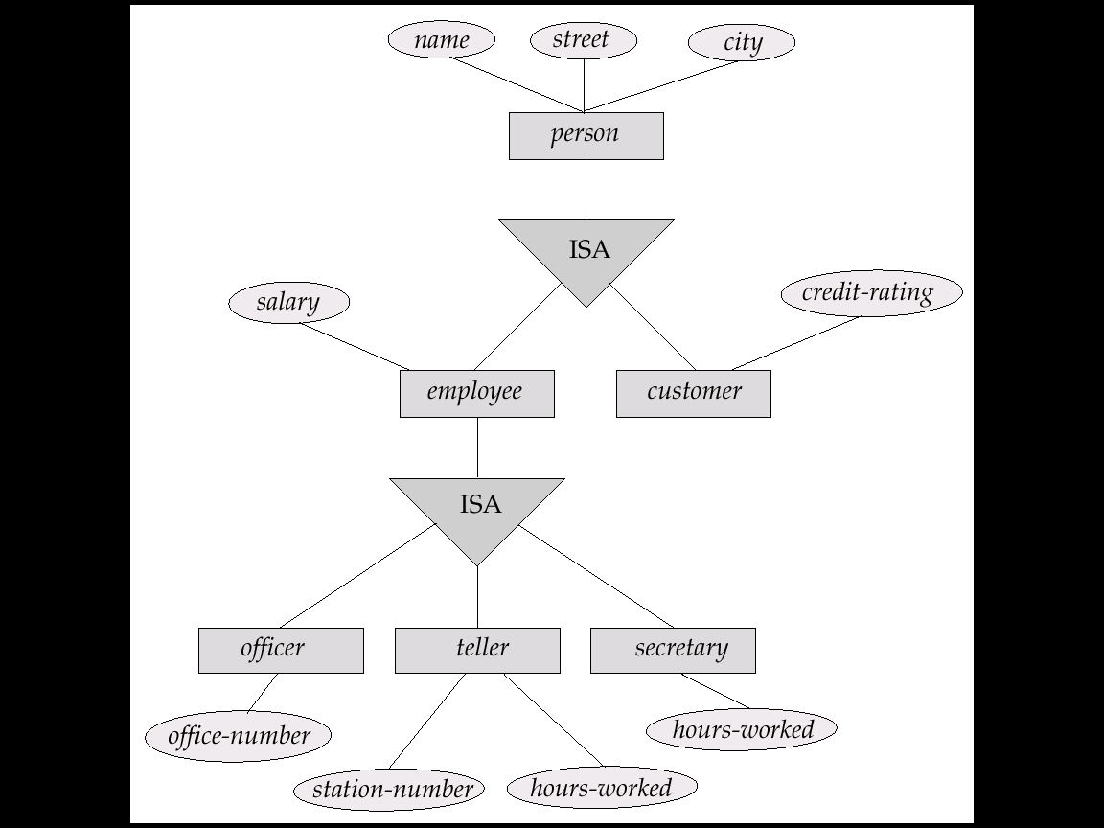
Specialization (Example)

Slide 35
Extended E-R Diagram : Generalization
The process of creating a main group from different entities is called generalization.
Bottom-Up design process; combine a number of entity sets that share the same features into a higher-level entity set.
The process of combining two or more low level entity sets to generate high level entity set.
Uses a triangle component labeled as “ISA”

Slide 36
Generalization (Example)

Slide 37
Aggregation
Created Single Entity “Customer”
Company
Customer
Employee
Works
Department
Customer
Can not connect two relationship
Borrow
Borrow
Loan
Loan
This process of merging various entities into one single entity is called Aggregation.

Slide 38
E-R Diagram (Summary)
Customer
Name
Hold
EmpID
Entity
Attribute
Relationship
Primary Key
Attribute
Payment
Age
PhoneNo
PymtID
Derived
Attribute
Multi Valued Attribute
Discriminating
Attribute
Weak Entity
Issue
ISA
E
R
Weak Entity
Relationship
Total
Participation
Specialization/
Generalization
E
R
E
E
R
E
One to One
One to Many
E
R
E
E
R
E
Many to One
Many to Many

Slide 39
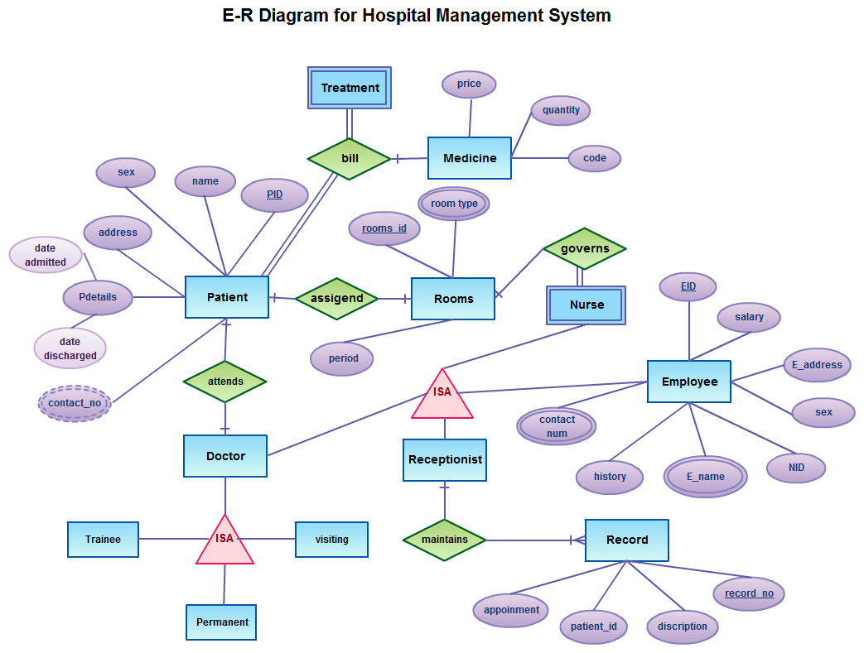
E-R Diagram (Example)

Slide 40
E-R Diagram (Home Work)
Draw E-R Diagram for the following:
Hospital Management
School Management
Library Management
Hotel Management
Bus/Airline/Train Reservation
Tips for Examination:
Define minimum 4 entities with at least 4 attributes.
Provide all types of attributes somewhere in any of the entities
Show weak entity set, few mapping cardinalities.

Slide 41
Thanks

