Slide 1


Database Management System (303105203)
Unit – 6: Transaction
Dr. Rachit Adhvaryu,
Assistant Professor, Computer Science & Engineering

Slide 2
Transaction concepts
ACID
Transaction Life Cycle
Serializability
Recovery
Concurrency Control
Locking mechanism
Deadlock

Slide 3
Transaction
Anything under execution can be known as Transaction.
A transaction is a sequence of operations performed as a single logical unit of work that contains one or more than one SQL statements.
Read(A);
A := A – 50;
Write(A);
Read(B);
B := B + 50;
Write(B);
Operations
Work as a single Unit
Transactions

Slide 4
Transaction (ACID Properties)
Atomicity (Either transaction is Complete or No Transaction)
Consistency (consistent data must be available whenever the database is accessed after any transaction)
Isolation (Transactions details of one transaction must be hidden from other transactions)
Durability (All changes made by the transaction must remain permanent through out the database)

Slide 5
Transaction (ACID Properties)
Atomicity
This property states that, in a transaction either all of its operations are executed or none.
Either transaction execute 0% or 100%.
For example, consider a transaction to transfer Rs. 1000 from account A to account B.
So, if Rs. 1000 is deducted from account A, then it must be added to account B else in case of error, it must be added back to Account A.

Slide 6
Transaction (ACID Properties)
Consistency
Consistent data/values must be available after any transaction.
If the database was in a consistent state before the execution of a transaction; then it must remain consistent after the execution of the transaction is completed.
If the amount has been debited from account A and has been added to account B, then both the accounts must show the amount after the transaction has been performed.
For e.g. Initial amount in account A = 5000 and account B = 3000. Amount to be transferred from A to B = 1000.
Thus, after the transaction is completed, amount in Account A should be 4000 and in account B should be 4000.

Slide 7
Transaction (ACID Properties)
Isolation
Transactions details of one transaction must be hidden from other transactions until the transaction is committed.
Intermediate transaction results must be hidden from other concurrently executed transactions.
For e.g. if account A start transferring amount to account B, then no other transaction should be allowed to access account A until the current transaction is fully completed.

Slide 8
Transaction (ACID Properties)
Durability
All changes made by the transaction must remain permanent through out the database.
After a transaction completes successfully, the changes to the database must be permanent, even if system fails.
For e.g. Initial amount in account A = 5000 and account B = 3000. Amount to be transferred from A to B = 1000.
Thus, after the transaction is completed, amount in Account A should be 4000 and in account B should be 4000.
This change should remain permanent until some other transaction changes any account’s amount.

Slide 9
Transaction (State Diagram or Life Cycle)
Active
This is the initial state.
The transaction remains in this state while execution.
Partial Committed
It is a state where a transaction actually enter in its last operation.
Failed
An execution cannot be performed due to errors.
Once a transaction cannot be completed, any changes that it made must be undone rolling it back.
Committed
It is a state where a transaction has completed all its operations and changes to the database are reflected
We cannot abort or rollback a committed transaction.
Aborted
The state after the transaction has been rolled back and the database has been restored to start of the transaction state.

Slide 10
Transaction (State Diagram or Life Cycle)
It is a state where a transaction has completed all its operations and changes to the database are reflected
We cannot abort or rollback a committed transaction.
It is a state where a transaction actually enter in its last operation.
Partial
Committed
Committed
Active
End
Failed
Aborted
This is the initial state.
The transaction remains in this state while execution.
The state after the transaction has been rolled back and the database has been restored to start of the transaction state.
An execution cannot be performed due to errors.
Once a transaction cannot be completed, any changes that it made must be undone rolling it back.

Slide 11
Transaction (Operations)
1. Read (X)
This operation is mainly used for accessing the data from the database.
It transfers the data item accessed from the database to the local buffer/memory.
2. Write (X)
This operation is mainly used for updating/modifying the data in the database.
It updates the data of the database as a result of any transaction been executed.

Slide 12
Transaction (Schedule)
A schedule is a process of grouping and ordering the operation of transactions.
A schedule is a sequence in which all the operations are executed.
A schedule is required in a database because when some transactions execute in parallel, they may affect the result of the transaction.
If a transaction is updating the data in the database and other transaction at the same time is accessing the same data, then the result of the database is fully dependent on the sequence of these transactions.

Slide 13
Transaction (Schedule - Example)
T1 | T2
Read (A) A = A - 1000 Write (A) Read (B) B = B + 1000 Write (B) Commit
 | Read (A) T = A * 0.7 A = A - T Write (A) Read (B) B = B + T Write (B) Commit

Slide 14
Transaction (Serial Schedule)
A serial schedule is one in which no transaction starts until an active transaction is complete or commit.
Transactions are executed one by one in a sequence.
This type of schedule is called a serial schedule, as transactions are executed in a serial manner.

Slide 15
Transaction (Serial Schedule Example)
T1 | T2
Read (A) A = A - 1000 Write (A) Read (B) B = B + 1000 Write (B) Commit
 | Read (A) T = A * 0.7 A = A - T Write (A) Read (B) B = B + T Write (B) Commit

Slide 16
Transaction (Interleaved Schedule)
Schedule that interferes during the execution of different transactions.
It means that any other transaction starts before the active transaction commits.
Execution can switch between the transactions in any of the schedules.

Slide 17
Transaction (Interleaved Schedule Example)
T1 | T2
Read (A) A = A - 1000 Write (A) | Read (B) B = B + 1000 Write (B)
Read (A) T = A * 0.07 A = A - T Write (A) Commit | Read (B) B = B + T Write (B) Commit

Slide 18
Transaction (Serializability)
Each transaction preserves database consistency
A schedule is serializable if it is equivalent to a serial schedule.
In serial schedules, execution of one transaction is allowed at a time i.e. no concurrency is allowed.
In serializable schedules, execution of more than one transactions are allowed at a same time i.e. concurrency is allowed.
Types (forms) of serializability
Conflict serializability
View serializability

Slide 19
Transaction (Conflicting Operations)
Let o1 and o2 be the two operations of transactions T1 and T2 respectively.
o1 = read(T), o2 = read(T) => o1 and o2 don’t conflict
o1 = read(T), o2 = write(T) => o1 and o2 conflict
o1 = write(T), o2 = read(T) => o1 and o2 conflict
o1 = write(T), o2 = write(T) => o1 and o2 conflict
Operations o1 and o2 conflict if there exists at least one of these operations o1 or o2 wrote T.
If both the transactions access different data item or both the transactions read the same data item then they are not conflict.

Slide 20
Transaction (Conflict Serializability)
If a given schedule can be converted into a serial schedule by swapping its non-conflicting operations, then it is called as a conflict serializability
T1 | T2
Read (A) A = A - 1000 Write (A) | Read (A) T = A * 0.25 A = A - T Write (A) Commit
Read (B) B = B + 50 Write (B) | Read (B) B = B + T Write (B) Commit
T1 | T2
Read (A) A = A - 1000 Write (A) | Read (B) B = B + 50 Write (B)
Read (A) T = A * 0.25 A = A - T Write (A) Commit | Read (B) B = B + T Write (B) Commit

Slide 21
Transaction (View Serializability)
Let there be two schedules with the same set of transactions. Both the schedules are said to be view serialized, if the following three conditions are satisfied, for each data item T:
Initial Read
Updated Read
Final Write

Slide 22
Transaction (View Serializability)
Initial Read
If in schedule R1, transaction T1 reads the initial value of T, then in schedule R2 also transaction T1 must read the initial value of T.
R1
T1 : Read (T)
T2 : Write (T)
R2
T1 : Write (T)
T2 : Read (T)
R3
T1 : Read (T)
T2 : Read (T)
Schedules R1 and R2 are not view equivalent because initial read operation in R1 is done by T1 and in R2 it is done by T2
Schedules R1 and R3 are view equivalent because initial read operation in R1 is done by T1 and in R3 it is also done by T1

Slide 23
Transaction (View Serializability)
Update Read
If in schedule R1 transaction T1 executes read(T), and that value was produced by transaction T2 (if any), then in schedule R2 also transaction T1 must read the value of T that was produced by transaction T2.
R1
R2
T1 | T2 | T3
Write (A) | Write (A) | Read (A)
T1 | T2 | T3
Write (A) | Write (A) | Read (A)
Schedules R1 and R2 are not view equivalent because; in R1, T3 reads the data item updated by T2 and in R2, T3 reads the data item updated by T1.

Slide 24
Transaction (View Serializability)
Update Read
If in schedule R1 transaction T1 executes read(T), and that value was produced by transaction T2 (if any), then in schedule R2 also transaction T1 must read the value of T that was produced by transaction T2.
R1
R2
T1 | T2 | T3
Write (A) | Read (A) Write (A) | Read (A)
T1 | T2 | T3
Write (A) | Read (A) Write (A) | Read (A)
Schedules R1 and R2 are view equivalent because; in R1, T3 reads the data item updated by T2 and in R2, T3 reads the data item updated by T2.

Slide 25
Transaction (View Serializability)
Final Write
If in schedule R1, transaction T1 performs final write operation on some data item T, then in schedule R2, transaction T1 also performs final write operation on same data item T.
R1
R2
T1 | T2 | T3
Write (A) | Read (A) | Write (A)
T1 | T2 | T3
Write (A) | Read (A) | Write (A)
Schedules R1 and R2 are view equivalent because; in R1 and R2, final write on data item A; is performed by transaction T3.

Slide 26
Transaction (Two Phase Commit Protocol)
Two phase commit protocol ensures that all the participating nodes perform the same task of transaction.
It is required to make sure either all the databases are updated or none of them are updated so as to main database synchronization.
In two phase commit protocol there is one node which acts as a Coordinator or a Controlling Node and all other participating nodes are known as Cohorts or Participant or Slave.
It involves 2 phases:
Prepare Phase (Preparing to Commit transaction)
Commit/Abort Phase (Final Response)

Slide 27



Coordinator send request asking for ready to commit
Participant send reply whether ready to commit or not
Request to prepare
Prepare
Phase
Prepared
Commit/Abort
Commit
Phase
Done
Send “ack” to inform whether commit done or not
Coordinator inform to do commit

Slide 28
Transaction (Two Phase Commit Protocol)
Prepare Phase
Once each slave completes its transaction, it sends a “DONE” message to the Coordinator.
When the Coordinator receives “DONE” message from all the slaves, it sends a “Prepare” (prepare to commit) message to the slaves.
If a slave wants to commit, it sends a “Ready” message.
If a slave do not want to commit, it sends a “Not Ready” message.

Slide 29
Transaction (Two Phase Commit Protocol)
Commit Phase
When the Coordinator receives “Ready” message from all the slaves, it sends a “Global Commit” message to all the slaves
The slaves commit the transaction and send “Commit Ack” message back to the Coordinator.
Once a Coordinator receives “Commit Ack” message from all the slaves, then the transaction is considered to be Committed or Completed.

Slide 30
Transaction (Two Phase Commit Protocol)
Commit Phase
When the Coordinator receives “Not Ready” message from all the slaves, it sends a “Global Abort” message to all the slaves
The slaves abort the transaction and send “Abort Ack” message back to the Coordinator.
Once a Coordinator receives “Abort Ack” message from all the slaves, then the transaction is considered to be Aborted or Error.

Slide 31
Transaction (Database Recovery)
There are many scenarios where a transaction could not reach commit or abort state. Some of them are:
Disk Failure
DBMS Crash
OS Failure
Power Failure
This may lead to Data Inconsistency or Data Loss.
For e.g., a DBMS crashes after about 20 out of 25 operations were executed successfully. This may lead to Inconsistent Database state.
Database Recovery is the process of restoring a database and its data to the consistent state.
It helps to recover the data up to the state of crash or failure.

Slide 32
Transaction (Log Based Recovery)
The log is a sequence of records, which maintain information about all the activities done by each operation on the database.
A log is kept on stable storage (i.e. HDD) and it contains:
Start of transaction
Transaction-id
Record-id
Type of operation (insert, update, delete)
Old value, new value
Status of transaction that is committed or aborted.
For e.g., when transaction T1 starts, it records <T1 Start> in the log.
When T1 is about to execute Write Operation, just before that, it records new log as <T1,X,D1,D2>, where X is a data item , D1 is the value of X before transaction and D2 is the new value to be updated for X.
If the transaction is completed, then it records <T1 Commit> and in case of failure, it records <T1 Abort>.

Slide 33
Transaction (Types of Log Based Recovery)
Immediate Database Modification
Changes to the database are executed immediately as they happen without waiting for commit command.
If the transaction is not committed, then the complete operation needs to be undone and transaction is restarted.
If the transaction is committed, then changes made will be permanent.
T1
Read (A) A = A - 50 Write (A) Read (B) B = B + 50 Write (B) Commit
A=100, B=200
<T1 start>
<T1, A, 100, 50>
A=50,B=200
<T1, B, 200, 250>
A=50,B=250
Before the commit is executed, all the updates are made in the database.

Slide 34
Transaction (Types of Log Based Recovery)
Deferred Database Modification
Changes to the database are executed only after the commit command is executed.
If the transaction is not committed, then the changes wont be reflected in database and only transaction is restarted.
If the transaction is committed, then all the changes are reflected and will be permanent.
T1
Read (A) A = A - 50 Write (A) Read (B) B = B + 50 Write (B) Commit
A=100, B=200
<T1 start>
<T1, A, 100, 50>
A=50,B=200
<T1, B, 200, 250>
A=50,B=250
After the commit is executed, all the updates are reflected in the database.

Slide 35
Transaction (Checkpoints)
It may be possible that Log Based Recovery consumes more time while recovering the data using Logs. Thus, to reduce the time consumption, we can use Checkpoints.
Checkpoint is a point which describes that any operation of the transaction done before that point are executed correctly and stored safely in the database.
Time
T_{C}
T_{F}
T1 will be ignored as it is committed before checkpoint.
T2 and T3 will restart again as they were active even after checkpoint, but committed before Failure.
T4 will be completely ignored as it was active even after the checkpoint and has not committed.
T1
T2
T3
T4
Checkpoint time
Failure
Working of Checkpoints in case of Failure

Slide 36
Transaction (Shadow Paging)
Shadow Paging is an another method of database recovery and it is very useful in case of serial transactions.
The database is fragmented into fixed sized blocks referred as PAGES. Each pages are stored in a Page Table.
Shadow Paging maintains 2 Page Tables:
Current Page Table
Shadow Page Table
When the transaction starts, both the tables are identical.
During transaction, only Current Page Table changes, Shadow Page Table never changes.
All the operations are performed on Current Page Table.
When a database page is updated:
A New Copy of the page is created
Current Page Table points to the New Copy.
Then, the updates are performed

Slide 37
Transaction (Shadow Paging)
Page 1
Page 2
Page 3
Page 4
Page 5
Page 1
Page 2
Page 3
Page 4
Page 5
Page 1
Page 2
Page 3
Page 4
Page 5
When the transaction starts, both Current Page Table and Shadow Page Table points to Same Pages in New Pages
Current Page
Table
New Pages
Shadow Page
Table
When the transaction updates Page 2 and Page 5, then a new copy of the Page 2 and 5 is created in New Pages.
Current Page Table points to New Copy and Shadow Page Table continues pointing Old Copy
Thus, in case of Failure, Shadow Page Table can be used to recover the data as it keeps pointing Old Pages.
Page 1
Page 2
Page 3
Page 4
Page 5
Page 1
Old Page 2
Page 3
Page 4
Old Page 5
New Page 2
New Page 5
Page 1
Page 2
Page 3
Page 4
Page 5
Current Page
Table
New Pages
Shadow Page
Table

Slide 38
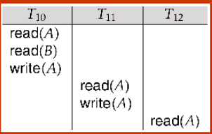
Transaction (Database Recovery)
Cascading Rollback
A cascading rollback occurs in database systems when a transaction (T1) causes a failure and a rollback must be performed.
Other transactions dependent on T1's actions must also be rollbacked due to T1's failure, thus causing a cascading effect. That is, one transaction's failure causes many to fail.
If T10 fails, T11 and T12 must also be rolled back.
If in a schedule, a transaction is not allowed to read a data item until the last transaction that has written it is committed or aborted, then such a schedule is called as a Cascadeless Schedule.

Slide 39
Concurrency Control
Concurrency control is the procedure for managing simultaneous operations without conflicting with each other.
Concurrency control is used to address conflicts which occur with a multi-user system who have access to perform READ and WRITE operation in database.
If T1 conflicts with T2 over a data item A, then the existing concurrency control decides if T1 or T2 should get the A and if the other transaction is rolled-back or waits.
Resolve read-write and write-write conflicts.
Apply isolation through mutual exclusion between conflicting transactions.
Concurrency control helps to ensure serializability.

Slide 40
Concurrency Control
Allowing Concurrent execution of operations may lead to following problems:
Lost Update: if two transactions T1 and T2 both read the same data and then update it; in this case, first update will be overwritten by the second update.
Dirty Read: when one transaction update some item and then fails. Moreover, this updated item is accessed by another transaction before it is rolled back to its initial value.
Incorrect Retrieval: when one transaction accesses data to use it in other operation; but before it can use, another transaction updates that data and commits.

Slide 41
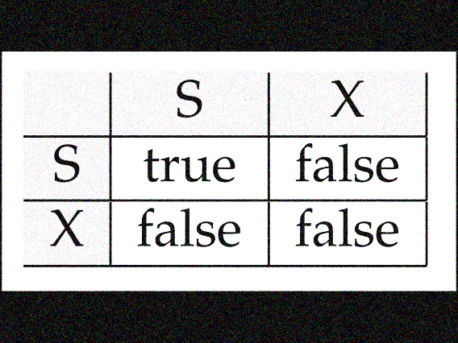
Concurrency Control
A lock is a variable associated with data item to control concurrent access to that data item.
Data items can be locked in 2 ways:
Exclusive (X) mode: Data item can be both read as well as write. X-lock is requested using lock-X instruction.
Shared (S) mode: Data item can only be read. S-lock is requested using lock-S instruction.
Lock-compatibility matrix:
Transaction can proceed only after request is granted.
T1 ----------------------------→
T2------→

Slide 42
Concurrency Control (Lock Based Protocol)
A transaction may be granted a lock on an item if the requested lock is compatible with locks already held on the item by other transactions
Any number of transactions can hold shared locks on an item,
but if any transaction holds an exclusive on the item no other transaction may hold any lock on the item.
If a lock cannot be granted, the requesting transaction is made to wait till all incompatible locks held by other transactions have been released.
T2: lock-S(A);
read (A);
unlock(A);
lock-S(B);
read (B);
unlock(B);
display(A+B)
Example of Transactions using Locking.
A locking protocol is a set of rules followed by all transactions while requesting and releasing locks

Slide 43
Concurrency Control (Lock Based Protocol)
The execution phase of transaction can be described as following:
When execution of transaction starts, create a list of data items and type of lock, it needs and request for that lock.
When all the locks are granted, transaction continues execution of its operation.
As soon as the transaction releases its first lock, it cannot demand for any lock; but can only release the acquired locks.
Transaction
Execution
Lock Request
Lock Release
Transaction
T begin
T end
Time

Slide 44
Concurrency Control (Two Phase Lock Protocol)
The Two Phase Lock protocol has 2 phases:
Growing Phase:
transaction may obtain locks
transaction may not release locks
Shrinking Phase:
transaction may release locks
transaction may not obtain locks
It ensures serialized transactions based on lock points (the point where a transaction acquired its final lock).
Growing Phase
Shrinking Phase
Transaction
T begin
T end
Time

Slide 45
Concurrency Control (Two Phase Lock Protocol – Lock Conversions)
The Two Phase Lock Conversions are as follows:
Growing Phase:
transaction receive Lock - S
transaction receive Lock - X
transaction convert Lock - S to Lock - X
Shrinking Phase:
transaction releases Lock - S
transaction releases Lock - X
transaction convert Lock - X to Lock – S and release
It ensures serialized transactions.

Slide 46
Concurrency Control (Two Phase Lock Protocol)
The Two Phase Lock can be of 2 types:
Strict two phase locking protocol:
A transaction may release all the shared locks after the Lock Point, but cannot release any of the exclusive locks until the transaction commits or aborts.
It ensures that if the data is being modified by one transaction, then other transaction cannot read it until first transaction commits.
Rigorous two phase locking protocol:
A transaction is not allowed to release any lock (either shared or exclusive) until it commits.
Until the transaction commits, other transaction can not acquire even a shared lock on a data item which is already been used by active transaction.

Slide 47
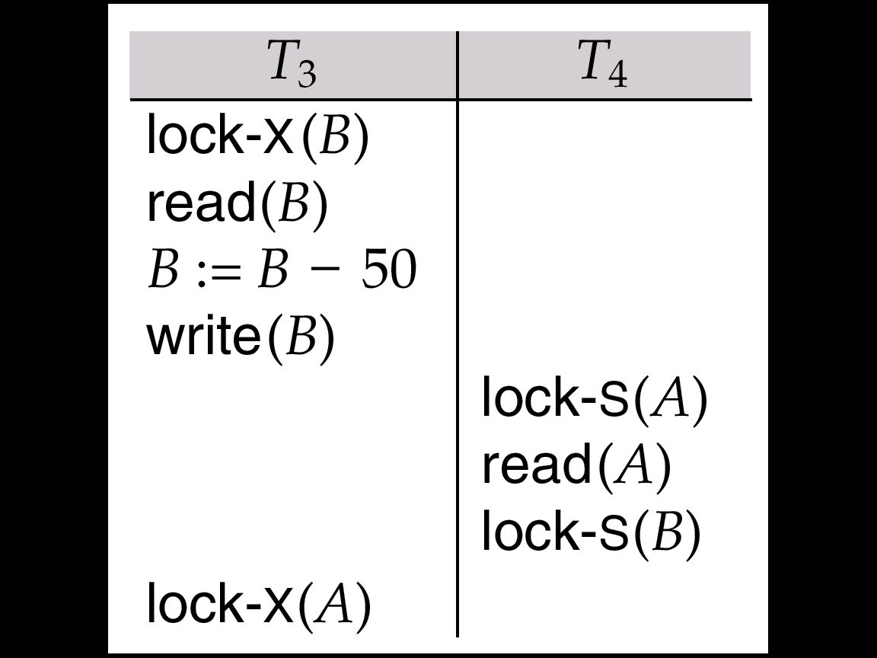
Concurrency Control (Pitfalls of Lock Based Protocol)
Consider the following schedule:
Neither T3 nor T4 can make progress. lock-X(B) causes T4 to wait for T3 to release its lock on B, while lock-X(A) causes T3 to wait for T4 to release its lock on A.
Such a situation is called a Deadlock.
To handle a deadlock, one of T3 or T4 must be rolled back and its locks must be released.

Slide 48
Concurrency Control (Pitfalls of Lock Based Protocol)
The potential for deadlock exists in most locking protocols. Deadlocks are a necessary evil.
Starvation is also possible if concurrency control manager is badly designed. For example:
Transaction may be waiting for an X-lock on an item, while a sequence of other transactions request and are granted an S-lock on the same item.
The same transaction is repeatedly rolled back due to deadlocks.
Starvation can be managed in following way:
There is no other transaction holding a lock that arises a certain type of conflicts.
There is no other transaction who requested lock before any other transaction and is still waiting to acquire lock.

Slide 49
Concurrency Control (Intention Locking)
In addition to S and X lock modes, there are three additional lock modes with multiple granularity:
intention-shared (IS): indicates explicit locking at a lower level of the tree but only with shared locks.
intention-exclusive (IX): indicates explicit locking at a lower level with exclusive or shared locks.
shared and intention-exclusive (SIX): the subtree rooted by that node is locked explicitly in shared mode and explicit locking is being done by exclusive lock.
T1 ----------------------------→
IS
IX
S
S IX
X
IS
✓
✓
✓
✓
×
×
Intention Lock Compatibility Matrix
IX
✓
✓
×
×
T2------→
S
✓
×
✓
×
×
S IX
✓
×
×
×
×
X
×
×
×
×
×

Slide 50
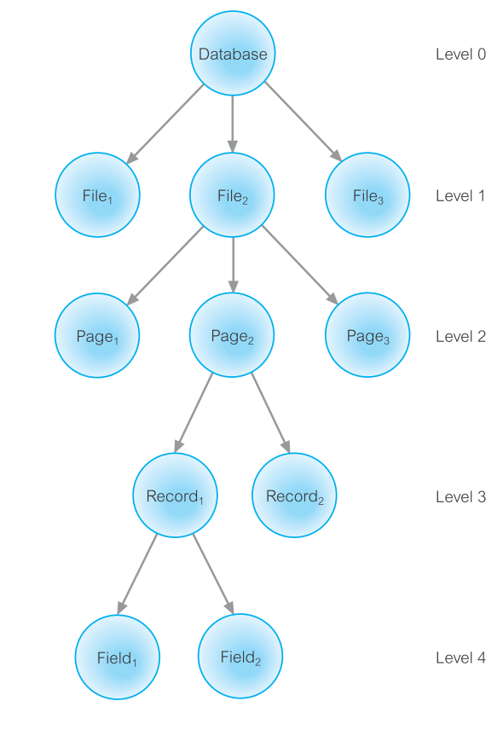
Concurrency Control (Multiple Granularity)
Data Items are represented in a tree like structure. It has a parent as well as child.
If a lock is acquired on Parent node, then automatically, all its children are locked.
If any transaction requests lock on any child, then compiler checks whether a Lock on any parent has not been given.
If Page2 has been locked by any transaction, then all its children i.e. Record1, Record 2, Field1 and Field2 will be locked.
At the same time, if other transaction request lock on Record2, then lock will not be granted as its Parent Page 2 has been locked by some other transaction.

Slide 51
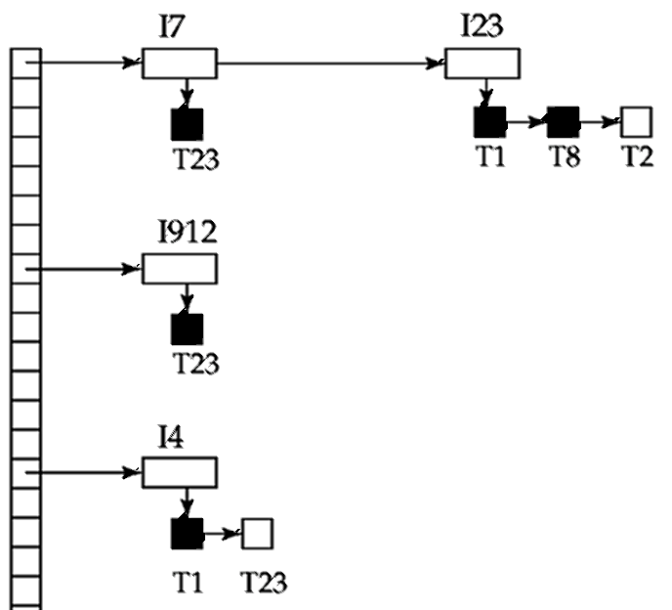
Concurrency Control (Implementing Locking)
Transactions send lock and unlock requests to Lock Manager. All transactions has to wait for lock manager’s response.
Lock manager responds to the request with either “Lock Granted” or “Wait” message.
Lock manager keeps all the records of lock grants and pending requests in a Lock Table.
Dark rectangles indicate granted locks, white ones indicate waiting requests.
It has the record of type of locks issued on the data items.
The new requests are listed in the queue from the bottom of the table.
If a transaction releases a lock, it will check which transaction can be provided with that lock.
Granted
Waiting

Slide 52
Concurrency Control (Time Stamp Based Protocol)
Each transaction is issued a timestamp when it enters the system. An old transaction T1 has time-stamp TS(T1) and new transaction T2 is assigned time-stamp TS(T2), then following condition satisfies: TS(T1) < TS(T2). For e.g. TS(T1) = 0002 and TS(T2) = 0005, then TS(T1) < TS(T2).
Transaction with older timestamp are give priority for execution.
The protocol manages concurrent execution such that the read and write operations are executed in timestamp order.
The protocol maintains for each data Q two timestamp values:
W-timestamp(Q): largest time-stamp of any transaction that executed write(Q) successfully.
R-timestamp(Q): largest time-stamp of any transaction that executed read(Q) successfully.

Slide 53
Concurrency Control (Time Stamp Based Protocol)
Suppose a transaction T1 issues a read(Q).
If TS(T1) <= W-timestamp(Q), then the read operation is rejected as write operation is in execution. For e.g. TS(T1) = 0002, W-timestamp(Q) = 0008
If TS(T1) >= W-timestamp(Q), then the read operation is executed as it is assumed that write operation is committed. For e.g. TS(T1) = 0005, W-timestamp(Q) = 0003
Suppose a transaction T1 issues a write(Q).
If TS(T1) <= R-timestamp(Q), then the write operation is rejected as read operation is in execution. For e.g. TS(T1) = 0002, R-timestamp(Q) = 0008
If TS(T1) >= R-timestamp(Q), then the write operation is executed as it is assumed that read operation is complete. For e.g. TS(T1) = 0005, R-timestamp(Q) = 0003

Slide 54
Deadlock
A deadlock is a situation in which one transaction is waiting for other transaction to release the resources.
Let there be a set of transaction {T1, T2, T3} such that T1 is waiting for a data item that T2 holds, and T2 is waiting for a data item that T3 holds, T3 is waiting for a data item that T1 holds.
Here, each transaction is waiting for some other. Hence, no transaction will work smoothly.
The only solution to this situation is transaction being rolled back to its initial state every time and come again to check the availability of resources.

Slide 55
Deadlock Detection
A Deadlock Condition arise only if all these four conditions are true together.
Mutual Exclusion: One Process to work at one time. If any other process requests the same resource, it will wait till the first release it.
Hold and Wait: One process holds one resource and waiting for other resource that is held by other process.
Non-Preemption: Process can release resources only when it has completed its task. No force to acquire resource
Circular Wait: One Process waiting for other, Other waiting for another and thus creates the cycle.

Slide 56
Deadlock Detection
The most simpler way to detect deadlock is to use Wait-for Graph.
Each Transaction is represented by a node. When a Transaction Ti is waiting for the resource held by Tj, a directed edge is drawn from Ti to Tj (Ti -----→ Tj).
If the Wait-for graph has any cycle, then we can say there is a Deadlock and all the transactions in the cycle are also said to be deadlocked.
B
D
B
D
DEADLOCK
A
C
A is waiting for B and C
A
C
A is waiting for B and C
C is waiting for B
B is waiting for D
Still, there is no cycle,
hence it is not Deadlock.
B is waiting for D
D is waiting for C
C is waiting for B
There is a cycle B – D – C - B, It is a Deadlock. for B, C, and D.

Slide 57
Deadlock Recovery
The most simpler way to recover from deadlock is to Roll Back any of the transactions.
The transaction which incurs minimum loss is rolled back and it is known as Victim.
The decision to roll back a transaction is made on following criteria:
The transaction which have minimum locks
The transaction which has executed less work
The transaction which is very far from completion

Slide 58
Deadlock Prevention
A Deadlock can be prevented using:
Wait-Die Approach:
If an older transaction is requesting a resource which is held by younger transaction, then older transaction waits.
If an younger transaction is requesting a resource which is held by older transaction, then younger transaction is killed and rolled back.
Wait-Die
O needs a resource held by Y | O Waits
Y needs a resource held by O | Y Dies

Slide 59
Deadlock Prevention
A Deadlock can be prevented using:
Wound-Wait Approach:
If an older transaction is requesting a resource which is held by younger transaction, then older transaction forces younger transaction to kill the transaction and releases the resource.
If an younger transaction is requesting a resource which is held by older transaction, then younger transaction waits till older transaction releases resource.
Wound-Wait
O needs a resource held by Y | Y Hurts / Dies
Y needs a resource held by O | Y Waits

Slide 60
Deadlock Prevention
A Deadlock can be prevented using:
Timeout-Based Approach:
A transaction waits for a lock only for a specified amount of time. After that, the transaction is rolled back.
So deadlock never occurs.

Slide 61
Thanks

