Slide 1
TITLE PAGE
Problem Statement ID – 05
Problem Statement Title- Grade Change Intelligence in Paper Making Process
PS Category- Software
Student Name (Registered on portal)- Mohit Upadhyay
Student ID- 23BAI10262

Slide 2
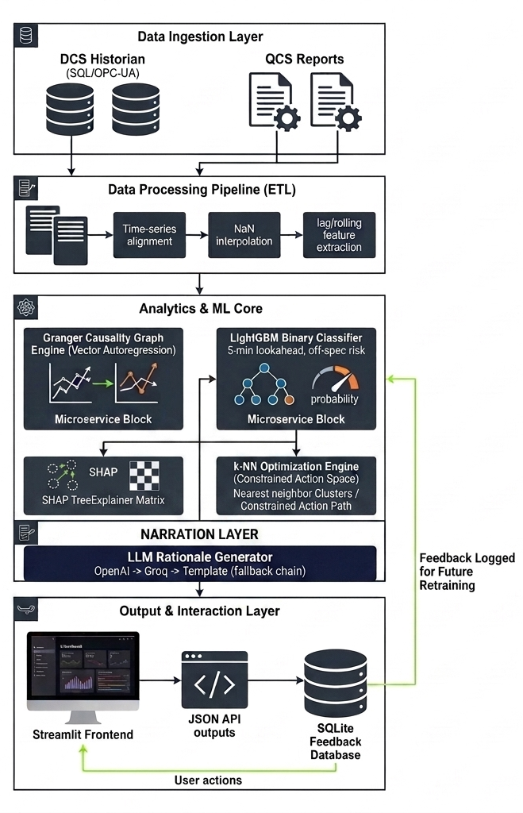
Grade Change Intelligence in Paper Making Process
Detailed Explanation:
Advisory intelligence layer on top of existing QCS/MPC — not a replacement
Predicts basis weight risk 5 min ahead (LightGBM)
Discovers hidden tag correlations via Granger causality - validated against ground truth
Recommends rate-safe setpoint nudges (k-NN + optimizer)
Explains every suggestion (SHAP + LLM rationale)
Logs operator accept/reject for continuous evaluation
How It Addresses the Problem:
Detects instability 3.5–4 min before breach — actionable lead time
Surfaces correlations not in documented control loops
Explains why — restores lost operator "tribal knowledge"
Every suggestion tagged by source (recipe / historical / discovered)
Innovation & Uniqueness:
LLM narrates only — stats/ML do the actual prediction & discovery
Correlation engine validated against known ground truth (5/5 recovered, 16 false positives rejected)
Self-correcting pipeline — caught & fixed its own methodology errors before trusting results

Slide 3
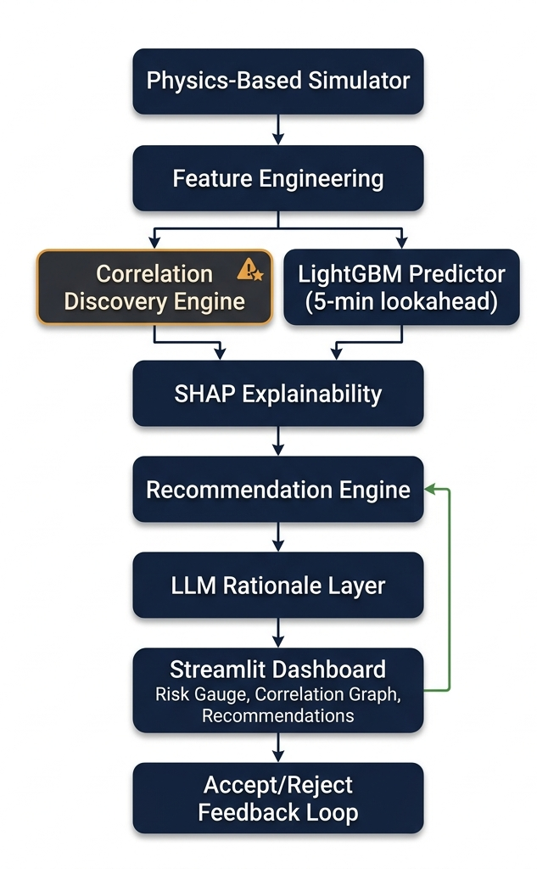
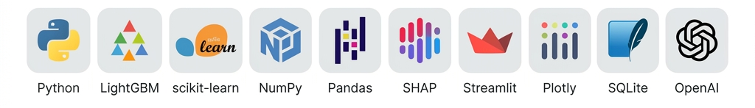
TECHNICAL APPROACH
Technologies Used:-
Modeling & Discovery:
LightGBM — off-spec risk prediction (5-min lookahead)
Granger causality + ΔR² filtering — correlation discovery
SHAP TreeExplainer — model interpretability
Recommendation Engine:
k-NN historical similarity search
Constrained optimizer — rate-safe setpoint suggestions
OpenAI → Groq(fallback) → Template — rationale narration only(
Interface & Feedback:
Streamlit + Plotly — interactive dashboard
SQLite — accept/reject feedback logging
Data Foundation:
Physics-based simulator (First-Order-Lag + Deadtime transfer functions, grounded in real paper-machine control patents) — used since no live plant data was available

Slide 4
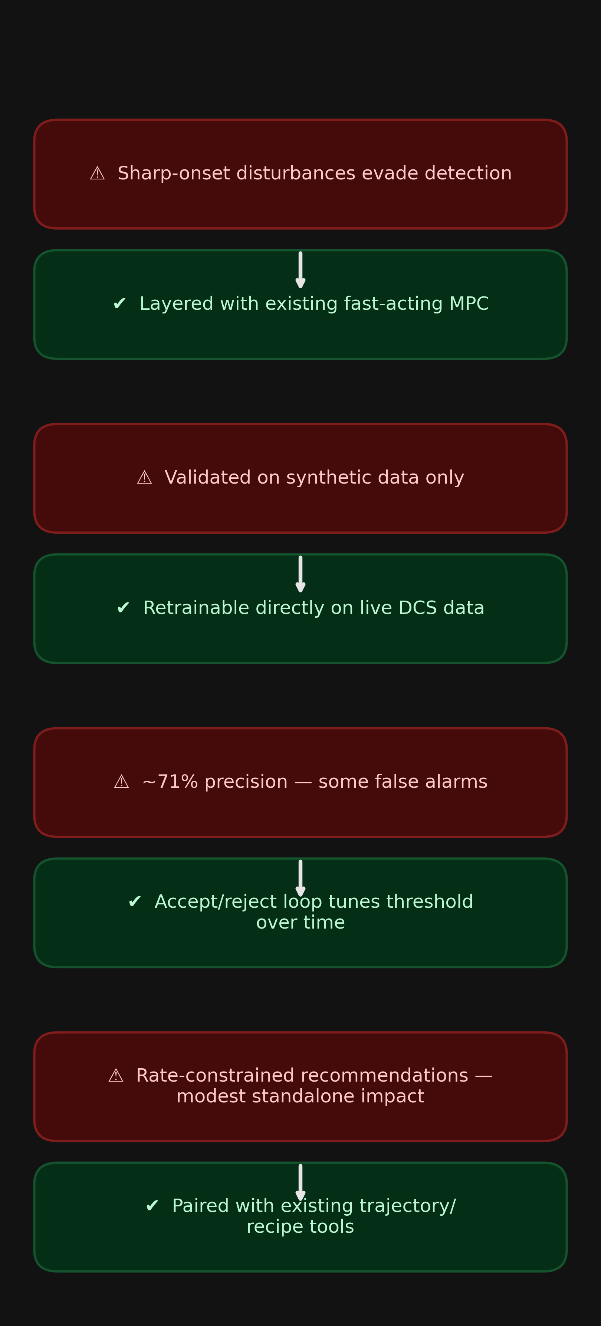
FEASIBILITY AND VIABILITY
Feasibility:
Full pipeline built & validated end-to-end within hackathon timeline — not theoretical
Correlation engine validated against known ground truth (5/5 links recovered)
Uses existing DCS/QCS data sources — no new hardware/sensors required
Deployed as advisory layer on top of QCS/MPC — low integration risk
Challenges & Risks:
Sharp-onset disturbances evade early detection (3/9 events, confirmed via pattern analysis)
Validated on synthetic data — real plant behavior unverified
~71% precision → some false alarms
Rate-constrained recommendations have modest standalone impact
Strategies:
Combine with existing fast-acting MPC as first line of defense
Retrain directly on live DCS historian data post-deployment (no architecture change needed)
Accept/reject feedback loop tunes threshold against real operator judgment over time
Pair with existing trajectory/recipe tools for larger corrections beyond trim range

Slide 5
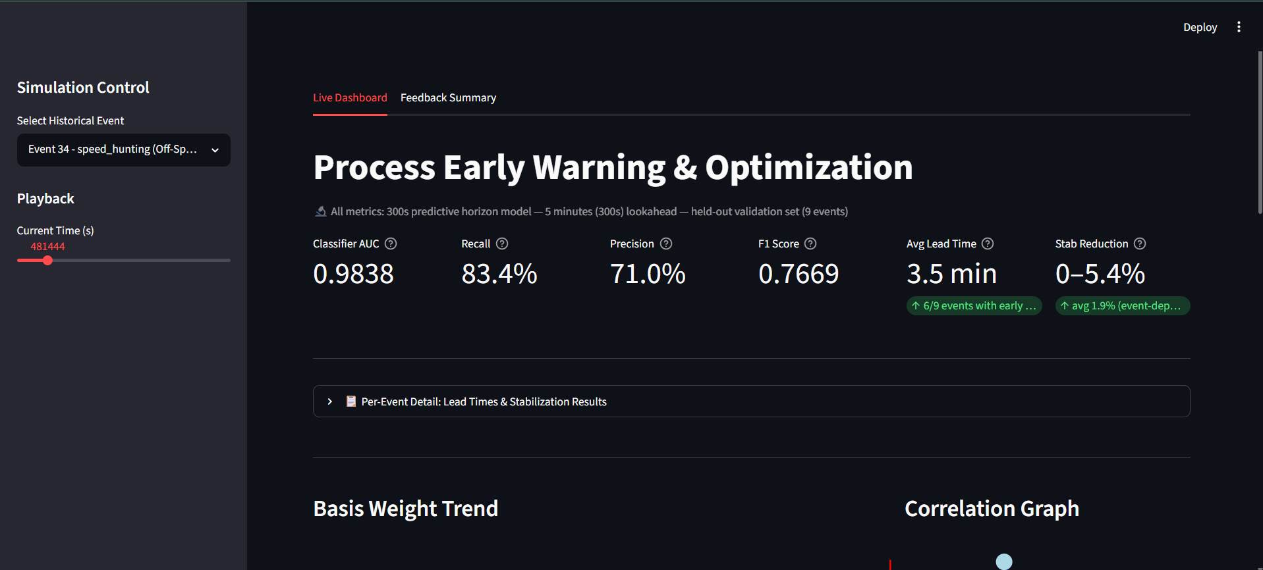
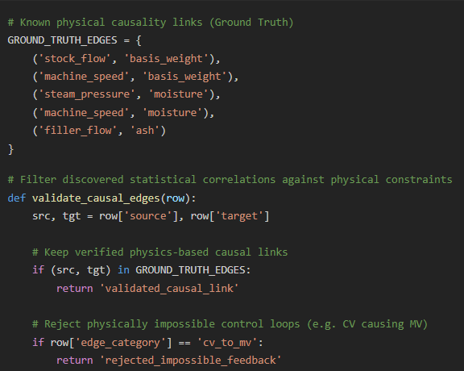
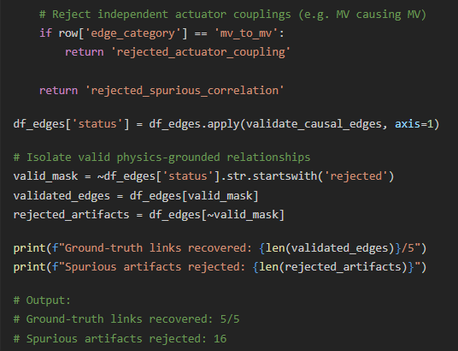
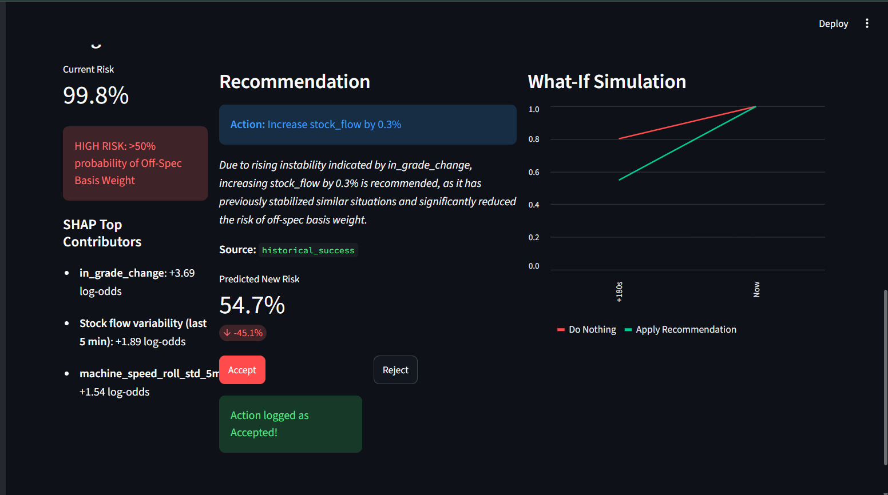
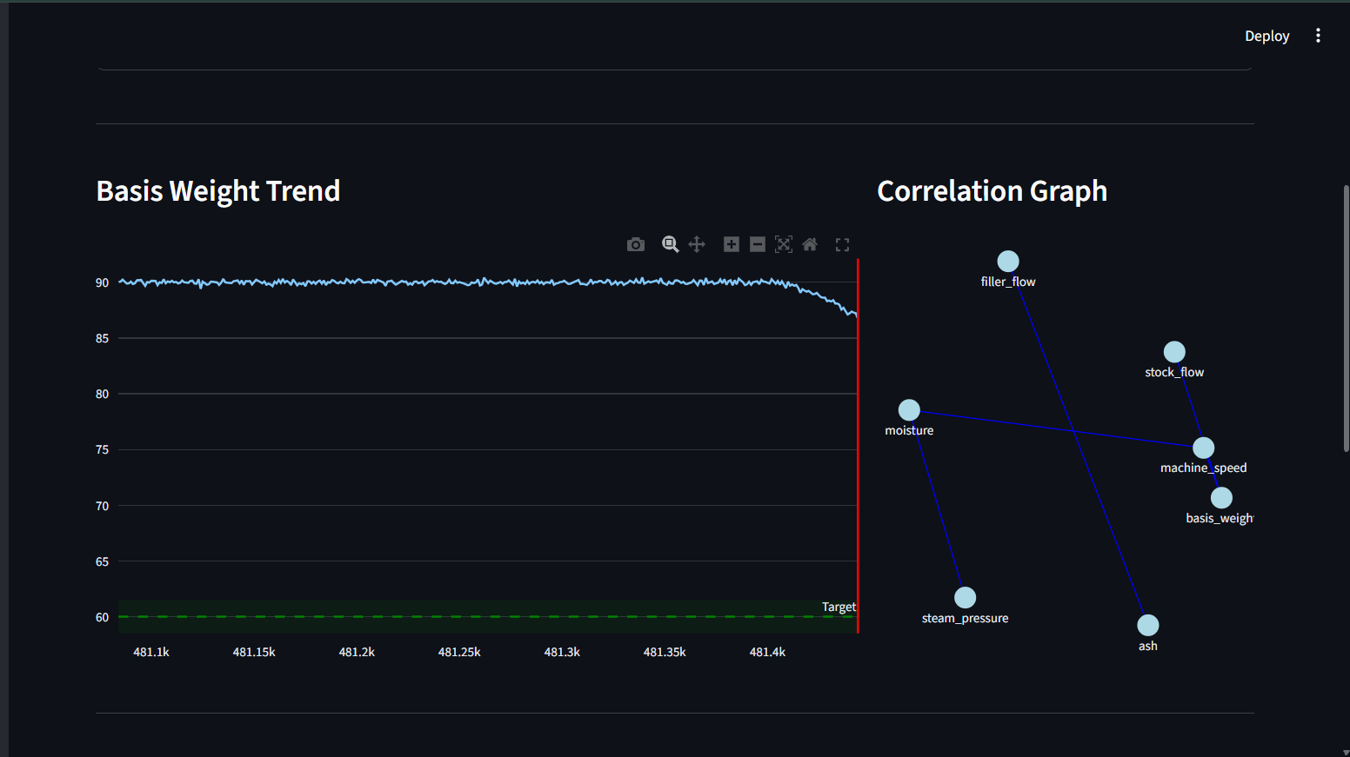
ARTIFACTS
Simulate → physics-grounded synthetic plant data (grade changes + disturbances) Engineer features → lags, rolling stats, rate-of-change (leakage-checked, event-stratified train/val split) Discover correlations → Granger causality across all tags, validated against known ground truth Predict risk → LightGBM classifier, ablation-tested to confirm it learns real dynamics, not shortcuts Explain → SHAP identifies leading indicators driving each prediction Recommend → k-NN + optimizer suggest rate-safe setpoint adjustments, tagged by source Narrate → LLM converts SHAP + recommendation into plain-English rationale
Visualize & log → dashboard displays everything; operator accept/reject feeds back into the system

Slide 6
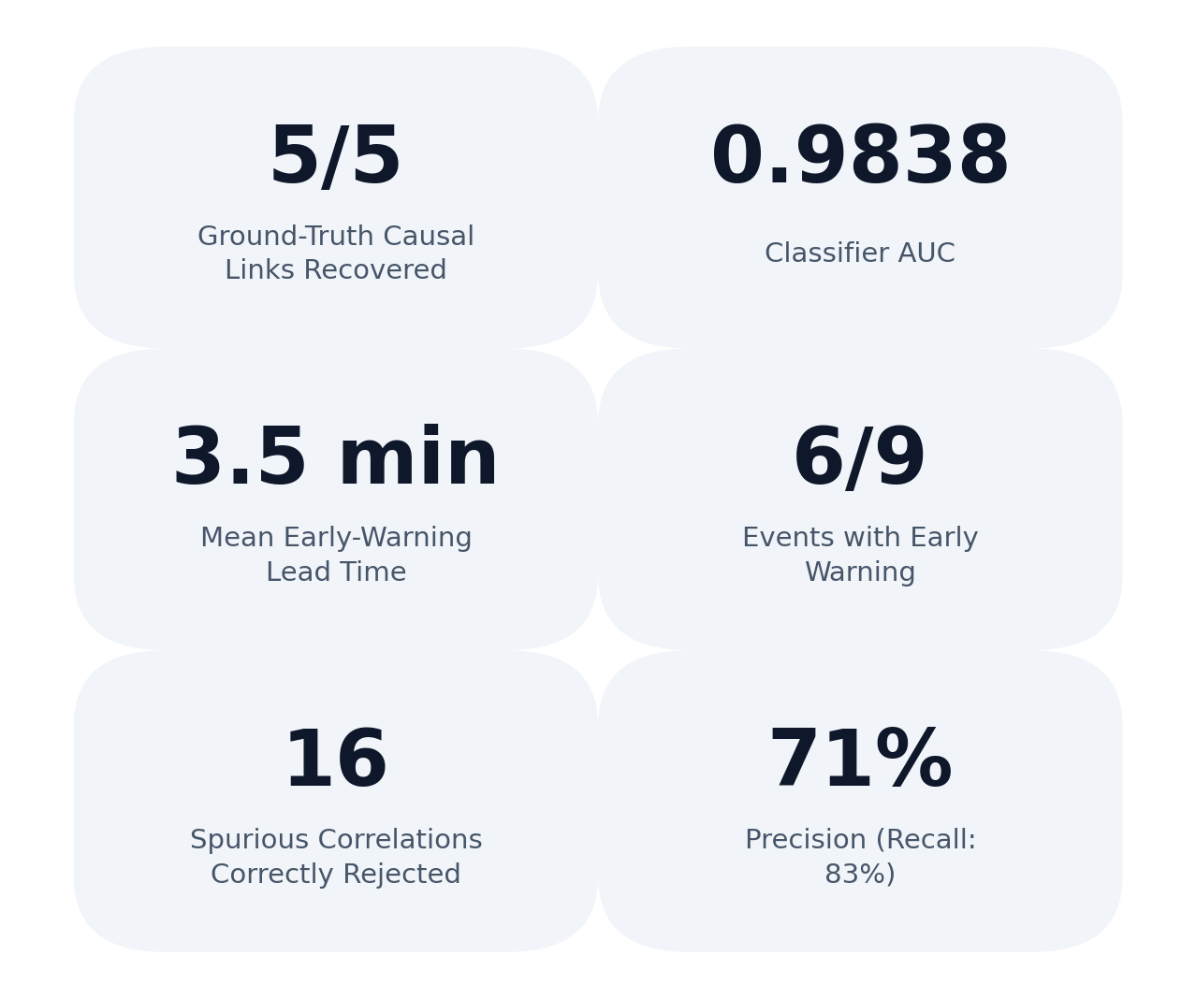
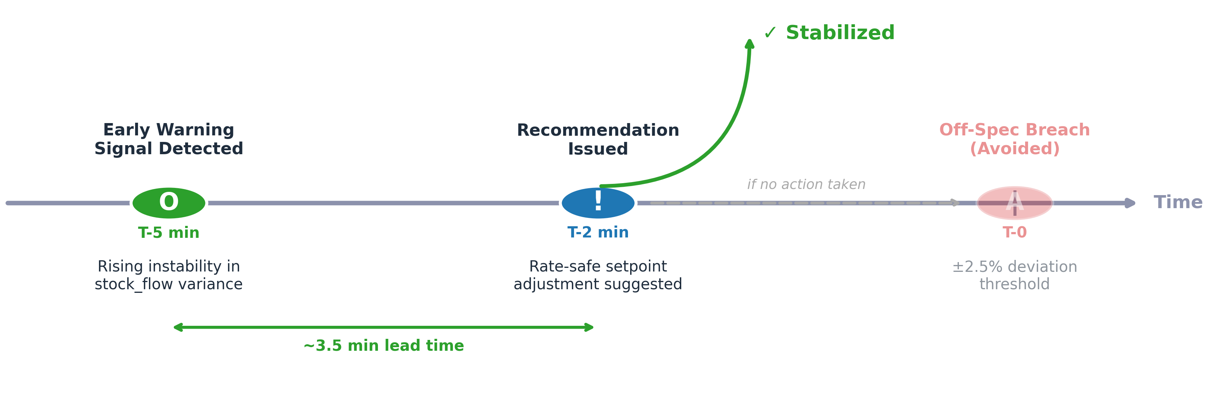
RESEARCH AND REFERENCES
Reference and Research Work
Paper machine grade-change control patents — transfer function structure & timing
Industry finding: machine speed (not steam pressure) controls moisture during grade change
TAPPI paper tolerance standards — basis for ±2.5% quality band
Granger (1969) — causality testing methodology
Lundberg & Lee (2017) — SHAP explainability
Ke et al. (2017) — LightGBM (Microsoft Research)
Honeywell QCS / MD-MPC — existing system this solution extends
Official docs: LightGBM, SHAP, Streamlit, Plotly, OpenAI, Groq
GitHub Repository: https://github.com/Mohit20198/Grade-Change-Intelligence-in-Paper-Making-Process

