Slide 1

EDA On Credit Risk Analysis
Presented By:
Mohit Chaudhari

Slide 2

About me
Educational Background : B.Tech (Computer Science and Engineering)
Want to learn Data Science because it allows me to turn raw data into meaningful insights that can solve real-world problems. In today’s digital world, data is everywhere, and I’m interested in understanding patterns, trends, and making data-driven decisions rather than relying on assumptions.
Experience : No
LinkedIn
GitHub

Slide 3

Problem Statement
The objective of this project is to perform Exploratory Data Analysis (EDA) on a Credit Risk dataset to identify the key factors affecting loan status and understand customer credit behaviour through statistical analysis and visualizations.
This involves examining demographic attributes, income, employment history, and loan characteristics to uncover patterns that distinguish approved loans from those that are not approved.

Slide 4

Objectives & Use Cases
Objectives
Analyze Customer profiles
Identify key risk factors
Study loan and income trends
Understand approval patterns
Support credit risk assessment
Use Cases
Loan approval decisions
Risk assessment of borrowers
Default risk identification
Financial loss reduction
Better lending strategies

Slide 5
Why this Project ?
Reason to choosing this dataset:
Credit risk is one of the most critical challenges faced by banks and lending institutions. Analysing this dataset offers a realistic, finance-domain problem that combines numerical, categorical, and behavioural features — ideal for practicing end-to-end EDA techniques.
Relevance to Domain & Interest:
As a Computer Science student, building strong data analysis skills is essential for roles in data science and analytics. Credit risk modelling connects technical skills (Python, statistics, visualization) with real-world business impact — helping lenders reduce default risk.

Slide 6
About the Dataset
The Credit Risk dataset contains demographic, financial, and loan-related information for individual borrowers. It captures attributes such as age, income, employment length, home ownership, loan amount, interest rate, loan intent, loan grade, and credit history length, along with the final loan status outcome.
Source: Kaggle
Scale:
32,581 records
12 columns
Mix of numerical & categorical features

Slide 7
Column Overview
Column | Description
person_age / person_income | Borrower's age and annual income
person_home_ownership | Housing status: RENT, OWN, MORTGAGE, OTHER
person_emp_length | Years of employment
loan_intent | Purpose of the loan (education, medical, etc.)
loan_grade | Credit grade assigned (A–G)
loan_amnt / loan_int_rate | Loan amount requested and interest rate
loan_percent_income | Loan amount as % of income
cb_person_default_on_file | Prior default on record (Yes/No)
cb_person_cred_hist_length | Length of credit history (years)

Slide 8
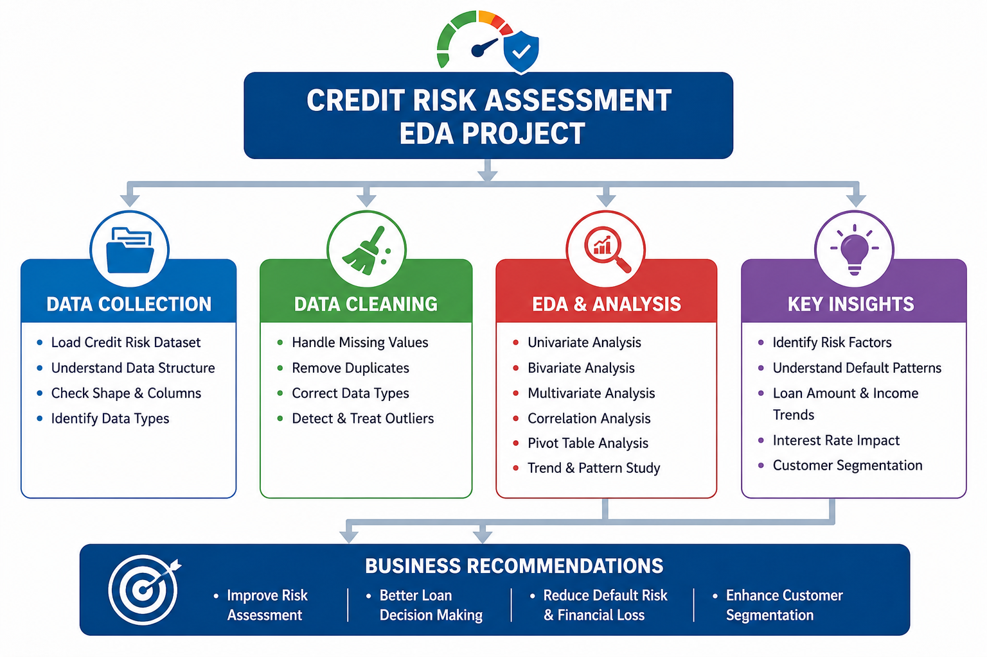

Slide 9
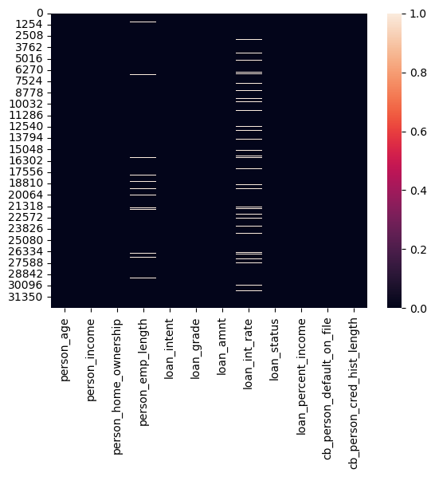
Missing Value Treatment
Missing value heatmap shows gaps in two columns:
• person_emp_length — 895 missing values
• loan_int_rate — 3,116 missing values
All other columns are complete.
Both columns were imputed using the median, since the underlying distributions contain outliers and the median is more robust than the mean to skew. This kept the dataset clean without distorting its distribution.

Slide 10
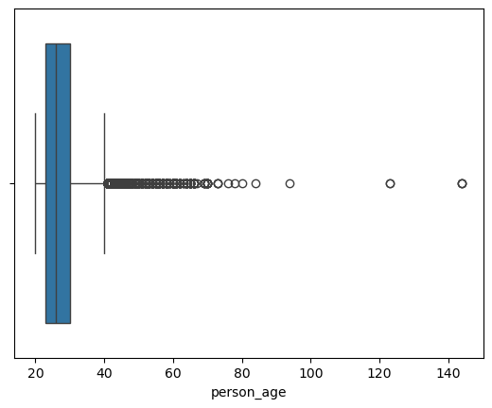
Duplicates & Outlier Treatment
Duplicates:
165 duplicate records were detected and removed. Duplicate rows can bias statistical summaries and visualizations, so each remaining record now represents a unique observation.
Outlier Treatment:
Outliers in person_age were identified using the IQR method and removed (unrealistic ages). Financial variables — person_income, loan_amnt, loan_int_rate — were deliberately left untouched, as extreme values there likely reflect genuine high-income or high-value customers rather than data errors.

Slide 11
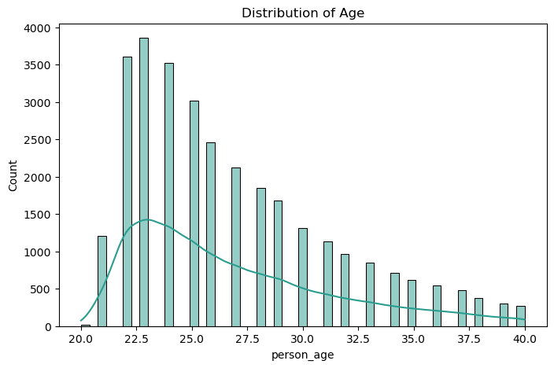
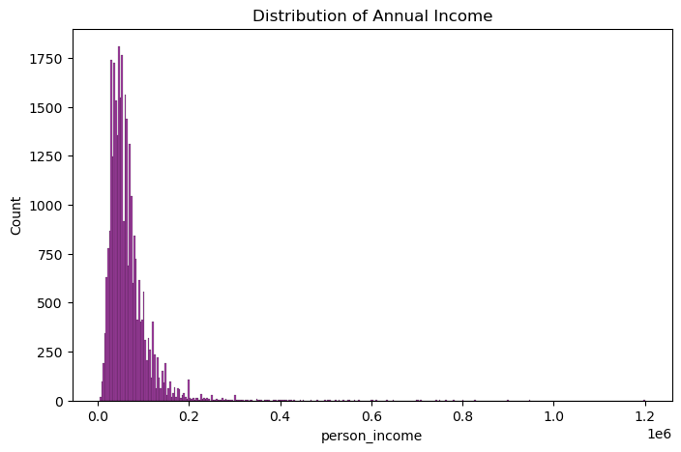
Age & Income Distribution
Age: Most applicants are concentrated in young/middle-age groups; histogram used to study spread and skew.
Income: Distribution is right-skewed — a small group of high-income earners pulls the tail.

Slide 12
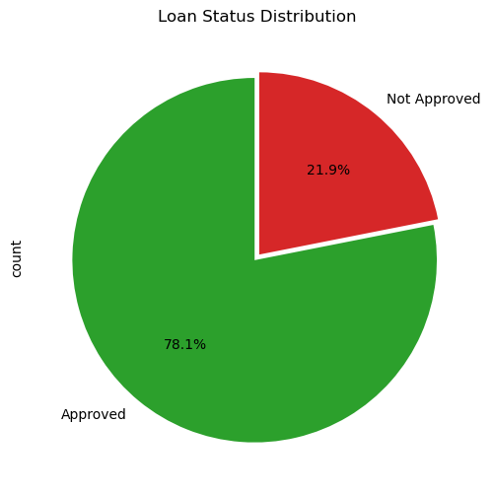
Loan Status Distribution
The loan_status pie chart shows a clear skew toward one outcome (Approved/Non-Default), with the other class forming a smaller minority share.
This confirms the dataset is imbalanced. While this does not affect descriptive EDA, it is an important consideration for any future predictive modelling — techniques like resampling or weighted metrics would be needed to avoid biased models.

Slide 13
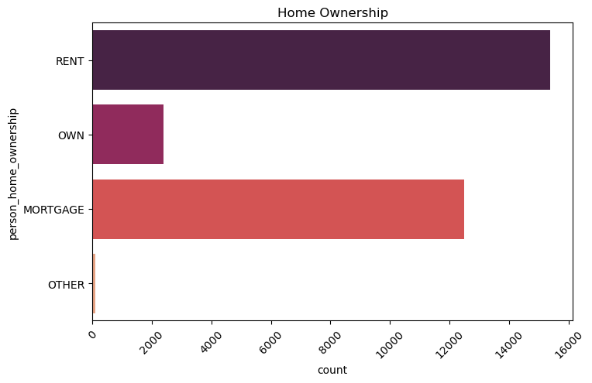
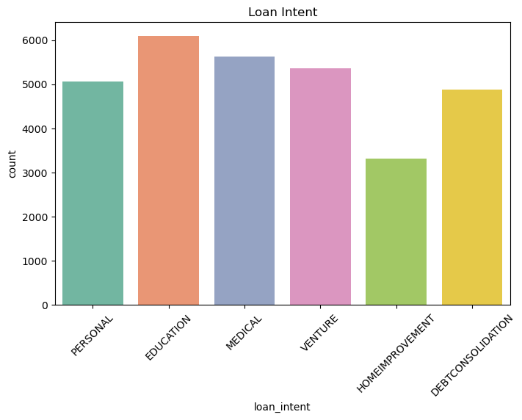
Home Ownership & Loan Intent
Home Ownership: RENT and MORTGAGE dominate the applicant base, with far fewer outright owners.
Loan Intent: Education and Medical purposes are among the most frequent reasons for borrowing.

Slide 14
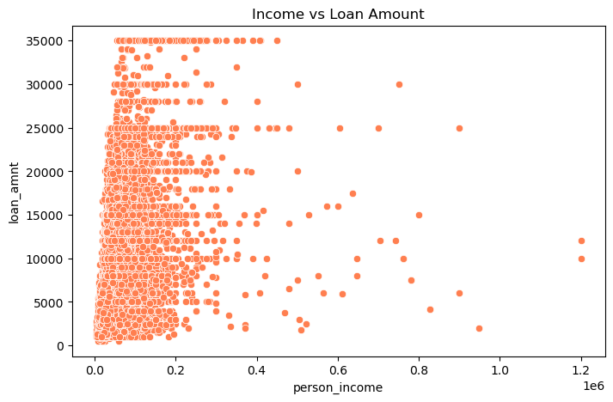
Bivariate Analysis
Income vs Loan Amount
A scatter plot was used to study the relationship between two continuous variables — income and loan amount.
Observation: Higher-income customers tend to request larger loans, but the relationship is loose, suggesting income alone does not fully determine loan size — loan_intent and loan_grade also play a role.

Slide 15
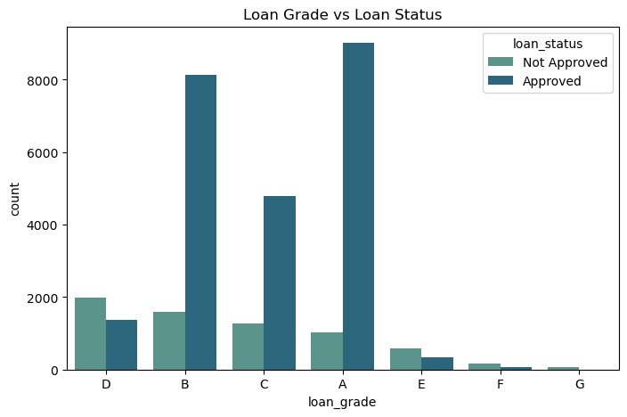
Loan Grade vs Loan Status
A grouped count plot compares loan status across credit grades.
Observation: Lower credit grades (towards G) show a proportionally higher share of 'Not Approved' outcomes, confirming that loan grade is a strong risk indicator — exactly what credit-grading systems are designed to capture.

Slide 16
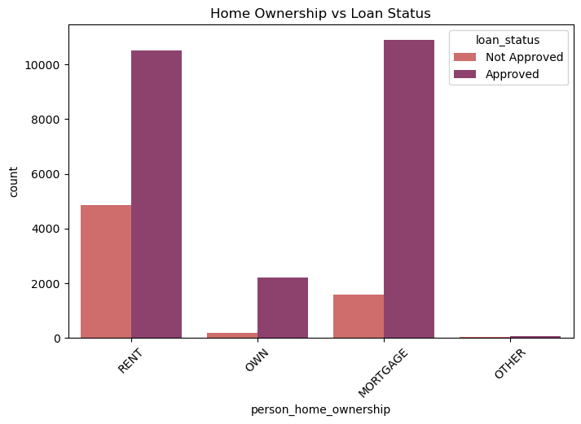
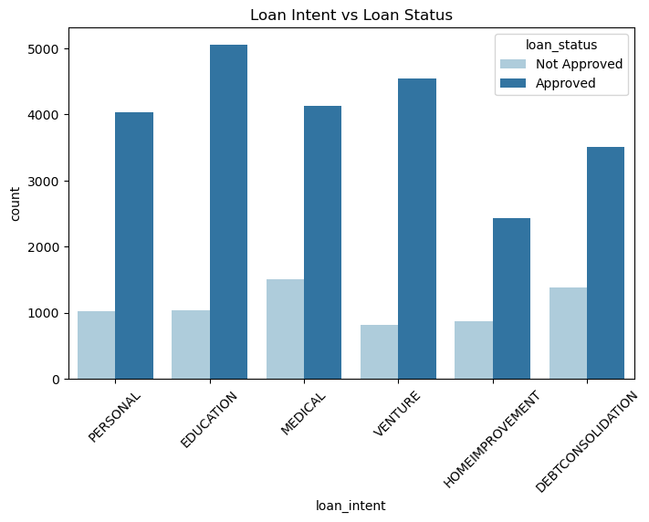
Home Ownership & Loan Intent vs Status
Observation: Renters show a relatively higher non-approval share than mortgage holders/owners; certain loan purposes (e.g. medical) also show different approval patterns, hinting at intent-based risk differences.

Slide 17
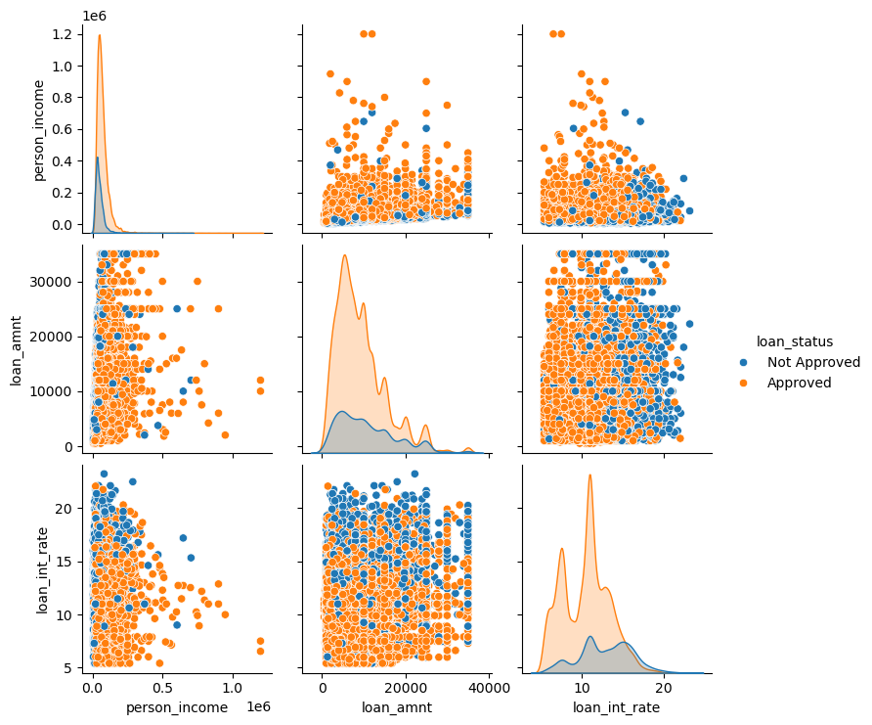
Multivariate Analysis
Income, Loan Amount & Interest Rate
The pair plot examines pairwise relationships among income, loan amount, interest rate and loan status together.
Observation: 'Not Approved' cases cluster at higher interest rates and higher loan-to-income ratios, while 'Approved' cases skew toward lower interest rates — a multivariate confirmation of single-variable findings.

Slide 18
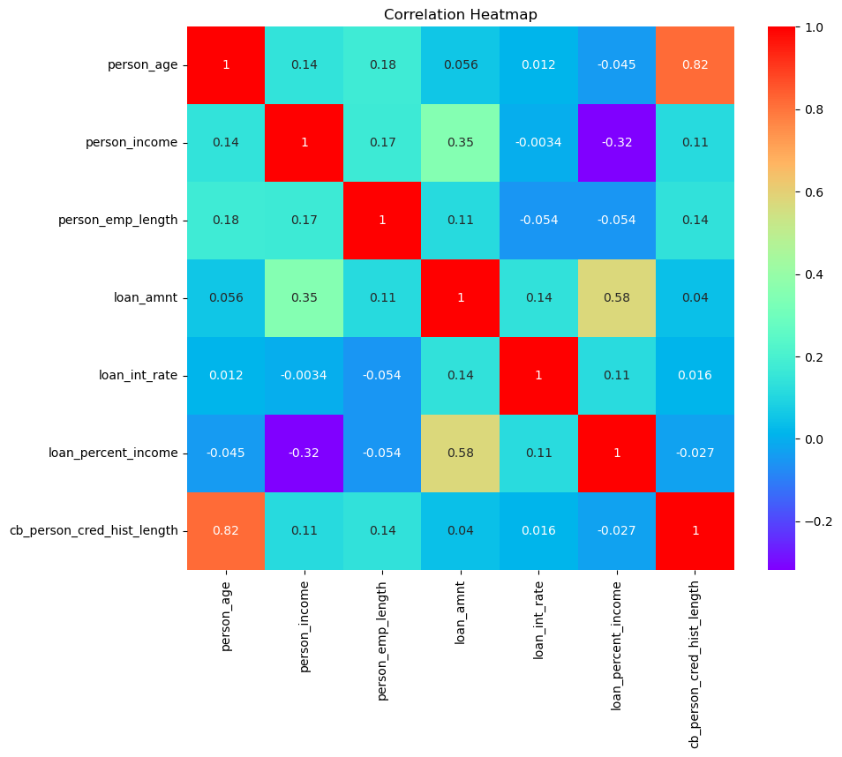
Correlation Heatmap
A correlation heatmap was used to quantify linear relationships between all numerical variables at once.
Observation: loan_amnt and loan_percent_income show a notable positive correlation; person_age and cb_person_cred_hist_length are strongly correlated, as expected. These relationships guide feature selection for any future modelling.

Slide 19
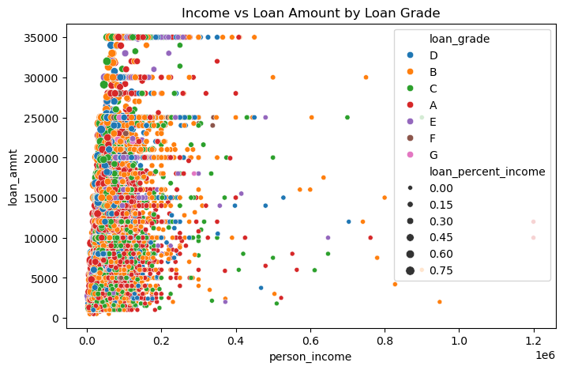
Income vs Loan Amount by Loan Grade & % Income
This advanced scatter plot encodes four dimensions at once: income (x), loan amount (y), loan grade (colour) and loan-percent-income (point size).
Observation: Higher grades (A/B) cluster at lower loan-to-income ratios; lower grades show larger, riskier loan sizes relative to income — multiple risk factors compounding together.

Slide 20
Key Insights at a Glance
Loan grade is the strongest predictor of approval outcome — risk rises steadily from A to G.
Income and loan amount are positively related, but loan_intent and grade also shape loan size.
Dataset is imbalanced toward one loan-status class — relevant for future modelling.
Renters show comparatively higher non-approval rates than mortgage holders.
Higher interest rates correlate with the 'Not Approved' outcome group.
Missing values and outliers were handled carefully to preserve genuine financial extremes.

Slide 21
Final Insights & Learning
FINAL INSIGHTS:
The EDA confirms that credit risk is shaped by a combination of factors — loan grade, interest rate, loan-to-income ratio, and home ownership — rather than any single variable. Lower-grade, higher loan-to-income borrowers consistently show greater risk of non-approval, validating the dataset's real-world credibility for risk modelling.
LEARNINGS FROM THE PROJECT:
• Hands-on experience with the full EDA pipeline: cleaning, univariate, bivariate and multivariate analysis.
• Learned to apply context-aware outlier handling instead of blanket removal.
• Strengthened skills in seaborn/matplotlib visual storytelling.
• Understood how pivot tables complement visual analysis for business insight.

Slide 22

THANK YOU

