Slide 1
Round Robin
Scheduling
Every process gets a fair turn.
Notes:
Introduce Round Robin as a scheduler built around turns. The key idea is simple: processes share the CPU through fixed time slices, returning to the queue when they still have work.

Slide 2
THE PROBLEM
Fairness keeps one process from owning the CPU.
Why CPU scheduling needs fairness
1
Multiple processes compete for CPU time.
2
A process that runs too long can make every other process wait.
3
Round Robin shares the CPU through fixed time slices.
Notes:
Frame the motivation first. The scheduler has to decide who runs next while multiple processes are ready. Round Robin makes that decision repeatable and fair by limiting each turn.

Slide 3



THE CORE IDEA
Every process gets a turn
Round Robin rotates through the ready queue until all processes finish.
Time quantum
Ready queue
The fixed CPU interval assigned per turn.
A FIFO queue of processes waiting to run.
Notes:
Define the two terms students need. The time quantum is the fixed interval. The ready queue is FIFO, so a process that still needs time goes to the rear and waits for its next turn.

Slide 4
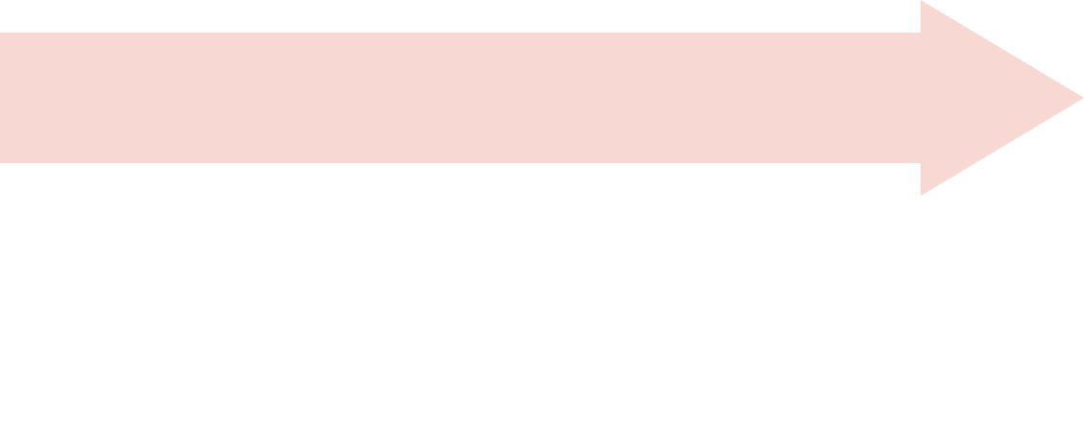
THE PIPELINE
From input to results
Queue
Set
Add arrived processes to the ready queue.
Enter
Set the time quantum.
Enter each process's arrival time and burst time.
Report
Run
Report completion, turnaround, and waiting times.
Run the scheduler and display the Gantt chart.
Notes:
Read the workflow left to right. Inputs become queue decisions, queue decisions become execution, and execution becomes a Gantt chart plus measurable timing results.

Slide 5




THE DECISION LOOP
Finish or reduce
Select front
The queue controls the schedule.
If it finishes, calculate completion time. If it does not, reduce its remaining time and move it to the rear.
Select the process at the front of the queue.
Run a slice
Run it for the smaller of the time quantum or remaining burst time.
Requeue
Add newly arrived processes as the clock advances.
Notes:
Trace the loop clockwise. Every decision depends on the queue front, the smaller of two times, and whether the process has finished. New arrivals join as the clock advances.

Slide 6
THE DATA MODEL
What the scheduler stores
Stored value | Purpose | Timing relationship
Process ID | Names the process. | Arrival time and burst time enter with it.
Remaining time | Tracks work still to run. | Reduced after each time slice.
Completion time | Records when the process finishes. | Set when remaining time reaches zero.
Turnaround time | Completion time minus arrival time. | completion − arrival
Waiting time | Turnaround time minus burst time. | turnaround − burst
Notes:
Separate the state from the formulas. Remaining time drives the next scheduling decision. Completion time lets the scheduler calculate turnaround time, then waiting time.

Slide 7
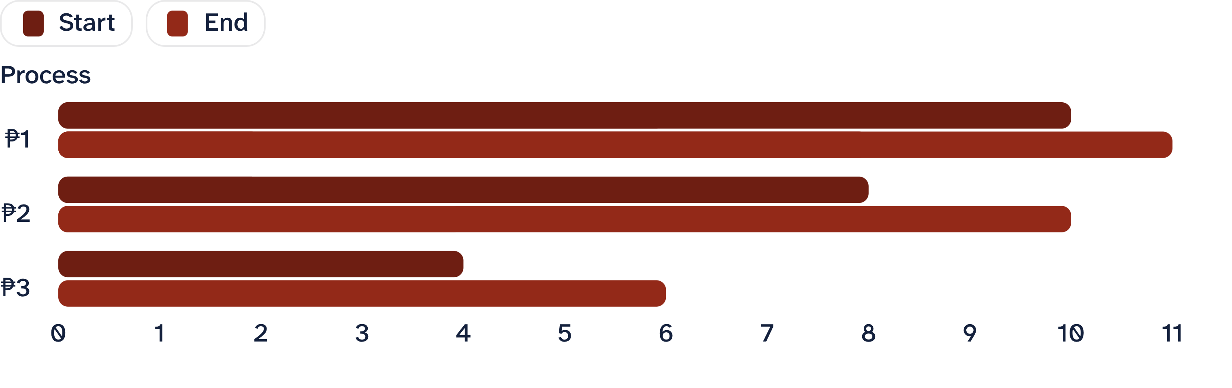
WORKED EXAMPLE
A complete rotation in six turns
With P1 = 5, P2 = 4, P3 = 2, all arriving at 0, and a time quantum of 2:
01
02
03
04
05
06
P1: 0–2
P2: 2–4
P3: 4–6
P1: 6–8
P2: 8–10
P1: 10–11
Notes:
Follow the six turns in order. Each ready process receives two units, returns if unfinished, and disappears from the queue when its burst is complete.

Slide 8
READ THE RESULT
P1 completes at time 11.
The example finishes with measurable results.
P2 completes at time 10.
P3 completes at time 6.
The Gantt chart makes the fair CPU rotation visible.
Notes:
Use the completion times as the first check on the example. The Gantt chart is more than a picture of execution: it makes the repeated, fair rotation visible.

Slide 9
A KEY DESIGN CHOICE
Time quantum changes the behavior
Small quantum
Large quantum
More frequent queue rotation.
Fewer queue rotations per process.
Needs more time: preempt it, then place it at the rear.
New process arrives: add it to the ready queue in arrival order.
A small quantum improves responsiveness.
Finishes within quantum: remove the process and continue.
A large quantum reduces queue rotation.
The process still returns only if it is unfinished.
Notes:
Compare the two behaviors rather than calling one universally better. A small quantum rotates more often and improves responsiveness. A large quantum reduces queue rotation. In both cases, completion removes the process.

Slide 10
FINAL CHECK
Test the edge cases.
Validate the scheduler
and remember the cycle.
Test different process counts, burst times, and arrival times.
Compare small and large time quanta.
Include equal burst times and processes arriving mid-schedule.
Check execution order, Gantt chart, averages, waiting time, and turnaround time.
Processes enter the ready queue, receive a fixed slice, return if unfinished, and continue rotating until completion.
Notes:
Close with validation, not a new claim. Change the process counts, burst times, arrival times, and quantum. Then check the order, chart, averages, waiting time, and turnaround time against the cycle.

