Slide 1

Round‑Robin: The Art of Fair CPU Scheduling
Concise explainer of Round‑Robin CPU scheduling — a preemptive, time‑shared approach that guarantees each process a fair share of the processor via fixed time slices (time quantum).

Slide 2




Introduction — Key Concepts
Time Quantum
Fixed CPU slice allocated to each runnable process. Determines preemption frequency and responsiveness.
Ready Queue
Processes wait here in FIFO order. After using their quantum, incomplete jobs are re‑enqueued at the back.
Fairness & Preemption
Round‑Robin prevents starvation by rotating the CPU among processes — it is inherently preemptive.

Slide 3
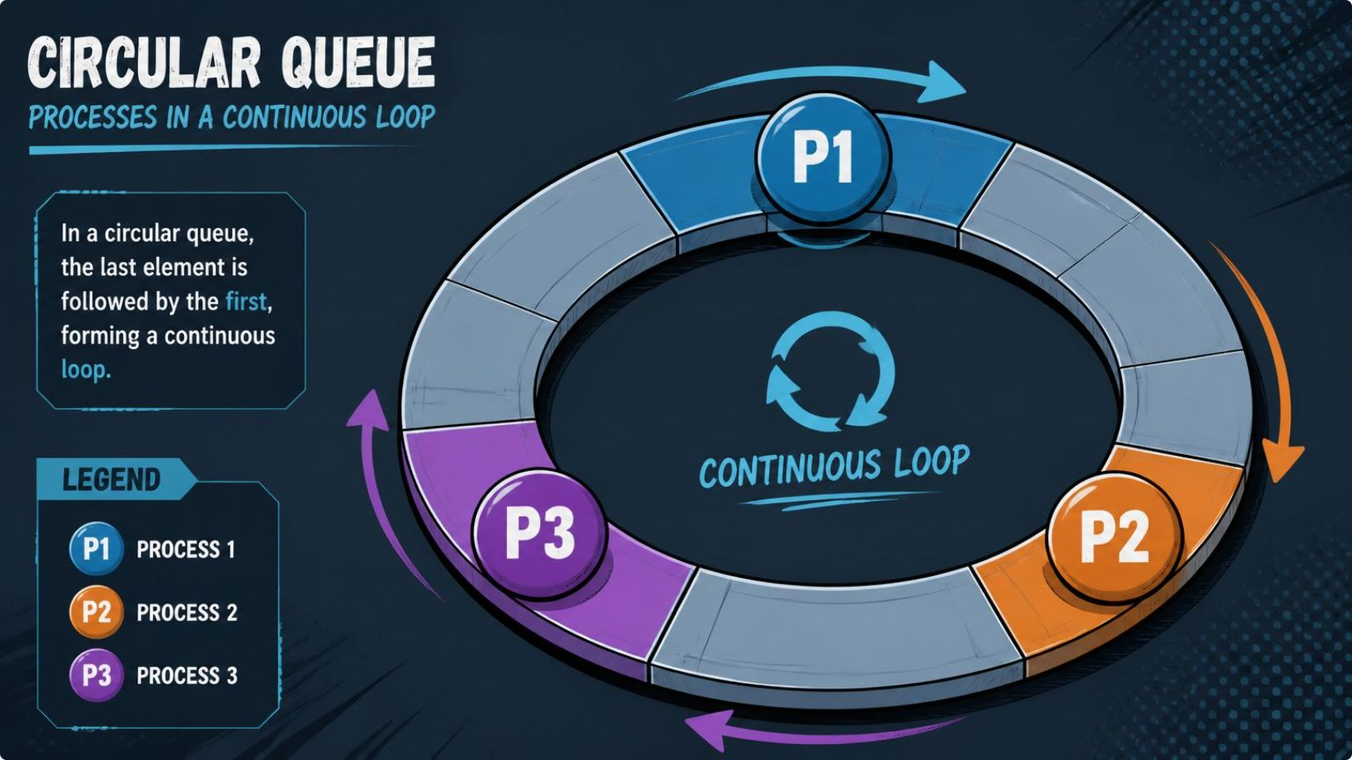
Objective & Implementation Goals
Understand preemptive scheduling and measure its behaviour under different quanta.
Implement Round‑Robin in C using a queue data structure to manage ready processes.
Execute each process for min(remaining_time, quantum) and re‑enqueue if incomplete.
Record completion times to compute turnaround and waiting times for analysis.
Practical goal: show how quantum choice trades off throughput, turnaround time and context‑switch overhead.

Slide 4
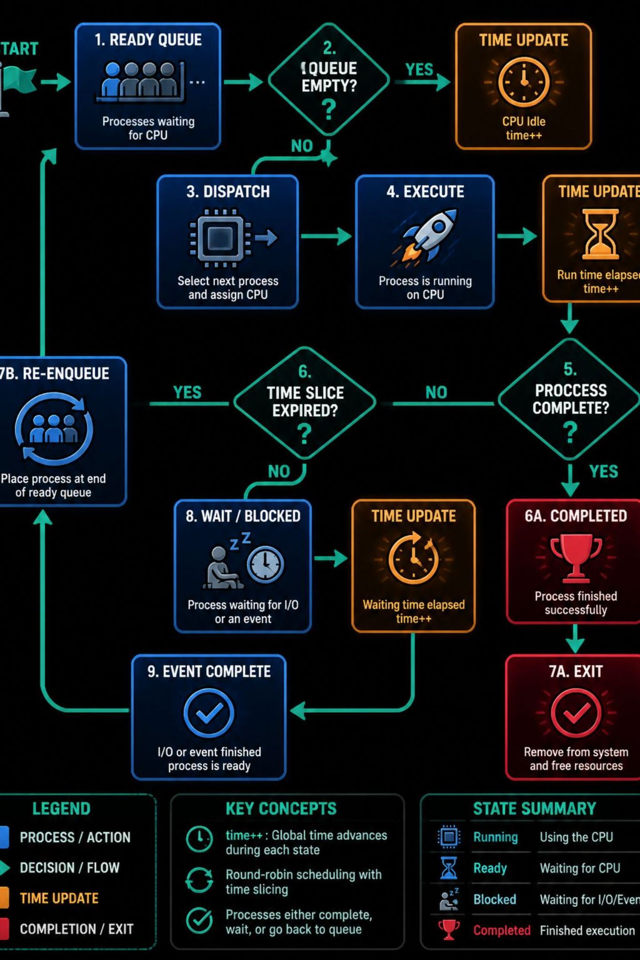

Algorithm Logic — Step by Step
Enqueue arrivals
Dispatch front
Update clock & remaining
Finish or re‑enqueue

Slide 5



Sample Test Cases & Practical Notes
Test Case 1 — Interleaving
Test Case 2 — Quantum ≥ Burst
Test Case 3 — Long Job
P1=5, P2=3, Quantum=2 → Execution: P1(2) → P2(2) → P1(2) → P2(1) → P1(1). Both complete after multiple slices; demonstrates interleaving and fairness.
P1=10, Quantum=3 → Execution: P1(3) → P1(3) → P1(3) → P1(1). Long jobs are sliced across multiple rotations; responsiveness for others improves at cost of more context switches.
P1=2, P2=2, Quantum=4 → Execution: P1(2) → P2(2). Behaviour reduces to FCFS when quantum exceeds bursts; fewer context switches.

