Slide 1

iOS Best Coding Practices
Presented by : Anubha Singh

Slide 2
Training Agenda:
Project Architecture
Project Organization
Coding styles
Dependency Management
Schema and Project Configuration
Useful Libraries

Slide 3
Project Architecture
A good architecture will make the app more testable
Easier to understand and reduce maintenance cost
Will make objects clear and specific and provides balanced distribution of responsibilities among entities with strict roles.
Provides simple data flow to debug
Nowadays, we have many options to accept as project architecture. These are
1. MVC - Model View Controller
2. MVP - Model View Presenter
3. MVVM - Model View ViewModel
4. Viper

Slide 4
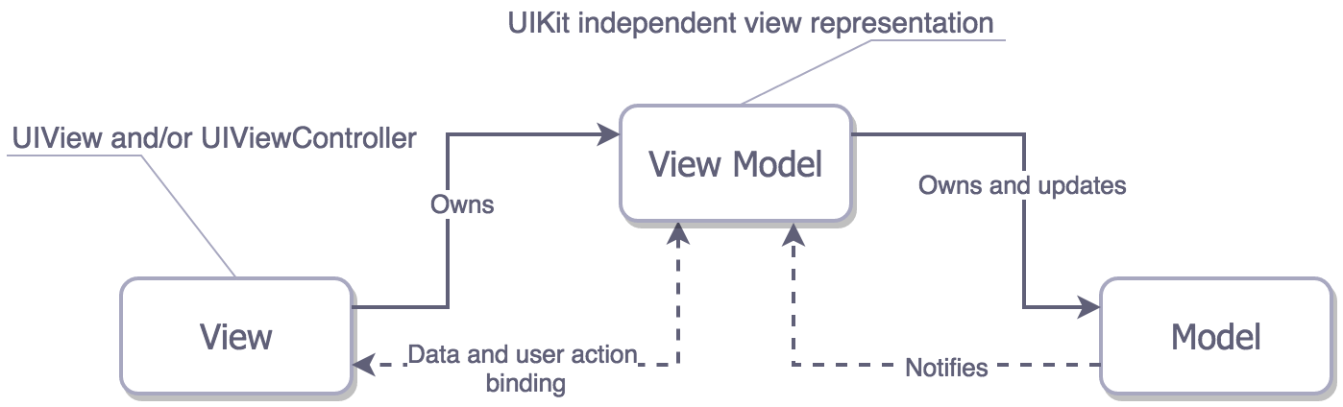
Model View ViewModel (MVVM)
MVVM (Model View ViewModel) was developed by engineers from Microsoft Ken Cooper and Ted Peters and announced by John Gossman in his blog in 2005.
The purpose of the pattern is separation between the user interface from development and business logic development
The MVVM design pattern is an improved version of MVC. As MVC comes with a concern of bloated viewcontroller.

Slide 5
Model View ViewModel (MVVM)
In MVVM, the View and Controller are united to form a view with an additional introduction of ViewModel, which now handles the presentation logic.
The ViewModel introduce changes in Model and updates itself regularly.
Furthermore, since View is bound strongly with View Model, the communication between Model and ViewModel with ease.

Slide 6
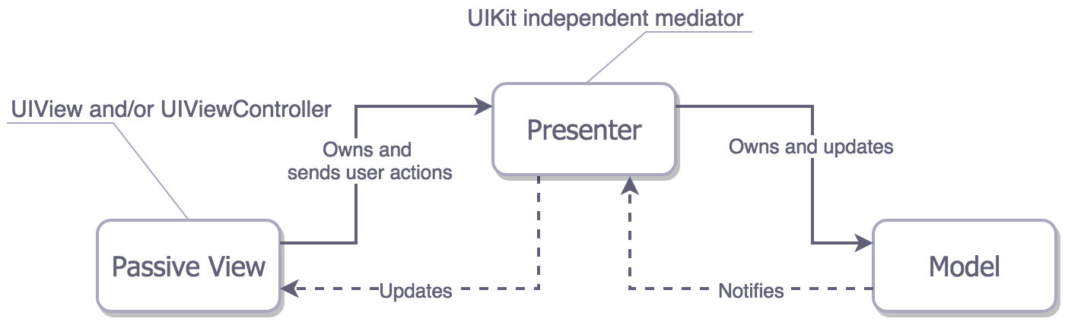
Model View Presenter (MVP)
The MVP pattern in iOS consists of:
Model - In iOS, the Model is a collection of different classes that represent the business logic (i.e. business model and data model). The model also defines the rules by which your data can be altered and manipulated.
View - The View in MVP consists of both UIView and UIViewController. The View hands over any user interaction to the presenter.
Presenter - The controller in MVC is replaced by Presenter in MVP. Now the presenter holds the responsibility of addressing all user events on the behalf of View. The presenter communicates with the model layer, converting the data to a UI-friendly format, and updates the View.

Slide 7
Viper
This architecture is based on Single Responsibility Principle which leads to a clean architecture.
View: The responsibility of the view is to send the user actions to the presenter and shows whatever the presenter tells it.
Interactor: This is the backbone of an application as it contains the business logic.
Presenter: Its responsibility is to get the data from the interactor on user actions and after getting data from the interactor, it sends it to the view to show it. It also asks the router/wireframe for navigation.
Entity: It contains basic model objects used by the Interactor.
Router: It has all navigation logic for describing which screens are to be shown when. It is normally written as a wireframe.

Slide 8
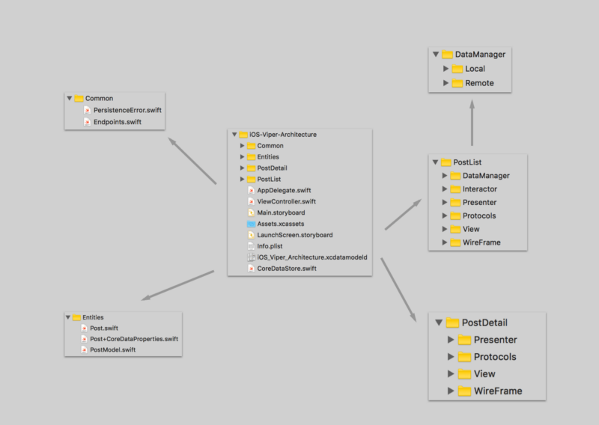
Viper Application Structure

Slide 9
Advantage of Viper Structure
It decouples the code for reusability and testability.
It divides the application components based on its role, called separation of concern.
Adding new features is easier.
It’s easier to write automated tests since your UI logic is separated from the business logic.

Slide 10
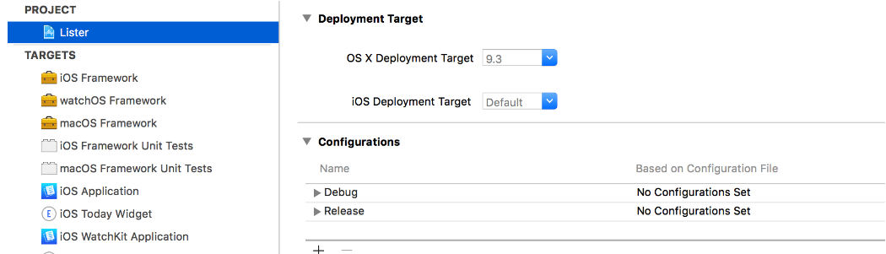
Project Organization
There should be reasonable naming concept and folder structure inside the application. This includes targets, schemes, bundle Identifier and source file names.
Target Naming
Name the targets like : [Platform][Template]
Platform Names should be - iOS/ macOS/ tvOS/ watchOS
Don’t include project name in the target

Slide 11
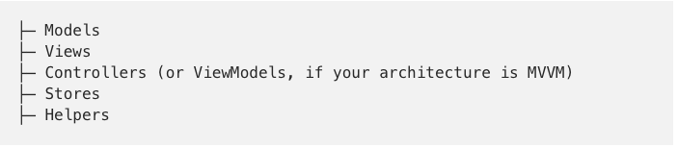
Schemes Naming
Name the targets like : [Project] [Platform][Template]
For the frameworks extend your project name with the "Kit" postfix.
Bundle Identifiers Naming
com.company.project bundle for iOS
don't use more than 4 dots!
Project Folder

Slide 12
Localization
Keep all user strings in localization files right from the beginning.
Constants
Keep your constants' scope as small as possible. For instance, when you only need it inside a class, it should live in that class
Those constants that need to be truly app-wide should be kept in one place. Group all the constants into “Constants.swift”/ ”Constants.h” files.
enum Config {
static let baseURL = NSURL(string: "http://www.example.org/")!
static let splineReticulatorName = "foobar"
}
Minimum iOS version
It’s useful to make an early decision on the minimum iOS version you want to support in your project: knowing which OS versions you need to develop and test against, and which system APIs you can rely on, helps you estimate your workload, and enables you to determine what’s possible and what’s not.

Slide 13
Coding Styles
Coding Style Guides refers to the style and conventions to follow before coding in a specific language.
It includes things like whether to use tabs or spaces, how to name variables or some conventions specific to a language(like in Swift whether to use Classes or Structs).
helps create an application which is easy to maintain and update.

Slide 14
Dependency Management
There are two important ways in which you can manage dependencies in your project.
Cocoappods
CocoaPods is the dependency manager for Swift and Objective-C Cocoa projects . It is the most effective way to manage dependencies similar to Ruby Gems in approach.
Go to your project directory in terminal and type below commands.
sudo gem install cocoapods
pod init
pod install
pod update

Slide 15
Carthage
Carthage takes the "simple, not easy" approach by building your dependencies into binary frameworks, without integrating them with the project.
This also greatly reduces build times, because your dependencies have already been compiled by the time you start building.
There is no centralized repository of projects, which means any library that can be compiled into a framework supports Carthage out of the box.
Go to your project directory and follow below commands to install through carthage.
touch cartfile
open -a Xcode Cartfile
add required cart file as [ github "Alamofire/AlamofireImage" ~> 3.2 ]
carthage update –platform iOS
If libraries installed successfully, then then type
Open carthage
Drag and drop the frameworks into your project from build folder

Slide 16
Advantage of Carthage
When adding “pods” to a project, CocoaPods creates a new Xcode project with a target for each individual pod, as well as a containing workspace. Then you have to use the workspace and trust that the CocoaPods project works correctly. Talk about a lot of extra build settings to maintain.
CocoaPods’ Podspecs repository is centralized, which could be problematic if for some reason it were to disappear or become inaccessible.
CocoaPods adds complexity to both the app development and the library distribution processes.

Slide 17
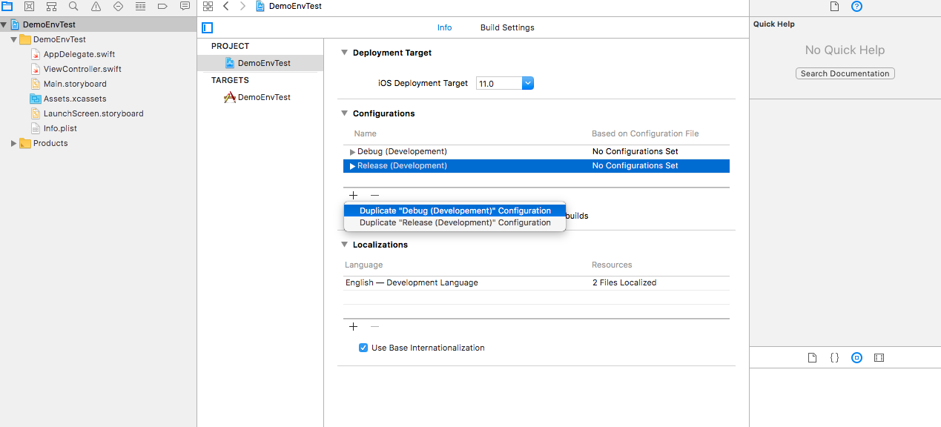
Schema and Project Configuration
Add a new configuration for the environment.

Slide 18
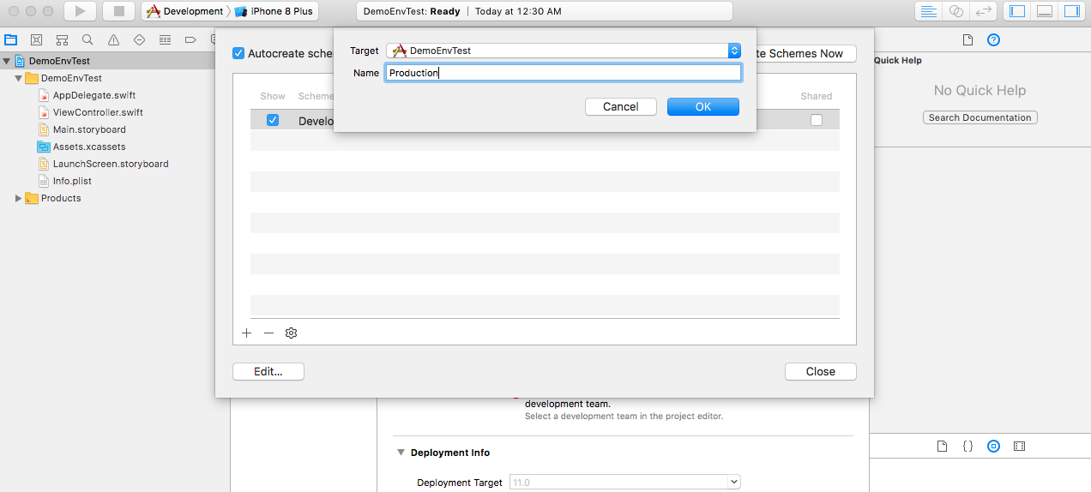
Add a new schema for environment.
c

Slide 19
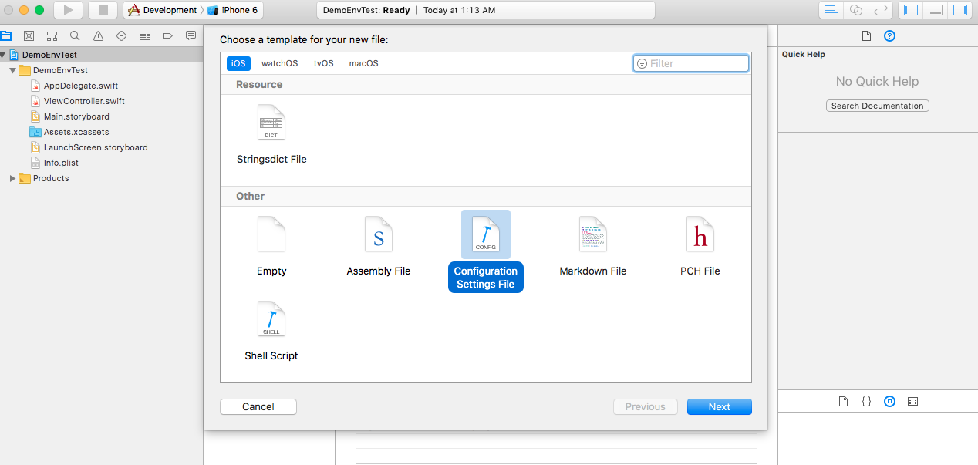
Add configuration settings file.
c

Slide 20
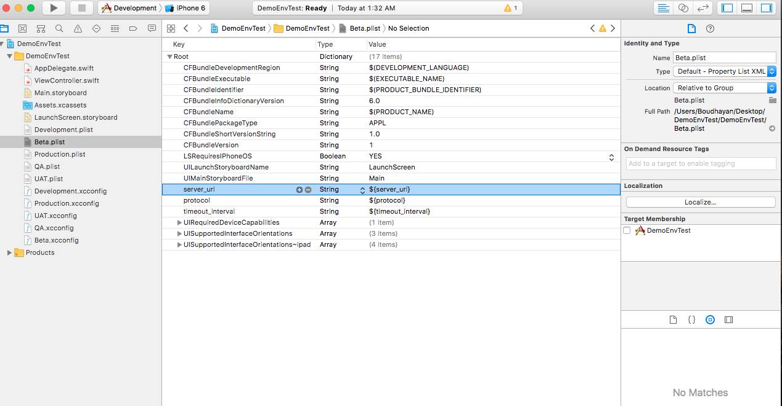
Add Plist files for configurations. And set some environment-specific keys and values in the plist files.

Slide 21
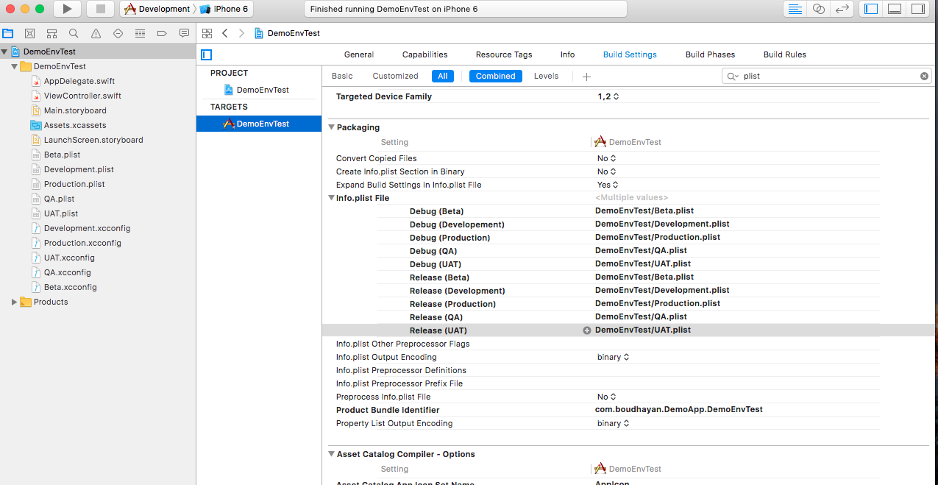

Slide 22
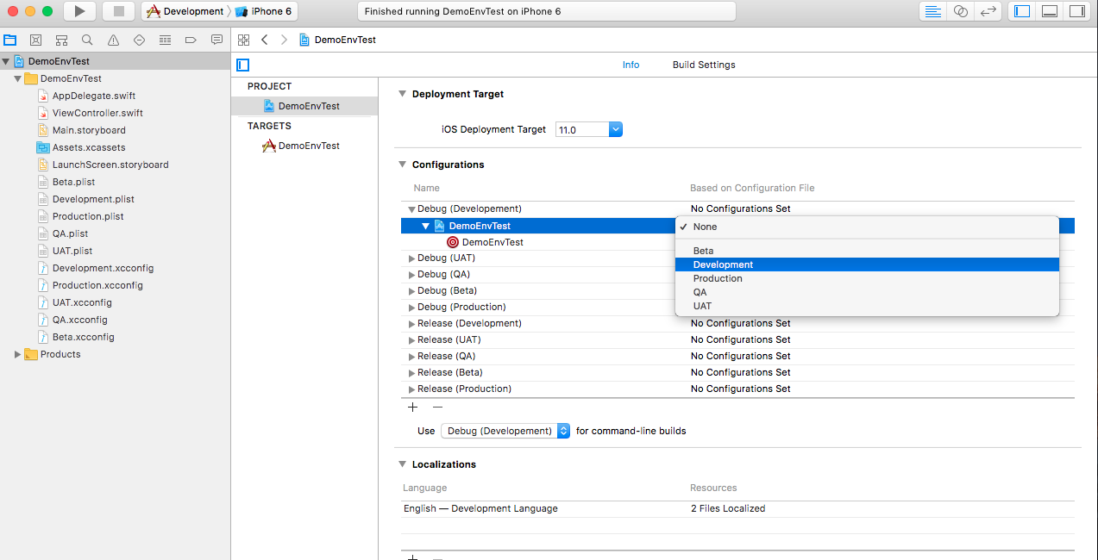

Slide 23
Useful Libraries
CleanroomLogger - CleanroomLogger provides an extensible Swift-based logging API that is simple, lightweight and performant.
Bolts-Swift- Bolts Tasks is a complete implementation of futures/promises for iOS/OS X/watchOS/tvOS and any platform that supports Swift. A task represents the result of an asynchronous operation, which typically would be returned from a function
◽️ Verbose messages are tagged with a small gray square — easy to ignore ◾️ Debug messages have a black square; easier to spot, but still de-emphasized
🔷 Info messages add a splash of color in the form of a blue diamond
🔶 Warnings are highlighted with a fire-orange diamond
❌ Error messages stand out with a big red X — hard to miss!
save(object).continueWith { task in if task.cancelled { // Save was cancelled } else if task.faulted { // Save failed }
else { // Object was successfully saved
let result = task.result
}
}
save(object).continueOnSuccessWith { task in // The object was saved succesfully
let result = task.result
}

Slide 24
Useful Resource..
https://academy.realm.io/posts/krzysztof-zablocki-mDevCamp-ios-architecture-mvvm-mvc-viper/
https://github.com/futurice/ios-good-practices#architecture
https://medium.com/ios-os-x-development/ios-architecture-patterns-ecba4c38de52
https://blog.mindorks.com/building-ios-app-with-viper-architecture-8109acc72227
https://en.wikipedia.org/wiki/Single_responsibility_principl

Slide 25
Thank You

