Slide 1

Ajay Kumar Garg Engineering College
MINI PROJECT FOR INTERNSHIP
Mohit Singh
(1900270310098)

Slide 2
About
I have completed my internship on “Embedded Systems” from Ajay Kumar Garg Engineering College, Ghaziabad. Ajay Kumar Garg Engineering College is one of the reputed colleges affiliated to AKTU and is AICTE And NAAC certified college.
My internship was for the duration of 3-4 weeks. The topics covered in the internship were:
Overview of Arduino Uno and Embedded Systems
Microprocessor-8085
Microcontroller-8051
Microcontroller-Raspberry Pi and Python Programming

Slide 3
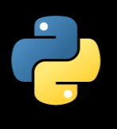
PYTHON
Python is an interpreted, high-level and general-purpose programming language. Created by Guido van Rossum and first released in 1991, Python's design philosophy emphasizes code readability with its notable use of significant whitespace. Its language constructs and object-oriented approach aim to help programmers write clear, logical code for small and large-scale projects.
Python is dynamically typed and garbage-collected. It supports multiple programming paradigms, including structured (particularly, procedural), object-oriented, and functional programming. Python is often described as a "batteries included" language due to its comprehensive standard library.

Slide 4
DataTypes in Python
Data types are the classification or categorization of data items. It represents the kind of value that tells what operations can be performed on a particular data. There are 5 data types in python.
Numeric (Integers, Float, Complex Numbers)
Sequence Type (Strings, Lists, Tuples)
Boolean
Set
Dictionary

Slide 5
Conditional Statements
Decision making statements in programming languages decides the direction of flow of program execution. Decision making statements available in python are:
If statement
If...else statement
If...elif...else statement
Nested If statement

Slide 6
Loops in Python
A loop statement allows us to execute a statement or group of statements multiple times. Python programming language provides following types of loops to handle looping requirements. Python provides three ways for executing the loops. While all the ways provide similar basic functionality, they differ in their syntax and condition checking time.
For Loop
While Loop
Nested Loop

Slide 7
Functions in Python
A function is a set of statements that take inputs, do some specific computation and produces output. The idea is to put some commonly or repeatedly done task together and make a function, so that instead of writing the same code again and again for different inputs, we can call the function.
Built-in functions
User-defined functions

Slide 8
Modules in Python
A module is a file containing Python definitions and statements. A module can define functions, classes and variables. A module can also include runnable code. Grouping related code into a module makes the code easier to understand and use. We can import the functions or elements of a module into our program by following ways:
The import Statement
The from import Statement

Slide 9

My Project
Creating a Hangman game using Python

Slide 10
About my project
I have created a Hangman game using Python in which I have incorporated several features of Python such as modules, datatypes, conditional statements, loops, functions and much more.
The game is a simple quiz type game in which you are given a word with few missing letters. You have to either guess the missing letters one by one or guess the full word. You get 6 chances to guess. Every time you guess wrong a man is shown being hanged from a rope. When all the chances are over, the man is fully hung from the rope.
The project contains 1 main and 3 supporting python files.

Slide 11
There are two types of modules that I have used in my project. First one of them is user-defined module and the second in built-in module.
There are 3 user-defined module in my project namely hang_body, uword_creator, pyword.
There are 2 built-in functions used in my project namely random, colorama.

Slide 12
hang_body.py
This module contains a list stages which contains the body of the hangman in six different stages. The stages are explained as follows:
Full body
Body without legs
Body without legs and torso
Body without legs, torso, and hands
Body with just head
Just the hanging rope no body
The link to the above mentioned python file is hang_body.py

Slide 13
uword_creator.py
This module contains a function create() which uses a built-in module random to create a word with few letters already filled in it. For e.g.: If the word is INDENTATION this function may create a word I _ _ _ N T _ _ I _ N.
The create() function returns 2 values uw, cw. Here ,
uw is a string type data which contains the random word created with few blanks.
cw is a dictionary type data which contains the index of the blanks as key and the correct letter as value.
The link to the above mentioned python file is uword_creator.py

Slide 14
pyword.py
This module contains a dictionary which contains the guess word as key and a respective hint as value. For e.g.: {“indentation”: “ I am a spacing technique.”}
This module also contains a list of keys from the previous dictionary which provides the word for the game.
The link to the above mentioned python file is pyword.py

Slide 15
hangman.py
This is the main python file which calls all the previous python files and also uses built-in modules named random and colorama.
Where colorama is used to make the output more attractive by giving them colors.
In this file, first we call all the previous files using import statement. Then we have the following functions in the program:
def getword(wlist) : This functions uses the list named words from pyword module and returns a random word from the list in upper case.

Slide 16
def play(word) : This function takes the word generated by getword() as parameter and starts the game.
def main() : This is the main function which executes our program by calling the getword() and play() functions. It also asks the user whether he wants to continue playing or not.

Slide 17
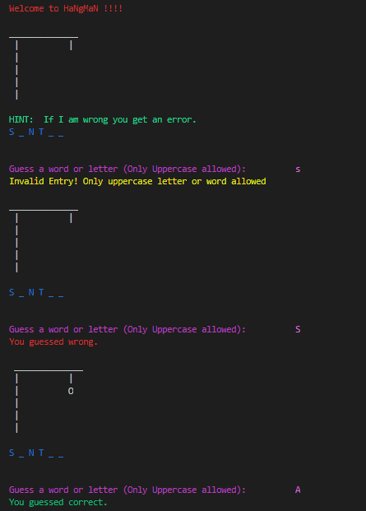
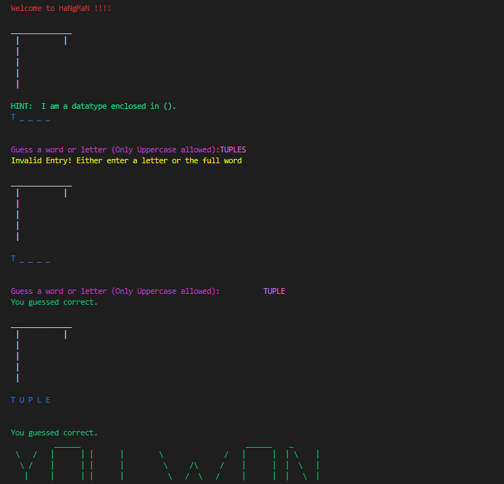

Slide 18
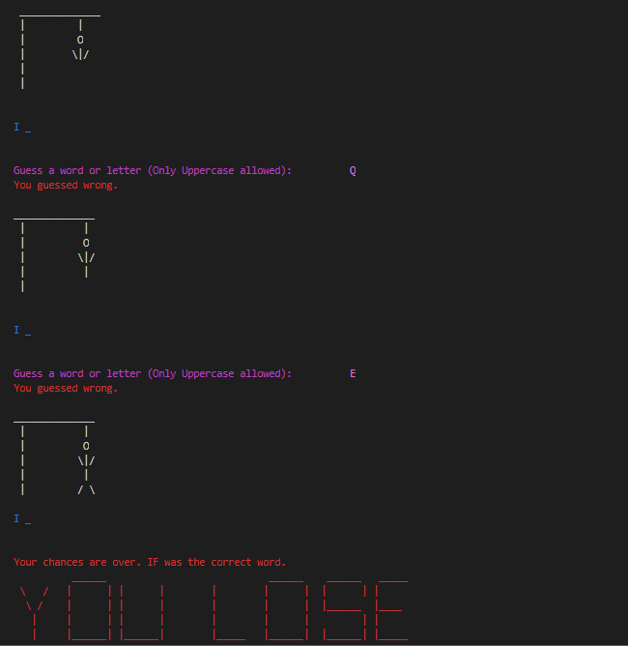
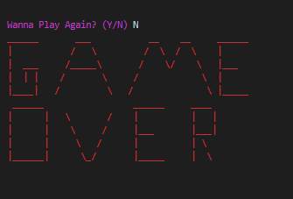

Slide 19
Applications of Python Programming
Python supports cross-platform which makes building applications with it all the more convenient. Some of the globally known applications such as YouTube, BitTorrent, DropBox, etc. use python to achieve their functionality. Some of the major applications of Python Programming are:
Web Development
Game Development
Machine Learning and Artificial Intelligence
Data Science and Data Visualization
Web Scrapping Application
Embedded Application
CAD Application
and so on.

Slide 20
References
Websites:-
https://www.geeksforgeeks.org
https://www.wikipedia.org
https://www.w3schools.com
Books:-
Computer Science with Python(Class 12)

