Slide 1

Presentation on AI based Entry/Exit management system based on Facial Recognition
Presented By: Projjal Gop and Abhradipta Chakraborty Thakur

Slide 2
Our understanding of the challenge
The challenge focuses on Artificial Intelligence (AI) based facial recognition system for a hassle-free entry and exit management in different types of communities.

Slide 3
Proposed Solution
An object can be recognized by its own characteristic traits. The same concept applies for recognition of face. At first, for an unknown face, it requires data gathering from the face so that it can be recognized there-after. The solution follows the following procedure to recognize a face:
Face Detection: Determine a face from a picture.
Data Gathering: Extract unique characteristics from the face.
Data Comparison: Despite variations in light or expression, it will compare those unique features to all the features of all the people it has gathered the data.
Face Recognition: It will recognize the face.
The solution uses the above concept to recognize a person’s face in an entry/exit management system to track the number of times an individual has entered and exited through the system.

Slide 4
Proposed Solution
The objective of the proposed solution is to recognize a face of a person from a trained data set. The solution recognizes the face and displays the name of the person.
The solution is fast and takes less execution time and has a great accuracy even for a smaller number of images in the training data set. It provides a hassle-free solution to an entry and exit management system based on facial recognition in different types of communities.
The solution determines the number of times a person has entered and exited through the system where the solution is implemented.

Slide 5
Proposed Solution
The solution detects a face and recognizes it from the training data set of the images stored in the server for hassle free entry and exit in different types of communities. The solution recognizes the face displays the name of the person along with their current image on the display screen. The solution also keeps the count of the number of times a person has entered and exited though the system where the solution is implemented.

Slide 6
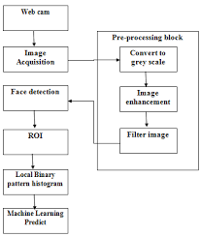
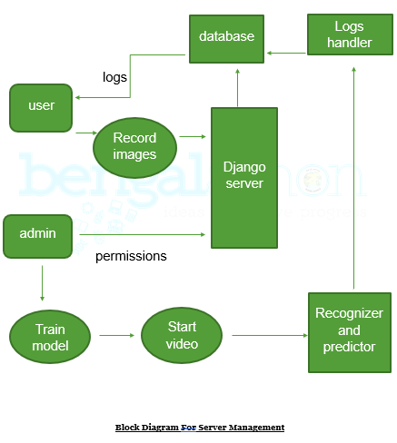
How does it work ?
Block diagram

Slide 7
What is the USP?
Our solution can be used as an employee attendance system, where a database can be used to mark one present.
Our solution can be used in automatic flight boarding pass generation systems.
Even in high security places, this will play an important role as admin will be alerted about any possible intruder.
This solution can be used in industry solutions to nationwide facial recognition systems which our country is planning to undertake by 2020.

Slide 8
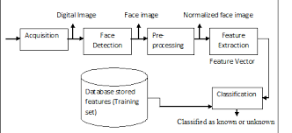
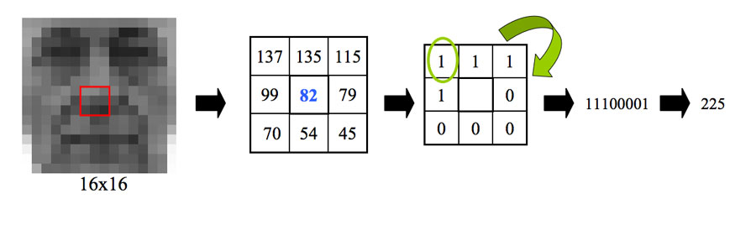
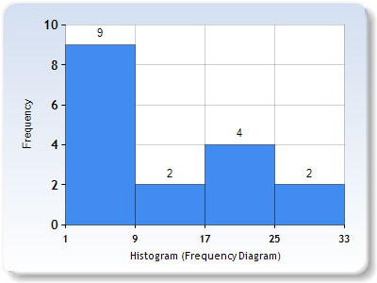
Solution Architecture
Conversion to histogram
Architecture of solution

Slide 9
Risk, Issues and Mitigation plan
The following are the current limitations to the solution:
A fair quality of images is required for training the data set and recognition of the face.
If multiple faces are very close to each other, it is difficult to extract each face from the image for recognition.
The above limitations can be resolved by:
The quality of the images can be made better by using a high resolution camera.
The size of image in the training data set can be compressed for faster training of the data.
Subject spacing should be properly gapped.

Slide 10
Thank You

