Slide 1
Q-EVM: A QUANTUM-RESISTANT
ACCOUNT ABSTRACTION LAYER FOR ETHEREUM
CSD-401 Project Presentation
on
Blockchain Security | Post-Quantum Cryptography | Zero Knowledge
By
Mohit Anuragi (2023KUCP1155)
Srikanth Reddy (2023KUCP1151)
Under the supervision of
Dr. Isha Pathak Tripathi
Department of Computer Science and Engineering
Indian Institute of Information Technology Kota
GROUP #52
14 OCT 2026
Notes:
Introduce Q-EVM as a forkless post-quantum security layer for Ethereum. The project does not change Ethereum consensus: it moves the expensive ML-DSA verification off-chain and keeps on-chain validation compact. Mention that this semester the gas-cost part of the design was implemented and measured.

Slide 2
PROBLEM STATEMENT & OBJECTIVES
Problem
Ethereum accounts rely on ECDSA, which Shor's algorithm breaks on a large quantum computer [1].
ML-DSA (FIPS 204) [2] is quantum-safe, but verifying it directly in the EVM costs about 2.8M gas per signature (our estimate).
A precompile such as EIP-8052 lowers the cost but requires a hard fork [6].
Objectives
Design a forkless post-quantum wallet layer using ERC-4337 and a zero-knowledge receipt.
Implement the gas-cost path and measure the on-chain cost instead of projecting it.
Quantify the gas and latency trade-off, including batching.
Design target
Quantum-safe signatures
(ML-DSA, FIPS 204)
Q-EVM
Low on-chain gas
(succinct ZK receipt)
Forkless deployment
(ERC-4337, no hard fork)
Figure 1: Q-EVM combines post-quantum security, low on-chain gas and forkless deployment.
Notes:
Focus on the engineering problem, not blockchain basics. ML-DSA gives quantum resistance, but native EVM verification is too expensive. Q-EVM uses ERC-4337 and a zero-knowledge receipt to avoid a hard fork. State the objective for this semester clearly: implement the gas-cost path and measure it instead of projecting it.

Slide 3
LITERATURE REVIEW & GAP IDENTIFIED
Reference | Key contribution | Limitation for our problem
Shor, 1994 [1] | Quantum algorithm that breaks ECDSA (discrete log) | Shows the threat; no migration path for Ethereum
NIST FIPS 204, 2024 [2] | Standardises ML-DSA, an integer-only lattice signature | 2,420-byte signature; no native EVM support
Schemitt et al., 2025 [3] | Benchmarks PQ signatures; simulates blockchain impact | Timing only; no EVM gas cost or deployment path
ERC-4337, 2021 [4] | Wallets define their own validation, no protocol change | Bundlers and wallets assume ECDSA
Raikwar et al., 2019 [5] | Survey: signature size versus verification cost | No deployable post-quantum design
EIP-8052, 2025 [6] | Falcon verification precompile with low gas | Needs a hard fork; Falcon is costly to prove in ZK
RISC Zero zkVM docs [7] | Proves Rust execution; succinct on-chain receipt | Existing zk wallets target ECDSA, not PQ signatures
CVE-2026-24850, 2026 [8] | RustCrypto ml-dsa accepted repeated hint indices | Implementations still maturing; needs upgradability
Research gap: No existing work combines ERC-4337 with a zero-knowledge receipt to validate ML-DSA signatures without a hard fork, or characterises its gas, proving-latency and batching trade-off. The on-chain costs reported so far are projections, not measurements on a running EVM.
Notes:
Walk through the references briefly: [1] gives the threat, [2] the standard, [3] timing benchmarks of post-quantum signatures on blockchains, [4] the mechanism we build on, [5] the survey view, [6] the hard-fork alternative, [7] the zkVM building block, [8] a reminder that post-quantum implementations are still maturing. Do not read every cell; use the limitation column to lead into the research gap. The gap has two parts: nobody had combined ERC-4337 with a ZK receipt for ML-DSA without a hard fork, and the costs reported so far were projections rather than measurements. If asked how Q-EVM compares: native ML-DSA is about 2.8M gas, a Falcon precompile about 50k but needs a hard fork, zk-ECDSA about 300k but is not post-quantum, and Q-EVM about 240k measured with no fork.

Slide 4
PROPOSED ARCHITECTURE
Core idea: move the expensive ML-DSA verification off-chain and verify only a compact ZK receipt on-chain.
Off-chain
On-chain (EVM)
User Wallet
Signs the UserOperation with ML-DSA
Rust Bundler
ERC-4337 mempool, simulation and batching
zkVM Prover
Runs ML-DSA verification and emits a receipt
Smart Wallet
validateUserOp verifies the receipt on-chain
UserOp
hash, pk, sig
receipt
Figure 2: Q-EVM end-to-end flow. The operation hash is a public input of the proof, which prevents replay.
Forkless
No Ethereum hard fork or client change is required.
Heavy work off-chain
ML-DSA verification never runs inside the EVM.
Constant on-chain cost
The wallet verifies one succinct proof per operation or batch.
Notes:
This is the main architecture slide. Ethereum still sees a normal ERC-4337 transaction path, but the smart wallet checks a proof that ML-DSA verification succeeded. Walk the flow left to right: the wallet signs, the bundler simulates and batches, the prover produces the receipt, and the wallet verifies it on-chain. The operation hash is a public input of the proof, which is what prevents replay.

Slide 5
WORK DONE THIS SEMESTER
The gas-cost part of the Q-EVM design is now implemented, so the on-chain cost is measured by running it, not projected.
1
Off-chain ML-DSA verification
Following Algorithm 1, the Rust bundler verifies each ML-DSA signature off-chain (Dilithium2, the ML-DSA-44 parameter set).
2
Groth16 receipt
For each valid operation the bundler generates a real Groth16 proof (BN254). The operation hash is a public input, which prevents replay.
3
On-chain verification
A Groth16 verifier contract runs on a local EVM (revm); the gas is taken directly from the EVM execution result.
4
Native baseline
The cost of verifying the same signature directly on-chain is estimated from the actual ML-DSA verification steps, priced with EVM opcode costs.
5
Batching
One Groth16 proof covers a whole batch, so the on-chain gas is shared across its operations.
6
Dashboard and CLI
A web dashboard and a command-line demo show these results live for each operation.
Result: the measured gas reduction is 91.4%, in agreement with the projection in the paper (Table II).
Notes:
This is the new work since the paper. Earlier we had a design and projected figures. This semester we implemented the gas-cost part of the design (Section IV-A, Figure 1 of the paper), so the on-chain cost is measured by running it. Go through the six items in order: off-chain ML-DSA verification, the Groth16 receipt, on-chain verification on revm, the native baseline, batching, and the dashboard and CLI.

Slide 6
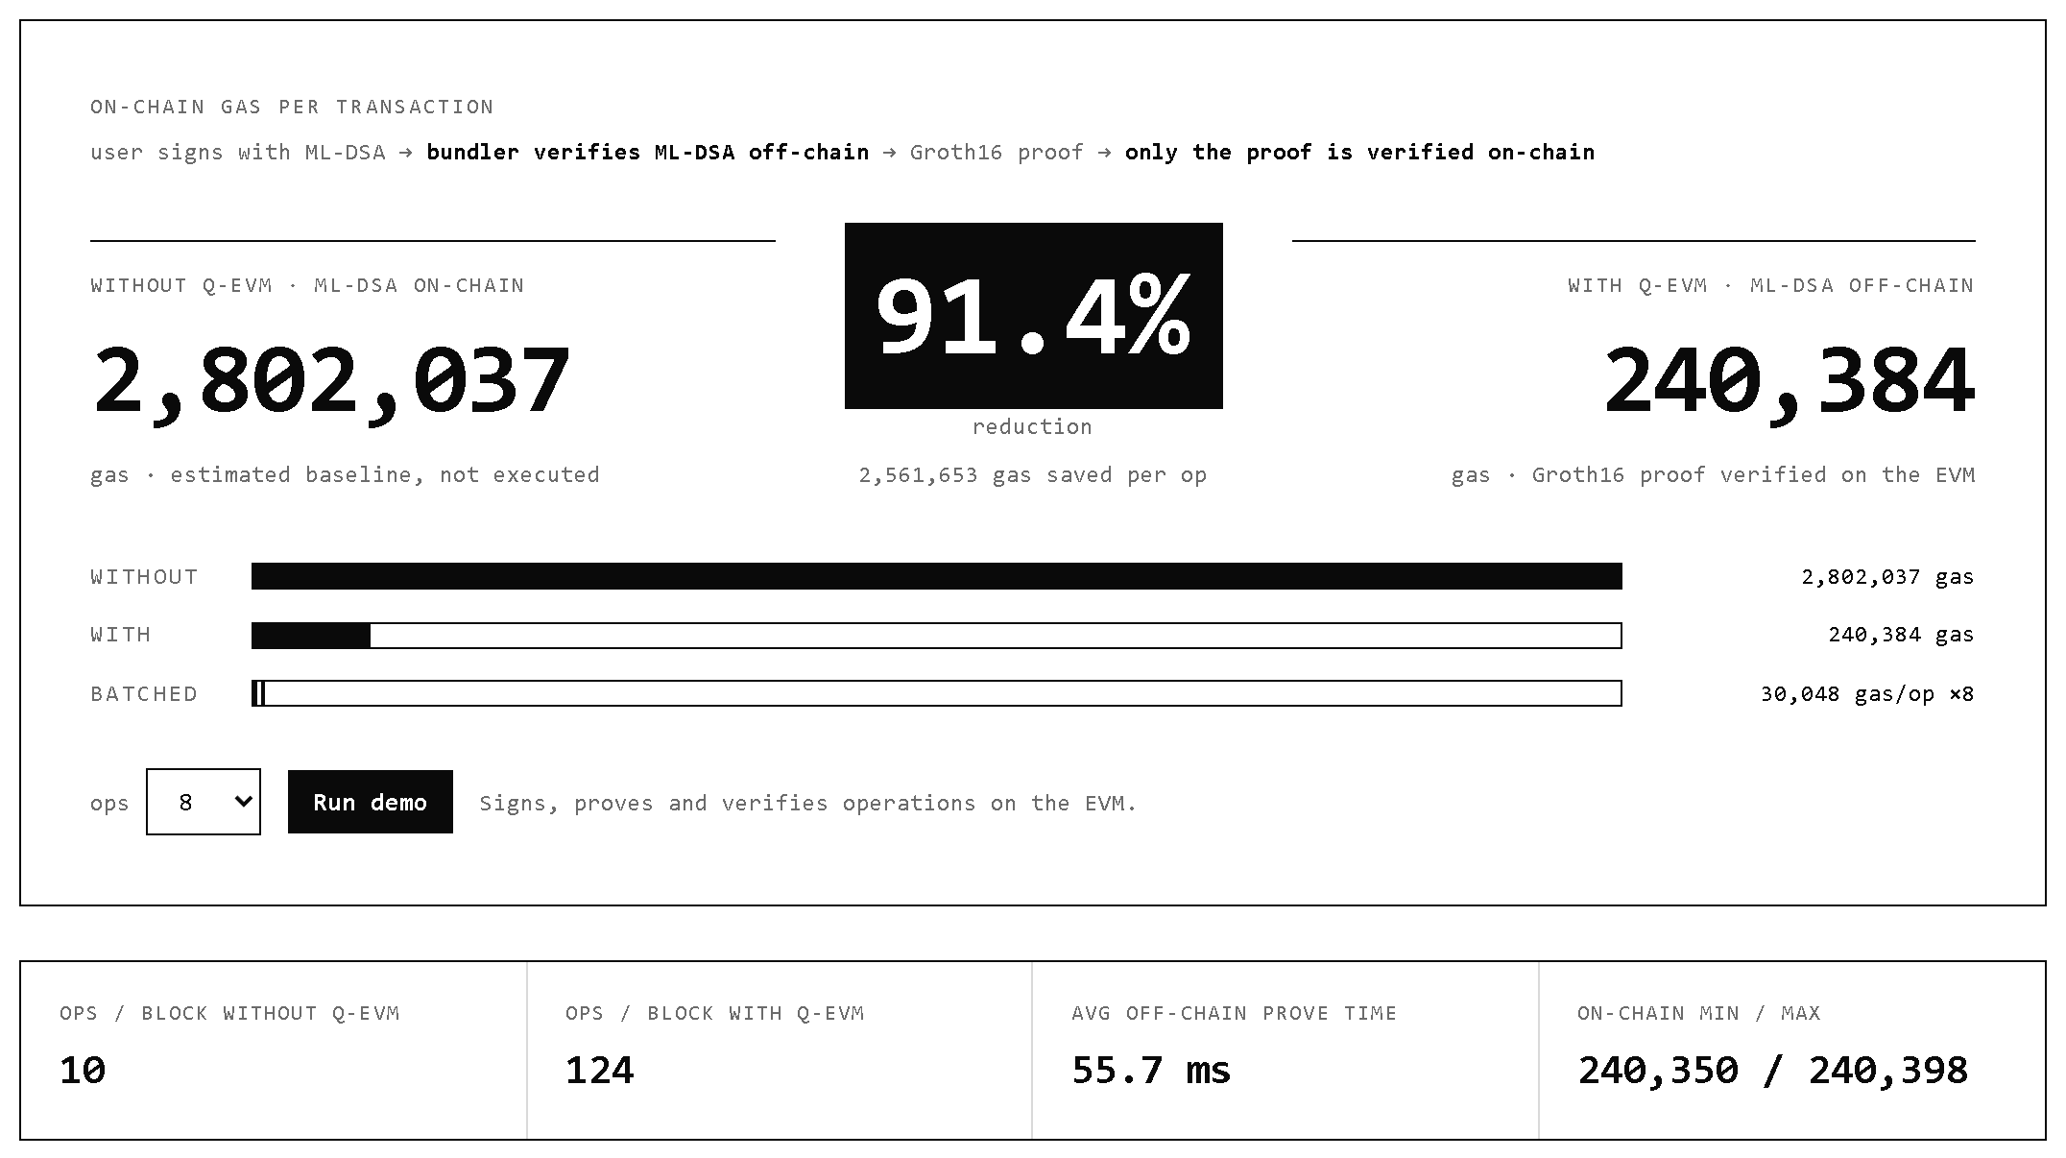
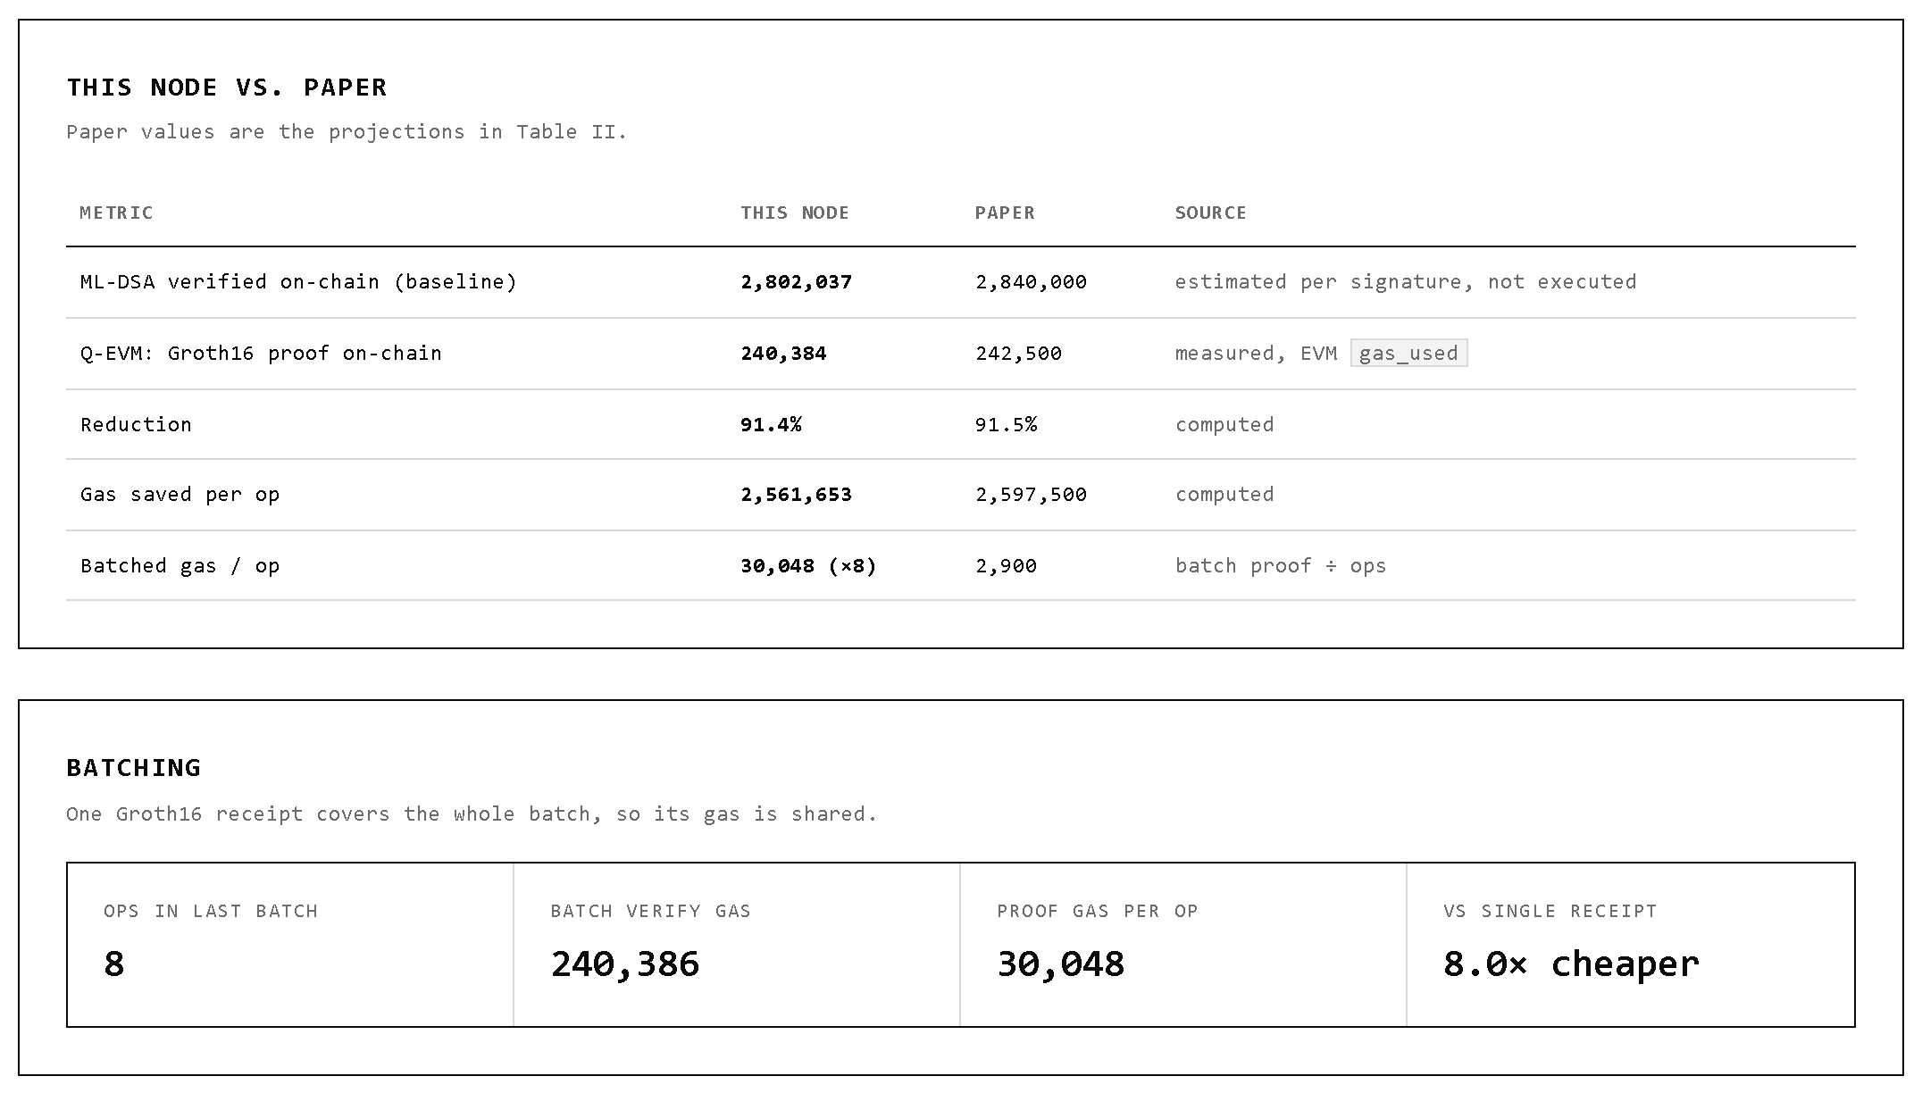
EXPERIMENTAL RESULTS
Measured on-chain gas confirms the projection: a 91.4% reduction against native ML-DSA verification.
Figure 3: Dashboard output, gas per operation without and with Q-EVM.
Figure 4: Our node against the paper (Table II), and batching.
Q-EVM gas is measured on a local EVM (revm); the native baseline is estimated from the ML-DSA verification steps.
Batching: one proof covered 8 operations, so the cost falls to about 30,000 gas per operation.
The prove time shown (55.7 ms) is for the receipt proof only; ML-DSA proving latency is still projected.
Notes:
These are screenshots of our running dashboard. Left: without Q-EVM one ML-DSA check is about 2.8 million gas, with Q-EVM it is 240,384 gas, a 91.4% reduction. Right: our node against the paper's Table II, and the batching result. The Q-EVM figure is measured on a local EVM; the native baseline is an estimate built from the actual verification steps. With a batch of 8, one proof is shared and the cost falls to about 30,000 gas per operation. The 55.7 ms prove time is only for the small receipt proof. The 12.4 s proving latency for ML-DSA inside a zkVM is still the projection from the paper. Q-EVM does not beat ECDSA, which has a native precompile at about 3,000 gas.

Slide 7
CHALLENGES / LIMITATIONS
Challenge | Root cause | Mitigation / future direction
Proof does not yet cover the ML-DSA check itself | The bundler verifies ML-DSA natively; the receipt records the result | Run the complete ML-DSA verification inside RISC Zero or SP1
Single-proof latency of about 12.4 s (projected) | Overhead of a general-purpose zkVM | Custom ML-DSA circuit; recursive proof aggregation
Gas measured on a local EVM only | No testnet deployment yet | Deploy on Sepolia or an L2 and measure real transactions
2,420-byte signature | ML-DSA-44 parameter size | Signature stays off-chain; only the proof is verified on-chain
zkVM maturity | Fast-evolving prover software | Audits and upgradable verifier contracts
Bundler liveness | Proving is delegated off-chain | Decentralised proving market
Trade-off: Q-EVM exchanges on-chain gas for off-chain proving and bundler infrastructure. It suits high-value and batched transactions rather than instant retail payments.
Notes:
This slide should sound honest. The most important limitation today is the first row: the ML-DSA check runs natively in the bundler and the Groth16 receipt records its result, so the proof does not yet cover the signature check itself. Q-EVM is also not suited to instant retail payments because single-proof latency is high. Its stronger use cases are batched settlement, exchanges, rollups and high-value wallets.

Slide 8
CONCLUSION & FUTURE WORK
Q-EVM demonstrates a forkless path to post-quantum Ethereum wallets, now backed by measured gas.
Before
The EVM verifies ML-DSA directly
About 2.8M gas per signature
Impractical for wallet validation
With Q-EVM
ML-DSA is verified off-chain
The wallet verifies a Groth16 receipt
About 240k gas (measured), no hard fork
91.4% less gas
Work remaining
1. ML-DSA inside a zkVM
Run the complete verification in RISC Zero or SP1, so the proof covers the signature check
2. Custom ML-DSA circuit
Purpose-built arithmetic circuit: proving time from about 12.4 s to under 1 s
3. Recursive aggregation
Combine batch proofs to reach about 20,000 gas per batch
4. Testnet deployment
Solidity smart wallet on Sepolia or an L2, with real transactions
Conclusion: Q-EVM turns post-quantum verification from an EVM gas bottleneck into a proof-verification workflow for high-value and batched Ethereum transactions.
Notes:
Close with the contribution: architecture plus quantified trade-offs, now supported by measurement. Say: Q-EVM shows that post-quantum Ethereum wallets do not necessarily need to wait for a hard fork. By combining ERC-4337 with an off-chain ML-DSA check and a Groth16 receipt, we reduce on-chain gas by 91.4 percent compared to native ML-DSA verification, and this figure is measured on an EVM. Remaining work: run ML-DSA inside a real zkVM, build a custom circuit, add recursive aggregation, and deploy on a testnet.

Slide 9
REFERENCES
[1]
P. W. Shor, “Algorithms for quantum computation: Discrete logarithms and factoring,” in Proc. 35th Annu. Symp. Found. Comput. Sci., Santa Fe, NM, USA, Nov. 1994, pp. 124–134.
[2]
Module-Lattice-Based Digital Signature Standard, FIPS 204, National Institute of Standards and Technology, Gaithersburg, MD, USA, Aug. 2024, doi: 10.6028/NIST.FIPS.204.
[3]
A. G. Schemitt, H. F. da Silva, R. C. Lunardi, D. Kreutz, R. B. Mansilha, and A. F. Zorzo, “Assessing the impact of post-quantum digital signature algorithms on blockchains,” in Proc. IEEE 24th Int. Conf. Trust, Secur. Privacy Comput. Commun. (TrustCom), Guiyang, China, Nov. 2025, pp. 2373–2380.
[4]
V. Buterin et al., “ERC-4337: Account abstraction using alt mempool,” Ethereum Improvement Proposals, no. 4337, Sep. 2021. [Online]. Available: https://eips.ethereum.org/EIPS/eip-4337
[5]
M. Raikwar, D. Gligoroski, and K. Kralevska, “SoK of used cryptography in blockchain,” IEEE Access, vol. 7, pp. 148550–148575, 2019.
[6]
R. Dubois et al., “EIP-8052: Precompile for Falcon support,” Ethereum Improvement Proposals, no. 8052, Oct. 2025. [Online]. Available: https://eips.ethereum.org/EIPS/eip-8052
[7]
RISC Zero. “RISC Zero developer docs.” Accessed: Oct. 13, 2026. [Online]. Available: https://dev.risczero.com/api/
[8]
“CVE-2026-24850: ML-DSA signature verification accepts signatures with repeated hint indices,” CVE Program, MITRE Corp., Jan. 2026. [Online]. Available: https://www.cve.org/CVERecord?id=CVE-2026-24850
Notes:
References are listed in IEEE format and were checked against their sources. The in-slide citation numbers [1] to [8] in the literature review point here. Note that [3] reports timing benchmarks, not EVM gas; the 2.8M gas figure is our own estimate from the native gas meter.

Slide 10
Thank You !
Notes:
Use this slide to show that the project is implementation-oriented. Every UserOperation goes down two paths. On the Q-EVM path the bundler verifies the ML-DSA signature, produces a Groth16 proof and the verifier contract is executed on revm, which gives the measured gas. On the baseline path the same key and signature are walked through FIPS 204 verification and each step is priced with EVM opcode costs. Be clear in the viva that the ML-DSA check currently runs natively in the bundler; the proof records its result.

