Slide 1
NeuroHack
MOHIT APTE

Slide 2
Mixed Machine Translation to Produce Hinglish

Slide 3
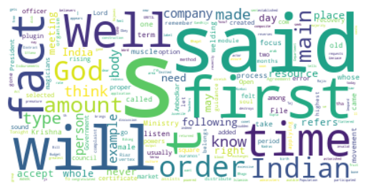
Exploratory Data Analysis

Slide 4
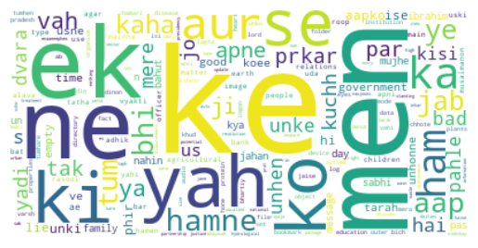

Slide 5
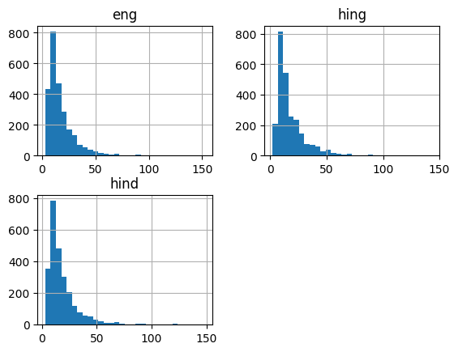

Slide 6
Model Buliding
Two approaches:
m-BART model for mixed machine translation to produce Hinglish Text
Encoder-Decoder LSTM RNN model
Ai4bharat Hindi to Hinglish Transliteration

