Slide 1

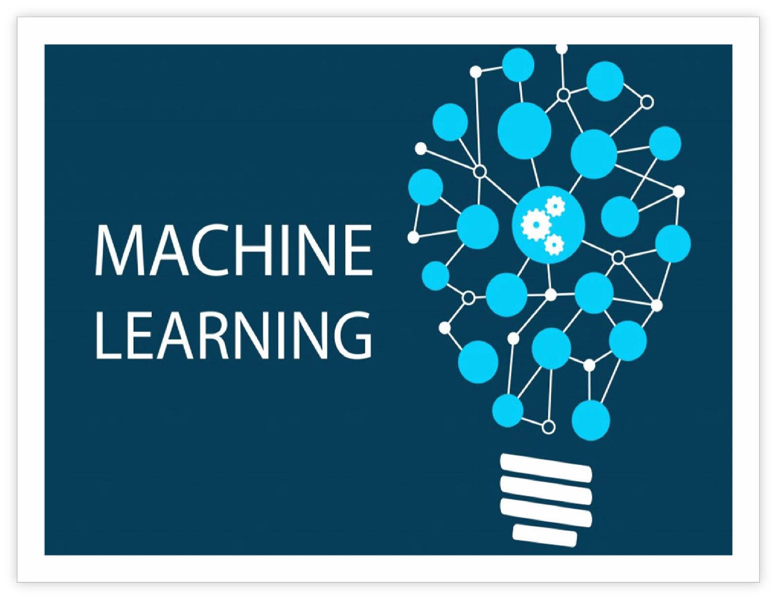


Sarcasm Detection
Submitted to: Yogendra Sir
Submitted by: Mohit Bansal & Vijay Shersiya

Slide 2
TABLE OF CONTENT
Certificate
Acknowledgement
Abstract
List of figures
Introduction
Theory
Methodology
Data Pre-processing
Classification Method used
Evolution
Conclusion
Annexure

Slide 3
Certificate
Date: 27/06/17
This is to certify that Mr. Mohit Bansal, student of 3rd Year from Department of Computer Science, Anand International College of Engineering, Kanota, Jaipur , has undergone a Project work from May 07, 2019 to June 27, 2019 in Data Science & Machine Learning titled “Sarcasm Detection”
Project Incharge
Seal

Slide 4
Certificate
Date: 27/06/17
This is to certify that Mr. Vijay Shersiya, student of 3rd Year from Department of Computer Science, Anand International College of Engineering, Kanota, Jaipur , has undergone a Project work from May 07, 2019 to June 27, 2019 in Data Science & Machine Learning titled “Sarcasm Detection”
Project Incharge
Seal

Slide 5
Acknowledgement
For making this project we would like to thank our course
instructor, Yogendra Sir, he has helped us in learning the various concepts of the Machine Learning. Here we would also like to
thank Kunal Sir and Sylvester Sir for mentoring us throughout this
project.

Slide 6
Abstract
Rapid growth of data comes with a challenge of sorting and analyzing them, where raw data exists in graphical form, textual form or in images. Data science and machine learning finds its application in various fields like stock market, recommendation systems, image processing, aerial photography, military, weather forecasting etc.
This report is about our project on “Sarcasm Detection” that addresses about data pre- processing and post processing which includes classification and prediction of sarcasm appearance in real time and the ability of machine learning algorithms to deal with different set of data. In this project, we have tackled a classification problem of predicting where the sarcasm in tweets will appears. We have tested and used Decision Tree, k-Nearest Neighbor , Random forest, NaiveBayes to determine the results.

Slide 7
List Of Figures
Fig. 1
Fig. 2
Fig. 3
Fig. 4
Fig. 5
Data Science Decision Tree
k-Nearest Neighbor
Random forest
NaiveBayes

Slide 8
Introduction
Sarcasm is defined as a cutting, often ironic remark intended to express contempt or ridicule. Sarcasm detection is the task of correctly labeling the text as ’sarcastic’ or ’non-sarcastic’. It is a challenging task owing to the lack of intonation and facial expressions in text. Nonetheless humans can still spot a sarcastic sentiment in the text and reason about what makes it so. Recognizing sarcasm in text is an important task for Natural Language processing to avoid misinterpretation of sarcastic statements as literal statements. Accuracy and robustness of NLP models are often affected by untruthful sentiments that are often of sarcastic nature. Thus, it is important to filter out noisy data from the training data inputs for various NLP related tasks. For example, a sentence like ”So thrilled to be on call for work the entire weekend!” could be naively classified as a sentence with a high positive sentiment. However, its actually the negative sentiment that is cleverly implied through sarcasm. The use of sarcasm is prevalent across all social media, micro-blogging and e-commerce platforms. Sarcasm detection is imperative for accurate sentiment analysis and opinion mining. It could contribute to enhanced automated feedback systems in the context of customer based sites. Twitter is a micro-blogging platform extensively used by people to express thoughts, reviews, discussions on current events and convey information in the form of short texts. Twitter data provides a diverse corpus for sentences which implicitly contain sarcasm. The target is to train a machine-learning algorithm so that it can predict where sarcasm will appear in future.
Our approach to the problem is very simple, we first retrieve the dataset that consists of roughly 26709 tweets sightings having websight link, tweer, is_sarcasm or not. Then we will check the dataset for some missing data i.e. the data pre-processing part. Then, we move towards data fetching followed by importing features, splitting dataset, applying machine-learning algorithms, plotting the data points on map, classification and finally prediction.
Finally, we compare the performance of each of these algorithms with the help of accuracy matrices, score matrices and then chooses the one that gives more accuracy.

Slide 9
Theory
Data science is a "concept to unify statistics, data analysis and their related methods" in order to "understand and analyze actual phenomena" with data.[3] It employs techniques and theories drawn from many fields within the broad areas of mathematics, statistics, information science, and computer science, in particular from the subdomains of machine learning, classification, cluster analysis, data mining, databases, and visualization.
Data science – discovery of data insight
This aspect of data science is all about uncovering findings from data. Diving in at a granular level to mine and understand complex behaviors, trends, and inferences. It's about surfacing hidden insight that can help enable companies to make smarter business decisions.
For example:
Netflix data mines movie-viewing patterns to understand what drives user interest, and uses that to make decisions on which Netflix original series to produce
Data science – development of data product
A "data product" is a technical asset that: (1) utilizes data as input, and (2) processes that data to return algorithmically generated results. The classic example of a data product is a recommendation engine, which ingests user data, and makes personalized recommendations based on that data.
For example:
Amazon's recommendation engines suggest items for you to buy, determined by their algorithms. Netflix recommends movies to you. Spotify recommends music to you.
Machine learning and statistics are part of data science. The word learning in machine learning means that the algorithms depend on some data, used as a training set, to fine-tune some model or algorithm parameters. This encompasses many techniques such as regression, naive Bayes or supervised clustering.

Slide 10
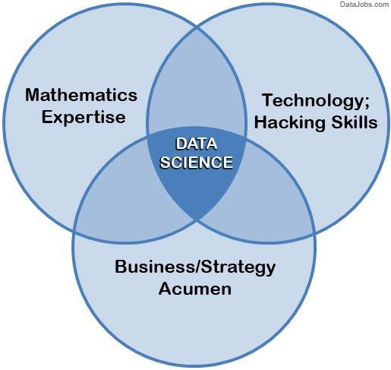
Fig. 1 Data Science
Supervised and unsupervised learning describe two ways in which machines algorithms can be set loose on a data set and expected to learn something useful from it.
Supervised:
If we are training our machine-learning task for every input with corresponding target, it is called supervised learning, which will be able to provide target for any new input after sufficient training. Our learning algorithm seeks a function from inputs to the respective targets. If the targets are expressed in some classes, it is called classification problem. Alternatively, if the target space is continuous, it is called regression problem.
Regression analysis is widely used for prediction and forecasting, where its use has substantial overlap with the field of machine learning. Regression analysis is also used to understand which among the independent variables are related to the dependent variable, and to explore the forms of these relationships. In restricted circumstances, regression analysis can be used to infer causal relationships between the independent and dependent variables.
Classification model attempts to draw some conclusion from observed values. Given one or more inputs a classification model will try to predict the value of one or more outcomes. Outcomes are labels that can be applied to a dataset.

Slide 11
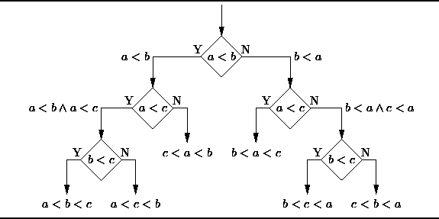
Unsupervised: If we are training our machine-learning task only with a set of inputs, it is called unsupervised learning, which will be able to find the structure or relationships between different inputs. Most important unsupervised learning is clustering, which will create different cluster of inputs and will be able to put any new input in appropriate cluster.
Cluster analysis or clustering is the task of grouping a set of objects in such a way that objects in the same group (called a cluster) are more similar (in some sense or another) to each other than to those in other groups (clusters). It is a main task of exploratory data mining, and a common technique for statistical data analysis, used in many fields, including machine learning, pattern recognition, image analysis, information retrieval, bioinformatics, data compression, and computer graphics.
1. Decision Trees: A decision tree is a decision support tool that uses a tree-like graph or model of decisions and their possible consequences, including chance-event outcomes, resource costs, and utility.
Fig. 2 Decision Tree
From a business decision point of view, a decision tree is the minimum number of yes/no questions that one has to ask, to assess the probability of making a correct decision, most of the time. As a method, it allows you to approach the problem in a structured and systematic way to arrive at a logical conclusion.
2. KNN (K- Nearest Neighbors)
It is also a lazy algorithm. What this means is that it does not use the training data points to do any generalization. K nearest neighbors is a simple algorithm that stores all available cases and classifies new cases by a majority vote of its k neighbors. The case being assigned to the class is most common amongst its K

Slide 12
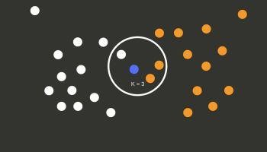
nearest neighbors measured by a distance function. These distance functions can be Euclidean, Manhattan, Minkowski and Hamming distance. First three functions are used for continuous function and fourth one (Hamming) for categorical variables. If K = 1, then the case is simply assigned to the class of its nearest neighbour. At times, choosing K turns out to be a challenge while performing KNN modeling.
Fig. 3 k-Nearest Neighbour
3. NaiveBayes
Naive Bayes classifiers are a collection of classification algorithms based on Bayes’ Theorem. It is not a single algorithm but a family of algorithms where all of them share a common principle, i.e. every pair of features being classified is independent of each other.
Bayes’ Theorem:
Bayes’ Theorem finds the probability of an event occurring given the probability of another event that has already occurred. Bayes’ theorem is stated mathematically as the following equation:
P(A/B) =
P(B/A) P(A)
P(B)

Slide 13
Methodology
To understand the methodology adopted, we first understand our dataset and the variables.
Dataset
Our dataset consists of roughly 26709 tweets , having web link, tweet text, and is_sarcam or not as features. The target is to train a machine-learning algorithm so that it can predict where sarcasmatic tweet appear in future.
Features:
Website link - the weblinkof a tweet, should be deleted to not affect predictions.
Headlines – the tweets used to train

Slide 14
Data Pre-processing
For pre-processing, we considered Python as our options for the project. After some experimentation, we found that while R was easier for statistics and analysis of the data, the lack of uniformity among the various ML packages made Python our preference. The ML algorithms provided by the scikit-learn package do not function if the input data has missing values. Hence we either had to impute data at the missing slots or remove the instances that had these missing fields. Upon examining the data, we realized that in this project we don’t have any missing data but have so many stop words and other noisy data that needs to be removed to make the model work efficiently.
Additionally, the statistical correlation between some features (for instances where they were available) were appeared to be not related. Hence, we dropped those features. In addition to this, sampling was necessary for machine learning algorithms.
Libraries used
numpy
pandas
matplotlib.pyplot
Pickle
Json
re
nltk
nltk.corpus
nltk.stem.porter

Slide 15
scikitlearn
sklearn.cross_validation
sklearn.preprocessing
sklearn.naive_bayes
sklearn.feature_extraction.text
sklearn.externals
Classification Method used
Here for making classification of the tweets we had used various algorithms like K – Nearest Neighbors in Classification mode, Decision Tree Classifier, Random Forest Classifier, Naïve Bayes, but we got the highest accuracy that of 82.70% from the Naïve Bayes ( Bernoulli NaiveBayes).

Slide 16
Evolution:
1. Random Forest Classifier
RF Parameters : No. of trees = 500
Confusion Matrix :
• Accuracy : 0.75
2. kNN
Parameters : No. of neighbours = 5
Confusion Matrix :
• Accuracy : 0.76
3. NaiveBayes ( Bernoulli NaiveBayes )
Confusion Matrix :
• Accuracy : 0.81
Confution Matrix | Prediction(0) | Prediction(1)
Actual (0) | 0.51 | 0.06
Actual (1) | 0.19 | 0.24
Confution Matrix | Prediction(0) | Prediction(1)
Actual (0) | 0.44 | 0.13
Actual (1) | 0.11 | 0.32
Confution Matrix | Prediction(0) | Prediction(1)
Actual (0) | 0.43 | 0.08
Actual (1) | 0.11 | 0.38

Slide 17
Conclusion
Here in this project we were able to correctly detect the sarcasm found in various tweeta around the world. We were able to correctly classify the tweets based on used words although accuracy score for classification was not that good, but good enough with the amount of data present with us and the features used to make classification. We were also able to make the predictions of the sarcasm present in particular tweet with the accuracy of about 81.12%.

