Slide 1

One Stop Shop
PIMPRI CHINCHWAD EDUCATION TRUST’S
PIMPRI CHINCHWAD COLLEGE OF ENGINEERING
DEPARTMENT OF COMPUTER ENGINEERING
A Software Engineering Case Study on
Presented by:
MOHIT BURKULE – TECOA118 (Team Leader)
VIVEK BULANI – TECOA117
SALONI AVHAD – TECOA105
ASHWIN MOHAN – TECOA101

Slide 2
INDEX
Introduction
Stakeholders
SRS
Requirements
Process Model
Use Cases
Feasibility

Slide 3
Introduction
The Traditional way of shopping utilizes more time. Every time the customer need to do shopping he has to go to the shops or market and perform the necessary actions, which may not be so feasible all the time. It may be a hard-hitting task for the customers and the shopkeepers too.
Internet shopping system is specifically developed for the customers who can directly buy goods or materials from home through internet connection on a mobile or a system.
Users will have the provision of giving ratings and reviews.
The system removes the role of intermediate dealers and managers and connect customers directly to the manufacturers.

Slide 4
Introduction
The online shopping system presents an online display of an order cut off time and an associated delivery window for items selected by the customer. The system accepts the customer's submission of a purchase order for the item in response to a time of submission being before the order cut off time.
Recommendations will be provided to customers on the basis of previous purchases , user reviews and ratings.
Merchants can upload their products’ images and give appropriate prices. The prices and validity will be checked at the administrator level.

Slide 5
Aim
To allow merchants to sell products over the internet and reach a larger customer base
To allow customers to buy / compare products with ease by simply logging into a website

Slide 6
Scope
The scope of this project is an online shopping system which allows
1) merchants to post products , edit and change details of their products , send product to customer , receive payment ,and give feedback
2) users to view ,purchase any product ,and send payment , give feedback
3) admin can verify / validate and block users/merchants/products
NOT IN SCOPE –
How payment is done(managed by third party)
Delivery of product (managed by courier service)

Slide 7
Stakeholders
The customers.
The merchants.
Developers.
Security Consultants.
Customer care.
Transport suppliers.
Social media team.
Administrator.

Slide 8
Software Requirement Specifications
Purpose The purpose of this SRS is to specify the requirements of the web based software application, which is an online shopping system. This Software Requirements Specification provides a complete description of all the functions and specifications of modules. This document contains the software requirements of online shopping.
System Description The Online Shopping system (OSS) application enables vendors to set up online shops, customers to browse through the shops, and a system administrator to approve and reject requests for new shops and maintain lists of shop categories. Also the developer is designing an online shopping site to manage the items in the shop and also help customers purchase them online without having to visit the shop physically. The online shopping system will use the internet as the sole method for selling goods to its consumers.

Slide 9
Functional requirements
Functional Requirements This section provides requirement overview of the system. Various functional modules that can be implemented by the system will be –
1. Hardware Requirements This system will work on client-server architecture. It will require an internet server and which will be able to run the application. The system should support some commonly used browser such as IE, Chrome etc.

Slide 10
Functional requirements
2. Software Requirements
Registration If customer wants to buy the product then he/she must be registered, unregistered user can’t go to the shopping cart.
Login Customer logins to the system by entering valid user id and password for the shopping.
Changes to Cart Changes to cart means the customer after login or registration can make order or cancel order of the product from the shopping cart.
Payment For customer there are many type of secure billing will be prepaid as debit or credit card, post paid as after shipping, check or bank draft. The security will provide by the third party like Pay-Pal etc.
Logout After the payment or surf the product the customer will logged out.
Report Generation After all transaction the system can generate the portable document file (.pdf) and then sent one copy to the customer’s Email-address and another one for the system data base to calculate the monthly transaction .

Slide 11
Non Functional Requirements
Availability The system should be available at all times, meaning the user can access it using a web browser, only restricted by the down time of the server on which the system runs. In case of a of a hardware failure or database corruption, a replacement page will be shown. Also in case of a hardware failure or database corruption, backups of the database should be retrieved from the server and saved by the administrator. Then the service will be restarted. It means 24 X 7availability.

Slide 12
Non Functional Requirements
Reliability The system provides storage of all databases on redundant computers with automatic switch over. The reliability of the overall program depends on the reliability of the separate components. The main pillar of reliability of the system is the backup of the database which is continuously maintained and updated to reflect the most recent changes. Thus the overall stability of the system depends on the stability of container and its underlying operating system.

Slide 13
Non Functional Requirements
Scalability The system is scalable. New features (modules) can be added whenever required.
Security The system will use SSL (secured socket layer) in all transactions that include any confidential customer information. The system must automatically log out all customers after a period of inactivity. The system should not leave any cookies on the customer’s computer containing the user’s password. The system’s back-end servers shall only be accessible to authenticated administrators. Sensitive data will be encrypted before being sent over insecure connections like the internet.

Slide 14
Non Functional Requirements
Maintainability A commercial database is used for maintaining the database and the application server take care of the site. In case of a failure, a re-initialization of the program will be done. Also the software design is being done with modularity in mind so that maintainability can be done efficiently
Performance There is no performance requirement in this system because the server request and response is depended on the end user internet connection

Slide 15
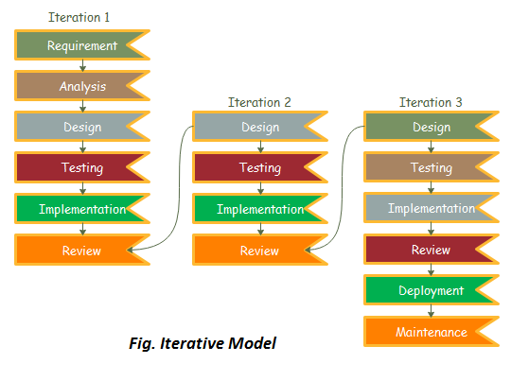
Process Model : Iterative

Slide 16
Iterative process model
Iterative process starts with a simple implementation of a subset of the software requirements and iteratively enhances the evolving versions until the full system is implemented. At each iteration, design modifications are made and new functional capabilities are added. The basic idea behind this method is to develop a system through repeated cycles (iterative) and in smaller portions at a time (incremental).
An iterative life cycle model does not attempt to start with a full specification of requirements. Instead, development begins by specifying and implementing just part of the software, which can then be reviewed in order to identify further requirements. This process is then repeated, producing a new version of the software for each cycle of the model.

Slide 17
Iterative process model
Consider an iterative life cycle model which consists of repeating the following four phases in sequence:
A Requirements phase, in which the requirements for the software are gathered and analysed. Iteration should eventually result in a requirements phase that produces a complete and final specification of requirements.
A Design phase, in which a software solution to meet the requirements is designed. This may be a new design, or an extension of an earlier design.
An Implementation and Test phase, when the software is coded, integrated and tested.
A Review phase, software is evaluated, the current requirements are reviewed, and changes and additions to requirements proposed.

Slide 18
Why we have chosen iterative model?
Requirements of the complete system are clearly defined and understood.
Major requirements are defined; however, some functionalities or requested enhancements may evolve with time.
There is a time to the market constraint.
A new technology is being used and is being learnt by the development team while working on the project.
There are some high-risk features and goals which may change in the future.

Slide 19
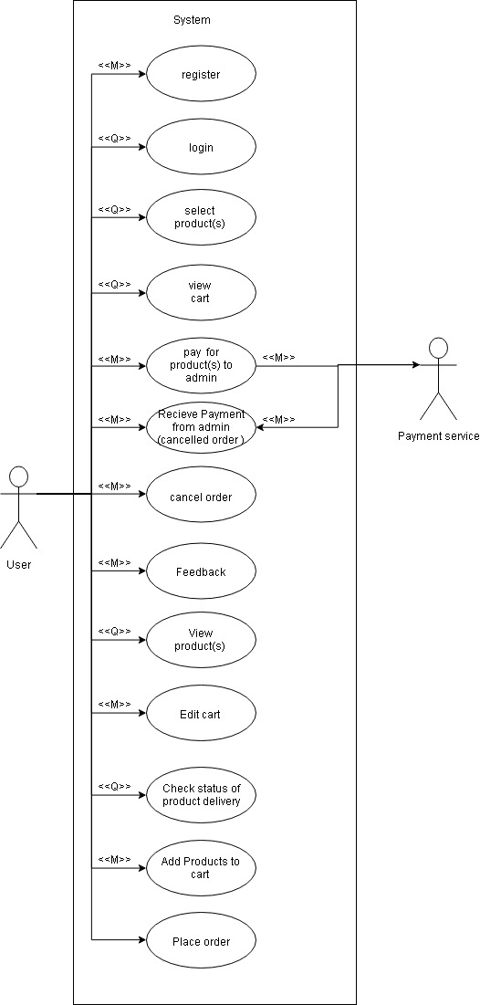
Use case - user

Slide 20
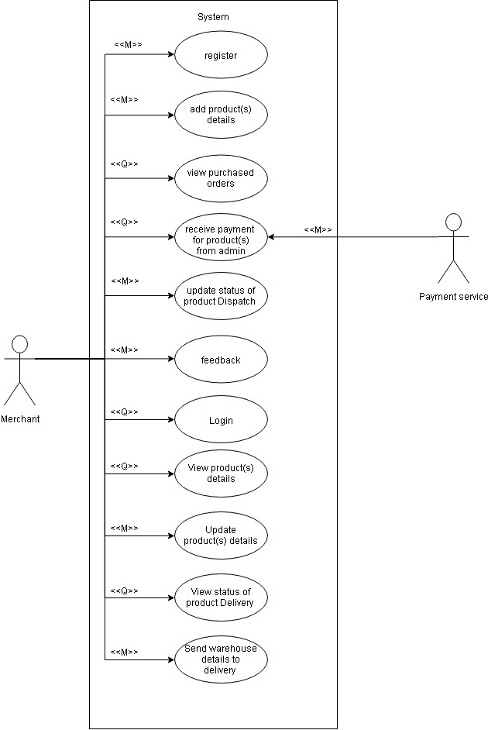
Use case - merchant

Slide 21
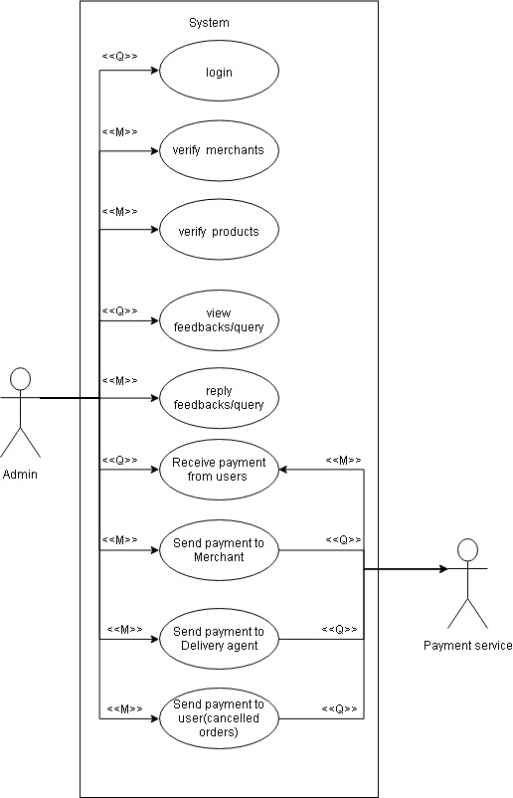
Use case – admin

Slide 22
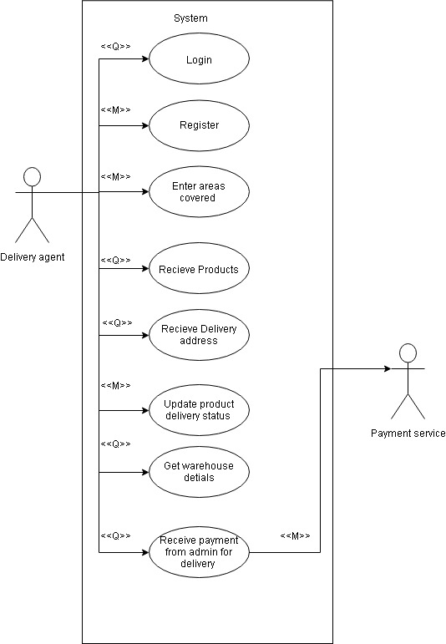
Use case – Delivery Agent

Slide 23
Name: Register.
Scope: For user to register.
Actor: User .
Pre-conditions: None
Main-scenario:
User opens the website
User clicks on register button
User enters his email and password
Appropriate msg is displayed if email already exists , password not strong ,etc
User enters his shipping address
Registration is complete and user is redirected to product view page
Post-conditions: User is Registered

Slide 24
Name: Login.
Scope: For user to Login.
Actor: User .
Pre-conditions: User is registered
Main-scenario:
User opens the website
User clicks on login button
User enters his email and password
Details are sent to a server and verified
If credentials are correct then user is allowed to proceed and is redirected to product view page
Else Appropriate msg is displayed if the authentication fails and user is asked to re-enter his details
If user enters incorrect details for 3 times continuously then a forgot password mail is sent to the user and no further action is permitted unless user resets the password by clicking a link on his mail
Post-conditions: User is Logged in.

Slide 25
Name: View Products.
Scope: For user to view product details.
Actor: User .
Pre-conditions: User is logged in
Main-scenario:
user is shown list of categories and products
products have a short one line description and a photo along with cost shown
user may either search for his needed product or choose one category
user may click on product to view its details such as photos , description , cost , discounts , delivery estimate time , etc
user may add it to cart and view another product
Post-conditions: User has viewed products

Slide 26
Name: View edit cart
Scope: to view and edit cart
Actor: User
Pre-conditions:
User logged in
Main-scenario:
user may click on cart button and will be directed to view cart page
user can see all items added to cart
user may remove the added products or add more quantity of existing items
user may click on purchase button to proceed to purchase
Post-conditions:User has viewd cart

Slide 27
Name: Pay
Scope:User can pay to products
Actor:User , Merchant
Pre-conditions:
User is logged in
User has added products to cart
Main-scenario:
user can change his delivery information
user can choose a mode of payment
user will proceed to payment gateway
after successful purchase user will be shown the expected delivery date with confirmation message
Post-conditions: User has purchased products

Slide 28
Name: Check status
Scope:.User can check status of order
Actor:User
Pre-conditions:
User has purchased products
User is logged in
Main-scenario:
user can click on orders button to view purchased orders
a list containing all purchased products sorted according to decreasing order of purchase will be shown
a status will be shown along with product (delivered / out for delivery / yet to be delivered )
user may cancel a particular product give a feedback to merchant
Post-conditions:User has checked status of products

Slide 29
Name: Cancel a product
Scope:User can cancel a product
Actor:User
Pre-conditions: User is logged in
User has purchased a product
Main-scenario:
user can click on cancel button for a particular purchased product which is not yet delivered
user will be shown a list of reasons for this cancellation
user may select one or write another reason for cancellation
after confirming cancel ,user will be shown a message of refunding the money to user
Post-conditions:User has cancelled a product

Slide 30
Name: Feedback
Scope:User can submit a feedback
Actor:User, Merchant,Admin
Pre-conditions:
User is logged in
Main-scenario:
user may give feedback on a particular product from any page where product is visible
user can write a title and message body
the feedback will be sent to respective product merchant on clicking submit button
Post-conditions: User has given a feeedback

Slide 31
Name: Merchant Register
Scope:Merchant can register
Actor:Merchant
Pre-conditions: None
Main-scenario:
merchant opens the website
merchant clicks on register button
merchant enters his email and password
Appropriate msg is displayed if email already exists , password not strong ,etc
merchant enters his shop address
Registration is complete and user is redirected to product add page
Post-conditions:Merchant has a account

Slide 32
Name: Merchant login
Scope:Merchant can login
Actor:.Merchant
Pre-conditions: Merchant has a account
Main-scenario: merchant opens the website
Merchant clicks on login button
Merchant enters his email and password
Details are sent to a server and verified
If credentials are correct then user is allowed to proceed and is redirected to product view page
Else Appropriate msg is displayed if the authentication fails and user is asked to re-enter his details
If Merchant enters incorrect details for 3 times continuously then a forgot password mail is sent to the user and no further action is permitted unless user resets the password by clicking a link on his mail
All his products are suspended and hidden from the site until next successful login
Post-conditions:Merchant has logged in

Slide 33
Name: Add products
Scope:Merchant can add / edit products
Actor:Merchant
Pre-conditions: Merchant is logged in
Main-scenario:
merchant can add products
one line detail , photos
other information about stock available ,price of product , discount etc
on clicking submit the product will be added to product list
Post-conditions: Product is added to website

Slide 34
Name: View received orders
Scope:view all pending orders
Actor:Merchant
Pre-conditions:
Merchant is logged in
Merchant has created a product
Main-scenario:
merchant can see all the products yet to delivered / delivered / out for delivery / cancelled
view payments for products
view total sales and other statistics
change status of a product
view or chance quantity of a product
Post-conditions:Merchant can get information about orders

Slide 35
Name: Receive payment
Scope:To receive payment of products
Actor:Merchant
Pre-conditions: Merchant is logged in
User has purchased a product and has payed
Main-scenario:
when user pays for a product it is notified to the merchant and seen in the view orders page of merchant
the details of payment will be sent to merchant and merchant can verify those
updated order details , quantity details will be shown
Post-conditions:Payment is transferred to merchants account

Slide 36
Name: Verify / validate Merchant
Scope:To check a particular merchant
Actor:Admin
Pre-conditions:
Admin is logged in
Merchant has post fake product listings
Main-scenario:
Admin sees a list of merchant and no of products blocked
If a particular merchant has posted many fake products then his account is suspended
All products corresponding to his account are also suspended
Post-conditions:fake sellers are blocked

Slide 37
Name: Verify / validate products
Scope: To verify products
Actor:Admin
Pre-conditions:
Admin is logged in
Many Users have submitted feedback about a product
Main-scenario:
Admin sees a list of Products and no of products marked as fake or misleading by user feedback
The merchant of the particular product will be contacted and will be asked to take corrective measures
If merchant fails to do so within specified time then product will be suspended
Post-conditions: only good quality and correct products remain

Slide 38
Name: Reply to feedbacks
Scope: to reply user ,merchant feedbacks
Actor:Admin, User, merchant
Pre-conditions:
Admin is logged in
User/Merchant sends any feedback
Main-scenario:
Admin visits feedbacks page
He sees and replies any feedbacks or grievances of a user/merchant
If Required contacts a particular merchant regarding a particular product
Admin logs the status of feedback / grievance
Post-conditions: Admin has replied to all feedbacks

Slide 39
Classes
Admin
User
Merchant
Product
Payment
Order
Cart
Feedback
39

Slide 40
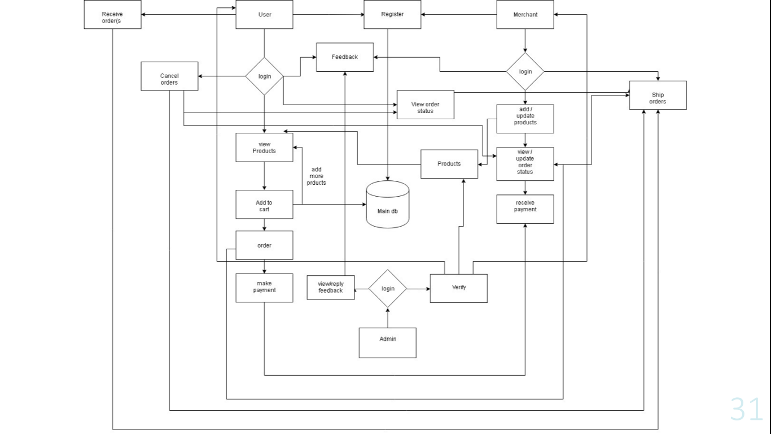

Slide 41
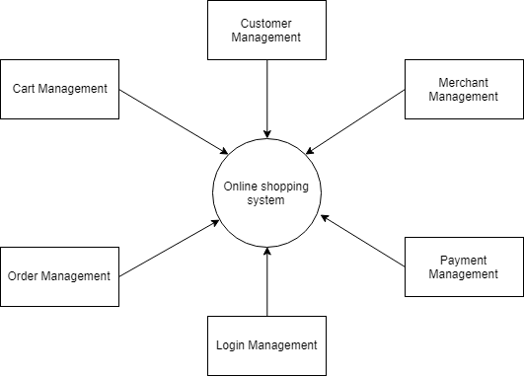

Slide 42
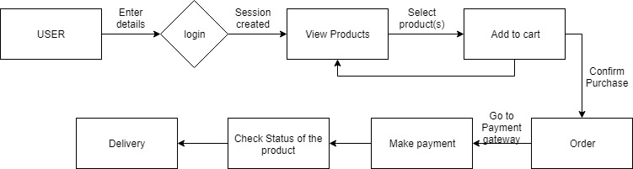
User – Flow of actions

Slide 43
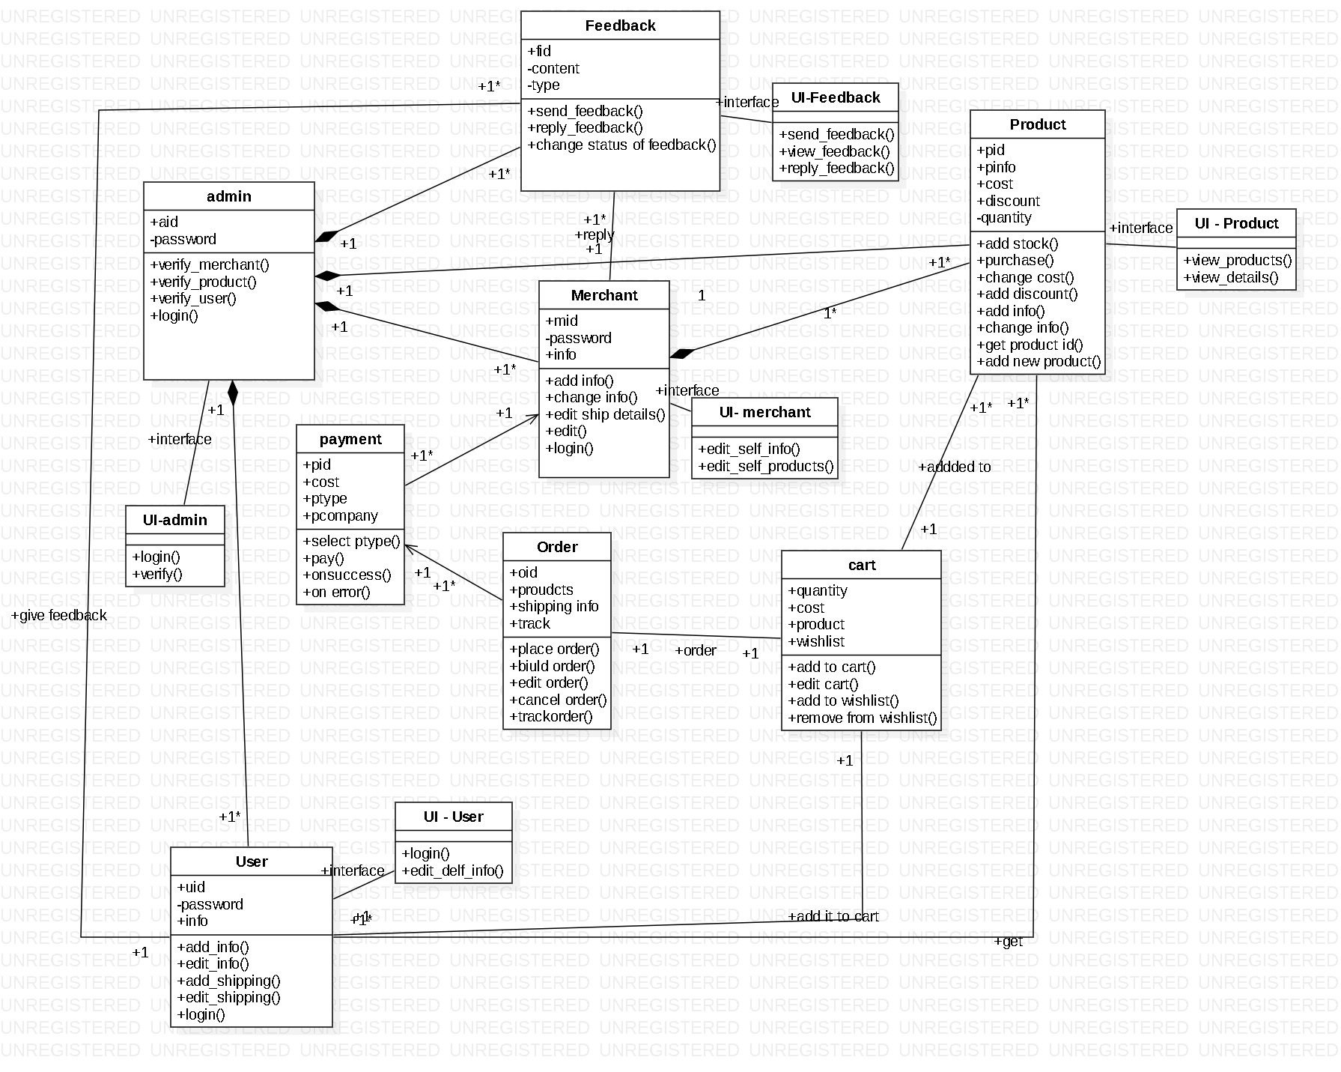

Slide 44
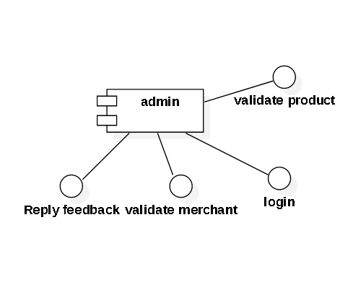
components
Admin will allow all admin related features only to the admin

Slide 45
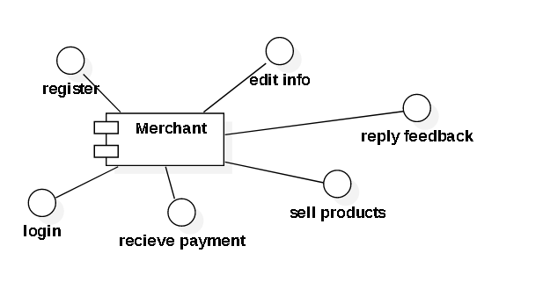
components
merchant will allow all merchant related features only to the merchant
Such as register ,login,receive payment , sell products , reply feedback, edit info

Slide 46
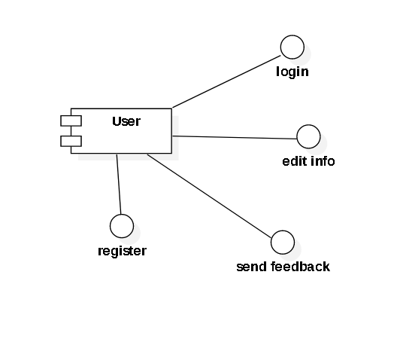
components
User will allow all user related features only to the user
They are login , personal info edit ,etc
Product related features wont be dealt by with this component

Slide 47
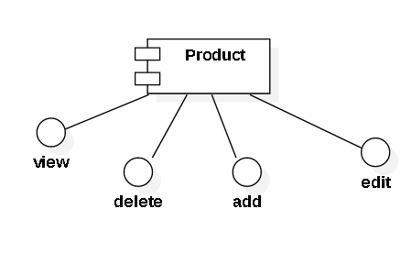
components
Product will allow all product related features to the user/merchant/admin
View is available to user
Add and delete , edit is available to merchant and admin

Slide 48
Feasibility Report
Feasibility is an important phase in the software development process it enables the developers to have an assessment of the product being developed It refers to the feasibility study of the product in terms of outcomes of the product, operational required for implement ting it. Feasibility study should be performed on the basic of various criteria and parameters.
Economic Feasibility: It refers to the benefits or outcomes we are deriving from the product as compared to the total cost we are spending for developing the benefits are less then it is not feasible to develop the product.
Operational Feasibility: It refers to the feasibility of the product to be operational. Some products may work very well at the design and implementation but many fail in the real time environment. It introduces the study of human resources required and their technical expertise.

Slide 49
Technical Feasibility
The system is self-explanting and does not need any entire sophisticated training. A system has been built by concentrating on the graphical uses interface concepts, the application can also be handled very easily with a novice uses. The overall time that a user needs to get trained is less than 15 minutes. The system has been added with features of menu device and button interaction methods, which makes him the master as he starts working through the environment. As the software that were used as developing this application are very economical and are readily available is the market the only time that is lost by the customer is just installation time

