Slide 1

One Stop Shop
PIMPRI CHINCHWAD EDUCATION TRUST’S
PIMPRI CHINCHWAD COLLEGE OF ENGINEERING
DEPARTMENT OF COMPUTER ENGINEERING
A Software Engineering Case Study on
Presented by:
MOHIT BURKULE – TECOA118 (Team Leader)
VIVEK BULANI – TECOA117
SALONI AVHAD – TECOA105
ASHWIN MOHAN – TECOA101

Slide 2
INDEX
Introduction
Stakeholders
SRS
Requirements
Process Model
Use Cases
Feasibility

Slide 3
Introduction
The Traditional way of shopping utilizes more time. Every time the customer need to do shopping he has to go to the shops or market and perform the necessary actions, which may not be so feasible all the time. It may be a hard-hitting task for the customers and the shopkeepers too.
Internet shopping system is specifically developed for the customers who can directly buy goods or materials from home through internet connection on a mobile or a system.
Users will have the provision of giving ratings and reviews.
The system removes the role of intermediate dealers and managers and connect customers directly to the manufacturers.

Slide 4
Introduction
The online shopping system presents an online display of an order cut off time and an associated delivery window for items selected by the customer. The system accepts the customer's submission of a purchase order for the item in response to a time of submission being before the order cut off time.
Recommendations will be provided to customers on the basis of previous purchases , user reviews and ratings.
Merchants can upload their products’ images and give appropriate prices. The prices and validity will be checked at the administrator level.

Slide 5
Aim
To allow merchants to sell products over the internet and reach a larger customer base
To allow customers to buy / compare products with ease by simply logging into a website

Slide 6
Scope
The scope of this project is an online shopping system which allows
1) merchants to post products , edit and change details of their products , send product to customer , receive payment ,and give feedback
2) users to view ,purchase any product ,and send payment , give feedback
3) admin can verify / validate and block users/merchants/products
NOT IN SCOPE –
How payment is done(managed by third party)
Delivery of product (managed by courier service)

Slide 7
Stakeholders
The customers.
The merchants.
Developers.
Security Consultants.
Customer care.
Transport suppliers.
Social media team.
Administrator.

Slide 8
Software Requirement Specifications
Purpose The purpose of this SRS is to specify the requirements of the web based software application, which is an online shopping system. This Software Requirements Specification provides a complete description of all the functions and specifications of modules. This document contains the software requirements of online shopping.
System Description The Online Shopping system (OSS) application enables vendors to set up online shops, customers to browse through the shops, and a system administrator to approve and reject requests for new shops and maintain lists of shop categories. Also the developer is designing an online shopping site to manage the items in the shop and also help customers purchase them online without having to visit the shop physically. The online shopping system will use the internet as the sole method for selling goods to its consumers.

Slide 9
Functional requirements
Functional Requirements This section provides requirement overview of the system. Various functional modules that can be implemented by the system will be –
1. Hardware Requirements This system will work on client-server architecture. It will require an internet server and which will be able to run the application. The system should support some commonly used browser such as IE, Chrome etc.

Slide 10
Functional requirements
2. Software Requirements
Registration If customer wants to buy the product then he/she must be registered, unregistered user can’t go to the shopping cart.
Login Customer logins to the system by entering valid user id and password for the shopping.
Changes to Cart Changes to cart means the customer after login or registration can make order or cancel order of the product from the shopping cart.
Payment For customer there are many type of secure billing will be prepaid as debit or credit card, post paid as after shipping, check or bank draft. The security will provide by the third party like Pay-Pal etc.
Logout After the payment or surf the product the customer will logged out.
Report Generation After all transaction the system can generate the portable document file (.pdf) and then sent one copy to the customer’s Email-address and another one for the system data base to calculate the monthly transaction .

Slide 11
Non Functional Requirements
Availability The system should be available at all times, meaning the user can access it using a web browser, only restricted by the down time of the server on which the system runs. In case of a of a hardware failure or database corruption, a replacement page will be shown. Also in case of a hardware failure or database corruption, backups of the database should be retrieved from the server and saved by the administrator. Then the service will be restarted. It means 24 X 7availability.

Slide 12
Non Functional Requirements
Reliability The system provides storage of all databases on redundant computers with automatic switch over. The reliability of the overall program depends on the reliability of the separate components. The main pillar of reliability of the system is the backup of the database which is continuously maintained and updated to reflect the most recent changes. Thus the overall stability of the system depends on the stability of container and its underlying operating system.

Slide 13
Non Functional Requirements
Scalability The system is scalable. New features (modules) can be added whenever required.
Security The system will use SSL (secured socket layer) in all transactions that include any confidential customer information. The system must automatically log out all customers after a period of inactivity. The system should not leave any cookies on the customer’s computer containing the user’s password. The system’s back-end servers shall only be accessible to authenticated administrators. Sensitive data will be encrypted before being sent over insecure connections like the internet.

Slide 14
Non Functional Requirements
Maintainability A commercial database is used for maintaining the database and the application server take care of the site. In case of a failure, a re-initialization of the program will be done. Also the software design is being done with modularity in mind so that maintainability can be done efficiently
Performance There is no performance requirement in this system because the server request and response is depended on the end user internet connection

Slide 15
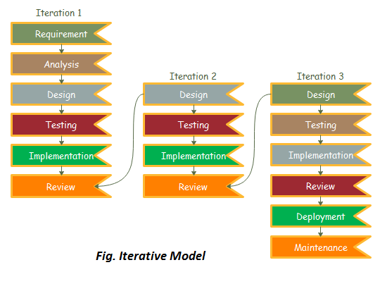
Process Model : Iterative

Slide 16
Iterative process model
Iterative process starts with a simple implementation of a subset of the software requirements and iteratively enhances the evolving versions until the full system is implemented. At each iteration, design modifications are made and new functional capabilities are added. The basic idea behind this method is to develop a system through repeated cycles (iterative) and in smaller portions at a time (incremental).
An iterative life cycle model does not attempt to start with a full specification of requirements. Instead, development begins by specifying and implementing just part of the software, which can then be reviewed in order to identify further requirements. This process is then repeated, producing a new version of the software for each cycle of the model.

Slide 17
Iterative process model
Consider an iterative life cycle model which consists of repeating the following four phases in sequence:
A Requirements phase, in which the requirements for the software are gathered and analysed. Iteration should eventually result in a requirements phase that produces a complete and final specification of requirements.
A Design phase, in which a software solution to meet the requirements is designed. This may be a new design, or an extension of an earlier design.
An Implementation and Test phase, when the software is coded, integrated and tested.
A Review phase, software is evaluated, the current requirements are reviewed, and changes and additions to requirements proposed.

Slide 18
Why we have chosen iterative model?
Requirements of the complete system are clearly defined and understood.
Major requirements are defined; however, some functionalities or requested enhancements may evolve with time.
There is a time to the market constraint.
A new technology is being used and is being learnt by the development team while working on the project.
There are some high-risk features and goals which may change in the future.

Slide 19
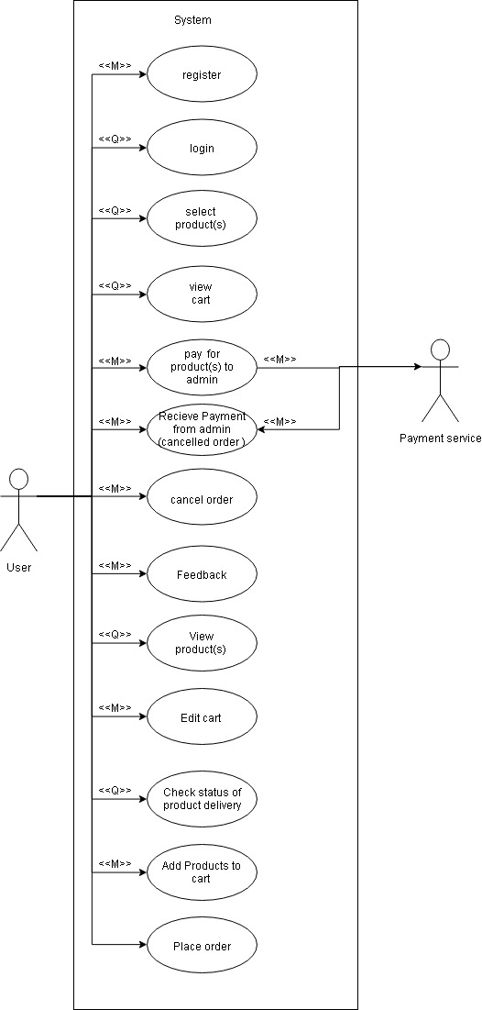
Use case - user

Slide 20
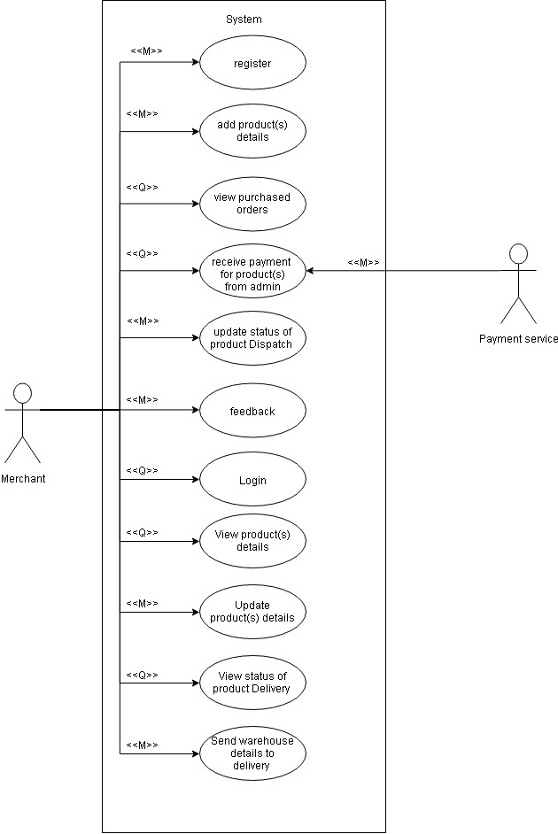
Use case - merchant

Slide 21
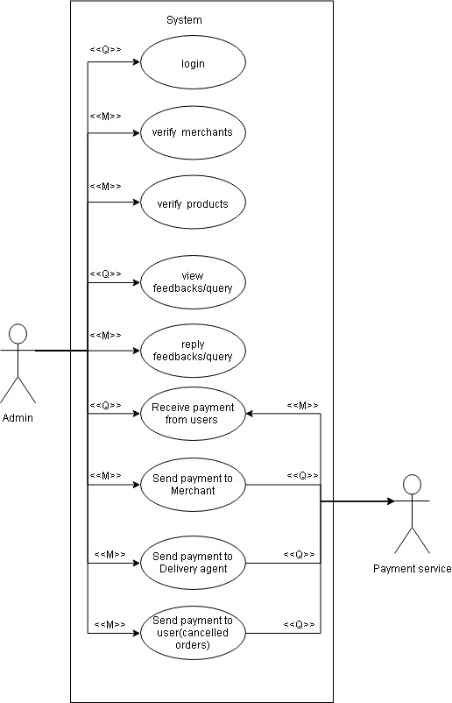
Use case – admin

Slide 22
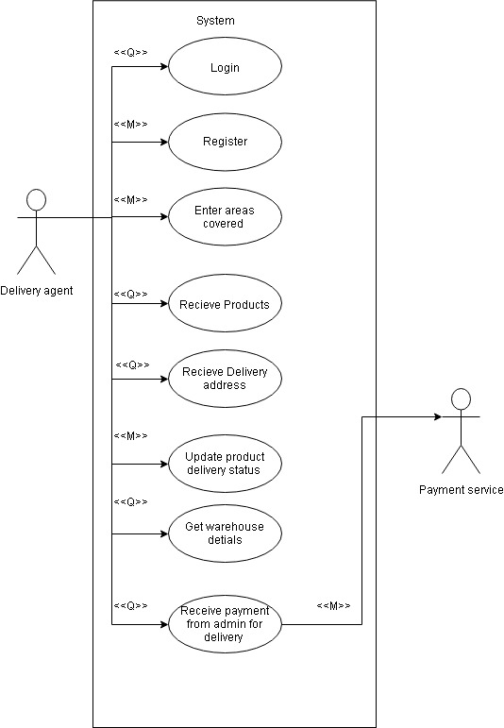
Use case – Delivery Agent

Slide 23
Name: Register.
Scope: For user to register
Actor: User
Pre-conditions: None
Main-scenario:
User opens the website
User clicks on register button
User enters his email and password
Username is checked by sending to backend if it is present or not.
Email and password is send to backend for verification
User enters his shipping address
Registration is complete and user is redirected to product view page
Alternative Sequence of (7):- Appropriate message is displayed if email already exists , password not strong , Incomplete address filled
Post-conditions: User is Registered

Slide 24
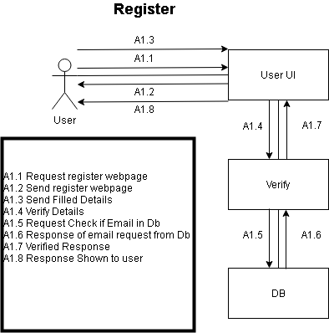

Slide 25
Name: Login.
Scope: For user to Login.
Actor: User .
Pre-conditions: User is registered
Main-scenario:
User opens the website
User clicks on login button
User enters his email and password
Details are sent to a server and verified
If credentials are correct then user is allowed to proceed and is redirected to product view page
Alternative Sequence of (5):- “Wrong password” message is displayed if the authentication fails and user is asked to re-enter his details
Alternative Sequence of (5):-“No user found” message is displayed if the Email does not exist user is asked to re-enter his details
Alternative Sequence of (6,7):- If user enters incorrect details for 3 times continuously then a forgot password mail is sent to the user and no further action is permitted unless user resets the password by clicking a link on his mail
Post-conditions: User is Logged in.

Slide 26
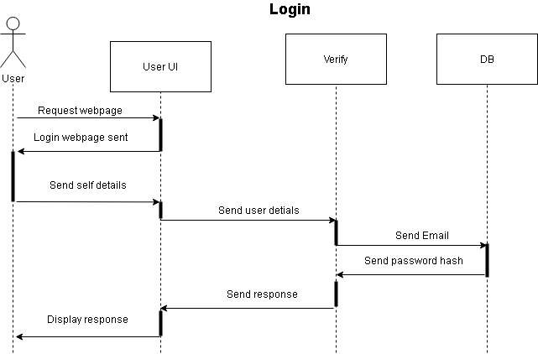

Slide 27
Name: View Products and Select Products.
Scope: For user to view the products and their details.
Actor: User
Pre-conditions: None
Main-scenario:
User opens the website
User is shown list of categories
User clicks on required category
User is shown all the products regarding to that category chosen by him/her
User is also shown the recommendations
User clicks on required product
User is shown all the product details i.e short one line description and a photo along with it’s cost

Slide 28
If user wants to see more details of the product, then he can click on particular item
If user wants to buy the product immediately then he/she clicks on Buy Now option.
The user will be redirected to register page if he is not registered
After complete registration , the user will be shown the place order page
Alternative sequence of (8):- User is redirected to place order page
Alternative sequence of (7):- User clicks on Add To Cart option
Alternative sequence of (3):- User can directly search for the required product by typing it’s name in the search bar. All the related search results will be shown to the user
Alternative sequence of (3,5):- User has an option to sort by filter according to cost, customer reviews, newly added items, previous history
Post-conditions: User has viewed the products
User has added required products to his/her cart or has placed an order

Slide 29
Name: View cart
Scope: To view all the products in the cart
Actor: User
Pre-conditions: User must be logged in
Main-scenario:
User clicks on menu button
User clicks on view cart option
User sees all products’ id and names which he/she has added to cart
User can click on particular product id to see all the details of that product
Alternative Sequence of (4):- If user has not added any item to the cart then a message “You have not added any product to your cart” is displayed to user.
Post-conditions: User has viewed cart

Slide 30
Name: Pay for product(s) to admin
Scope: User can pay for the products which he/she has ordered
Actor: User
Pre-conditions: User must be logged in
Main-scenario:
User is shown the previous delivery address used.
If user wants to change his delivery address information, he clicks on change delivery address option and then the user can change the address.
He clicks on save button to permanently save the new address.
User is shown different payment modes available such as Credit Card, Debit Card and Net Banking.
User must choose an option among these 3 for making the payment.

Slide 31
If User clicks on Credit Card option then in the next page, he must enter the card details such as Card number, Expiry date and CVV number. Then he clicks on proceed button to proceed through the payment gateway .
After successful payment, user will be shown the expected delivery date with a confirmation message of payment.
Also the e-receipt will be shown in the payment history page.
Alternative Sequence of (6):- If User clicks on Debit Card option then in the next page, he must enter the card details such as Card number, Expiry date and CVV number. Then he clicks on proceed button to proceed through the payment gateway .
Alternative Sequence of (6):- If User clicks on Net Banking option then in the next page, he must enter the bank details such as Account number. Then he clicks on proceed button to proceed through the payment gateway .
Post-conditions: User has purchased the required products.

Slide 32
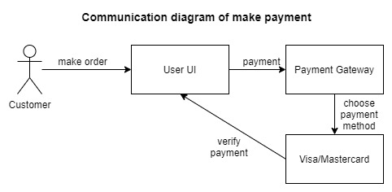

Slide 33
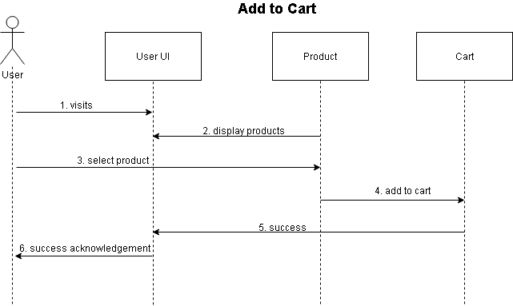

Slide 34
Name: Receive Payment from Admin(Cancelled order)
Scope: User will receive the refund amount from admin after cancellation of purchased order
Actor: User
Pre-conditions: User must be logged in
User has cancelled purchased order
Main-scenario:
User gets a notification that refunded amount has been credited to his account for the particular product id and name
Post-conditions: User has received the refund payment from admin.

Slide 35
Name: Cancel order
Scope: User can cancel an order which has been placed previously
Actor: User
Pre-conditions: User must logged in
User has purchased 1 or more product(s)
Main-scenario:
User clicks on menu button
User can click on orders button to view purchased orders
A list of all purchased products sorted according to decreasing order of purchase date will be shown
User clicks on particular product which he wants to cancel
User clicks on cancel button
Then the user will be shown a list of reasons for this cancellation

Slide 36
User have to select any one of these or write another reason for cancellation
Also along with this, the penalty amount will be displayed and the refund amount that the user will get will be displayed.
Afterwards, a dialogue box will appear for confirmation of cancellation of the product
If user clicks “Yes” , user will be shown a message “Your order has been successfully cancelled”
User will be shown refund amount that he/she will receive and within how many days
Alternative sequence of (9) :- If user clicks “No” , user will be shown a message “Your order has not been cancelled”
Alternative Sequence of (3):- If user has not purchased any product, a message “You have not purchased any item yet” will be shown to user.
Post-conditions: User has cancelled a product

Slide 37
Name: Feedback
Scope: User/Merchant can submit a feedback
Actor: User, Merchant
Pre-conditions:
User/Merchant must be logged in
Main-scenario:
User/Merchant clicks on menu button
User/Merchant clicks on feedback button
User/Merchant is shown all the previous feedback given by him/her
To give a new feedback , user/merchant clicks on New Feedback option
User/Merchant types title and body of the feedback
User/Merchant clicks on send feedback button

Slide 38
Message is prompted “Thank You for your feedback”
Alternative Sequence for (1) :- User may give feedback on a particular product from any page where product is visible
User types title and body of the feedback
User clicks on send feedback button
Message is prompted “Thank You for your feedback”
The feedback will be sent to respective product merchant and also to the admin
Post-conditions: User/Merchant has given the feedback

Slide 39
Name: Edit cart
Scope: To edit cart(Add/Remove Products/Change quantity)
Actor: User
Pre-conditions: User must be logged in
Main-scenario:
User clicks on menu button
User clicks on edit cart option
User sees all products’ id and names which he/she has added to cart
User can click on particular product id to see all the details of that product
To remove an item, user has to click on Remove option against the particular product which he/she wants to remove
After clicking Remove option, a dialogue box appears for confirmation of removal
If user clicks “Yes”, the product gets removed from the cart
User is shown edit cart page again.

Slide 40
9. To add an item to the cart, user needs to click Add To Cart option at top right corner.
10. Then user is redirected to view product page
11. User selects the required product and then as per wish , adds the product to cart
12. User is shown edit cart page again
13. Alternative Sequence of (7):- If User clicks “No”, product remains as it is in the cart
14. Alternative Sequence of (5,9):- If User wants to change the quantity of particular product, then he firstly clicks on that product
15. Then he clicks on Change The Quantity option
16. User enters the new quantity
17. User clicks on Save Changes option
18. User is shown edit cart page again.
19. Alternative Sequence of (3):- If user has not added any product to the cart, a message “You have not added any item to your cart” will be shown to user.
Post-conditions: User has edited his/her cart

Slide 41
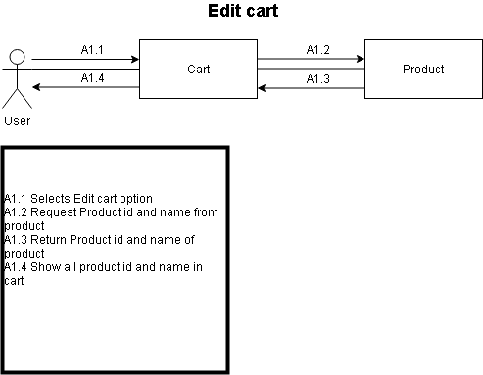

Slide 42
Name: Check status of product delivery
Scope: User can check the status of products which have been purchased but yet to be delivered
Actor: User
Pre-conditions:
User must be logged in
User has purchased 1 or more product(s)
Main-scenario:
User clicks on menu button
User can click on orders button to view purchased orders
A list of all purchased products sorted according to decreasing order of purchase date will be shown
User clicks on particular product whose status he/she wants to know.
A status will be shown along with product details (delivered / out for delivery / yet to be delivered )
Alternative Sequence of (3):- If user has not purchased any product, a message “You have not purchased any item yet” will be shown to user.
Post-conditions: User has checked the status of required products .

Slide 43
Name: Place order
Scope: User can place an order for 1 or more products
Actor: User
Pre-conditions: User must be logged in
Main-scenario:
User clicks on menu button
User clicks on view cart
User sees all the product ids and names which are added to his cart.
User may click on particular product to view it’s complete details
User selects 1 or more products
User then clicks on place order button at the bottom of the page
Alternative sequence for 2 :- User selects a product from view product page. User clicks on Buy now option.
User enters the quantity needed of that product
User is then redirected to Payment page.
Alternative Sequence of (3):- If user has not added any product to the cart, a message “You have not added any item to your cart” will be shown to user.
Post-conditions: User has placed an order for required products

Slide 44
Name: Register
Scope: For merchant to register
Actor: Merchant
Pre-conditions: None
Main-scenario:
Merchant opens the website
Merchant clicks on register button
Merchant enters his email and password
Username is checked by sending to backend if it is present or not.
Email and password is send to backend for verification
Merchant enters his shop address
Registration is complete and merchant is redirected to Add Product page
Alternative Sequence of (7):- Appropriate message is displayed if email already exists , password not strong ,etc
Post-conditions: Merchant is registered

Slide 45
Name: Login
Scope: For merchant to login
Actor: Merchant
Pre-conditions: Merchant is registered
Main-scenario:
Merchant opens the website
Merchant clicks on login button
Merchant enters his email and password
Details are sent to a server and verified
If credentials are correct then merchant is allowed to proceed and is redirected to Add Product page
Alternative Sequence of (5):- “Wrong password” message is displayed if the authentication fails and merchant is asked to re-enter his details
Alternative Sequence of (5):- “No user found” message is displayed if the Email does not exist , merchant is asked to re-enter his details
Alternative Sequence of (8,9):- If merchant enters incorrect details for 3 times continuously then a forgot password mail is sent to the merchant and no further action is permitted unless merchant resets the password by clicking a link on his mail
All his products are suspended and hidden from the site until next successful login
Post-conditions: Merchant has logged in

Slide 46
Name: Add product details
Scope: Merchant can add new products and it’s details
Actor: Merchant
Pre-conditions: Merchant is logged in
Main-scenario:
Merchant clicks on Add New Product button
Merchant adds the product id, product name, one line description
Merchant clicks on next button
On the next page, merchant adds other information such as photos, stock availability ,price of product, date of manufacturing, any discounts available, etc
On clicking submit button, the product will be added to product list which will be then also shown in the View Product page to users
Post-conditions: Product is added to website

Slide 47
Name: View purchased orders / View status of product delivery
Scope: Merchant can view all the purchased orders and their status
Actor: Merchant
Pre-conditions: Merchant must be logged in
Merchant has created a product
Main-scenario:
Merchant clicks on menu button
Merchant clicks on view purchased orders option
Merchant then sees all his/her products which have been purchased by different users along with their status of delivery(yet to delivered / delivered / out for delivery / cancelled)
Merchant can view the payments made for all these products
Merchant can view total sales and other statistics.
Alternative Sequence of (3):- If user has not purchased any product, a message “No user has purchased any of your item yet” will be shown to merchant.
Post-conditions: Merchant gets information about all his/her orders

Slide 48
Name: Receive payment for products from admin
Scope: To receive payment for purchased products
Actor: Merchant
Pre-conditions: Merchant must be logged in
User has purchased a product and has payed for it
Main-scenario:
When user pays for a product , it is notified to the respective merchant
This transaction is also shown in the view purchased orders page of the merchant
The details of payment will be sent to merchant and merchant can verify those details
Along with this, the shipping address provided by user will also be shown to the merchant
After this, the merchant dispatches the item for the dilevery
The money will be transferred to merchant’s account after some period of time depending on mode of payment selected by user and other factors
Post-conditions: Payment is transferred to merchants account

Slide 49
Name: Update status of product delivery
Scope: To update the status of all products’ delivery
Actor: Merchant
Pre-conditions: Merchant must be logged in
Merchant has created a product
Main-scenario:
Merchant clicks on menu button
Merchant clicks on update status of product delivery option
Merchant then sees all his/her products which have been purchased by different users along with their status of delivery(yet to delivered / delivered / out for delivery / cancelled)
To update the status of some product, merchant clicks on update status option against particular product
Then merchant enters the new status
Merchant clicks on Save The Updates option
Merchant then again sees all the products, their details and status
Alternative Sequence of (3):- If user has not purchased any product, a message “No user has purchased any of your item yet” will be shown to merchant.
Post-conditions: Payment is transferred to merchants account

Slide 50
Name: View product details / Update product details
Scope: Merchant can update his product’s details
Actor: Merchant
Pre-conditions: Merchant is logged in
Merchant has added a product
Main-scenario:
Merchant clicks on menu button
Merchant clicks on View Product Details button
Merchant views all the product ids and their names
Merchant can click on particular product id to see all the details of that product
To remove an item, merchant has to click on Remove option against the particular product which he/she wants to remove
After clicking Remove option, a dialogue box appears for confirmation of removal
If merchant clicks “Yes”, the product gets removed from the list
Merchant is shown view product details page again.

Slide 51
Alternative Sequence of (7):- If Merchant clicks “No”, product remains as it is in the list
Alternative Sequence of (5,9):- If Merchant wants to change the price or other details of particular product, then he firstly clicks on that product
Then he clicks on Change The Details option
Merchant enters the new details
Merchant clicks on Save Changes option
Merchant is shown view product details page again.
Alternative Sequence of (3):- If merchant has not added any product, a message “You have not added any item yet” will be shown to merchant.
Post-conditions: Merchant has viewed/updated the product list

Slide 52
Name: Send warehouse details to delivery
Scope: To send the warehouse details to delivery
Actor: Merchant
Pre-conditions: Merchant must be logged in
Main-scenario:
Merchant clicks on menu button
Merchant clicks on send warehouse details to delivery option
Merchant then sees all the delivery agents which are linked to him/her
Merchant then selects one of them to whom the details are to be sent , by clicking on it
Merchant then sends the warehouse details to the delivery agent
Merchant clicks on submit button
The details will be sent to the delivery agent
Alternative Sequence of (3):- If there are no delivery agents linked, a message “No delivery agent are there” will be shown to merchant.
Post-conditions: Warehouse details are sent to required delivery agent.

Slide 53
Name: Verify / validate Merchant
Scope:To check a particular merchant
Actor:Admin
Pre-conditions:
Admin is logged in
Merchant has post fake product listings
Main-scenario:
Admin sees a list of merchant and no of products blocked
If a particular merchant has posted many fake products then his account is suspended
All products corresponding to his account are also suspended
Post-conditions:fake sellers are blocked

Slide 54
Name: Verify / validate products
Scope: To verify products
Actor:Admin
Pre-conditions:
Admin is logged in
Many Users have submitted feedback about a product
Main-scenario:
Admin sees a list of Products and no of products marked as fake or misleading by user feedback
The merchant of the particular product will be contacted and will be asked to take corrective measures
If merchant fails to do so within specified time then product will be suspended
Post-conditions: only good quality and correct products remain

Slide 55
Name: Reply to feedbacks
Scope: to reply user ,merchant feedbacks
Actor:Admin, User, merchant
Pre-conditions:
Admin is logged in
User/Merchant sends any feedback
Main-scenario:
Admin visits feedbacks page
He sees and replies any feedbacks or grievances of a user/merchant
If Required contacts a particular merchant regarding a particular product
Admin logs the status of feedback / grievance
Post-conditions: Admin has replied to all feedbacks

Slide 56
Classes
Admin
User
Merchant
Product
Payment
Order
Cart
Feedback
56

Slide 57
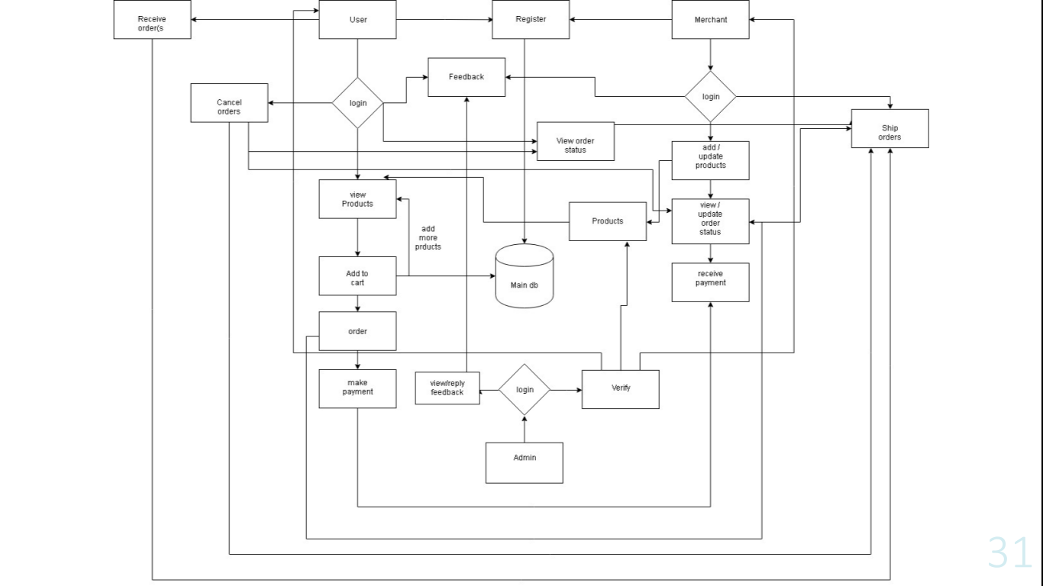

Slide 58
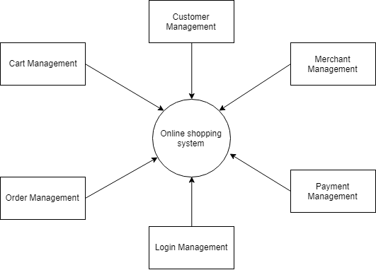

Slide 59
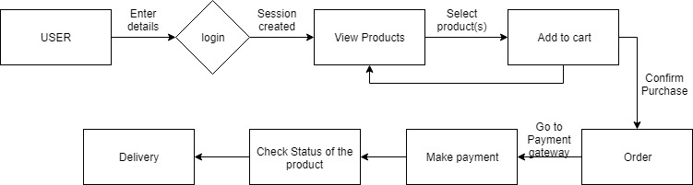
User – Flow of actions

Slide 60
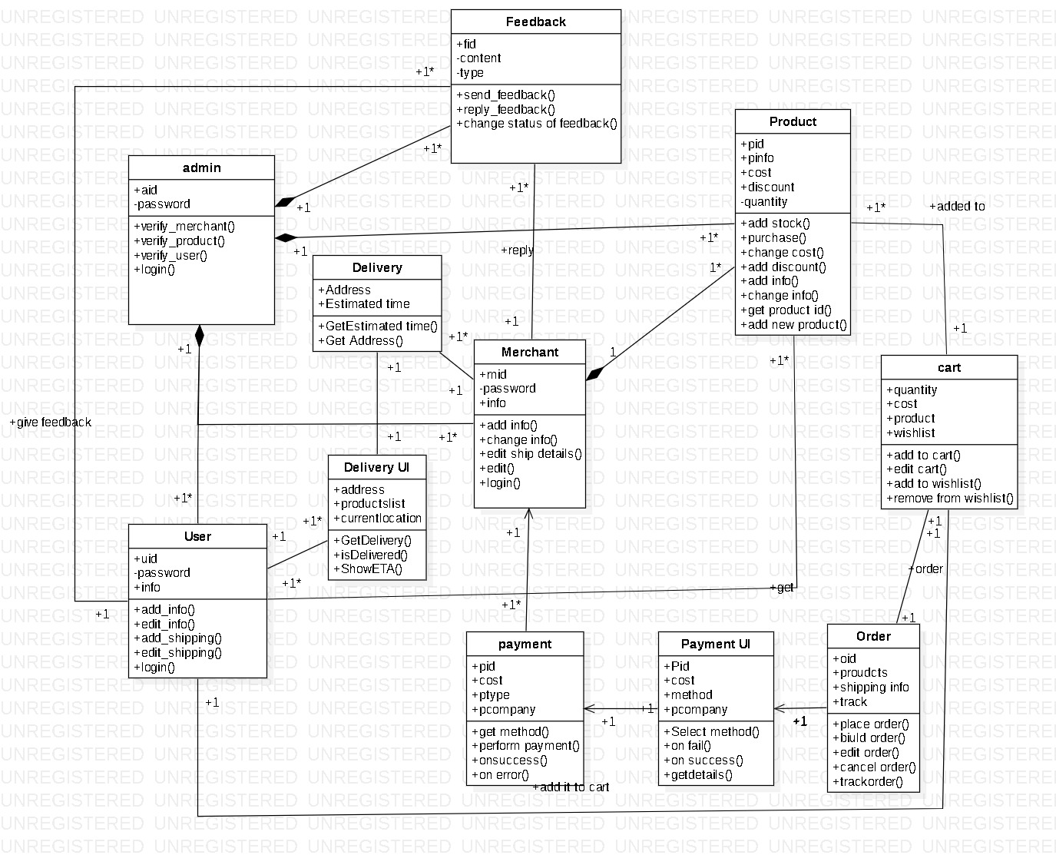

Slide 61
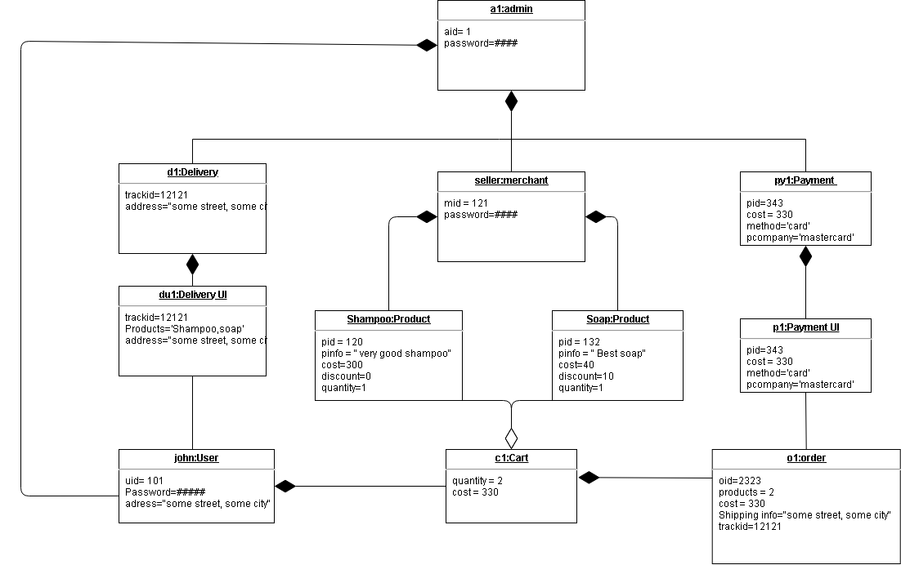

Slide 62
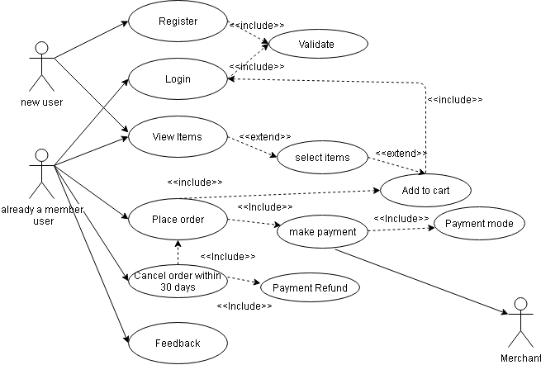

Slide 63
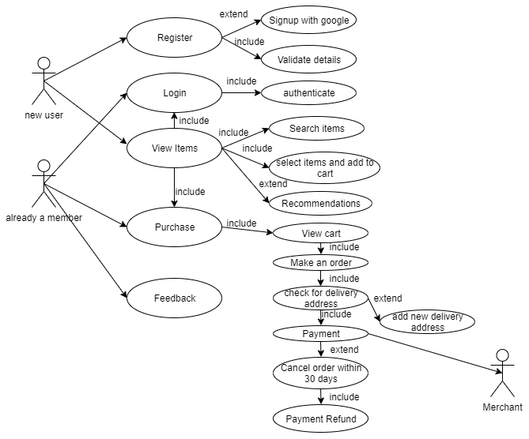

Slide 64
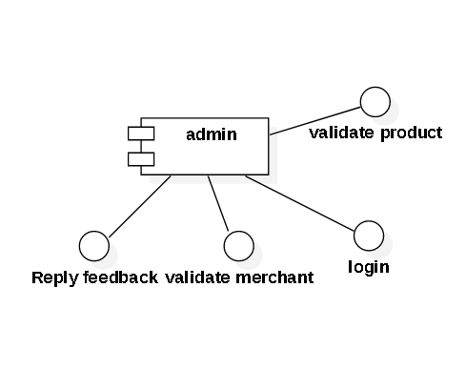
components
Admin will allow all admin related features only to the admin

Slide 65
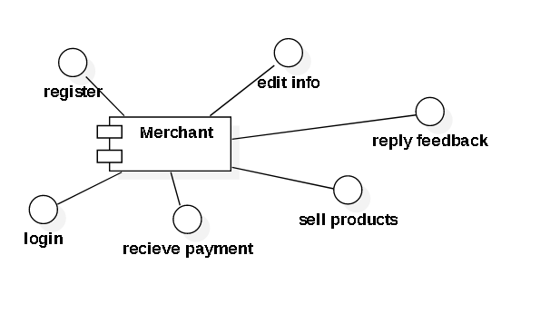
components
merchant will allow all merchant related features only to the merchant
Such as register ,login,receive payment , sell products , reply feedback, edit info

Slide 66
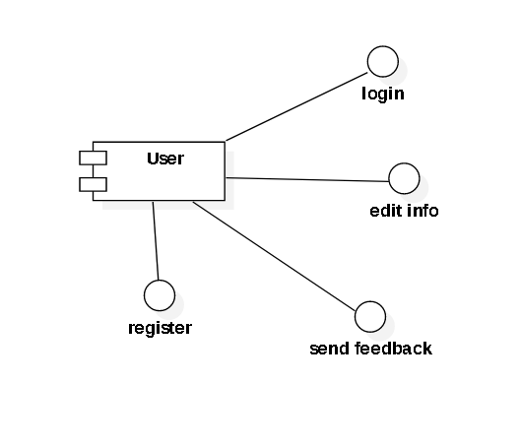
components
User will allow all user related features only to the user
They are login , personal info edit ,etc
Product related features wont be dealt by with this component

Slide 67
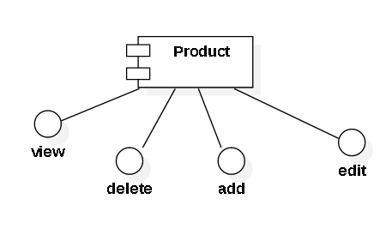
components
Product will allow all product related features to the user/merchant/admin
View is available to user
Add and delete , edit is available to merchant and admin

Slide 68
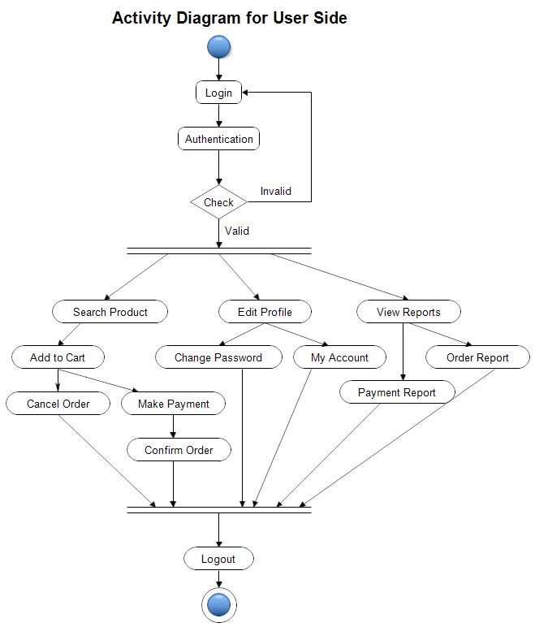

Slide 69
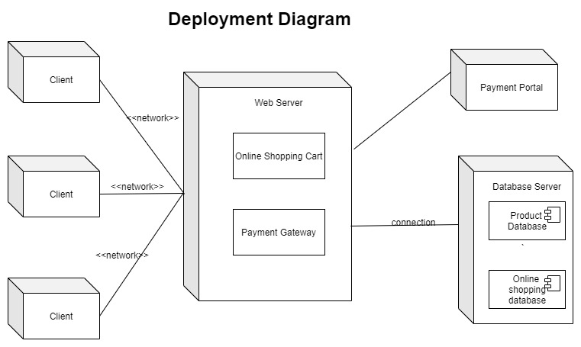

Slide 70
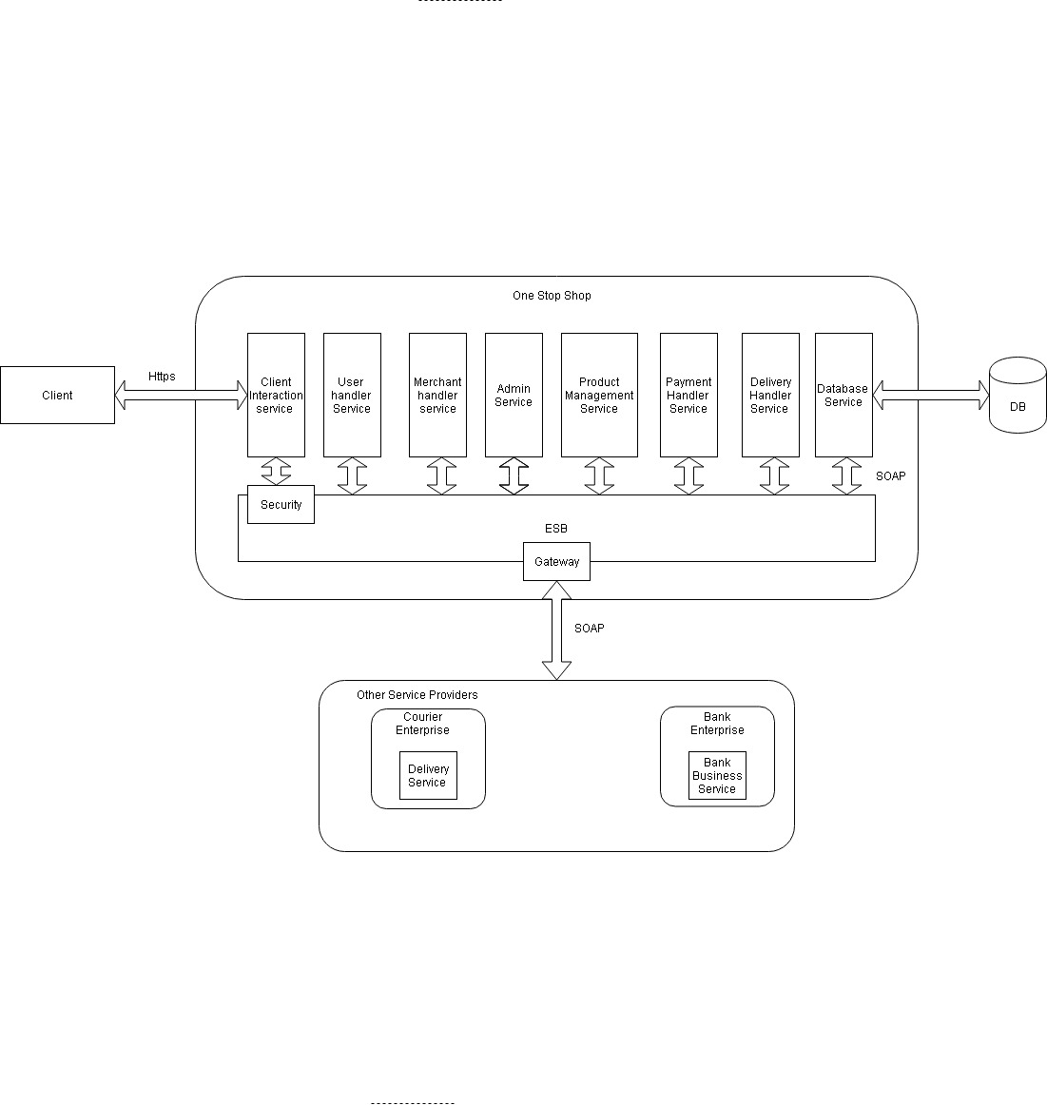

Slide 71
Feasibility Report
Feasibility is an important phase in the software development process it enables the developers to have an assessment of the product being developed It refers to the feasibility study of the product in terms of outcomes of the product, operational required for implement ting it. Feasibility study should be performed on the basic of various criteria and parameters.
Economic Feasibility: It refers to the benefits or outcomes we are deriving from the product as compared to the total cost we are spending for developing the benefits are less then it is not feasible to develop the product.
Operational Feasibility: It refers to the feasibility of the product to be operational. Some products may work very well at the design and implementation but many fail in the real time environment. It introduces the study of human resources required and their technical expertise.

Slide 72
Technical Feasibility
The system is self-explanting and does not need any entire sophisticated training. A system has been built by concentrating on the graphical uses interface concepts, the application can also be handled very easily with a novice uses. The overall time that a user needs to get trained is less than 15 minutes. The system has been added with features of menu device and button interaction methods, which makes him the master as he starts working through the environment. As the software that were used as developing this application are very economical and are readily available is the market the only time that is lost by the customer is just installation time

