Slide 1

Classifying Music into Genres
Mohit Francis, Mahdieh Raoofpanah, Earla Smith

Slide 2
Overview
Background
Data Selection and Description
Data Tidying
Exploratory Data Analysis
Predictive Modelling
Model Evaluation
Discussion and Conclusion

Slide 3
Classifying Music - Humans
Music theory/technical background in music unnecessary.
Easily perceive differences in music.
“an art of sound in time that expresses ideas and emotions in significant forms through the elements of rhythm, melody, harmony, and colour” (Dictionary.com, 2022).
E.g. Jazz and Country Music.
Use qualifiers/labels to enough to classify music into ‘types’ or ‘genres’.
Happy/sad, workout/relax, etc.

Slide 4
Classifying Music – Machine Learning Models
Models cannot ‘perceive’ differences – have to be trained
Require audio features - technical information - to classify music.
Volume, tempo, frequency, etc.
Audio features typically quantifiers/numeric.

Slide 5
Data Selection
Data set from Spotify – collection of songs and related technical information.
Compiled in 2020 by Kayvan Pavlik, Jon Harmon and Neal Grantham.
Used `spotifyr` package in R to access technical information hosted on Spotify.
Could have pulled our own song data if needed.
Publicly hosted on R For Data Science: Tidy Tuesday GitHub.

Slide 6

One of the largest music streaming services in the world.
Over 76 million songs, 456 million monthly active users.
Collect and track metrics of users and songs they listen to.
Favourite songs
Favourite genres
How long you listen to music for
Which songs, artists, genres are most popular, etc.
Use metrics to recommend new music, genres, artists.

Slide 7
Purpose
Which features are best for differentiating between various genres of music?
If possible, classify music into genres using supervised machine learning models.
Find the best performing models.

Slide 8

Predictions
May be difficult to classify.
Lots of similarities between genres.
High rates of misclassification expected.

Slide 9
Data Description
32833 observations in total
23 variables
11 categorical (song descriptions)
12 numeric (audio features)
4 numeric descriptors
4 perceptual measures – scale from 0 to 1
4 confidence measures – scale from 0 to 1
Each song put into a playlist of 1 specific genre and subgenre by Spotify.

Slide 10
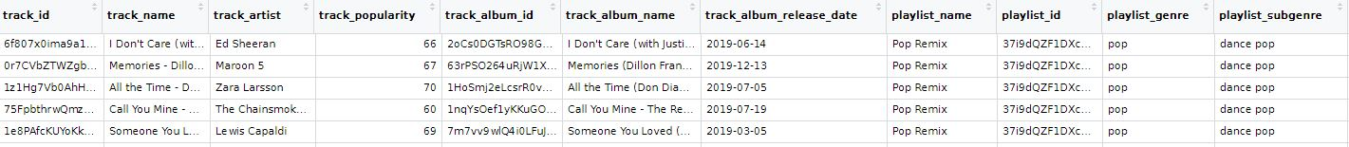
Categorical Variables
Track ID
Track Name
Track Artist
Track Popularity
Track Album Id
Track Album Name
Track Album Release Date
Playlist Name
Playlist Genre
Playlist Subgenre

Slide 11

Numeric Descriptors
Tempo (bpm) - Speed
Duration (milliseconds) – Song length
Key – key of song from 0 to 11
C = 0, C♯ = 1, D = 2 … B = 11
Unknown key = -1
Mode – Major or Minor

Slide 12

Perceptual Measures
Danceability – 0 = cannot dance to this, 1 = can dance to this
Energy – 0 = not intense, 1 = really intense
Loudness – -60dB = quiet mix, 0 dB = loud mix, lots of distortion
Valence – 0 = sad/angry, 1 = happy/euphoric

Slide 13
Confidence/Probability Measures
Instrumentalness – 0 = contains vocals, 1 = no vocals
‘oohs’ and ‘ahhs’ are instrumental
Speechiness – 0 = singing; 1 = spoken word
Rapping in the middle
Acousticness – 0 = ‘digital’ instruments; 1 = ‘actual’ instruments
Liveness – 0 = not performed live; 1 = performed live
i.e. in front of an audience.

Slide 14
Genres and Sub-Genres
Pop
Dance pop
Post-teen pop
Electropop
Indie poptimism
Rap
Hip-Hop
Southern Hip-Hop
Gangster Rap
Trap
Rock
Album Rock
Classic Rock
Permanent Wave
Hard Rock
Latin
Tropical
Latin Pop
Reggaeton
Latin Hip-Hop
R&B (Rhythm and Blues)
Urban Contemporary
Hip-Pop
New Jack Swing
Neo Soul
EDM (Electronic Dance Music)
Electro House
Big Room
Pop EDM
Progressive Electro-House

Slide 15
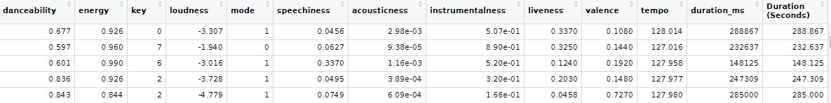
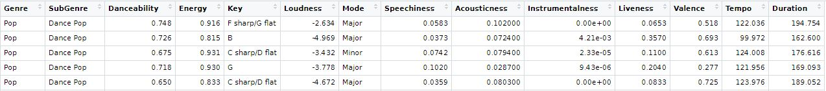
Data Tidying
Genre
SubGenre
Pop
Pop
Dance Pop
Dance Pop
Key
Danceability
Energy
Loudness
Mode
C
G
F#/G♭
D
Major
Minor
Major
Divided by 1000

Slide 16
Exploratory Data Analysis
Exploratory Data Analysis (EDA) (Tukey, 1997) can be simply defined as the critical process of performing initial investigations on data so as to discover patterns and to check assumptions with the help of graphical representations.
Some of our plots are mentioned below:
Histogram
Bar Graph
Box Plot
Density Plot
Heat Map
Scatter Plot
Scatter Plot Matrix

Slide 17
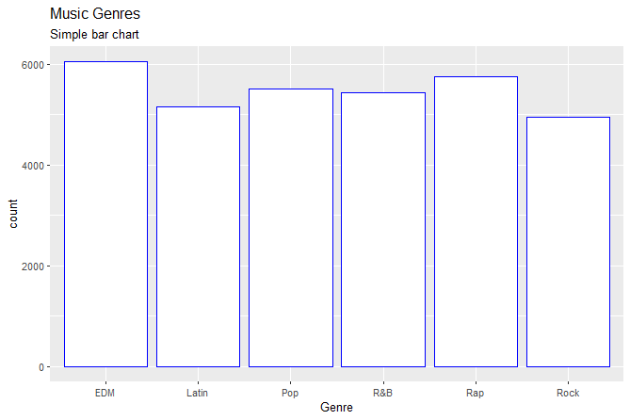
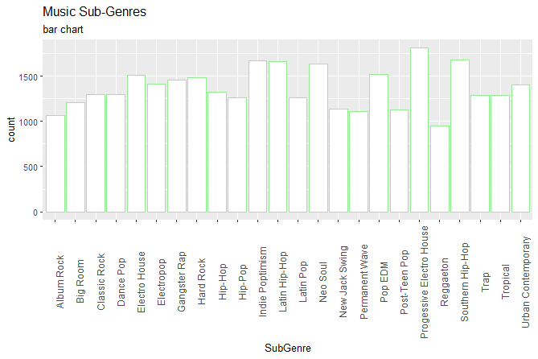
Analysis of a Single Variable
Shows the six genres that have been assigned to each song
EDM has most songs (~6000)
Rock has least songs (~4500)
Progressive Electronic House* has the most songs assigned to it (> 1750)
Reggaeton (blended reggae music with Latin American dance hall music) has the fewest

Slide 18
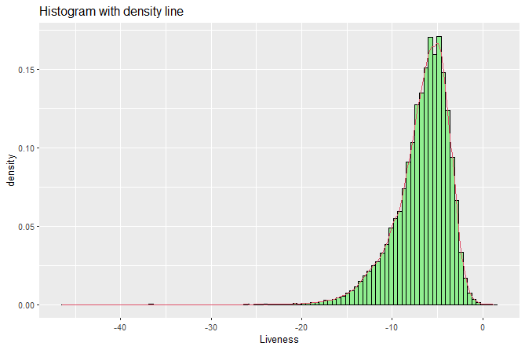
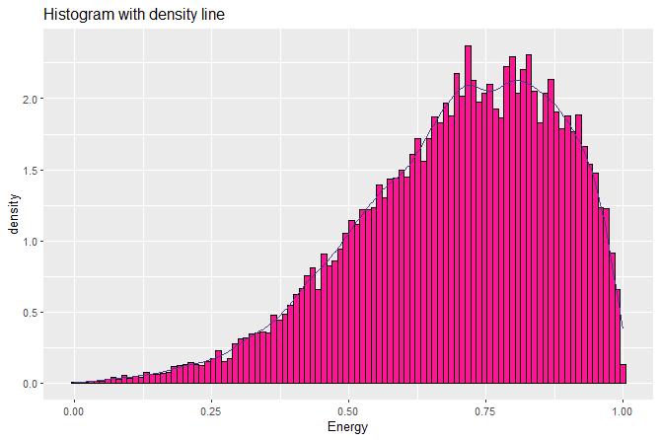
Number of songs declines after 6 dB of loudness
Shows that as loudness rises, the number of songs increases
No songs after ~ 45 dB of loudness
Left-skewed distribution
Majority of tracks are active and have a high energy
Majority of songs have an energy value ranging from 0.37 to 0.87

Slide 19
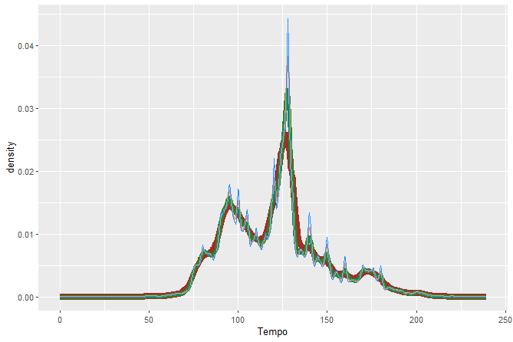
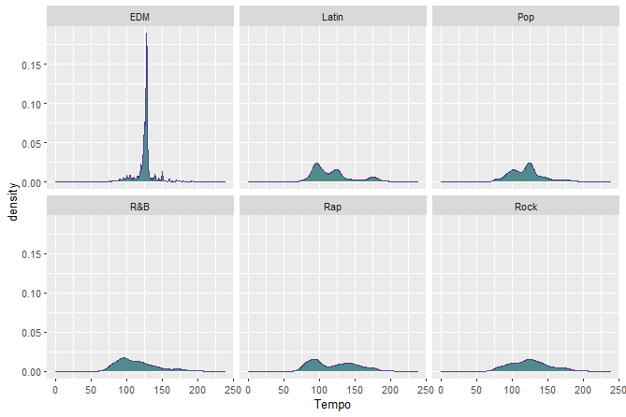
Distribution appears to be bimodal
Main peak at around 125
Lower peak around 90
Plot is distributed between 0 and 240
Number of songs with Tempo higher than 200 is insignificant
Almost all Genres have a fairly normal distribution
Number of EDM songs sharply rises at a Tempo of 125 and falls again
Indicates most EDM songs has ~125 beats per minute or BPM

Slide 20
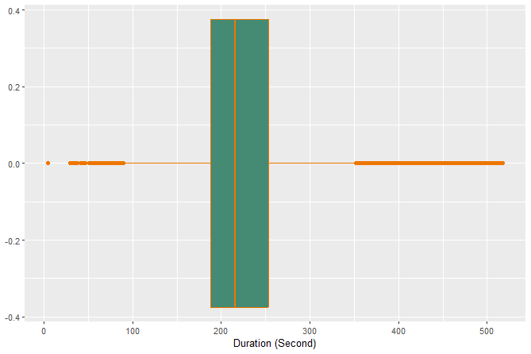
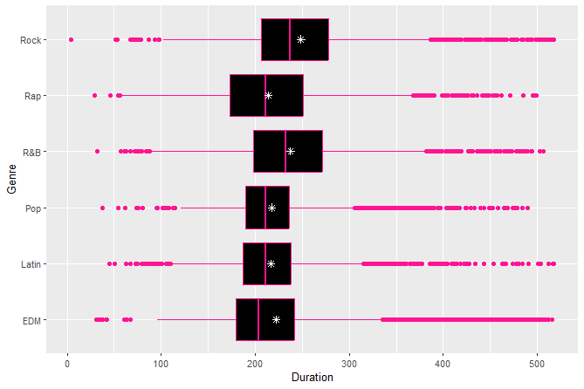
Purpose of using a box plot for “duration”: to discover outliers.
Farthest non-outlier: ~100 seconds on one side and 350 seconds on the other
Indicates songs less than 1.5 minutes and more than 5.8 minutes are our outliers
Shortest song duration is 4 seconds
Genre: Rock
Longest song is 517.8 seconds
Genre: EDM
Extreme values in our dataset

Slide 21
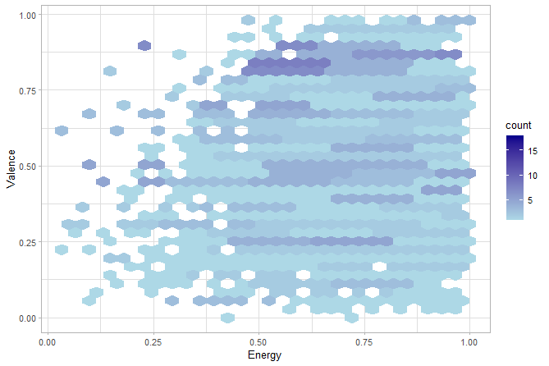
Positive correlation between energy and valences
The higher the energy of a music, the happier the song
Songs with higher energy levels, approximately 0.5 and above, are more cheerful and happy

Slide 22
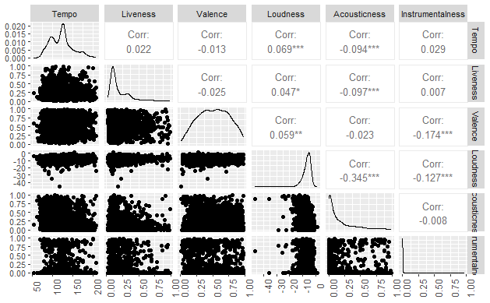
Negative correlation between Loudness and Acousticness
As loudness of music increases, the acousticness of the track decreases
For example, most loud musics belonged to the EDM genre, which has the least Acousticness (as acoustic means 'without electrical amplification') because it is more electronic sounds.
Some positive correlations exist, such as liveness and loudness, instrumentality and liveness, etc.
Can also observe certain outliers in dataset, such as those relating to Acousticness and Loudness or Loudness and Valence.

Slide 23
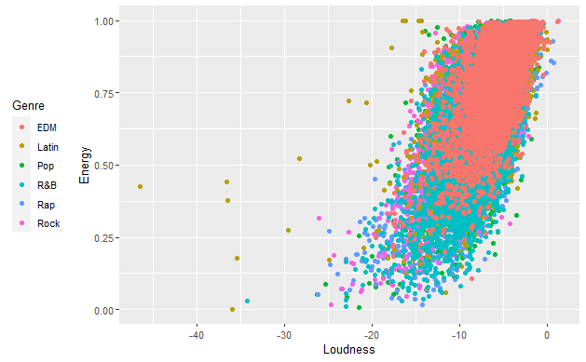
Positive Correlation: When the loudness of the track increases the energy of the track increases as well.
Almost all EDM Genre tracks have 15dB loudness and more than 0.25 Energy
Implies EDM genre is the most energetic and loud genre

Slide 24
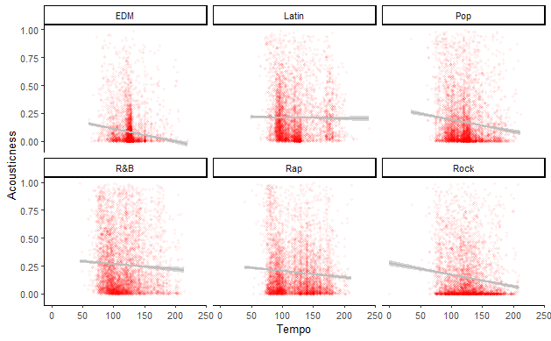
Slight negative trend between Tempo and Acousticness.
More evident in Pop and Rock songs.
Shows that Tempo and Acousticness have a negative or inverse relationship.

Slide 25
Predictive Modelling
Target variable: Genre
Training and testing data
80% partition

Slide 26
Data Tidying for Predictive Modelling
Numeric data already normalised
Outliers need to be visualised first before removal
Data preparation:
Created subset of 3000 variables
Removed Subgenre
Change categorical variables to factors

Slide 27
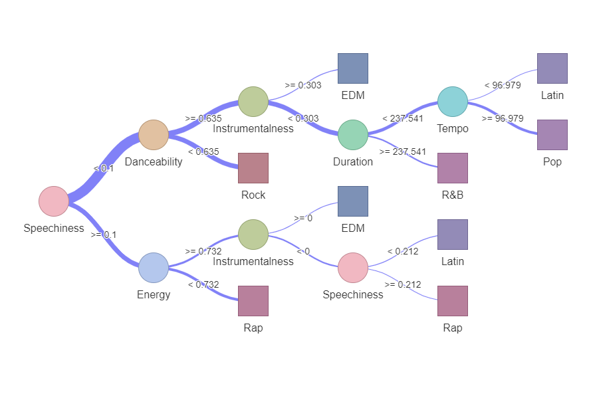
Decision Tree
Used 5 of 12 potential variables
Speechiness, Danceability, Energy, Instrumentalness, Duration, and Tempo
Could indicate higher importance as variables
Returned each Genre at least once
Some issues with model found with confusion matrix
Not all songs will be correctly sorted, but could still point to potential qualities and relationships to explore in further research

Slide 28
Algorithms & Confusion Matrices
Three algorithms
Linear discriminant analysis
k-nearest neighbours
Support vector machine
Show ~600 categorized songs from test partition
Models trained with ~2400 songs from training partition
Compares number of properly and improperly categorized songs from each genre
Higher numbers in purple squares do not necessarily mean higher accuracy
Unequal number of songs in each genre in data

Slide 29
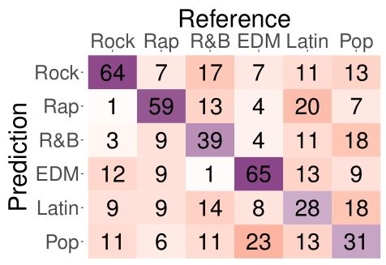
Linear Discriminant Analysis
286 correct classification out of 597
Highest number of correct categorisations were Rock, EDM, and Rap
Very few EDM songs were identified as R&B and vice versa

Slide 30
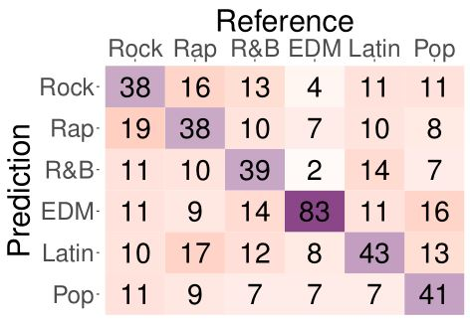
k-Nearest Neighbours
325 correct categorisations out of 597
EDM has highest number correct at 85
Same pattern between R&B and EDM, but numbers have changed

Slide 31
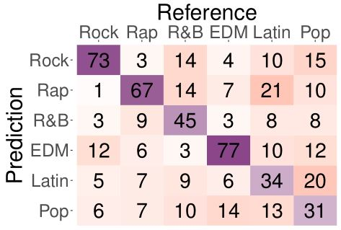
Support Vector Machine
327 correct categorisations out of 597
Very close to k-NN by total, but different spread across genres
All genres having a correct categorisation of 40 or above
Three highest are the same as the linear discriminant analysis

Slide 32
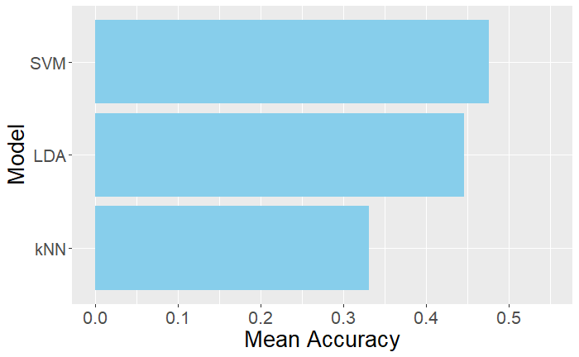
Mean Accuracy
Averaged accuracy from results of 10-fold cross validation (i.e. 10 resamples)
Overall accuracy was poor

Slide 33
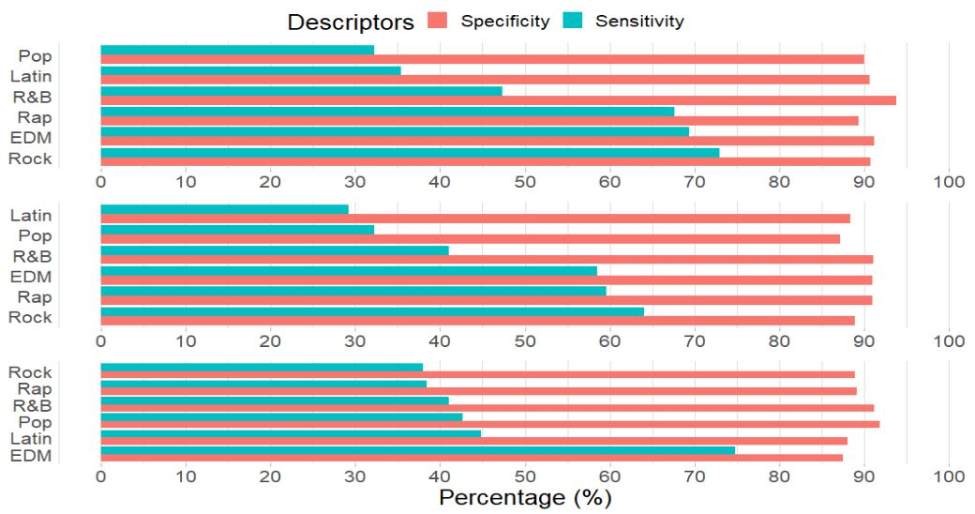
Sensitivity and Specificity
Sensitivity = True Positive Rate: correctly classify song into right genre.
Rock song into Rock Genre
Specificity = True Negative Rate: correctly identify songs not belonging to genre.
Pop song identified as not in rock genre
Based on model purpose, need high Sensitivity or Specificity.
Ideally, in this case, Sensitivity should be high, Specificity should be low

Slide 34
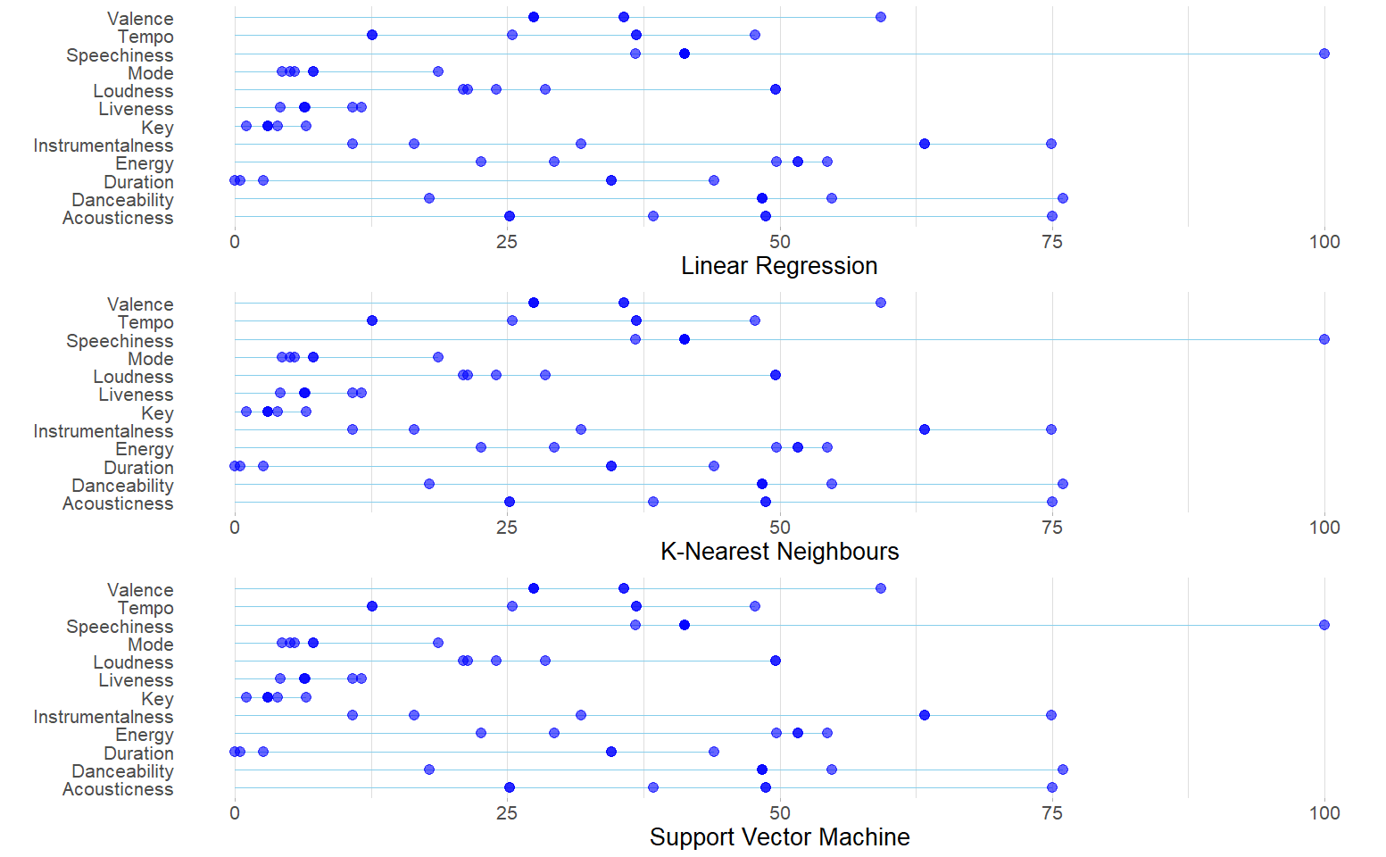
Variable Importance
By definition, cannot calculate variable importance for kNN, LDA, and SVM models.
Instead outputs ‘Generalised’, ‘model-free’ variable importance.
What `varImp()` thinks a model would use when classifying

Slide 35
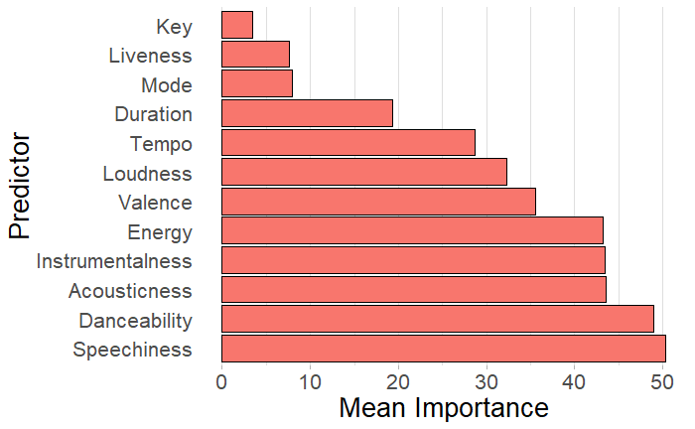
Mean Variable Importance
Displays which variables were least and most important for classification overall.
Key, Liveness, Mode not important.
Danceability and Speechiness most important.

Slide 36
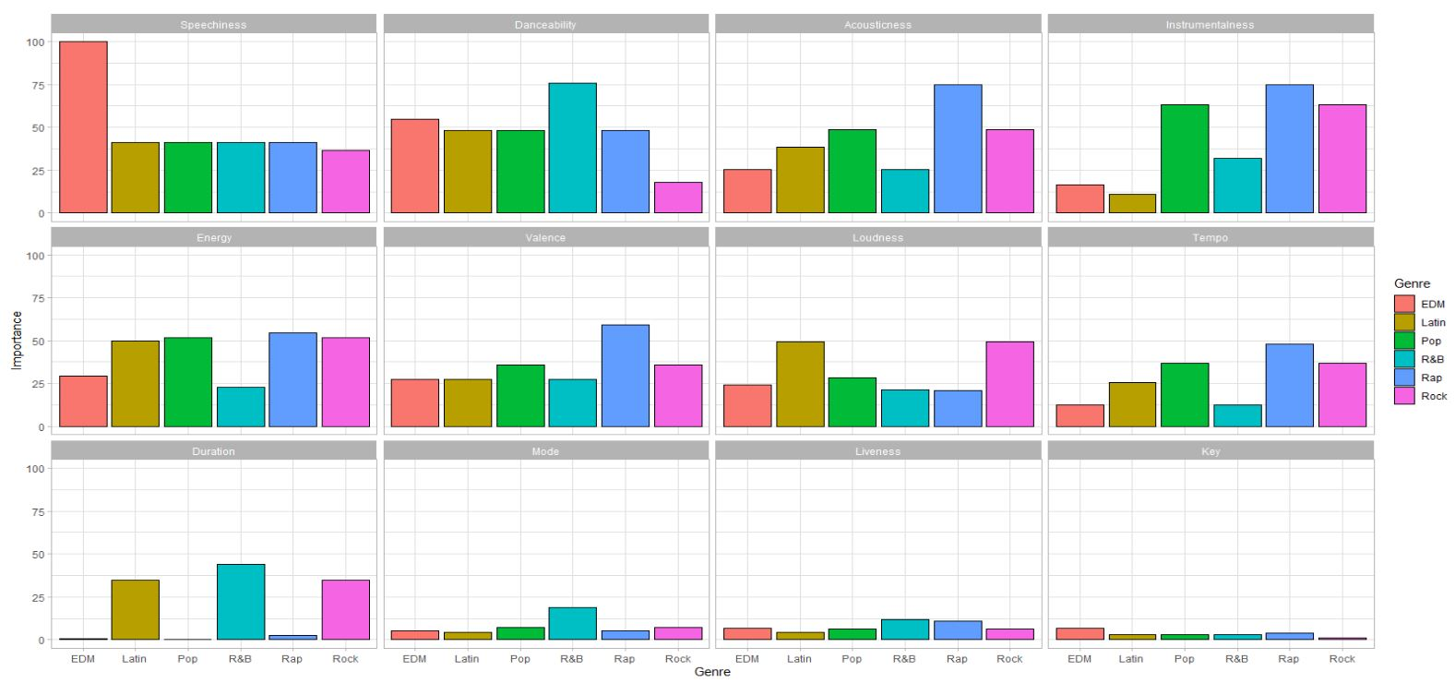
Variable Importance by Genre

Slide 37
Discussion – Summary
As expected, quite difficult
High degree of misclassifications
Poor overall model performance
Some genres better classified than others
Rock, EDM, Rap
Some genres not as well classified
Latin, R&B, Pop

Slide 38
Discussion – Genre Summary
EDM – High energy
Rap – High Speechiness
Rock – Low Danceability/Higher Duration
Latin – Danceable
R&B – Lack of easily distinguishable qualities
Pop - Lack of easily distinguishable qualities

Slide 39
Discussion – Too May Genres?
High number of subgenres limited usefulness
Number of genres may also have been too high
Reducing number of target variables may reduce model applicability – classification not always binary

Slide 40
Discussion – Genre Selection
Problem with genres selected in data set.
Pop, R&B, Latin, and Rap fairly similar to each other
Shared histories and influences, similar subgenres
Using wildly dissimilar genres may lead to better success?
Jazz, Classical, Country, Death Metal, Children’s Music?

Slide 41
Discussion – Issues with Methodology
No song belongs solely to one genre
E.g. Latin Pop, Hip Pop, Dance Pop, etc.
Classifying songs into one genre overly reductive
Predict top 3 most likely genres?
May help when classifying Pop, R&B, Latin, and Rap

Slide 42
Discussion – Too many variables
‘Curse of dimensionality’
Too many variables included, lowered model efficacy
Greater confusion when classifying
Two ways of dealing with it
Use much larger data set
Reduce number of variables (dimension reduction)

Slide 43
Discussion – Reducing no. of variables used
Model efficacy tends to increase when fewer predictors are used
kNN models require 10 or fewer
Key, Mode, Liveness not important for classifying
May be removed when running models again.
Best to increase number of observations and reduce number of variables.

Slide 44
Discussion – Increasing no. of observations
Number of observations must increase exponentially with increase in variables used for modelling
Probably need more than 32833 songs.
Downsampled data set
Allowed models to complete, but reduced model efficacy

Slide 45
References
Dataset:
Link to CSV: https://raw.githubusercontent.com/rfordatascience/tidytuesday/master/data/2020/2020-01-21/spotify_songs.csv
Readme for Dataset: jthomasmck. (January 20, 2020). Spotify Songs. https://github.com/rfordatascience/tidytuesday/blob/master/data/2020/2020-01-21/readme.md
Citations:
Bambrick, N. (2016). Support Vector Machines: A Simple Explanation. Kdnuggets.com.
https://www.kdnuggets.com/2016/07/support-vector-machines-simple-explanation.html
Behrens, J. T. (1997). Principles and procedures of exploratory data analysis. Psychological Methods, 2(2), 131–160.
https://doi.org/10.1037/1082-989x.2.2.131
Curtis, M. E., & Bharucha, J. J. (2010). The minor third communicates sadness in speech, mirroring its use in music. Emotion, 10(3), 335–348.
https://doi.org/10.1037/a0017928
Dash, S. K. (August 5, 2022). A brief introduction to linear discriminant analysis. AnalyticsVidhya.com.
https://www.analyticsvidhya.com/blog/2021/08/a-brief-introduction-to-linear-discriminant-analysis/
Davies, S. (2012). On Defining Music. Monist, 95(4), 535–555.
https://doi.org/10.5840/monist201295427
Dictionary.com. (2022). Music definition & meaning. Dictionary.com. Retrieved December 1, 2022,
from https://www.dictionary.com/browse/music
Evolution of Latin Hip Hop – Recording Arts Canada. (n.d.). Recordingarts.com.
https://recordingarts.com/record/evolution-of-hip-hop/latin/
Glossary of Music Terms: Streaming – Spotify for Artists. (n.d.). Artists.spotify.com. Retrieved December 15, 2022, from https://artists.spotify.com/en/blog/glossary-of-music-terms-streaming
Harmon, J., & Grantham, N. (2022, March 8). DataSets. GitHub.
https://github.com/rfordatascience/tidytuesday/blob/master/data/2020/2020-01-21/readme.md
Kuhn, M. (2019). 15 Variable Importance | The caret Package. In topepo.github.io.
https://topepo.github.io/caret/variable-importance.html
Malloch, S., & Trevarthen, C. (2018). The Human Nature of Music. Frontiers in Psychology, 9.
https://doi.org/10.3389/fpsyg.2018.01680
Parikh, R., Mathai, A., Parikh, S., Chandra Sekhar, G., & Thomas, R. (2008). Understanding and using sensitivity, specificity and predictive values. Indian Journal of Ophthalmology, 56(1), 45. https://doi.org/10.4103/0301-4738.37595
Pavlik, K. (2019, December 20). Classifying genres in R using Spotify data. Kaylin Pavlik.
https://www.kaylinpavlik.com/classifying-songs-genres/
Pavlik, K., Harmon, J., & Grantham, N. (2019). Githubusercontent.com.
https://raw.githubusercontent.com/rfordatascience/tidytuesday/master/data/2020/2020-01-21/spotify_songs.csv
Spotify. (2022). About Spotify. Spotify; Spotify Newsroom. https://newsroom.spotify.com/company-info/
Thompson, C. (n.d.). R Wrapper for the “Spotify” Web API. Www.rcharlie.com.
https://www.rcharlie.com/spotifyr/
Trehub, S. E., Becker, J., & Morley, I. (2015). Cross-cultural perspectives on music and musicality. Philosophical transactions of the Royal Society of London. Series B, Biological sciences, 370(1664), 20140096.
https://doi.org/10.1098/rstb.2014.0096
Web API Reference | Spotify for Developers. (n.d.). Developer.spotify.com.
https://developer.spotify.com/documentation/web-api/reference/#/operations/get-audio-features
Xiaozhou, Y. (2020, October 7). Linear Discriminant Analysis, Explained. Medium.
https://towardsdatascience.com/linear-discriminant-analysis-explained-f88be6c1e00b
Yıldırım, S. (2020, March 1). K-Nearest Neighbors (kNN) — Explained. Medium.
https://towardsdatascience.com/k-nearest-neighbors-knn-explained-cbc31849a7e3
Yiu, T. (2019, July 20). The Curse of Dimensionality. Medium; Towards Data Science.
https://towardsdatascience.com/the-curse-of-dimensionality-50dc6e49aa1e
Images: All other open domain
Shapilova, M. (May 5, 2021). Spotify Logo, Dark Mode. https://www.dreamstime.com/vinnytsia-ukraine-may-spotify-logo-dark-mode-cool-music-service-offers-legal-streaming-music-spotify-logo-dark-mode-image218033923

