Slide 1

Predicting Air Quality in Urban Areas Using Machine Learning
Shayshank Rathore [x23348186]
Mohit [x23315253]

Slide 2
Introduction
Air pollution is a major global challenge affecting health and climate.
PM2.5 is particularly harmful due to its deep respiratory penetration.
Traditional air quality monitoring is expensive and limited in coverage.
Machine learning provides accurate, data-driven air quality predictions.
This study predicts PM2.5 levels using pollutant metrics and AQI data.
It identifies pollution hotspots and visualizes global air quality trends.
Insights support policymakers in improving urban air quality.

Slide 3
Dataset Description
Dataset Name: Global Air Pollution Data (2024).
Scope: Covers 170 countries and 300 cities globally.
Size: Over 20,000 records of air quality data.
Key Features:
Country and City for geographic details.
PM2.5 AQI Value and other pollutant AQI values (CO, NO2, Ozone).
AQI Value and AQI Category (e.g., Good, Moderate, Unhealthy).
Data Quality:
Missing values in numeric columns filled with the median.
Categorical columns filled with the most frequent value.
Feature Engineering:
Added pollutant_sum to aggregate pollutant levels.
Added pollutant_avg for average pollutant load per record.
Utility:
Enables analysis of global air pollution trends.
Suitable for building predictive models to forecast PM2.5 levels.
Tools Used: Preprocessed using Python libraries like Pandas and NumPy.

Slide 4
Methodology
Data Preprocessing:
Cleaned missing values:
Numeric columns filled with median values.
Categorical columns filled with mode.
Encoded categorical variables (e.g., Country, City) using label encoding.
Feature Engineering:
Created new features:
pollutant_sum: Aggregate of pollutant metrics.
pollutant_avg: Average pollutant level per record.
Exploratory Data Analysis (EDA):
Visualized PM2.5 distribution across countries and cities.
Used correlation heatmaps to find relationships between pollutants.
Generated scatterplots and bar plots to understand pollutant patterns.
Model Training:
Split data into 80% training and 20% testing sets.
Trained a Random Forest Regressor to predict PM2.5 AQI values.
Used pollutant_sum, pollutant_avg, and individual AQI metrics as features.
Evaluation Metrics:
Mean Squared Error (MSE): Measured prediction accuracy.
R-squared (R²): Assessed model variance explained.

Slide 5
Methodology
Model Training:
Data split: 80% training, 20% testing.
Model: Random Forest Regressor for PM2.5 prediction.
Features: pollutant_sum, pollutant_avg, AQI metrics.
Evaluation Metrics:
MSE: Evaluates prediction accuracy.
R²: Measures variance explained by the model.
Visualization:
Scatterplot: Actual vs. predicted PM2.5.
Feature importance: Bar chart.
Heatmaps and graphs: Pollution trends by country.
Tools:
Libraries: Pandas, NumPy, Matplotlib, Seaborn, Scikit-learn.
Fully implemented in Python for reproducibility.

Slide 6
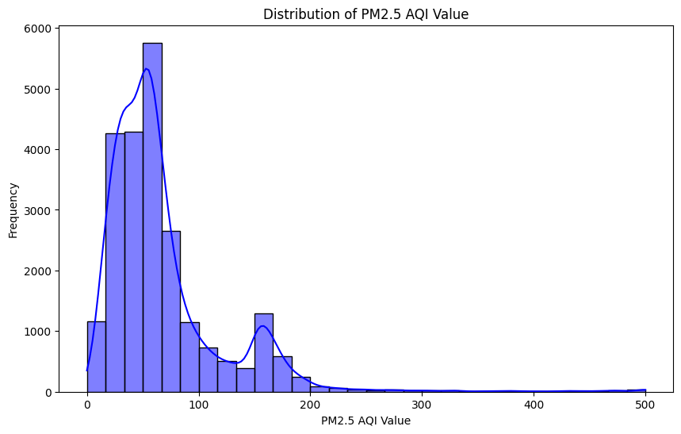
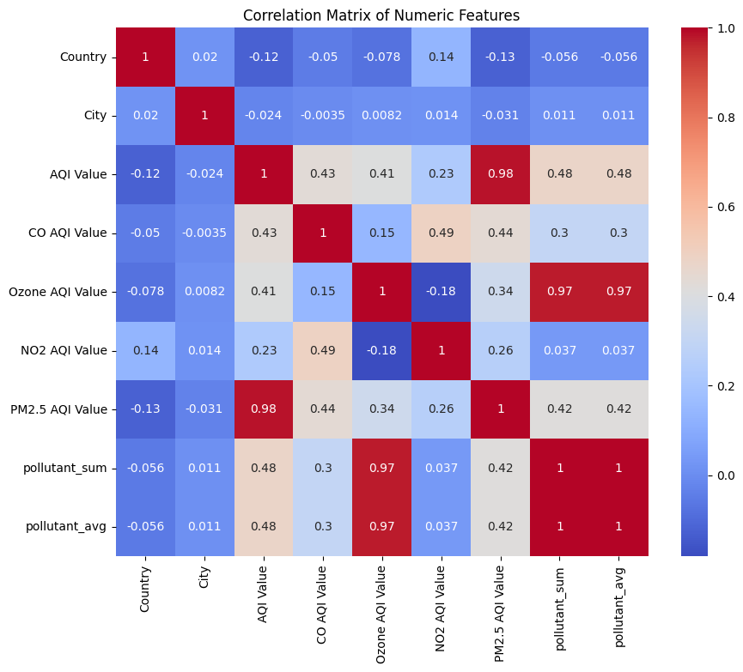
Analysis
Data Insights:
PM2.5 distribution is skewed, with hotspots in industrialized regions.
High correlations observed between PM2.5 and other pollutants like CO and NO2.
Visualization Findings:
Heatmaps highlighted regions with critical pollution levels.
Boxplots showed disparities in air quality across countries.
Scatterplots confirmed linear relationships between PM2.5 and pollutant metrics.
Model Performance:
Random Forest achieved R² of 0.99 and MSE of 31.35.
AQI Value and pollutant_sum were key predictors.
Country-Wise Trends:
South Asia and parts of Africa identified as major pollution hotspots.
Visualized predicted vs. actual PM2.5 trends by region.
Residual Analysis:
Errors showed no significant pattern, confirming model robustness.
Figure 1: HIstogram
Figure 2: Correlation Matrix

Slide 7
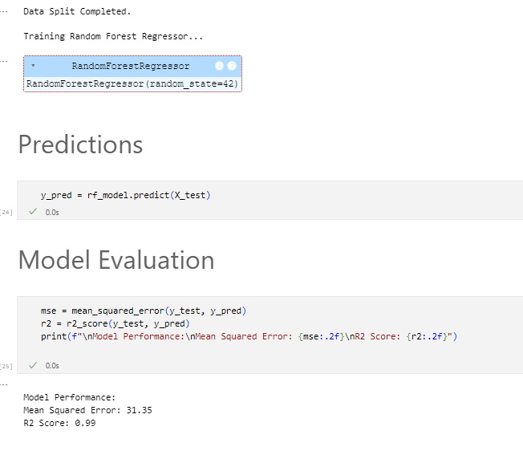
Model Performance
Model Used:
Random Forest Regressor for PM2.5 prediction.
Key Metrics:
R² Score: 0.99 (99% variance explained).
MSE: 31.35 (low average error).
Feature Importance:
Top predictors: AQI Value, pollutant_sum, pollutant_avg.
Validation Results:
Strong alignment between actual and predicted PM2.5 values.
Residual errors distributed evenly, indicating robust predictions.
Conclusion:
The model is highly accurate and reliable for air quality forecasting.
Figure 3: Model Performance

Slide 8
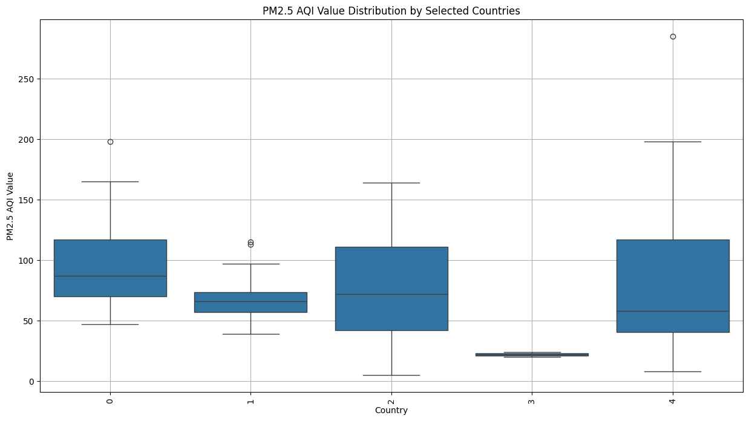
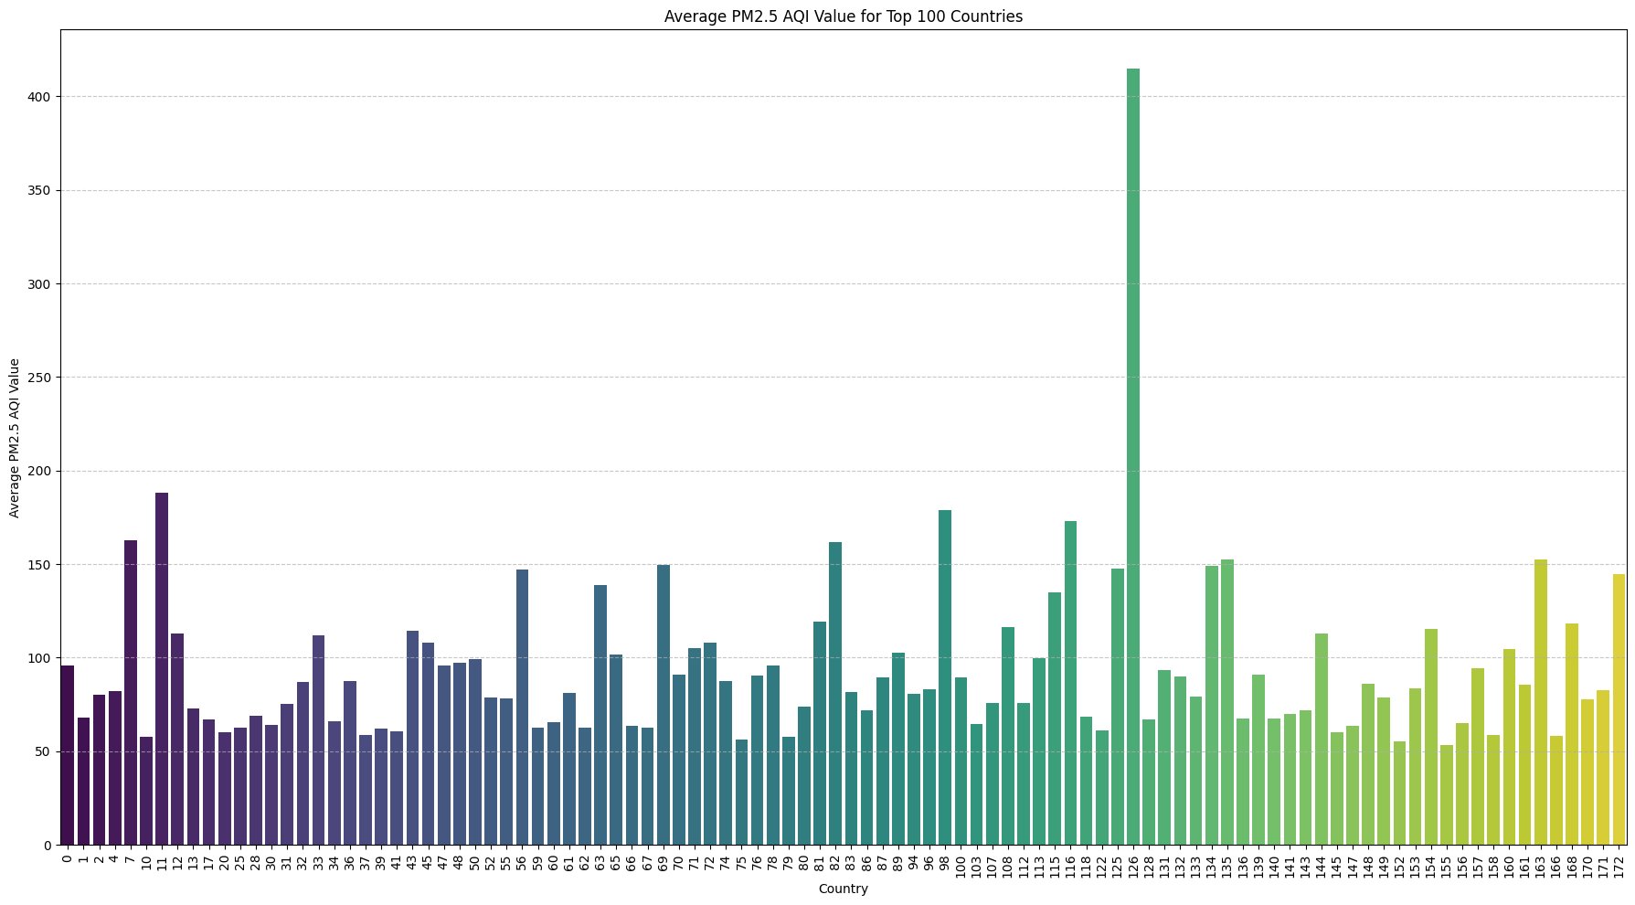
Visualizations
PM2.5 Distribution:
Histogram shows skewed distribution, with many regions exceeding safe levels.
Correlation Heatmap:
Highlights strong relationships between PM2.5 and pollutants like CO, NO2, and Ozone.
Country-Wise Trends:
Boxplots: Show disparities in air quality between countries.
Bar Plots: Average PM2.5 values for top-polluting countries.
Actual vs. Predicted:
Scatterplot compares actual and predicted PM2.5 values, showing strong alignment.
Pollution Patterns:
Heatmaps visualize pollutant averages across countries.
Country-specific PM2.5 trends over time presented in line graphs.
Feature Importance:
Bar chart of feature contributions to model predictions (e.g., AQI Value, pollutant_sum).
Residual Analysis:
Histogram shows balanced residual distribution, validating model accuracy.
Figure 4: PM2.5 Distribution by Selected Countries
Figure 5: Average PM2.5 by Country (Bar Plot)

Slide 9
Conclusions
Model Success:
Random Forest Regressor achieved high accuracy with an R² of 0.99 and MSE of 31.35.
Key Predictors:
AQI Value, pollutant_sum, and pollutant_avg were identified as the most impactful features.
Global Insights:
South Asia and parts of Africa were identified as major pollution hotspots.
Significant disparities in air quality observed across regions.
Actionable Visualizations:
Heatmaps, scatterplots, and bar charts provided insights for targeted interventions.
Limitations:
Excluded meteorological and real-time factors.
Limited focus on rural air quality trends.
Future Work:
Integrate weather data, satellite imagery, and real-time monitoring.
Develop explainable AI models for better decision-making.
Impact:
Demonstrates the potential of machine learning to support evidence-based air quality management.

Slide 10
Bibliography
Alahmadi, M. (2024). Optimizing data quality for sustainable development: An integration of green finance with financial market regulations. Sustainability, 16(23). Retrieved from https://www.mdpi.com/2071-1050/16/23/10418 Bai, L., Du, P., Wang, S., Li, H., & Wang, J. (2024). A novel combined multi-variate prediction framework for air pollution based on feature selection and deep learning models. Process Safety and Environmental Protection. Retrieved from https://www.sciencedirect.com/science/article/pii/S0957582024015106 Chen, S., Sun, W., Ren, M., Xie, Y., & Zeng, D. (2024). A hybrid model for monthly runoff forecasting based on mixed signal processing and machine learning. Environmental Science and Pollution Research. Retrieved from https://link.springer.com/article/10.1007/s11356-024-35528-4 Hong-zhao, D., Guo, H., Shi-kai, L., & Fang, Y. (2024). Synergistic effect evaluation method of atmospheric emission reduction based on deep learning fusion model. Journal of Hazardous Materials. Retrieved from https://www.sciencedirect.com/science/article/pii/S0304389424032904

Slide 11

Thank You

