Slide 1



PLACEMENT MANAGEMENT SYSTEM

Slide 2

Bachelor of Computer Applications
Semester VI
Jan - Jun, 2023
Under the guidance of Submitted By
Faculty Name Name & Roll No.
Dr. Hitesh Ninama Arun Meena (2011105)
Chetan Yadav (2011108
Lokendra Mahale (2011216)

Slide 3
TABLE OF CONTENTS
INTRODUCTION
TECHNOLOGY USED
MODULES
DIAGRAM
SCREENSHOTS
CONCLUSION
REFERENCES

Slide 4
INTRODUCTION
Aim
Objective
Motivation
Hardware & Software Requirements

Slide 5
AIM
The aim of this project is to develop a system to store the details of eligible students for placement and recruiters coming to the campus.

Slide 6
OBJECTIVE
The objective of the project is to explain and elaborate the concept of “Placement management system” to the students and company, hence providing a reliable and efficient platform to assist them to afford it without much trouble.

Slide 7
MOTIVATION
Placement Management System is a web application designed to store data of students eligible for placement and the recruiters coming to the campus. Main motivation of this project is to reduce again and again form filling processes to collect records of students and also to provide better data storage at one place.

Slide 8
TECHNOLOGY USED
Hardware Requirements: - i3 Processor 4GB RAM 512 KB Cache Memory Hard disk 10 GB Microsoft Compatible 101 or more Keyboard. | Software Requirements: - Operating System: Windows Programming language: Designing: CSS Front-End: HTML Back-End: PHP Server: Xampp server and localhost

Slide 9
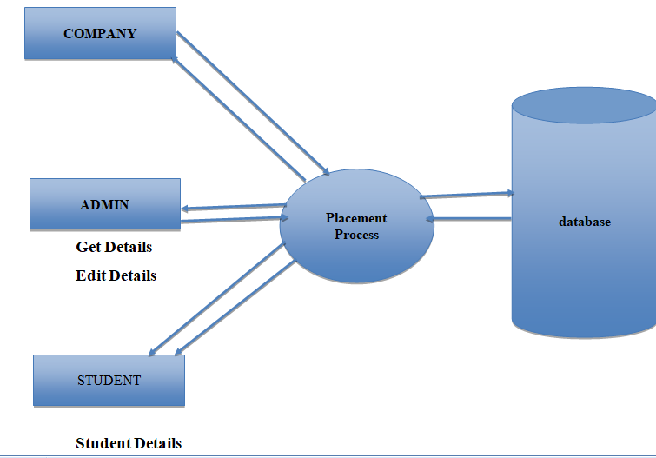
DFD

Slide 10
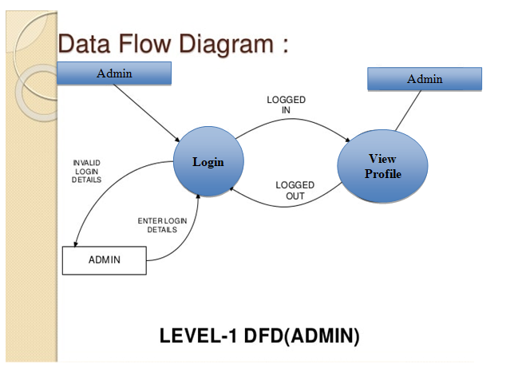

Slide 11
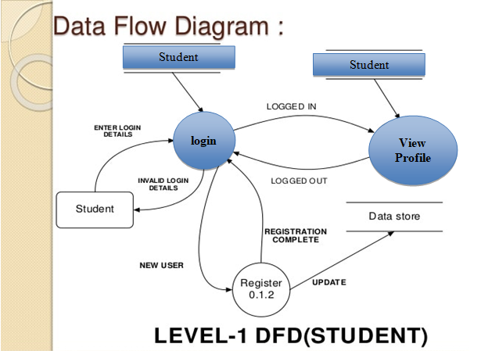

Slide 12
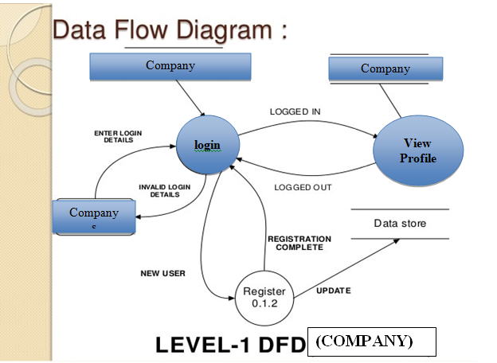

Slide 13
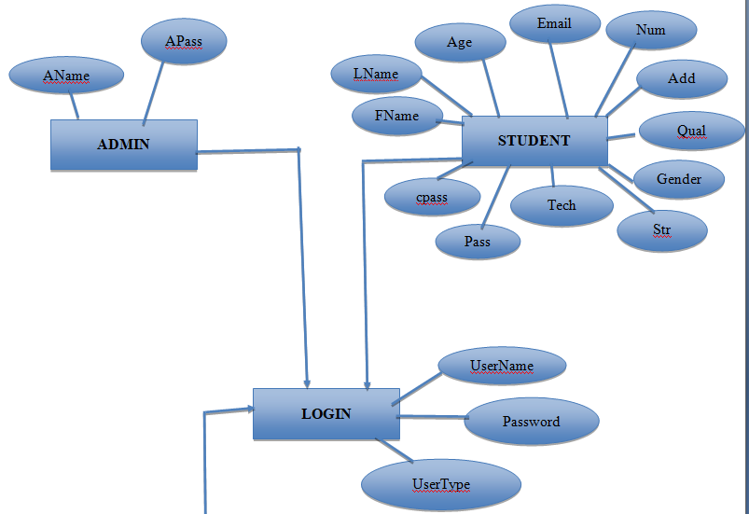
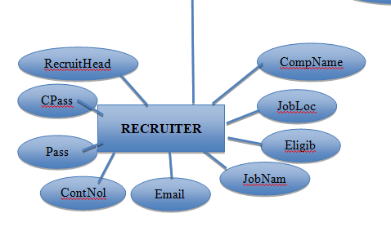

Slide 14
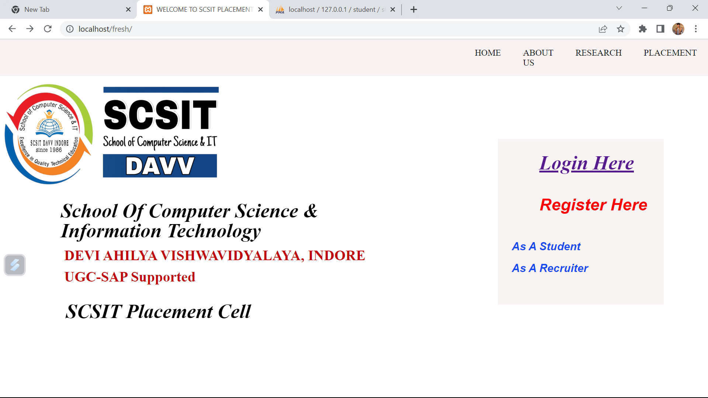
OUTPUT SCREENSHOTS

Slide 15
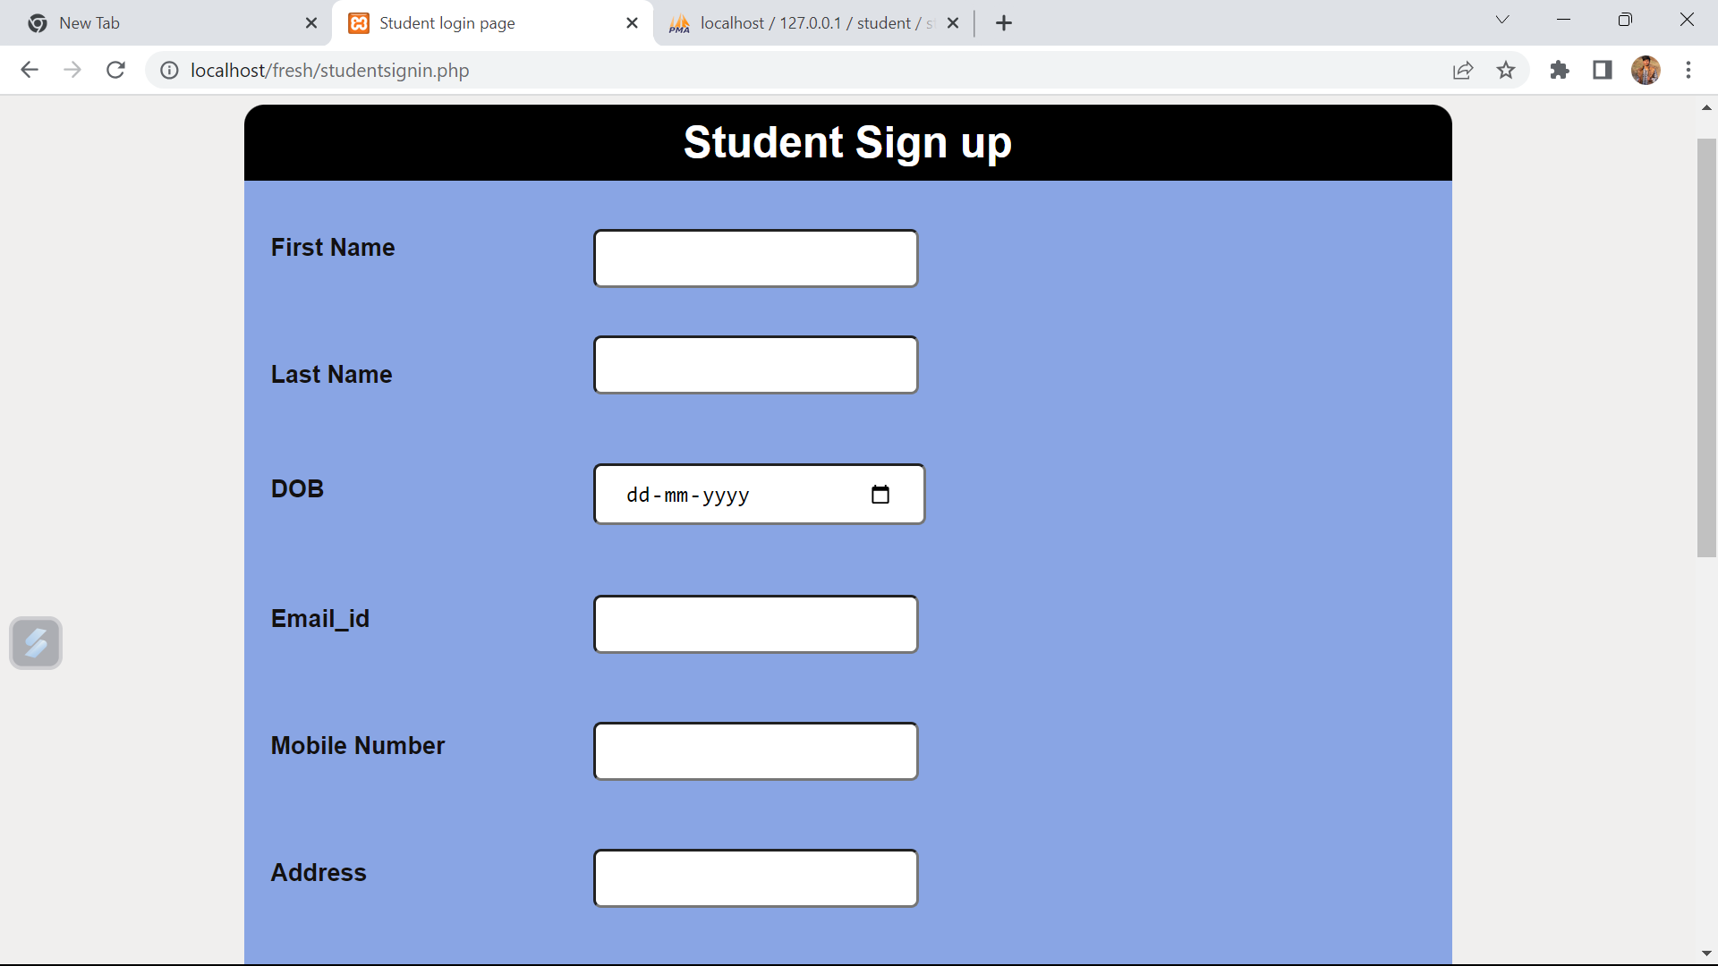

Slide 16
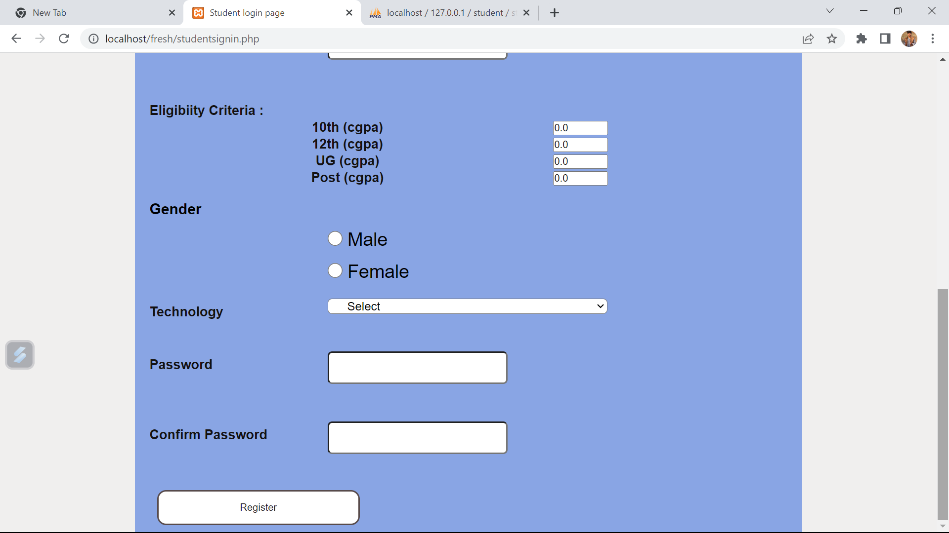

Slide 17
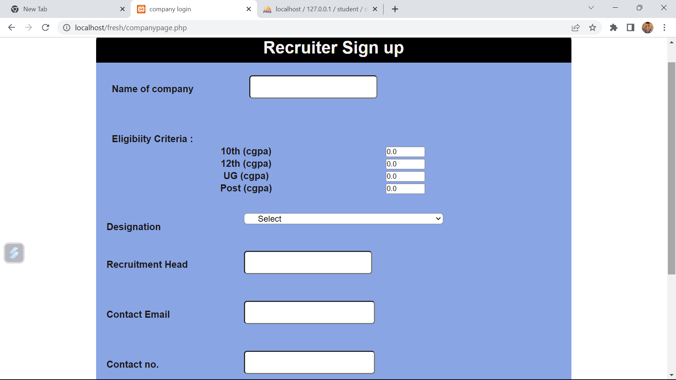

Slide 18
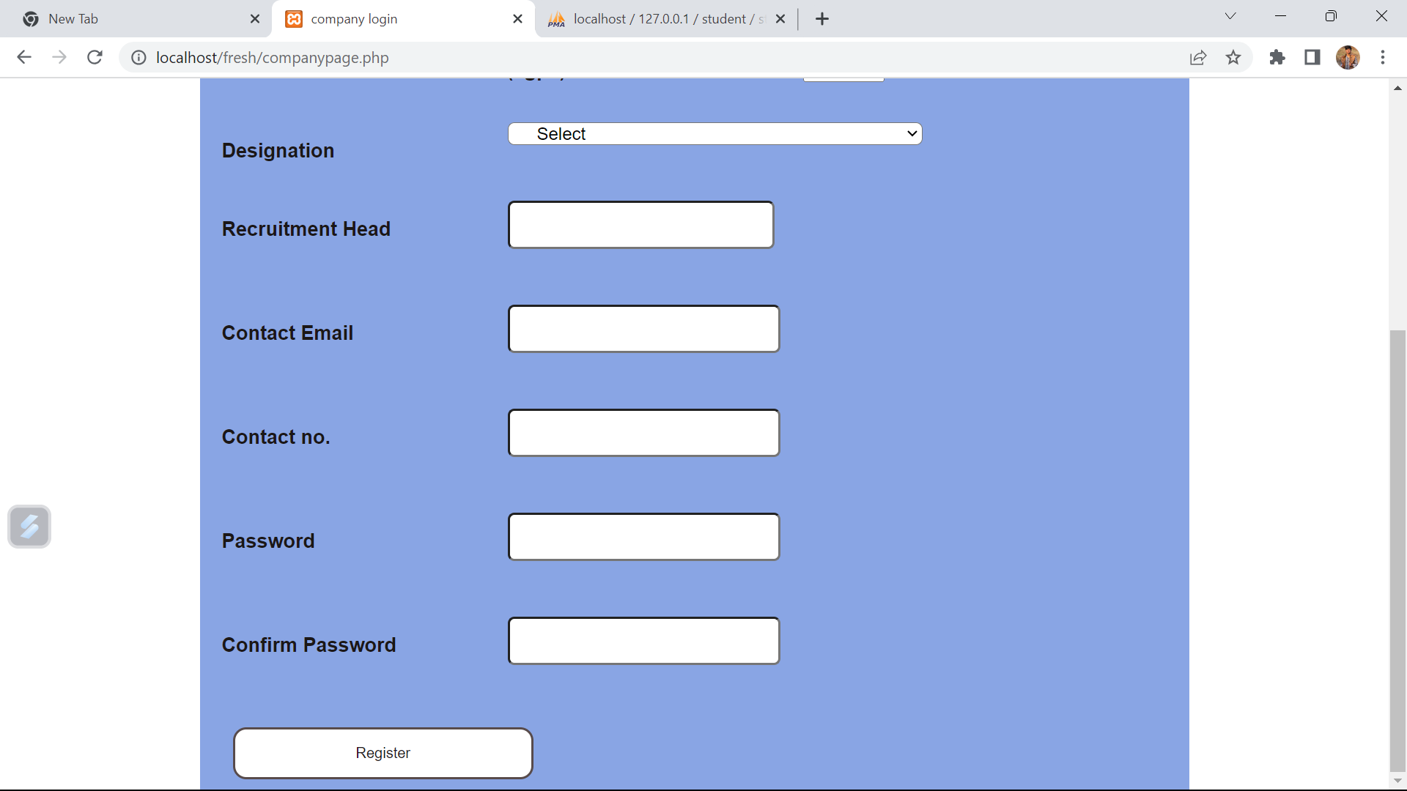

Slide 19
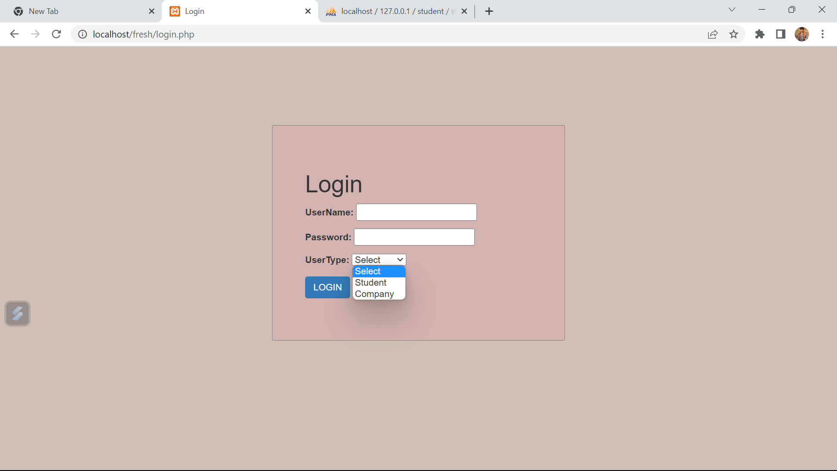

Slide 20
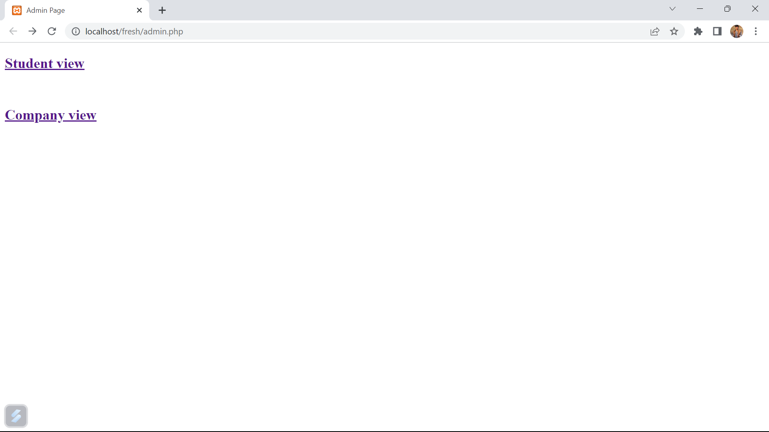

Slide 21
CONCLUSION
The package was designed in such a way that future
modifications can be done easily. The following conclusions
can be deduced from the development of the project.
Automation of the entire system improves efficiency
It provides a friendly graphical user interface which proves to
be better when compared to the existing system.
It gives appropriate access to the authorized users depending
on their permissions.
It effectively overcomes the delay in communications.
Updating information becomes so much easier.
System security, data security, and reliability are striking
features.
The System has adequate scope for modification in the future if
necessary.

Slide 22
REFERENCES
Book Reference:
1)The complete reference HTML & CSS (Writer-Thomas A. Powell).
2)PHP for professionals.
Web Reference:
www.google.com
www.youtube.com
www.geeksforgeeks.org
www.w3schools.com
www.stackoverflow.com

Slide 23

ANY QUESTIONS ?

Slide 24
THANK YOU!

