Slide 1

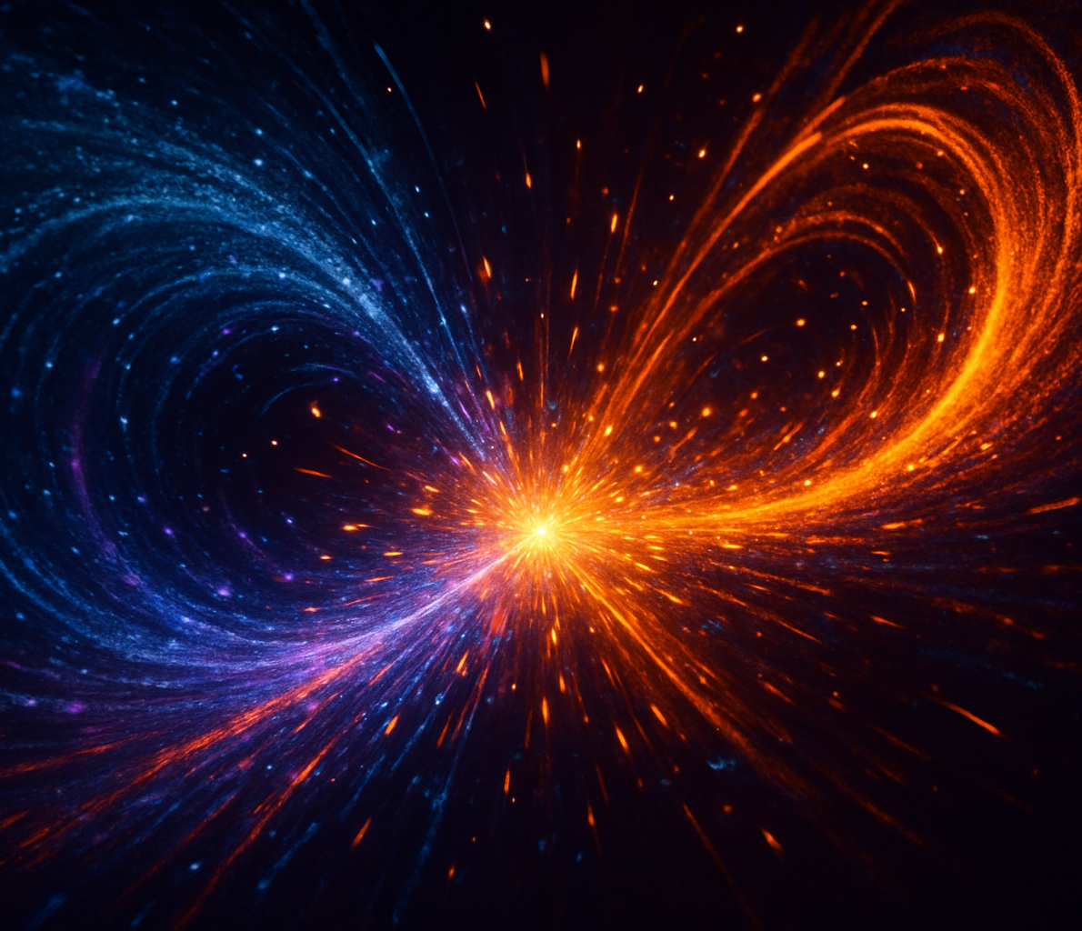
Particle Physics Event Classification
Distinguish rare Higgs‑boson signal events from overwhelming background noise in proton–proton collisions. Build a robust machine‑learning pipeline to separate the signal (s) from background (b) using rich kinematic features derived from detector data.
13 Sept 2025
[1]

Slide 2
Methodology
Preprocessing: impute missing values, cap outliers and drop irrelevant columns.
Base models: train XGBoost, LightGBM & CatBoost with tuned hyper‑parameters.
Stacking: use base probabilities as features and fit a logistic‑regression meta‑learner.
Cross‑validation & threshold tuning (0.49) balance recall versus precision.
Statistic | Value
Total events (n) | 200,000
Signal events (s) | 68,534
Background events (b) | 131,466
Raw features | 30
Features used | 18
[1]

Slide 3
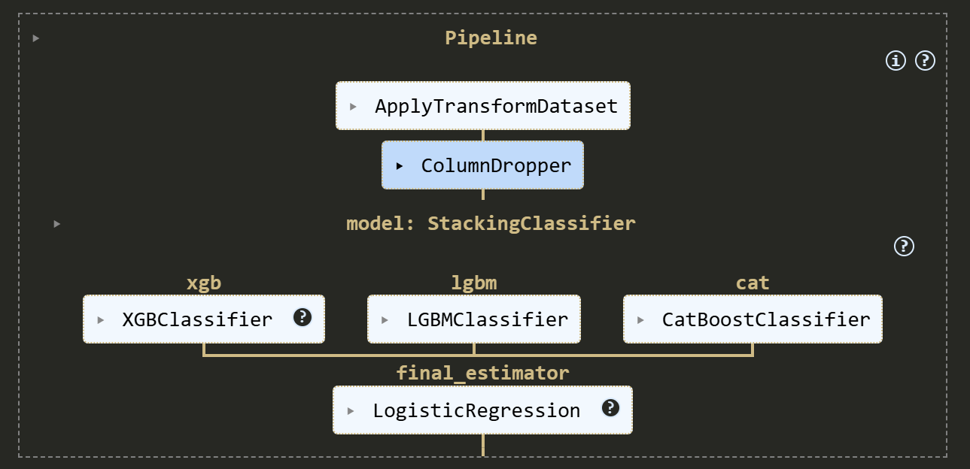
Model Architecture
Transform dataset: impute missing values and cap outliers (ApplyTransformDataset).
Drop non‑feature columns (ColumnDropper).
Base estimators: XGBoost, LightGBM & CatBoost trained on cleaned features.
Stacking: collect base probabilities and feed them into a logistic‑regression meta‑learner.
Cross‑validated predictions prevent overfitting and enable robust ensemble learning.
Model | n_estimators | max_depth | learning_rate
XGBoost | 700 | 7 | 0.1
LightGBM | 700 | 7 | 0.1
CatBoost | 700 | 7 | 0.1
[2]

Slide 4
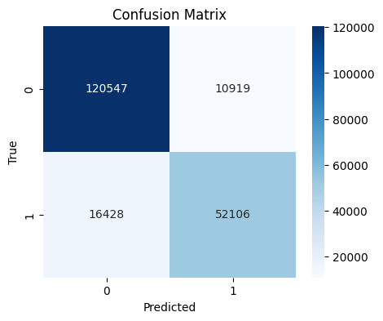
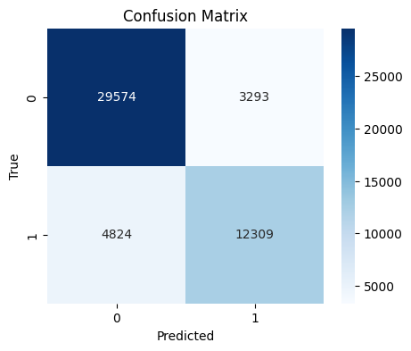
Results & Summary
High training AUC (~0.93) and accuracy (~0.86) show the ensemble captures signal–background patterns well.
Cross‑validated performance remains strong (AUC ≈ 0.91, ACC ≈ 0.84) on unseen folds and the held‑out test set.
The stacking ensemble combines XGBoost, LightGBM and CatBoost under a logistic meta‑learner.
More false negatives in training hint at mild overfitting; calibration and regularisation could help.
Future work: investigate deeper architectures and fine‑tune thresholds for better recall.
Train
Test
Dataset | Accuracy (µ ± σ) | ROC‑AUC (µ ± σ)
Train | 0.863 | 0.934
CV (mean ± σ) | 0.838 ± 0.002 | 0.908 ± 0.002
Test | 0.838 | 0.907
[1] [2]

