Slide 1
Capstone Project
AirBnb Booking Analysis
By:- Mohit Jain

Slide 2
Topics For discussion
Data Summary
Demand Insights
Price range
Revenue
Conclusion

Slide 3
Data Summary: -
1. Room types= There are 3 types of rooms are available.
1.Private room
2. Entire home/apt
3. Shared room
2. Demand= People belongs to many other places stayed in AirBnb . And every one has different types of rooms & minimum nights as per their need.
3. Price range is also vary for different rooms
4.We are calculating revenue with price & minimum nights so we can analyze which section generated more revenue.

Slide 4
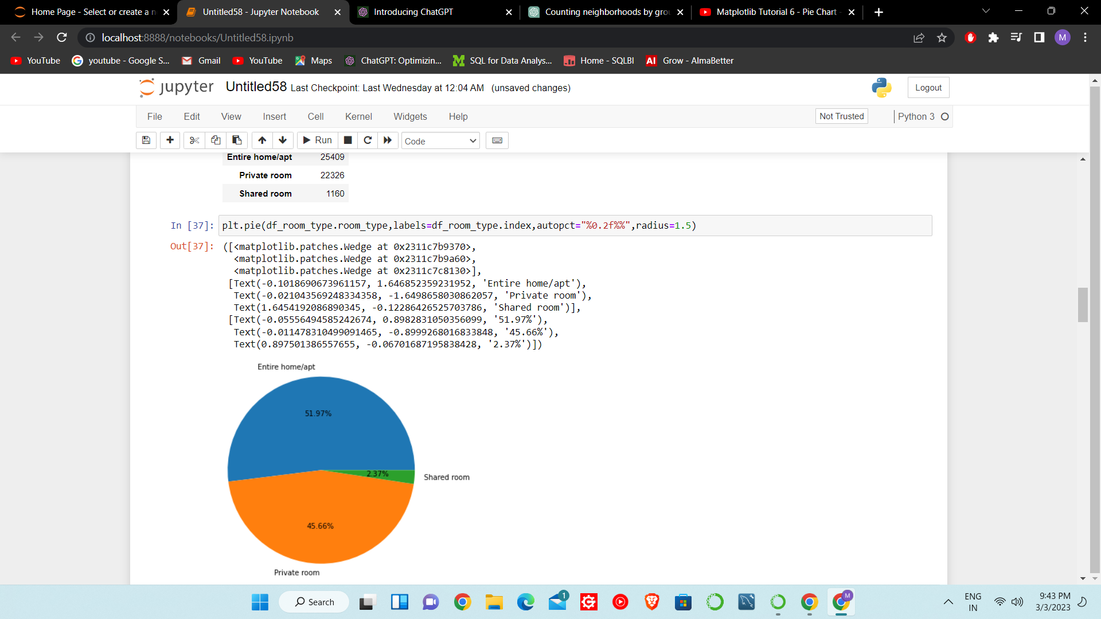
Demand Insights:-
As we see in dataset there are 3 types of rooms are available in the AirBnb
1.Private room
2. Entire home/apt
3. Shared room
Insights:-
1. Entire home/apt are most booked room with 51.97%
2. Shared room are booked only 2.37%

Slide 5
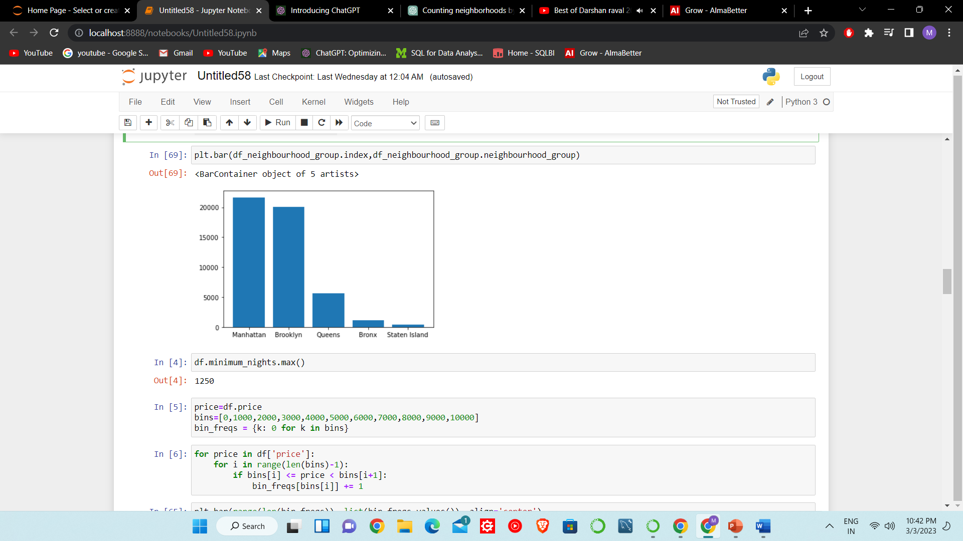
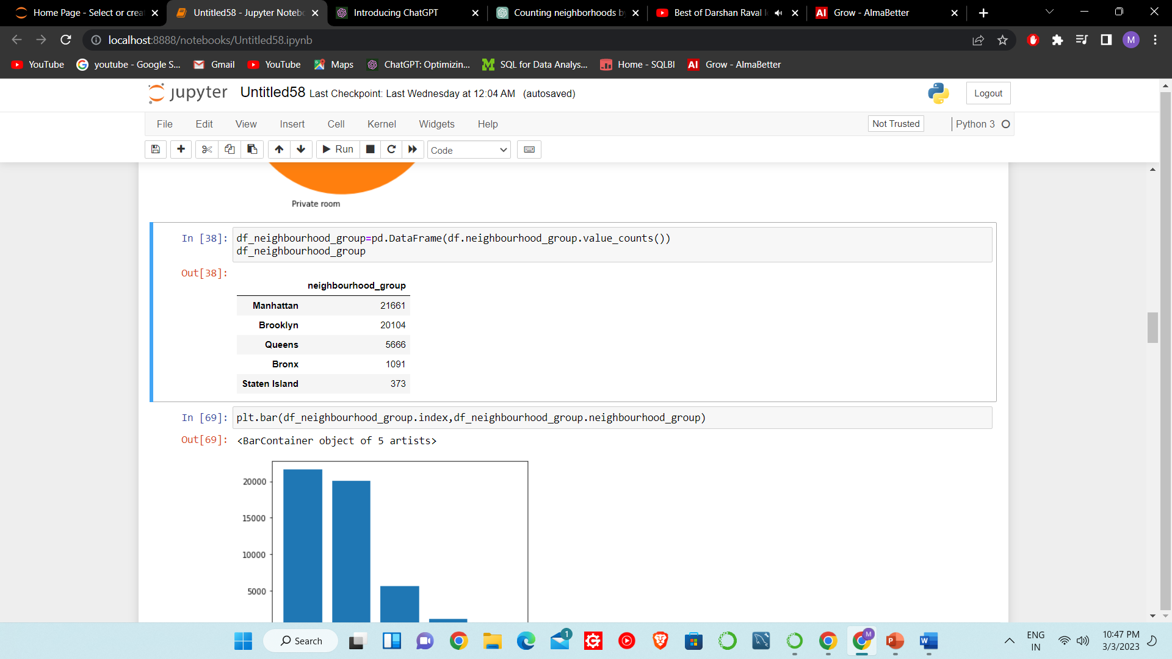
Most of the people use the AirBnb belongs to Manhattan Neighbourhood_group. i.e. 21661

Slide 6
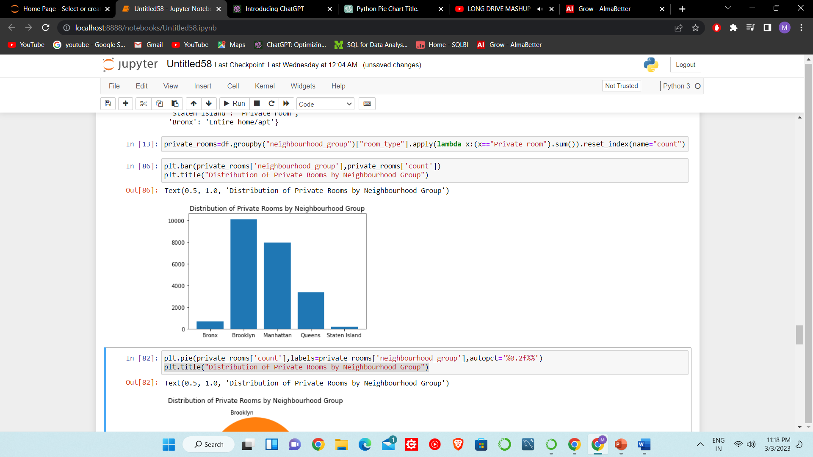
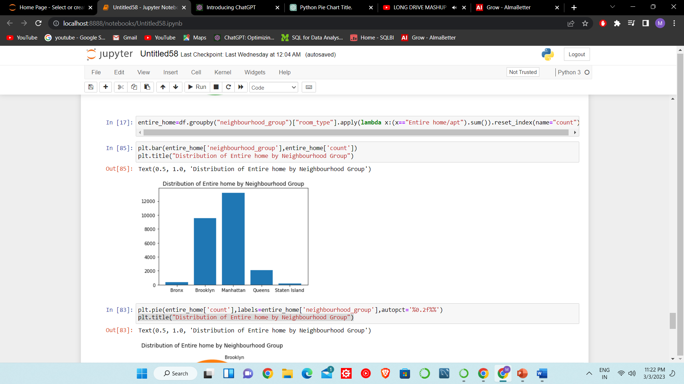
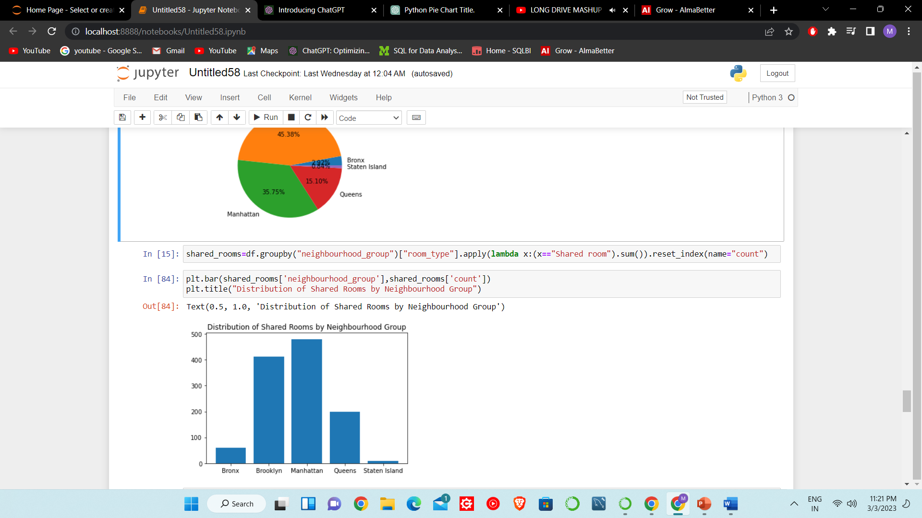
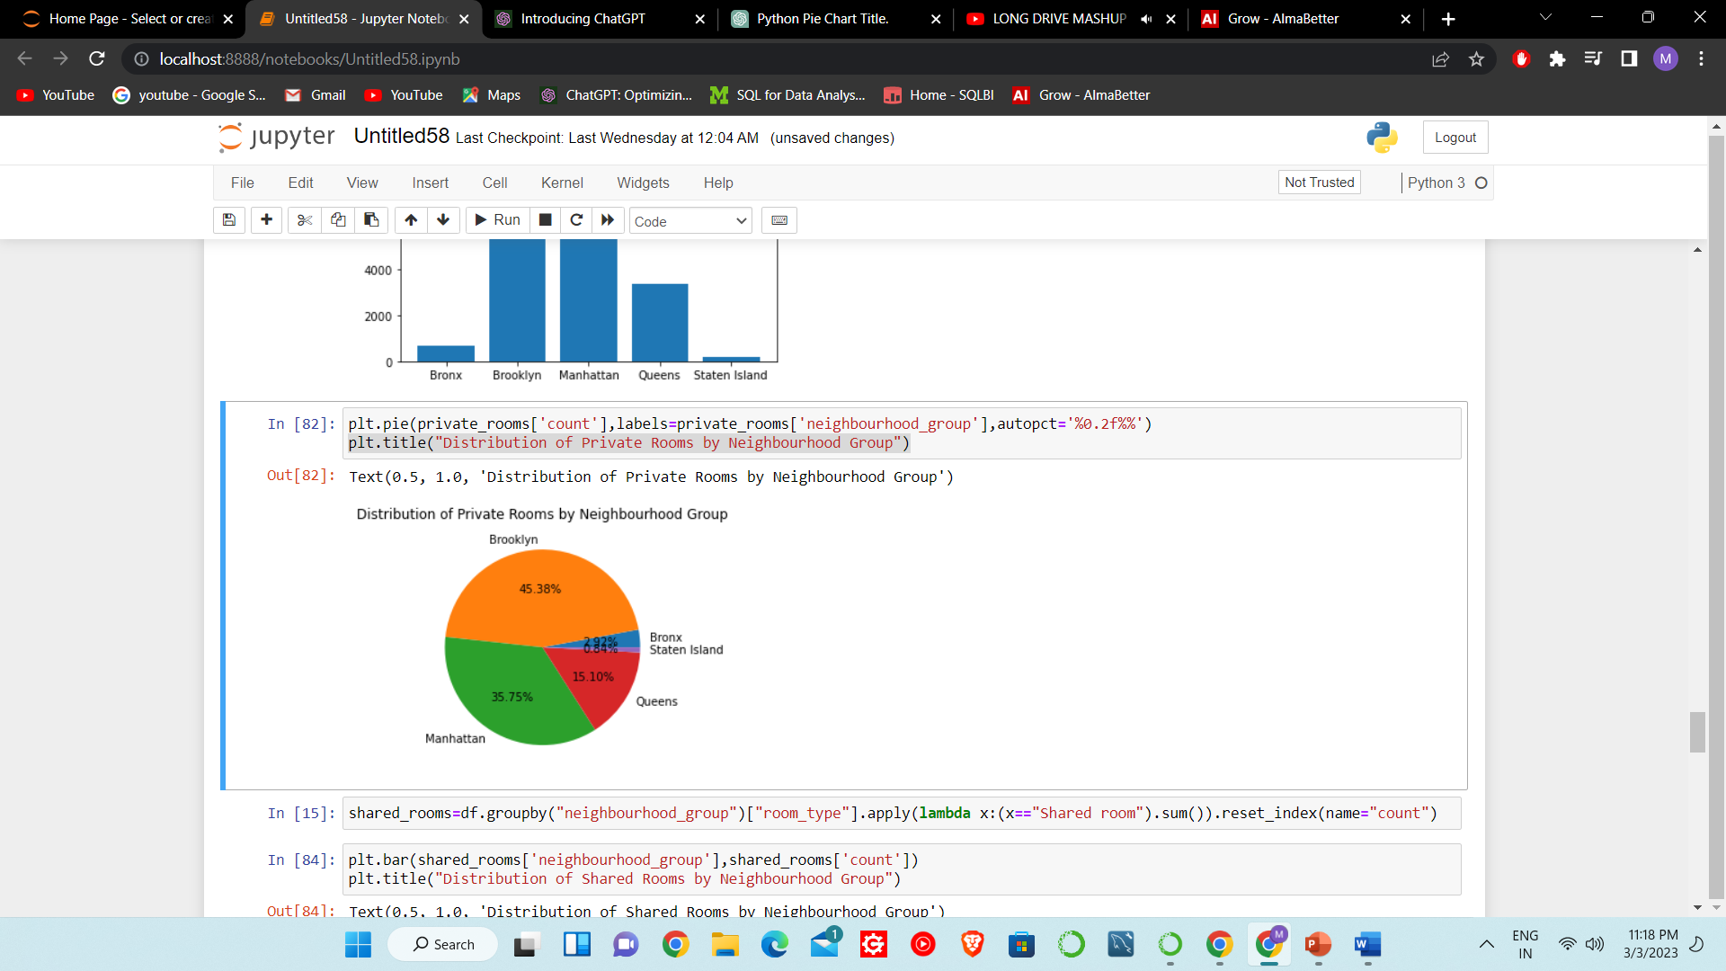
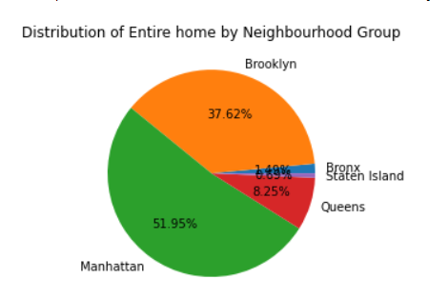
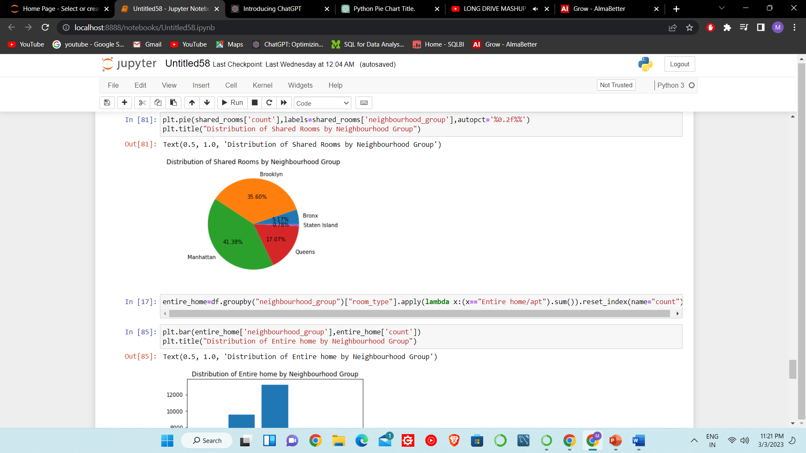
Private room
Entire home/apt
Shared Room

Slide 7
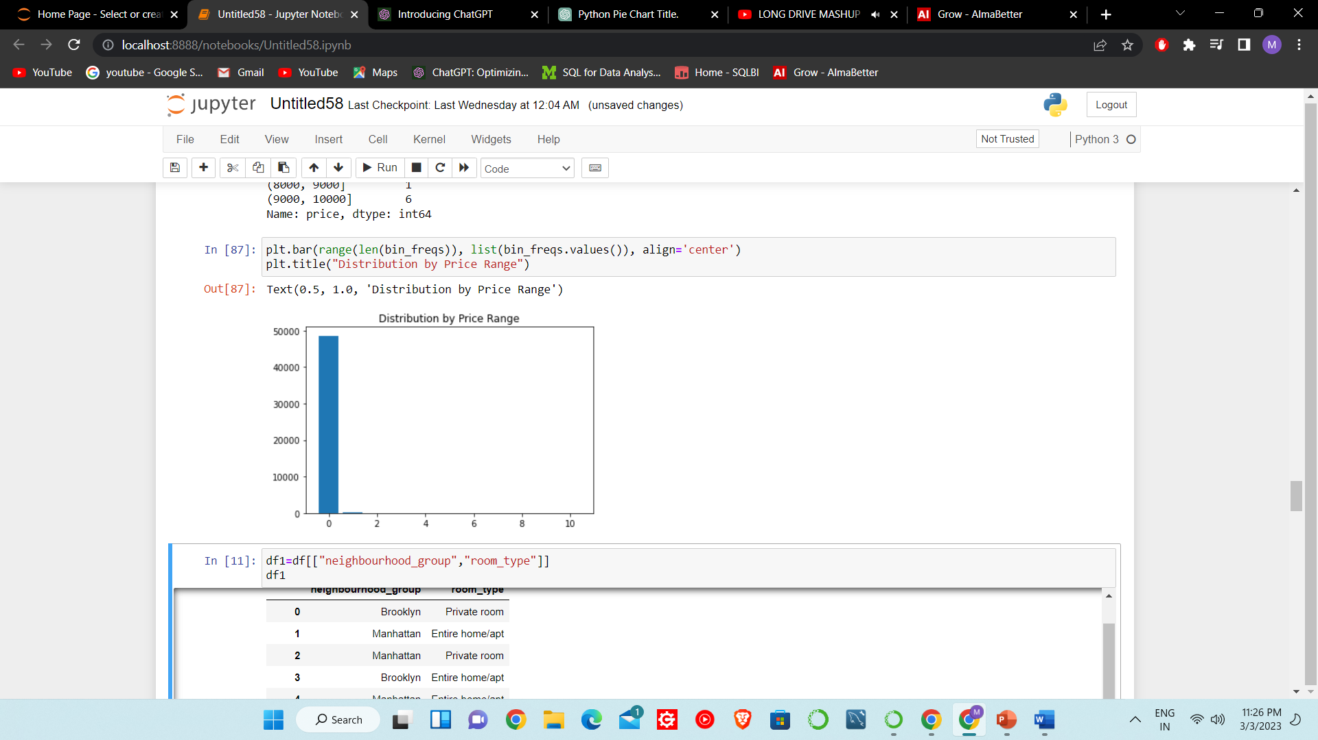
The rooms have price range from 0$ to 10000$. In this most of rooms booked in the range of 0$ to 1000$.
Some of them also have in the range of 1000$ to 2000$.

Slide 8
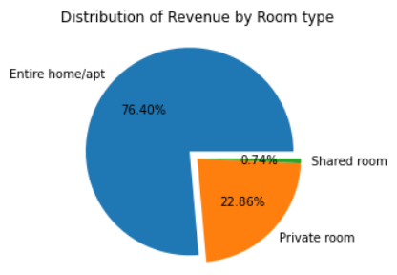
Total revenue generated = $62802340
Revenue Generated by Entire home/apt is 76.40% which highest among all 3 types of rooms
Shared rooms revenue is only 0.74%.

Slide 9
Conclusion:-
The most used rooms are Entire home/apt type.
Entire home/apt rooms Generated most of revenue.
People belongs to Manhattan Used AirBnb most.
Mostly Private rooms are used by Brooklyn Neighbourhood
Mostly Entire home rooms are used by Manhattan Neighbourhood
Mostly Shared rooms are used by Manhattan Neighbourhood

Slide 10
Thank You

