Slide 1


Analyse Promotions and Provide Tangible Insights to Sales Director

Slide 2
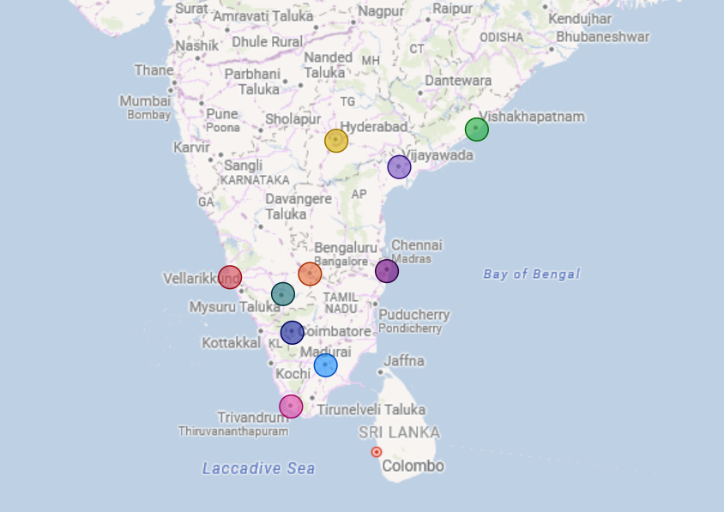
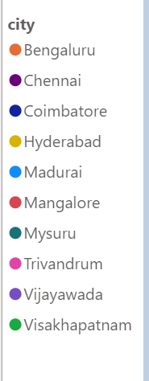
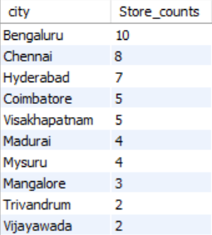
Atliq Stores
Atliq has 50 stores in the southern part of India. In which Bangaluru has the highest numbers of stores i.e. 10 and Vijayawada & Trivandrum has the lowest i.e. 2

Slide 3




Performance before Promotion Campaign:-
We can see the performance of the stores Before Promotion campaign is:
Revenue
+110.1%
Quantity Sold
+211.28%

Slide 4
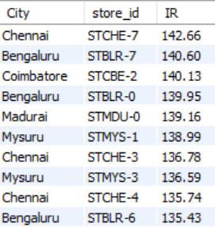
Store Performance by IR
Top stores by Increment Revenue%
Chennai's Store 7 boasts the highest overall incremental revenue, achieving a remarkable growth of 142.66%.
During the Sankranti Campaign, Madurai’s Store- 0 leads with the highest incremental revenue at 148.78%.
In the Diwali Campaign, Coimbatore's Store 2 showcases the highest incremental revenue, reaching 144.57%.

Slide 5
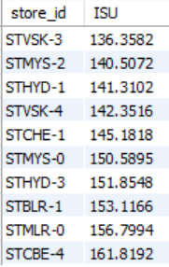
Store Performance by ISU
Bottom Store by ISU%
Vishakhapatanam’s Store-3 experiences the lowest increment in sold units, recording a modest 136.35% growth.
During the Diwali Campaign, Chennai's Store-1 shows the lowest increment in sold units, with a growth rate of 70.55%.
In the Sankranti Campaign, Vishakhapatanam’s Store-3 again records the lowest growth rate at 201.15%.

Slide 6
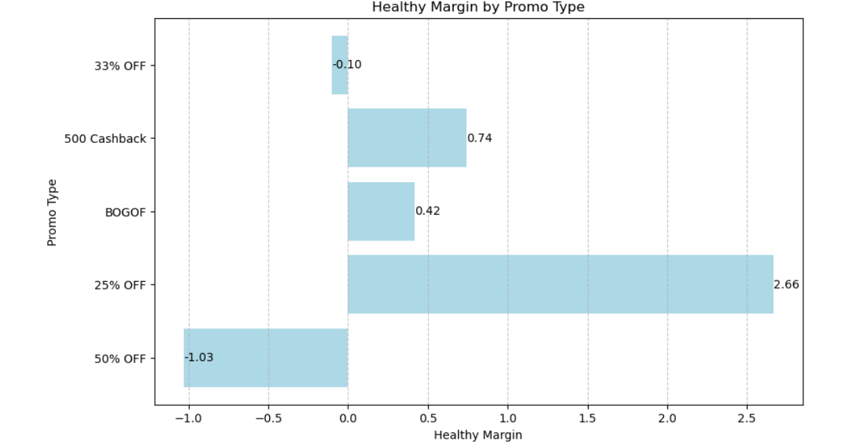

Healthy Margins
Incorporating weighted IR and ISU yields a more accurate measure of healthy margins.
"25% off" emerges as the promotional type with the best healthy margins.
"BOGOF" demonstrates the highest figures in both IR and ISU, indicating its effectiveness in driving revenue and sales.

Slide 7
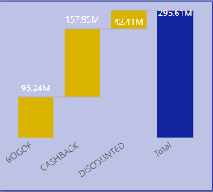
Performance of Discounted Based Promo vs BOGOF/Cashback
Cashback & BOGOF performs very well as compared to Discounted type in terms of Incremental Revenue.

Slide 8


Top 2 Products By IR% & Bottom 2 products by ISU%
Top 2 Products By IR%
Bottom 2 products by ISU%

Slide 9
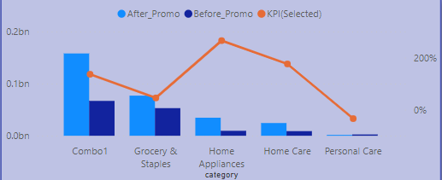
Product Category Performance by IR
Home Appliances has the highest increment in Revenue.
Personal Care category has the decline in Revenue.
Home Appliances increments the revenue by offering BOGOF.

Slide 10

Ad-hoc requested
Products with a base price greater than 500 & that are featured in Promo Type “BOGOF”
Despite an overall ROI of -27%, the "Atliq Waterproof Immersion Rod (P14)" product demonstrates the highest increment in revenue following promotional campaigns, indicating its significant sales potential. Despite the challenging ROI landscape, "Atliq Double Bedsheet Set (P08)" ranks third in revenue increase percentage, showcasing its effectiveness in generating sales growth and potentially mitigating the negative ROI impact.

Slide 11
Store Counts By City (Descending Orders)
Bengaluru, Chennai, and Hyderabad have the highest number of stores, indicating significant retail activity.
Trivandrum and Vijayawada have the lowest number of stores among the cities listed, indicating potentially smaller retail markets or less commercial activity.
Among the cities with the highest number of stores, such as Chennai, Bengaluru, and Coimbatore, revenue increment is notably high

Slide 12

Financial Impacts of Campaigns
In the Sankranti Campaign, the revenue after the promotion surged to 124.16 million, marking an impressive increase of 113.58% from the revenue before the promotion.
During the Diwali Campaign, the revenue post-promotion reached 171.45 million, representing a substantial growth of approximately 107% from the pre-promotion revenue.

Slide 13
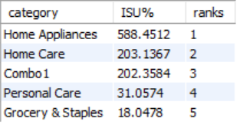
Impact of campaigns on Category by ISU%
The most significant increase in units sold is observed in the Home Appliances category, with a remarkable surge of 588.45%.
Grocery and Staples secure the 5th position with a growth of 18% in units sold.

Slide 14
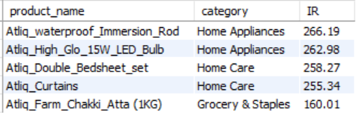
Products By IR
Atliq Waterproof Immersion Rod and Atliq High Glow 15W Bulb are the products with the highest incremental revenue, exhibiting an impressive growth of 266.19%.
Atliq Farm Chakki Atta secures the 5th position with an incremental revenue of 160.01%.

Slide 15
THANK YOU

