Slide 1
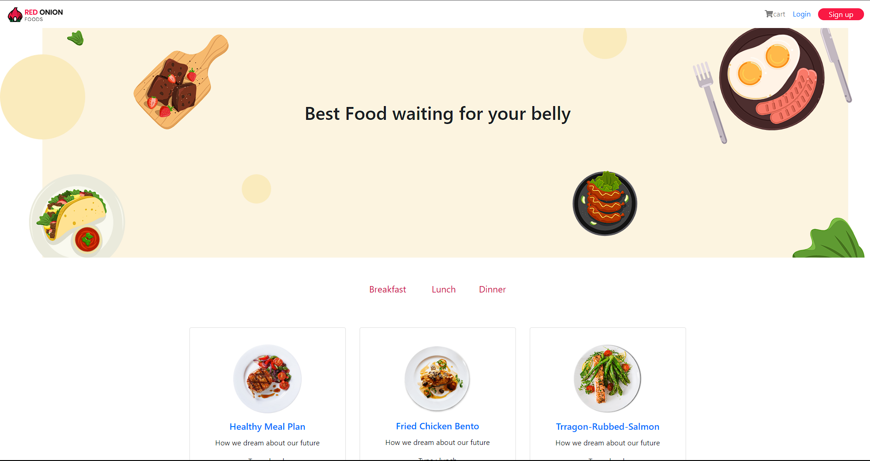

Ecommerce Website Design:
Red Onion Restaurant
Name Mohit
2110992071 G19

Slide 2

Introduction: Order Food with Speed
Discover how Red Onion is Taking your order as your belly is waiting for it., Eat Breakfast, lunch and Dinner.

Slide 3
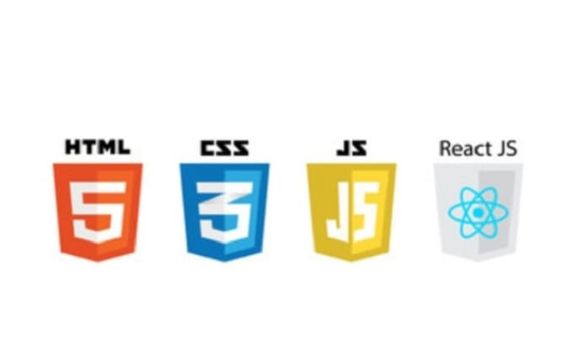
Technology Used: Innovation at its Core
1
HTML
2
CSS
3
JavaScript
4
React

Slide 4
Key Components: Powering Your Success
User-Friendly Interface
Flexible Inventory Management
Personalized Recommendations
Seamless Checkout Process
Navigate through the website effortlessly with an intuitive user interface.
Efficiently manage your inventory with real-time tracking and inventory optimization tools.
Boost sales with personalized product recommendations based on user behavior and preferences.
Streamline the buying process with a one-click checkout and secure payment options.

Slide 5

Showcasing Red Onion
Get a glimpse of Red Onion beautiful and intuitive interface, seamless navigation, and impactful product display.

Slide 6
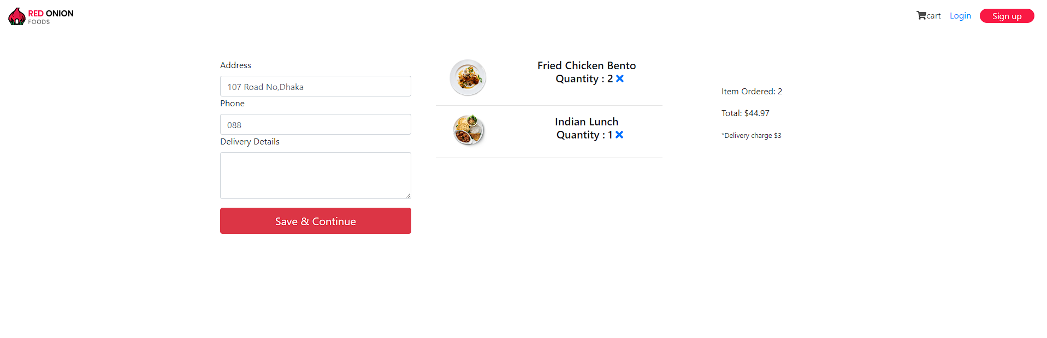
Easy And Simple Cart Option help you to check if everything is there that you want to order Or Not.

Slide 7
Conclusion
Red Onion is dedicated to providing a user-friendly and seamless Food ordering experience. With advanced features like personalized recommendations and a seamless checkout process, customers can easily navigate the website and make secure purchases. Explore our demo to see Red Onion stunning interface and impressive product display for yourself.

