Slide 1
PORTFOLIO OPTIMIZATION USING
CREDIT RISK ANALYSIS
Under the Guidance of Dr. Arun Kumar

Slide 2
TABLE OF CONTENTS
01
02
03
Objectives
Recap
DL Models
04
05
06
Stock Analysis
Portfolio Optimization
Results and Conclusions
Problem definition and our objectives and goals
A brief summary of key points covered during mid sem
Techniques leveraging deep learning algorithms to analyze data and make predictions.
Statistical analysis of stocks price movements
Optimizing weights
Discussion about the outcomes derived from analysis

Slide 3
Objectives
To find a key feature which can predict credit risk most accurately.
To find best machine learning or deep learning model to apply on the best feature for credit risk prediction.
Optimize portfolio based on statistics, returns, correlation, views, market situations and credit risk.

Slide 4
Recap
Feature Selection: Applied Linear Regression on many combinations of features of data and found MScore predicts credit risk most accurately among all of them.
Machine Learning models: Used many ML models such as Logistic Regression, Decision Tree, Random Forest and Support Vector Machine. Support Vector Machine performed superior to others with training and testing accuracy of 81.8% and 82.2% respectively.

Slide 5
Deep Learning Models

Slide 6
Convolution Neural Network
Convolutional Neural Network is specialized type of deep learning algorithm which is predominantly used to extract the feature from the grid-like matrix dataset.
It is made up of multiple layers, including convolutional layers, pooling layers, and fully connected layers.
The Convolutional layer applies filters to the input data to extract features, the Pooling layer downsamples the data to reduce computation, and the fully connected layer makes the final prediction.

Slide 7
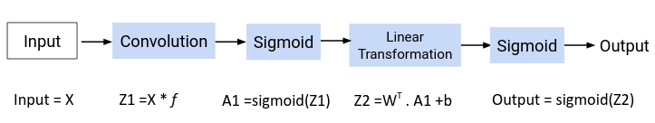
Convolution Neural Network
The CNN delivered impressive performance, achieving training and test accuracies of 83% and 84.1%, respectively.
The model has performed well with precision: 89%, recall: 76%, F1-score: 81%

Slide 8
Long Short Term Memory
Long Short-Term Memory Networks is a deep learning sequential neural network model that allows information to persist.
It is a special type of Recurrent Neural Network(RNN) that is capable of handling the vanishing gradient problem faced by RNN.
LSTMs address this problem by introducing a memory cell, which is a container that can hold information for an extended period.
Source

Slide 9
Long Short Term Memory
The LSTM stood out with impressive training and test accuracies of 83.6% and 84.6%, respectively.
LSTM model demonstrated a strong overall performance with precision: 90%, recall: 76%, F1-score: 82%.

Slide 10
Stocks Analysis

Slide 11
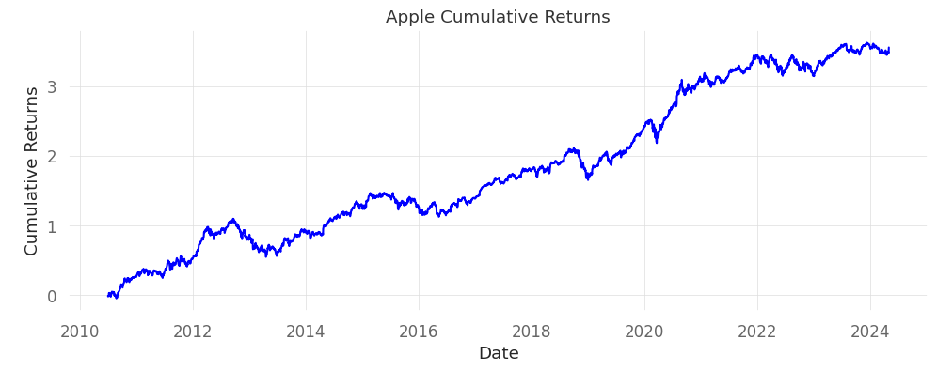
Returns
Daily Returns: Daily returns are relevant for investors because they provide a quick way to check the performance of a stock over a short period.
Cumulative Returns: Cumulative returns are calculated by taking the difference between the Stock's final price and Initial Price for a specified period, adding any dividends or other income received, and dividing the result by the initial price.

Slide 12
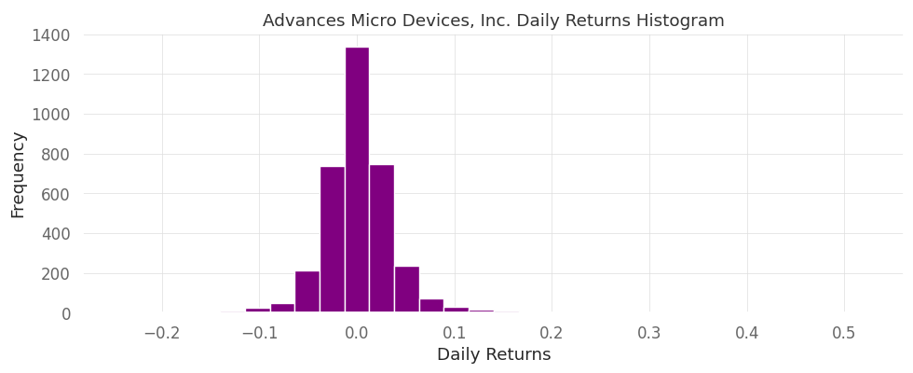
Returns
Histogram: Histograms are a graphical representation of the distribution of values, displaying how frequent they are in a dataset.
It helps us to identify patterns, such as the range of daily returns of an asset over a certain period, indicating its level of stability and volatility.

Slide 13
Statistics
Kurtosis: A high kurtosis value for daily returns may indicate frequent fluctuations in price that deviate significantly from the average returns of that investment, which can lead to increased volatility and risk associated with the stock.
Apple | 5.34
Tesla | 0.491
Google | 8.592
Meta | 21.1
AMD | 16.587

Slide 14
Statistics
Skewness: Skewness is a metric that quantifies the asymmetry of returns. It reflects the shape of the distribution and determines if it is symmetrical, skewed to the left, or skewed to the right.
Apple | -0.05
Tesla | 0.33
Google | 0.44
Meta | 0.412
AMD | 1.003

Slide 15
Statistics
Standard Deviation: A stock exhibiting high daily return volatility, characterized by a high standard deviation, is considered riskier when compared to one with low daily return volatility, represented by a low standard deviation.
Apple | 0.018
Tesla | 0.036
Google | 0.017
Meta | 0.025
AMD | 0.036

Slide 16
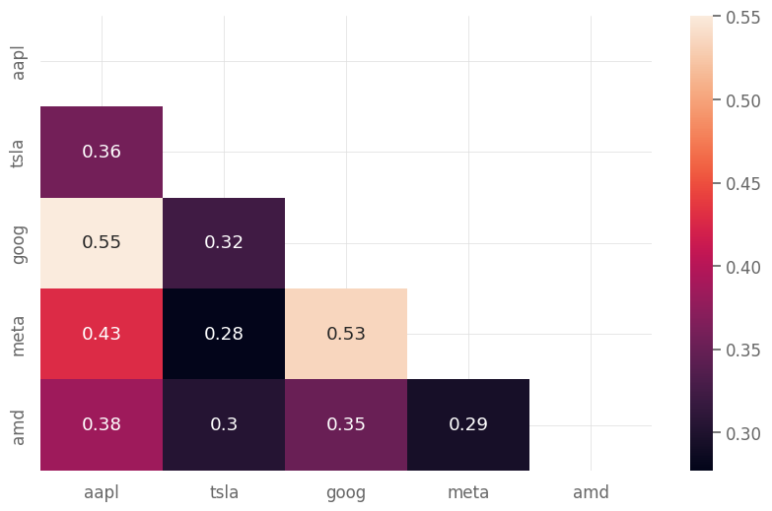
Statistics
Correlation Matrix: We utilize a correlation matrix to analyze relationships between different companies' stock prices, providing insights into how these stocks move in relation to each other. This analysis aids in constructing diversified investment portfolios, reducing overall portfolio risk by spreading investments across assets with low correlation.

Slide 17
Statistics
Sharpe Ratio: It is a measure of the risk-adjusted return of an investment. It is calculated by dividing the average excess return of the investment over the standard deviation of the returns.
Apple | 0.92
Tesla | 0.89
Google | 0.86
Meta | 0.71
AMD | 0.67

Slide 18
Portfolio Optimization

Slide 19
Portfolio
A portfolio in financial markets is a collection of financial assets. The weights in a portfolio refer to the percentage of the total value allocated to each individual asset. Allocating weights is a critical aspect of portfolio building because it determines the level of risk and return characteristics of the portfolio.
Portfolio optimization is the process of selecting the optimal combination of assets and weights to maximize returns and minimize risk by taking into account the historical performance of the assets, their correlations with each other, and other relevant factors such as market conditions and economic outlook.

Slide 20
Markowitz Mean Variance Optimization Model
It is a widely-used framework for constructing portfolios with the best risk-return relationship. It is based on the idea that investors should maximize the expected return of a portfolio while minimizing its risk.
There are two key requirements for mean-variance optimization:
We need to have expected returns for each of the assets in the portfolio. We calculated the expected returns for the assets by computing the arithmetic mean of their daily percentage changes.
We need to choose a risk model that quantifies the level of risk in each asset. The most commonly used risk model is the covariance matrix, which describes the volatilities of assets and the degree to which they are codependent.

Slide 21
Markowitz Mean Variance Optimization Model
We take the covariance matrix, expected returns and statistics as inputs. The weights variable stores the optimized weights for each asset.
- | Apple | Tesla | Google | Meta | AMD
Apple | 0.078242 | 0.056900 | 0.042235 | 0.048849 | 0.060719
Tesla | 0.056900 | 0.323816 | 0.050379 | 0.063244 | 0.097666
Google | 0.042235 | 0.050379 | 0.075212 | 0.058964 | 0.054299
Meta | 0.048849 | 0.063244 | 0.058964 | 0.163034 | 0.069253
AMD | 0.060719 | 0.097666 | 0.054299 | 0.068253 | 0.317881

Slide 22
Markowitz Mean Variance Optimization Model
Based on mean historical return and covariance matrix, the optimized portfolio appears to have performed better than the original portfolio in which the weights were equal.
Apple | 0.52349
Tesla | 0.18953
Google | 0.27286
Meta | 0.01412
AMD | 0.0

Slide 23
Black Litterman Allocation Model
It takes a Bayesian approach to asset allocation and combines a prior estimate of returns with the investor's particular views on the expected returns to generate an optimal allocation.
The Black-Litterman formula calculates a weighted average between the prior estimate of returns and the views, with the weighting determined by the level of confidence for each view.
Apple | 0.07798
Tesla | 0.0
Google | 0.45696
Meta | 0.38499
AMD | 0.08007
By considering the calculated credit level of the company we took the values of views and the level of confidence and got the following results.

Slide 24
WEBSITE

Slide 25
Results

Slide 26
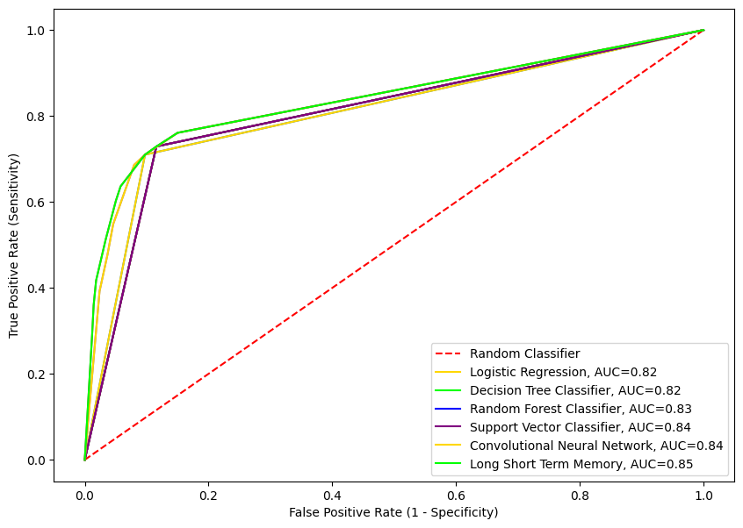
Results
Our analysis revealed that out of all the the features of data, MScore emerged as the most influential feature in credit risk assessment. All MScores of previous years predict credit risk with the most accuracy.
Long Short-Term Memory demonstrated superior performance among all the learning models evaluated. Support Vector Machine performed best in
the machine learning models

Slide 27
Results
Portfolio optimization using Markowitz mean-variance optimization and the Black Litterman allocation model yielded promising results, enabling effective allocation of assets as compared to equally weighted portfolios.
Markowitz's mean-variance optimization model uses stats like historical data and covariance matrix to determine the optimized weights of the stocks, whereas the Black Litterman Allocation Model is more dependent on individual views, current market situations, and the level of confidence.

Slide 28
References
Academic Papers:
Isaac, P. (2022). Prediction of Credit Risk using Machine Learning Models. Uppsala University.
Shi, S., Tse, R., Luo, W. et al. Machine learning-driven credit risk: a systematic review. Neural Comput \& Applic 34, 14327–14339 (2022).
Bessler, W., Opfer, H., & Wolff, D. (2017). Multi-asset portfolio optimization and out-of-sample performance: an evaluation of Black–Litterman, mean-variance, and naïve diversification approaches. The European Journal of Finance, 23(1).
Online Articles:
"Credit Risk Analysis with Machine Learning" (n.d.). Towards Data Science. Retrieved from Toward Data Science.
Journal Article:
Jorion, P. (1992). Portfolio Optimization in Practice. Financial Analysts Journal, 48(1), 68–74.

Slide 29
Guide: Dr. Arun Kumar
TEAM
Ankit
Mohit Kumar
Samual
2020mcb1227
2020mcb1242
2020mcb1249

Slide 30
THANKS

