Slide 1


Amazon Sales Analysis

Slide 2
Introduction
Objective:
Introduction
ETL Process Overview
Month-wise Sales Trend
Year-wise Sales Trend
Yearly-Month-wise Sales Trend
Regional Sales and Profit Analysis
Key Metrics and Insights

Slide 3
Dataset Description
Key Attributes of the Dataset:
Order Date
Order ID
Customer ID
Item Type
Sales Channel
Data Collection Methods and Preprocessing Steps:
Data extraction from Amazon sales records
Data cleaning and handling missing values
Conversion of date fields to datetime format
Aggregation and grouping for analysis
Computation of key metrics
Region
Total Revenue
Total Profit
Unit Price
Quantity Ordered

Slide 4
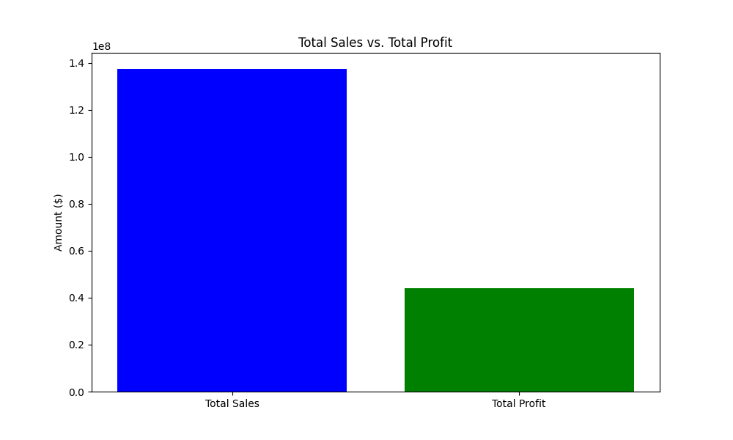
Total Sales and Profit

Slide 5
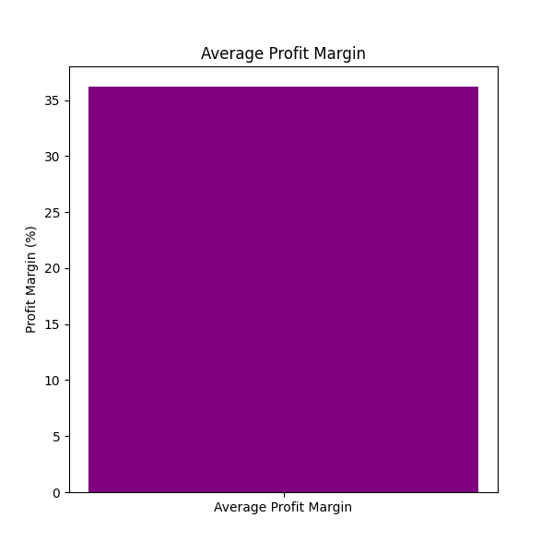
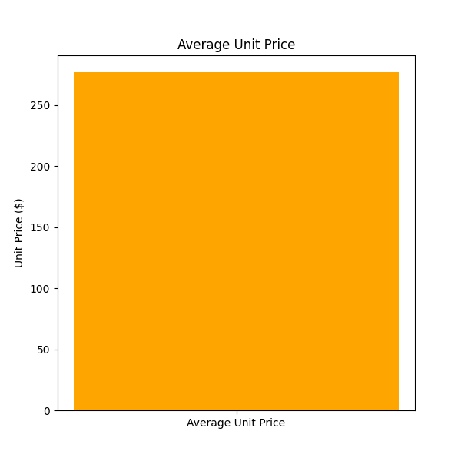
Average Profit Margin and Unit Price

Slide 6
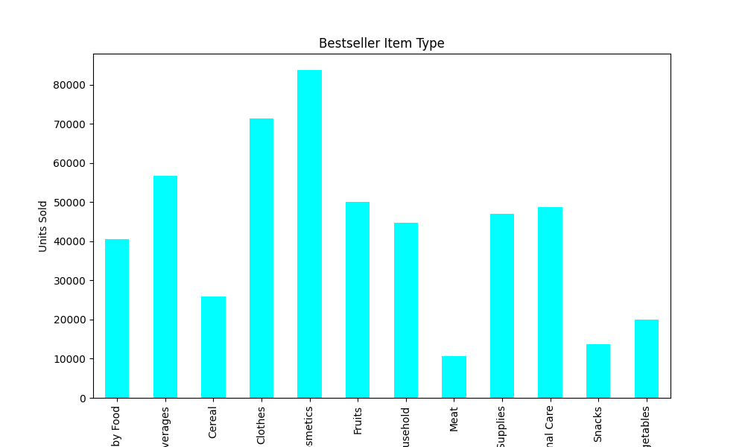
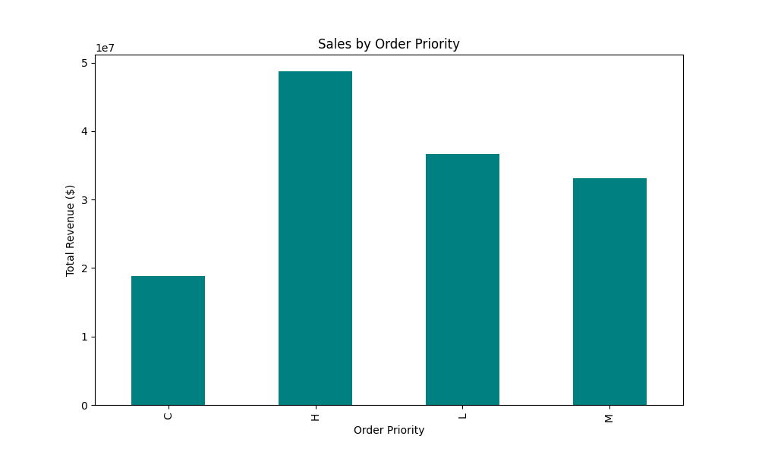
Order Priority and Bestseller Item Type

Slide 7
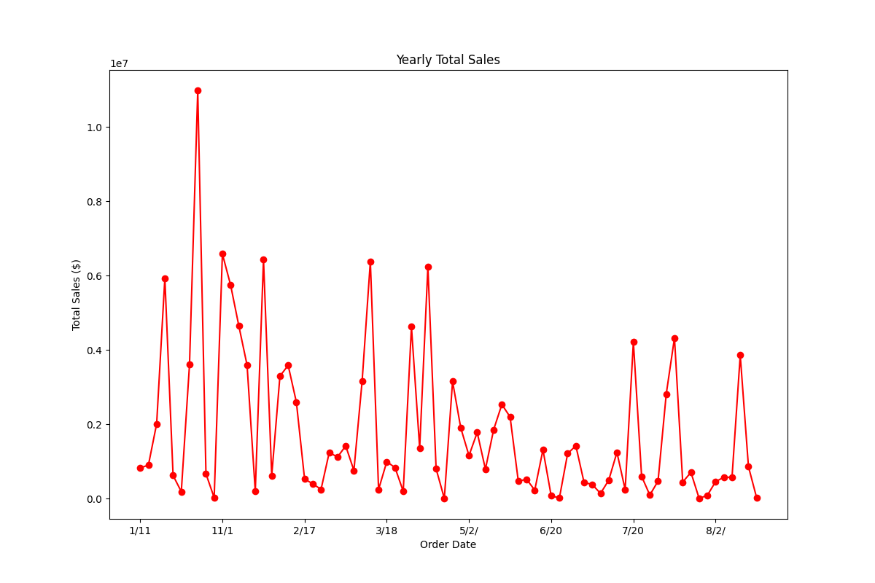
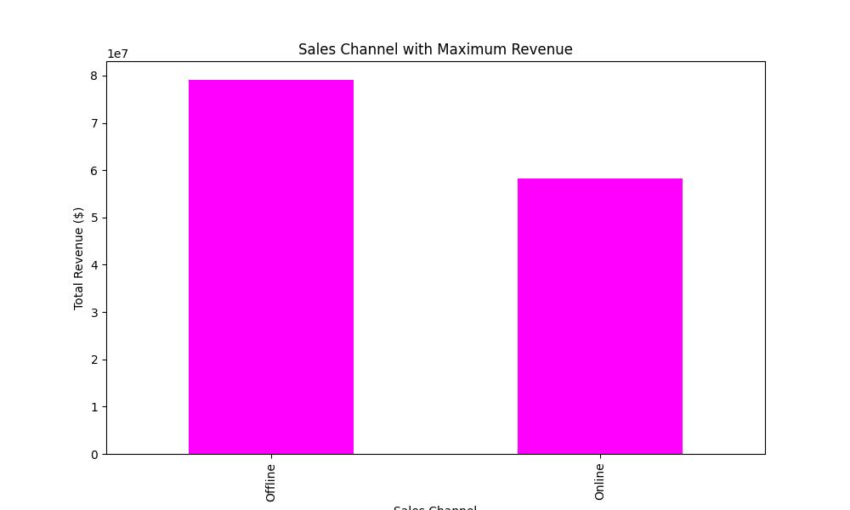
Channel and Yearly Sales

Slide 8
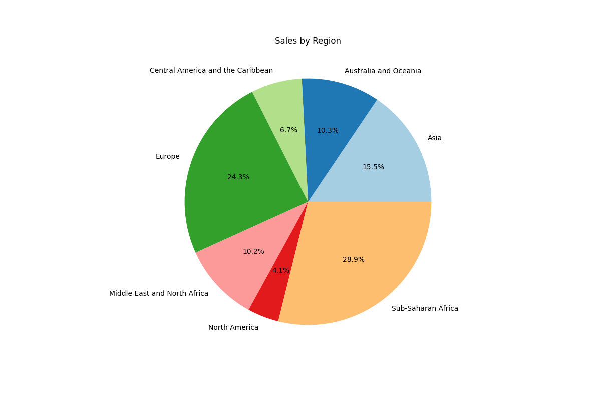
Total Sales by Region

Slide 9
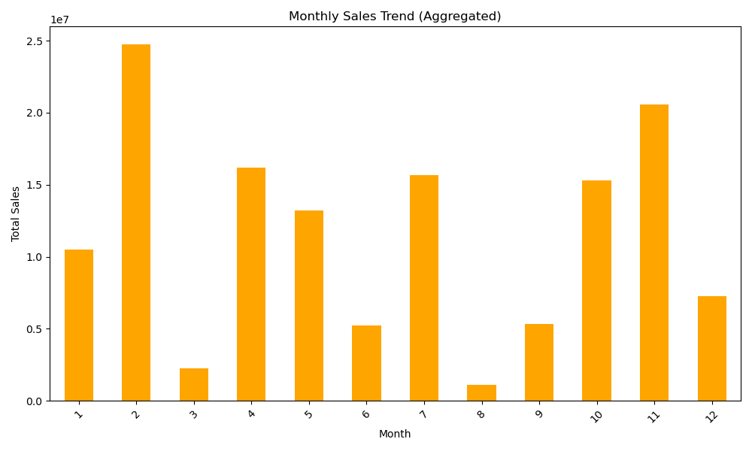
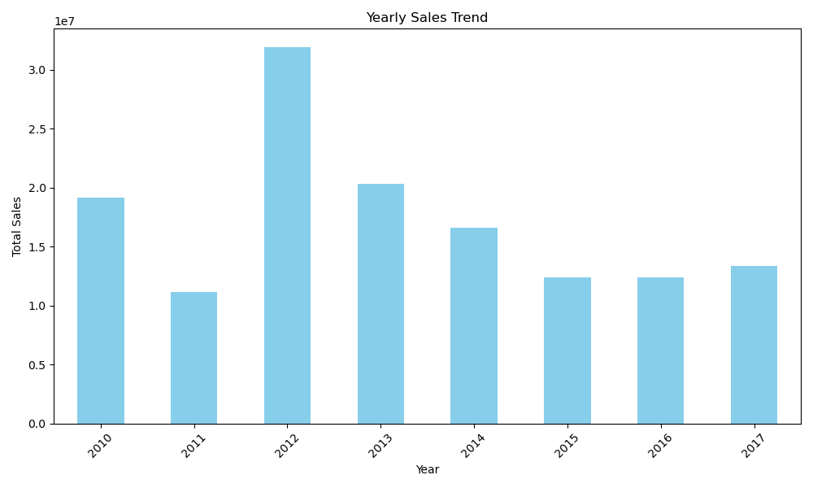
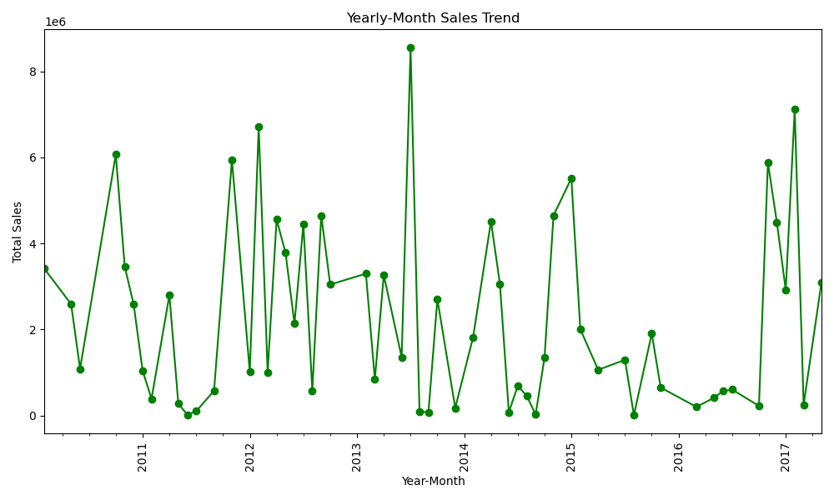

Slide 10
Thank you
A Comprehensive Analysis of Amazon Sales Data
Mohit Kansal
14-Sep-2024

