Slide 1
Dcube Analytics Case Study
CREATED BY
MOHIT KEDIA

Slide 2





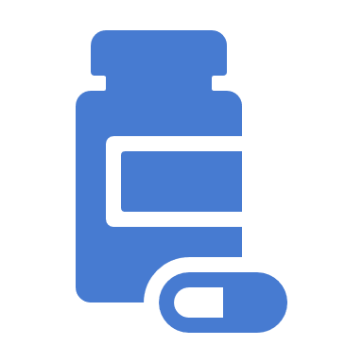
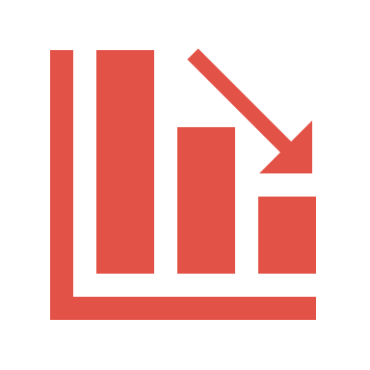
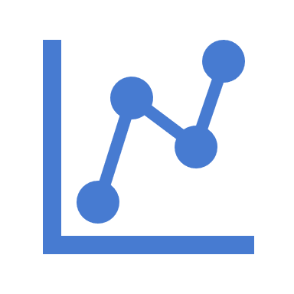
BASED ON
TRx COUNT
(TOTAL PRESCRIPTIONS SOLD)
Branded drugs sale was 35.87% of the total drugs sale during Quarter 1 of 2015
After Quarter 1 of 2015, Sale of Branded drugs have shown an increasing trend till Q4 of 2015.
Similar trend is observed in the year 2016 from Q1 to Q4 in the sale of Branded drugs.
Generic drugs sale was 64.13% of the total drugs sale during Q1 of 2015.
Sale of Generic drugs has shown a decreasing trend from Q1 to Q4 of 2015.
Similar trend is observed in the year 2016 in the sale of Generic drugs.

Slide 3

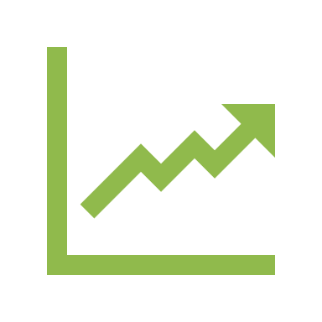
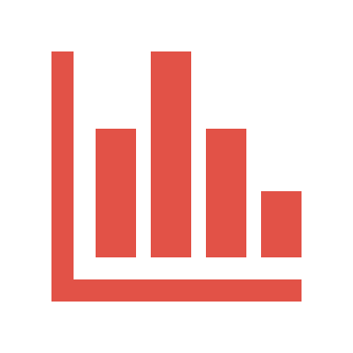

BASED ON
NRx COUNT
(NEW PRESCRIPTIONS SOLD)
Branded drugs sale was 36.21% of the total drugs sale during Quarter 1 of 2015
There is no clear trend observed in the sale of Branded drugs from Q1 to Q4 in both the years.
Highest percentage sales of Branded drugs was recorded during Q4 of 2015
Generic drugs sale was 63.79% of the total drugs sale during Q1 of 2015.
There is no clear trend observed in the sale of Generic drugs from Q1 to Q4 in both the years.
Highest percentage sales of Generic drugs was recorded during Q2 of 2016

Slide 4

BASED ON
TRx MBS $
Market Share of GLP1,Metformin/SU and SGLT have increased from 2015 to 2016
Only GLP1 and SGLT have shown a continuous increasing trend in market share from Q1 of 2015 – Q4 of 2016
Glitazone,Insulin Long Acting and Others have shown a continuous decreasing trend in market share from Q1 of 2015 – Q4 of 2016
Market Share of DPP4,Glitazone,Insulin (Fast,Intermediate,Long Acting) have decreased from 2015 to 2016
Insulin Long Acting had the highest decrease of 3.43% in market share from 2015 to 2016.
Most Preferred Product classes are Insulin Long Acting, Insulin Fast Acting and DPP4 in both the years in terms of market share.
Insulin Long Acting has the highest market share in both the years.
GLP1 had the highest increase of 2.38% in market share from 2015 to 2016.
Least Preferred Product classes are Glitazone, Others and Insulin Intermediate Acting.

Slide 5





BASED ON
TRx MBS $
Market Share of 12 Product Families have remained 0 in both the years.
Product Family 31 has the highest market share in both the years.
Product Family 44 had the highest increase in market share from 2015 to 2016..
Product Family 31 had the highest decrease in market share from 2015 to 2016.
Most Preferred Product Families are 1,25 and 31 in both the years in terms of market share.

Slide 6
BASED ON
TRx COUNT
Market Share of GLP1 and SGLT have increased from 2015 to 2016
Only GLP1 and SGLT have shown a continuous increasing trend in market share from Q1 of 2015 – Q4 of 2016
Insulin Intermediate Acting and Others have shown a continuous decreasing trend in market share from Q1 of 2015 – Q4 of 2016
Market Share of DPP4,Glitazone,Insulin (Fast,Intermediate,Long Acting) and Metformin have decreased from 2015 to 2016
Metformin/SU had the highest decrease of 0.76% in market share from 2015 to 2016.
Most Preferred Product class is Metformin/SU in both the years in terms of market share.
Metformin/SU has the highest market share in both the years.
SGLT had the highest increase of 0.83% in market share from 2015 to 2016.
Least Preferred Product classes are Glitazone, Others and Insulin Intermediate Acting.

Slide 7
BASED ON
TRx COUNT
Market Share of 12 Product Families have remained 0 in both the years.
Product Family 44 has the highest market share in both the years.
Product Family 20 had the highest increase in market share from 2015 to 2016..
Product Family 34 had the highest decrease in market share from 2015 to 2016.
Most Preferred Product Families are 44,34 and 31 in both the years in terms of market share.

Slide 8



BASED ON TRx MBS $
Product 49 has the highest sale among all Products in both the years.
Products
2,3,11,23,26,27,31,34,35,49,101,105 and 106 have shown growth with respect to sales from 2015 to 2016.
Products
9,19,22,48,50,63 have shown decline with respect to sales from 2015 to 2016.
Products
1,7,10,20,21,29,30,32,40,45,64,71,98 were stable with respect to sales from 2015 to 2016.

Slide 9

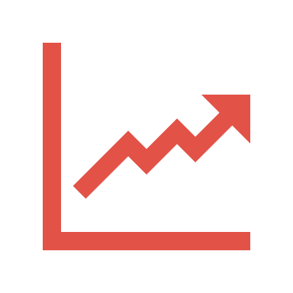



BASED ON TRx COUNT
Sale of GLP1 class products was 2.8% of the total sale of all the product classes in 2015
In the year 2016, GLP1 sale has increased to 3.51% of the total sale of all the products.
GLP1 class have shown a continuous increasing trend in total prescriptions sold from Q1 of 2015 – Q4 of 2016
Product 27 has witnessed the highest sale of 59.6% in 2015 to 51.57% in 2016 among all the products in GLP1 class.
Product 26 has shown tremendous growth in sale from 6.58% in 2015 to 20.49% in 2016.
Product 22 has performed the worst as its sale has declined from 8.95% in 2015 to 3.8% in 2016

Slide 10
BASED ON TRx COUNT
Sale of SGLT class products was 3.62% of the total sale of all the product classes in 2015
In the year 2016, SGLT sale has increased to 4.45% of the total sale of all the products.
SGLT class have shown a continuous increasing trend in total prescriptions sold from Q1 of 2015 – Q4 of 2016
Product 104 has witnessed the highest sale of 59.13% in 2015 to 49.16% in 2016 among all the products in SGLT class.
Product 105 has shown highest growth in sale from 8.17% in 2015 to 13.96% in 2016.
Product 102 has witnessed the lowest sale of 1.97% in 2015 and 4.16% in 2016

