Slide 1
JSP (Java Server Pages)

Slide 2
Outline
Introduction to JSP
Advantages over Servlet
JSP Architecture
JSP Scripting Elements
Implicit Objects
Directives
Action tags
Life Cycle of JSP Page
MVC in JSP
Working with Databases

Slide 3
What is JSP?
JavaServer Pages (JSP) is a server-side programming technology that enables the creation of dynamic, platform-independent method for building Web-based applications.
JSP have access to the entire family of Java APIs, including the JDBC API to access enterprise databases.
Web developers write JSPs as text files that combine HTML or XHTML code, XML elements, and embedded JSP actions and commands.

Slide 4
A web application consists of both presentation and business logic.
Presentation represents the elements used to design the structure of a web page in terms of page layout, color and text.
Business logic involves application of financial and business calculations.
JSP technology separates presentation from the business logic.
Therefore, both web designers and web developers can simultaneously work in their area of specialization, leading to better quality and productivity.

Slide 5
JSP development
The process of developing a JSP page that can respond to client requests involves three main steps:
Creation: The developer creates a JSP source file that contains HTML and embedded
Java code.
Deployment: The JSP is installed into a server. This can be a full Java EE server or a stand-alone JSP server.
Translation and compilation: The JSP container translates the HTML and Java code into a Java code source file. This file is then compiled into a Java class that is executed by the server. The class file created from the JSP is known as the JSP page implementation class.

Slide 6
Advantages over Servlet
Extension to Servlet Technology
All features of Servlet
+
implicit objects, predefined tags, expression language, Custom tags
Easily Managed
Separates business logic with presentation logic
Easily deployed
If JSP page is modified, no need to redeploy but if changes are required in servlet , the entire code needs to be updated and recompile

Slide 7
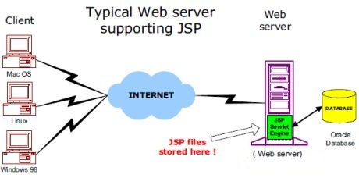
JSP Architecture
JSP Servlet Engine

Slide 8
JSP Architecture
JSP Processing:
Browser sends an HTTP request to the web server.
The web server recognizes that the HTTP request is for a JSP page (.jsp page) and forwards it to a JSP engine.
The JSP engine loads the JSP page from disk and converts it into a servlet content. All template text is converted to println( ) statements and all JSP elements are converted to Java code that implements the corresponding dynamic behavior of the page.
The JSP engine compiles the servlet into an executable class and forwards the original request to a servlet engine.
Servlet engine loads the Servlet class and executes it. & produces an output in HTML format, which the servlet engine passes to the web server inside an HTTP response.
The web server forwards the HTTP response to your browser in terms of static HTML content.

Slide 9
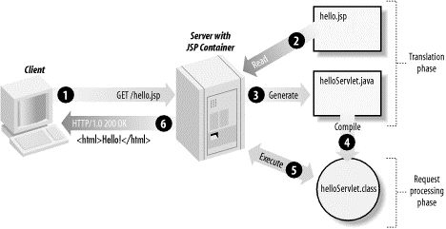
JSP Architecture
JSP Processing:

Slide 10
JSP Scripting Elements
Three types of scripting elements:
Scriplet tag
Expression tag
Declaration tag

Slide 11
Scriplet tag
In JSP JAVA code can be written inside the JSP page using Scriplet tag
Syntax:
<% java source code %>
Example:
<html>
<body>
<% out.print(“Hello world…”);%>
</body>
</html>

Slide 12
Expression tag
Code placed within expression tag is written to the output stream of the response. So, no need to write out.print() to write data. It is mainly used to print values of variable or method
Syntax:
<%= Statement %>
Example:
<html>
<body>
<%= “Hello world…” %>
</body>
</html>
Note: Do not end statement with semicolon (;)

Slide 13
Declaration tag
Used to declare fields and methods. The code written inside this tag is placed outside the service() method of auto generated servlet .So it doesn’t get memory at each request
Syntax:
<%! Statement %>
Example:
<html>
<body>
<%! int data=60;%>
<%= “Value is: “ + data %>
</body>
</html>

Slide 14
JSP Implicit Objects
Object | Type
Out | JspWriter
Request | HttpServletRequest
Response | HttpServletResponse
Config | ServletConfig
Application | ServletContext
Session | HttpSession
pageContext | PageContext
Page | Object
Exception | Throwable

Slide 15
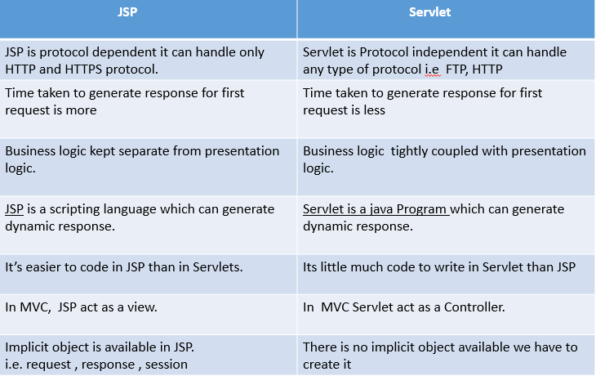

Slide 16
JSP Scope
The availability of a JSP object for use from a particular place of the application is defined as the scope of that JSP object. Every object created in a JSP page will have a scope. Object scope in JSP is segregated into four parts and they are page, request, session and application.
page ‘page’ scope means, the JSP object can be accessed only from within the same page where it was created. The default scope for JSP objects created using <jsp:useBean> tag is page. JSP implicit objects out, exception, response, pageContext, config and page have ‘page’ scope.
request A JSP object created using the ‘request’ scope can be accessed from any pages that serves that request. More than one page can serve a single request. The JSP object will be bound to the request object. Implicit object request has the ‘request’ scope.
session ‘session’ scope means, the JSP object is accessible from pages that belong to the same session from where it was created. The JSP object that is created using the session scope is bound to the session object. Implicit object session has the ‘session’ scope.
application A JSP object created using the ‘application’ scope can be accessed from any pages across the application. The JSP object is bound to the application object. Implicit object application has the ‘application’ scope.

Slide 17
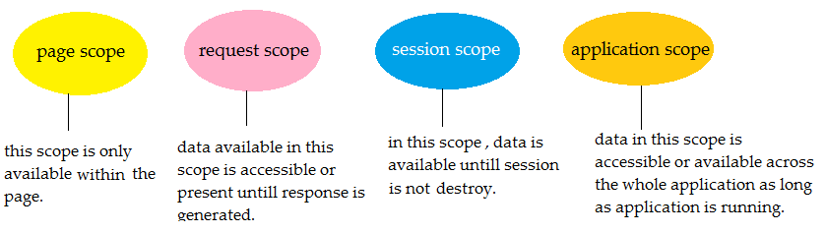

Slide 18
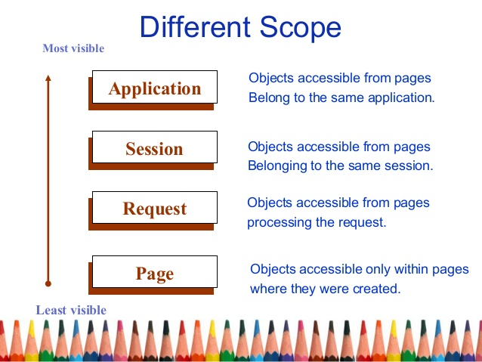

Slide 19
Assignment
Describe all the implicit objects with suitable Example.
What is jsp?
Advantages & disadvantages of JSP.

Slide 20
JSP Directives
Directives are messages that tells the web container how to translate a JSP page into corresponding servlet.
Three types:
page directive
include directive
taglib directive
Syntax of JSP directives
<%@ directive attribute=“value” %>

Slide 21
page directive
Defines attributes that apply to an entire JSP page
Syntax:
<%@ page attribute=“value” %>
Attributes :
import ,contentType, extends, info, buffer, language,autoFlush,
session, pageEncoding, errorPage, isErrorPage

Slide 22
Include directive
Includes the contents of any resource(may be jsp file, html file or text file
It includes the original content of the included resources at page translation time
Reusability is the advantage
Syntax:
<%@include file=“resourcename” %>
Note : this tag includes the original content, so the actual page size grows at run time

Slide 23
taglib directive
Used to define a tag library that defines many tags
We use the TLD (Tag Library Descriptor) file to define the tags
Syntax:
<%@ taglib uri=“uriofthetaglibrary” prefix=“prefixoftaglibrary”%>

Slide 24
JSP Action tags
Used to control the flow between pages and to use java beans
Following are JSP Action tags:
jsp:forward
jsp:include
jsp:param
jsp:useBean
jsp:setProperty
jsp:getProperty
Uses Bean Class

Slide 25
jsp:forward
Forwards the request to another resource, it may be jsp, html or another resource
Syntax:
<jsp:forward page=“relativeURL |<%=expression%>” />
With parameter:
<jsp:forward page=“relativeURL |<%=expression%>” />
<jsp:param name=“parametername” value=“parametervalue|<%=expression%> “/>
</jsp:forward>

Slide 26
JSP include directive | JSP include action
includes resource at translation time. | includes resource at request time.
better for static pages. | better for dynamic pages.
includes the original content in the generated servlet. | calls the include method.

Slide 27
jsp:include
Includes the resources at request time. Here file is being included during request processing phase
Syntax:
<jsp:include page=“relativeURL |<%=expression%>” />
With parameter:
<jsp:include page=“relativeURL |<%=expression%>” />
<jsp:param name=“parametername” value=“parametervalue|<%=expression%> “/>
</jsp:include>

Slide 28
Cookie
In JSP cookie are the object of the class javax.servlet.http.Cookie.
This class is used to creates a cookie, a small amount of information sent by a servlet to a Web browser, saved by the browser, and later sent back to the server.
A cookie's value can uniquely identify a client, so cookies are commonly used for session management.
A cookie has a name, a single value, and optional attributes such as a comment, path and domain qualifiers, a maximum age, and a version number.
The getCookies() method of the request object returns an array of Cookie objects. Cookies can be constructed using the following code:
Cookie(java.lang.String name, java.lang.String value)

Slide 29
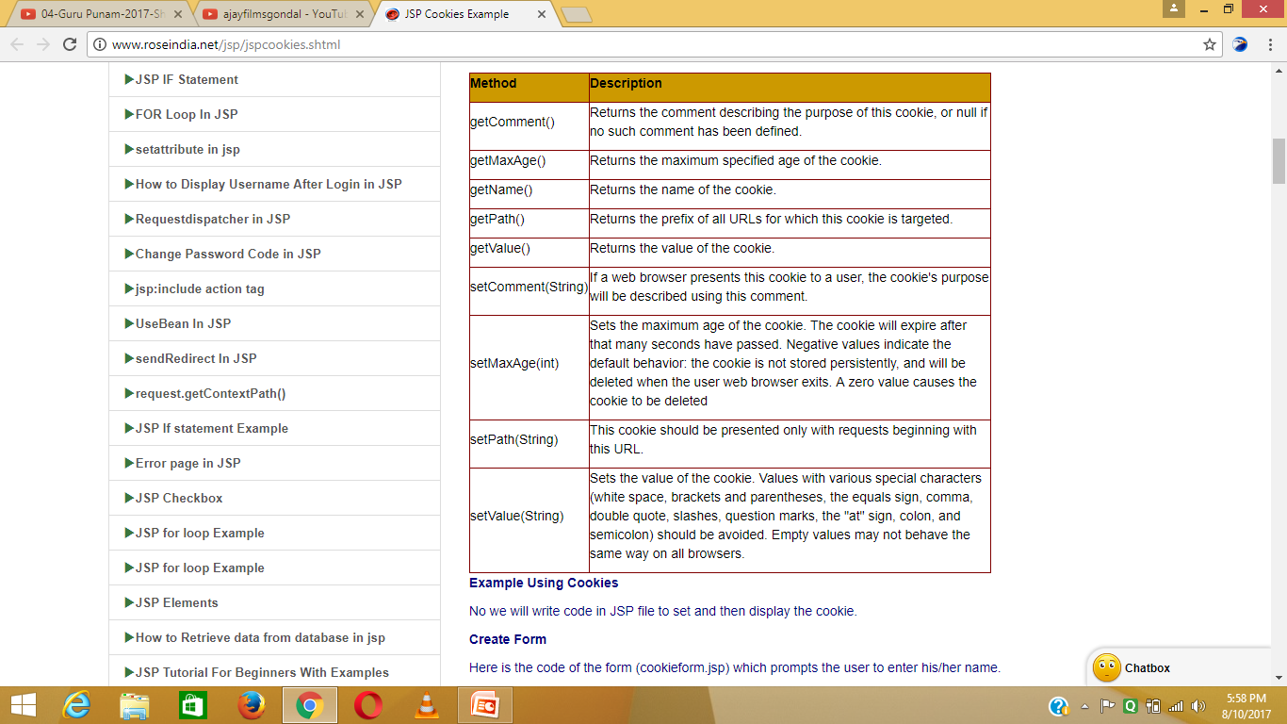

Slide 30
Exception Handling
Checked exceptions
A checked exception is an exception that is typically a user error or a problem that cannot be foreseen by the programmer.
For example, if a file is to be opened, but the file cannot be found, an exception occurs. These exceptions cannot simply be ignored at the time of compilation.
Runtime exceptions
A runtime exception is an exception that probably could have been avoided by the programmer.
As opposed to the checked exceptions, runtime exceptions are ignored at the time of compilation.
Errors
These are not exceptions at all, but problems that arise beyond the control of the user or the programmer.
Errors are typically ignored in your code because you can rarely do anything about an error.
For example, if a stack overflow occurs, an error will arise. They are also ignored at the time of compilation.
We will further discuss ways to handle run time exception/error occuring in your JSP code.

Slide 31
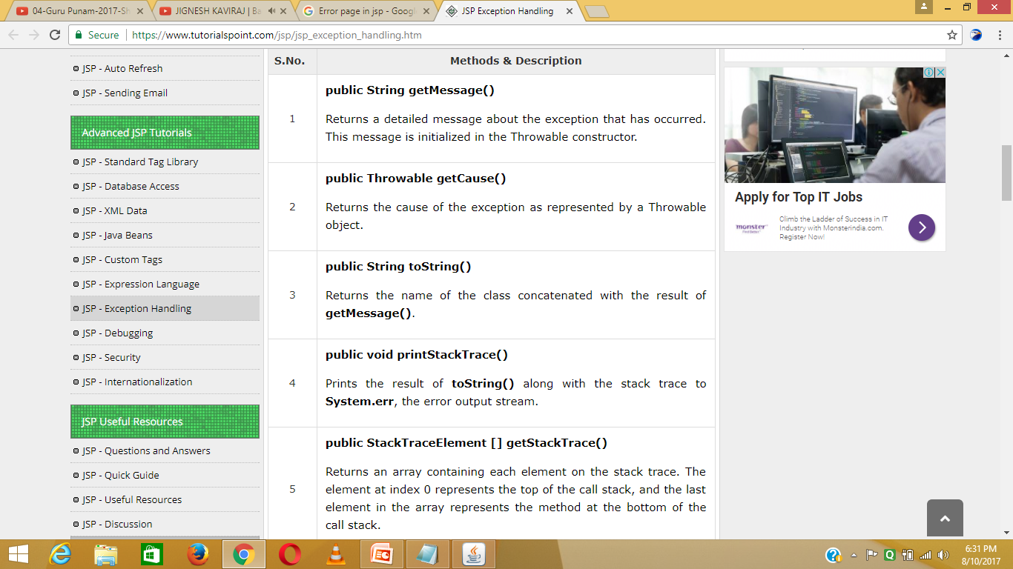

Slide 32
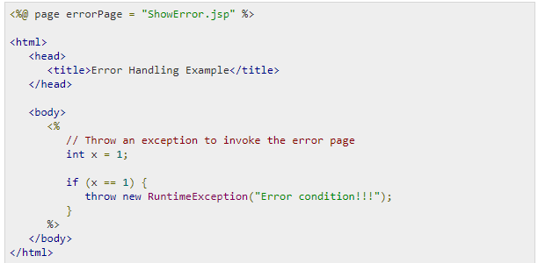
JSP gives you an option to specify Error Page for each JSP.
Whenever the page throws an exception, the JSP container automatically invokes the error page.
Following is an example to specifiy an error page for a main.jsp. To set up an error page, use the <%@ page errorPage = "xxx" %> directive.>

Slide 33
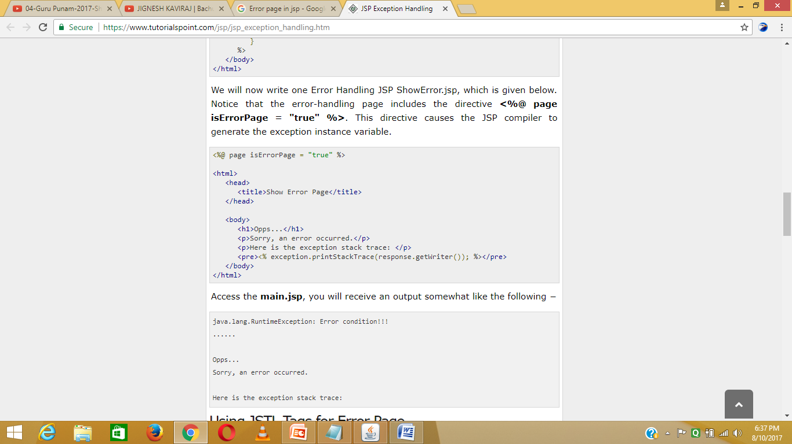

Slide 34
Java Beans
is a Java class
It should not have argument/parameterized constructor
It should be serializable (Serialization in java is a mechanism of writing the state of an object into a byte stream. It is mainly used in Hibernate, RMI, JPA, EJB and JMS technologies. The reverse operation of serialization is called deserialization.)
It should provide methods to set and get the values of the properties (getters/setters)
It is a reusable software components

Slide 35
Why Java Beans
They are used to encapsulate many objects into a single object (the bean), so that they can be passed around as a single bean object instead of as multiple individual objects.

Slide 36
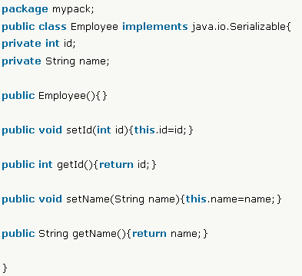
Example of java Bean Class
Employee .java

Slide 37
jsp:useBean
To instantiate a Bean Class
If bean object of Bean class is already created , it does not create the bean
If object of Bean is not created ,it instantiates the Bean
Syntax:
<jsp:useBean id=“instancename”
scope=“page | request | session |application” class=“packagename.classname” type=“packagename.classname” beanName=“packagename.classname | <%=expression %>” />

Slide 38
Attributes of jsp:useBean
Attributes | Description
Id | To identify the Bean in specified scope
scope | Default scope is page page- specifies bean can be used within JSP page request – specifies bean can be used from any JSP page that processes the same request. Wider scope than Page session - specifies bean can be used from any JSP page in the same session whether processes the same request or not. Wider scope than request application - specifies bean can be used from any JSP page in the same application. Wider scope than session
class | Instantiates the specified bean class (i.e. creates an object of the bean class)
type | Provides the bean data type if the bean already exists in the scope.Mainly used with class or beanName attribute other wise no bean is instantiated
beanName | Instantiates the bean using the java.beans.Beans.instantiate() method

Slide 39
jsp:setProperty
Sets a property value or values in a bean using the setter method
Syntaxes:
1) Setting all values of incoming request in the bean
<jsp:setProperty name=“instanceofBean” property=“*” />
2) Setting value of incoming specific property
<jsp:setProperty name=“instanceofBean” property=“propertyName” param=“parameterName” />
3) For setting specific value in the property
<jsp:setProperty name=“instanceofBean” property=“propertyName” value=“string | <%=expression%>” />

Slide 40
jsp:getProperty
Returns the value of the property
Syntax:
<jsp:getProperty name=“instanceofBean” property=“propertyName” />

Slide 42
Assignment
Create an index.jsp page for getting the values from the user.(username,password and email )
Create a bean class User that have 3 properties username,password and email with its getter and setter methods
Display all the information in display.jsp page

Slide 43
Life cycle of JSP page
A JSP life cycle can be defined as the entire process from its creation till the destruction similar to a servlet life cycle with an additional step of compiling a JSP into servlet.
The following are the paths followed by a JSP
Compilation – 3 steps
Parsing jsp
Turning the JSP into a servlet
Compiling the servlet
Initialization
Execution
destroy

Slide 44
Life cycle of JSP page
[Intialization]
[Execution ]
[destroy]
jspInit()
_jspService()
jspDestroy()
Request
Response

Slide 45
Life cycle of JSP page
JSP Initialization:
- When a container loads a JSP it invokes the jspInit() method before servicing any requests.
- If you need to perform JSP-specific initialization, override the jspInit() method:
public void jspInit()
{
// Initialization code...
}
- initialization is performed only once
- generally initialize database connections, open files, and create lookup tables in this method.

Slide 46
Life cycle of JSP page
JSP Execution:
- Whenever a browser requests a JSP and the page has been loaded and initialized, the JSP engine invokes the _jspService() method in the JSP.
void _jspService(HttpServletRequest request, HttpServletResponse response)
{
// Service handling code...
}
- This method is invoked once per request and is responsible for generating the response for that request

Slide 47
Life cycle of JSP page
JSP Cleanup:
- The destruction phase when a JSP is being removed from use by a container.
- The jspDestroy() method is the JSP equivalent of the destroy method for servlets.
- Override jspDestroy when you need to perform any cleanup, such as releasing database connections or closing open files.
public void jspDestroy()
{
// Your cleanup code (Destroy Method )
}

Slide 48
MVC in JSP
MVC – Model View Controller
It is a design pattern that separates the business logic ,presentation logic and data
Model – represents the state(data) and business logic of the application (Eg. Java Beans)
View – responsible for display data or presentation ( Eg.JSP/HTML pages)
Controller –
Acts as interface between view and model
Receives input and commands to Model/View to change accordingly
(Eg . Servlet page)

Slide 50
MVC Architecture
(Controller)
Servlet
1
(Client)
Browser
Request
Enterprise Servers/
Data
sources
2
instantiate
3
5
(View)
JSP
(Model)
Java Beans
Response
4
Application server

Slide 51
JDBC With JSP

