Slide 1
RMI
Remote Method Invocation

Slide 2
Distributed Application
If any application performs these tasks, it can be distributed application.
The application need to locate the remote method
It need to provide the communication with the remote objects, and
The application need to load the class definitions for the objects.
The RMI application have all these features, so it is called the distributed application.
Ex: COM
DCOM (Microsoft)
CORBA (OMG)

Slide 3
RMI
The RMI (Remote Method Invocation) is an API that provides a mechanism to create distributed application in java.
The RMI allows an object to invoke methods on an object running in another JVM.
The RMI provides remote communication between the applications using two objects stub and skeleton.
RMI uses stub and skeleton object for communication with the remote object.
A remote object is an object whose method can be invoked from another JVM. Let's understand the stub and skeleton objects:

Slide 4
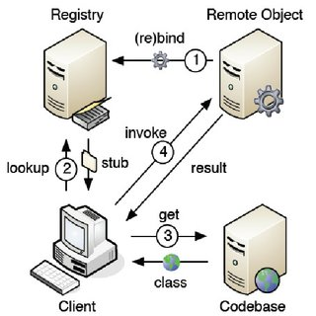
stub
The stub is an object, acts as a gateway for the client side. All the outgoing requests are routed through it.
It resides at the client side and represents the remote object. When the caller invokes method on the stub object, it does the following tasks:
It initiates a connection with remote Virtual Machine (JVM),
It writes and transmits (marshals) the parameters to the remote Virtual Machine (JVM),
It waits for the result
It reads (unmarshals) the return value or exception, and
It finally, returns the value to the caller.

Slide 5
skeleton
The skeleton is an object, acts as a gateway for the server side object. All the incoming requests are routed through it.
When the skeleton receives the incoming request, it does the following tasks:
It reads the parameter for the remote method
It invokes the method on the actual remote object, and
It writes and transmits (marshals) the result to the caller.

Slide 6
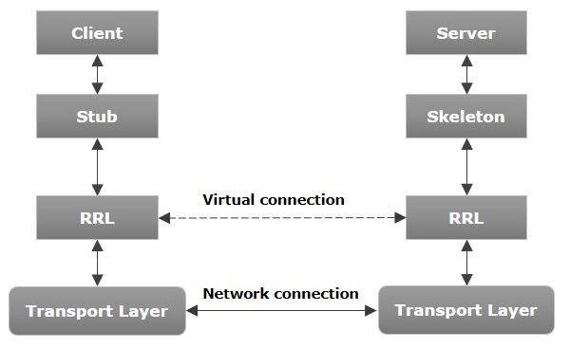
Architecture of RMI

Slide 7
Transport Layer − This layer connects the client and the server. It manages the existing connection and also sets up new connections.
Stub − A stub is a representation (proxy) of the remote object at client. It resides in the client system; it acts as a gateway for the client program.
Skeleton − This is the object which resides on the server side. stub communicates with this skeleton to pass request to the remote object.
RRL(Remote Reference Layer) − It is the layer which manages the references made by the client to the remote object.

Slide 8
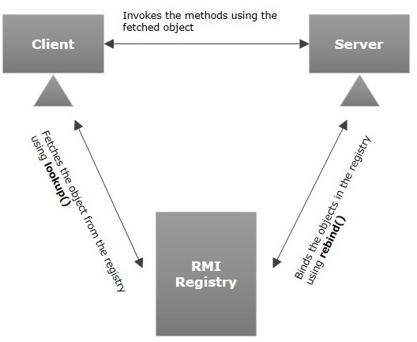
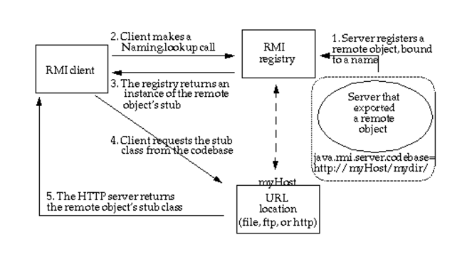

Slide 9
Working of an RMI Application
The following points summarize how an RMI application works −
When the client makes a call to the remote object, it is received by the stub which eventually passes this request to the RRL.
When the client-side RRL receives the request, it invokes a method called invoke() of the object remoteRef. It passes the request to the RRL on the server side.
The RRL on the server side passes the request to the Skeleton (proxy on the server) which finally invokes the required object on the server.
The result is passed all the way back to the client.
Marshalling and Unmarshalling
Whenever a client invokes a method that accepts parameters on a remote object, the parameters are bundled into a message before being sent over the network. These parameters may be of primitive type or objects. In case of primitive type, the parameters are put together and a header is attached to it. In case the parameters are objects, then they are serialized. This process is known as marshalling.
At the server side, the packed parameters are unbundled and then the required method is invoked. This process is known as unmarshalling.
RMI Registry
RMI registry is a namespace on which all server objects are placed. Each time the server creates an object, it registers this object with the RMIregistry (using bind() or reBind() methods). These are registered using a unique name known as bind name.
To invoke a remote object, the client needs a reference of that object. At that time, the client fetches the object from the registry using its bind name (using lookup() method)

Slide 10
RMI Example
Create the remote interface
Provide the implementation of the remote interface
Compile the implementation class and create the stub and skeleton objects using the rmic tool
Start the registry service by rmiregistry tool
Create and start the remote application
Create and start the client application

Slide 11
