Slide 1
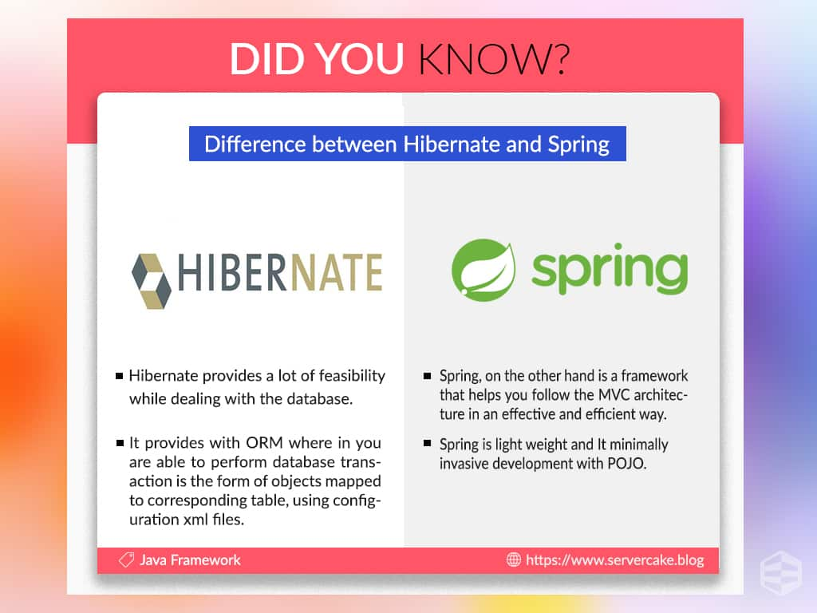



Slide 2


Overview
The spring framework is powerful java platform that provides inclusive infrastructure support for creating java apps. Also spring framework is an open source java platform.
Spring framework is first time introduce in June 2003.
It was developed by Rod Johnson in 2003.

Slide 3
Spring is a lightweight framework.
It can be thought of as a framework of frameworks because it provides support to various frameworks such as Struts, Hibernate, Tapestry, EJB, JSF etc.
The framework, in broader sense, can be defined as a structure where we find solution of the various technical problems.
The Spring framework comprises several modules such as IOC, AOP, DAO, Context, ORM, WEB MVC etc.
We will learn these modules in next page. Let's understand the IOC and Dependency Injection first.

Slide 4
Inversion Of Control (IOC) and Dependency Injection
These are the design patterns that are used to remove dependency from the programming code. They make the code easier to test and maintain. Let's understand this with the following code:
class Employee
{
Address address;
Employee()
{
address=new Address();
}
}
In such case, there is dependency between the Employee and Address (tight coupling). In the Inversion of Control scenario, we do this something like this:
class Employee{
Address address;
Employee(Address address)
{
this.address=address;
}
}

Slide 5
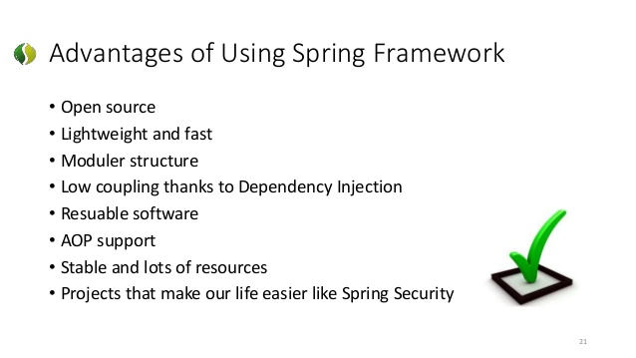
Advantages of Spring

Slide 6
Spring Framework Architecture
Data Access
Web
JDBC
ORM
Web Socket
Servlet
OXM
JMS
Web
Portal
Transactions
AOP
Aspects
Instrumentations
Messaging
Core Container
Beans
Core
Context
SpEL
Run & Test

Slide 7
The Core Container consists of the Core, Beans, Context, and Expression Language modules the details of which are as follows −
→. The Core module provides the fundamental parts of the framework, including the IoC and Dependency Injection features.
→The Bean module provides BeanFactory, which is a sophisticated implementation of the factory pattern.
→ The Context module builds on the solid base provided by the Core and Beans modules and it is a medium to access any objects defined and configured. The ApplicationContext interface is the focal point of the Context module.
→ The SpEL module provides a powerful expression language for querying and manipulating an object graph at runtime.

Slide 8
Data Access/Integration
The Data Access/Integration layer consists of the JDBC, ORM, OXM, JMS and Transaction modules whose detail is as follows −
→ The JDBC module provides a JDBC-abstraction layer that removes the need for tedious JDBC related coding.
→ The ORM module provides integration layers for popular object-relational mapping APIs, including JPA, JDO, Hibernate, and iBatis.
→ The OXM module provides an abstraction layer that supports Object/XML mapping implementations for JAXB, Castor, XMLBeans, JiBX and XStream.
→ The Java Messaging Service JMS module contains features for producing and consuming messages.
→ The Transaction module supports programmatic and declarative transaction management for classes that implement special interfaces and for all your POJOs.

Slide 9
Web
The Web layer consists of the Web, Web-MVC, Web-Socket, and Web-Portlet (Portlets are pluggable user interface software components) modules the details of which are as follows −
The Web module provides basic web-oriented integration features such as multipart file-upload functionality and the initialization of the IoC container using servlet listeners and a web-oriented application context.
The Web-MVC module contains Spring's Model-View-Controller (MVC) implementation for web applications.
The Web-Socket module provides support for WebSocket-based, two-way communication between the client and the server in web applications.
The Web-Portlet module provides the MVC implementation to be used in a portlet environment and mirrors the functionality of Web-Servlet module.

Slide 10
Miscellaneous
The AOP module provides an aspect-oriented programming implementation allowing you to define method-interceptors and pointcuts to cleanly decouple code that implements functionality that should be separated.
The Aspects module provides integration with AspectJ, which is again a powerful and mature AOP framework.
The Instrumentation module provides class instrumentation support and class loader implementations to be used in certain application servers.
The Messaging module provides support for STOMP as the WebSocket sub-protocol to use in applications. It also supports an annotation programming model for routing and processing STOMP messages from WebSocket clients.
The Test module supports the testing of Spring components with JUnit or TestNG frameworks.

Slide 11
Aspect Oriented Programming (AOP) compliments OOPs in the sense that it also provides modularity. But the key unit of modularity is aspect than class.
AOP breaks the program logic into distinct parts (called concerns). It is used to increase modularity by cross-cutting concerns.
A cross-cutting concern is a concern that can affect the whole application and should be centralized in one location in code as possible, such as transaction management, authentication, logging, security etc.
Understanding Scenario I have to maintain log and send notification after calling methods that starts from m.
Problem without AOP We can call methods (that maintains log and sends notification) from the methods starting with m. In such scenario, we need to write the code in all the 5 methods.
But, if client says in future, I don't have to send notification, you need to change all the methods. It leads to the maintenance problem.
Solution with AOP We don't have to call methods from the method. Now we can define the additional concern like maintaining log, sending notification etc. in the method of a class. Its entry is given in the xml file.
In future, if client says to remove the notifier functionality, we need to change only in the xml file. So, maintenance is easy in AOP.
Where use AOP?
AOP is mostly used in following cases:
to provide declarative enterprise services such as declarative transaction management.
It allows users to implement custom aspects.

Slide 12
Join point
Join point is any point in your program such as method execution, exception handling, field access etc. Spring supports only method execution join point.
Advice
Advice represents an action taken by an aspect at a particular join point. There are different types of advices:
Before Advice: it executes before a join point.
After Returning Advice: it executes after a joint point completes normally.
After Throwing Advice: it executes if method exits by throwing an exception.
After (finally) Advice: it executes after a join point regardless of join point exit whether normally or exceptional return.
Around Advice: It executes before and after a join point.
Pointcut
It is an expression language of AOP that matches join points.
Aspect
It is a class that contains advices, joinpoints etc.
Interceptor
It is an aspect that contains only one advice.
AOP Proxy
It is used to implement aspect contracts, created by AOP framework. It will be a JDK dynamic proxy or CGLIB proxy in spring framework.
Weaving
It is the process of linking aspect with other application types or objects to create an advised object. Weaving can be done at compile time, load time or runtime. Spring AOP performs weaving at runtime.

Slide 13
What Is a Spring Context?
Spring contexts are also called Spring IoC containers, which are responsible for instantiating, configuring, and assembling beans by reading configuration metadata from XML, Java annotations, and/or Java code in the configuration files.

Slide 14
Benefit of using spring platform
Predefined Templates
Spring framework provides templates for JDBC, Hibernate, JPA etc. technologies. So there is no need to write too much code. It hides the basic steps of these technologies. Let's take the example of JdbcTemplate, you don't need to write the code for exception handling, creating connection, creating statement, committing transaction, closing connection etc. You need to write the code of executing query only.
You can build enterprise applications using "plain old Java objects" (POJOs).
Loose Coupling
It becomes simpler to operate dependency injection for injecting test data (easy to Test)
Spring provides a useful API to translate technology-specific exceptions like as Hibernate, JDBC and JDO.

Slide 15
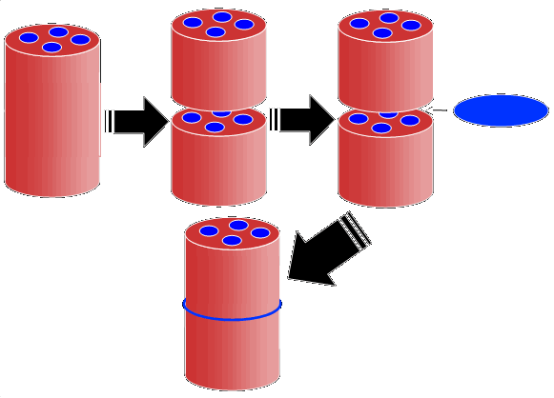
Spring support AOP Framework
One of the import components of spring is the AOP (Aspect oriented programming) framework. Here to explain some key example security, transactions, declarative and caching etc.
Aspects
Insert
Define
Additional
Components
Starting
Output

Slide 16
Version History
Spring 1st version release in March 2004
Spring 1.2.6 version release in 2006
Spring 2.0 version release in Oct 2006
Spring 2.5 version release in Nov 2007
Spring 3 version release in Dec 2007
Spring 3.1 version release in Dec 2011
Spring 3.2.5 version release in Nov 2013
Spring framework 4 version release in Dec 2013
Spring framework 4.2.0 version release in July 2015
Spring framework 4.2.1 version release in Sept 2015

Slide 17
Dependency Injection
Generally include objects that merge to from the application proper. Include objects in an application or programs have dependencies on each other.
The spring framework systemize formalized design model as 1st class objects that you can combine your own apps.
Number of IT firm and other organizations use the spring framework in proper manner to engineer robust and manage applications.

Slide 18





Data Access Framework
Spring data access framework addresses ordinary issue programmers face when working with database applications. Some list of data access frameworks in java platform: Hibernate, JDO, Oracle, Apache OJB, Apache Cayenne and JDBC.
Apache OJB
JDBC

Slide 19
MVC (Model-View-Controller) Framework
Java spring developers using MVC (model view controller) framework and ready elements that can be used to build simple and flexible connected web applications.
Model
Controller
View

Slide 20
The Spring Web MVC framework provides Model-View-Controller (MVC) architecture and ready components that can be used to develop flexible and loosely coupled web applications.
The MVC pattern results in separating the different aspects of the application (input logic, business logic, and UI logic), while providing a loose coupling between these elements.
The Model encapsulates the application data and in general they will consist of POJO.
The View is responsible for rendering the model data and in general it generates HTML output that the client's browser can interpret.
The Controller is responsible for processing user requests and building an appropriate model and passes it to the view for picture.

Slide 21
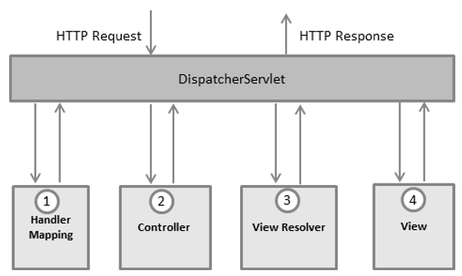
The Spring Web model-view-controller (MVC) framework is designed around a DispatcherServlet that handles all the HTTP requests and responses.
The request processing workflow of the Spring Web MVC DispatcherServlet is illustrated in the following diagram −
After receiving an HTTP request, DispatcherServlet consults the HandlerMapping to call the appropriate Controller.
The Controller takes the request and calls the appropriate service methods based on used GET or POST method. The service method will set model data based on defined business logic and returns view name to the DispatcherServlet.
The DispatcherServlet will take help from ViewResolver to pickup the defined view for the request.
Once view is finalized, The DispatcherServlet passes the model data to the view which is finally rendered on the browser.

Slide 22
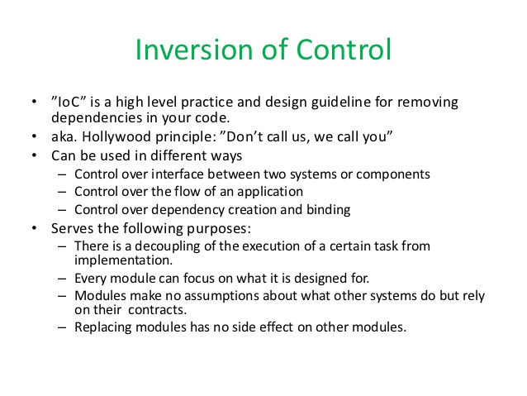

Slide 23
IoC Container
The IoC container is responsible to instantiate, configure and assemble the objects. The IoC container gets informations from the XML file and works accordingly. The main tasks performed by IoC container are:
to instantiate the application class
to configure the object
to assemble the dependencies between the objects
There are two types of IoC containers. They are:
BeanFactory
ApplicationContext

Slide 24
Spring - Bean Life Cycle
Instantiate
Populate properties
BeanNameAware’s setBeanName()
BeanFactoryAware’s setBeanFactory()
Application Content Aware’ssetApplicationContent()
Bean is Ready to use
Preinitialization BeanPostProcessors
InitializingBeans afterPropertiesSet()
Call custom init-Method
Postinitialization Beanpostprocessors
Container is
shut down
Display beans destroy()
Call Custom destroy-method()

