Slide 1

Course title:- Data Visualization
Topic – Dashboard Overview Data Science Job and Salaries
Course – INT233
Section – K22MP
Submitted to
LOVELY PROFESSIONAL UNIVERSITY PHAGWARA, PUNJAB
Session - 2024
Submitted by
MOHIT KUMAR - 12207717

Slide 2
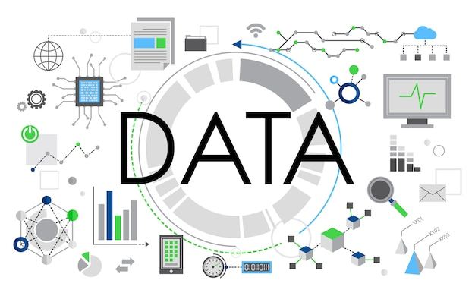
      Introduction to Dashboard
      Overview Data Science Job and Salaries
The dashboard gives a clear picture of the current global data science job market. It uses information from various sources to show trends, job roles, salaries, required skills, and career growth opportunities for data science professionals.

Slide 3
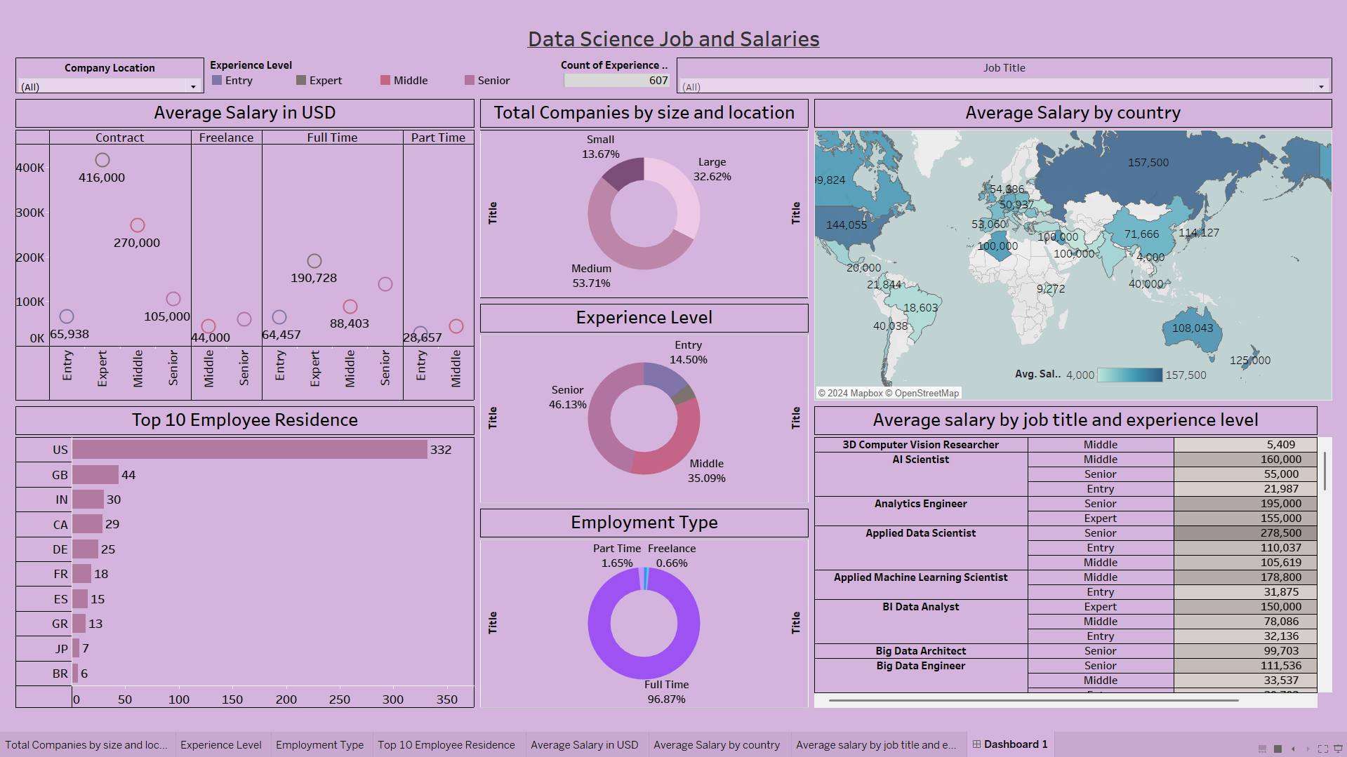

Slide 4



Popular Skills and Certifications for Data Science Professionals
Python
R Programming
A powerful statistical computing language widely used in data analysis and
visualization.
The go-to programming language for data science, with a vast ecosystem of libraries and frameworks.
Machine Learning
Data Visualization
Expertise in applying various ML algorithms and techniques to extract insights from data.
Proficiency in tools like Tableau, Power BI, and D3.js to communicate data-driven insights effectively.

Slide 5
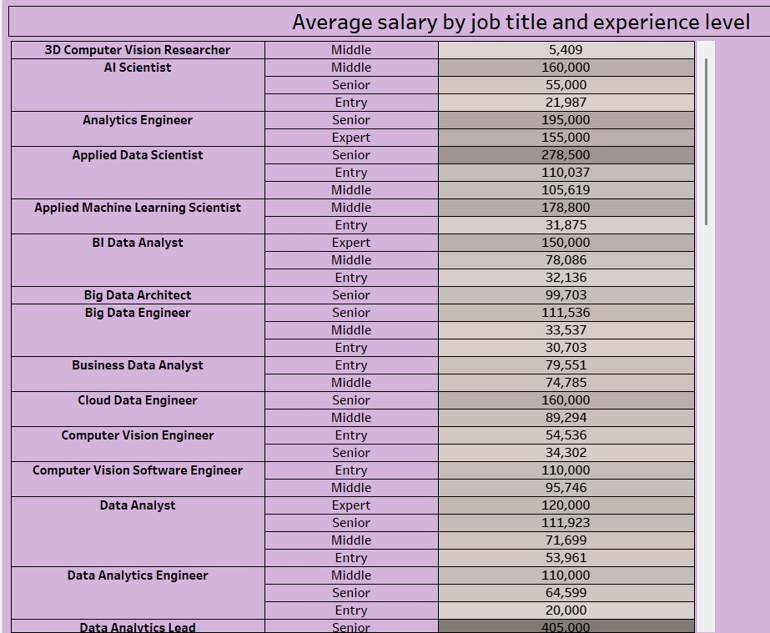
Average salary by job title & experience level Across the Industry
1
Data Analyst
Responsible for collecting, analyzing, and interpreting data to uncover insights and drive business decisions.
2
Analytics Engineer
Designs and develops the infrastructure and pipelines to gather, process, and store large datasets for analysis.
3
AI Scientist
Applies advanced statistical and machine learning techniques to extract meaningful patterns and predictions from data.

Slide 6
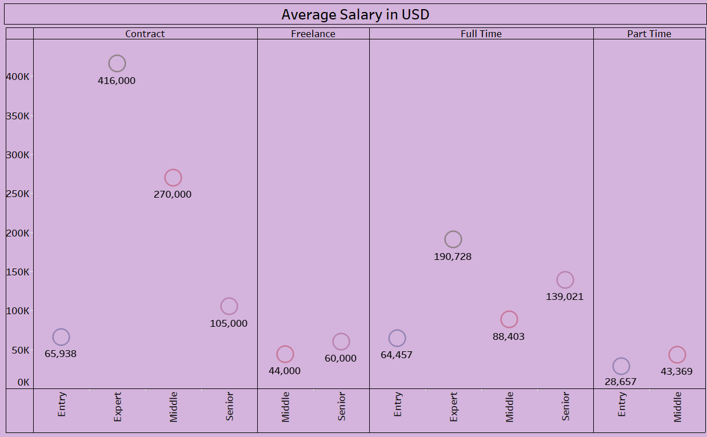



Hiring Trends & Average salary : Full-Time, Contract, Freelance and Remote Opportunities
Full-Time Roles
Traditional full-time data science jobs are still the most common, especially in big companies and tech giants.
Contract/Freelance
There is a growing need for flexible, project-based data science experts, especially for short-term projects.
Remote Work
The pandemic has sped up the use of remote and hybrid work setups, giving employers access to more data science talent from different places.

Slide 7
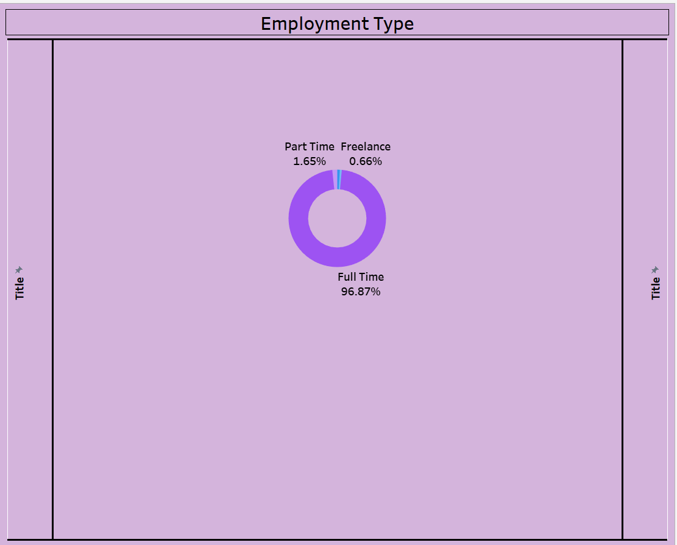
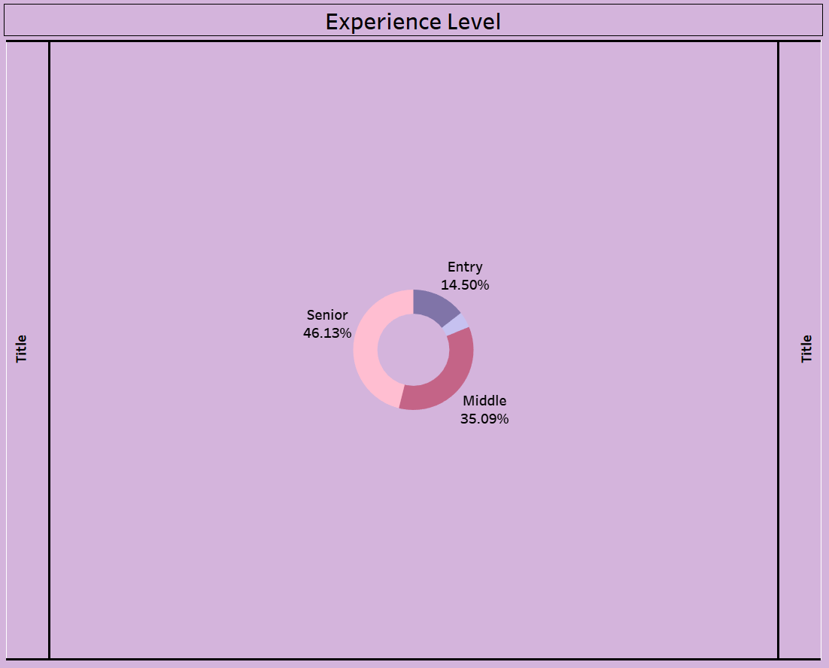
Data science offers various employment types, including Experience levels:
Full-Time/Part time : Stable, long-term roles in companies with benefits
Fewer hours, flexible for balancing other commitments.
Contract-Based/Freelancing : Temporary roles for specific projects or durations
Independent work on multiple projects for various
clients.
Remote Work/Hybrid role : Fully online roles, offering location flexibility
a mix of remote and in-office work.

Slide 8
Global Data Science Job Trends: Geographic Insights
North America
Europe
Asia-Pacific
The United States and Canada continue to dominate the global data science job market, with a high concentration of opportunities in technology hubs like Silicon Valley, Seattle, Boston, and Toronto.
Major European data science job centers include London, Berlin, Paris, and Amsterdam, driven by the thriving tech and finance sectors. Salaries tend to be competitive, though slightly lower than North America.
China, India, and Singapore are emerging as prominent data science job markets, fueled by rapid digitalization and the growth of tech and e-commerce companies. Salaries are generally lower compared to North America and Europe.

Slide 9
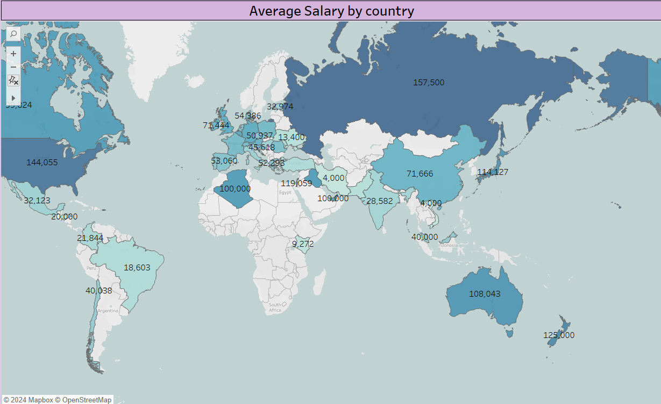
Average Salary by Benchmarks by Location, Company Size, and Experience Level
Location
Entry-Level
Mid-Level
Senior-Level
San Francisco
$90,000 - $120,000
$120,000 - $180,000
$180,000 - $250,000
New York
$80,000 - $110,000
$110,000 - $160,000
$160,000 - $220,000
London
£45,000 - £65,000
£65,000 - £100,000
£100,000 - £150,000
Sydney
AU$80,000 - AU$100,000
AU$100,000 - AU$150,000
AU$150,000 - AU$200,000

Slide 10
Conclusion and Key Takeaways
This dashboard gives a detailed overview of the global data science job market. It highlights important trends, job roles, salaries, skills, and career growth opportunities. These insights can help companies make better decisions about hiring, pay, and developing their workforce. By promoting diversity and inclusion, businesses can create strong data science teams that foster innovation and help the company grow.
As more companies rely on data to make decisions, it's important to stay informed about the latest changes in the industry. This dashboard will be updated regularly to keep the information current and useful. We recommend checking it periodically to stay updated with the fast-changing data science field.

Slide 11
Thank you

