Slide 1

Smart Disaster Management System
A Web-Based Platform for Disaster Response and Resource Management
Presented by: Mohit Kumar KS

Slide 2

Introduction: Empowering Disaster Response
Our Smart Disaster Management System is a web application designed to significantly enhance real-time information access and resource coordination during critical disaster events. It provides a centralized platform for both affected populations and response teams.
Resource Visibility
Disaster Reporting
Admin Control
The system provides a clear overview of available resources, including food, water, and medical supplies, at various designated locations.
Users can quickly and easily report disaster incidents directly through the platform, ensuring timely dissemination of critical information.
Authorized administrators can efficiently manage and update supply data and disseminate crucial disaster alerts to all users.

Slide 3
Core Objectives: Bridging Information Gaps
The primary objectives of this system are to provide immediate and critical information to those affected by disasters and to empower administrators with effective management tools. By focusing on these key areas, we aim to streamline the disaster response process.
1
Supply Visibility Across Locations
2
User-Friendly Disaster Reporting
Display real-time availability of essential provisions such as food, water, and medical supplies for 10 pre-defined disaster-prone locations.
Enable affected individuals to submit incident reports detailing their specific needs and the nature of the disaster in their respective areas.
3
Centralized Admin Management
4
Secure Access Control
Allow administrators to securely update supply inventories, add new resources, and issue urgent disaster alerts across the system.
Implement a robust login system to ensure that only authorized users and administrators can access their respective functionalities.

Slide 4
Defined Scope: Focused and Secure Operations
The system's scope is meticulously defined to ensure a focused and efficient implementation. We have established clear boundaries regarding the operational areas, data management, and user interactions to deliver a reliable platform.
Fixed Location Support
Web-Based Accessibility
MongoDB for Data Management
Role-Based Functionality
The system is currently designed to operate within 10 pre-selected, fixed geographical locations, allowing for concentrated resource allocation and management.
As a web-based application, the system is accessible to both general users and administrators through any standard web browser, ensuring broad reach and ease of use.
All critical data, including supply inventories, disaster reports, and user credentials, are securely stored and managed using a MongoDB database.
The system implements clear distinctions between user and administrator functionalities: admins control supply updates and alerts, while users can view current supplies and submit incident reports.
This targeted approach ensures that the initial deployment is robust and efficient, focusing resources where they are most critically needed.
This platform independence minimizes technical barriers for users during emergencies.
MongoDB's flexibility allows for efficient handling of diverse data types and rapid scaling.
This separation of duties ensures data integrity and operational security.

Slide 5




System Overview: Architectural Flow
The Smart Disaster Management System is structured logically to facilitate intuitive navigation and efficient data management. Each primary page serves a distinct purpose, ensuring a streamlined user experience from login to data interaction.
Login Page
The initial entry point for all users, enabling both general users and administrators to securely access the system with their respective credentials.
Admin Page
Exclusive access for authorized personnel, allowing them to manage and update critical data related to supplies and disaster alerts in real-time.
User Page
Provides general users with the ability to view available supplies at various locations and submit new disaster reports as needed.
MongoDB Integration
Serves as the central data repository, ensuring all information is stored persistently and can be retrieved dynamically for system operations.

Slide 6










Key Features: Empowering Users and Admins
The system is equipped with robust features tailored to the specific needs of both administrators and general users, ensuring comprehensive management and efficient information dissemination during disaster scenarios.
Admin: Update Supplies
Secure Login System
Administrators can easily modify and update the inventory levels of food, water, and medical supplies across all specified locations.
A secure authentication process that validates user credentials, ensuring only authorized individuals can access administrator or general user functionalities.
Admin: Manage Disaster Alerts
Admins have the capability to create, edit, or remove disaster alerts, providing timely notifications to all system users.
User: Report Disaster Events
Allows users to submit detailed reports of disaster incidents, including location and specific needs, facilitating rapid response coordination.
User: View Supplies
General users can access up-to-date information on available resources at different disaster zones, aiding in their decision-making during crises.

Slide 7




Technologies Utilized: A Robust Stack
The Smart Disaster Management System is built upon a modern and efficient technology stack, leveraging industry-standard tools to ensure high performance, scalability, and maintainability. This combination provides a solid foundation for the application's functionality.
Frontend: HTML, CSS, Bootstrap
Backend: Django (Python)
Database: MongoDB
MVT Architecture
Employs MongoDB, a NoSQL database, for flexible data storage and retrieval, capable of handling large volumes of unstructured and semi-structured data efficiently.
Organized using the Model-View-Template (MVT) architectural pattern, enhancing code organization, separation of concerns, and ease of development.
Utilizes HTML for structure, CSS for styling, and Bootstrap for a responsive and mobile-first design, ensuring a consistent user experience across devices.
Powered by Django, a high-level Python web framework that encourages rapid development and clean, pragmatic design, providing a secure and scalable backend.

Slide 8
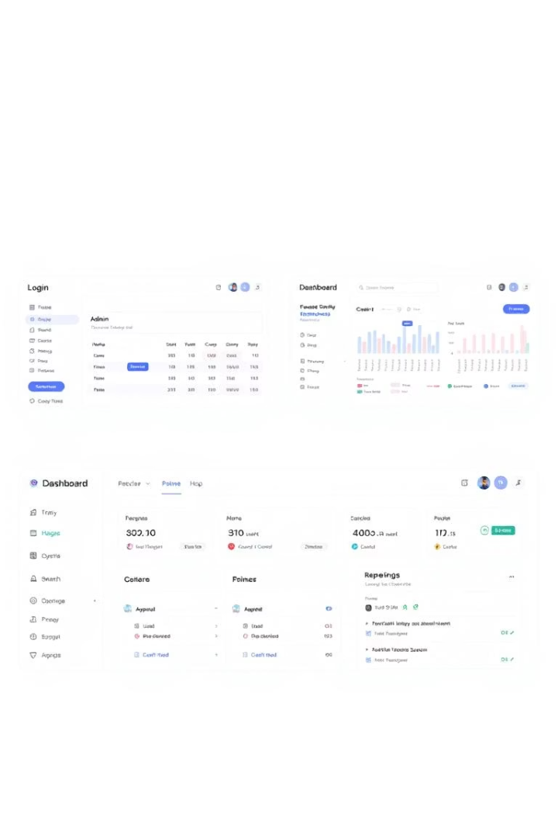
Sample Pages: Intuitive Interfaces
The design philosophy behind each page prioritizes clarity, ease of use, and quick access to critical information. The interfaces are clean and intuitive, ensuring that users can navigate the system effectively, even under stressful conditions.
1
2
Login Page
Admin Dashboard
A straightforward interface for users to enter their username and password, designed for quick and secure access.
A comprehensive control panel allowing administrators to effortlessly update food, water, and medicine supplies with simple input fields.
3
User Dashboard
Provides a clear overview of available supplies and an intuitive form for users to submit disaster reports, ensuring critical information is easily accessible and submittable.

Slide 9



Conclusion: A Foundation for Future Growth
The Smart Disaster Management System represents a significant step forward in leveraging technology for humanitarian aid. It provides a valuable tool for organizing and disseminating critical information during times of crisis. The current implementation serves as a strong foundation, with clear avenues for future enhancements to broaden its impact and utility.
Valuable Management Tool
Effectively manages disaster information, streamlining coordination and response efforts.
Optimized Resource Allocation
Helps users quickly identify locations with the most abundant supplies, ensuring resources reach those in need efficiently.
Future Enhancements: Mobile & GPS
Future iterations can integrate GPS capabilities for dynamic location tracking and dedicated mobile application support for wider accessibility and real-time updates on the go.

