Slide 1
Amazon RDS
Relational Database Services

Slide 2
AWS Database Service
Database refers to storing of data in a structured manner.
DBMS is a database program, it is a software system that uses a standard method of cataloging, retrieving, and running queries on data.
A relational database is structured, meaning the data is organized in tables. Many times, the data within these tables have relationships with one another, or dependencies.
A non-relational database is a database that does not use the tabular schema of rows and columns found in most traditional database systems. Instead, non-relational databases use a storage model that is optimized for the specific requirements of the type of data being stored.

Slide 3
Database Services
Relational DBMS
Non Relational DBMS
RDS ( Relational database service ) *
Redshift ( Datawarehouse ) *
Aurora ( MySQL & PostgreSQL ) *
Dynamo DB ( Key-value ) *
Document DB ( MongoDB )
QLDB ( Quantum Ledger Database )
Neptune ( Graph )
Elastic Cache ( Caching ) *
* Redis * Memcached
Keyspaces ( apache cassandra )
Timestreams ( time series )

Slide 4
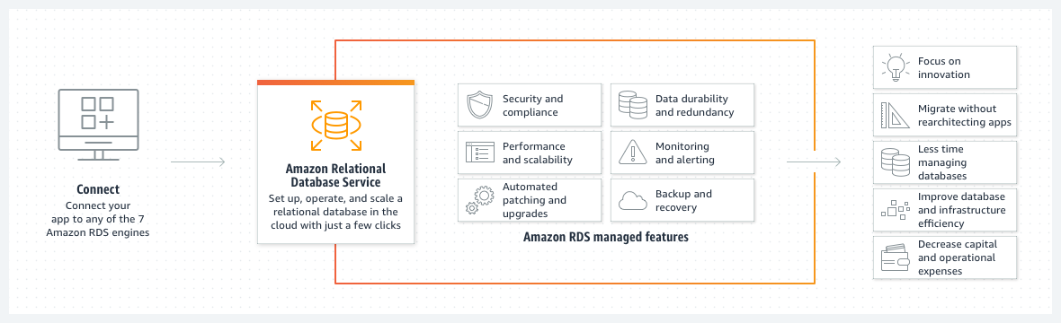

Slide 5
Steps to Configure RDS
1. Select RDS Engine ( amazon aurora, microsoft mysql, oracle, postgresql, MariaDB, sql server )
2. Choosing the template ( production, dev/test, free tier )
3. DB Instance Identifier ( Name )
4. Configuring Credentials
5. Instance Configuration depending upon compute, network & memory capability

Slide 6
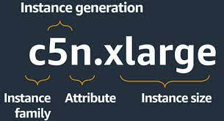
6. Storage Configuration ( autoscaling )
7. Connectivity has EC2, DB Subnet Group, Public/Private Access
8. VPC security group (firewall)
9. Database authentication

