Slide 1
Facial Emotion Detection System

Slide 2
Presented By :-
Mohit Mahajan (0176CD211070)
Virat Raghuvanshi (0176CD211133)
Gourav Chouhan (0176CD211048)

Slide 3
Acknowledgement :-
I express a deep sense of gratitude to my Supervisor “Mrs. Reeta Boursai”, for the valuable and inspirational guidance from the initial to the final level that enabled me to develop an understanding of this Project work. I would like to give my sincere thanks to Prof.(Dr.) Neetesh Kumar Gupta, Head, Dept. of CSE-Data Science for their kind help, encouragement and co-operation throughout my Project period and I owe my special thanks to our Principal Prof. (Dr.) V.N. Bartaria for their guidance and suggestions during the Project work. Lastly, I want to thank my parents, friends and to all those people who had contributed to my project directly or indirectly for their moral and psychological support.
MOHIT MAHAJAN (0176CD211070)
GOURAV CHOUHAN (0176CD211048)
VIRAT RAGHUWANSHI (0176CD211133)

Slide 4
Introduction and Motivation :-
Introduction :-
Facial emotion recognition systems are advanced technologies designed to detect and interpret human emotions through analyzing facial expressions. Leveraging techniques from computer vision, machine learning, and artificial intelligence, these systems can identify key facial features and map them to specific emotional states such as happiness, sadness, anger, surprise, and more.
Motivation :-
Enhanced Human-Computer Interaction: One of the primary motivations is to create more natural and intuitive interactions between humans and computers. By enabling machines to understand and respond to human emotions, facial emotion recognition systems can enhance user experiences in various applications, including virtual assistants, gaming, and customer service chatbots.
Advancing Behavioral Analysis and Research: Researchers and psychologists are interested in understanding human behavior and emotions better. Facial emotion recognition systems provide a non-intrusive means of capturing and analyzing emotional responses in various contexts, enabling researchers to study human behavior more comprehensively and gain insights into emotional patterns and reactions.

Slide 5
Scope :-
Human-Computer Interaction (HCI):
Facial emotion recognition systems play a crucial role in HCI by enabling more natural and intuitive interactions between humans and computers.
Applications include virtual assistants, chatbots, and interactive systems in gaming and entertainment.
Healthcare and Mental Health:
These systems have significant potential in healthcare for diagnosing and monitoring mental health conditions such as depression, anxiety, and autism spectrum disorders.
They can assist therapists and healthcare professionals in assessing patients' emotional states and progress during therapy sessions.
Market Research and Consumer Behavior:
In marketing and consumer research, facial emotion recognition systems are used to analyze consumer reactions to products, advertisements, and user interfaces.
They help companies understand consumer preferences, improve product design, and tailor marketing strategies.
Security and Surveillance:
Facial emotion recognition systems contribute to security and surveillance efforts by identifying individuals displaying suspicious behavior or signs of distress in public spaces, airports, and other high-security areas.

Slide 6
Objective :-
The primary objective of a facial emotion detection system is to accurately recognize and classify human emotions based on facial expressions, enabling real-time analysis, cross-cultural adaptation, user experience enhancement, healthcare applications, and addressing privacy and ethical considerations.

Slide 7
Features :-
Facial Landmark Detection:
Facial emotion recognition systems often begin by detecting and localizing facial landmarks such as the eyes, nose, mouth, and eyebrows. This feature extraction step helps identify regions of interest for further analysis.
Feature Extraction:
After detecting facial landmarks, these systems extract features from the face that are indicative of different emotions. Features may include the shape of the mouth, the position of the eyebrows, wrinkles around the eyes, and overall facial expressions.
Machine Learning Algorithms:
Facial emotion recognition systems employ machine learning algorithms to analyze extracted facial features and classify them into different emotional states. Commonly used algorithms include neural networks, and deep learning models such as convolutional neural networks (CNNs).
Emotion Classification:
The core feature of these systems is their ability to classify facial expressions into discrete emotional categories such as happiness, sadness, anger, surprise, fear, disgust, and neutrality. Each emotional state is assigned a probability score indicating the likelihood of the detected emotion.
Real-time Processing:
Many facial emotion recognition systems are designed to process facial expressions in real-time, enabling immediate responses or interventions based on detected emotions. Real-time processing is essential for applications such as interactive interfaces, virtual reality environments, and surveillance systems.

Slide 8
Minimum System Requirements :-
Processor:
Any modern processor capable of running Java applications should suffice. A basic processor like Intel Core i3 or equivalent is recommended.
RAM (Memory):
At least 2GB of RAM is sufficient for running the Java application smoothly. However, more RAM (4GB or higher) would enhance performance, especially if dealing with larger datasets.
Storage:
A minimum of 100MB of free storage space for the application and data storage.
Display:
Any standard display with a resolution of 1024x768 or higher would suffice for running the application's user interface.
Camera:
Any camera of 720p can be used.

Slide 9
Methodology :-
Project Planning and Requirements Gathering :
Define Objectives: Clearly outline what functionalities the Facial emotion Detector should have.
Gather Requirements: List down all the required features, user interactions, and data handling functionalities.
Convolutional Neural Networks (CNNs):
CNNs are widely used in facial emotion recognition due to their ability to automatically learn hierarchical features from raw pixel data. They consist of multiple convolutional layers followed by pooling layers and fully connected layers for feature extraction and classification.
Facial landmark detection algorithms:
Facial landmark detection algorithms localize key points on the face, such as the eyes, nose, mouth, and eyebrows. These landmarks serve as input for subsequent emotion recognition algorithms.
Real-time and Streaming Processing:
Efficient algorithms and optimization techniques are employed to enable real-time processing of facial expressions, allowing systems to analyze and respond to emotions in streaming video feeds or interactive applications with minimal latency.

Slide 10

Snapshot :-
Fig 1: All the required libraries for the Project

Slide 11
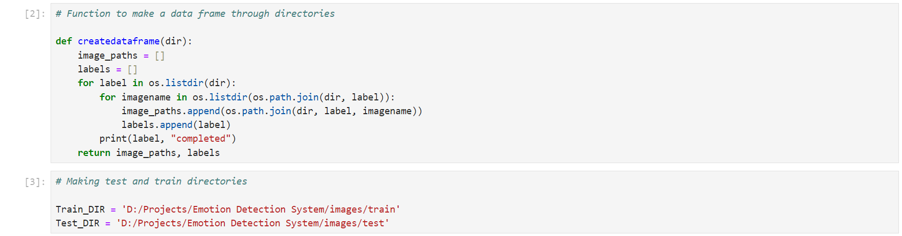
Snapshot :-
Fig 2: Method to make DataFrame from Directory

Slide 12
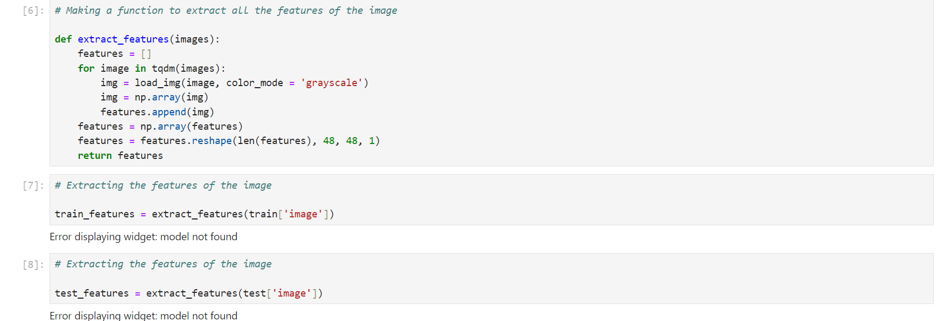
Snapshot :-
Fig 3: Features Extraction

Slide 13
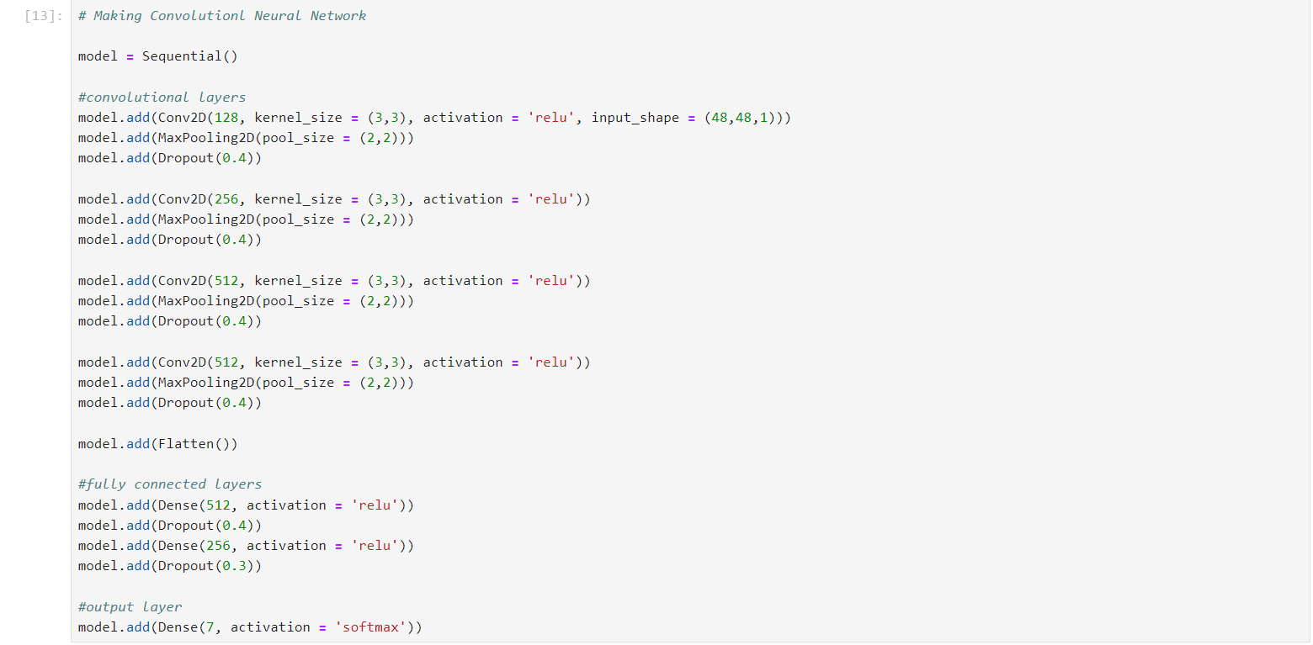
Snapshot :-
Fig 4: Convolutional Neural Network

Slide 14
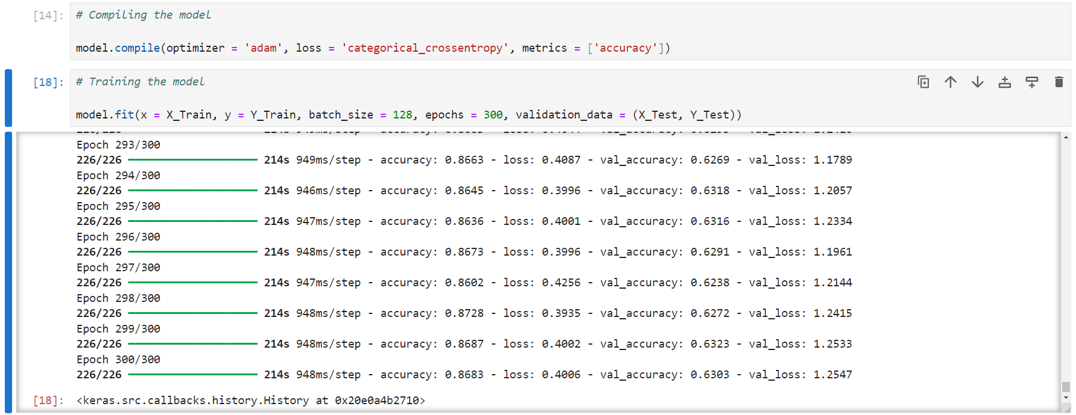
Snapshot :-
Fig 5: Training Model and Accuracy score

Slide 15
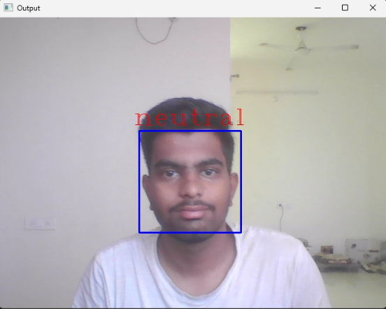
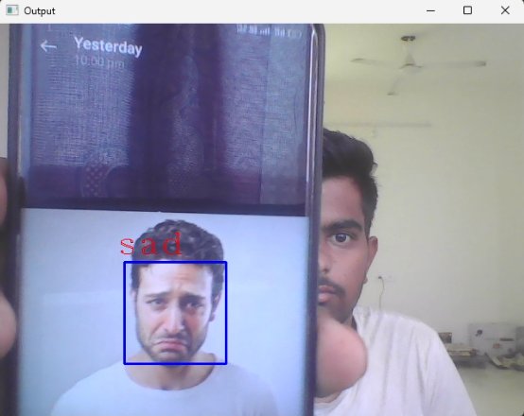
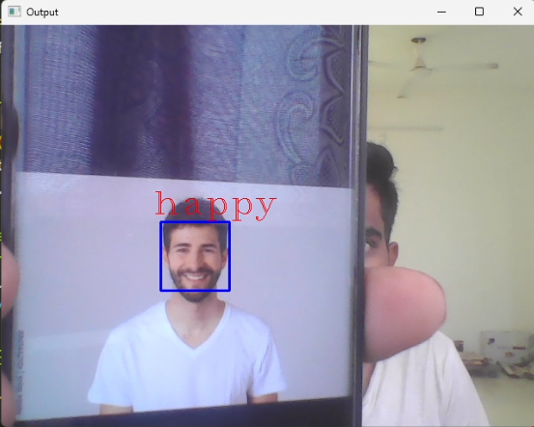
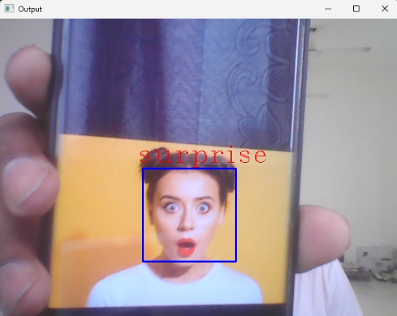
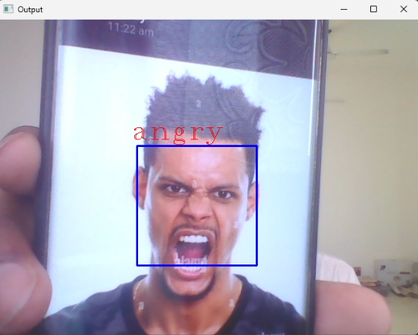
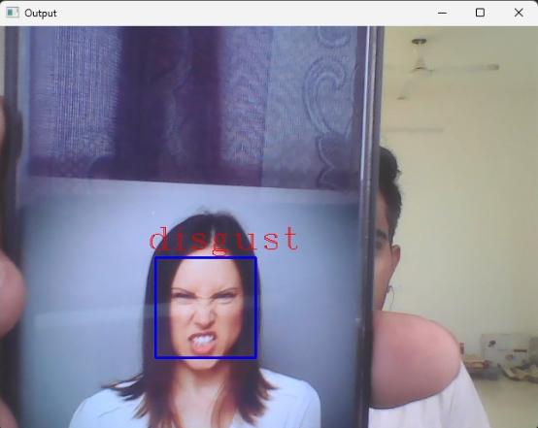
Snapshot :-
Fig 6: Output of Facial Emotion Detection System

Slide 16
Conclusion :-
Facial emotion detection systems represent a significant advancement in human computer interaction, with far-reaching implications across various domains. While these systems have demonstrated remarkable accuracy and utility in recognizing and interpreting human emotions from facial expressions, they also come with ethical considerations and societal implications that must be carefully addressed. As we continue to innovate and refine facial emotion detection technology, it is imperative to prioritize ethical considerations such as privacy, fairness, transparency, and accountability. Proactive measures to mitigate biases, protect user privacy, and ensure responsible deployment are essential for fostering trust and acceptance among users.

