Slide 1

CUSTOMER SHOPPING BEHAVIOR
Customer shopping
behavior points to
a loyalty
opportunity
Executive readout

Slide 2
THE BASELINE
3,900 purchases reveal a broad but uneven customer base
3,900
$59.76
3.75
transactions
average purchase
average review rating
Across 4 categories, 25 products, and 50 locations. 37 ratings were imputed during cleaning.

Slide 3
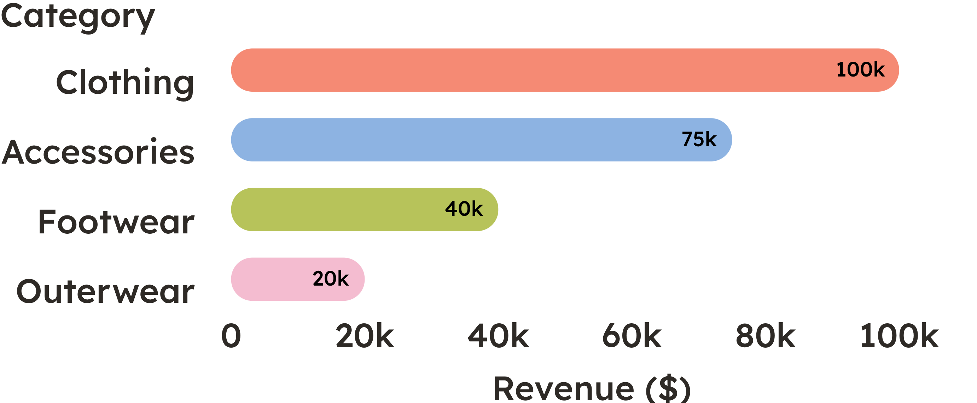
CATEGORY ECONOMICS
Clothing carries the business, while accessories provide the next growth pool
~2,000 Clothing sales
~1,200 Accessories sales
Protect the core clothing engine while using accessories to expand basket size.

Slide 4
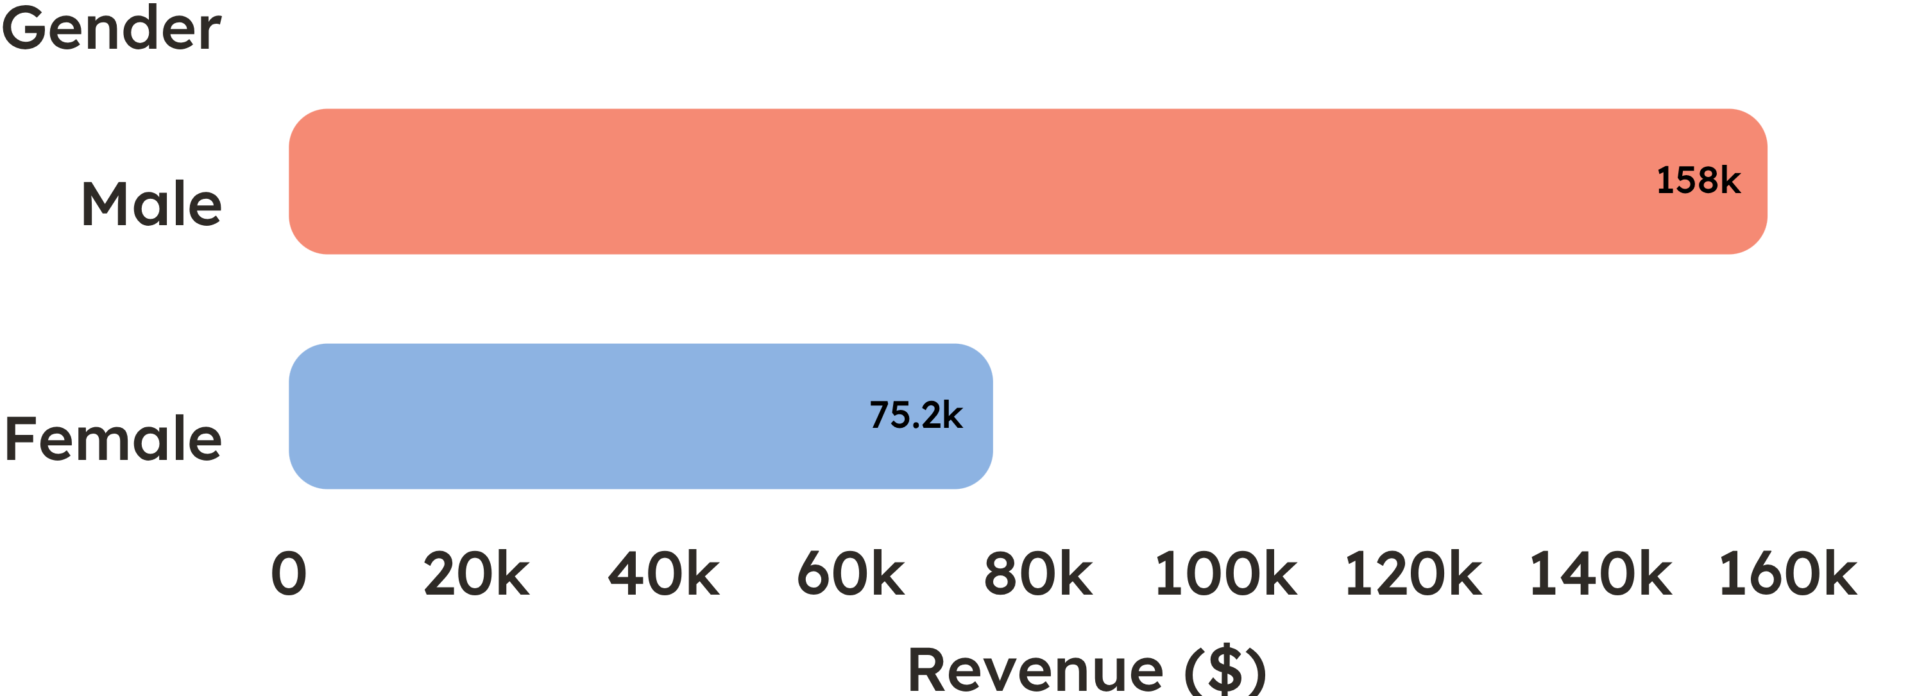
Revenue is concentrated among male customers, but the segment story needs more nuance
Revenue split: Male customers generate $157,890 versus $75,191 from female customers.
Read carefully: Revenue concentration is not customer profitability or conversion efficiency.
Next test: Test differentiated merchandising and messaging before reallocating spend solely on revenue share.

Slide 5
The biggest unlock is converting loyal repeat buyers into subscribers
CUSTOMER BASE
SUBSCRIPTION REACH
3,116
27%
customers are classified as Loyal
701 Returning · 83 New
of customers subscribe; 73% do not
$170,436 from non-subscribers · $62,645 from subscribers
The opportunity is not simply acquisition; it is a better conversion path for existing loyal demand.

Slide 6

Discounts attract high-value demand, but some products may be over-dependent on them
Most discount-dependent
Hat | 50.00%
Sneakers | 49.66%
Coat | 49.07%
Sweater | 48.17%
Pants | 47.37%
839
customers used discounts and still spent above the average purchase amount.
Separate profitable discount use from margin-eroding habit by product and customer segment.

Slide 7

Top-rated products and shipping behavior point to practical merchandising moves
Top-rated: Gloves 3.86, Sandals 3.84, Boots 3.82, Hat 3.80, and Skirt 3.78.
Shipping signal: average purchase amount is $60.48 with Express versus $58.46 with Standard shipping. Action: feature high-rated products; test express-shipping offers as a basket-building lever.

Slide 8
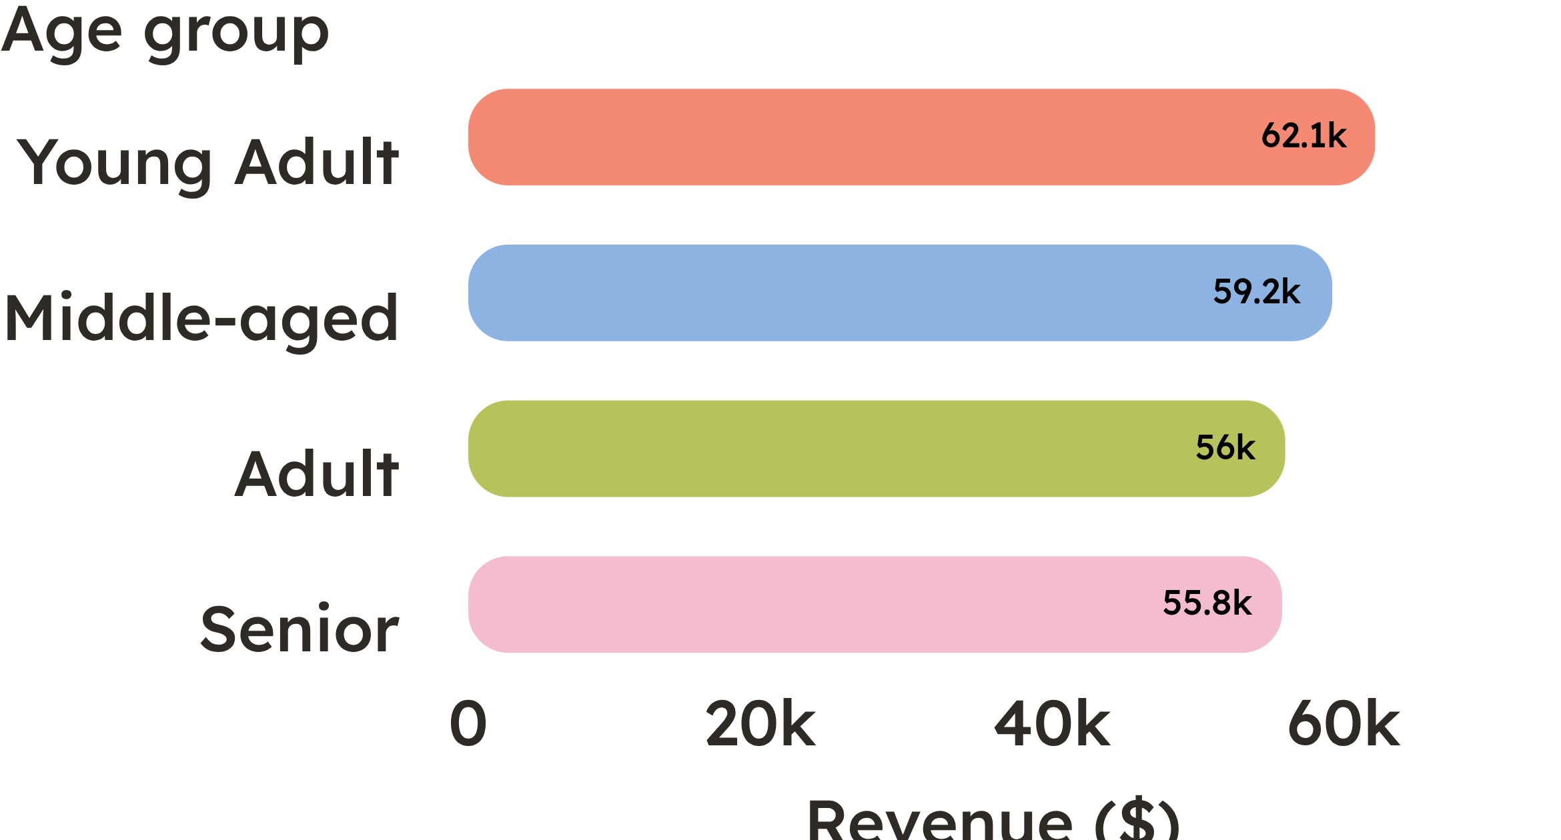
Young adults contribute the most revenue, but every age group matters
Pattern: The spread is meaningful but not extreme, supporting differentiated rather than exclusive targeting. Action: Lead with young adults while tailoring offers and product stories for the other groups.

Slide 9

Five moves can turn the analysis into a growth agenda
Boost subscriptions: make benefits tangible for loyal repeat buyers
Reward loyalty: move Returning customers toward the Loyal segment
Audit discounts: protect margin on discount-dependent products
Merchandise winners: promote top-rated and best-selling products by category
Target smarter: focus campaigns on high-revenue age groups and express-shipping users

