Slide 1
Final Project Presentation 6070: Communication/Visual Data Analysis Presented to: Smith Mathew
Presented by:
Mohit Patel
Shruti Sawale
Fangxun Wang
Shuguang Zang
Pranshi Kumar Premi

Slide 2
Introduction to Dataset
Dataset: Boston Property Assessment Dataset.
Attributes: 75
Entries: Around 175k

Slide 3
Storytelling
Approach to communicate with data
Three key elements : data, visualizations and narrative
Our dataset allows us to revolve around various properties in the area of Boston .

Slide 4

Our business question
Whether the property values will have great returns in the future or not.
Research about the connectivity to office location

Slide 5
Questions that can be addressed
Average pricing of areas.
Expected tax for the property.
Prime Location
Transportation accessibility nearby.

Slide 6
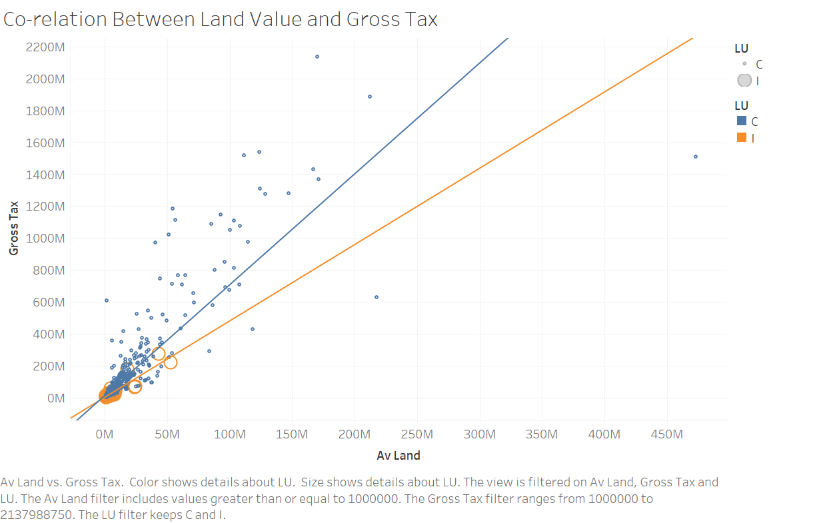
Co-relation LAND value vs gross tax
Av Land vs Gross Tax is plotted.
Color and size shows us values about Land Use, on which the view is filtered.
Avg Land filter and Gross tax includes values greater than or equal to 1000000.
We can see positive co-relations in both the variables

Slide 7
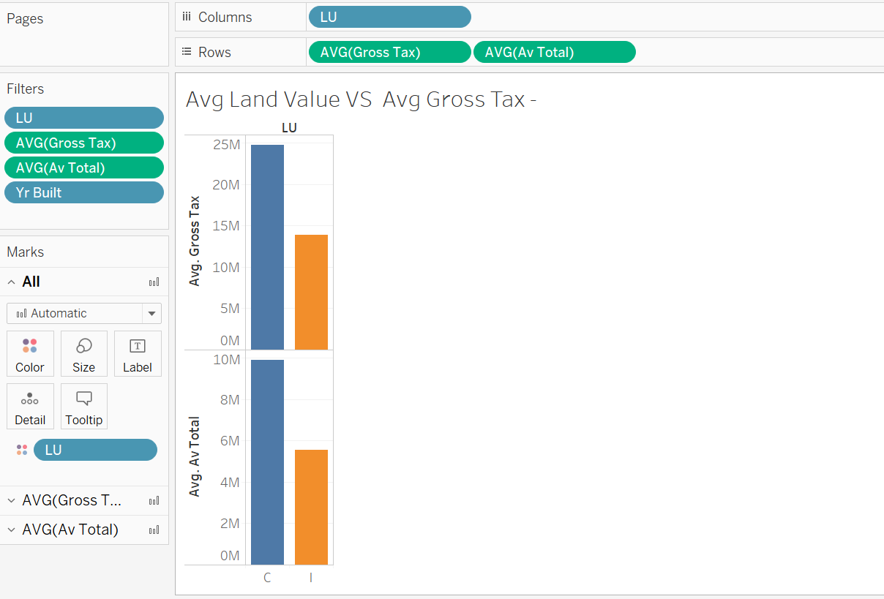
Average of land value and gross tax
Average of Gross Tax and Average of Avg Total for each Land Use is taken.
Data is filtered over on year built.
Average of Gross Tax filters ranges from 128,750 to 263,633,382
The average of Avg Total filter keeps non-null values.

Slide 8
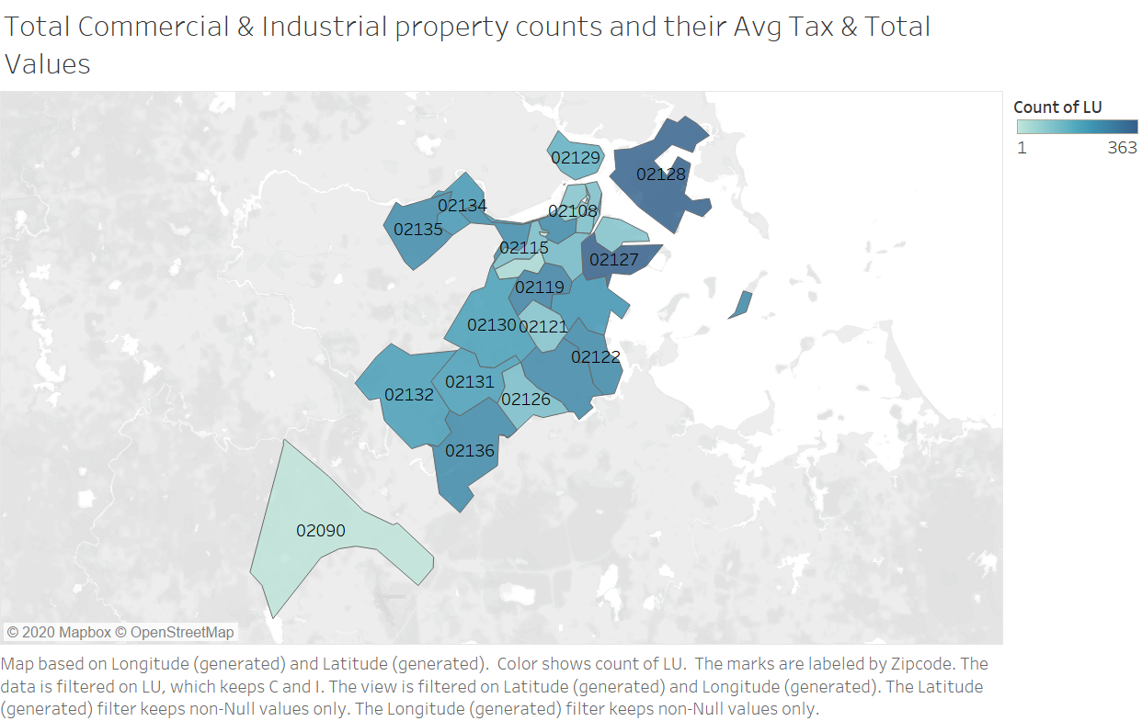
Total commercial & industrial property counts and their Avg tax & Total values
Map based on generated Longitude and Latitude.
Color show count of Land Use and marks are labeled by Zip code.
Both the latitude and longitude contains Avg gross tax values and Avg total values of the properties

Slide 9
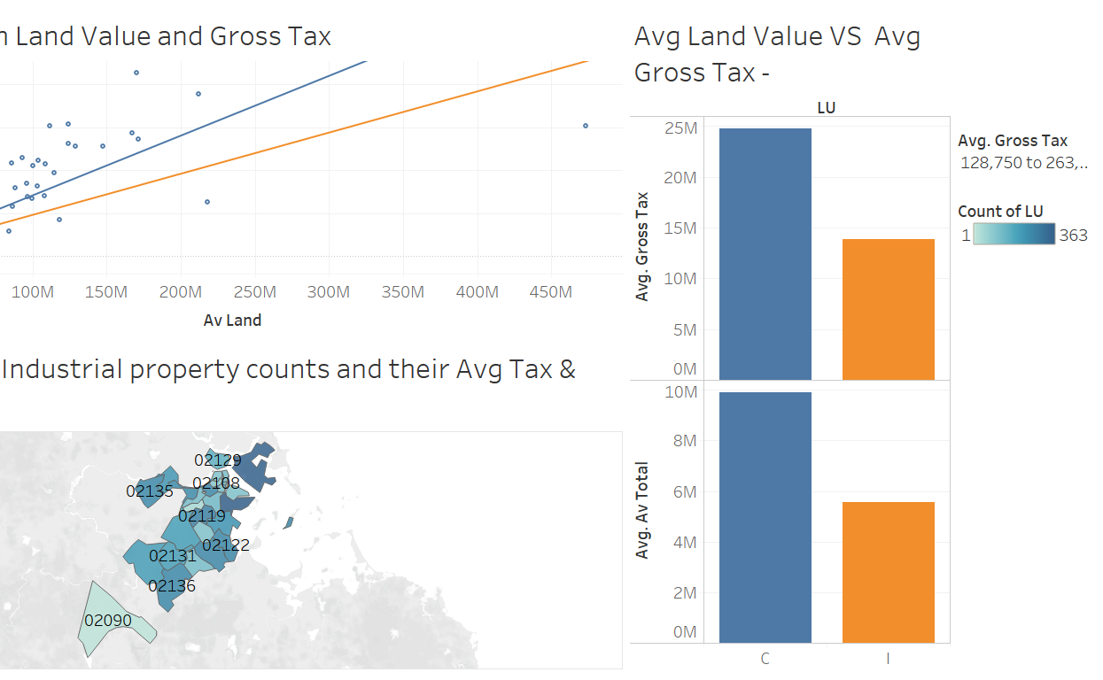
FINAL Dashboard
With this final dashboard, we can answer the business and research questions all together.

Slide 10
Conclusion
Land is an asset which is very close to one and it can be very useful in future for gaining profit depending on the market value.
From the generated dashboard, we can find out about the pricing of the Industrial and commercial properties, which location has the best nearby transportation.
Whether we will gain profit in the future through that property or not and various other questions.
We can Find Avg price for both commercial & industrial properties based on requirements and location.

Slide 11
Thank you

