Slide 1
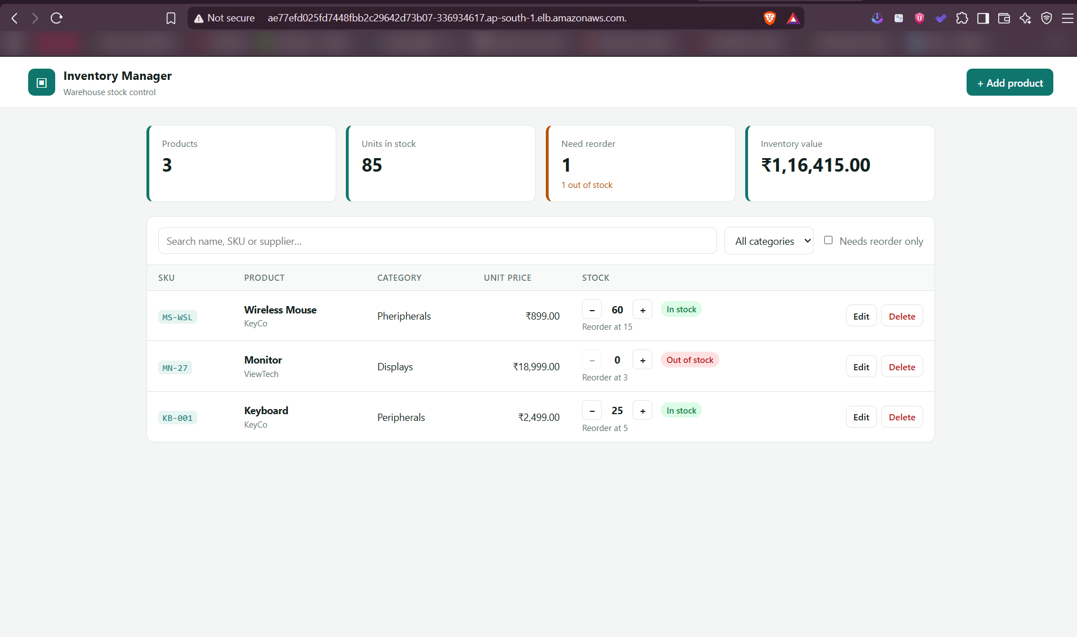
Inventory Manager
From git push to a monitored Kubernetes deployment on AWS
DevOps Capstone · Mohit Sagar · October 2026
Notes:
Inventory Manager is a warehouse stock-control app. The app itself is small on purpose: the project is the delivery pipeline around it, from a commit on my laptop to a monitored deployment on AWS EKS.

Slide 2
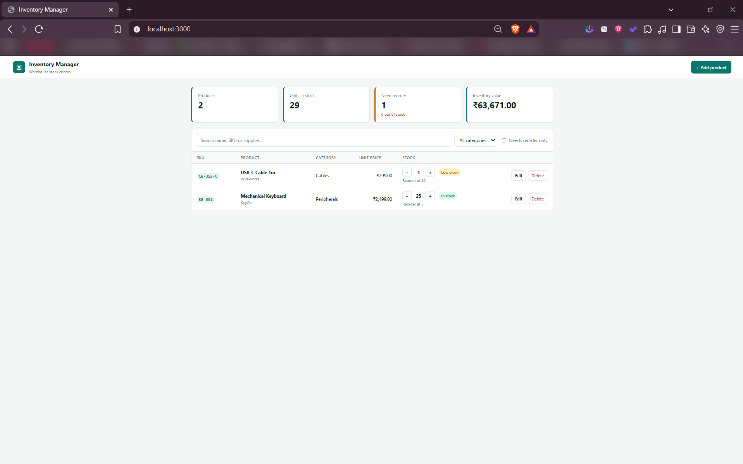
What the app does
M1 · Application
1
Track products by SKU
Category, supplier, unit price and reorder level
2
Receive and ship stock
One-click + / −; stock can never go below zero
3
Reorder alerts and value
Low / out-of-stock badges and total inventory value
React · FastAPI · PostgreSQL · Alembic · 10 REST endpoints
Notes:
Three things the user can do: manage products by SKU, receive and ship stock, and see what needs reordering. FastAPI exposes create, read, update, delete plus a stock-adjust and a stats endpoint. Alembic owns the database schema with two migrations.

Slide 3
Architecture
Developer
git push to main
GitHub Actions
test · lint · build · Trivy
GHCR
images tagged with commit SHA
Helm deploy
keyless AWS login (OIDC)
AWS ap-south-1 · VPC + EKS provisioned by Terraform
/
Frontend ×2
React + Nginx, non-root
Prometheus
scrapes /metrics
Grafana
live dashboard
ingress-nginx
AWS load balancer
/api
Backend ×2
FastAPI · HPA 2→8
PostgreSQL
StatefulSet · EBS gp3
Also in the cluster: metrics-server (feeds the HPA) and the EBS CSI driver (Postgres volume)
Notes:
Top row is the delivery path: a push to main runs GitHub Actions, images go to GitHub Container Registry tagged with the commit SHA, and Helm deploys them. The dashed box is AWS, created by Terraform. Ingress sends / to the React frontend and /api to FastAPI; Postgres runs as a StatefulSet on an EBS volume; Prometheus scrapes the backend and Grafana visualises it.

Slide 4
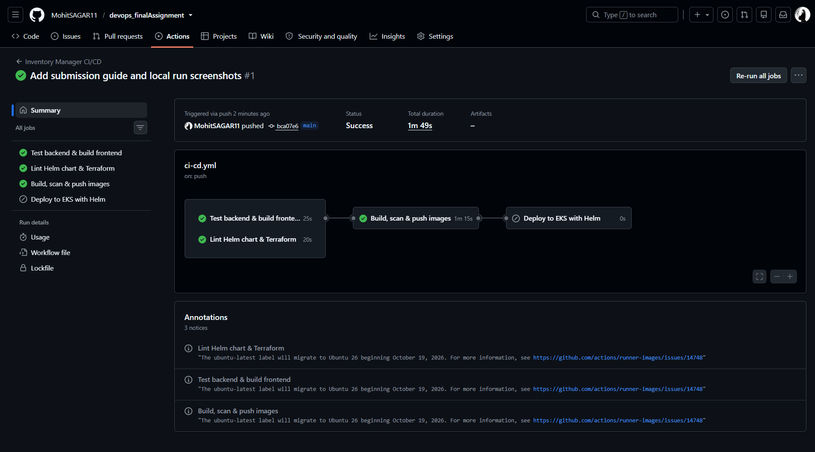
CI/CD on every push to main
M5 · CI/CD
1 Test
pytest (19) + frontend build
2 Lint
helm lint + terraform validate
3 Build · Scan · Push
SHA tags, Trivy gate, GHCR
4 Deploy
OIDC → helm upgrade on EKS
Why the commit SHA?
Every running pod traces back to the exact commit that built it, and a rollback is just redeploying an older tag.
Fails fast
A failing test or a HIGH/CRITICAL CVE stops the pipeline before anything reaches the registry or the cluster.
Notes:
Four jobs. Tests and infrastructure linting run first; only if both pass do we build the images, scan them with Trivy, and push to GHCR with the commit SHA as the tag. The deploy job logs in to AWS with a short-lived GitHub OIDC token, so no AWS keys are stored in GitHub.

Slide 5
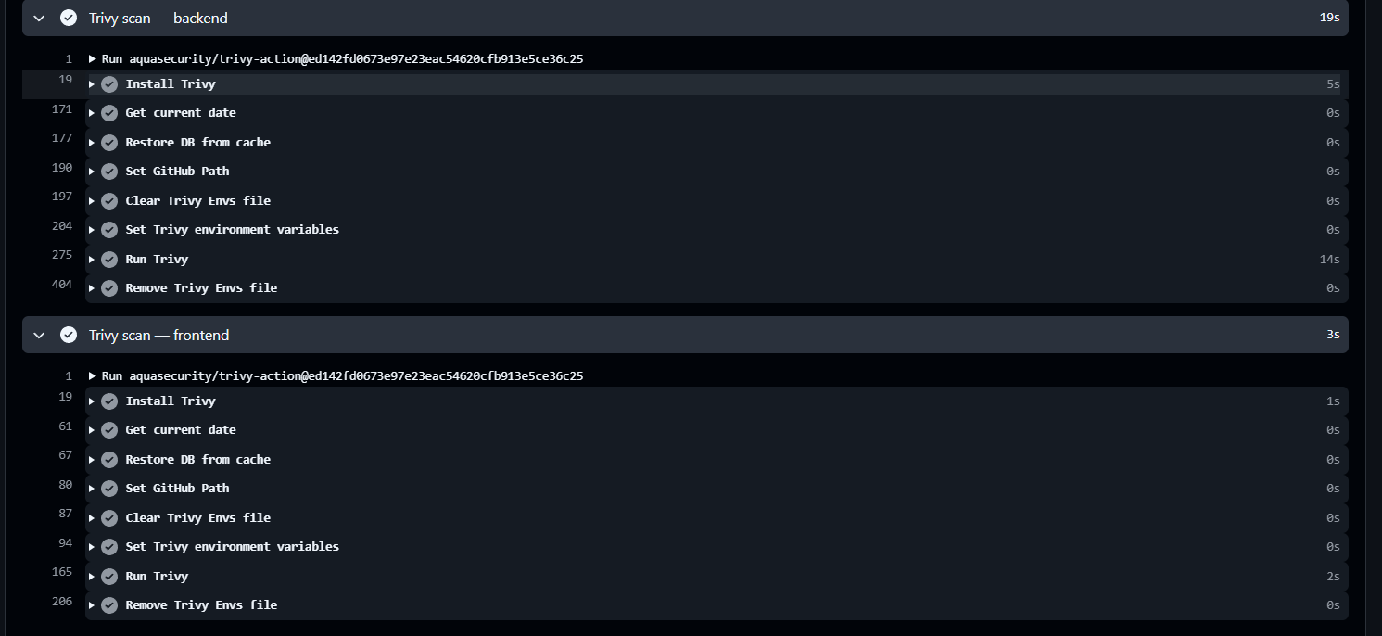
Security gate: Trivy
M6 · DevSecOps
Before
starlette 0.41.3: CVE-2025-62727 (Range-header DoS)
nginx 1.27 base: fixable CVEs in libxml2, musl, zlib
After
Upgraded FastAPI / Starlette 1.8
nginx-unprivileged 1.30 + apk upgrade
0
HIGH / CRITICAL CVEs in both images
Supply chain
Every action pinned to a commit SHA: trivy-action tags were hijacked in March 2026 (CVE-2026-33634).
Notes:
Trivy scans OS packages and app libraries in both images and fails the job on any HIGH or CRITICAL CVE that has a fix. Our first scan failed: Starlette 0.41.3 had CVE-2025-62727, where a crafted Range header could tie up the CPU and deny service. Upgrading Starlette and the nginx base image brought both images to zero.

Slide 6
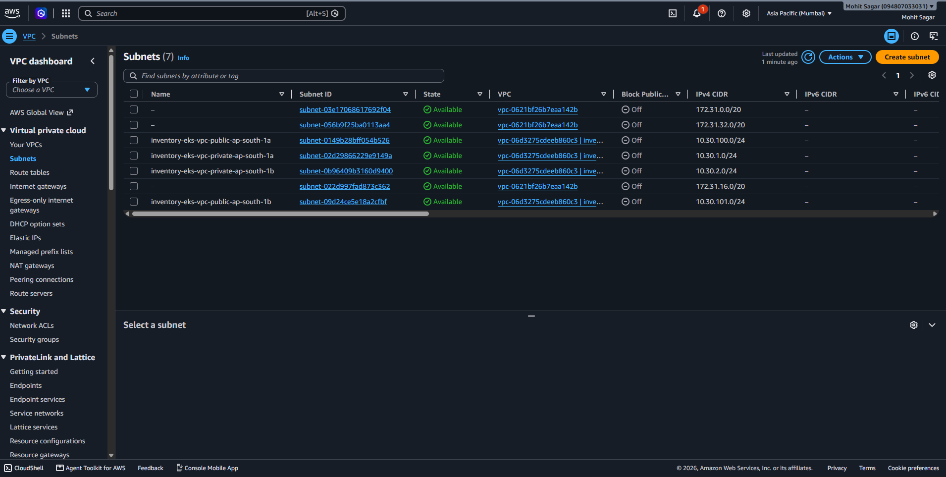
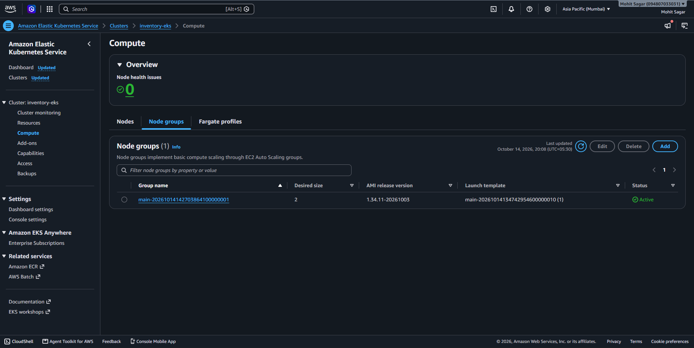
Infrastructure as Code on AWS
M7 · Terraform
66
resources from terraform apply
4 subnets
2 public + 2 private across 2 AZs
2 nodes
m7i-flex.large, EKS 1.34
66
destroyed afterwards: no runaway cost
Notes:
Terraform creates the VPC with public subnets for the load balancer and NAT, private subnets for the nodes, the EKS cluster and node group, the EBS CSI driver and the GitHub OIDC deploy role. Everything was torn down with terraform destroy after the demo: 66 created, 66 destroyed.

Slide 7
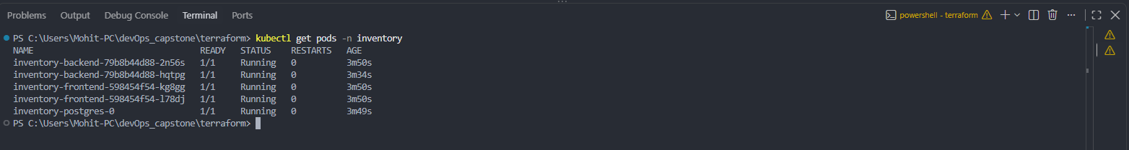
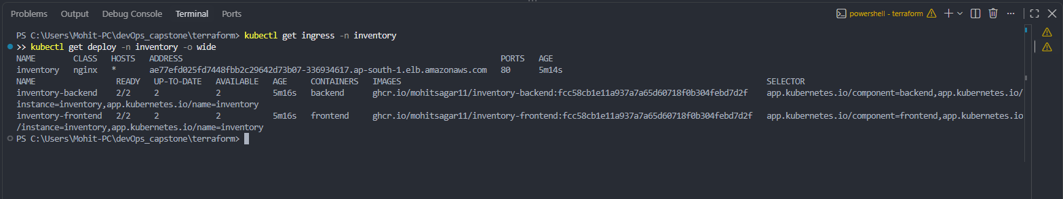
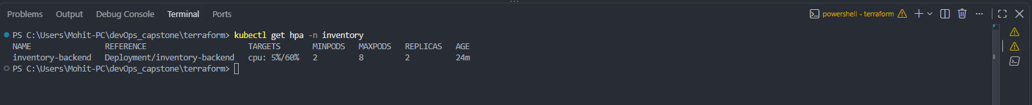
Kubernetes + Helm
M8 · K8s + Helm
Deployments
backend + frontend, 2 replicas
StatefulSet
Postgres on EBS gp3
Services
ClusterIP for all three
Ingress
/ → frontend, /api → backend
HPA
backend 2→8 at 60% CPU
ServiceMonitor
+ Grafana dashboard
One chart, three values files (default, dev, prod).
CI deploys every push with helm upgrade --install.
Notes:
The Helm chart packages everything the app needs. All pods are Running; the deployments run images tagged with the commit SHA; the Ingress is backed by an AWS load balancer; and the HPA watches backend CPU between 2 and 8 replicas.

Slide 8
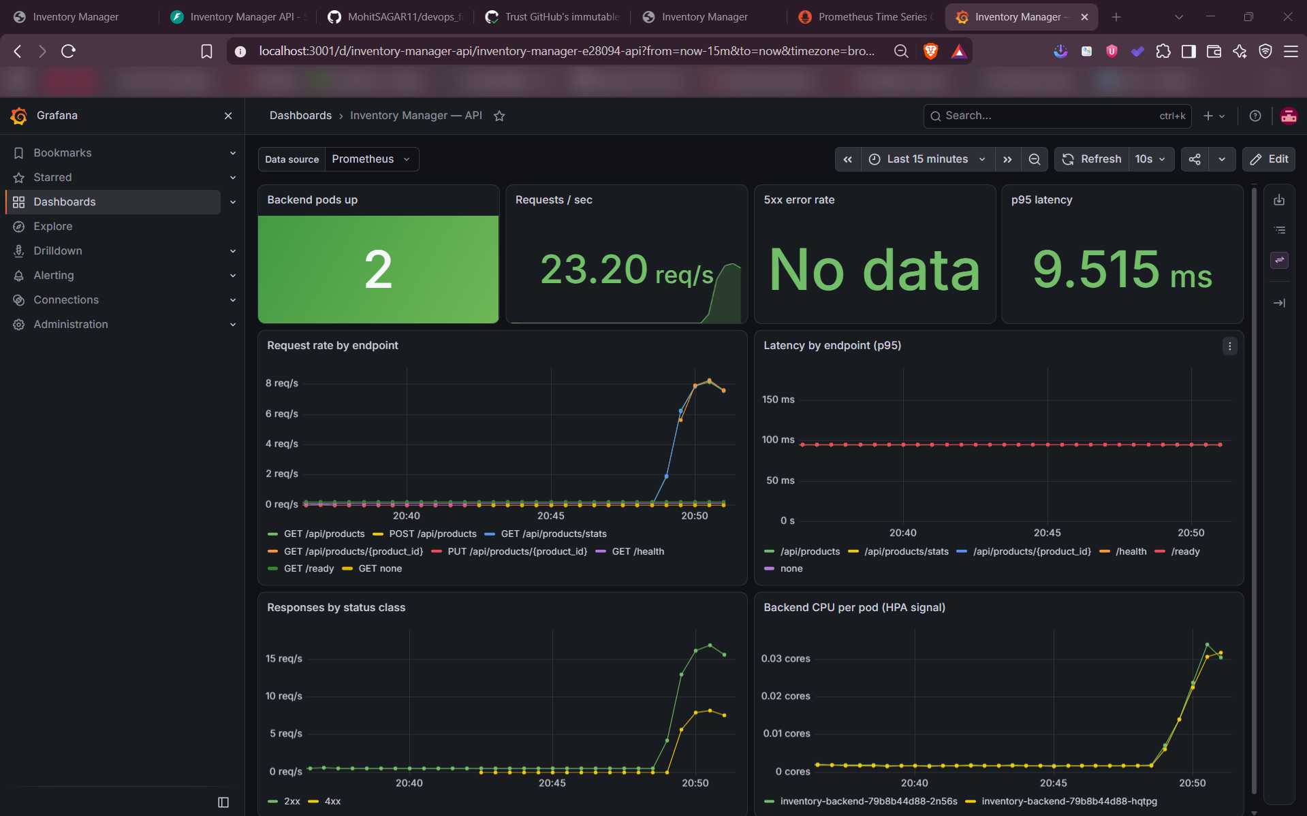
Observability
M9 · Monitoring
2 / 2
backend targets UP in Prometheus
23 req/s
during the load test
9.5 ms
p95 latency under load
Notes:
The backend exposes Prometheus metrics at /metrics. A ServiceMonitor tells Prometheus to scrape both pods every 15 seconds, and the Grafana dashboard is provisioned automatically from a ConfigMap in the Helm chart. Under load we saw about 23 requests per second with a p95 latency under 10 milliseconds.

Slide 9
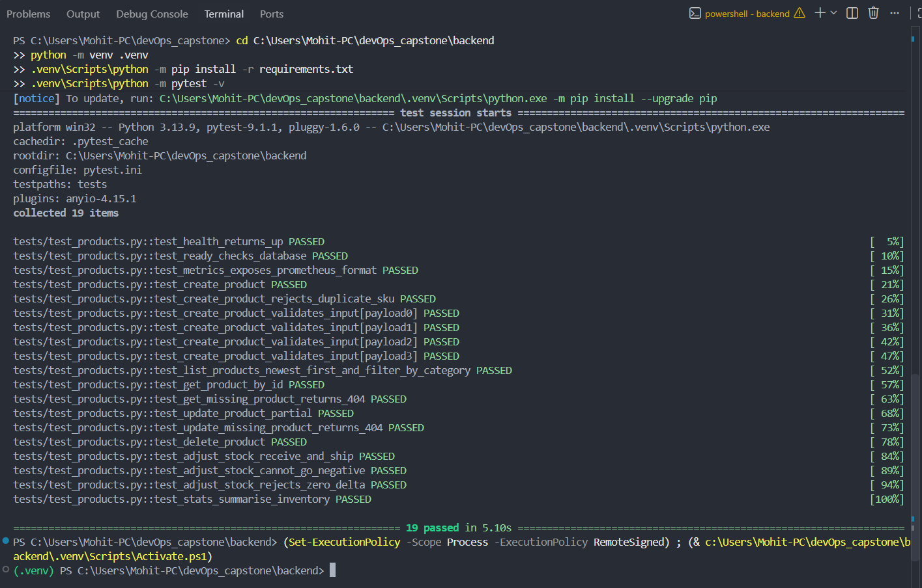
Quality gates before anything ships
M2 · M4
19
pytest cases, isolated SQLite DB
Non-root
uid 10001 backend, uid 101 Nginx
Multi-stage frontend image
Node builds the bundle; only static files ship in unprivileged Nginx.
One-command local stack
docker compose up --build starts Postgres, backend and frontend with health checks.
Notes:
Tests are the first gate: 19 cases over every endpoint, running against SQLite so they never touch the real database. Both containers run as non-root users, and the frontend uses a multi-stage build so Node never ships to production.

Slide 10
Problems solved along the way
Trivy blocked the first release
Fix: Upgraded Starlette and the nginx base image
Two pods raced on DB migrations
Fix: Postgres advisory lock around alembic upgrade
Backend started before Postgres
Fix: TCP health check and a
wait-for-postgres init container
AWS Free plan rejected t3.medium
Fix: Switched worker nodes to
m7i-flex.large
CI deploy: AssumeRole denied
Fix: Trusted GitHub's immutable OIDC subject
Uppercase username invalid in GHCR
Fix: Lowercased the owner in image names
Notes:
Real issues found by actually running the system. Each one was diagnosed from logs or error messages and fixed in code, not worked around by hand.

Slide 11
Live demo: commit to production
M10 · Demo
1
2
3
4
5
6
Edit header to “v2”
git push
Tests + Trivy
Images to GHCR
Helm upgrade on EKS
v2 live in browser
≈ 3 min
from git push to the new version serving traffic
Recorded walkthrough
demo/demo.mp4 · embedded in the README
github.com/MohitSAGAR11/devops_finalAssignment
Notes:
Live: change the header subtitle, commit and push. Show the Actions tab running tests, Trivy and the deploy, then kubectl get pods -w to watch pods roll to the new SHA, and refresh the browser to show v2. If live AWS is not available, play demo/demo.mp4.

Slide 12
Thank you
27
commits
19
tests
Questions?
0
HIGH/CRITICAL CVEs
66 / 66
AWS resources created / destroyed
github.com/MohitSAGAR11/devops_finalAssignment
Notes:
Summary: 27 commits, 19 tests, zero high or critical vulnerabilities shipped, and all 66 AWS resources destroyed after the demo. Happy to take questions.

