Slide 1

Interactive Truth Table Generator: Understanding Propositional Logic
Welcome to our presentation on truth tables and propositional logic. We'll explore how truth tables work, understand the fundamental concepts of propositional logic, and learn how to use our interactive truth table generator to visualize logical expressions.
Throughout this presentation, we'll examine various logical operators, demonstrate how to construct truth tables, and explore important logical equivalences that form the foundation of computational thinking and formal logic.

Slide 2

Fundamentals of Propositional Logic
Propositional logic deals with statements (propositions) that are either true or false. The building blocks include propositional variables (typically represented by letters like p, q, r), truth values (True or False), and logical connectives that join propositions together.
These elements combine to form the language of logical reasoning, allowing us to analyze arguments, design digital circuits, and create the foundation for computational systems.
1
Propositional Variables
Letters like p, q, r that represent statements which can be either true or false.
2
Truth Values
Every proposition has exactly one truth value: either True (T) or False (F).
3
Logical Connectives
Operators that connect propositions to form compound statements with new truth values.

Slide 3

Essential Logical Operators
Logical operators are the connectives that join simple propositions to create complex ones. Each operator has specific behavior defined by its truth table, showing how the truth value of the compound proposition depends on its components.
Operator
Symbol
Name
Description
NOT
¬, !
Negation
Reverses the truth value
AND
&
Conjunction
True only when both operands are true
OR
|
Disjunction
True when at least one operand is true
XOR
^
Exclusive OR
True when exactly one operand is true
IMPLIES
->
Implication
False only when premise is true and conclusion is false
EQUIV
<—>
Equivalence
True when both operands have the same truth value

Slide 4
Basic Truth Tables Explained
Truth tables systematically show all possible combinations of truth values for variables in a logical expression, along with the resulting truth value of the entire expression. They provide a visual way to understand how logical operators behave.
Negation (NOT)
Conjunction (AND)
Disjunction (OR)
The NOT operator simply flips the truth value:
The AND operator is true only when both inputs are true:
The OR operator is true when at least one input is true:
p
!p
p
q
p & q
p
q
p | q
T
F
T
T
T
T
T
T
F
T
T
F
F
T
F
T
F
T
F
F
T
T
F
F
F
F
F
F

Slide 5
Advanced Truth Tables: XOR, Implies, and Equivalance
p
q
p ^ q (XOR)
p -> q (IMPLIES)
p <—> q (EQUIVALENCE)
T
T
F
T
T
T
F
T
F
F
F
T
T
T
F
F
F
F
T
T

Slide 6




Advanced Operators: Implication and Equivalence
Implication (->) and equivalence (<—>) are more complex logical operators that play crucial roles in logical reasoning and mathematical proofs. Understanding their truth tables is essential for working with complex logical expressions.
Understand Implication
Create Truth Table
Recognize Equivalence
Apply in Expressions
Map all possible combinations of p and q values
p <—> q is true when p and q have the same truth value
Use these operators in complex logical formulas
p -> q is only false when p is true and q is false
The implication p → q can be read as "if p then q" and is equivalent to !p | q. The equivalence p <—> q means "p if and only if q" and is true precisely when p and q have identical truth values.

Slide 7






Important Logical Equivalences
Logical equivalences are powerful tools that allow us to transform logical expressions while preserving their meaning. These equivalences form the foundation for simplifying complex expressions and are essential in digital circuit design and formal verification.
Double Negation
Commutativity
!!p ≡ p - Negating a proposition twice returns the original proposition
p & q ≡ q & p, p | q ≡ q | p - Order doesn't matter for AND and OR operations
Associativity
Distributivity
(p & q) & r ≡ p & (q & r), (p | q) | r ≡ p | (q | r) - Grouping doesn't matter
p & (q | r) ≡ (p & q) | (p & r), p | (q & r) ≡ (p | q) & (p | r)
De Morgan's Laws
Implication
!(p & q) ≡ !p | !q, !(p | q) ≡ !p & !q - Rules for distributing negation
p -> q ≡ !p | q - An implication can be rewritten as a disjunction

Slide 8




Using the Interactive Truth Table Generator
Our truth table generator allows you to input logical expressions and instantly see the resulting truth table. This tool helps visualize how complex expressions evaluate across all possible input combinations.
Enter Your Expression
Review Variable Detection
Generate the Truth Table
Analyze the Results
Use operators: & (AND), | (OR), ! (NOT), -> (IMPLIES), <-> (EQUIVALENCE), ^ (XOR). Variable names can be any single letter (a-z). Use parentheses to control operation order.
Examine the truth table to understand how your expression evaluates under different conditions. For complex expressions, intermediate results may be shown.
The system will automatically detect the variables used in your expression. Verify these are correct before proceeding.
Click the "Generate Truth Table" button to create a complete table showing all possible combinations of truth values.

Slide 9
Example Truth Tables and Applications
1
Digital Circuits
2
Programming Conditions
Used to design logic gates in electronics, such as alarms, traffic lights, and calculators.
Help in writing and testing if-else conditions in software and apps.
3
Home Security Systems
4
Decision Making
Determine when an alarm should activate based on sensor inputs (e.g., door OR window open).
Assist in planning daily actions, like going out only if it's not raining AND you’re free.
5
Troubleshooting Devices
6
Mathematical Reasoning
Used to test combinations of inputs to find when a device works or fails.
Truth tables are used in logic and mathematics to verify the validity of arguments and prove logical equivalence between statements.

Slide 10
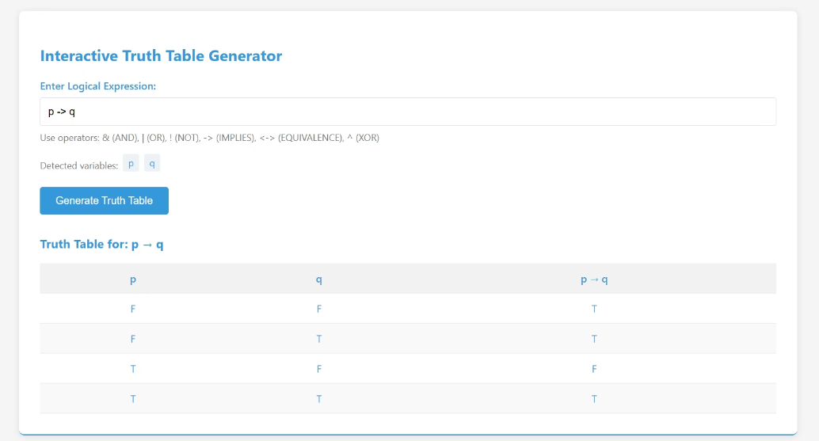
Implies ( → ) Operation
The implication (→) is false only when the premise is true and the conclusion is false.
In all other cases, the implication evaluates as true, reflecting conditional logic.
This refinement helps clarify reasoning in proofs and digital logic design.

Slide 11
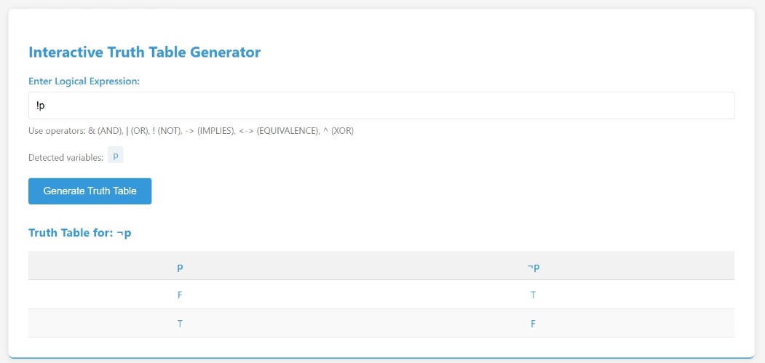
Not ( ¬, ! ) Operation
It inverts the truth value of a single statement—true becomes false, and false becomes true.
NOT is a unary operator, meaning it works with only one input.
The image visually shows this simple yet fundamental logic operation.

Slide 12
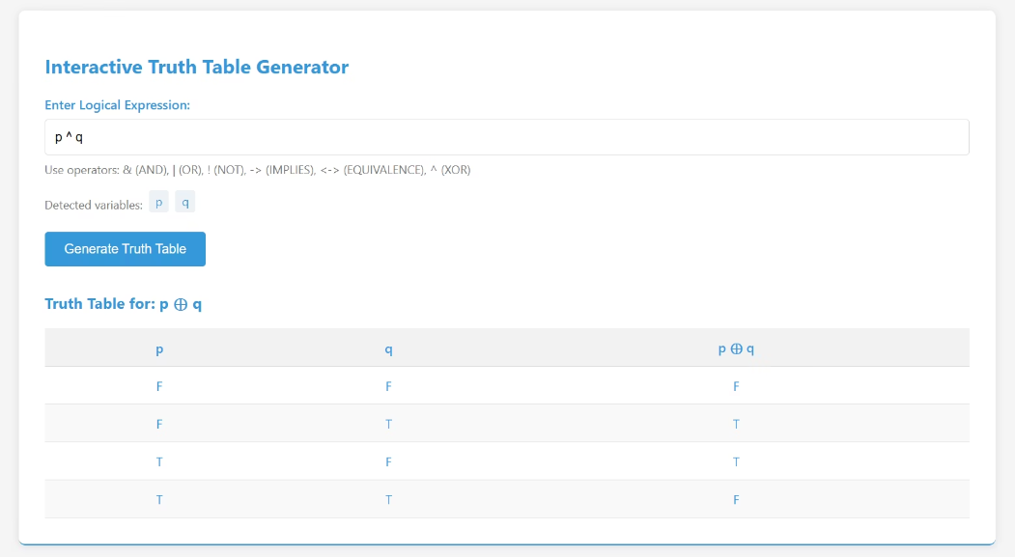
XOR ( ⊕ ) Operation
This slide shows the image of the truth table for the XOR (exclusive OR) operation.
XOR returns true only when the inputs are different—one true, one false
If both inputs are the same, the result is false.

Slide 13

OR ( V ) Operation
This slide displays the truth table for the OR (∨) logical operation.
OR returns true if at least one of the inputs is true.
It only gives false when both inputs are false.

