Slide 1
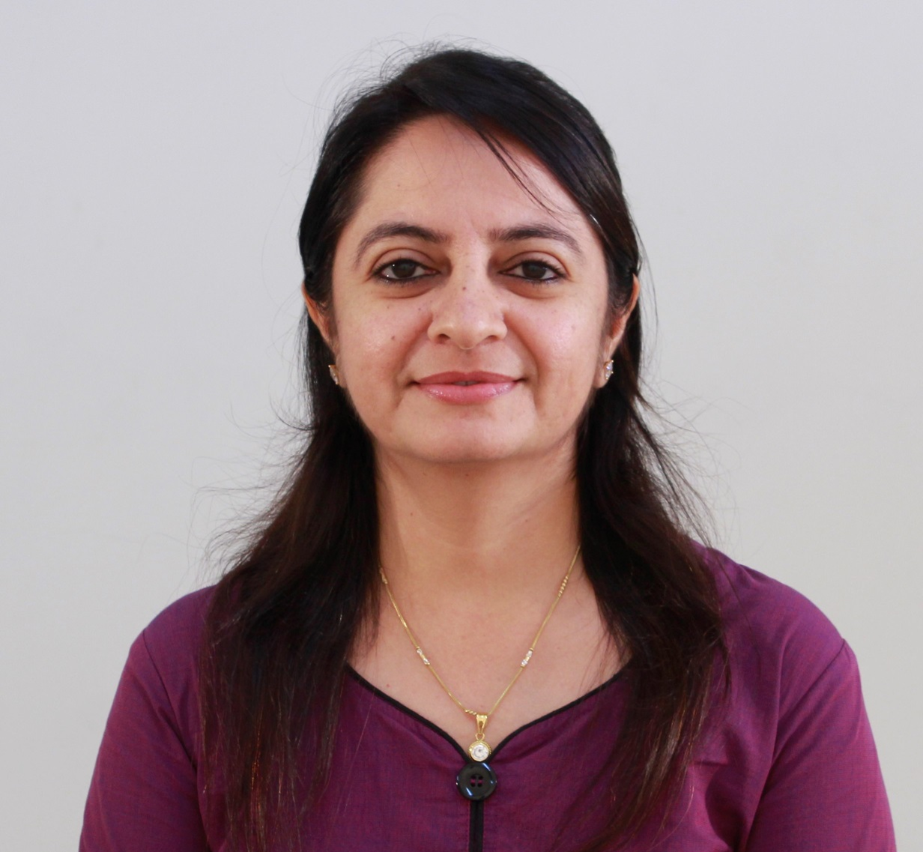
Unit-2
Application Layer
Computer Networks (CN)
DU #2305CS332
Prof. Devangi L. Kotak
Department of Computer Application
Devangi.kotak@darshan.ac.in

Slide 2

Looping
Outline
  Principles of Network Applications
  Web
  HTTP
  Cookies, Web Cache
  FTP
  E-mail
  SMTP
  IMAP, POP3
  DNS
  Socket programming with TCP and UDP

Slide 3
FTP – File Transfer Protocol

Slide 4
FTP (File Transfer Protocol)
File Transfer Protocol (FTP) is the commonly used protocol for exchanging files over the Network or Internet.
  Example: Filezilla
FTP uses the Internet's TCP/IP protocols to enable data transfer.
FTP uses client-server architecture.
FTP promotes sharing of files via remote computers with reliable and efficient data transfer.
FTP user interface
FTP client
File transfer
FTP server
User or Host
Local file system
Remote file system

Slide 5
FTP (File Transfer Protocol) – Cont…
FTP client connect FTP server at port 21 using TCP.
FTP uses two parallel TCP connections to transfer a file,
  Control Connection: Used for sending control information between two hosts.
  Data Connection: To send a file.
Control Information like user identification, password, commands to change remote directory, commands to “put” and “get” files
Client will browse remote file directory, sends commands over control connection.
FTP server maintains “state” about user like current directory, earlier authentication.

Slide 6

FTP (File Transfer Protocol) – Example

Slide 8
Telnet

Slide 9
Telnet
TELNET (TELecommunication NETwork) is an Application Layer protocol used for remote login and command execution on another computer over a TCP/IP network.
Feature | Description
Protocol Type | Application Layer (OSI Model), uses TCP port 23
Main Purpose | Remote terminal access to another system (as if you're using local terminal)
Connection Type | Text-based, Full-duplex, Reliable
Transport Layer | Uses TCP (ensures reliable delivery)

Slide 10
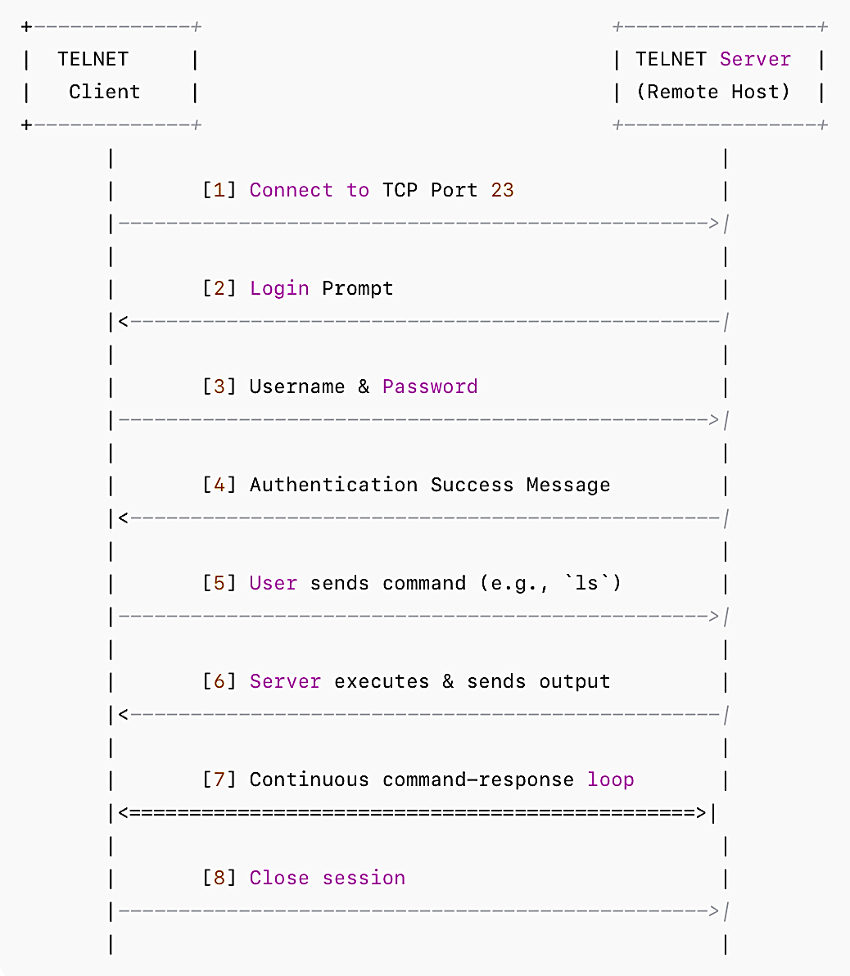
How TELNET Works?
Client runs a TELNET program.
Connects to TELNET server on port 23.
Authenticates with username and password.
Allows remote command execution.
TELNET is replaced by SSH in most secure environments.
SSH uses encryption and runs on port 22.

Slide 11


Challenge
Task
Set up a local TELNET server.
You have to connect from another system using telnet.

Slide 12
Email – SMTP, POP3, IMAP

Slide 13
Electronic Mail (Email)
Email is an asynchronous communication medium in which people send and read messages as convenient for them.
Modern Email has many powerful features like:
  A messages with attachments
  Hyperlinks
  HTML-formatted text
  Embedded photos
Email is fast, easy to distribute, and inexpensive.
High level view of Internet mail system and its key components.
  User agents
  Mail servers
  Simple Mail Transfer Protocol (SMTP)

Slide 14

Email - Cont…
User Agent
  User agents allow users to read, reply to, forward, save, and compose messages.
  E.g. Microsoft Outlook and Apple Mail.
Mail servers
  A mailbox contains incoming messages for user.
  A message queue of outgoing (to be sent) mail messages.
SMTP
  It is a principal application layer protocol between mail servers to send email messages.
    client: sending mail to server
    server: receiving mail from other different mail server
user
agent
mail
server
user
agent
SMTP
mail
server
user
agent
SMTP
SMTP
user
agent
mail
server
user
agent
user
agent
Outgoing
message queue
user mailbox

Slide 15
SMTP
Simple Mail Transfer Protocol used in sending and receiving e-mail.
It use TCP to reliably transfer email message from client to server using port 25.
It restricts the body (not just the headers) of all mail messages to simple 7-bit ASCII.
SMTP does not use intermediate mail servers for sending mail.
If receiving end mail server is down, the message remains in sending end mail server and waits for a new attempt.

Slide 16
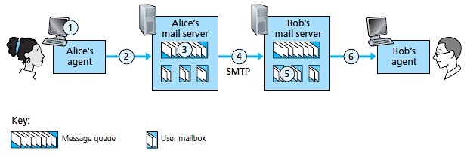
SMTP - Example
1) Alice uses user agent to compose message to computer@darshan.ac.in
2) Alice’s user agent sends message to her mail server; message placed in message queue.
3) Client side of SMTP opens TCP connection with Bob’s mail server
4) SMTP client sends Alice’s message over the TCP connection
5) Bob’s mail server places the message in Bob’s mailbox
6) Bob invokes his user agent to read message

Slide 17
SMTP - Example
Alice uses user agent to compose message to computer@darshan.ac.in
Alice’s user agent sends message to her mail server; message placed in message queue.
Client side of SMTP opens TCP connection with Bob’s mail server.
4. SMTP client sends Alice’s message over the TCP connection.
5. Bob’s mail server places the message in Bob’s mailbox.
6. Bob invokes his user agent to read message.

Slide 18
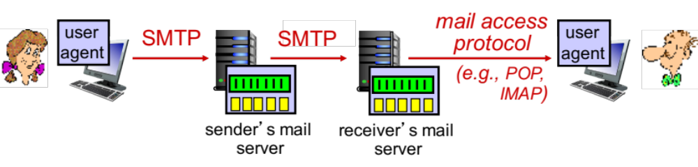
Mail Access Protocols (POP3 and IMAP)
POP3
  Post Office Protocol – Version 3
IMAP
  Internet Mail Access Protocol
A mail access protocol, such as POP3, is used to transfer mail from the recipient’s mail server to the recipient’s user agent.

Slide 19
POP3 – Post Office Version 3
POP3 is an extremely simple mail access protocol.
With the TCP connection established, POP3 progresses through three phases: authorization, transaction and update.
In authorization, the user agent sends a username and a password to authenticate the user.
In transaction, the user agent retrieves messages, mark messages for deletion, remove deletion marks and obtain mail statistics.
In update, after the quit command by client, ending the POP3 session; the mail server deletes marked messages.
POP3 is designed to delete mail on the server as soon as the user has downloaded it.

Slide 20
  IMAP - Internet Mail Access Protocol
To keeps all messages in one place: at server
The recipient can then move and organize the message into a new, user-created folder, read the message, delete the message, move messages from one folder to another and so on.
To allow users to search remote folders for messages matching specific criteria.
Also permit a user agent to obtain components of messages, When low-bandwidth connection between the user agent and its mail server.
In this case, user not to download all the messages in its mailbox, particularly avoiding long messages like an audio or video clip.

Slide 21
SNMP
Simple Network Management Protocol
SNMP Architecture
SNMP Operation

Slide 22
SNMP - Simple Network Management Protocol
SNMP is an Application Layer protocol used to monitor, manage, and control network devices such as routers, switches, servers, firewalls, printers, and more.
Feature | Description
Protocol Type | Application Layer
Transport Protocol | Uses UDP (typically ports 161 and 162)
Purpose | Network monitoring and device management
Communication | Manager ↔ Agent model

Slide 23
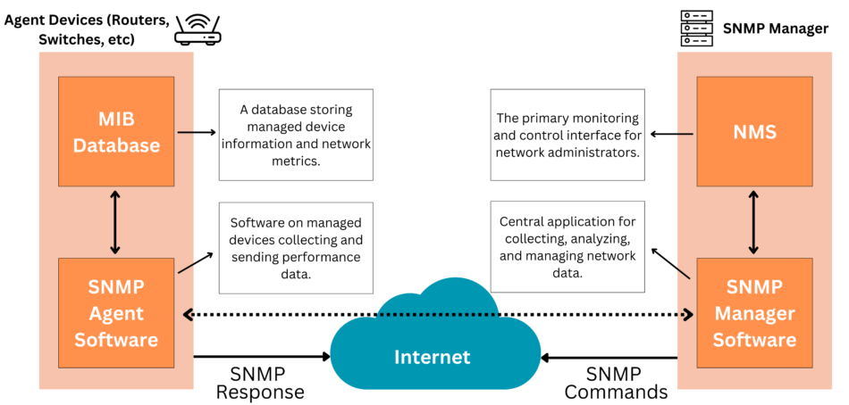
SNMP Architecture

Slide 24
SNMP Architecture
SNMP Manager
  Central system (like a NMS – Network Management Station)
  Sends requests and receives responses or traps
SNMP Agent
  Software running on network devices
  Collects and stores management data in a structure (MIB)
MIB (Management Information Base)
  Hierarchical database of device properties
  Uses OIDs (Object Identifiers) to locate data

Slide 25
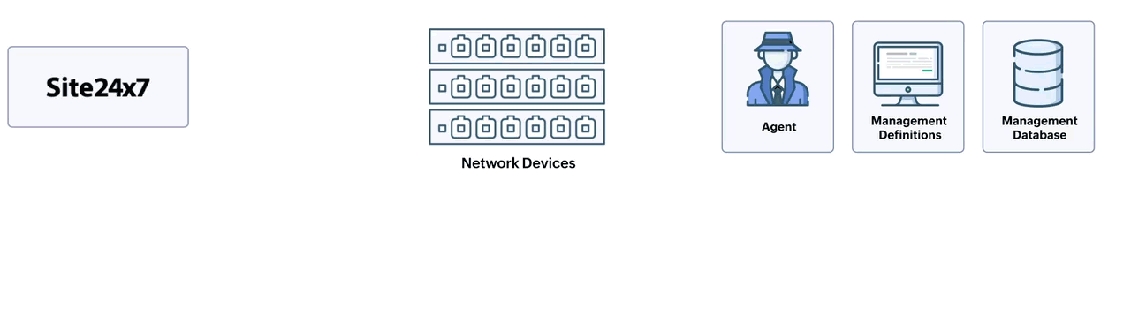
SNMP Operation
Operation | Purpose
GET | Retrieve a value from an agent
SET | Modify a value on an agent
GET-NEXT | Traverse MIB tree
TRAP | Asynchronous alert from agent to manager
INFORM | Like TRAP but expects acknowledgment
Example Use Cases
Monitor CPU or memory usage on a server
Track interface traffic on a router
Receive alerts when a link goes down
Auto-generate network maps and logs

Slide 26
DHCP
Dynamic Host Configuration Protocol

Slide 27
DHCP
DHCP stands for Dynamic Host Configuration Protocol.
It is a network management protocol used to automatically assign IP addresses and other network settings to computers and devices on a network.
Why we need DHCP?
Example: Imagine you have 100 computers in a lab.
Without DHCP, You would have to manually configure each computer with an IP address, subnet mask, gateway, and DNS.
With DHCP, All devices get their IP addresses automatically, saving time and avoiding mistakes like duplicate IPs.
Benefits of DHCP
  Automatic IP assignment.
  Prevents IP conflicts.
  Saves time for network admins.
  Supports mobile devices easily (laptops, phones, IoT).

Slide 28
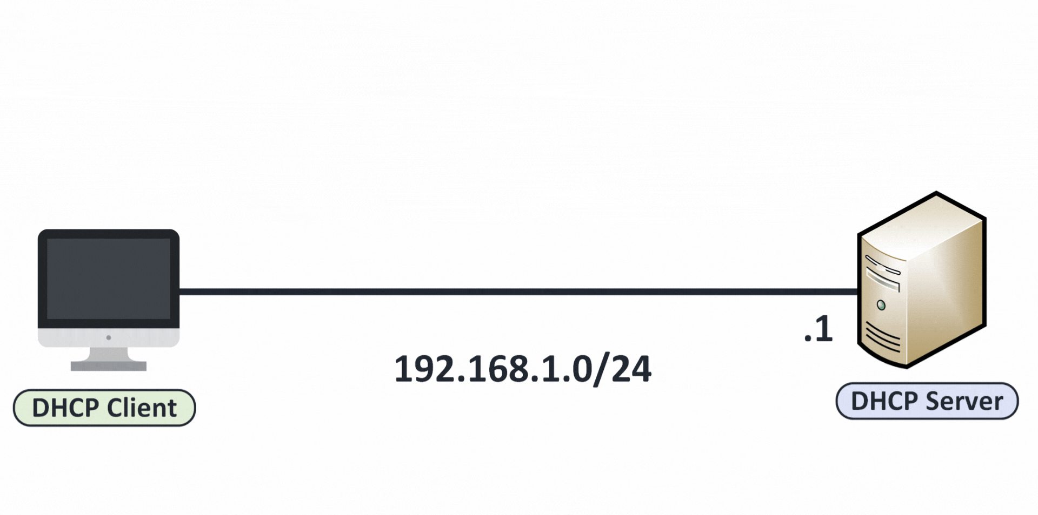
How does DHCP work?
DHCP works using a client-server model.
DHCP Server: A device (like a router or dedicated server) that manages and gives out IP addresses.
DHCP Client: The device (laptop, phone, PC) that needs an IP address.
The IP address given by DHCP is not permanent.
It is given for a certain time period, called a lease time.
After it expires, the device must renew the lease or get a new IP.

Slide 29
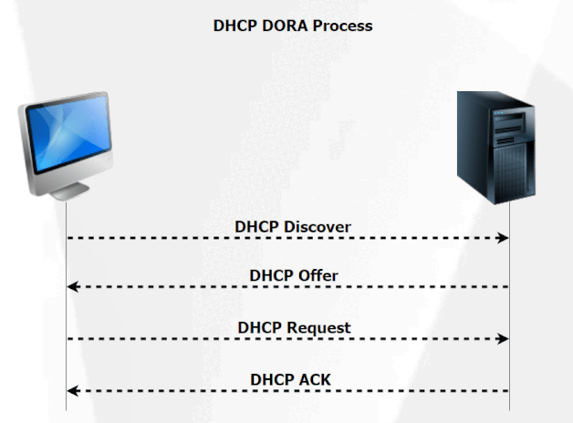
DHCP Process (DORA Process)
When a new device connects to a network, 4 main steps happen — DORA:
Discover:
  The client sends a DHCP Discover message to find any available DHCP servers.
Offer:
  The DHCP server replies with a DHCP Offer, offering an IP address to the client.
Request:
  The client sends a DHCP Request to say “Yes, I want this IP!”
Acknowledge:
  The server sends a DHCP Acknowledge, confirming the lease of the IP address.

Slide 30
DNS – Domain Name System

Slide 31
DNS - Domain Name System
It is an internet service that translates domain names into IP addresses.
It is application-layer protocol.
DNS service must translate the domain name into the corresponding IP address.
In DNS system, If one DNS server doesn't know how to translate a particular domain name, it asks another one, and so on, until the correct IP address is returned.
Alphabetic name remember by human
IP Address

Slide 32
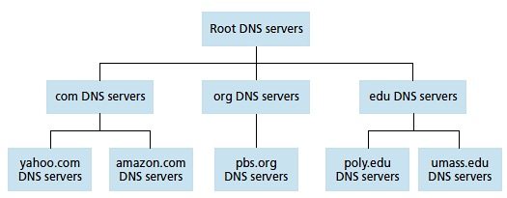
DNS - Example
DNS client wants to determine the IP address for the hostname www.amazon.com
The client first contacts one of the root servers, which returns IP addresses for TLD servers - top-level domain .com.
Then contacts TLD servers, which returns the IP address of an authoritative server for www.amazon.com
Finally, contacts one of the authoritative servers for www.amazon.com, which returns the IP address for the hostname www.amazon.com

Slide 33
DNS: A distributed - hierarchical database
Root DNS Servers – Total 13

Slide 34
DNS – Cont…
Top-level domain (TLD) servers:
  It is responsible for com, org, net, edu, aero, jobs, museums, and all top-level country domains, e.g.: uk, fr, ca, jp
  Network Solutions maintains servers for .com TLD
  Education for .edu TLD
Authoritative DNS servers:
  To organization’s own DNS servers, providing authoritative hostname to IP mappings for organization’s named hosts.
  It can be maintained by organization or service provider.
Local DNS name servers:
  It does not strictly belong to hierarchy
  when host makes DNS query, query is sent to its local DNS server.
    It acts as proxy, forwards query into hierarchy.

Slide 35
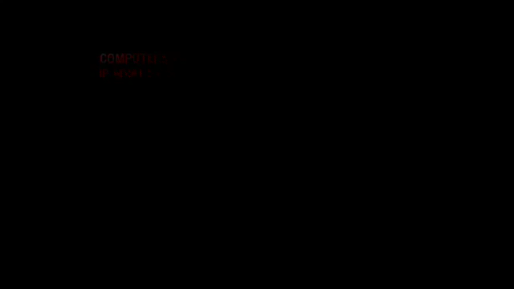
DNS - Example

Slide 36
DNS Name Resolution Example
Iterated Query:
  A host at cis.poly.edu wants IP address for gaia.cs.umass.edu
root DNS server
2
3
TLD DNS server
4
5
local DNS server
dns.poly.edu
7
6
1
8
authoritative DNS server
dns.cs.umass.edu
requesting host
cis.poly.edu
gaia.cs.umass.edu

Slide 37
DNS Name Resolution Example
Recursive Query:
  A host at cis.poly.edu wants IP address for gaia.cs.umass.edu
root DNS server
2
3
7
6
TLD DNS
server
local DNS server
dns.poly.edu
5
4
1
8
authoritative DNS server
dns.cs.umass.edu
requesting host
cis.poly.edu
gaia.cs.umass.edu

Slide 38
DNS – Cont...
Distributed database design is more preferred over centralized design to implement DNS in the Internet.
A single point of failure: If the DNS server crashes then the entire Internet will not stop.
Traffic volume: With millions of device and users accessing its services from whole globe at the same time.
A Single DNS Server cannot handle huge DNS traffic but with distributed system its distributed and reduce overload on server.
Distant centralized database: A single DNS server cannot be “close to” all the querying clients.
  If it is in New York City, then all queries from Australia must travel to the other side of the globe, perhaps over slow and congested links cause significant delays.
Maintenance: To keep records for all Internet hosts. it would have to be updated frequently to account for every new host.

Slide 39
Socket Programming – TCP, UDP

Slide 40
Socket Programming
Socket is interface between application and network.
  An application creates a socket.
  Two type of socket:
    TCP Socket – Reliable Transmission
    UDP Socket – Unreliable Transmission
Once configured the application can pass data to the socket for transmission and receive data from the socket (transmitted through the network by some other host).
application
socket
application
controlled by
app developer
process
process
transport
transport
network
network
controlled
by OS
link
Internet
link
physical
physical

Slide 41
Type of Socket
SOCK_STREAM
  E.g. TCP
  Reliable delivery
  In-order guaranteed
  Connection-oriented
  Bidirectional
SOCK_DGRAM
  E.g. UDP
  Unreliable delivery
  No order guarantees
  Connection-less
  Unidirectional
App
D1
App
3
2
3
1
2
D2
socket
Dest.
1
socket
D3

Slide 42
Client-Server socket interaction: UDP
server (running on serverIP)
client
create socket:
create socket, port= x:
clientSocket =
socket(AF_INET,SOCK_DGRAM)
serverSocket =
socket(AF_INET,SOCK_DGRAM)
Create datagram with server IP and
port=x; send datagram via
clientSocket
read datagram from
serverSocket
write reply to
serverSocket
specifying
client address,
port number
read datagram from
clientSocket
close
clientSocket

Slide 43
Client-Server socket interaction: TCP
server (running on hostid)
client
create socket,
port=x, for incoming request:
serverSocket = socket()
wait for incoming
connection request
TCP
connection setup
create socket,
connect to hostid, port=x
connectionSocket =
serverSocket.accept()
clientSocket = socket()
send request using
clientSocket
read request from
connectionSocket
write reply to
connectionSocket
read reply from
clientSocket
close
connectionSocket
close
clientSocket

Slide 44
Outline - Summary
Principles of Computer Applications
  Browser, Web Server, Email, P2P Applications etc…
Application Layer (TCP – UDP Services)
Web (Web Pages – Objects like html, jpeg, mp3, etc…)
HTTP (TCP connection, port-80, persistent & non-persistent conn.), Request & Response Message format, Cookies, Web caches, FTP, Port-21
E-mail (User agent, Mail Server, SMTP port - 25), POP3, IMAP
DNS (Domain names to IP Address), hierarchy structure
Socket programming with TCP and UDP (TCP – Sock_Stream, UDP – Sock_DGram)

Slide 45
Computer Networks (CN)
DU #2305CS332
Prof. Devangi L. Kotak
Department of Computer Application
Devangi.kotak@darshan.ac.in

