Slide 1
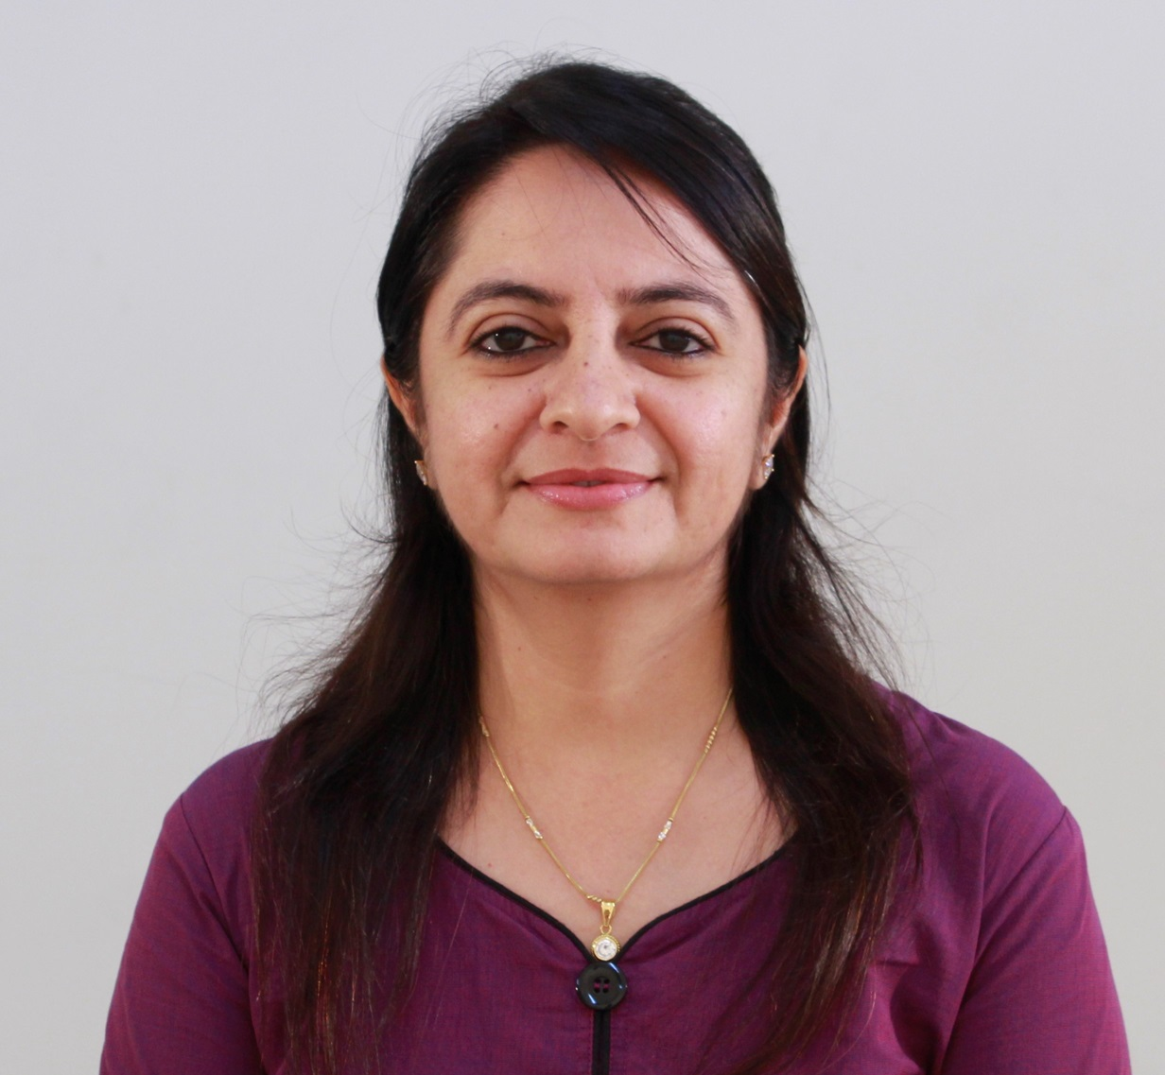
Unit-3 :
Transport Layer
Computer Networks (CN)
DU #2305CS332
Prof. Devangi L. Kotak
Department of Computer Application
Devangi.kotak@darshan.ac.in

Slide 2

Looping
Outline
  Introduction and Transport Layer Services
  Multiplexing and Demultiplexing
  Connectionless Transport (UDP)
  Principles of Reliable Data Transfer
  Concept of Sliding Window Protocol
  Connection oriented Transport (TCP)
  Flow Control
  Congestion Control

Slide 3
Introduction
Transport Layer Services

Slide 4


















Transport Layer Services and Protocols
It provides logical communication between application processes running on different hosts.
A transport protocols run in end systems.
Sender side: It breaks application messages into segments, then passes to network layer.
Receiver side: It reassembles segments into messages, then passes to application layer.
Example: TCP and UDP
application
transport
network
data link
physical
logical end-end transport
application
transport
network
data link
physical

Slide 5
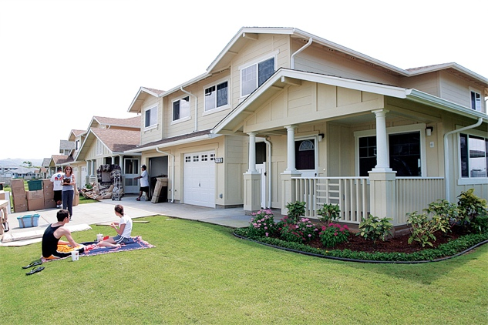

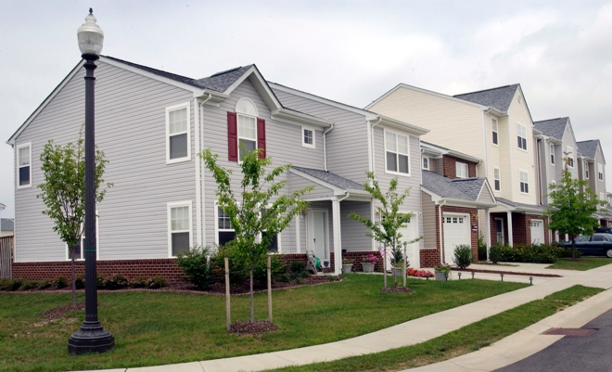
Transport Layer Services and Protocols – Example
West Side
Applications Messages = Letters in envelops
Network Layer Protocol = postal service
(including mail persons)
East Side
Hosts(End Systems) = Houses
Processes = Cousins
Transport Layer Protocol = Ann & Bill

Slide 6
Multiplexing & De-multiplexing

Slide 7
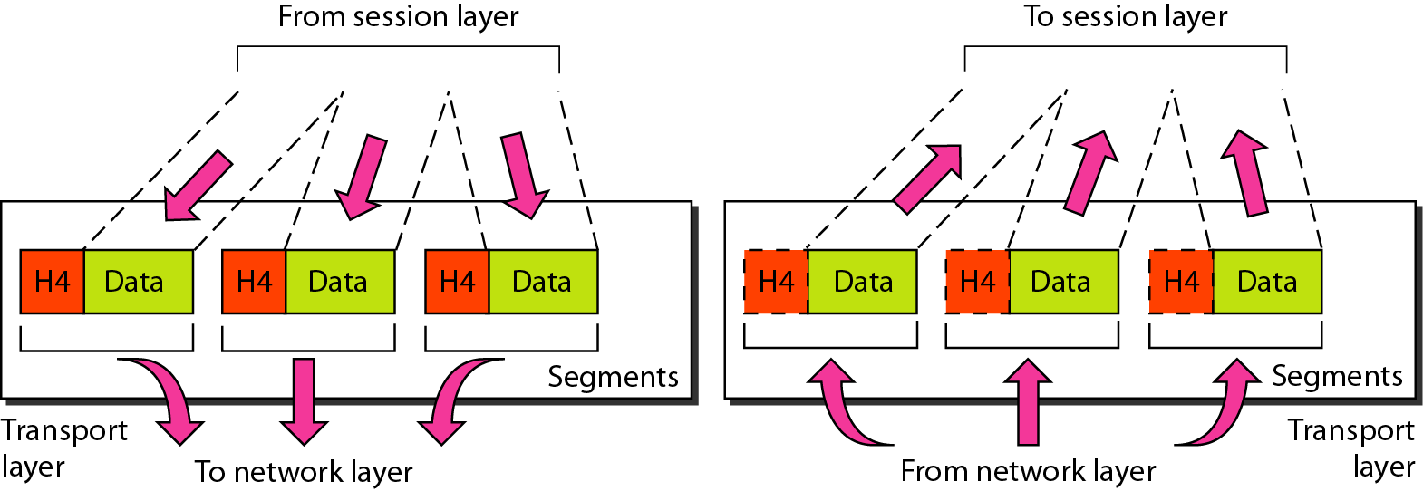
Multiplexing / Demultiplexing
Roll of transport layer is to extend host-to-host delivery to process-to-process delivery.
Identify receiving socket information and direct this segment to upper layer
Encapsulating with header information

Slide 8
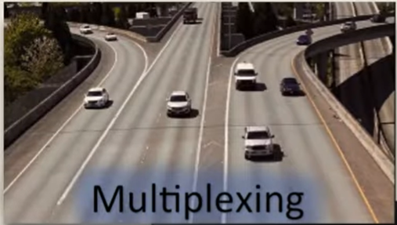
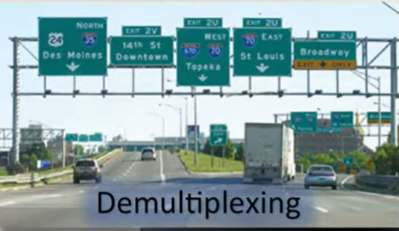
Multiplexing / Demultiplexing

Slide 9

Multiplexing / Demultiplexing
Multiplexing at sender:
Demultiplexing at receiver:
Job of collecting data from multiple
Sockets and add transport header (like source port no and destination port no (later used for demultiplexing)
Job of delivering data to correct socket is called
demultiplexing. Use header information to
deliver received segments to correct socket
application
application
P1
P2
application
socket
P3
transport
P4
process
transport
network
transport
network
link
network
link
physical
link
physical
Server B
physical
Host A
Host C

Slide 10
How de-mulptiplexing works?
A host PC receives IP datagrams.
Each datagram has source IP address and destination IP address.
Each datagram carries one transport-layer segment.
Each segment has source and destination port number.
Port no is 32 bits so range will from 0 to 65535. But well known ports are between 0 to 1023 so practically available range is 1024 to 65535.
A host PC uses IP addresses & port numbers to direct segment to appropriate socket.
Well known port 0-1023 for eg. http-80, ftp-21, smtp-25
32 bits
source port #
dest port #
other header fields
Application data (message)
TCP/UDP segment format

Slide 11
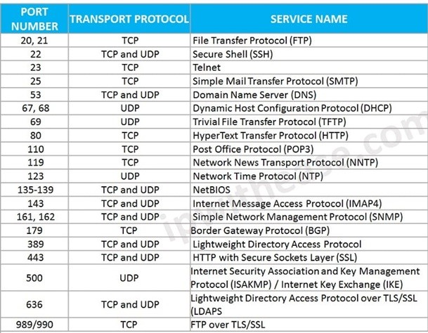
Well-known Port Nos

Slide 12
Connectionless demultiplexing
Create socket with host-local port #:
  DatagramSocket mySocket1 = new DatagramSocket(12534);
After creating datagram, must specify:
  destination IP address
  destination port #
When host receives UDP segment:
  It checks destination port # in segment and directs UDP segment to socket with that port #.
IP datagrams with same destination port #, but different source IP addresses and/or source port numbers will be directed to same socket at destination.

Slide 13
Example: Connectionless
DatagramSocket mySocket2 = new DatagramSocket
(9157);
DatagramSocket serverSocket = new DatagramSocket
(6428);
DatagramSocket mySocket1 = new DatagramSocket (5775);
application
application
P1
application
P3
P4
transport
transport
network
transport
network
link
network
link
physical
link
physical
Server B
physical
Host A
source port: 6428
dest port: 9157
source port: ?
dest port: ?
6428
5775
Host C
source port: 9157
dest port: 6428
source port: ?
dest port: ?
5775
6428

Slide 14
Connection-oriented demultiplexing
TCP socket identified by 4-tuple:
  Source IP address
  Source port number
  Destination IP address
  Destination port number
When TCP segment arrives, receiver uses all four values to direct(demultiplex) segment to appropriate socket.
Server host may support many simultaneous TCP sockets:
  each socket identified by its own 4-tuple.
Web servers have different sockets for each connecting client.
Persistent HTTP will have same socket per each request.
Non-persistent HTTP will have different socket for each request.

Slide 15
Example: Connection-oriented
Apache HTTP server
application
application
P4
P5
P6
application
P3
P2
P3
transport
transport
network
transport
network
link
network
link
physical
link
physical
physical
server:
IP address B
host:
IP address C
host:
IP address A
source IP,port: B,80
dest IP,port: A,9157
source IP,port: C,5775
dest IP,port: B,80
source IP,port: A,9157
dest IP, port: B,80
source IP,port: C,8585
dest IP,port: B,80
three segments, all destined to IP address: B,
dest port: 80 are demultiplexed to different sockets

Slide 16
Connectionless Transport - UDP

Slide 17
Connectionless Transport - UDP
User Datagram Protocol – Transport layer protocol.
It takes message from application process, attach source & destination port# for Multiplexing/Demultiplexing then pass to network layer.
Making best effort to deliver the segment.
No handshaking between sender and receiver in transport layer.
So, that UDP is connectionless protocol. E.g. DNS, SNMP, RIP
UDP used in streaming multimedia apps (loss tolerant, rate sensitive).

Slide 18
UDP Segment - Header
length (in bytes)
UDP segment - including header
32 bits
source port #
dest port #
Why UDP?
length
checksum
No connection establishment (so there is no delay).
Simple: No connection state at sender, receiver (like seq parameter, ack parameter)
Small header size
No congestion control:
  UDP can blast away as fast as desired
  Can function in case of congestion
application
data
(payload)
UDP segment format

Slide 19
UDP - Checksum
Checksum is used to detect errors in transmitted segment.
Sender:
  Take segment contents, including header fields, as sequence of 16-bit integers.
  Checksum: addition (one’s complement sum) of segment contents.
  Sender puts checksum value into UDP checksum field.
Receiver:
  Compute checksum of received segment.
  Check if computed checksum equals checksum field value:
    Not equal - error detected
    Equal - no error detected

Slide 20

UDP Checksum
Goal: To detect error (i.e. flipped bits) in transmitted segment
For example:
If checksum is different then, there is a problem in data received
1st number
2nd number
Sum
Transmitted:
5
6
11
Received:
4
6
11
$$≠$$
Receiver-computed
checksum
Sender-computed
checksum (as received)

Slide 21
Checksum - Example
Add two 16-bit integers word
Sender
Receiver
1 1 1 1 0 0 1 1 0 0 1 1 0 0 1 1 0
1 1 1 0 1 0 1 0 1 0 1 0 1 0 1 0 1
1 1 0 1 1 1 0 1 1 1 0 1 1 1 0 1 1
+
1 1 0 1 1 1 0 1 1 1 0 1 1 1 1 0 0
0 1 0 0 0 1 0 0 0 1 0 0 0 0 1 1
1 1 1 1 0 0 1 1 0 0 1 1 0 0 1 1 0
1 1 1 0 1 0 1 0 1 0 1 0 1 0 1 0 1
1 1 0 1 1 1 0 1 1 1 0 1 1 1 0 1 1
+
1 1 0 1 1 1 0 1 1 1 0 1 1 1 1 0 0
1 0 1 0 0 0 1 0 0 0 1 0 0 0 0 1 1
1 1 1 1 1 1 1 1 1 1 1 1 1 1 1 1
wraparound
sum
sum
checksum
If one of the bits is a 0, then we can
say that error introduced into packet
Note: when adding numbers, a carryout from the most significant bit needs to be added to the result

Slide 22
Checksum - Practice Example
10011001 11100010 00100100 10000100 (Use 8 bit word)
1001001110010011 1001100001001101 (Use 16 bit word)
Checksum Value:
11011010
1101010000011110

Slide 23
Principles of Reliable Data Transfer

Slide 24
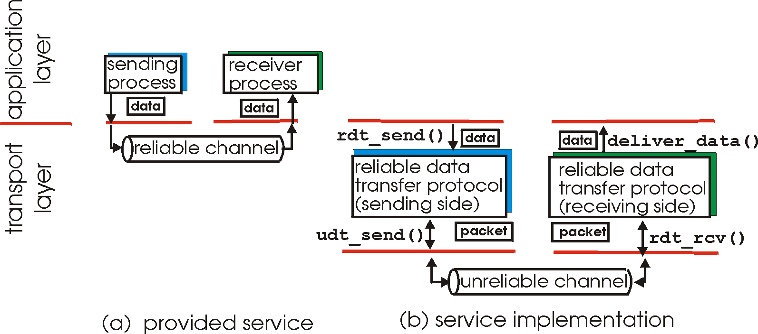
Principles of reliable data transfer
Characteristics of unreliable channel will determine complexity of reliable data transfer protocol (rdt)

Slide 25
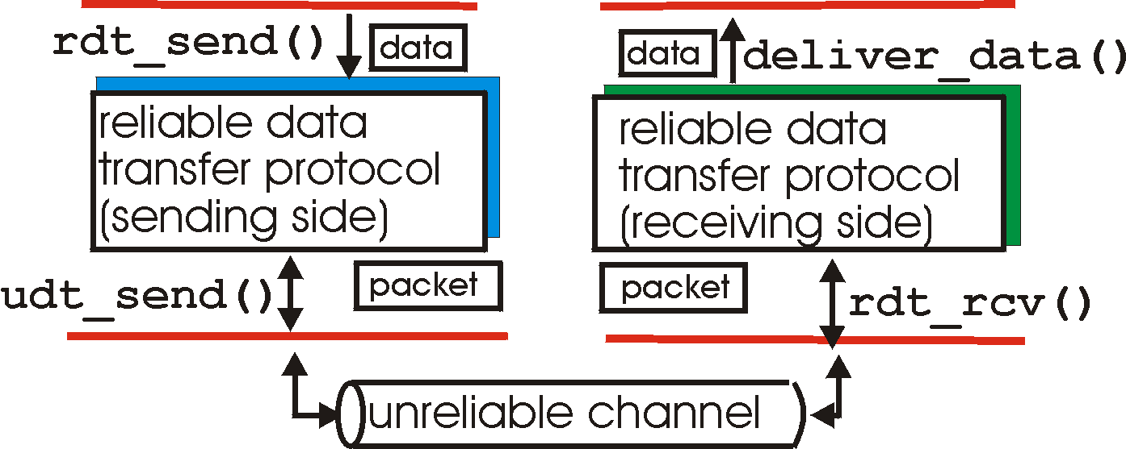
Reliable Data Transfer(rdt)
rdt_send(): called from above layer, (e.g., by application layer).
Passed data to receiver
deliver_data(): called by rdt to deliver data to upper layer
sender
side
receiver
side
udt_send(): called by rdt,
to transfer packet over
unreliable channel to receiver
rdt_rcv(): called when packet arrives on receiver side of channel

Slide 26
Reliable Data Transfer – Cont…
In this topic, we will incrementally develop the sender and receiver side of Reliable Data Transfer (rdt) protocol.
First we will develop rdt 1.0 then rdt 2.0, rdt 2.1, rdt 2.2, rdt 3.0
Consider only unidirectional data transfer.
  A control information will flow on both directions.
Use finite state machines (FSM) to specify sender and receiver.
When in this “state” next state uniquely determined by next event.
Arrow indicates the transition of protocol from one state to another.
A model used to represent and control the behaviour of systems that can exist in a finite number of states at any given time.
event causing state transition
actions taken on state transition
state
1
state
2
event
actions

Slide 27
rdt 1.0
Reliable transfer over a reliable channel. (assume this so that it will be easy to design protocol in the beginning).
Underlying channel perfectly reliable channel.
  no bit errors
  no loss of packets
Separate FSMs for sender & receiver:
  Sender sends data into underlying channel
  Receiver reads data from underlying channel
Wait for call from above
rdt_send(data)
Wait for call from below
rdt_rcv(packet)
extract (packet,data)
deliver_data(data)
packet = make_pkt(data)
udt_send(packet)
sender
receiver

Slide 28
rdt 2.0 – Stop & Wait Protocol

Slide 29
rdt 2.0 – channel with bit errors
Underlying channel may flip bits in packet.
  checksum to detect bit errors.
To recover from errors:
  acknowledgements (ACKs): receiver explicitly tells sender that packet received OK.
  negative acknowledgements (NAKs): receiver explicitly tells sender that packet had errors.
  sender retransmits packet on receipt of NAK.
New mechanisms in rdt 2.0 (beyond rdt 1.0):
  Error detection
  Feedback: control messages(ACK,NAK) from receiver to sender
  Retransmission: Error in received packet, retransmitted by the sender
It is known as stop-and-wait protocol.

Slide 30
rdt 2.0 – with no error
rdt_send(data)
sndpkt = make_pkt(data, checksum)
udt_send(sndpkt)
receiver
rdt_rcv(rcvpkt) &&
isNAK(rcvpkt)
Wait for call from above
Wait for ACK or NAK
rdt_rcv(rcvpkt) &&
corrupt(rcvpkt)
udt_send(sndpkt)
udt_send(NAK)
rdt_rcv(rcvpkt) && isACK(rcvpkt)
Wait for call from below
Λ
sender
rdt_rcv(rcvpkt) &&
notcorrupt(rcvpkt)
extract(rcvpkt,data)
deliver_data(data)
udt_send(ACK)

Slide 31
rdt 2.0 – with error
rdt_send(data)
snkpkt = make_pkt(data, checksum)
udt_send(sndpkt)
receiver
rdt_rcv(rcvpkt) &&
isNAK(rcvpkt)
Wait for call from above
Wait for ACK or NAK
rdt_rcv(rcvpkt) &&
corrupt(rcvpkt)
udt_send(sndpkt)
udt_send(NAK)
rdt_rcv(rcvpkt) && isACK(rcvpkt)
Wait for call from below
Λ
sender
rdt_rcv(rcvpkt) &&
notcorrupt(rcvpkt)
extract(rcvpkt,data)
deliver_data(data)
udt_send(ACK)

Slide 32
rdt 2.0 – FSM Specification
rdt_send(data)
sndpkt = make_pkt(data, checksum)
udt_send(sndpkt)
receiver
rdt_rcv(rcvpkt) &&
isNAK(rcvpkt)
Wait for call from above
Wait for ACK or NAK
rdt_rcv(rcvpkt) &&
corrupt(rcvpkt)
udt_send(sndpkt)
udt_send(NAK)
rdt_rcv(rcvpkt) && isACK(rcvpkt)
Λ
Wait for call from below
sender
rdt_rcv(rcvpkt) &&
notcorrupt(rcvpkt)
extract(rcvpkt,data)
deliver_data(data)
udt_send(ACK)

Slide 33
rdt 2.1 - handled ACKs/NAKs

Slide 34
rdt 2.1
The difficulty in rdt 2.0 is that if an ACK or NAK is corrupted, the sender has no way of knowing whether or not the receiver has correctly received the last piece of transmitted data.
An approach is for the sender to simply resend the current data packet when it receives a garbled ACK or NAK packet.
This, however, introduces duplicate packets into the sender-to-receiver channel.
The fundamental difficulty with duplicate packets is that the receiver doesn't know whether the ACK or NAK it last sent was received correctly at the sender. Thus, it cannot know a priori whether an arriving packet contains new data or is a duplicate.
A simple solution to this new problem is to add a new field to the data packet and have the sender number its data packets by putting a sequence number into this field.
The receiver then need only check this sequence number to determine whether or not the received packet is a retransmission.

Slide 35
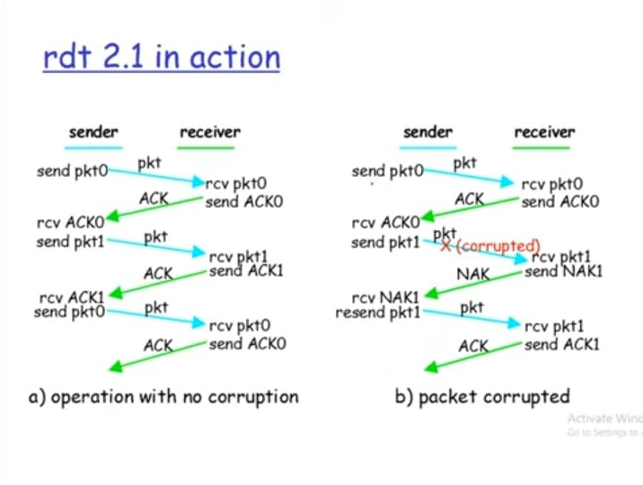
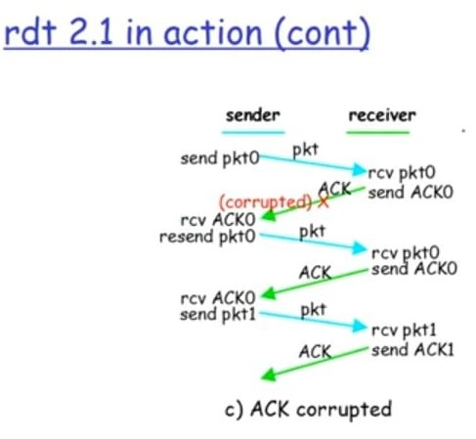
Rdt 2.1

Slide 36
rdt 2.1 - handled ACKs/NAKs
Sender:
Sequence # added to packet
Two sequence #’s (0,1) will suffix
It must check if received ACK/NAK corrupted or not
It can be twice as many states
  State must “remember” whether “expected” packet should have sequence # of 0 or 1
Receiver:
It must check if received packet is duplicate or not
State indicates whether 0 or 1 is expected packet sequence #
Receiver can not know if its last ACK/NAK received OK at sender

Slide 37
rdt 2.1 - Sender, handled ACKs/NAKs
rdt_send(data)
sndpkt = make_pkt(0, data, checksum)
udt_send(sndpkt)
rdt_rcv(rcvpkt) &&
( corrupt(rcvpkt) ||
isNAK(rcvpkt) )
Wait for call 0 from above
Wait for ACK or NAK 0
udt_send(sndpkt)
rdt_rcv(rcvpkt)
&& notcorrupt(rcvpkt)
&& isACK(rcvpkt)
rdt_rcv(rcvpkt)
&& notcorrupt(rcvpkt)
&& isACK(rcvpkt)
Λ
Λ
Wait for ACK or NAK 1
Wait for
call 1 from above
rdt_rcv(rcvpkt) &&
( corrupt(rcvpkt) ||
isNAK(rcvpkt) )
rdt_send(data)
udt_send(sndpkt)
sndpkt = make_pkt(1, data, checksum)
udt_send(sndpkt)

Slide 38
rdt 2.1 - Receiver, handled ACKs/NAKs
rdt_rcv(rcvpkt) && notcorrupt(rcvpkt)
&& has_seq0(rcvpkt)
extract(rcvpkt,data)
deliver_data(data)
sndpkt = make_pkt(ACK, chksum)
udt_send(sndpkt)
rdt_rcv(rcvpkt) && (corrupt(rcvpkt)
rdt_rcv(rcvpkt) && (corrupt(rcvpkt)
sndpkt = make_pkt(NAK, chksum)
udt_send(sndpkt)
sndpkt = make_pkt(NAK, chksum)
udt_send(sndpkt)
Wait for
0 from below
Wait for
1 from below
rdt_rcv(rcvpkt) &&
not corrupt(rcvpkt) &&
has_seq1(rcvpkt)
rdt_rcv(rcvpkt) &&
not corrupt(rcvpkt) &&
has_seq0(rcvpkt)
sndpkt = make_pkt(ACK, chksum)
udt_send(sndpkt)
sndpkt = make_pkt(ACK, chksum)
udt_send(sndpkt)
rdt_rcv(rcvpkt) && notcorrupt(rcvpkt)
&& has_seq1(rcvpkt)
extract(rcvpkt,data)
deliver_data(data)
sndpkt = make_pkt(ACK, chksum)
udt_send(sndpkt)

Slide 39
rdt 2.2 & rdt 3.0

Slide 40
rdt 2.2
Use same functionality as rdt2.1, using ACKs only.
Instead of NAK, receiver sends ACK for last packet received OK.
Receiver must explicitly include sequence # of packet being ACKed.
Duplicate ACK at sender results in same action as NAK: retransmit current packet.

Slide 41
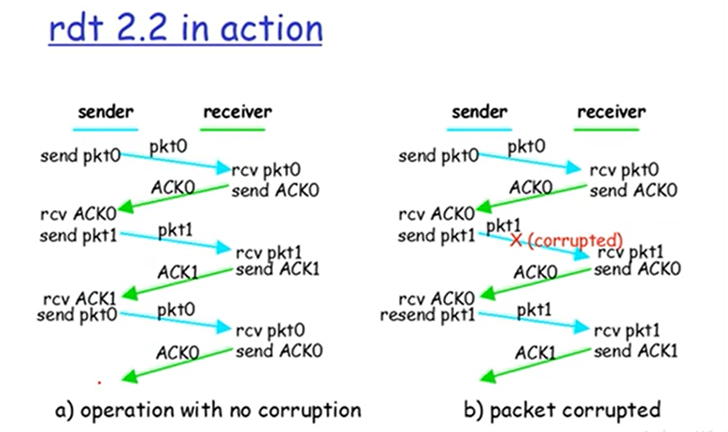
rdt 2.2

Slide 42
rdt 2.2 – Sender and Receiver
rdt_send(data)
sndpkt = make_pkt(0, data, checksum)
udt_send(sndpkt)
rdt_rcv(rcvpkt) &&
( corrupt(rcvpkt) ||
isACK(rcvpkt,1) )
Wait for call 0 from above
Wait for ACK
0
udt_send(sndpkt)
sender FSM
fragment
rdt_rcv(rcvpkt)
&& notcorrupt(rcvpkt)
&& isACK(rcvpkt,0)
rdt_rcv(rcvpkt) &&
(corrupt(rcvpkt) ||
has_seq1(rcvpkt))
Λ
Wait for
0 from below
receiver FSM
fragment
sndpkt = make_pkt(ACK,1, chksum)
udt_send(sndpkt)
rdt_rcv(rcvpkt) && notcorrupt(rcvpkt)
&& has_seq1(rcvpkt)
extract(rcvpkt,data)
deliver_data(data)
sndpkt = make_pkt(ACK,1, chksum)
udt_send(sndpkt)

Slide 43
rdt 3.0: channel with error and loss
Underlying channel can also lose packets (data, ACKs).
  Even checksum, sequence #, ACKs, retransmissions will not enough help.
Sender waits “reasonable” amount of time for ACK.
It retransmits if no ACK received in this time.
If packet(or ACK) just delayed (not lost):
  Retransmission will be duplicate, but sequence #’s already handled it.
Receiver must specify sequence # of packet being ACKed.
It requires countdown timer.

Slide 44

Rdt 3.0: Alternating-bit protocol
sender
receiver
sender
receiver
send pkt0
pkt0
send pkt0
pkt0
rcv pkt0
rcv pkt0
ack0
send ack0
ack0
send ack0
rcv ack0
rcv ack0
send pkt1
pkt1
send pkt1
pkt1
rcv pkt1
X
ack1
send ack1
loss
rcv ack1
send pkt0
pkt0
rcv pkt0
timeout
resend pkt1
ack0
send ack0
pkt1
rcv pkt1
ack1
send ack1
rcv ack1
send pkt0
pkt0
(a) no loss
rcv pkt0
ack0
send ack0
(b) packet loss

Slide 45
Rdt 3.0 – Cont…
sender
receiver
sender
receiver
send pkt0
pkt0
send pkt0
pkt0
rcv pkt0
rcv pkt0
ack0
send ack0
send ack0
rcv ack0
ack0
send pkt1
pkt1
rcv ack0
rcv pkt1
send pkt1
pkt1
send ack1
rcv pkt1
ack1
send ack1
ack1
X
loss
timeout
resend pkt1
pkt1
rcv pkt1
timeout
resend pkt1
rcv ack1
pkt1
rcv pkt1
pkt0
(detect duplicate)
send pkt0
send ack1
ack1
(detect duplicate)
ack1
rcv pkt0
rcv ack1
send ack1
rcv ack1
ack0
send ack0
pkt0
send pkt0
pkt0
send pkt0
rcv pkt0
rcv pkt0
ack0
(detect duplicate)
ack0
send ack0
send ack0
(c) ACK loss
(d) premature timeout /
delayed ACK

Slide 46
Pipelined Protocol
Go-back-N Protocol (Sliding window)
Selective Repeat Protocol

Slide 47

Pipelined Protocol
Its a technique in which multiple requests are written out to a single socket without waiting for the corresponding responses (acknowledged).
  No. of Packets(request) must be increased.
  Data or Packet should be buffered at sender and/or receiver.
Two generic forms of pipelined protocols:
  Go-back-N
  Selective Repeat

Slide 48
Go-back-N Protocol (Sliding window)
Sender can have up to N unacked packets in pipeline.
Receiver only sends cumulative ACK. It doesn’t ACK packet if there’s a gap.
Sender has timer for oldest unacked packet.
When timer expires, retransmit all unacked packets.
Sender send a number of frames specified by a window size even without receiving an ACK packet from the receiver.

Slide 49
Go-back-N Protocol Cont…
Receiver keeps track of the sequence #number of the next frame it expects to receive, and sends that number with every ACK it sends.
Receiver will discard any frame that does not have the exact sequence number it expects.
  Either a duplicate frame it already ACKed OR
  An out-of-order frame it expects to receive later
Receiver will resend an ACK for the last correct in-order frame.
Once the sender has sent all of the frames in its window.
It will detect that all of the frames since the first lost frame are outstanding.
Then go back to the sequence number of the last ACK it received from receiver.
Go-back-N protocol also known as sliding window protocol.

Slide 50
Go-back-N Protocol works
sender window (N=4)
0 1 2 3 4 5 6 7 8
send pkt0
send pkt1
send pkt2
send pkt3
(wait)
0 1 2 3 4 5 6 7 8
receive pkt0, send ack0
receive pkt1, send ack1
receive pkt3, discard,
(re)send ack1
0 1 2 3 4 5 6 7 8
X
0 1 2 3 4 5 6 7 8
loss
0 1 2 3 4 5 6 7 8
rcv ack0, send pkt4
rcv ack1, send pkt5
0 1 2 3 4 5 6 7 8
receive pkt4, discard,
(re)send ack1
ignore duplicate ACK
receive pkt5, discard,
(re)send ack1
pkt 2 timeout
0 1 2 3 4 5 6 7 8
send pkt2
send pkt3
send pkt4
send pkt5
0 1 2 3 4 5 6 7 8
0 1 2 3 4 5 6 7 8
rcv pkt2, deliver, send ack2
rcv pkt3, deliver, send ack3
rcv pkt4, deliver, send ack4
rcv pkt5, deliver, send ack5
0 1 2 3 4 5 6 7 8

Slide 51
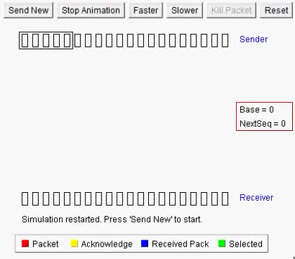
Go-back-N Visualization

Slide 52
Selective Repeat
A sender can have up to N unACKed packets in pipeline.
Receiver sends individual ACK for each packet.
Sender maintains timer for each unACKed packet.
When timer expires, retransmit only that unACKed packet.

Slide 53
Selective Repeat
Selective Repeat attempts to retransmit only those packets that are actually lost due to errors.
Receiver must be able to accept packets out of order.
Since receiver must release packets to higher layer in order, the receiver must be able to buffer some packets.
The receiver acknowledges every good packet, packets that are not ACKed before a time-out are assumed lost or in error.
This approach must be used to be sure that every packet is eventually received.
An explicit NAK (selective reject) can request retransmission of just one packet.

Slide 54
Selective Repeat Works
sender window (N=4)
sender
receiver
0 1 2 3 4 5 6 7 8
send pkt0
send pkt1
send pkt2
send pkt3
(wait)
0 1 2 3 4 5 6 7 8
receive pkt0, send ack0
receive pkt1, send ack1
receive pkt3, buffer,
send ack3
0 1 2 3 4 5 6 7 8
X
0 1 2 3 4 5 6 7 8
loss
0 1 2 3 4 5 6 7 8
rcv ack0, send pkt4
rcv ack1, send pkt5
0 1 2 3 4 5 6 7 8
receive pkt4, buffer,
send ack4
record ack3 arrived
receive pkt5, buffer,
send ack5
pkt 2 timeout
0 1 2 3 4 5 6 7 8
send pkt2
0 1 2 3 4 5 6 7 8
record ack4 arrived
0 1 2 3 4 5 6 7 8
rcv pkt2;
deliver pkt2,pkt3, pkt4, pkt5;
send ack2
record ack5 arrived
0 1 2 3 4 5 6 7 8
Q: what happens when ack2 arrives?

Slide 55
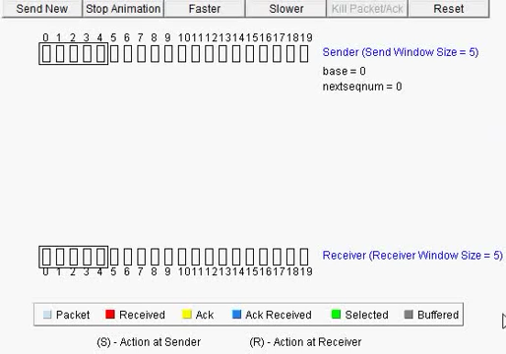
Selective Repeat Visualization

Slide 56
Connection oriented Transport (TCP)

Slide 57
TCP Segment Structure
32 bits
URG: urgent data
(generally not used)
counting
by bytes
of data
(not segments)
source port #
dest port #
sequence number
ACK: ACK #
valid
acknowledgement number
head
len
not
used
U
receive window
A
PSH: push data now
(generally not used)
P
R
S
F
# bytes
receiver
willing
to accept
checksum
Urg data pointer
RST, SYN, FIN:
connection establish
(setup, teardown
commands)
options (variable length)
application
data
(variable length)
Internet
checksum
(as in UDP)

Slide 58
TCP Segment – Cont…
The unit of transmission in TCP is called segments.
The header includes source and destination port numbers, which are used for multiplexing/demultiplexing data from/to upper-layer applications.
The 32-bit sequence number field and the 32-bit acknowledgment number field are used by the TCP sender and receiver in implementing a reliable data transfer service.
The sequence number for a segment is the byte-stream number of the first byte in the segment.
The acknowledgment number is the sequence number of the next byte a Host is expecting from another Host.

Slide 59
TCP Segment – Cont…
The 4-bit header length field specifies the length of the TCP header in 32-bit words. The TCP header can be of variable length due to the TCP options field.
The 16-bit receive window field is used for flow control. It is used to indicate the number of bytes that a receiver is willing to accept.
The 16-bit checksum field is used for error checking of the header and data.
Unused 6 bits are reserved for future use and should be sent to zero.
Urgent Pointer is used in combining with the URG control bit for priority data transfer. This field contains the sequence number of the last byte of urgent data.

Slide 60
TCP Segment – Cont…
Data: The bytes of data being sent in the segment.
URG (1 bit): indicates that the Urgent pointer field is significant.
ACK (1 bit): indicates that the Acknowledgment field is significant.
PSH (1 bit): Push function. Asks to push the buffered data to the receiving application.
RST (1 bit): Reset the connection.
SYN (1 bit): Synchronize sequence numbers. Only the first packet sent from each end should have this flag set. Some other flags and fields change meaning based on this flag, and some are only valid for when it is set, and others when it is clear.
FIN (1 bit): No more data from sender.

Slide 61
Flow Control & Congestion Control

Slide 62
Flow Control
Flow control is the process of managing the rate of data transmission between two nodes to prevent a fast sender from overwhelming a slow receiver.
It prevent receiver from becoming overloaded.
Receiver advertises a window rwnd(receiver window) with each acknowledgement.
Window:
  Closed (by sender) when data is sent and ack’d
  Opened (by receiver) when data is read
The size of this window can be the performance limit.

Slide 63
Congestion Control
Too many sources sending too much data too fast for network to handle.
When a connection is established, a suitable window size has to be chosen.
The receiver can specify a window based on its buffer size.
If the sender sticks to this window size, problems will not occur due to buffer overflow at the receiving end, but they may still occur due to internal congestion within the network.

Slide 64
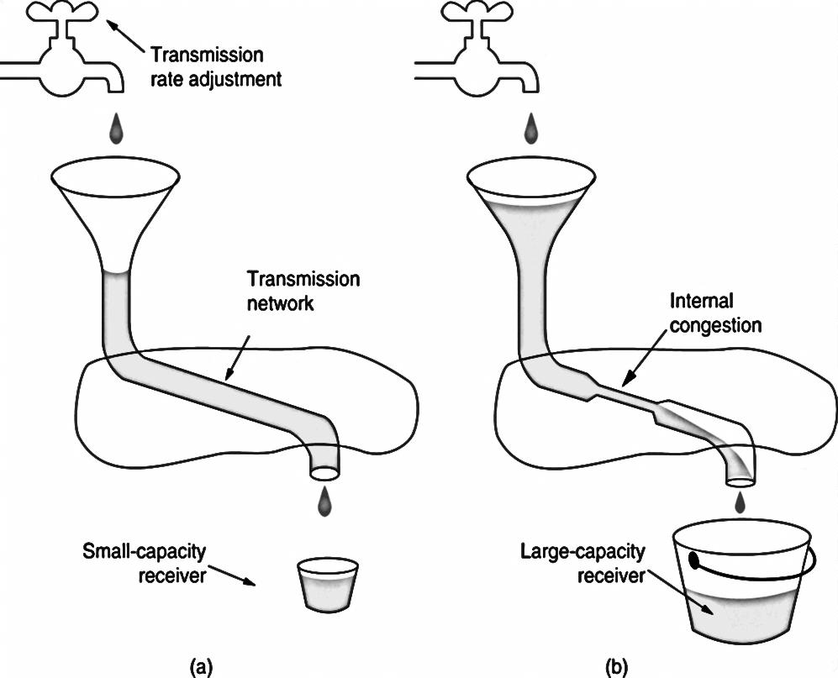
Congestion Control – Cont…
In Figure(a), we see a thick pipe leading to a small-capacity receiver.
In Figure(b), the limiting factor is not the bucket capacity, but the internal carrying capacity of the network.
As long as the sender does not send more water than the bucket can contain, no water will be lost.

Slide 65
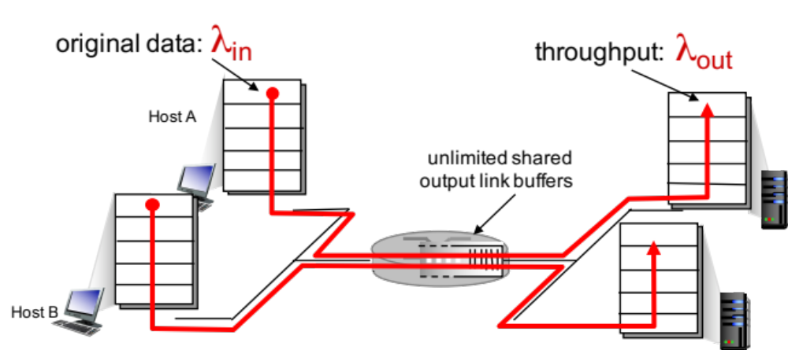
Causes/costs of Congestion: Scenario 1
Two senders, Two receivers
One router, Infinite buffers
No retransmission
λ means Lambda

Slide 66
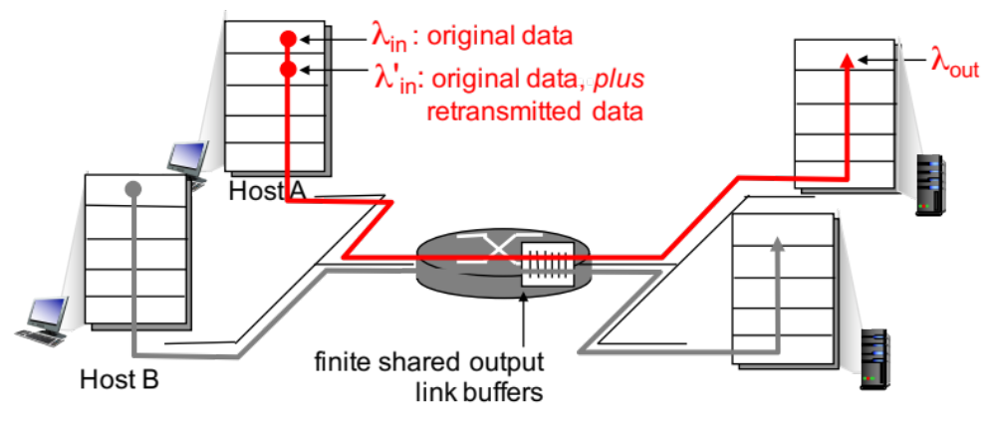
Causes/costs of Congestion: Scenario 2
One router, finite buffers
Sender retransmission of timed-out packet
  application-layer input = application-layer output: λ_{in} = λ_{out}
  transport-layer input includes retransmissions : λ’ _{in} >= λ_{in}

Slide 67

Causes/costs of Congestion: Scenario 2
Idealization: Perfect knowledge about buffer space
Sender sends only when router buffers available
λ_{in} : original data
copy
λ'_{in}: original data, plus retransmitted data
λ_{out}
A
free buffer space!
finite shared output link buffers
Host B

Slide 68

Causes/costs of Congestion: Scenario 2
Idealization: Known loss
Packets can be lost, dropped at router due to full buffers
Sender only resends if packet known to be lost
λ_{in} : original data
copy
λ'_{in}: original data, plus retransmitted data
λ_{out}
A
no buffer space!
Host B

Slide 69


Causes/costs of Congestion: Scenario 2
Realistic: duplicate packets
Packets can be lost, dropped at router due to full buffers
Sender times out prematurely, sending two copies, both of which are delivered
λ_{in}
copy
λ'_{in}
λ_{out}
timeout
A
free buffer space!
Host B

Slide 70
Approaches towards Congestion Control
Two broad approaches towards congestion control
End to End congestion control
  No explicit feedback from network
  Congestion inferred from end-system observed loss, delay
  Approach taken by TCP
Network-assisted congestion control
  Routers provide feedback to end systems
  Single bit indicating congestion (SNA, DECbit, TCP/IP ECN, ATM)
  Explicit rate for sender to send

Slide 71
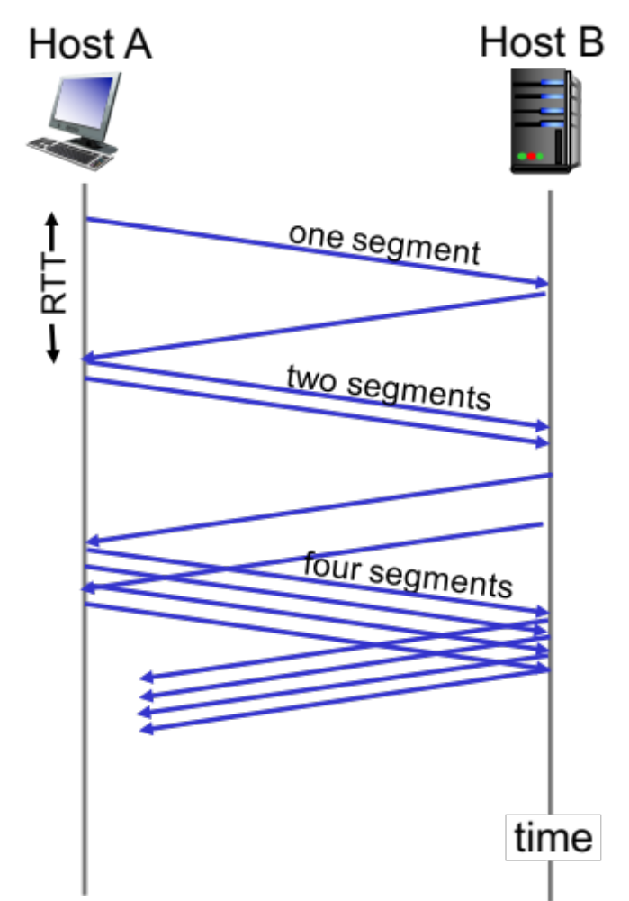
TCP Slow Start
An algorithm which balances the speed of a network connection.
TCP slow start is one of the first steps in the congestion control process.
It balances the amount of data a sender can transmit (known as the congestion window) with the amount of data the receiver can accept (known as the receiver window).

Slide 72
TCP Slow Start – Cont…
Slow start gradually increases the amount of data transmitted until it finds the network’s maximum carrying capacity.
A sender communicate to a receiver. Initial packet contains a small congestion window, which is determined based on the sender’s maximum window.
A receiver acknowledges the packet and responds with its own window size.
If the receiver fails to respond, the sender knows not to continue sending data.
After receiving the acknowledgement, the sender increases the next packet’s window size.
The window size gradually increases until the receiver can no longer acknowledge each packet, or until either the sender or the receiver’s window limit is reached.

Slide 73
Summary
Introduction about Transport Layer Services and Protocol
Multiplexing and Demultiplexing (Connection-less & Connection Oriented)
Connection less transport (UDP, Checksum)
Principles of Reliable Data Transfer(rdt 1.0, rdt 2.0, rdt 2.1, rdt 2.2, rdt 3.0)
Pipelined Protocol (GobackN, Selective Repeat)
Connection oriented transport (TCP)
Flow Control & Congestion Control
TCP Slow Start approach

Slide 74
Computer Networks (CN)
DU #2305CS332
Prof. Devangi L. Kotak
Department of Computer Application
Devangi.kotak@darshan.ac.in

