Slide 1

Unit-4 :
Network Layer
Computer Networks (CN)
DU #2305CS332
Prof. Devangi L. Kotak
Department of Computer Application
Devangi.kotak@darshan.ac.in

Slide 2

Looping
Outline
  Introduction
  Virtual and Datagram networks
  Study of Router
  IP protocol and addressing in the Internet
  Routing algorithms
  Broadcast and Multicast Routing

Slide 3
Introduction of Network Layer

Slide 4

















Introduction: Network Layer
To deliver segment from transport layer of sending device to receiving host/ router.
On sending side, it encapsulates segments into datagrams(packet).
On receiving side, it delivers datagram to transport layer.
Network layer protocols in every host and router.
Router examines header fields in all IP datagrams passing through it.
application
transport
network
data link
physical
network
data link
physical
network
data link
physical
network
data link
physical
network
data link
physical
network
data link
physical
network
data link
physical
network
data link
physical
network
data link
physical
network
data link
physical
application
transport
network
data link
physical
network
data link
physical
network
data link
physical

Slide 5
Key Function of Network Layer
Role of the network layer is simple - to move packets from a sending host to a receiving host.
Two important network layer functions can be identified:
Packet Forwarding
  When a packet arrives at a router’s input link, the router must move the packet to the appropriate output link.
Routing
  It’s a process of selecting best paths in a network.
  The network layer must determine the route or path taken by packets as they flow from a sender to a receiver.
  The algorithms that calculate these paths are referred to as routing algorithms.

Slide 6
Routing and Forwarding
routing algorithm
routing algorithm determines
end-end-path through network
local forwarding table
forwarding table determines
local forwarding at this router
header value
output link
0100
0101
0111
1001
3
2
2
1
value in arriving
packet’s header
0111
1
3
2

Slide 7
Network Service Model
Services provided by network layer for:
individual datagrams(packets)
  Guaranteed delivery
  Guaranteed delivery with bounded delay
flow of datagrams(packets).
  In-order packet delivery
  Guaranteed minimal bandwidth
  Guaranteed maximum jitter
  Security services

Slide 8
Network Service Model
Services provided by network layer for individual datagrams(packets).
Guaranteed delivery
  This service guarantees that the packet will eventually arrive at its destination.
Guaranteed delivery with bounded delay
  This service not only guarantees delivery of the packet, but delivery within a specified host-to-host delay bound (for example within 100 msec).

Slide 9
Network Service Model – Cont…
Services provided by network layer for a flow of datagrams(packets).
In-order packet delivery
  This service guarantees that packets arrive at the destination in the order that they were sent.
Guaranteed minimal bandwidth
  It's a promise of speed. The network guarantees you a specific minimum data speed, like 1 Mbps.
  If you send data at or below that promised speed (e.g., 1 Mbps or less), your packets will not get lost or delayed due to network traffic. They will all get through smoothly.
Guaranteed maximum jitter
  This service guarantees that the amount of time between the transmission of two successive packets at the sender is equal to the amount of time between their receipt at the receiver.
Security services
  Using a secret session key known only by a source and destination host.
  The network layer in the source host could encrypt the payloads of all datagrams being sent to the destination host.
  The network layer in the destination host would then be responsible for decrypting the payloads.

Slide 10
Types of services by Network layer
Types of services provided by Network layer are:
  Virtual-Circuit (VC) networks (Connection service)
  Datagram networks (Connectionless service)
Like TCP and UDP in transport layer, Network layer provide either a host-to-host connectionless services or a host-to-host connection service, but not both.
Computer network that provide only a connection services at the network layer are called Virtual-Circuit (VC) network
Computer network that provide only a connectionless services at the network layer are called datagram networks.

Slide 11
Virtual Circuit Switching
A VC consists of
  A path between the source and destination hosts
  VC numbers, one number for each link along the path
  Entries in the forwarding table in each router along the path
A packet belonging to a virtual circuit will carry a VC number in its header.
VC number can be changed on each link
  New VC number comes from forwarding table.

Slide 12

VC Forwarding Table
12
22
32
1
3
2
VC number
interface
number
Forwarding table in router:
Incoming interface Incoming VC # Outgoing interface Outgoing VC #
1 12 3 22
2 63 1 18
3 7 2 17
1 97 3 87
… … … …
VC routers maintain connection state information

Slide 13

Virtual Circuit Setup
There are three identifiable phases in a virtual circuit:
VC setup:
  During setup phase, the sending transport layer contact the network layer, specifies the receiver’s address and waits for the network to setup the VC.
  The network layer decides the path between sender and receiver, that is, the series of links and routers of routes.
  Network layer decides the VC number for each link of the path and adds an entry in forwarding table in each router.
Data transfer: Packets begin to flow along the VC
VC teardown: Termination of call and deletion of VC in forwarding table
application
transport
network
data link
physical
application
transport
network
data link
physical
5. data flow begins
6. receive data
4. call connected
3. accept call
1. initiate call
2. incoming call

Slide 14
Datagram Network
In connectionless service, packets are injected into the subnet individually and routed independently of each other.
No advance setup is needed. The packets are frequently called datagrams and the subnet is called a datagram subnet.
Only directly-connected lines can be used.
application
transport
network
data link
physical
application
transport
network
data link
physical
1. send datagrams
2. receive datagrams

Slide 15
Datagram Network vs. Virtual Circuit Network
 | Datagram | Virtual Circuit
Connection Setup | None | Required
Addressing | Packet contains full source and destination address | Each packet contains a short VC number
Routing | Each packet is routed independently | Route chosen during setup; all packets of a VC follow this route
Effect of Router Failure | None except for packets lost during the crash | All virtual circuits passing through failed router terminated.
Congestion Control | Difficult since all packets routed independently so router resource requirements can vary. | Simple by pre-allocating enough buffers to each virtual circuit at setup.
Used in | Public internet | Traditional telecom, ATM

Slide 16
Router Architecture

Slide 17
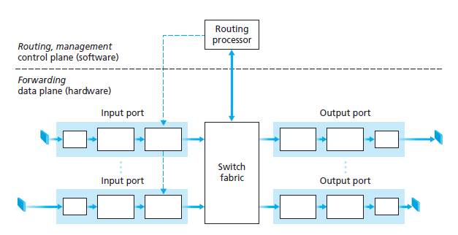
Router Architecture
Routers have four components:
  Input ports
  Switching fabric
  Output ports
  Routing processor

Slide 18
Input Port Functions
It performs the physical layer function of terminating an incoming physical link at a router.
It performs link-layer functions needed to interoperate with the link layer at the other side of the incoming link; this is represented by the middle boxes in the input and output ports.
A lookup function is performed at the input port; this will occur in the rightmost box of the input port.
lookup,
forwarding
queueing
line
termination
link
layer
protocol
(receive)
switch
fabric

Slide 19
Input Port Functions – Cont…
The forwarding table is consulted to determine the router output port to which an arriving packet will be forwarded via the switching fabric.
Control packets (for example, packets carrying routing protocol information) are forwarded from an input port to the routing processor.
lookup,
forwarding
queueing
line
termination
link
layer
protocol
(receive)
switch
fabric

Slide 20
Switching Fabrics
It connects the router’s input ports to its output ports.
It is completely contained within the router - a network inside of a network router.
Switching rate: A rate at which packets can be transfer from inputs to outputs.
Also measured as multiple of input/output line rate.
Three types of switching fabrics:
memory
memory
bus
crossbar

Slide 21
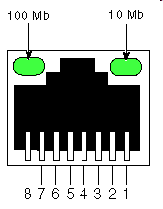
Switching via Memory
Like traditional computers, with switching between input and output ports being done under direct control of the CPU (routing processor).
Packet via routing processor copied from the input port into processor memory.
Routing processor extracted the destination address from the header, from forwarding table, and copied the packet to the output port’s buffers.
input
port
(e.g.,
Ethernet)
output
port
(e.g.,
Ethernet)
memory
system bus

Slide 22
Switching via Memory – Cont…
If the memory bandwidth is such that B packets per second can be written into, or read from, then the overall forwarding throughput must be less than B/2.
Two packets cannot be forwarded at the same time, even if they have different destination ports.
Only one memory read/write over the shared system bus can be done at a time.

Slide 23
Switching via bus
An input port transfers a packet to the output port over a shared bus, without intervention by the routing processor.
The packet is received by all output ports, but only the port that matches the label will keep the packet.
The label is then removed at the output port, and only used within the switch to cross the bus.
Switching speed of the router is limited to the bus speed.
For eg: if the bus can carry only 1 packet then other packets has to wait.
bus

Slide 24
Switching via an interconnection network
Crossbar switch consists 2N buses.
N input ports to N output ports.
It overcomes the bandwidth limitation of shared bus; used to interconnect processors in a multiprocessor computer architecture.
Cross-point connection can be opened or closed at any time by the switch fabric controller.
Crossbar networks are capable of forwarding multiple packets in parallel.

Slide 25
Output Port
It buffers packets received from the switching fabric and transmits these packets on the outgoing link.
Packets can be lost due to congestions, lacks of buffers.
When a link is bidirectional, an output port will typically be paired with the input port for that link on the same line card.
datagram
buffer
queueing
switch
fabric
link
layer
protocol
(send)
line
termination

Slide 26
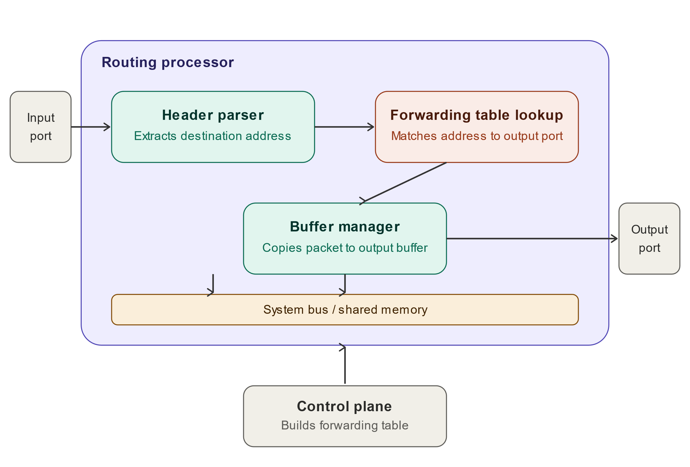
Routing Processor
The routing processor executes the routing protocols, maintains routing tables and attach link state information and computes the forwarding table for the router.
It also performs the network management functions.

Slide 27
Internet Network Layer
transport layer: TCP, UDP
routing protocols
path selection
RIP, OSPF, BGP
IP protocol
addressing conventions
datagram format
packet handling conventions
network
layer
forwarding
table
ICMP protocol
error reporting
router “signaling”
link layer
physical layer

Slide 28
IPv4 Datagram format
IP protocol version
number
32 bits
total datagram
length (bytes)
header length
(bytes)
head.
len
type of
service
ver
length
for
fragmentation/
reassembly
“type” of data
flags
fragment
offset
16-bit identifier
max number
remaining hops
(decremented at
each router)
time to
live
upper
layer
header
checksum
32 bit source IP address
upper layer protocol
to deliver payload to
32 bit destination IP address
options (if any)
e.g. timestamp,
record route
taken, specify
list of routers
to visit.
data
(variable length,
typically a TCP
or UDP segment)

Slide 29
IP Address
IP addresses are useful in identifying a specific host in a network.
IP addresses are 32 bit numbers which are divided into 4 octets. Each octet represents 8 bit binary number.
Below is an example of an IP address:
10101100
00010000
11111110
00000001
172
16
254
1
IP addresses are divided into 2 parts:
Network ID & Host ID
<NID> <HID> = IP Address

Slide 30
IP address
IP address = network id + host id
192.168.10
Network id
.25
host id
Postal address = street name + house number
MG Road
Street name
House 25
House number

Slide 31
Classification of IP Addresses (Classful Addressing)
Class: A
0
7 Bit Network ID
Fix
24 Bit Host ID
Class: B
1 | 0
Fix
14 Bit Network ID
16 Bit Host ID
Class: C
1 | 1 | 0
Fix
21 Bit Network ID
8 Bit Host ID
Class: D
1 | 1 | 1 | 0
Fix
Class: E
Multicast address
1 | 1 | 1 | 1
Fix
Reserved address

Slide 32
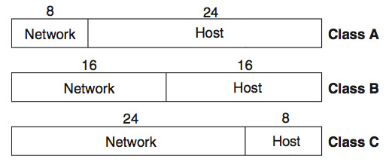
IPv4 Addresses : Classful Addressing
32-bit address that uniquely and universally defines the connection of a device.
32-bit IP address
0
1
0
1
1
0
Class
Binary
Dotted
-
Decimal
CIDR
A
11111111 00000000 00000000 00000000
255.0.0.0
8
B
11111111 11111111 00000000 00000000
255.255.0.0
16
C
11111111 11111111 11111111 00000000
255.255.255.0
24

Slide 33
Class A: (0.0.0.0 to 127.255.255.255)
Only 126 addresses are used for network address.
All 0’s and 1’s in Network-ID are dedicated for special IP address. So, total number of IP address in class A can be represented:
0
7 Bit Network ID
24 Bit Host ID
0.0.0.0 | Special IP Address
00000001.0.0.1 1.0.0.2 1.0.0.3 . . . 126.255.255.254 | 2²⁴ – 2 are Host IP
127.255.255.255 | Special IP Address – Loopback

Slide 34
Class B: (128.0.0.0 to 191.255.255.255)
No special network address here. All are usable.
1 | 0
Fix
14 Bit Network ID
16 Bit Host ID
128.0.0.0 | Special IP Address
10000001.0.0.1 130.0.0.2 130.0.0.3 . . . 190.255.255.254 | 2¹⁶ – 2 are Host IP
10111111.255.255.255 | Special IP Address

Slide 35
Class C: (192.0.0.0 to 223.255.255.255)
1 | 1 | 0
Fix
21 Bit Network ID
8 Bit Host ID
192.0.0.0 | Special IP Address
11000001.0.0.1 194.0.0.2 194.0.0.3 . . . 222.255.255.254 | 2⁸ – 2 are Host IP
11011111.255.255.255 | Special IP Address – Loopback

Slide 36
Class D: (224.0.0.0 to 239.255.255.255)
Very first four bits of the first octet in Class D IP addresses are set to 1110, giving a range of:
Class D has IP address rage from 224.0.0.0 to 239.255.255.255.
Class D is reserved for Multicasting.
In multicasting data is not destined for a particular host, that is why there is no need to extract host address from the IP address, and Class D does not have any subnet mask.
11100000 – 11101111
224 - 239

Slide 37
Class E: (240.0.0.0 to 255.255.255.255)
This IP Class is reserved for experimental purposes only for R&D or Study.
IP addresses in this class ranges from 240.0.0.0 to 255.255.255.255.
Like Class D, this class too is not equipped with any subnet mask.

Slide 38
IPv4 address range summary
Class | Range
Class A | 0.0.0.0 to 127.255.255.255
Class B | 128.0.0.0 to 191.255.255.255
Class C | 192.0.0.0 to 223.255.255.255
Class D | 224.0.0.0 to 239.255.255.255
Class E | 240.0.0.0 to 255.255.255.255

Slide 39
IP Addressing Summary
Class | Leading bits | Size of n/w number bit field | Size of rest bit field | Number of networks | Addresses per network | Total addresses in class | Start address | End address | Default subnet mask in dot-decimal notation | CIDR notation
Class A | 0 | 8 | 24 | 128 (2⁷) | 16,777,216 (2²⁴) | 2,147,483,648 (2³¹) | 0.0.0.0 | 127.255.255.255 | 255.0.0.0 | /8
Class B | 10 | 16 | 16 | 16,384 (2¹⁴) | 65,536 (2¹⁶) | 1,073,741,824 (2³⁰) | 128.0.0.0 | 191.255.255.255 | 255.255.0.0 | /16
Class C | 110 | 24 | 8 | 2,097,152 (2²¹) | 256 (2⁸) | 536,870,912 (2²⁹) | 192.0.0.0 | 223.255.255.255 | 255.255.255.0 | /24
Class D (multicast) | 1110 | not defined | not defined | not defined | not defined | 268,435,456 (2²⁸) | 224.0.0.0 | 239.255.255.255 | not defined | not defined
Class E (reserved) | 1111 | not defined | not defined | not defined | not defined | 268,435,456 (2²⁸) | 240.0.0.0 | 255.255.255.255 | not defined | not defined

Slide 40
IP Addressing - Example
IP address:
It is 32-bit identifier for host & router interface
Interface:
It is a connection between host/router and physical link.
  A router’s typically have multiple interfaces.
  A host typically has one or two interfaces.
IP addresses associated with each interface.
223.1.1.1
223.1.2.1
223.1.1.4
223.1.2.9
223.1.1.2
223.1.1.3
223.1.3.27
223.1.2.2
223.1.3.1
223.1.3.2
223.1.1.1 = 11011111 00000001 00000001 00000001
223
1
1
1

Slide 41
Subnet
Subnet: high order bits defines subnet
Host: low order bits defines host
To determine the subnets, detach each interface from its host or router.
Creating islands of isolated networks, with interfaces terminating the end points of the isolated networks.
Each of these isolated networks is called a subnet.
223.1.1.0/24
223.1.2.0/24
223.1.1.1
223.1.1.2
223.1.2.1
223.1.1.4
223.1.2.9
223.1.2.2
223.1.1.3
223.1.3.27
subnet
223.1.3.1
223.1.3.2
223.1.3.0/24
Network consisting of 3 subnets

Slide 42
Type of addresses in IPv4 Network
Network address - The address by which we refer to the network.
  E.g.: 10.0.0.0
Broadcast address - A special address used to send data to all hosts in the network.
  The broadcast address uses the highest address in the network range.
  E.g.: 10.0.0.255
Host addresses - The addresses assigned to the end devices in the network.
  E.g.: 10.0.0.1

Slide 43
Classless Inter-Domain Routing(CIDR)
CIDR is a slash notation of subnet mask. CIDR tells us number of bits in a network address.
A single IP address can be used to designate many unique IP addresses with CIDR.
A CIDR IP address looks like a normal IP address except that it ends with a slash followed by a number, called the IP network prefix.
CIDR addresses reduce the size of routing tables and make more IP addresses available within organizations.
subnet
part
host
part
11001000 00010111 00010000 00000000
200.23.16.0/25

Slide 44
Subnetting
Subnetting take places when we extend the default subnet mask.
We cannot perform subnetting with default subnet mask and every classes have default subnet mask.
Now find the host bits borrowed to create subnets and convert them in decimal.
For example find the subnet mask of address 188.25.45.48/20 ?
Class B, Default Subnet mask: 255.255.0.0
Borrowed 4 bit from host part so mask is now:
11111111 11111111 11110000 00000000
  255 255 240 0

Slide 45
How many subnets from given subnet mask?
To calculate the number of subnets provided by given subnet mask we use 2^{N} , where N = number of bits borrowed from host bits to create subnets.
For example, 192.168.1.0/27, N is 3.
By looking at address we can determined that this address is belong to class C and default subnet mask 255.255.255.0 [/24 in CIDR].
In given address we borrowed 27 - 24 = 3 host bits to create subnets.
Now 2³ = 8, so our answer is 8.

Slide 46
What are the valid subnets?
Calculating valid subnet is two steps process.
First calculate total subnet by using formula 2^{N}.
In second step find the block size and count from zero in block until subnet mask value.
For example calculate the valid subnets for 192.168.1.0/26
  Borrowed host bits are 2 [26-24]
  Total subnets are 2² = 4
  Subnet mask would be 255.255.255.192
  Block size would be 256-192 = 64
  Start counting from zero at blocks of 64, so our valid subnets would be 0,64,128,192
1
Valid subnet
ID: 192.168.1.0
2
Valid subnet
ID: 192.168.1.64
3
Valid subnet
ID: 192.168.1.128
4
Valid subnet
ID: 192.168.1.192
BLOCK SIZE = 64
BLOCK SIZE = 64
BLOCK SIZE = 64
BLOCK SIZE = 64
0
64
128
192

Slide 47
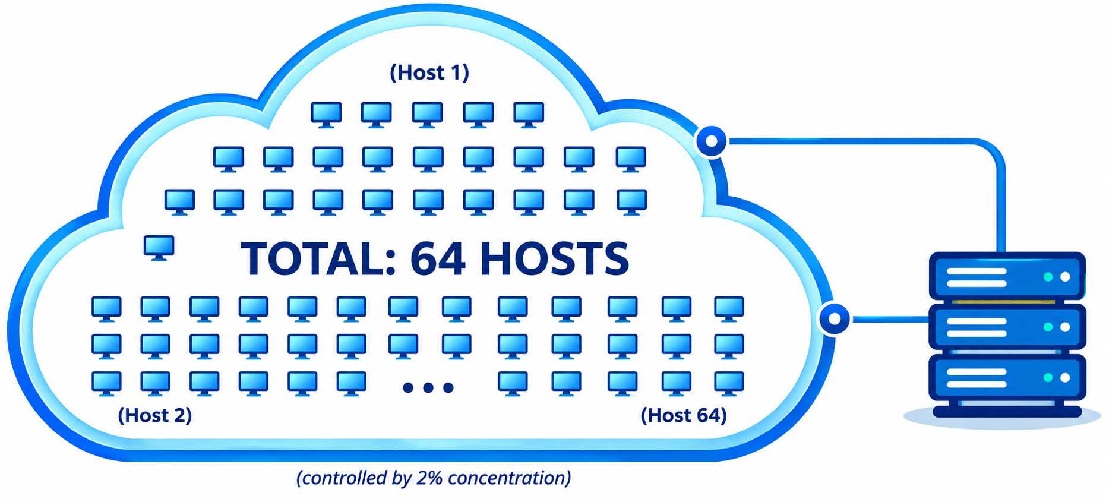
What are the total hosts?
Total hosts are the hosts available per subnet
To calculate total hosts use formula 2^{H} = Total hosts
H is the number of host bits
For example in address 192.168.1.0/26
We have 32 - 26
  [Total bits in IP address - Bits consumed by network address] = 6
  Total hosts per subnet would be 2⁶ = 64

Slide 48
Network Prefixes
For Class C, Default subnet mask of class C is 255.255.255.0
CIDR notation of class C is /24, which means 24 bits from IP address are already consumed by network portion.
We have 8 host bits remain.
Subnetting moves from left to right. So Class C subnet masks can only be the following:
CIDR | Decimal | Binary
/25 | 128 | 10000000
/26 | 192 | 11000000
/27 | 224 | 11100000
/28 | 240 | 11110000
/29 | 248 | 11111000
/30 | 252 | 11111100

Slide 49
Network Prefixes- Example
/25
  CIDR /25 has subnet mask 255.255.255.128 and 128 is 10000000 in binary.
  We used one host bit in network address.
N = 1 [Number of host bit]
H = 7 [Remaining host bits]
Total subnets ( 2^{N} ) : 2¹ = 2
Block size (256 - subnet mask) :- 256 - 128 = 128
Valid subnets ( Count blocks from 0) :- 0, 128
Total hosts (2^{H}) :- 2⁷ = 128
Valid hosts per subnet ( Total host - 2 ) :- 128 - 2 = 126

Slide 50
Summary -Valid Subnet Masks
/n | Mask | /n | Mask | /n | Mask | /n | Mask
/1 | 128.0.0.0 | /9 | 255.128.0.0 | /17 | 255.255.128.0 | /25 | 255.255.255.128
/2 | 192.0.0.0 | /10 | 255.192.0.0 | /18 | 255.255.192.0 | /26 | 255.255.255.192
/3 | 224.0.0.0 | /11 | 255.224.0.0 | /19 | 255.255.224.0 | /27 | 255.255.255.224
/4 | 240.0.0.0 | /12 | 255.240.0.0 | /20 | 255.255.240.0 | /28 | 255.255.255.240
/5 | 248.0.0.0 | /13 | 255.248.0.0 | /21 | 255.255.248.0 | /29 | 255.255.255.248
/6 | 252.0.0.0 | /14 | 255.252.0.0 | /22 | 255.255.252.0 | /30 | 255.255.255.252
/7 | 254.0.0.0 | /15 | 255.254.0.0 | /23 | 255.255.254.0 | /31 | 255.255.255.254
/8 | 255.0.0.0 | /16 | 255.255.0.0 | /24 | 255.255.255.0 | /32 | 255.255.255.255
/1:
10000000.00000000.00000000.00000000
/9:
11111111.10000000.00000000.00000000
/20:
11111111.11111111.11110000.00000000
/24:
11111111.11111111.11111111.00000000

Slide 51
Example
Subnet Mask (Decimal) | Subnet Mask (Binary) | Valid / Invalid
255.255.255.240 | 11111111.11111111.11111111.11110000
Valid
255.230.255.0 | 11111111.11100110.11111111.00000000
Invalid
Valid
255.255.0.0 | 11111111.11111111.00000000.00000000
240.0.0.0 | 11110000.00000000.00000000.00000000
Valid
Invalid
223.0.0.0 | 11011111.00000000.00000000.00000000
255.0.255.0 | 11111111.00000000.11111111.00000000
Invalid

Slide 52
Example - Practice
A host in a class __ network has been assigned an IP address 192.168.17.9.
Find the number of addresses in the block, the first address, and the last address.
  Class ?
  Default Subnet is ?
  Given IP Address: ?
  This network: ?
  Number of addresses: ?
  Number of usable addresses = ?
  First address: ?
  Last address: ?
Solution:
Class C Network
Default Subnet is N.N.N.H (255.255.255.0 or /24)
Given IP Address: 192.168.17.9
This network: 192.168.17.0 – 192.168.17.255
Number of addresses: 2⁸ = 256
Number of usable addresses = 256 – 2 = 254
First address: 192.168.17.0 (Network Address)
Last address: 192.168.17.255 (Broadcast Address)

Slide 53
Example - Practice
An address in a block is given as 185.28.17.9.
Find the number of addresses in the block, the first address, and the last address.
  Class ?
  Default Subnet is ?
  Given IP Address: ?
  This network: ?
  Number of addresses: ?
  Number of usable addresses = ?
  First address: ?
  Last address: ?
Solution:
Class B Network
Default Subnet is N.N.H.H (255.255.0.0 or /16)
Given IP Address: 185.28.17.9
This network: 185.28.0.0 – 185.28.255.255
Number of addresses: 2¹⁶ = 65,536
Number of usable addresses = 65,536 – 2 = 65,534
First address: 185.28.0.0 (Network Address)
Last address: 185.28.255.255 (Broadcast Address)

Slide 54
Example - Practice
An address in a block is given as 10.200.240.4. Find the number of addresses in the block, the first address, and the last address.
  Class ?
  Default Subnet is ?
  Given IP Address: ?
  This network: ?
  Number of addresses: ?
  Number of usable addresses = ?
  First address: ?
  Last address: ?
Solution:
Class A Network
Default Subnet is N.H.H.H (255.0.0.0 or /8)
Given IP Address: 10.200.240.4
This network: 10.0.0.0 – 10.255.255.255
Number of addresses: 2²⁴ = 16,777,216
Number of usable addresses = 16,777,216 – 2 = 16,777,214
First address: 10.0.0.0 (Network Address)
Last address: 10.255.255.255 (Broadcast Address)

Slide 55
Example - Practice
A block of addresses is granted to a small organization. We know that one of the addresses is 205.16.37.39/28. What is the first address, last address, number of addresses in a block.
  Class ?
  Default Subnet is ?
  Given IP Address: ?
  This network: ?
  Number of addresses: ?
  Number of usable addresses = ?
  First address: ?
  Last address: ?
Solution:
Class C Network
Default Subnet is N.N.N.H (255.255.255.0 or /24)
Given IP Address: 205.16.37.39
This network: 205.16.37.32 – 205.16.37.47
Number of addresses: 2³²⁻²⁸ = 16
Number of usable addresses = 16– 2 = 14
First Address | 205.16.37.33
Last Address | 205.16.37.46
Network Address | 205.16.37.32
Broadcast Address | 205.16.37.47
Hint: AND operation between IP address and Subnet Mask
Hint: OR operation between IP address and Subnet Mask

Slide 56
Example - Practice
Subnet the IP address 216.21.5.0 into 30 hosts in each subnet.
Subnet the IP address 150.15.0.0 into 500 hosts in each subnet.
  Class ?
  Default Mask ?
  Bit Borrowed ?
  New subnet mask
  No. of Hosts/Subnet ?
  Network Ranges (Subnets)
Solution:
Class C Network
Default Subnet is N.N.N.H (255.255.255.0 or /24)
Bit Borrowed – 3 (11111111.11111111.11111111.11100000)
New Subnet mask - 255.255.255.224 or /27
No. of Hosts/Subnet – 30
Network Ranges (Subnets)
  216.21.5.0 to 216.21.5.31
  216.21.5.32 to 216.21.5.63
  216.21.5.64 to 216.21.5.95
  And so on….

Slide 57


Dynamic Host Configuration Protocol - DHCP
DHCP is a protocol for assigning dynamic IP addresses to devices on a network.
DHCP
server
223.1.1.0/24
223.1.1.1
223.1.2.1
223.1.1.2
arriving DHCP
client needs
address in this
network
223.1.1.4
223.1.2.9
223.1.3.27
223.1.2.2
223.1.1.3
223.1.2.0/24
223.1.3.1
223.1.3.2
223.1.3.0/24

Slide 58
DHCP – Cont…
With dynamic addressing, a device can have a different IP address every time it connects to the network.
In some systems, the device's IP address can even change while it is still connected.
It allows reuse of addresses (only hold address while connected “on”).
It also support mobile users who want to join network.

Slide 59
DHCP Client Server Interaction
DHCP server: 223.1.2.5
DHCP discover
arriving
client
src : 0.0.0.0, 68
dest.: 255.255.255.255,67
yiaddr: 0.0.0.0
transaction ID: 654
Broadcast: is there a DHCP server out there?
DHCP offer
src: 223.1.2.5, 67
dest: 255.255.255.255, 68
yiaddrr: 223.1.2.4
transaction ID: 654
lifetime: 3600 secs
Broadcast: I’m a DHCP server! Here’s an IP address you can use
DHCP request
src: 0.0.0.0, 68
dest:: 255.255.255.255, 67
yiaddrr: 223.1.2.4
transaction ID: 655
lifetime: 3600 secs
Broadcast: OK. I’ll take that IP address!
DHCP ACK
src: 223.1.2.5, 67
dest: 255.255.255.255, 68
yiaddrr: 223.1.2.4
transaction ID: 655
lifetime: 3600 secs
Broadcast: OK. You’ve got that IP address!

Slide 60
Network Address Translation
NAT is a method that is used to translate Private IP addresses to Public IP addresses.
rest of
Internet
local network
(e.g., home network)
10.0.0.0
10.0.0.1
10.0.0.4
10.0.0.2
138.76.29.7
10.0.0.3
all datagrams leaving local
network have same single source NAT IP address: 138.76.29.7,different source port numbers
datagrams with source or destination in this network have 10.0.0.0 address for source, destination (as usual)

Slide 61
NAT – Cont…
Local network uses just one IP address as far as outside world is concerned.
This means that only a single, unique IP address is required to represent an entire group of computers.
The technique was originally used for ease of rerouting traffic in IP networks without readdressing every host.
The concept of NAT as developed to solve two problems:
  Solve shortage of IPv4 IP addresses
  To Hide the Network Address

Slide 62
NAT Terminology
Inside Local Address:
  The name of the inside source address before translation. This would be a Private IP.
Inside Global Address:
  The name of the inside host after translation. This would be the Public IP.
Outside Local Address:
  The name of the destination host before translation.
Outside Global Address:
  The name of the destination host after translation.
Where:
  Global Addresses → Public
  Local Addresses → Private
  Inside Hosts → Within Local Network
  Outside Hosts → Outside Local Network

Slide 63
NAT – Cont…
NAT translation table
WAN side addr LAN side addr
2: NAT router
changes datagram
source addr from
10.0.0.1, 3345 to
138.76.29.7, 5001,
updates table
1: host 10.0.0.1
sends datagram to
128.119.40.186, 80
138.76.29.7, 5001 10.0.0.1, 3345
…… ……
S: 10.0.0.1, 3345
D: 128.119.40.186, 80
10.0.0.1
1
2
S: 138.76.29.7, 5001
D: 128.119.40.186, 80
10.0.0.4
10.0.0.2
138.76.29.7
S: 128.119.40.186, 80
D: 10.0.0.1, 3345
4
S: 128.119.40.186, 80
D: 138.76.29.7, 5001
3
4: NAT router
changes datagram
dest addr from
138.76.29.7, 5001 to 10.0.0.1, 3345
10.0.0.3
3: reply arrives
dest. address:
138.76.29.7, 5001

Slide 64
IPv4 Datagram format
IP protocol version
number
32 bits
total datagram
length (bytes)
header length
(bytes)
head.
len
type of
service
ver
length
for
fragmentation/
reassembly
“type” of data
flags
fragment
offset
16-bit identifier
max number
remaining hops
(decremented at
each router)
time to
live
upper
layer
header
checksum
32 bit source IP address
upper layer protocol
to deliver payload to
32 bit destination IP address
options (if any)
e.g. timestamp,
record route
taken, specify
list of routers
to visit.
data
(variable length,
typically a TCP
or UDP segment)

Slide 65
IPv6 Datagram Format

Slide 66
Difference between IPv4 & IPv6
IPv4 | IPv6
32 bit length | 128 bit length
Fragmentation is done by sender and forwarding routers | Fragmentation is done only by sender
No packet flow identification | Packet flow identification is available within the IPv6 header using the Flow Label field
Checksum field in header | No checksum field in header
Options fields are available in header | No option fields, but Extension headers are available
Address Resolution Protocol (ARP) is available to map IPv4 addresses to MAC addresses | Address Resolution Protocol (ARP) is replaced with Neighbor Discovery Protocol
Broadcast messages are available | Broadcast messages are not available
Static IP addresses or DHCP is required to configure IP addresses | Auto-configuration of addresses is available

Slide 67
Link State Routing Algorithm
Also known as Dijkstra’s Algorithm.
It computes the least-cost path from one node (source node) to all other nodes in the network.
It works iteratively. After the kth iteration, the least-cost paths to k destination nodes are known.
Notation:
  c(x,y): link cost from node x to y; = ∞ if not direct neighbours
  D(v): current value of cost of path from source to destination v
  p(v): predecessor node along path from source to v
  N': set of nodes whose least cost path definitively known

Slide 68
Dijkstra’s Algorithm
1 Initialization:
2 N' = {u}
3 for all nodes v
4 if v adjacent to u
5 then D(v) = c(u,v)
6 else D(v) = ∞
7
8 Loop
9 find w not in N' such that D(w) is a minimum
10 add w to N'
11 update D(v) for all v adjacent to w and not in N' :
12 D(v) = min( D(v), D(w) + c(w,v) )
13 /* new cost to v is either old cost to v or known
14 shortest path cost to w plus cost from w to v */
15 until all nodes in N'

Slide 69
Dijkstra’s Algorithm – Example:1
D(v)
p(v)
D(w)
p(w)
D(x)
p(x)
D(y)
p(y)
D(z)
p(z)
Step
N'
0
u
7,u
3,u
5,u
∞
∞
1
uw
6,w
5,u
11,w
∞
2
uwx
6,w
11,w
14,x
3
uwxv
10,v
14,x
x
4
uwxvy
12,y
9
5
uwxvyz
5
7
4
8
u
3
w
y
z
2
3
7
4
v

Slide 70
Dijkstra’s Algorithm – Example:2
Step
0
1
2
3
4
5
N'
u
ux
uxy
uxyv
uxyvw
uxyvwz
D(v),p(v)
2,u
2,u
2,u
D(w),p(w)
5,u
4,x
3,y
3,y
D(x),p(x)
1,u
D(y),p(y)
∞
2,x
D(z),p(z)
∞
∞
4,y
4,y
4,y
5
v
3
w
2
5
u
2
1
z
3
1
2
x
y
1

Slide 71
Dijkstra’s Algorithm – Example:2
resulting shortest-path tree from u:
v
w
u
z
x
y
resulting forwarding table in u:
destination
link
v
(u,v)
x
(u,x)
y
(u,x)
w
(u,x)
z
(u,x)

Slide 72
Distance Vector Algorithm
Distance-vector (DV) algorithm is iterative, asynchronous, and distributed.
It is distributed in that each node receives some information from one or more of its directly attached neighbours, performs a calculation, and then distributes the results of its calculation back to its neighbours.
It is iterative. so, process continues on until no more information is exchanged between neighbours.
The algorithm is asynchronous. It does not require all of the nodes to operate with each other.

Slide 73
Distance Vector Algorithm – Cont…
Let d_{x}(y) be the cost of the least-cost path from node x to node y.
Then least costs are related by the calculated Bellman-Ford equation:
d_{x}(y) = cost of least-cost path from x to y then
d_{x}(y) = min {c(x,v) + d_{v}(y) }
v
cost from neighbor v to destination y
cost to neighbor v
min taken over all neighbors v of x

Slide 74
Distance Vector Algorithm – Cont…
each node:
wait for (change in local link cost or message from neighbor)
recompute estimates
if DV to any destination has changed, notify neighbors

Slide 75
Distance Vector Algorithm - Example
node x
table
cost to
cost to
x y z
x y z
x
0 2 7
x
0
2
3
D_{x}(y) = min{c(x,y) + D_{y}(y), c(x,z) + D_{z}(y)}
= min{2+0 , 7+1} = 2
y
y
2 0 1
from
∞
∞
∞
from
z
∞
∞
∞
z
7 1 0
D_{x}(z) = min{c(x,y) + D_{y}(z), c(x,z) + D_{z}(z)}
= min{2+1 , 7+0} = 3
=min{(me to Y in 2 +Y to Z in 1),(me to Z in 7 + Z to Z in 0)}
node y
table
cost to
x y z
x
∞
∞
∞
2 0 1
from
y
z
∞
∞
∞
y
2
1
node z
table
cost to
x
z
x y z
7
x
∞ ∞ ∞
from
y
∞
∞
∞
z
7
1
0
time

Slide 76
Distance Vector Algorithm - Example
node x
table
cost to
cost to
cost to
x y z
x y z
x y z
x
0 2 7
x
0
2
3
x
0 2 3
y
y
2 0 1
from
∞
∞
∞
from
y
2 0 1
y
z
z
from
2
∞
∞
∞
7 1 0
z
3 1 0
1
x
z
node y
table
cost to
cost to
cost to
7
x y z
x y z
x y z
x
∞
∞
x
0 2 7
∞
2 0 1
x
0 2 3
from
y
y
2 0 1
y
from
from
2 0 1
z
∞
∞
∞
z
7 1 0
z
3 1 0
node z
table
cost to
cost to
cost to
x y z
x y z
x y z
x
∞ ∞ ∞
x
0 2 7
x
0 2 3
y
y
2 0 1
from
y
∞
∞
from
2 0 1
from
∞
z
z
3 1 0
z
3 1 0
7
1
0
time
time

Slide 77
Computer Networks (CN)
DU #2305CS332
Prof. Devangi L. Kotak
Department of Computer Application
Devangi.kotak@darshan.ac.in

