Slide 1

Unit-1
Introduction to Digital Marketing
CO1: explain digital marketing fundamentals and the legal frameworks governing Indian cyberspace.
Digital Marketing & SEO
2505CS313
Mr. Prashant Parmar
Darshan Institute of Management
Prashant.parmar@darshan.ac.in
9586371604

Slide 2

    Concept of Digital Marketing
    Evolution of Digital Marketing from Traditional to Modern Era
    Traditional Marketing vs. Digital Marketing
    Penetration of Internet in India & World
    Understanding the Digital Customer Journey
    Digital Marketing Components and Frameworks
    Role of Internet in Digital Marketing
    Advantages and Limitations of Digital Marketing
    Skills Required in Digital Marketing
    Implications for Business & Society of Digital Marketing
    Infographics: Introduction, Why Infographics? Types of Infographics
    Ethical and Legal Framework of Digital Marketing: Laws Legal Issues
    How Marketers can Prevent Ethical and Legal Infringements

Slide 3
Concept of Digital Marketing

Slide 4
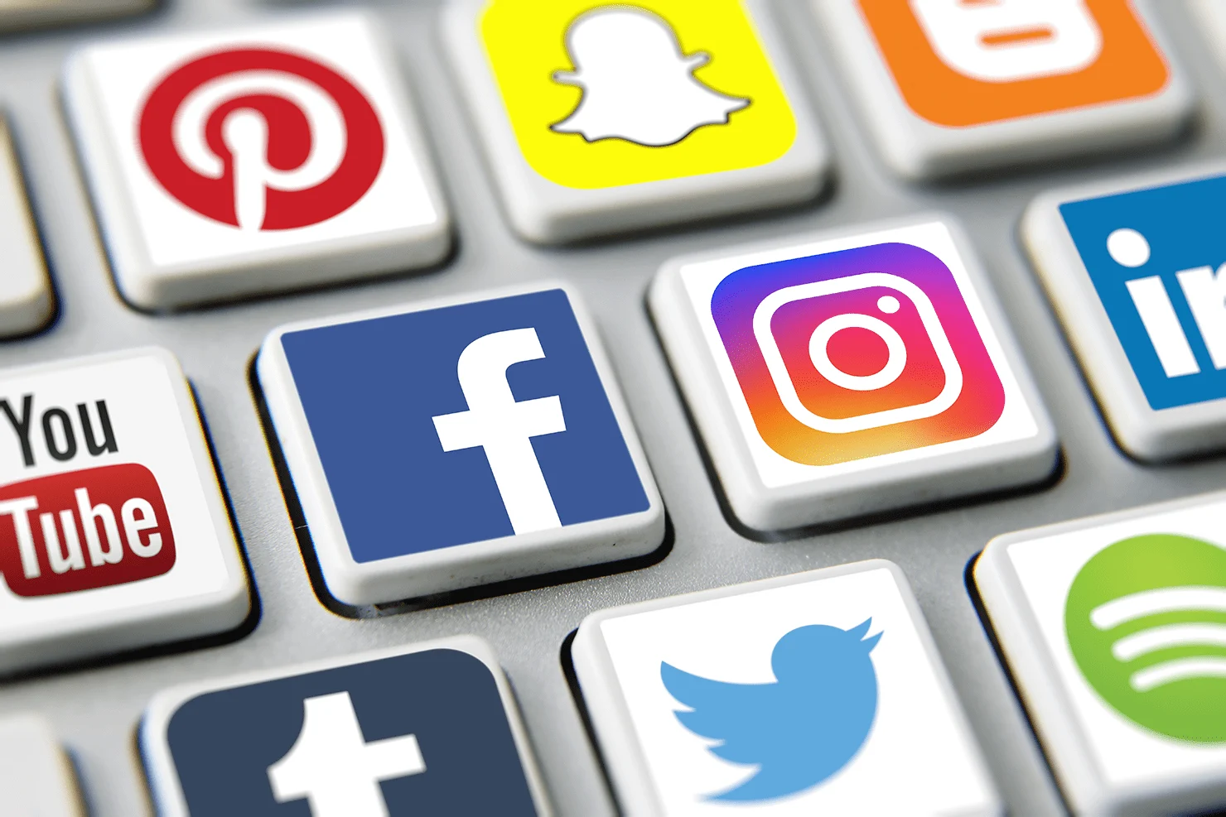

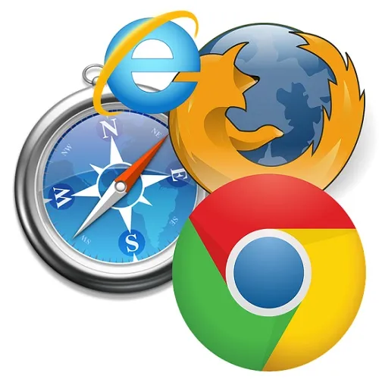
Concept of Digital Marketing
The Big Change: The internet gives businesses a massive network to showcase products, find customers, and increase profits.
Fast & Real-Time: Because data transmission is fast and easy, companies can connect with users instantly.
The Main Channels:
  Websites & Search Engines (Google)
  Social Media (Instagram, LinkedIn)
  Mobile Apps & Devices

Slide 5
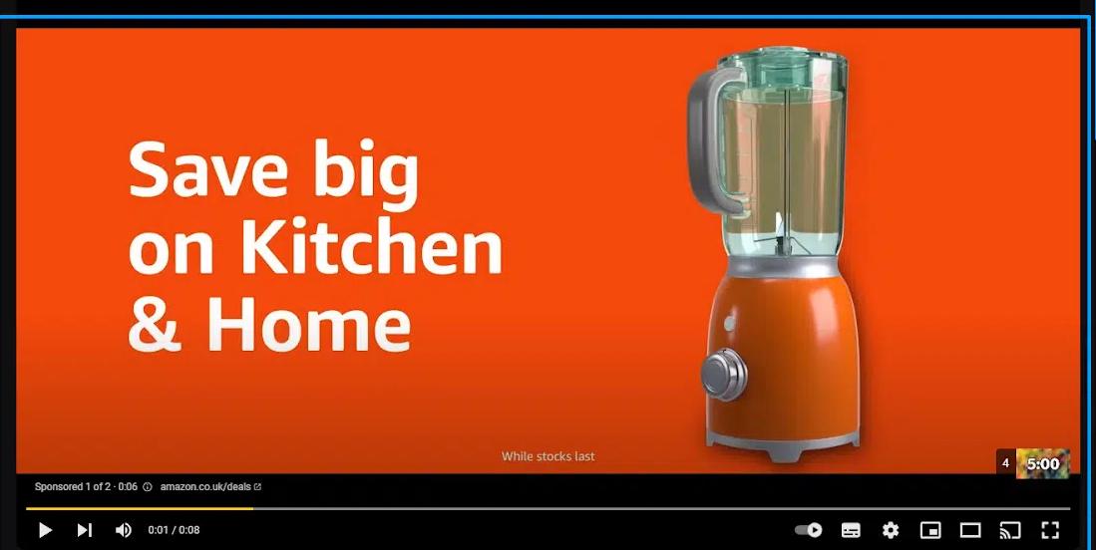
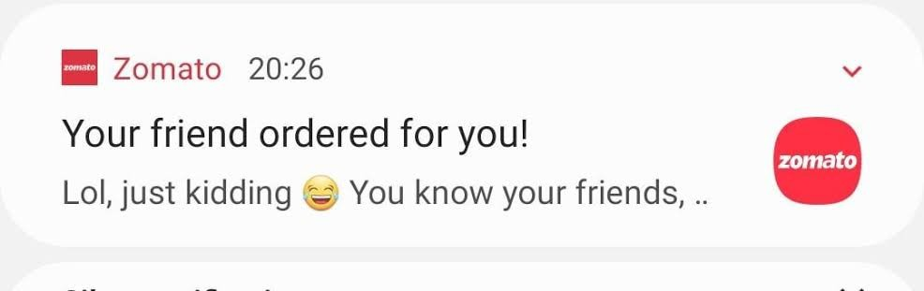
Concept of Digital Marketing (Continue..)
“Digital marketing is the promotion and marketing of goods and services to consumers through digital channels and digital/electronic technologies.”
Example 1 (Swiggy / Zomato): Push notification on your phone saying, “Your Friend Ordered for you” That is real-time, location-based digital marketing.
Example 2 (Amazon / Flipkart): You search for a Grinder on Amazon but don't buy it. Ads for that exact same Grinder follow you everywhere—on YouTube, Instagram, and news websites.

Slide 6
Evolution of Digital Marketing from Traditional to Modern Era

Slide 7

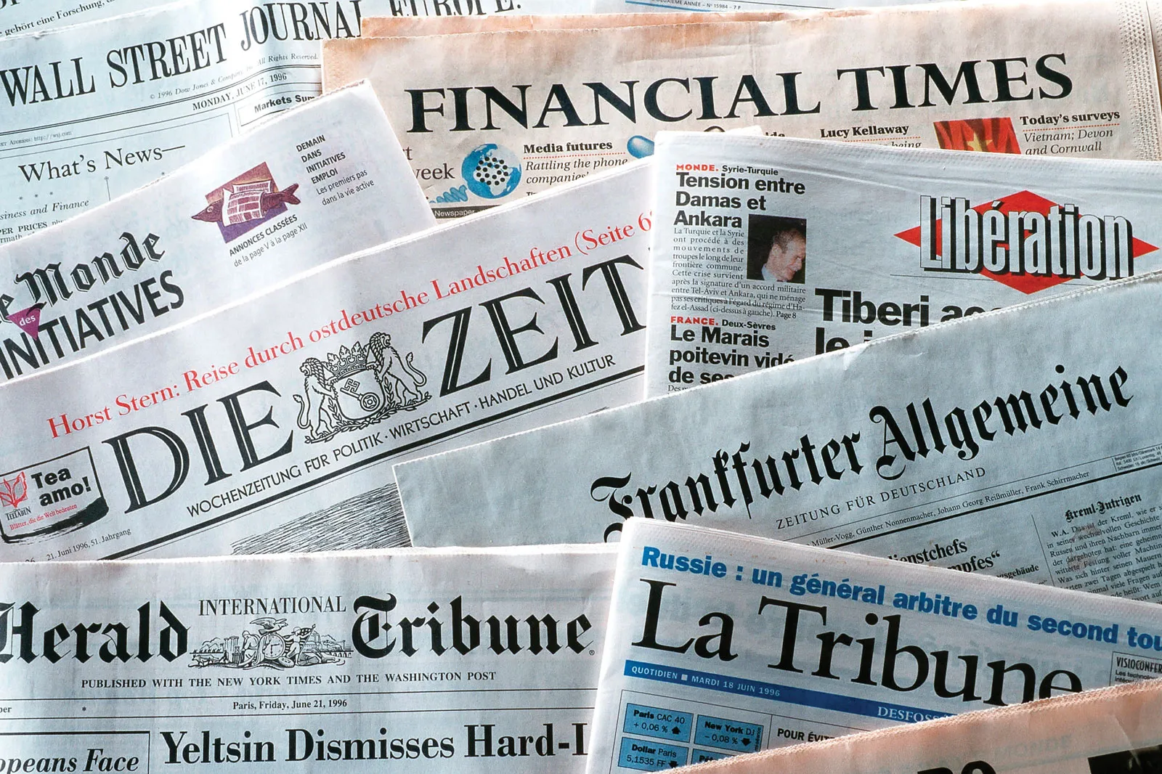


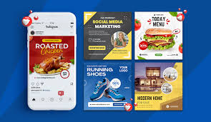
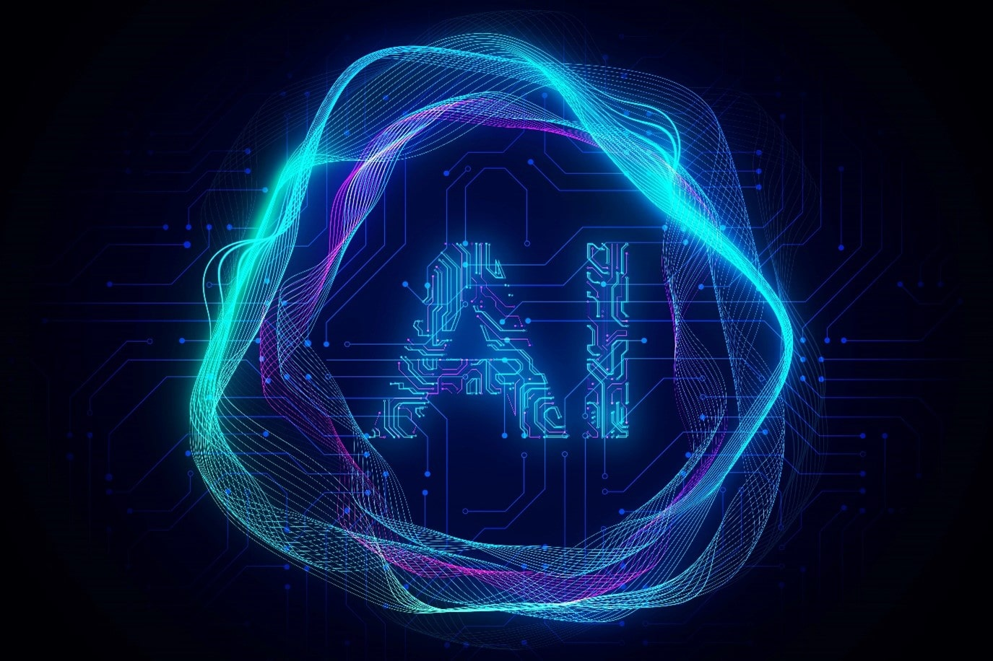
Evolution of Digital Marketing from Traditional to Modern Era
The Traditional Era (1.0): Before 1990
  One-way broadcasting (TV, Radio, Newspapers, Billboards).
  No tracking, no user data, and zero interaction.
The Early Digital Era (2.0): 1990s
  The birth of the Internet, static websites, and basic emails.
  Information shifted from paper to screens, but users could only read it.
The Modern Era (3.0): 2000s
  Dynamic, real-time, and two-way interaction (Social Media, AI, Apps).
  Driven by data pipelines, user analytics, and hyper-targeted automation.

Slide 8
Traditional Marketing vs. Digital Marketing

Slide 9
Traditional Marketing vs. Digital Marketing
Point | Traditional Marketing | Digital Marketing
Meaning | Traditional marketing is a promotional strategy that uses offline channels to reach a broad audience and promote products and services to consumers. | Digital marketing is a way to promote brands to connect with potential customers using the internet and other digital communication channels.
Channels | Uses offline channels like TV, radio, newspapers, magazines, billboards, and direct mail. | Utilizes online channels like websites, social media, email, search engines, and online ads.
Cost | Often involves higher costs due to production and placement fees (e.g., TV commercials, print ads). | Generally, more cost-effective with options for low-cost campaigns (e.g., social media ads, email marketing).
Reach | Limited to specific geographic areas based on the chosen medium (e.g., local newspaper or TV channel). | Can reach a global audience with no geographic limitations.

Slide 10
Traditional Marketing vs. Digital Marketing (Continue..)
Point | Traditional Marketing | Digital Marketing
Interaction | Mostly one-way communication with limited audience interaction. | Allows for two-way communication and real-time interaction with the audience.
Measurement | Difficult to measure and track the effectiveness of campaigns (e.g., estimating TV viewership). | Easier to measure and analyze campaign performance with analytics tools (e.g., website traffic, conversion rates).
Personalization | Limited personalization options, often relies on broad targeting (e.g., demographics). | Highly customizable and can target specific audiences based on their behavior and preferences.
Adaptability | Less flexible; changes to campaigns can be time-consuming and costly (e.g., reprinting ads). | Highly adaptable; campaigns can be adjusted quickly based on performance data.

Slide 11
Traditional Marketing vs. Digital Marketing (Continue..)
Point | Traditional Marketing | Digital Marketing
Durability | Ads have a fixed lifespan (e.g., a magazine issue or a billboard rental period). | Content can have a longer lifespan and continuous visibility online (e.g., blog posts, social media updates).
Consumer Engagement | Limited engagement opportunities (e.g., passive viewing of a TV ad). | High engagement potential through interactive content (e.g., social media comments, live chats).
Examples | TV commercials, radio spots, newspaper ads, billboards, direct mail campaigns. | Social media ads, email newsletters, search engine marketing, content marketing, influencer collaborations.

Slide 12
Penetration of Internet in
India & World

Slide 13
Penetration of Internet in India & World
Point | India | World
Total Internet Users | Over 900 Million to 1 Billion | ~6 Billion total users
Internet Penetration Rate | ~62.5% of the population is online | ~73% to 74% of the population is online
Primary Access Device | Mobile Phones (Over 70%-80%) — highly mobile-dependent | Mix of Mobile (~52%-60%) and Desktop/Laptops
Data Costs | Extremely Cheap: Among the lowest data pricing globally | Moderate to High cost per GB depending on the country

Slide 14
Penetration of Internet in India & World (Continue…)
Source: https://www.indiadigitalsummit.in/wp- content/uploads/2026/01/Internet-in-India-2025-Press-Release-Final.pdf
Source: https://www.itu.int/en/ITU-D/Statistics/pages/stat/default.aspx

Slide 15
Understanding the Digital Customer Journey

Slide 16
Understanding the Digital Customer Journey
AWARENESS
Social Media
Web Sites
Search
Direct Mail
Word of Mouth
Radio TV Print Outdoor
PURCHASE
Website
Shop
Online Booking
Store
Salesperson
ADVOCACY
Social Post
Reviews
Blog
Word of Mouth
Engage
Recommend
INTEREST
Reviews
Blog
Media
Articles
RETENTION
Call Center
Chat
Social Media
Community
Blog
Newsletter

Slide 17
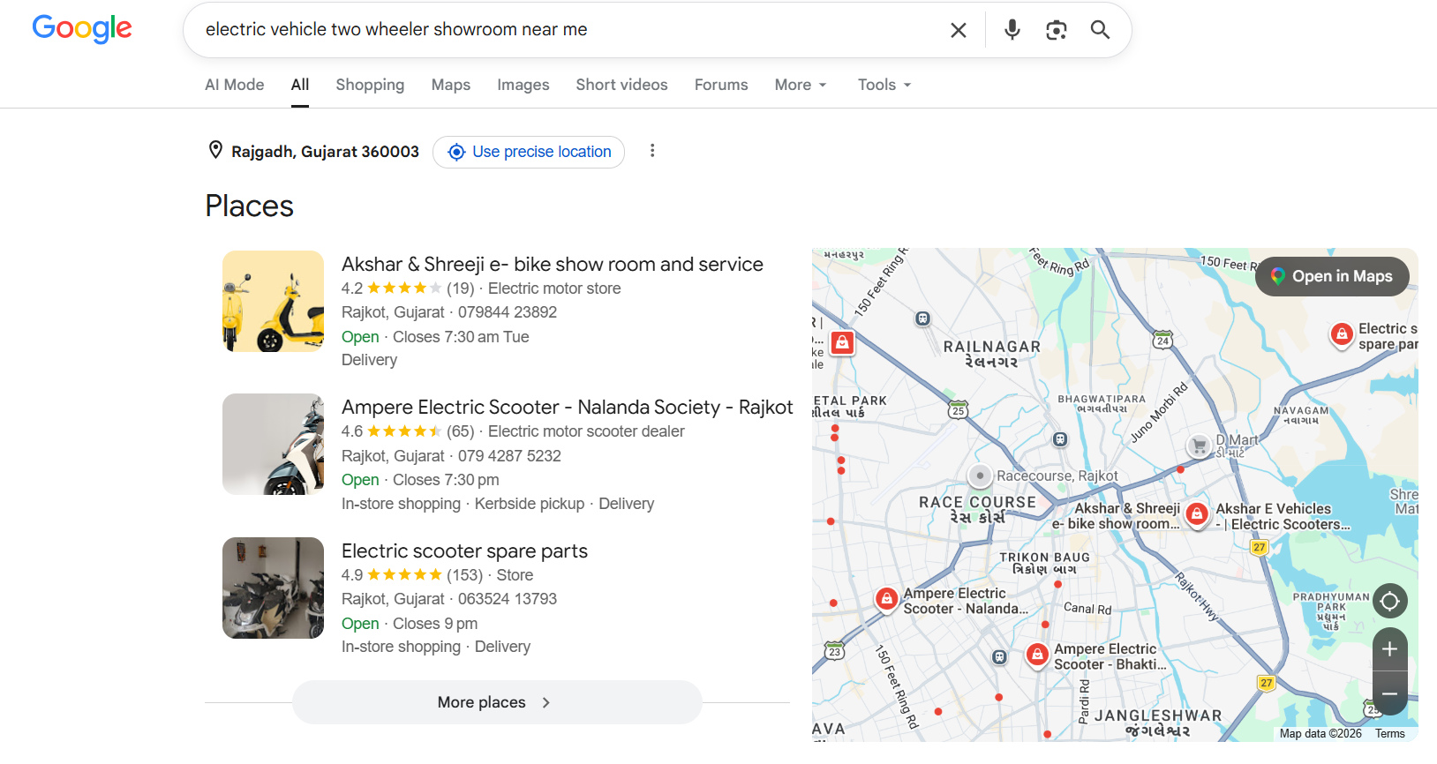
Understanding the Digital Customer Journey (Continue…)
Awareness (Discovery Stage)
  What happens: The user realizes they have a problem or a need, and they discover your brand online.
  When customer need something they search for it.
  Example: You realize that electric vehicle is pocket friendly, so you search on internet about electric vehicle. Here you will discover about different electric vehicle available in market.

Slide 18
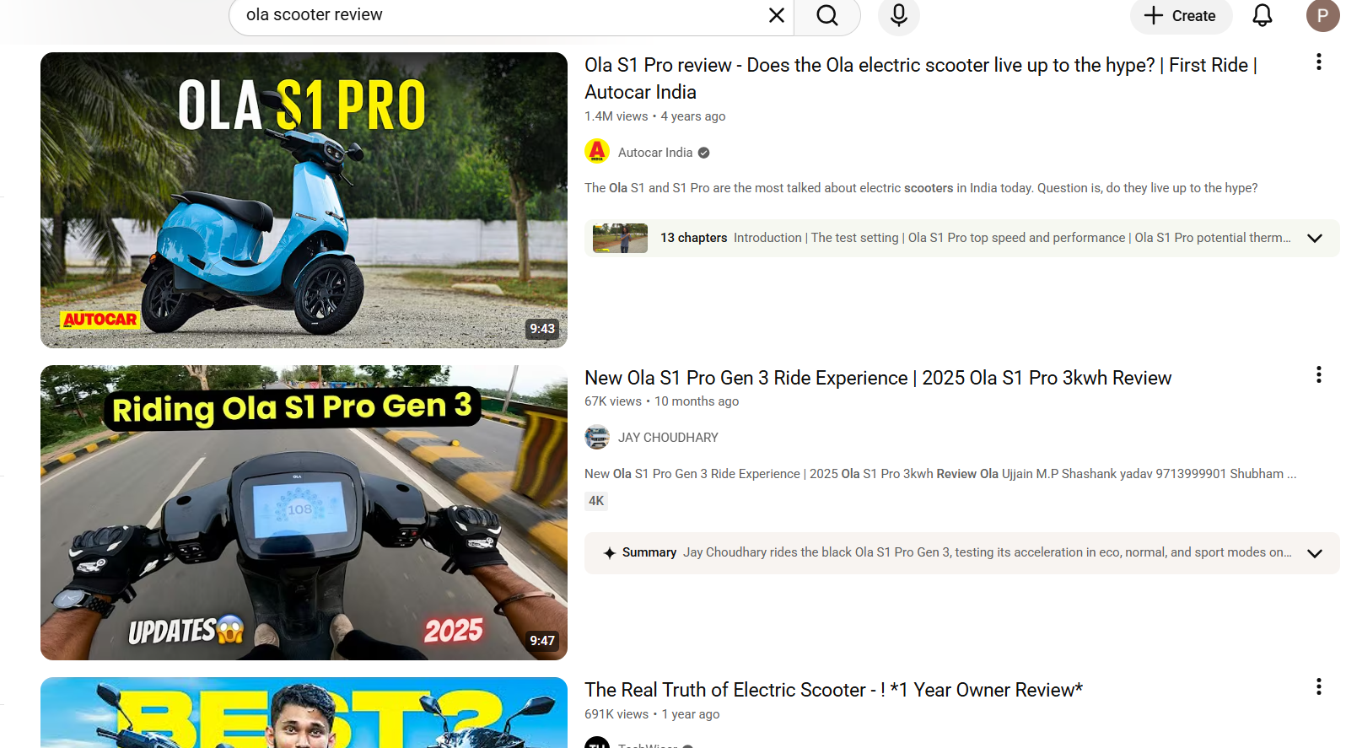
Understanding the Digital Customer Journey (Continue…)
Interest (Evaluation Stage)
  What happens: The user compares your product with competitors. They read reviews and check features.
  Customer check online reviews (Blogs, YouTube etc.), Compare products base on
    Quality
    Price
    Quantity, etc.
Example: You want to purchase a Scooter, you will compare, prices, Milage, Brand, After sales service, color & other features of different scooter before deciding.

Slide 19
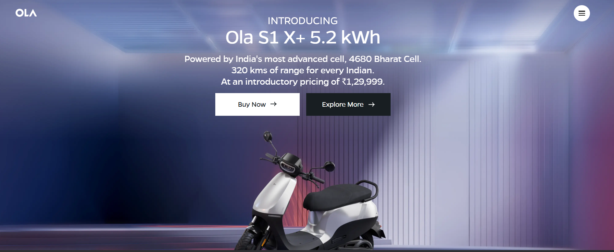
Understanding the Digital Customer Journey (Continue…)
Purchase (Conversion Stage)
What happens: The user decides to buy the product or sign up for the service.
  Website checkout, mobile app payment gateway (UPI, Net banking).
Example: Once you select electric scooter that you like, you will head to the official website to book the order to purchase.

Slide 20
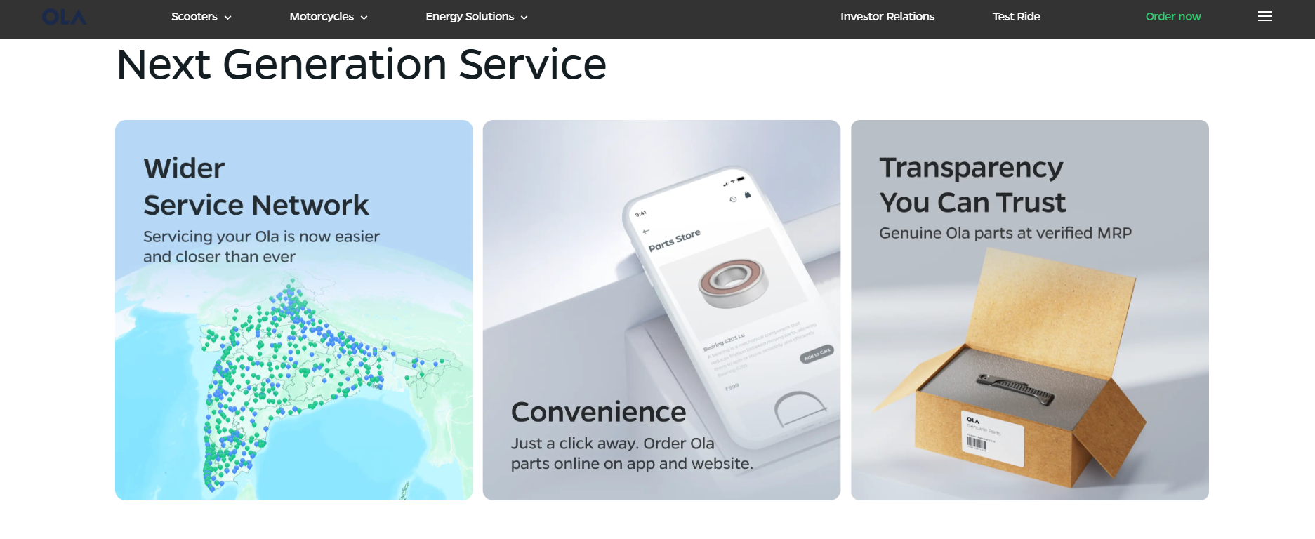
Understanding the Digital Customer Journey (Continue…)
Retention (Engagement Stage)
What happens: The customer uses the product. The business sends updates to make sure the user stays active.
Notifications, automated emails, customer care calls, after sales service.
Example: Ola Provides Next Generation Service so customer does not switch to other brands in future, this is retention of customer.

Slide 21
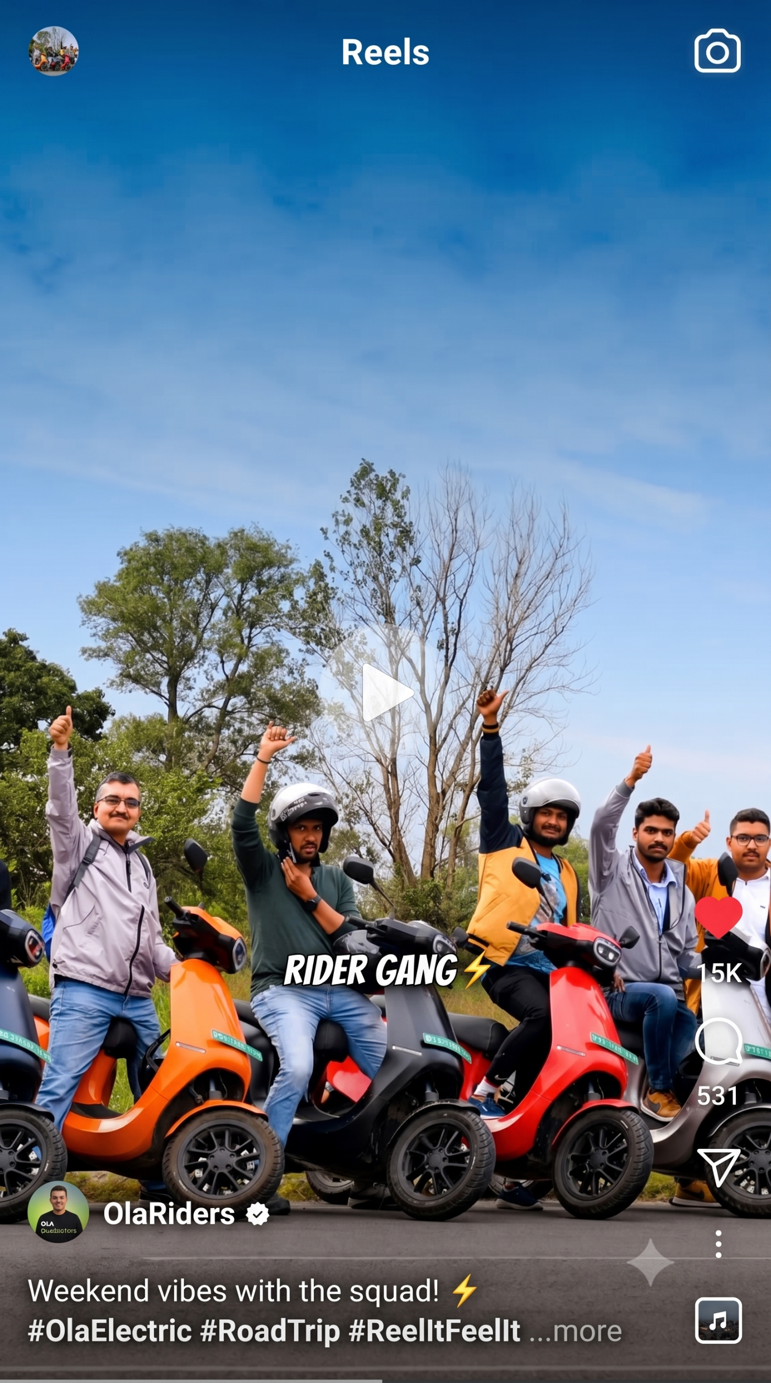
Understanding the Digital Customer Journey (Continue…)
Advocacy (Loyalty Stage)
  What happens: The customer loves the product so much that they tell their friends and write good reviews online.
  Posting on social media, writing reviews on Google.
Example: You liked the Scooter very much that you start suggesting your relatives and friend to purchase Electric scooter. You share photos of your scooter on social media, and give positive feedback.

Slide 22
Digital Marketing Components and Frameworks

Slide 23
Digital Marketing Components and Frameworks
Search Engine Optimization (SEO)
Content Marketing
Email Marketing
Social Media Marketing
Pay Per Click
Mobile Marketing
Key Components of Digital Marketing:

Slide 24
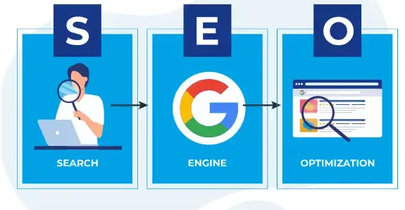
Digital Marketing Components and Frameworks (Continue…)
1. Search Engine Optimization (SEO)
  SEO is the process of improving a website's ranking on search engines like Google.
  It helps businesses appear in search results when users look for related products or services.
  Better rankings increase website traffic and brand visibility.
  SEO focuses on keywords, content quality, and website performance.
  Example: Imagine a bakery that wants to sell more chocolate cakes. If their website just says "Welcome to our shop," they stay hidden on page 5 of Google.
  But if they change their website title to "Best Chocolate Cakes in Rajkot" and make the page load fast, Google pushes them to the #1 spot so everyone hungry for cake finds them first.

Slide 25
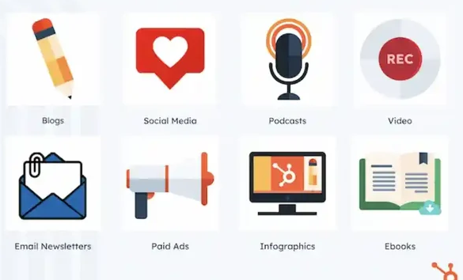
Digital Marketing Components and Frameworks (Continue…)
2. Content Marketing
  Content marketing involves creating and sharing useful information for customers.
  Common content formats include blogs, videos, articles, infographics, and e-books.
  It helps attract, educate, and engage potential customers.
  Good content builds trust and strengthens the brand image.

Slide 26

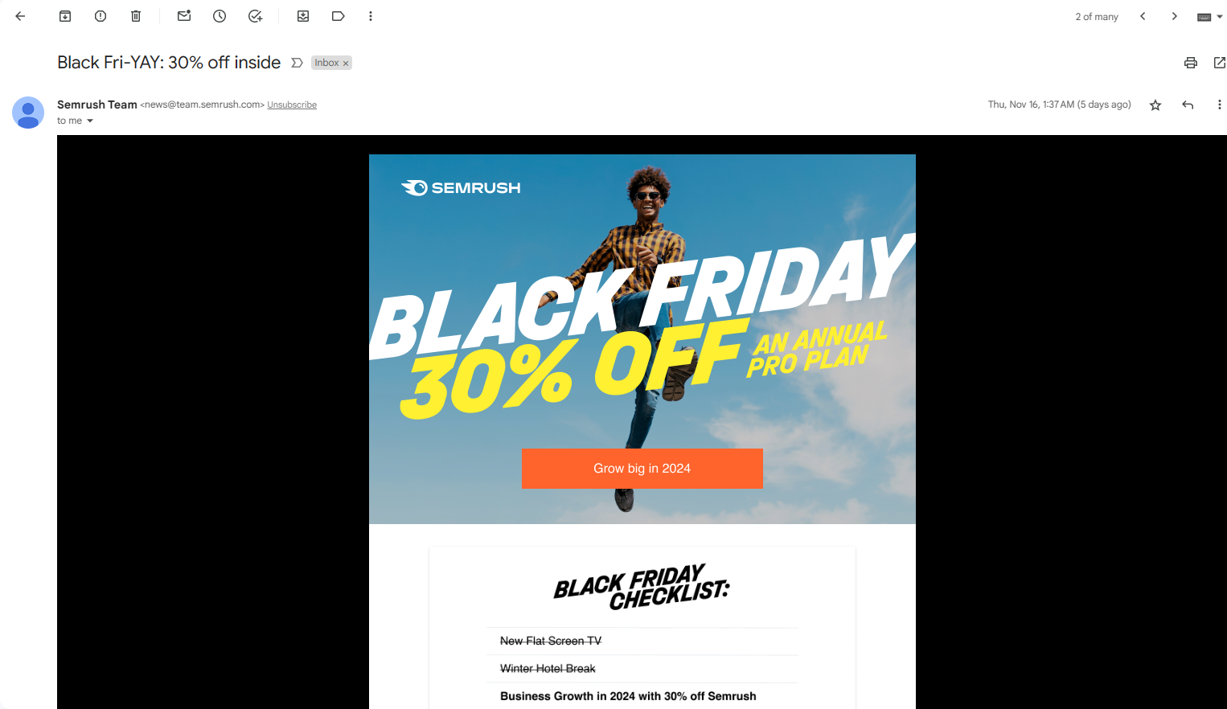
Digital Marketing Components and Frameworks (Continue…)
3. Email Marketing
  Email marketing involves sending promotional and informational emails to customers.
  It is used to share offers, updates, newsletters, and announcements.
  Businesses can maintain regular communication with their audience.
  It helps improve customer relationships and encourage repeat purchases.

Slide 27


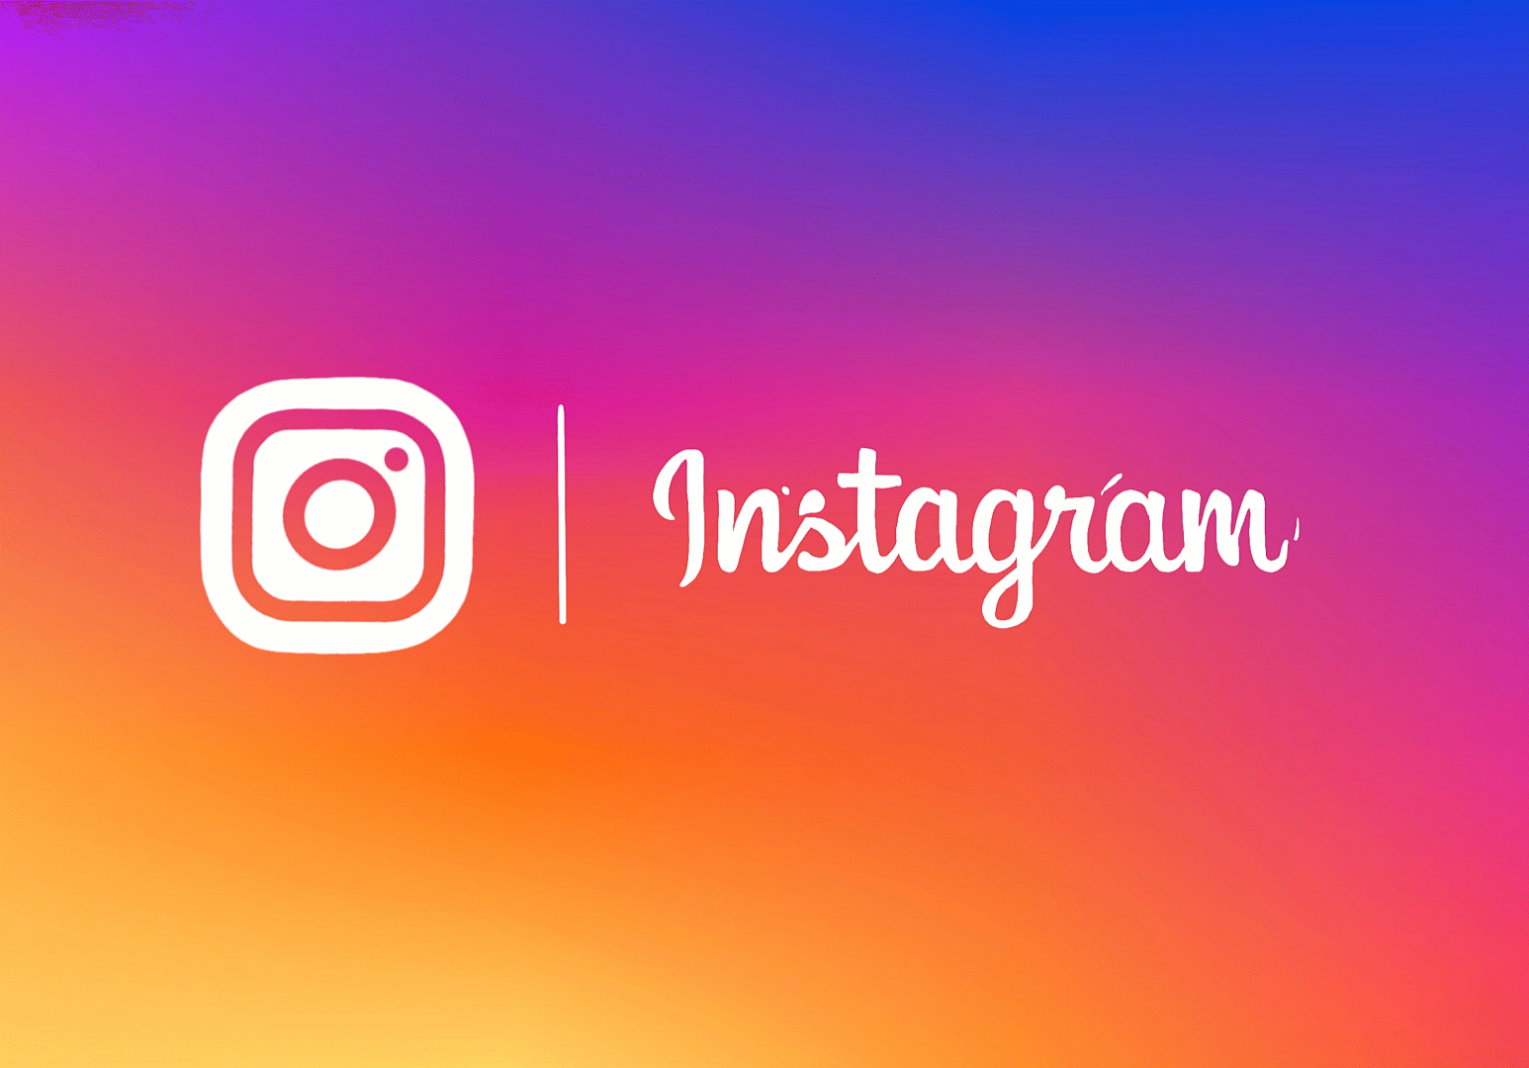

Digital Marketing Components and Frameworks (Continue…)
3. Social Media Marketing (SMM)
  Social media marketing uses platforms such as
    Facebook
    Instagram
    LinkedIn
    X.
  Businesses share content, interact with customers, and promote products online.
  It helps increase brand awareness and customer engagement.
  Social media also allows businesses to run targeted advertisements.

Slide 28
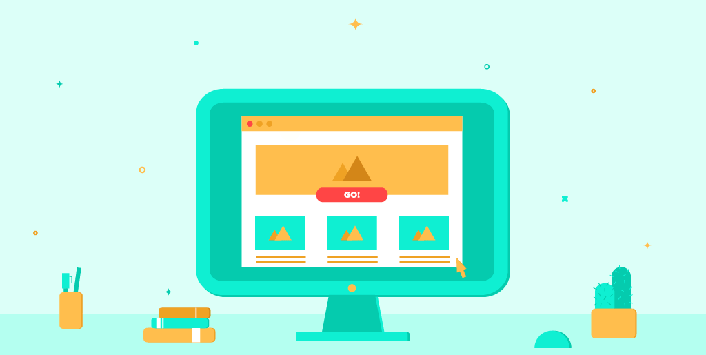
Digital Marketing Components and Frameworks (Continue…)
5. Pay-Per-Click (PPC) Advertising
  PPC is a form of online advertising where businesses pay when users click on their ads.
  These ads appear on search engines, websites, and social media platforms.
  PPC helps generate quick traffic and leads.
  It allows businesses to target specific audiences based on interests and demographics.
Ads

Slide 29
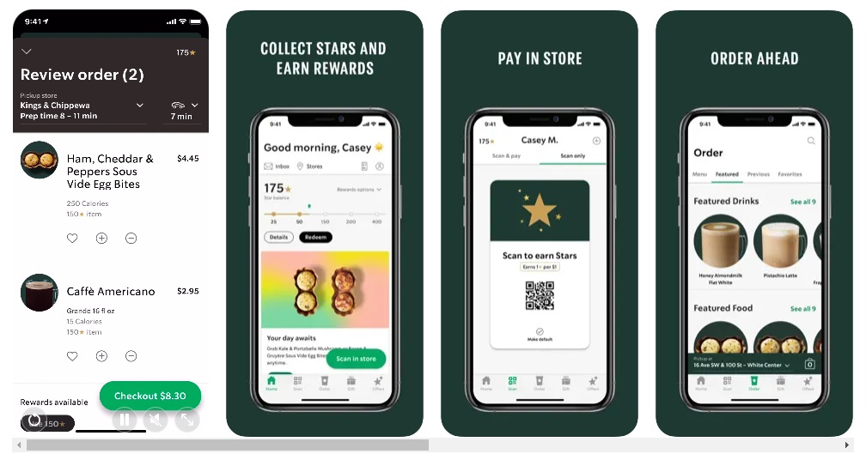
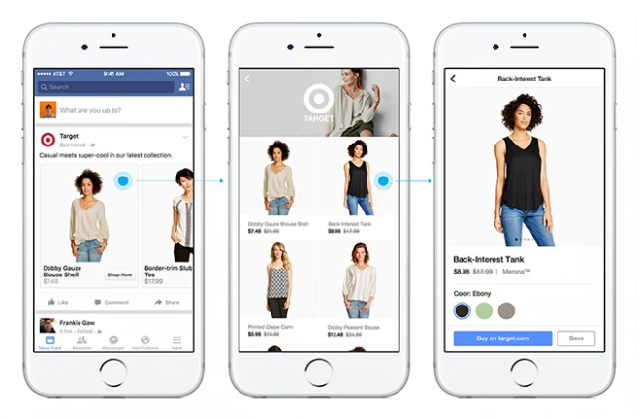
Digital Marketing Components and Frameworks (Continue…)
6. Mobile Marketing
  Mobile marketing focuses on reaching customers through smartphones and tablets.
  It includes mobile apps, SMS marketing, mobile-friendly websites.
  Businesses can connect with customers anytime and anywhere.
  It improves user experience and increases customer engagement.

Slide 30
Digital Marketing Components and Frameworks (Continue…)
Digital Marketing Framework – RACE Model:
R
Reach
A
Act
C
Convert
E
Engage

Slide 31
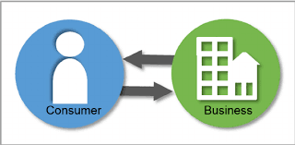
Digital Marketing Components and Frameworks (Continue…)
R – Reach
First step in attracting potential customers, reach your customers
Increase Visibility of your brand among potential customers.
It includes Publishing and promoting Digital content on Internet
Brand Uses
  SEO
  Social Media
  Online Ads
  Content Marketing
This attracts potential customers toward Brand
Connect

Slide 32
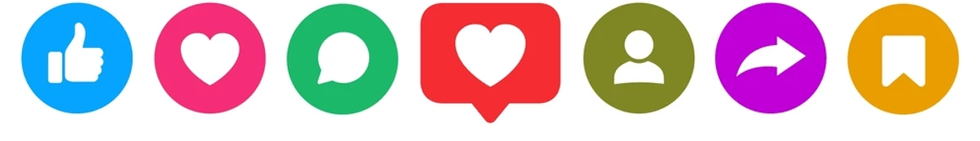
Digital Marketing Components and Frameworks (Continue…)
A – Act
Once connected with customers, You need to act, that is Interaction with your customers.
Customer may read your blogs, watch video, visit you on social media.
Your goal is to generate interest in customer.
Customer should
  Like
  Share
  Comment
Interested customer will engage and may purchase your product.

Slide 33


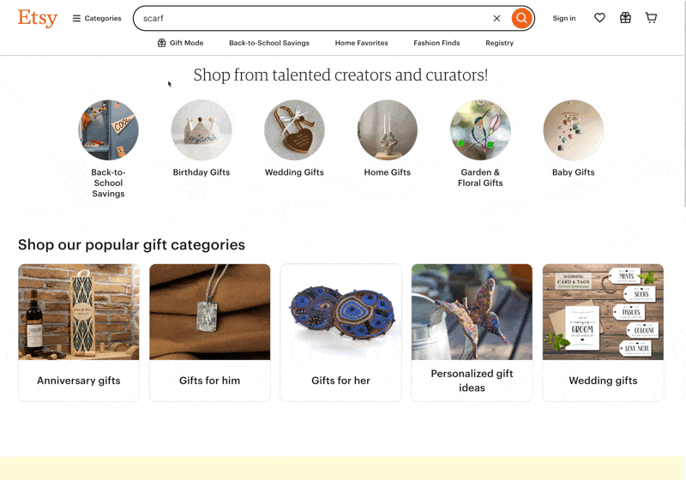



Digital Marketing Components and Frameworks (Continue…)
C – Convert
Here potential customers are converted to paying customers.
Directly contribute to business revenue.
Make Customer
  Purchase
  Register
  Subscribe to service
Use
  Effective landing page
  Call for action

Slide 34


Digital Marketing Components and Frameworks (Continue…)
E – Engage
Building long term relation with customers who has purchased from you.
It helps in improving customer satisfaction.
Stay in connection with your customers by
  Regular mail
  Social media
  Customer support calls
It increase repeat purchase and brand recommendation.
Business
Customer

Slide 35
Role of Internet in Digital Marketing

Slide 36
Role of Internet in Digital Marketing
The internet acts as the foundation of modern digital marketing.
communication from one-way broadcasting to an interactive, 24/7 network at lower cost.
Global Reach: Removes physical boundaries. Application or campaign can connect with a worldwide audience instantly.
Targeted Advertising: Filter audiences by specific demographics, behaviors, and interests.
Measurable Analytics: Enables real-time tracking of customers.
Two-Way Interaction: social media and automated AI chatbots to create a direct feedback with users.
High ROI / Low Cost: cost much less than traditional TV or print media.
24/7 High Availability: digital marketing runs continuously.

Slide 37
Advantages and Limitations of Digital Marketing

Slide 38
Advantages of Digital Marketing
Wider Reach
Brand Development
Personalization
Accessibility
Better Engagement
Lower Cost
Track-able Results
Improved Conversion Rates
Digital marketing helps improve awareness about products and services through an online platform to reach a wide base of customers across the world.
Digital marketing helps to build the brand in various ways of direct campaigning and personalized approach.
Bringing the audience closer and approaching them with the product that meets their requirement, helps to create brand loyalty and reputation.
Marketing methods using digital platforms provide the opportunity for both sellers and buyers to get easy access with the flexibility of time and location.
A suitable promotional strategy using blogs, social media content, and promotional offers allow the brand to get a hold of the customer’s attention and build credibility.
The digital marketing methodology is easier to implement with a limited budget and infrastructure which is beneficial especially for small businesses.
The digital analytical tools and other online metrics help to track how effective the marketing campaign has been in terms of customer reach and response.
The digital marketing process creates a seamless and immediate connection with potential customers with the convenience of making a purchase just with a few clicks on your website.

Slide 39
Limitations of Digital Marketing
Skills Requirement: With regular advancements in technology, it is essential to remain updated on tools, platforms, and methods to quickly respond to any changes.
Time-consuming: We need to plan and implement various tasks related to optimization of online advertising and creating suitable content for promotions that can take up a lot of time.
High Competition: A wider reach to the global audience with digital marketing also requires building capabilities to face global competition.
Complaints and Feedback: Any negative review can create an adverse impact on some part of your customers unless you have a strong foothold through brand loyalty and efficient customer service.

Slide 40
Limitations of Digital Marketing
Dependability on Technology: There can be instances of failure when the links may not work, the website may not respond, and user may not be able to access website.
This may create dissatisfaction among the prospective customers that forces them to switch to other brands.
Security and Privacy Issues: The more use of online platforms demands better security and website protection.
For a digital marketer, securing and safeguarding the network connections by using firewalls and good antivirus is always desirable.

Slide 41
Skills Required in Digital Marketing

Slide 42
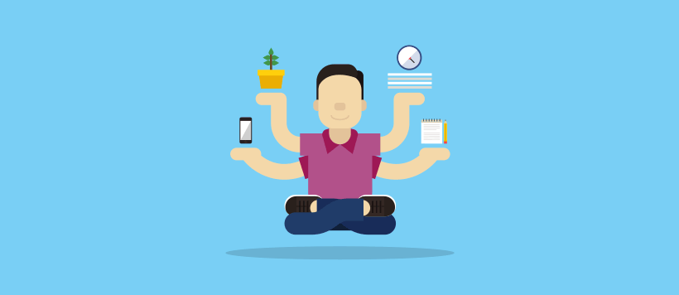
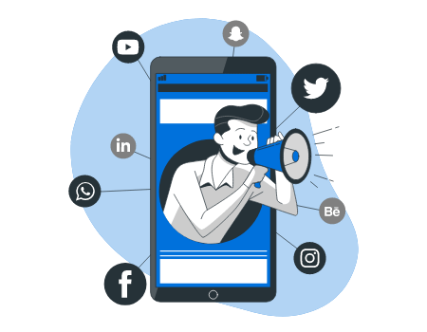
Skills Required in Digital Marketing
Communication Skills
Content Creation Skills
SEO Skills
Social Media Management Skills
Data Analysis Skills
Creativity and Innovation
Email Marketing Skills
Advertising & Campaign Management Skills
Adaptability and Continuous Learning Skills

Slide 43
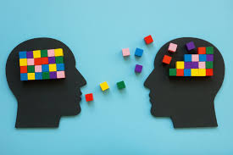
Skills Required in Digital Marketing
Communication Skills
  Digital marketers must communicate ideas clearly through advertisements, social media posts, emails, and website content.
  Good communication helps
    attract
    Engage
    retain customers
  It also improves customer relationships and brand reputation.
  Illustration:
    Writing an attractive Instagram caption to promote a new product launch.
    Creating script for Ads, video and podcast.

Slide 44
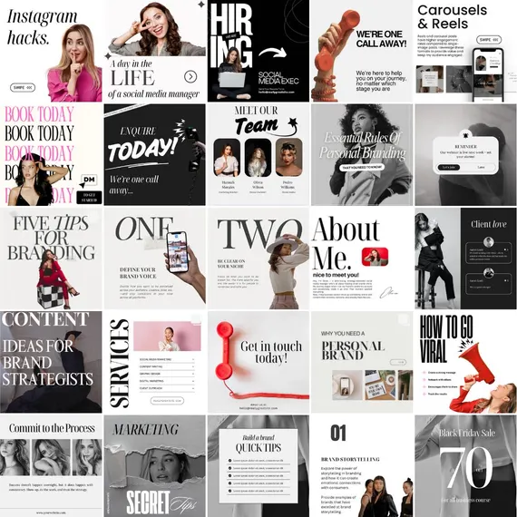
Skills Required in Digital Marketing
Content Creation Skills
  Creating valuable and engaging content is essential for digital marketing success.
  Content can include
    blogs,
    videos,
    social media posts,
    infographics,
    podcasts.
  High-quality content helps educate customers and build trust.
  Illustration: Creating a video demonstration of your product
    creating a poster of special discount for social media.

Slide 45
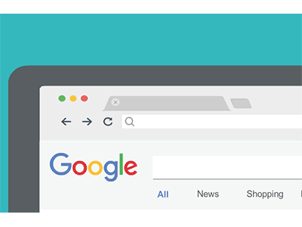
Skills Required in Digital Marketing
Search Engine Optimization (SEO) Skills
  SEO skills help improve a website's visibility on search engines like Google.
  Marketers must understand
    keywords
    Optimization of elements on web page
    link building.
  Better SEO leads to increased website traffic and brand awareness.
  Illustration: Optimizing a webpage using the keyword “best online shopping app.” So when someone search best online shopping app your app is visible.

Slide 46
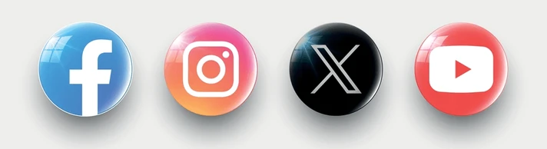
Skills Required in Digital Marketing
Social Media Management Skills
  Digital marketers should know how to manage and promote brands on social media platforms.
  They must
    create engaging posts
    Understand Hashtag
    Create attractive captions
    interact with followers regularly.
  Effective social media management increases customer engagement.
  Illustration: Running a Facebook campaign to promote a festive discount offer.

Slide 47
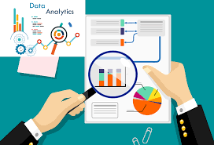
Skills Required in Digital Marketing
Data Analysis Skills
  Basic Understanding of chart, graphs and numbers.
  Data analysis helps marketers understand customer behavior and campaign performance.
  Marketers analyze
    Number of new customer reach
    Web Traffic
    Customer engagement
    Return of Investment, etc.
  Data-driven decisions improve marketing effectiveness.
  Illustration: Analyzing website traffic number of customers visiting a webpage to identify the most popular product pages on E-commerce site.

Slide 48
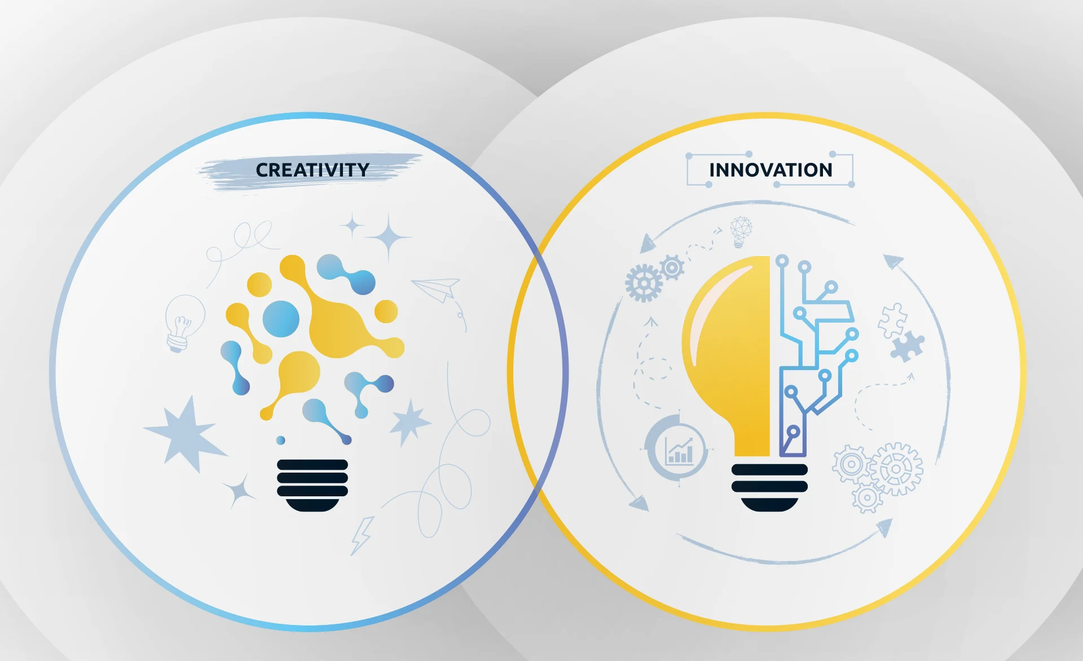
Skills Required in Digital Marketing
Creativity and Innovation
  Design unique campaigns that capture customer attention.
  Innovative ideas make brands stand out from competitors.
  It include
    Mascot (Amul Girl, Duracell Rabbit)
    Music or song
    Color combinations
    Attention grabbing content (Hook)
    Viral content, etc.
  Creative marketing improves audience engagement and brand recall.
  Illustration: Creating a viral social media challenge for a new product launch.

Slide 49
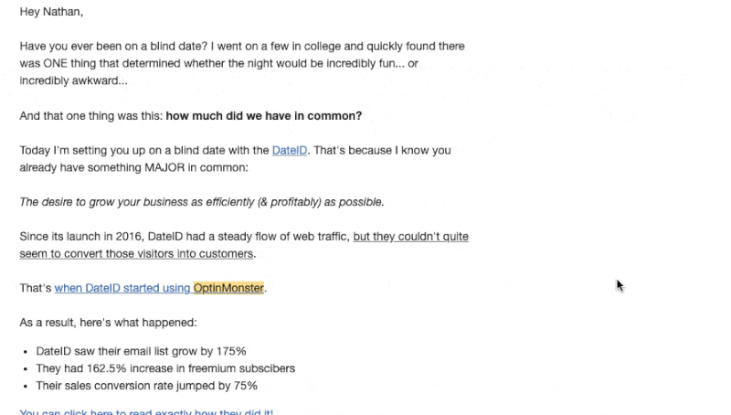
Skills Required in Digital Marketing
Email Marketing Skills
  Ability to create effective and personalized email campaigns.
  Marketers use emails to
    Share offers
    Updates
    Important information.
  Well-designed emails help increase customer engagement and sales.
  Illustration: Sending personalized discount coupons to loyal customers through email.

Slide 50

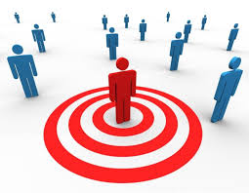
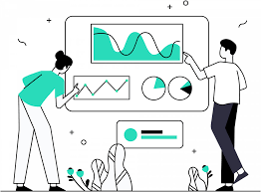
Skills Required in Digital Marketing
Advertising and Campaign Management Skills
  How to create and manage online advertising campaigns.
  They must
    plan budgets
    target audiences
    monitor performance
  Effective campaign management maximizes return on investment (ROI).
  Illustration: Running a Google Ads campaign for an online clothing store.

Slide 51
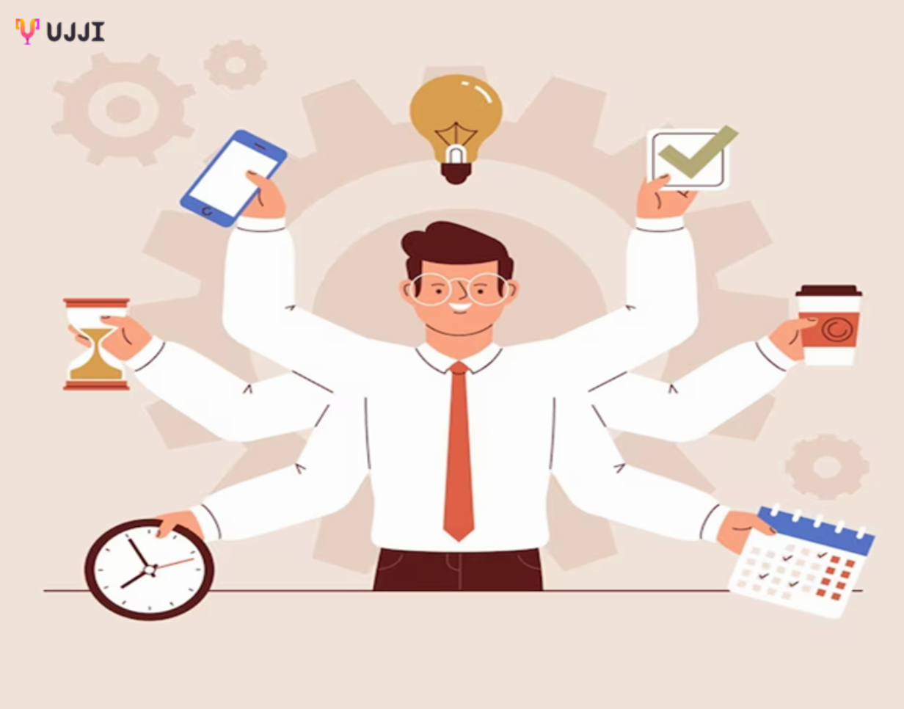
Skills Required in Digital Marketing
Adaptability and Continuous Learning
  Digital marketing trends and technologies change rapidly.
  Marketers must continuously update their knowledge and skills.
  Staying updated helps businesses remain competitive in the digital world.
  Illustration: Learning to use new AI-powered marketing tools for content creation and analytics.

Slide 52
Implications for Business & Society of Digital Marketing

Slide 53
Implication for business
Global Reach: Small shops can easily sell to customers anywhere in the world.
Smart Targeting: Ads are shown only to people who are likely to buy (based on age, interests, or location).
Trackable Results: Companies can see exactly how many people clicked an ad and what they bought.
Save Money: Digital ads are much cheaper and more flexible than TV or billboard ads.
Trapped by Algorithms: If Google or Instagram changes its rules, a business can lose its audience overnight.
Too Much Competition: The internet is crowded. It is very hard for a brand to stand out.

Slide 54
Implication for Society
Power to the Buyer: Customers can read reviews and compare prices instantly before buying.
Demand for Honesty: Fake or bad products are exposed quickly online, forcing brands to be more honest.
The Privacy Trade-off: To get personalized ads and recommendations, we give up a lot of our private personal data.
Echo Chambers: People are only shown ideas they already agree with, creating social division.
The Digital Divide: One-third of the world is still offline, meaning they get left out of these economic opportunities.

Slide 55
Infographics
Introduction
Why Infographics?
Types of Infographics

Slide 56
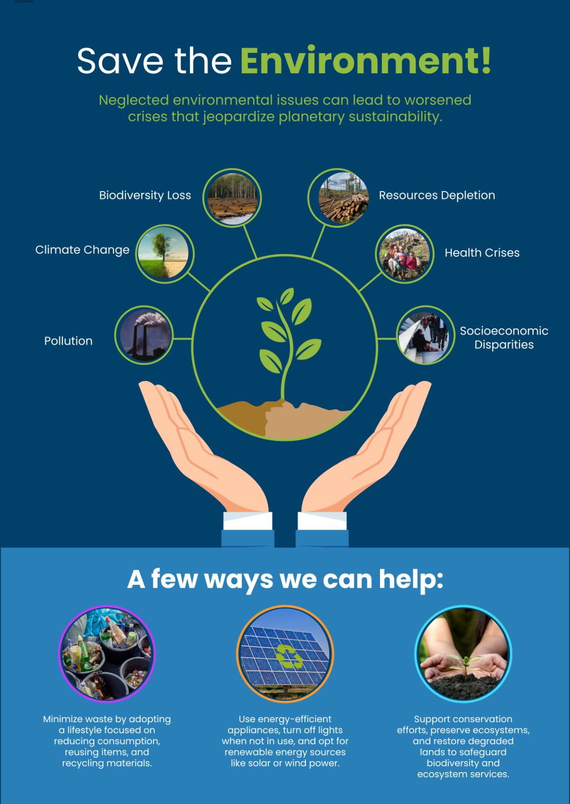
Introduction of Infographics
An infographic is a visual representation of information, data, or knowledge using graphics, icons, charts, and text.
It helps present complex information in a simple and attractive format.
Infographics improve understanding and make content easier to remember.
They are widely used in digital marketing, education, and business communication.
Illustration: An infographic showing Save Environment.

Slide 57
Why Infographics?
Easy to Understand
  Infographics convert lengthy and complex information into simple visual content.
  They help users quickly grasp important concepts and key messages.
Increases Engagement
  People are more likely to view and share visually appealing content.
  Infographics attract attention on websites and social media platforms.
Improves Information Retention
  Visual content is easier to remember than plain text.
  Combining images, icons, and statistics helps users retain information longer.
Enhances Brand Awareness
  Businesses can use branded infographics to communicate information professionally.
  Consistent use of logos, colors, and design elements strengthens brand identity.
  .

Slide 58
Types of Infographics
Process Infographics
Statistical Infographics
Informational Infographics
Timeline Infographics
Geographic Infographics
Comparison Infographics
Hierarchical Infographics
List Infographics

Slide 59
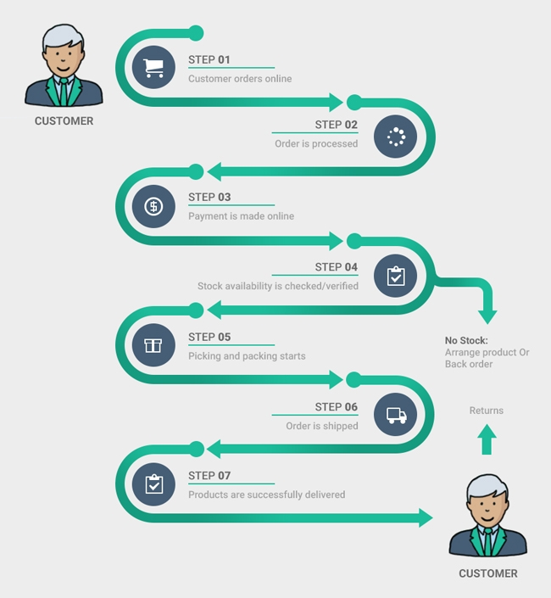
Types of Infographics (Continue…)
Process Infographics
  Used to explain the steps of a process in a simple way.
  Helps readers understand a procedure from start to finish.
  Usually follows a top-to-bottom or left-to-right flow.
  Numbering the steps makes the process easy to follow.
  Example: Steps involved in Online Shopping.

Slide 60
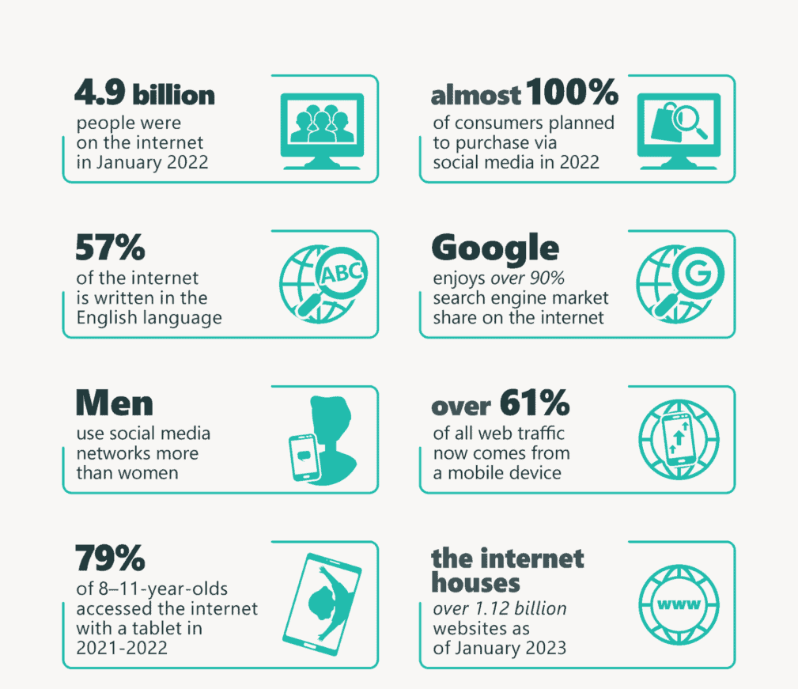
Types of Infographics (Continue…)
Statistical Infographics
  Used to present data, facts, and survey results visually.
  Helps explain the story behind numbers and statistics.
  Makes complex data easy to understand.
  Uses charts, graphs, icons, and images to attract attention.
  Example: Use of Internet.

Slide 61
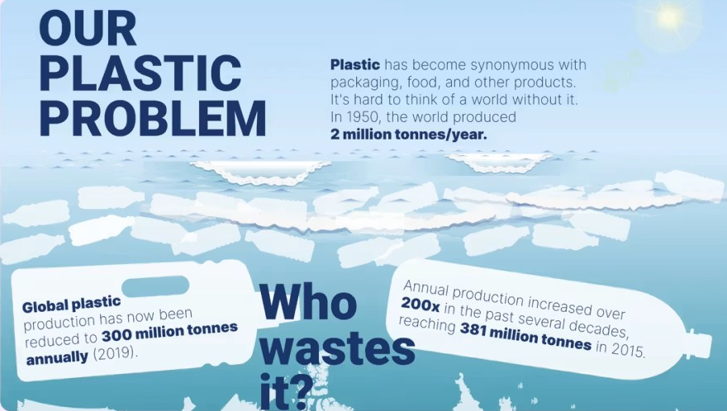
Types of Infographics (Continue…)
Informational Infographics
  Used to explain a concept, topic, or idea clearly.
  Provides an overview of a subject in a structured format.
  Information is divided into sections with headings.
  Easy to read and understand.
  Example: About Plastic Problem.

Slide 62
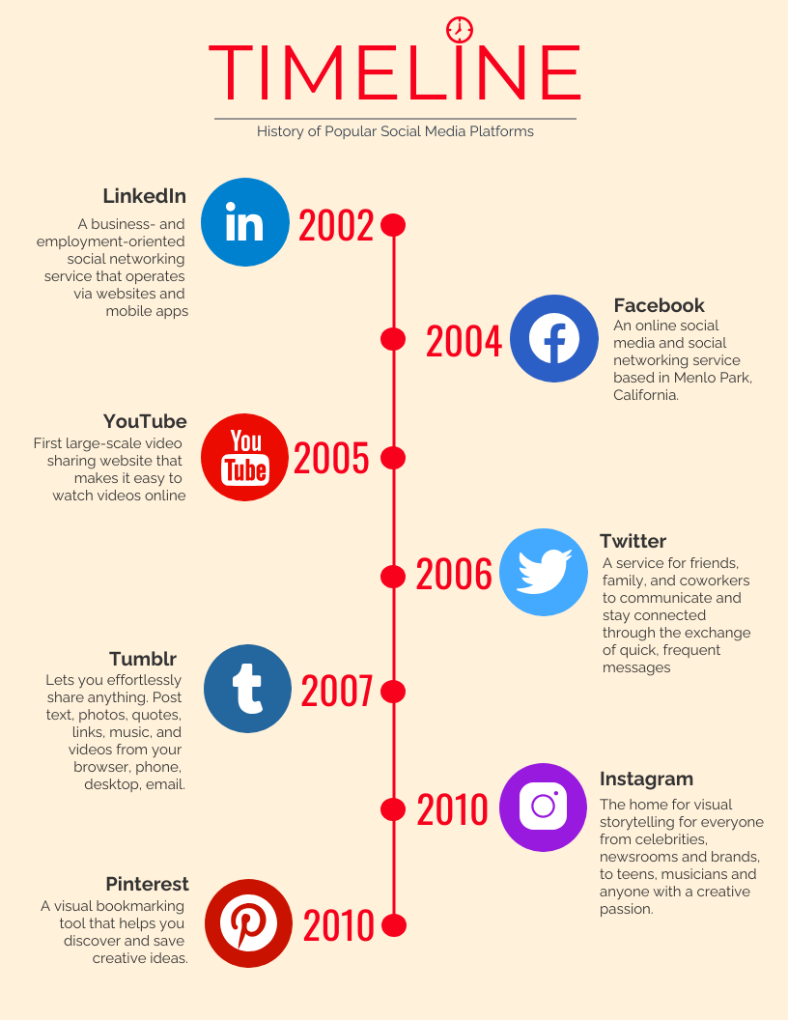
Types of Infographics (Continue…)
Timeline Infographics
  Used to show events in chronological order.
  Helps visualize history, milestones, or project schedules.
  Important dates are highlighted using icons and visuals.
  Makes time-based information easy to understand.
  Example: A brief History of Social media.

Slide 63
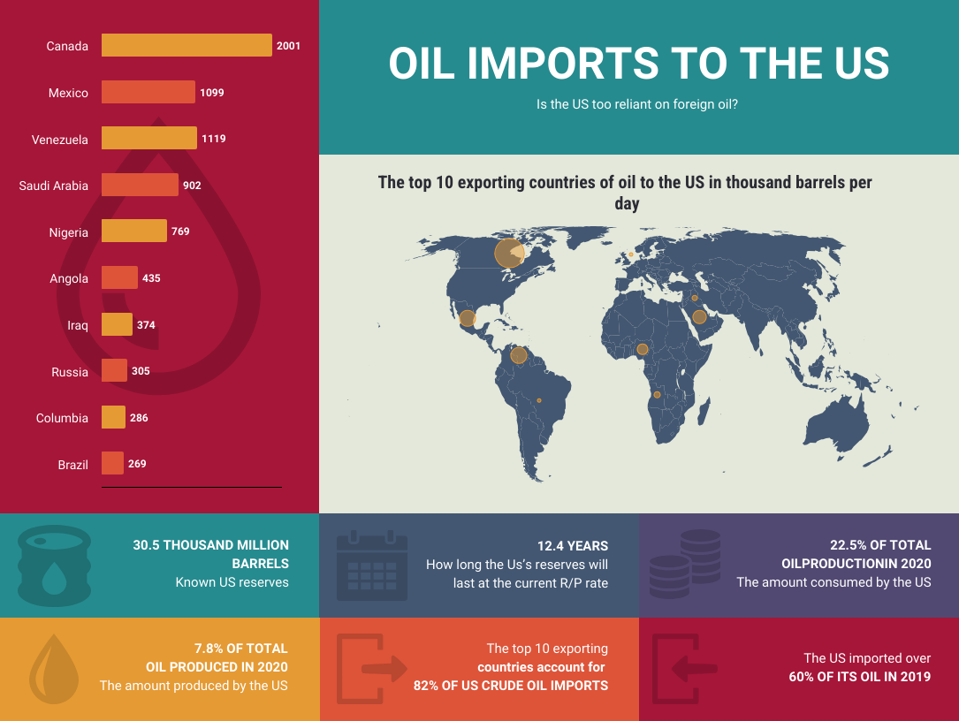
Types of Infographics (Continue…)
Geographic Infographics
  Used to present location-based or regional data.
  Focuses on maps and geographical information.
  Helps compare data across different areas.
  Useful for demographic and population studies.
  Example: Oil Imports to the US.

Slide 64
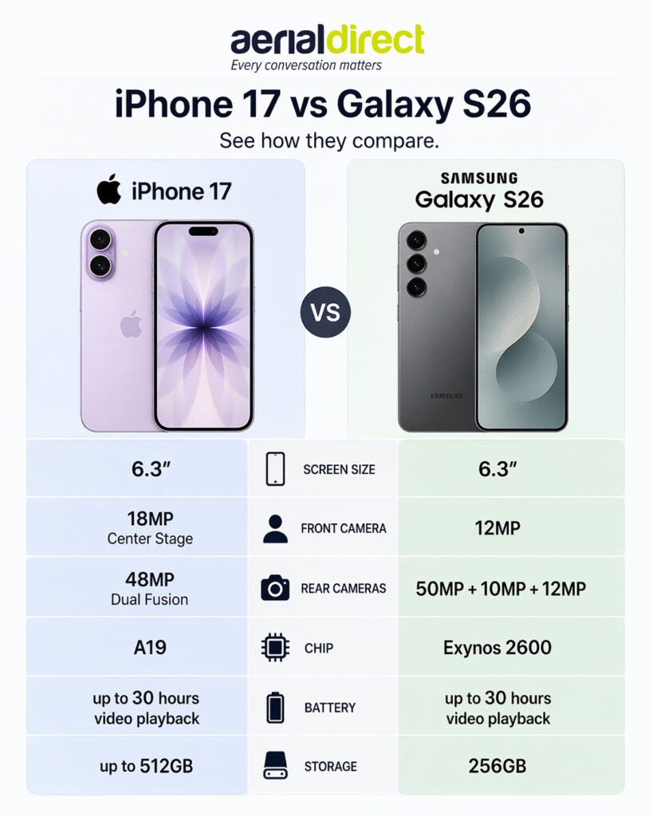
Types of Infographics (Continue…)
Comparison Infographics
  Used to compare two or more products, services, or ideas.
  Shows similarities and differences clearly.
  Information is usually displayed side-by-side.
  Helps users make better decisions.
  Example: Comparison iPhone 17 vs Samsung Galaxy S26.

Slide 65
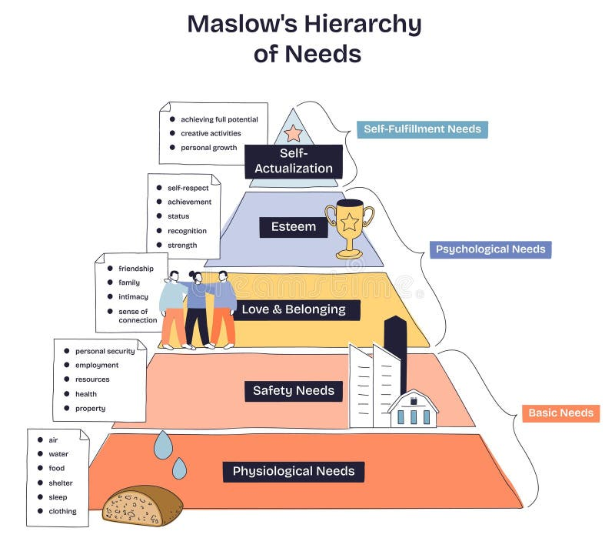
Types of Infographics (Continue…)
Hierarchical Infographics
  Used to organize information from highest to lowest importance.
  Often displayed in a pyramid or layered structure.
  Helps show ranking, levels, or priorities.
  Makes relationships between levels easy to understand.
  Example: Maslow’s Hierarchy of Needs Pyramid.

Slide 66
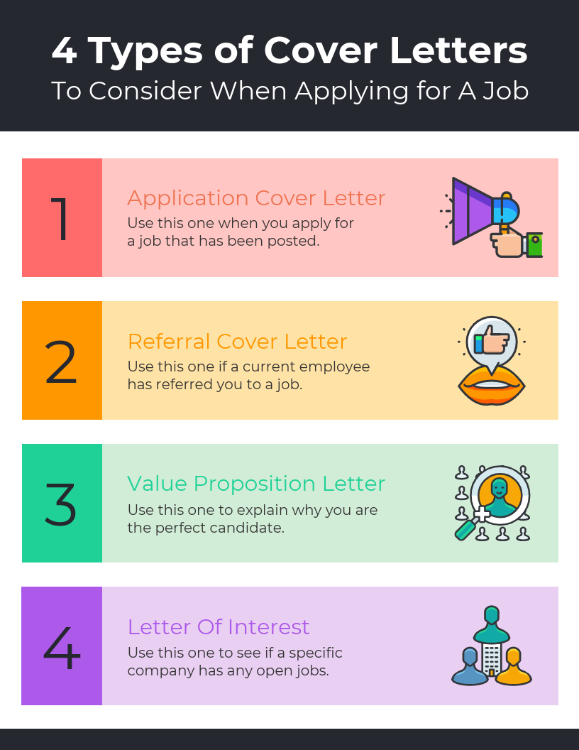
Types of Infographics (Continue…)
List Infographics
  Used to present a collection of tips, ideas, or resources.
  Makes long lists more attractive and engaging.
  Uses icons, colors, and visuals instead of simple bullet points.
  Easy to scan and remember.
  Example: 4 Types of Cover Letters.

Slide 67
Ethical and Legal Framework of Digital Marketing

Slide 68
Ethical and Legal Framework of Digital Marketing
It is Important for any company to function within the ethical and legal framework
It is challenging in the digital marketing domain as laws for this area are still evolving.
Often, companies rely on ethics
For example, laws regarding digital piracy came into force in 2019 only after millions of music albums were stolen and the damage was already done.

Slide 69
Law
Laws
IT ACT 2000
(Information Technology Act)
TRAI
(Telecom Regulatory Authority of India)

Slide 70
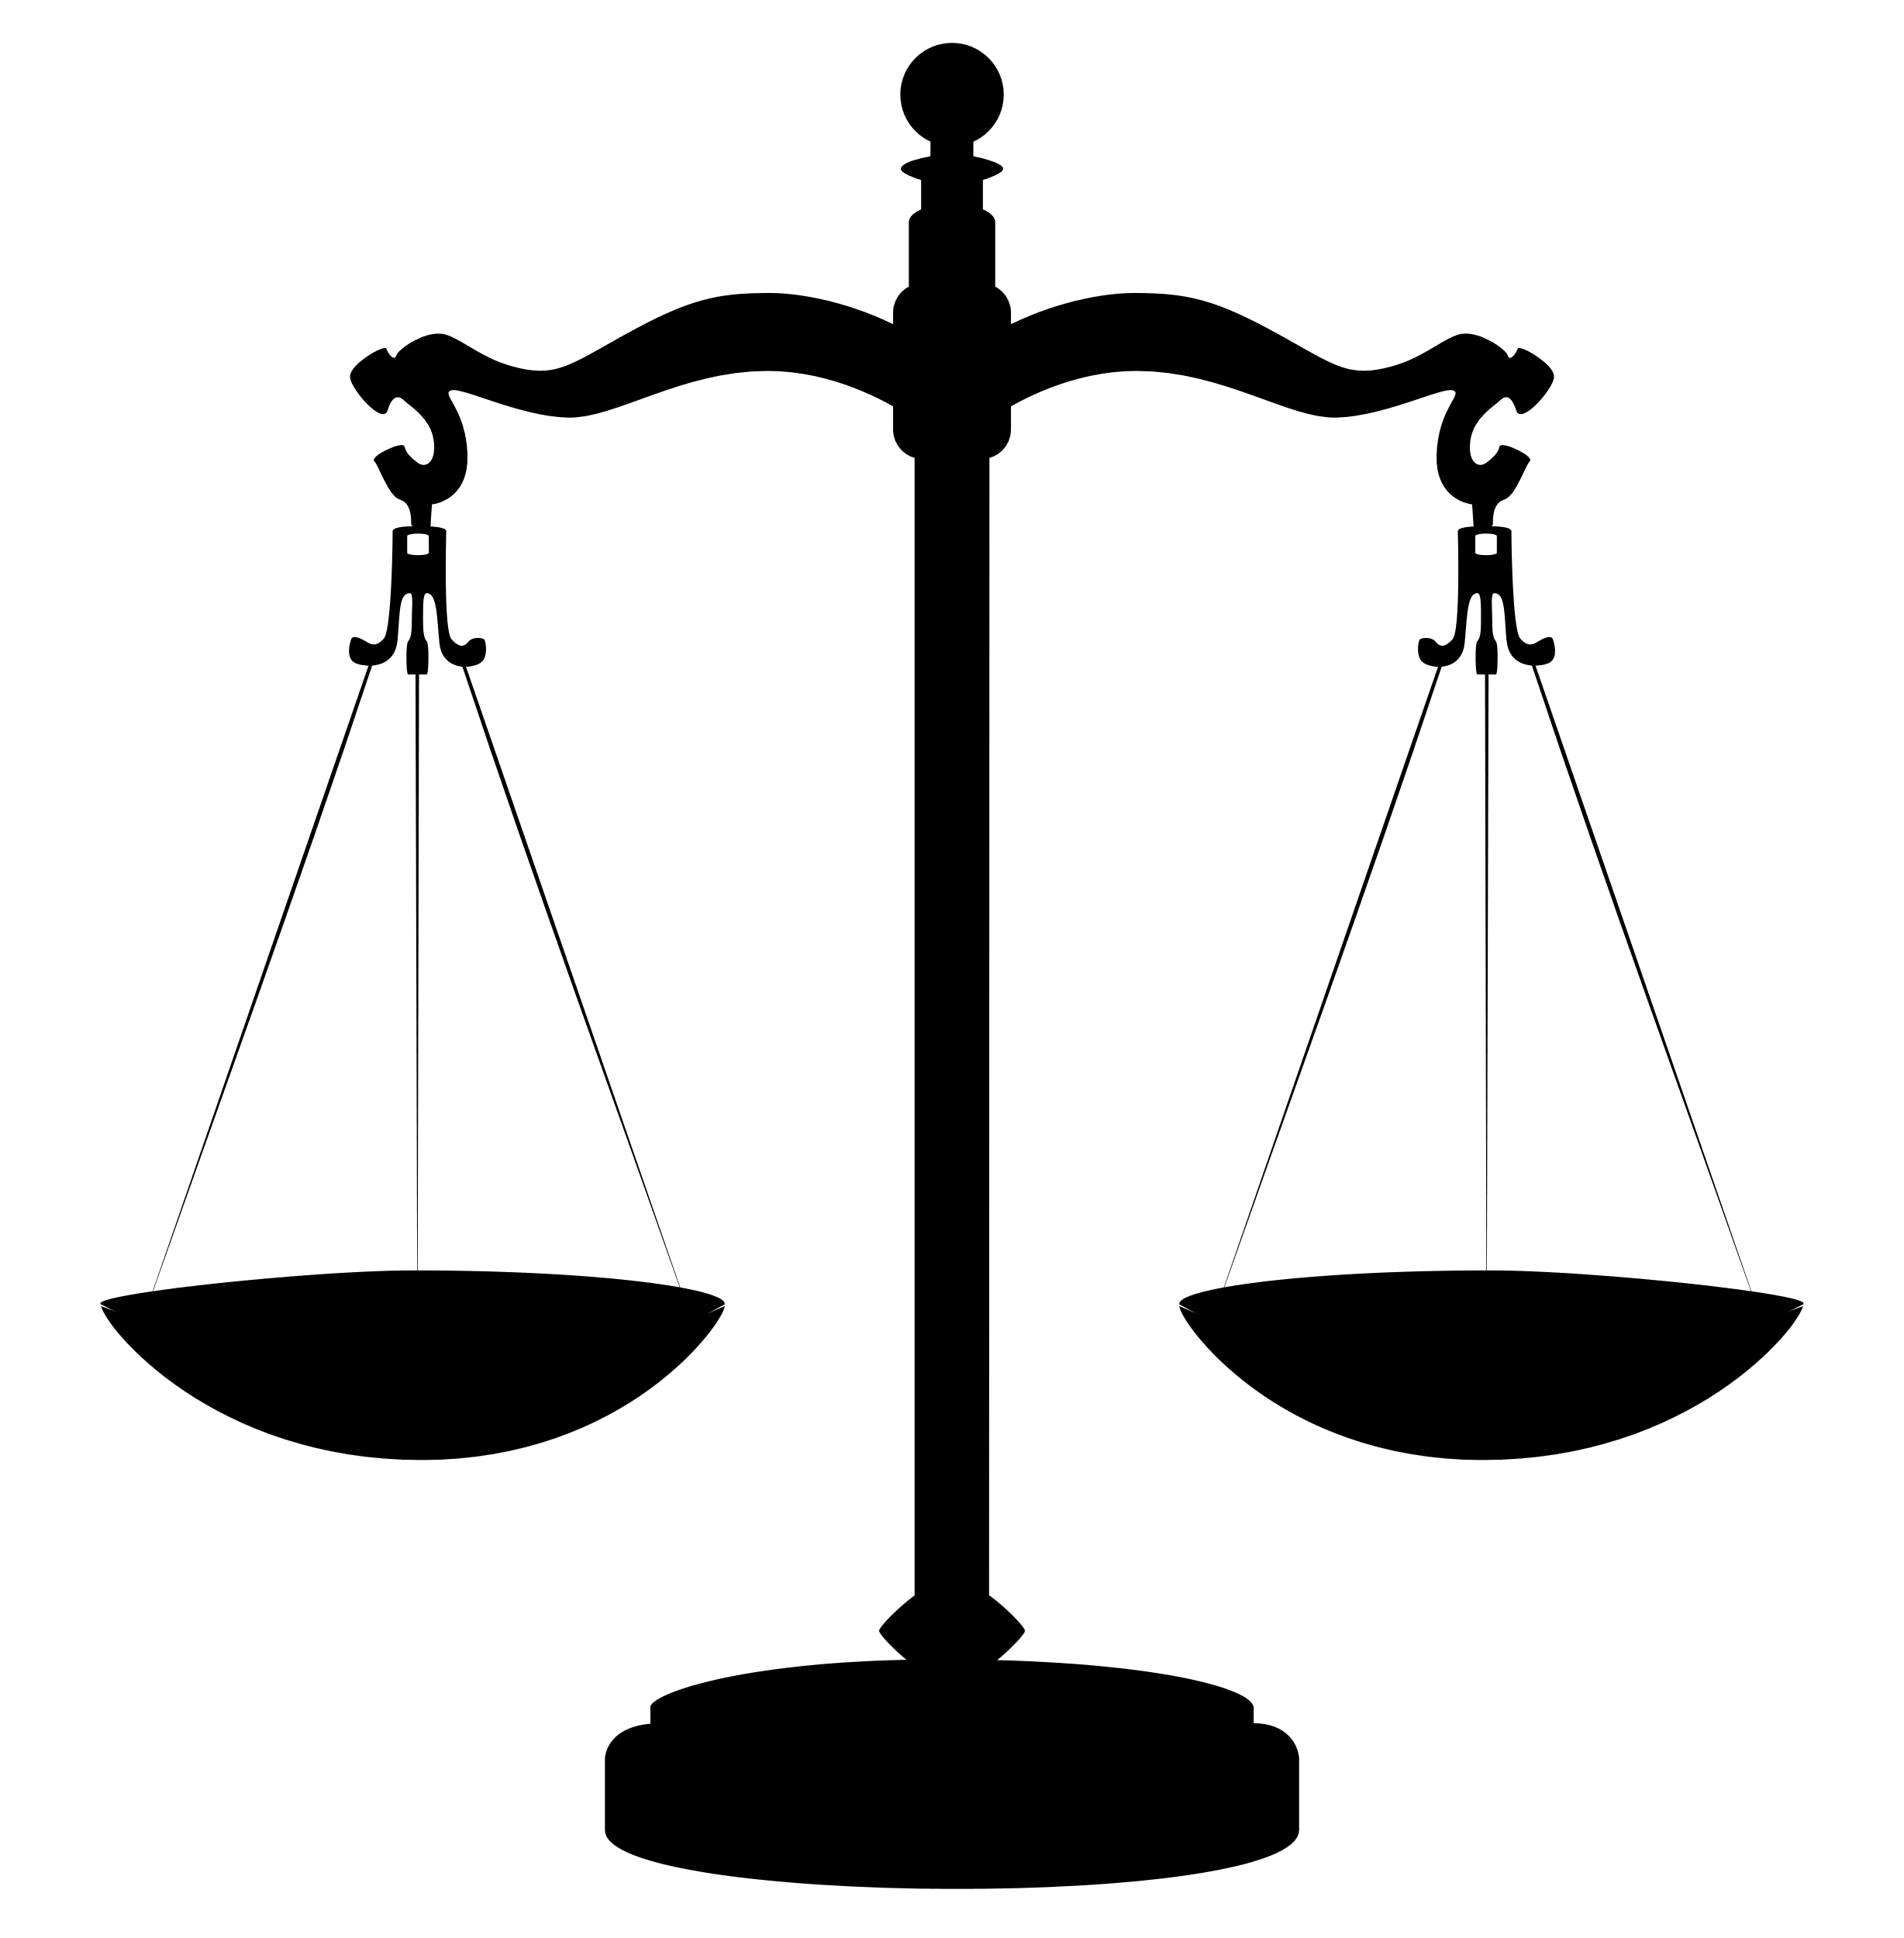




The IT Act 2000
India's primary law dealing with cybercrime and e-commerce.
It give legal recognition to electronic records, digital signatures, and online transactions.
If it happens online (ads, emails, data collection, social media), this law governs it.

Slide 71
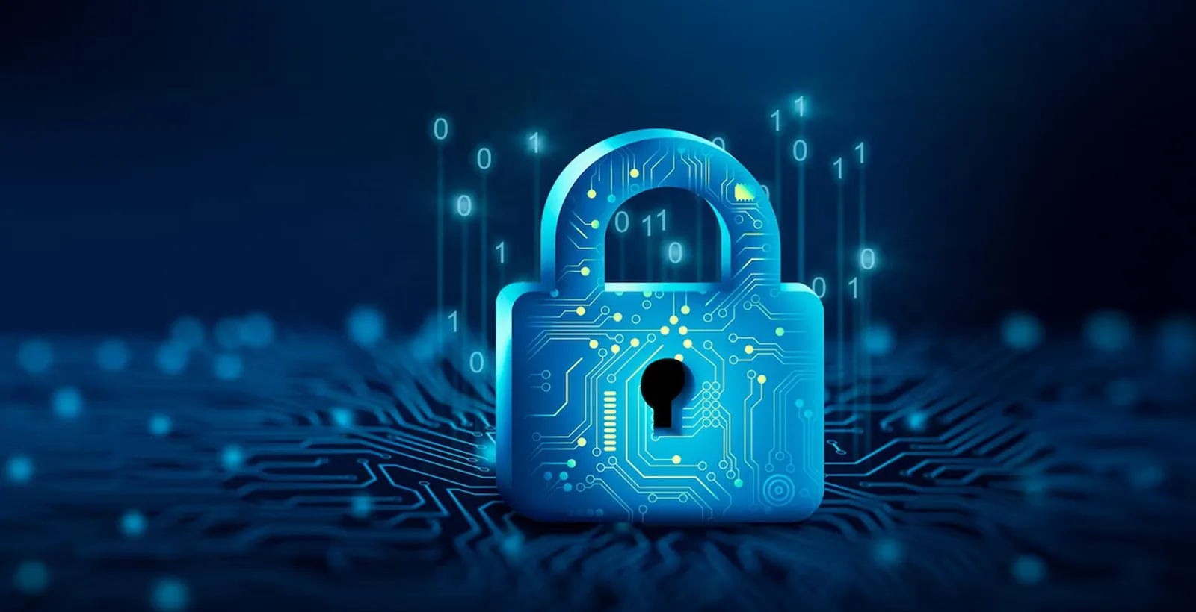
The IT Act 2000 (Continue)
Customer Data is Sacred (Section 43A)
  Companies must use "reasonable security practices" to protect sensitive personal data (passwords, financial info, health data).

Slide 72
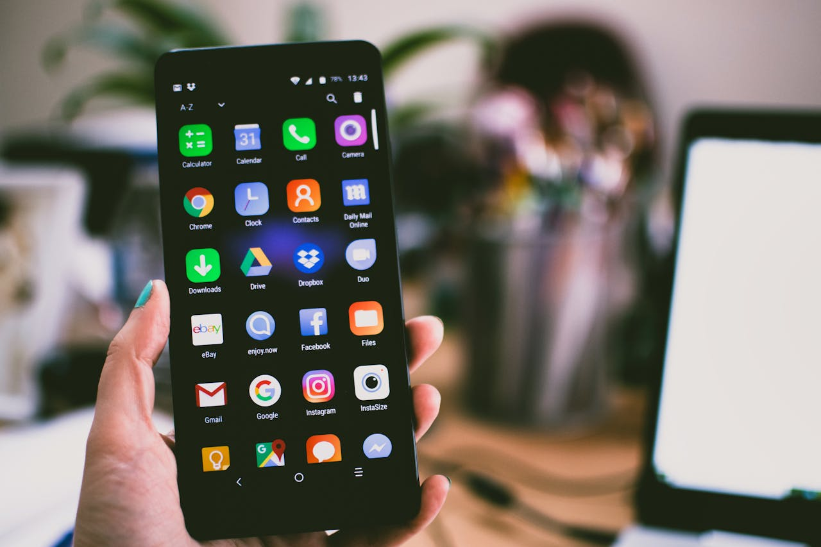
The IT Act 2000 (Continue)
Watch What You Publish! (Sections 66A, 67, 67A)
  Publishing or transmitting obscene material online is a major criminal offense.
  Spreading false information or intentionally damaging a competitor's reputation online can lead to jail time.
  Memes, ads, and social copy must be respectful and verified.

Slide 73
The IT Act 2000 (Continue)
Intermediary Liability (Section 79)
Platforms like Facebook, Instagram, or even your brand's website if it allows user comments.
Platforms aren't liable for what users post, provided they follow government rules and take down illegal content quickly when notified.
Moderating user-generated content (UGC) on brand pages is a must.

Slide 74
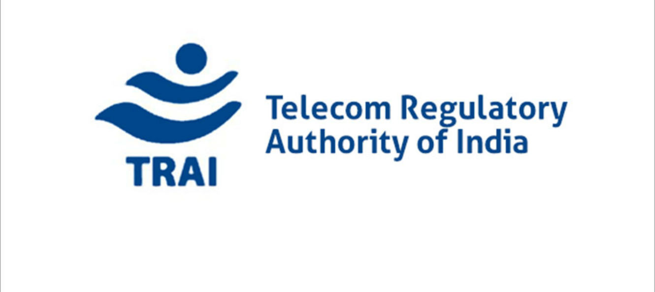
Telecom Regulatory Authority of India (TRAI)
The Role of TRAI in Marketing
  TRAI supervises all electronic and mobile marketing in India based on laws passed by Parliament.
  Anyone doing mobile marketing (telemarketers) must register with TRAI. They cannot bypass this step.
  Marketers are blocked from contacting any user listed on the Do-Not-Call / Do-Not-Disturb (DND) registry.
  TRAI limits how many transactional text messages a normal, unregistered user can send per day to prevent spam algorithms.
  Telemarketers cannot use regular, personal phone lines. They must buy separate, dedicated telecom services explicitly meant for marketing.

Slide 75
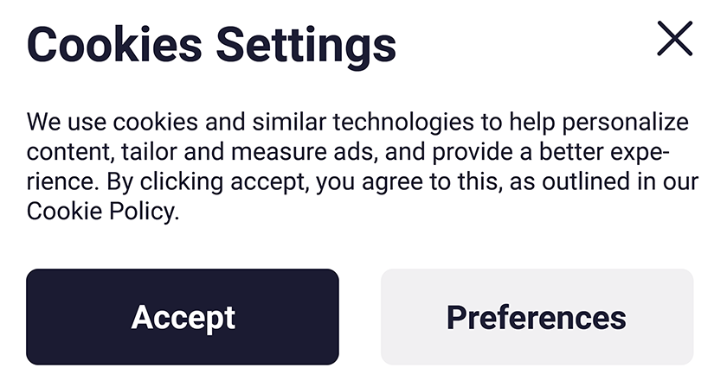
Legal Issues
Privacy and Data Collection
Companies have a strict legal duty to tell users when, how, and why their data is being collected.
First-Party vs. Third-Party Cookies
  First-Party Cookies (Safe/Preferred): * Small text files stored locally by the website you are directly visiting.
    Only the browser and that specific website can read them. Used for basic session management (like keeping a user logged in).
  Third-Party Cookies (Regulated/High-Risk): * Placed by outside domains (like ad networks) to track a user's behavior across completely different websites.
    Tracking users across multiple domains and using that data for profit without explicit consent is a cyber crime.

Slide 76
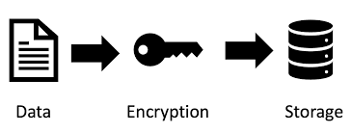
Legal Issue
Data Storage
  It is necessary for the customers to know that the collected customer information is protected.
  There should be a Secure Sockets Layer Certificate for security of data.
  Companies must let the customers know that they have protocols to secure important customer information such as credit card details, personal details etc.

Slide 77
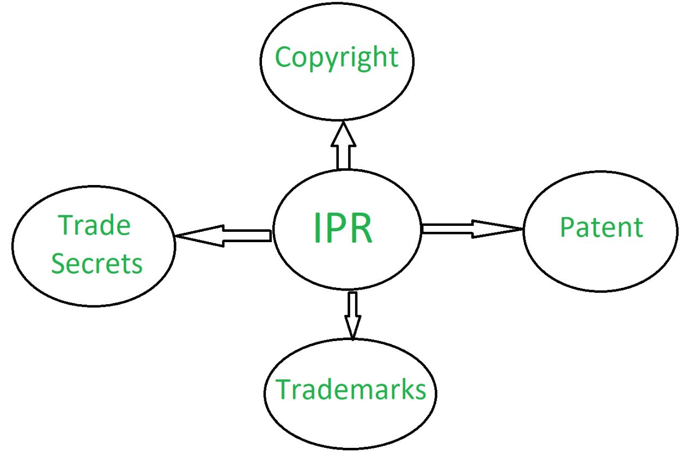
Legal Issue
Intellectual Property and Copyright Infringement
Marketers must protect their unique digital assets—such as logos, content, brand names, and creative assets.
Prevents competitors from copying, stealing, or using a brand's hard work for their own profit without permission.
How
  Copyrights
  Trademarks

Slide 78
Legal Issue
Copyright
Automatically protects original creations, such as books, music, films, photographs, and paintings.
You do not have to write a script to register it; protection is granted to the creator the moment the work is created.
Lasts for the creator's entire lifetime.
Continues for an additional 60 years after the creator passes away.

Slide 79

Legal Issue
Trademark
Protects a brand or product's unique visual identity, including logos, symbols, brand names, or catchy slogans.
Can be claimed simply through common use in everyday business operations, but formal registration grants maximum legal ownership.
Coca Cola MacDonald classic trademark example—it legally protects distinctive visual signs tied explicitly to their goods and services.

Slide 80
Legal Issue
DMCA and Copyright Infringement
Under the Digital Millennium Copyright Act (DMCA), businesses are legally banned from using another company's copyrighted material in their marketing campaigns.
Stealing digital media leads to direct copyright infringement charges, which can result in massive financial lawsuits and heavy fines.
Copyright violations stand as the most common ethical and legal crisis in modern digital marketing.
Moving forward, digital marketers must prioritize automated and manual preventive measures to block these legal risks entirely.

Slide 81
How Marketers Can Prevent Ethical and Legal Infringements
Build your own creative assets, or use open-source media with correct license attributes.
Read the documentation for stock assets to confirm they allow commercial distribution.
Implement clear opt-in frameworks before collecting tracking data or cookies.
Periodically scan all active campaigns to catch and update expiring tracking scripts or media rights.
If a company pays an influencer or partner network to promote a product, that relationship must be completely transparent.
When training automated algorithms or targeting systems, prevent bias that can accidentally isolate or discriminate against demographics.

Slide 82
Digital Marketing & SEO
2504MN313
Mr. Prashant Parmar
Darshan Institute of Management
Prashant.parmar@darshan.ac.in
9586371604

