Slide 1

Unit-2
Digital Marketing Strategy, Channels & Analytics
CO2: Understand Google Analytics 4 to monitor web traffic and multi-channel performance metrics.
Digital Marketing & SEO
2505CS313
Mr. Prashant Parmar
Darshan Institute of Management
prashant.parmar@darshan.ac.in
9586371604

Slide 2

    Digital Marketing Plan & Strategies: AIDA Model, Pirate Model, The P-O-E-M Framework
    Buying Models: Cost per Click (CPC), Cost per Mille (CPM), Cost per Lead (CPL), and Cost per Acquisition (CPA), Types of Digital
    Marketing Channels: Website, Content Marketing, Search Engine Optimization, Email Marketing, Affiliate Marketing, Referral Marketing, Influencer Marketing, Online Public Relation, Conversational AI, Web Blogs, Page Tagging;
    Google Analytics 4: Setup and Configuration, Conversion Tracking and Goal Setting,
    Key Metrics: Unique Visitors, Pageviews, Pages/Visit, Average Visit Duration, Bounce Rate, New Visits.

Slide 3
Digital Marketing Plan

Slide 4
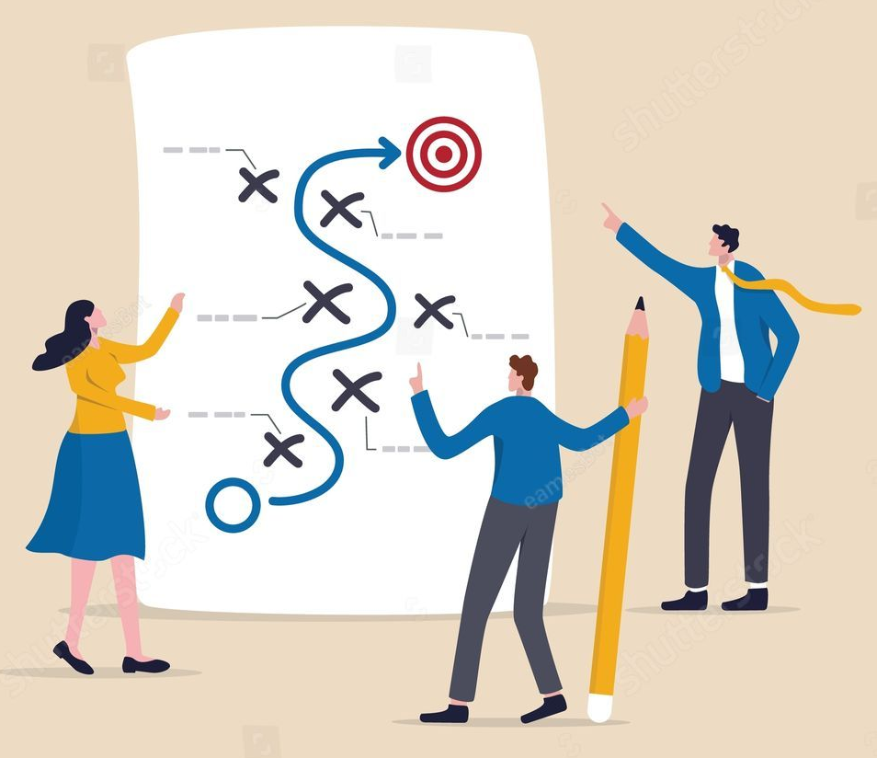
What is Digital Marketing Plan?
A digital marketing plan is a comprehensive strategy outlining how your company will use digital channels to promote its products and services.
it focuses on identifying your target audience.
connecting with consumers via online platforms and channels.

Slide 5
What is Digital Marketing Plan?
A Digital Marketing Plan is a written roadmap that explains:
  Marketing goals, Target customers
  Marketing channels
  Budget,
  Timeline
  Performance measurement
It helps businesses use resources effectively.
Example: A coaching institute prepares a 3-month online admission campaign.

Slide 6

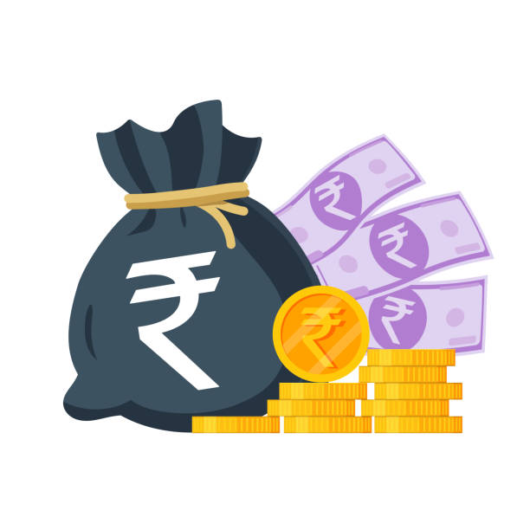
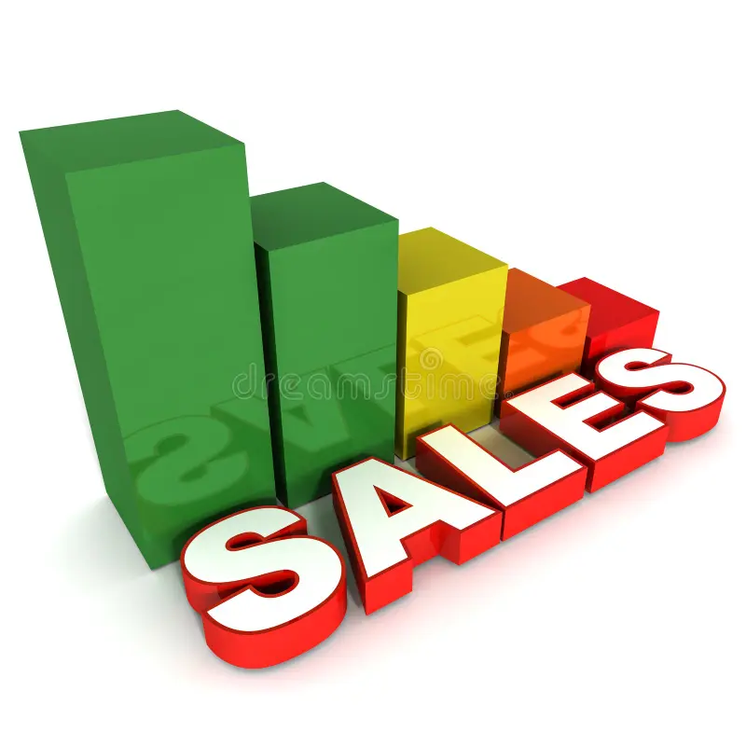

Digital Marketing Plan: Importance
Benefits
  Gives clear direction
  Saves time and money
  Improves customer reach
  Increases sales
  Helps measure performance
  Supports better decision making
Example: Without planning, advertisements may target the wrong audience and waste budget.

Slide 7
Digital Marketing Plan: Components
A good plan includes:
  Business Goals
  Target Audience
  Market Research
  Competitor Analysis
  Digital Channels
  Content Strategy
  Budget
  Timeline
  KPIs
Example: An online clothing brand prepares all these before launching a festive sale.

Slide 8
Digital Marketing Plan: Process
Situation Analysis
Set Marketing Objectives
Identify Target Audience
Competitor Analysis
Select Digital Marketing Channels
Develop Content Strategy
Allocate Budget & Resources
Execute Campaign
Monitor & Measure Performance
Review & Optimize

Slide 9

Digital Marketing Plan: Process
Situation Analysis
Understand the current position of the business by analyzing
  products,
  customers,
  competitors, and
  online presence.
This helps identify strengths, weaknesses, opportunities, and challenges before planning.
Example: A local café finds that it has good Instagram engagement but low website traffic.

Slide 10
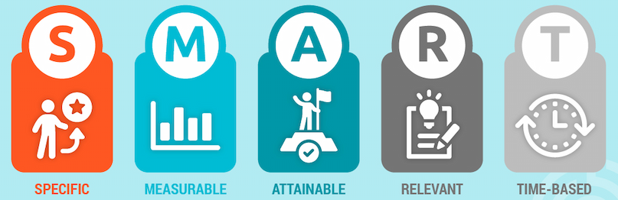
Digital Marketing Plan: Process
Set Marketing Objectives
Define clear and measurable goals that the business wants to achieve through digital marketing.
Objectives should follow the SMART
  Specific,
  Measurable,
  Attainable,
  Relevant,
  Time-bound
Example: Increase website traffic by 30% and generate 100 online inquiries within the next three months.

Slide 11
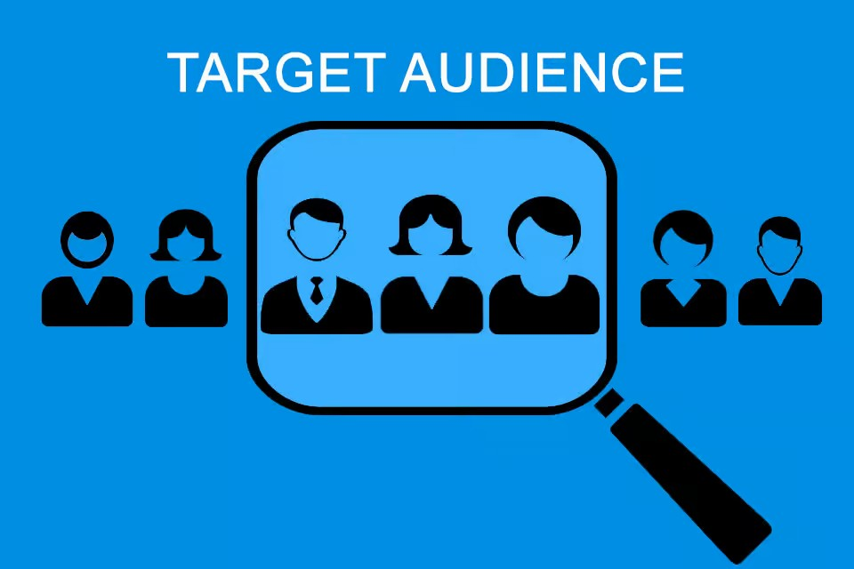
Digital Marketing Plan: Process
Identify the Target Audience
Determine who the ideal customers are based on factors such as
  age,
  location,
  interests,
  income,
  online behavior.
Understanding the audience helps create relevant marketing campaigns.
Example: An online coding course targets college students aged 18–25 who are interested in programming and technology.

Slide 12
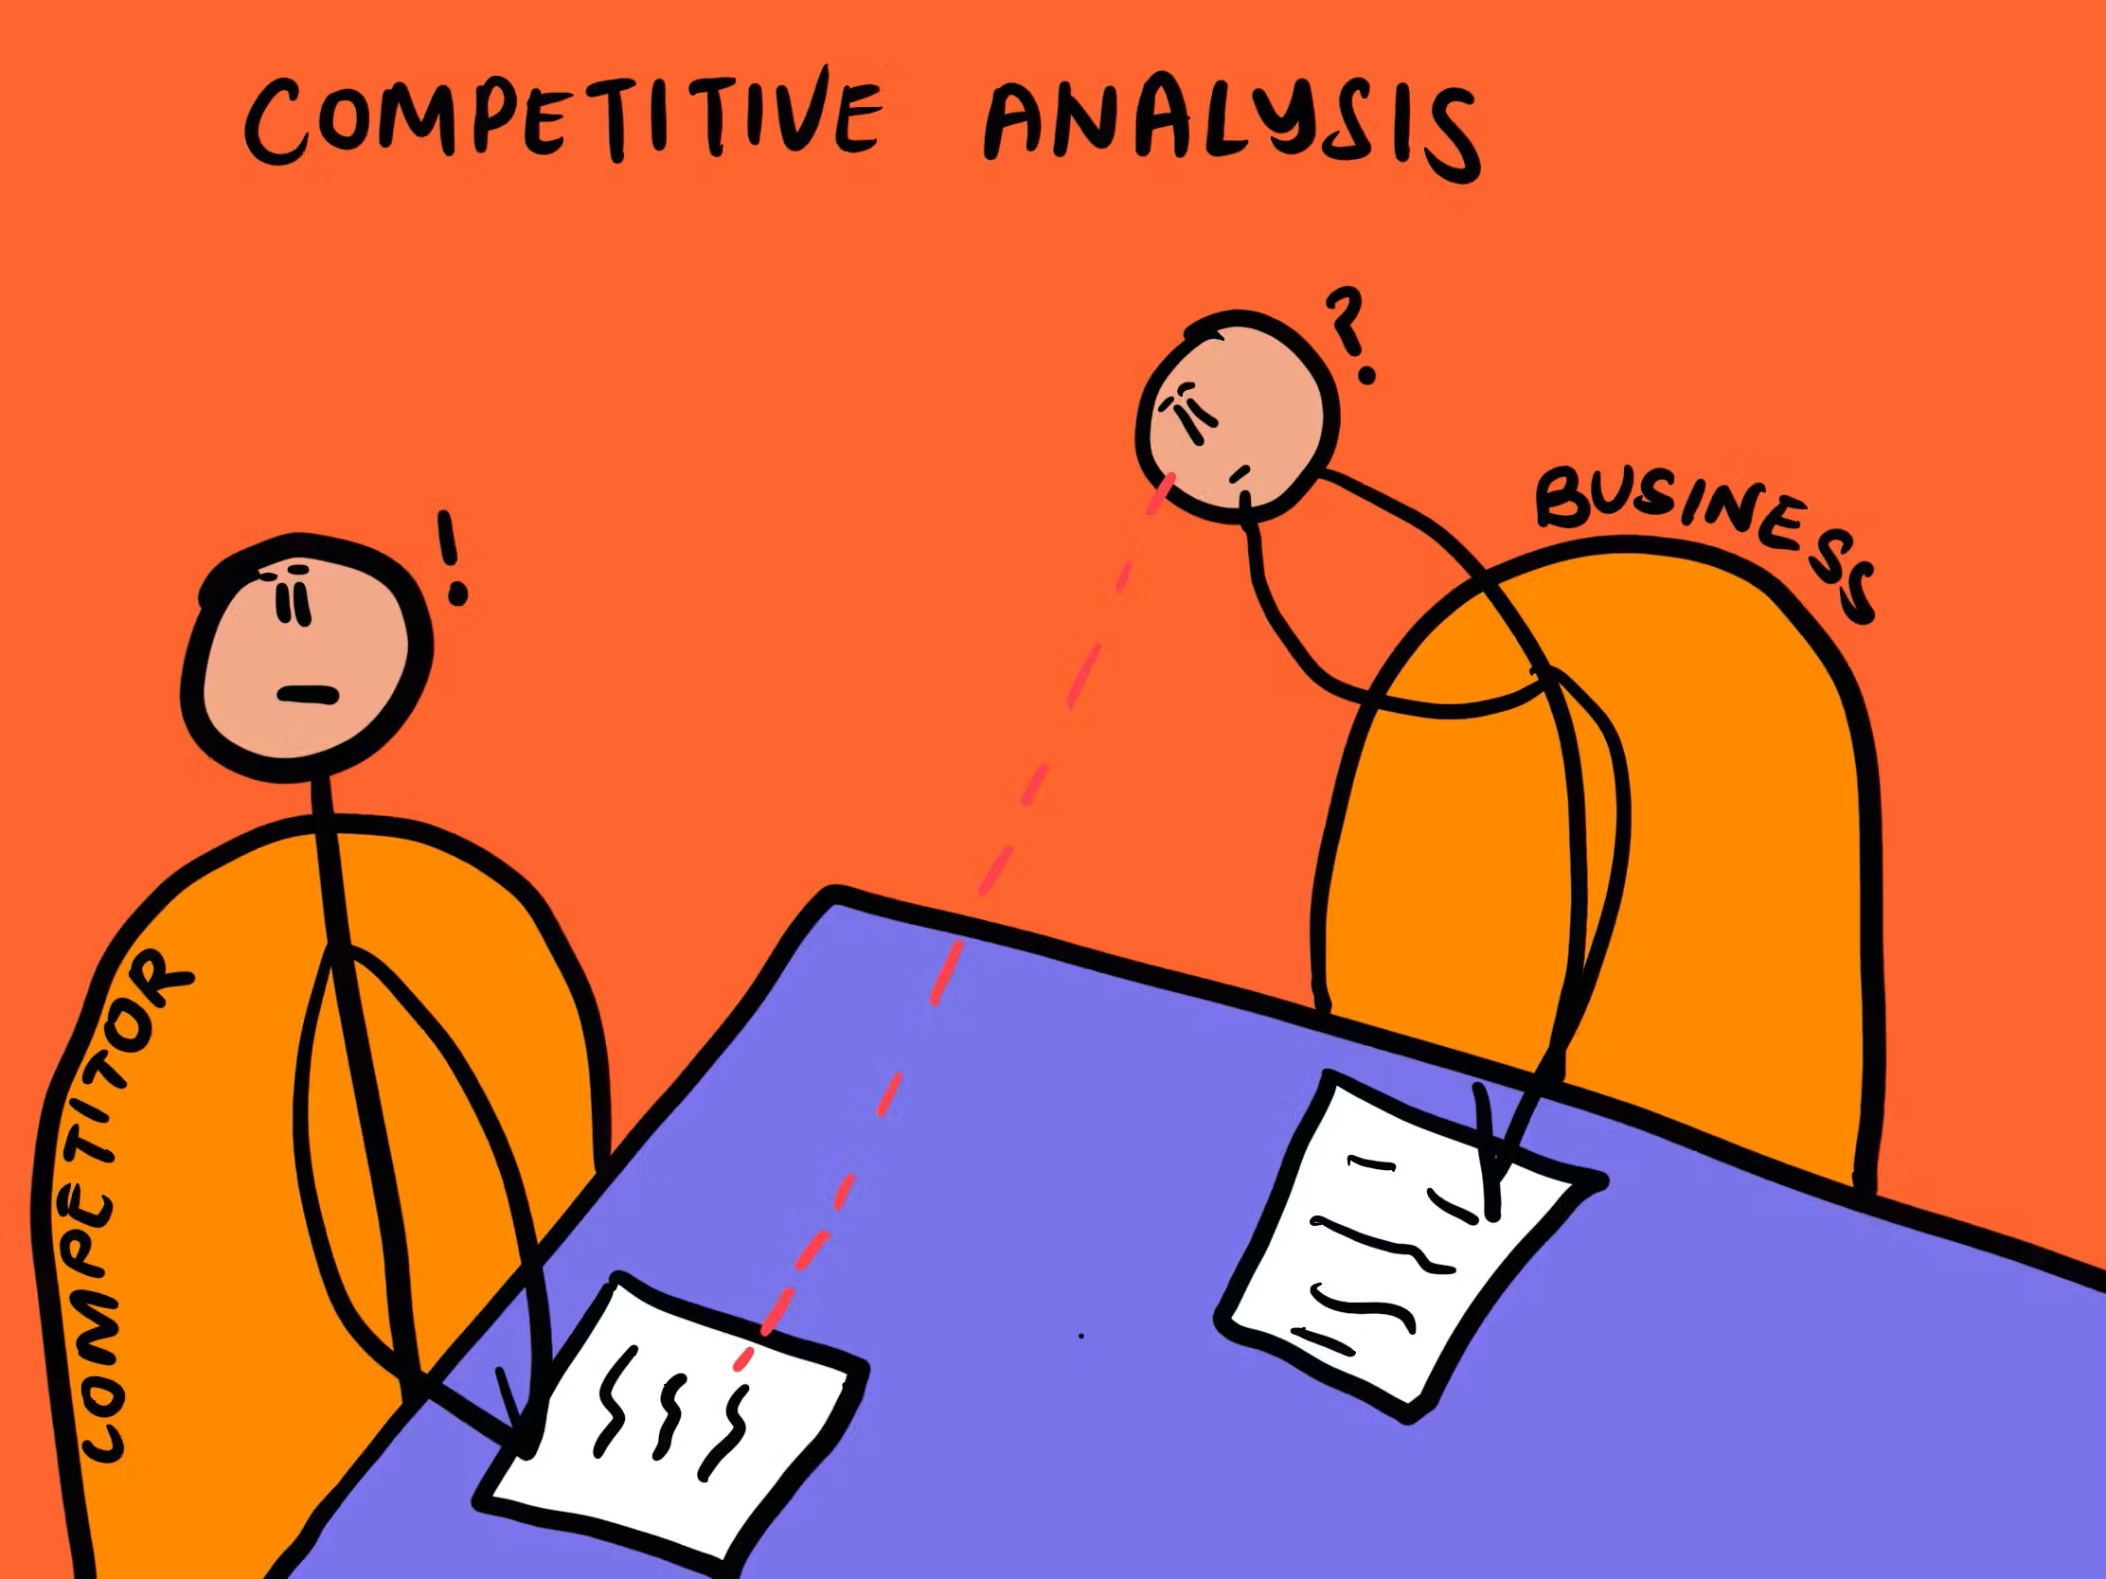
Digital Marketing Plan: Process
Conduct Competitor Analysis
  Study
  competitors' websites,
  social media activities,
  advertisements,
  SEO strategies
Identify their strengths and areas where your business can perform better.
Example: A new clothing brand analyzes how Myntra and local fashion stores promote seasonal sales on Instagram.

Slide 13
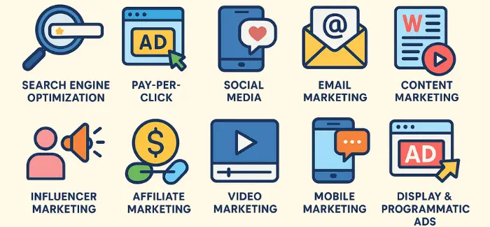
Digital Marketing Plan: Process
Select Digital Marketing Channels
Choose the most suitable online platforms based on business goals and where the target audience spends most of their time.
Different channels serve different marketing purposes.
Example: A restaurant uses Instagram for food promotions, Google Business Profile for local searches, and WhatsApp for customer orders.

Slide 14

Digital Marketing Plan: Process
Develop a Content Strategy
Plan the
  type of content,
  posting schedule, and
  communication style
To engage customers and provide useful information.
High-quality content builds trust and attracts more visitors.
Example: A fitness center shares workout videos, healthy diet tips, success stories, and promotional offers every week.

Slide 15

Digital Marketing Plan: Process
Allocate Budget and Resources
Estimate the cost of
  advertisements,
  content creation,
  software tools,
  manpower.
A proper budget ensures that marketing activities are carried out efficiently without overspending.
Example: A startup allocates ₹15,000 for Google Ads, ₹10,000 for Instagram Ads, and ₹5,000 for graphic design.

Slide 16
Digital Marketing Plan: Process
Execute the Marketing Campaign
Launch the planned activities across selected digital channels and ensure that campaigns are implemented according to the schedule.
Regular monitoring is important during execution.
Example: An e-commerce store launches a Diwali campaign with Google Ads, Instagram Reels, email newsletters, and discount coupons.

Slide 17

Digital Marketing Plan: Process
Monitor and Measure Performance
Track campaign performance using Key Performance Indicators (KPIs) such as
  website traffic,
  clicks,
  conversions,
  engagement,
  sales.
This helps evaluate whether the objectives are achieved.
Example: Google Analytics shows that website visitors increased by 40% after the SEO campaign.

Slide 18
Digital Marketing Plan: Process
Review and Optimize
Analyze campaign results, identify successful strategies, and improve weak areas for future campaigns.
Digital marketing is a continuous process of testing and optimization.
Example: A business notices that Instagram Reels generate more customer inquiries than Facebook posts, so it increases its focus on Reels.

Slide 19
Digital Marketing Strategy

Slide 20
Digital Marketing Strategies: AIDA Model
The AIDA model was introduced in the late 19th century and early 20th century by American businessman and advertising advocate Elias St. Elmo Lewis.
It help businesses understand the various stages a consumer experiences before making a purchase decision.
It is used in marketing, advertising, and sales to help businesses craft communications for each stage and encourage buyers to complete a purchase.
The AIDA model is a hierarchy of effects model, which means it assumes that consumers move through a series of stages when making a purchase decision.
  cognitive (thinking)
  affective (feeling)
  behavioral (doing)

Slide 21
Digital Marketing Strategies: AIDA Model (Continue…)
It is commonly used in advertising and digital marketing, the model outlines the process of capturing and engaging customers by guiding them through four key stages:
  Attention: Grab the attention of your target audience.
  Interest: Generate interest by providing valuable and engaging content.
  Desire: Create a desire for the product or service by showcasing its benefits.
  Action: Prompt the consumer to take action, such as making a purchase.
This model helps businesses strategically move potential customers from awareness to conversion in a structured manner.

Slide 22
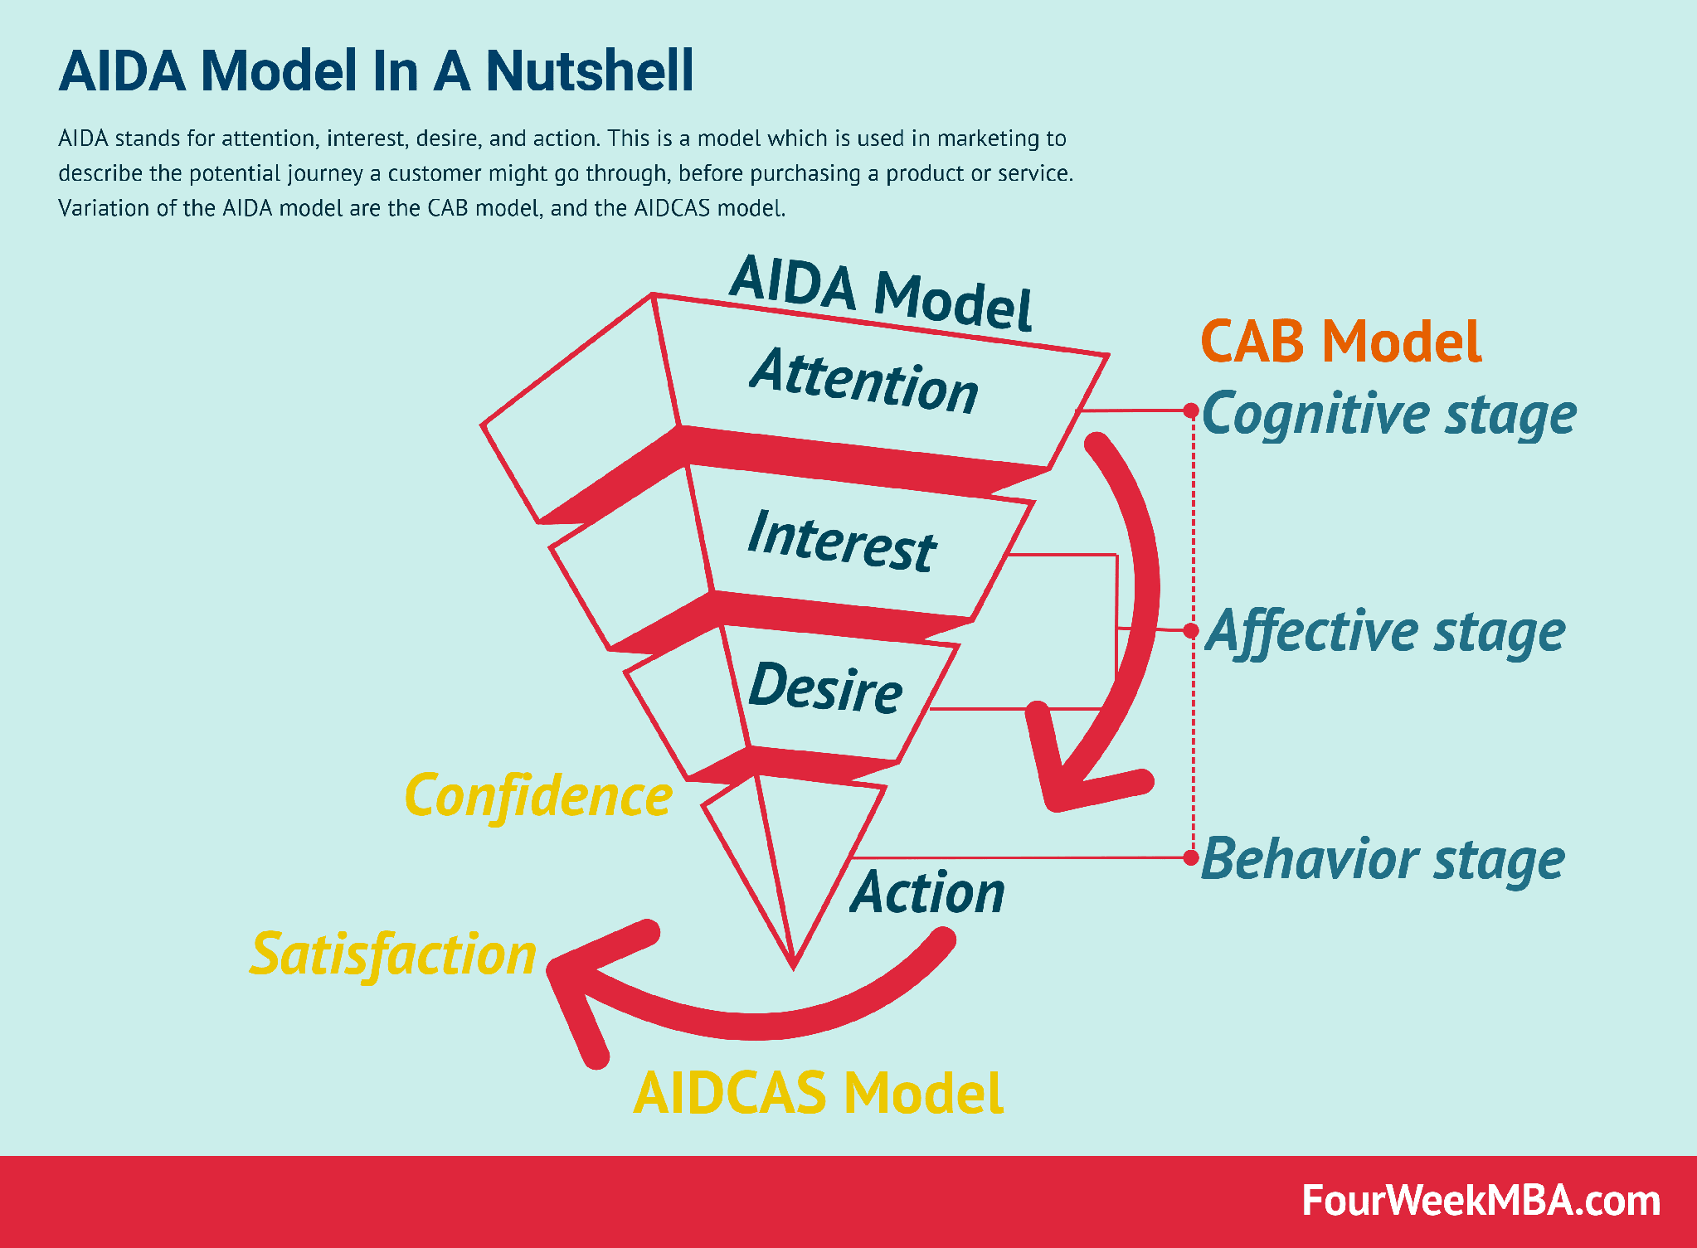
Digital Marketing Strategies: AIDA Model (Continue…)

Slide 23
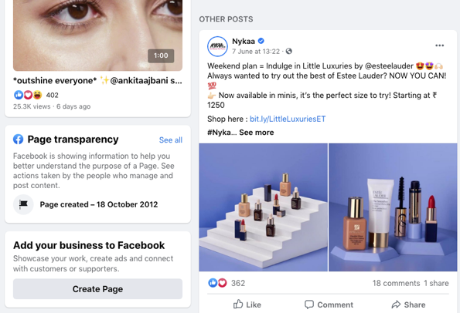

Digital Marketing Strategies: AIDA Model (Continue…)
Example:
Nykaa, an Indian beauty and fashion e-commerce company, effectively uses the AIDA model.
Attention: Nykaa grabs attention through social media ads featuring influencers and beauty tutorials.

Slide 24
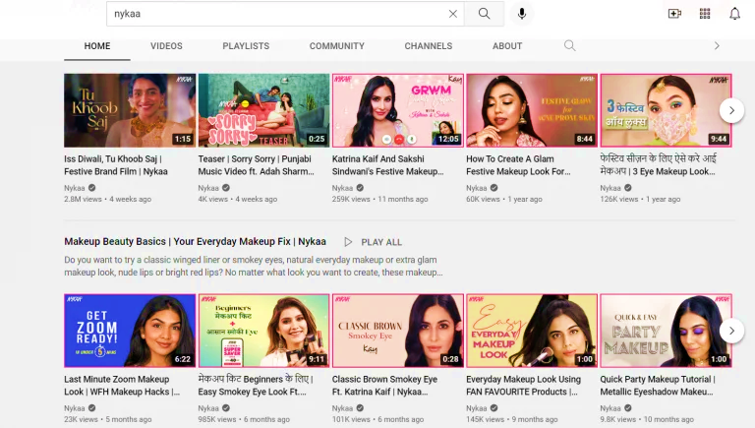
Digital Marketing Strategies: AIDA Model (Continue…)
Example: Continue…
Interest: They maintain interest by offering educational content, product reviews, and tips on their YouTube channel.

Slide 25

Digital Marketing Strategies: AIDA Model (Continue…)
Example: Continue…
Desire: By showcasing how their products can help consumers achieve a glamorous look, Nykaa builds a strong desire for their premium brands.

Slide 26
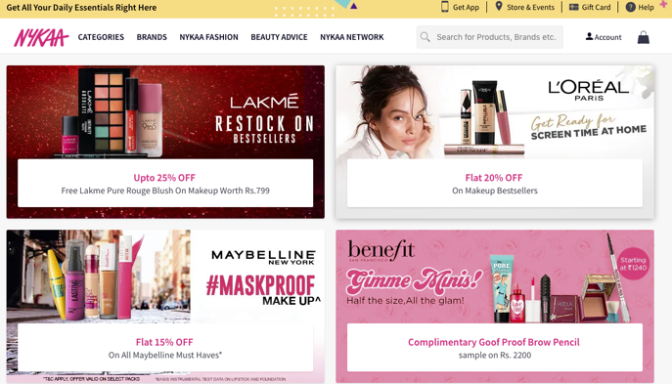
Digital Marketing Strategies: AIDA Model (Continue…)
Example: Continue…
Action: Nykaa drives consumers to their website with limited-time offers and discounts, encouraging purchases.

Slide 27
Digital Strategies: Pirate Model
Pirate Model is also known as AARRR.
Dave McClure, a Silicon Valley investor and founder of 500 Startups, developed the AARRR framework. McClure saw that many startup companies were easily distracted by Superficial Metrics*, such as likes on social media.
  (Superficial metrics*, also known as vanity metrics, are statistics that look good but don't provide meaningful insights into business performance. They can be misleading and don't help improve performance.)

Slide 28
Digital Strategies: Pirate Model (Continue…)
With Pirate Model/AARRR, McClure had a twofold goal.
  First, show young companies how to narrow their focus to only those metrics that can directly affect the health of their business.
  Second, help these companies use the right data to measure the success of their product management and marketing efforts, then improve those initiatives that aren’t working.

Slide 29
Digital Strategies: Pirate Model (Continue…)
AARRR Framework
  Growth marketing funnel/model used to optimize the customer lifecycle across five stages:
  Acquisition,
  Activation,
  Retention,
  Revenue,
  Referral.
It helps businesses understand where to focus their efforts for customer growth and revenue maximization.

Slide 30
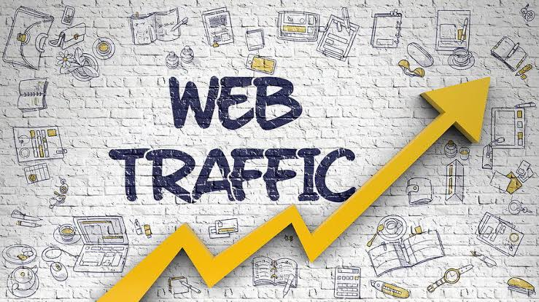
Digital Strategies: Pirate Model (Continue…)
Acquisition: This stage focuses on attracting visitors to your platform
various channels like
  paid ads,
  social media,
  SEO,
  content marketing.
The goal is to create awareness and generate traffic.

Slide 31

Digital Strategies: Pirate Model (Continue…)
Activation: Activation is about ensuring a great first experience for the user.
It involves
  optimizing the sign-up process,
  providing easy navigation,
  offering an immediate value proposition
It is done to engages users right from the start.

Slide 32

Digital Strategies: Pirate Model (Continue…)
Retention: Retention involves keeping users engaged with platform over time.
Through tactics like
personalized content,
offers,
loyalty programs,
regular communication via email
push notifications.

Slide 33

Digital Strategies: Pirate Model (Continue…)
Revenue: This stage focuses on monetizing the user base.
Common revenue strategies include
  subscription models,
  in-app purchases,
  upselling,
  premium services.

Slide 34
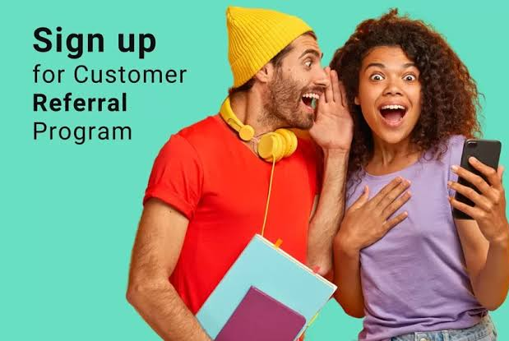
Digital Strategies: Pirate Model (Continue…)
Referral: Referral is about leveraging existing users to bring in new users
Business try
  word-of-mouth,
  referral programs,
  incentivized sharing.
The goal is to create a viral growth loop.

Slide 35
Digital Strategies: The P-O-E-M Framework
The POEM framework is a marketing methodology used by digital marketing experts to formulate the social media marketing strategy.
It stands for
  Paid,
  Owned, and
  Earned Media
It is an approach used to promote a product or service and looks at how the right mix of media channels can attract more customers, deepen and strengthen relationships with existing customers, and push the business towards ultimate goals of growth and success.

Slide 36
Digital Strategies: The P-O-E-M Framework (Continue…)
Digital marketers use the POEM model to develop the basic framework and implement digital marketing strategies.
The frameworks help companies improve their marketing strategies and achieve goals and targets.
It involves listing and selecting channels to roll out the marketing communication and what it needs to make the plan successful.

Slide 37
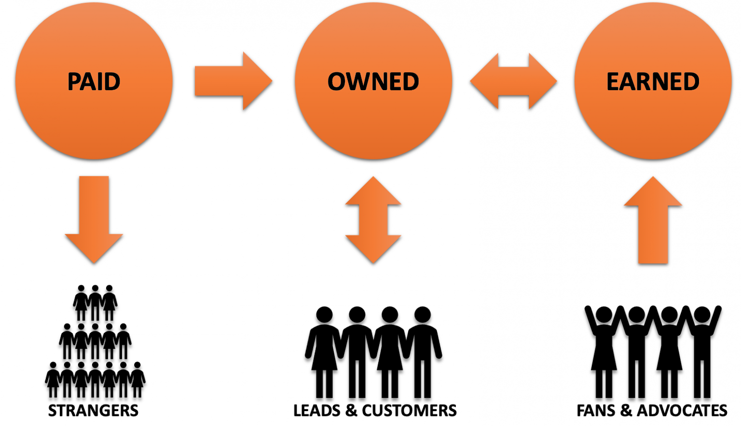
Digital Strategies: The P-O-E-M Framework (Continue…)
Paid
Earned Media
Owned

Slide 38
Digital Strategies: The P-O-E-M Framework (Continue…)
1. Paid Media
Definition:
  Paid media refers to the advertising and promotional content that a brand pays for. This includes all marketing efforts where brands invest money to drive traffic, increase visibility, or encourage customer engagement.
Example:
  Google Ads
  Social Media Ads
  Display Ads
  Influencer Marketing

Slide 39
Digital Strategies: The P-O-E-M Framework (Continue…)
Owned Media
Definition:
  Owned media includes all digital assets and channels that a brand fully controls.
  These platforms are the foundation of brand’s digital presence and serve as long-term assets for engaging their audience
Example:
  Website
  Blog
  Social media profile
  Mobile App
  Email marketing

Slide 40
Digital Strategies: The P-O-E-M Framework (Continue…)
Earned Media
  Definition:
  Earned media refers to the organic, unpaid exposure that a brand gains through
    word-of-mouth,
    customer reviews,
    media mentions, and
    social shares.
  Essentially, it is the recognition a brand earns through its reputation, product quality, and customer interactions.

Slide 41
Digital Strategies: The P-O-E-M Framework (Continue…)
Example:
Earned Media
  Social Shares: When people share your content on Social Media without being paid to do so.
  Online Reviews: Positive or negative reviews on platforms like Google Reviews, Apps, or e-commerce sites.
  Media Coverage: Press articles, features, or news stories about your brand, product, or service.
  Influencer Endorsements: Influencers organically mention or recommend your brand without being paid.
  Word-of-Mouth: Customers recommending your brand to others based on their personal experiences.

Slide 42
Buying Models

Slide 43
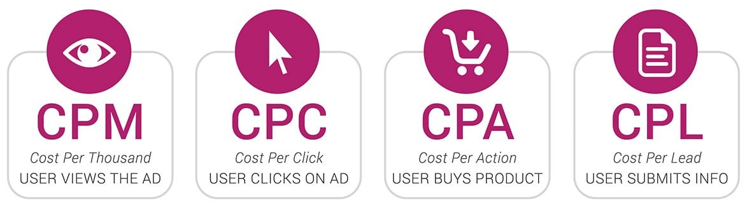
Buying Models
Buying models refer to the various ways advertisers pay for digital ad campaigns.
The most common models are:
  Cost per Click (CPC)
  Cost per Mille (CPM)
  Cost per Lead (CPL)
  Cost per Acquisition (Action) (CPA)
These models help businesses optimize ad spending based on their marketing goals.

Slide 44
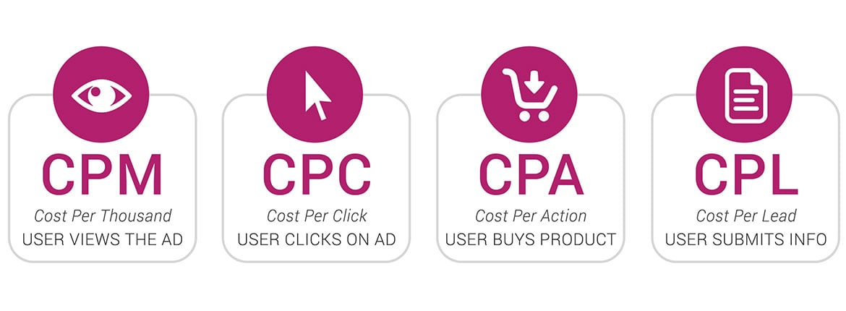
Buying Models: Cost Per Click (CPC)
Cost per Click (CPC)
Advertisers pay each time a user clicks on their ad. This model is ideal for driving traffic to a website or landing page.
Example: If an advertiser sets a CPC bid of ₹5, they pay ₹5 each time someone clicks on their ad.
Objective: Drive traffic to the advertiser's website by paying for each click on the ad.

Slide 45
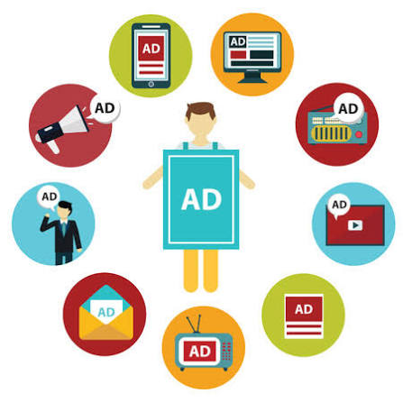
Buying Models: Cost Per Click (CPC) (Continue…)
Steps
  Ad Creation: The advertiser creates an ad, text-based for search engines (like Google Ads) or image/video ads for social media

Slide 46
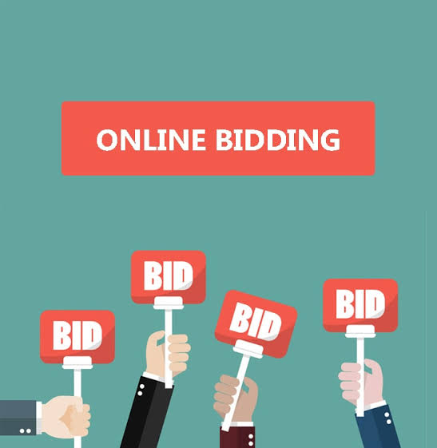
Buying Models: Cost Per Click (CPC) (Continue…)
Steps
  Bidding: The advertiser sets a maximum bid (the highest they are willing to pay) for each click. Platforms like Google Ads or Facebook Ads use an auction system to display ads.

Slide 47
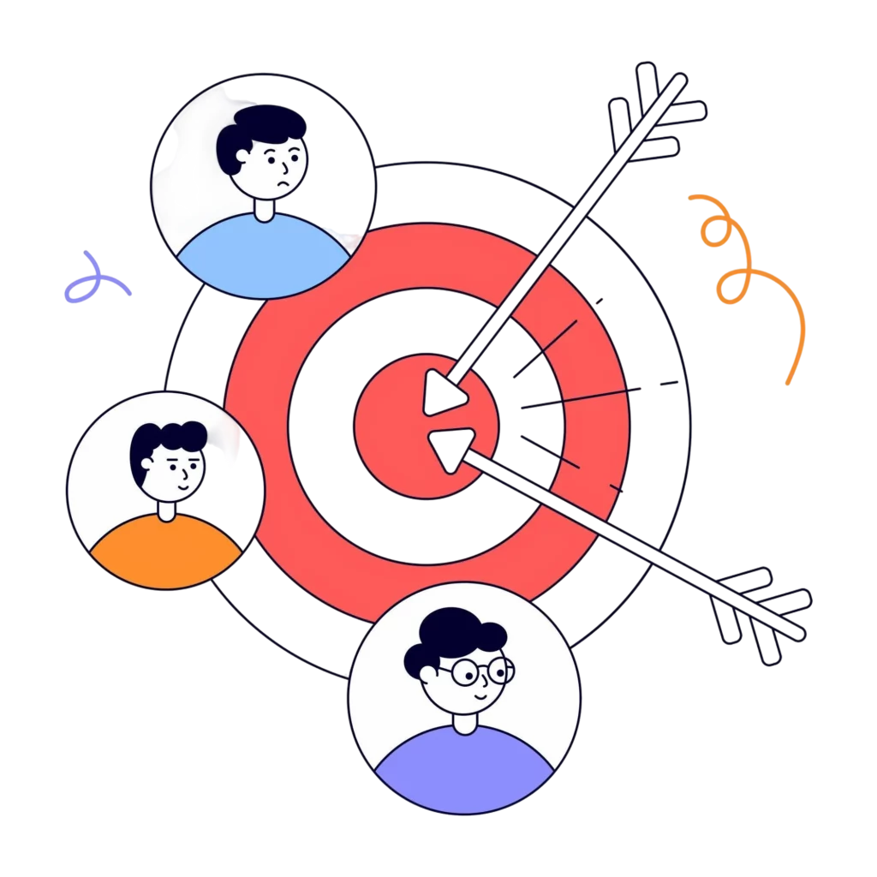
Buying Models: Cost Per Click (CPC) (Continue…)
Steps
  Targeting: The advertiser selects the audience based on demographics, interests, or keywords relevant to the product or service.

Slide 48
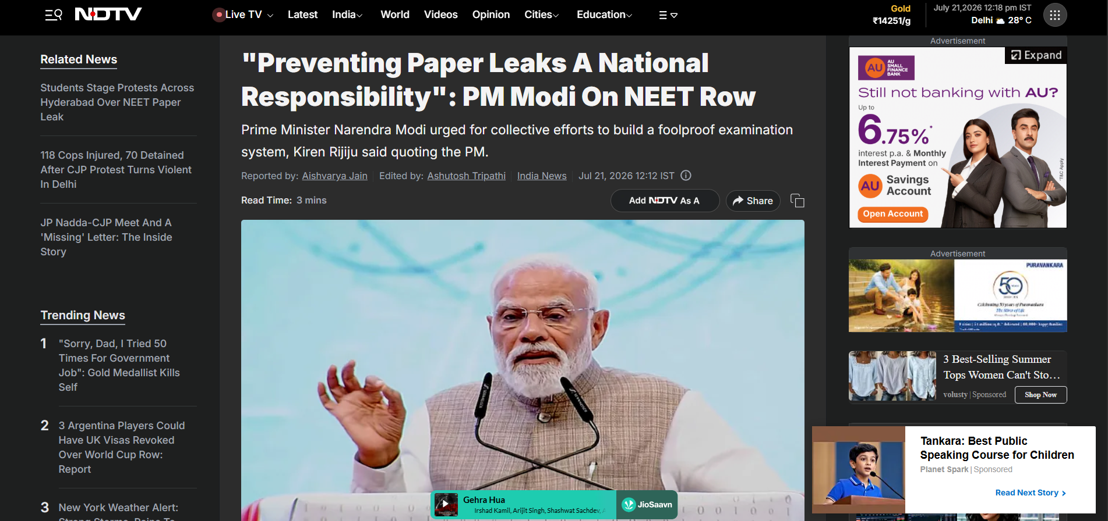
Buying Models: Cost Per Click (CPC) (Continue…)
Steps
  Ad Display: The ad is shown to users within the target audience across various

Slide 49
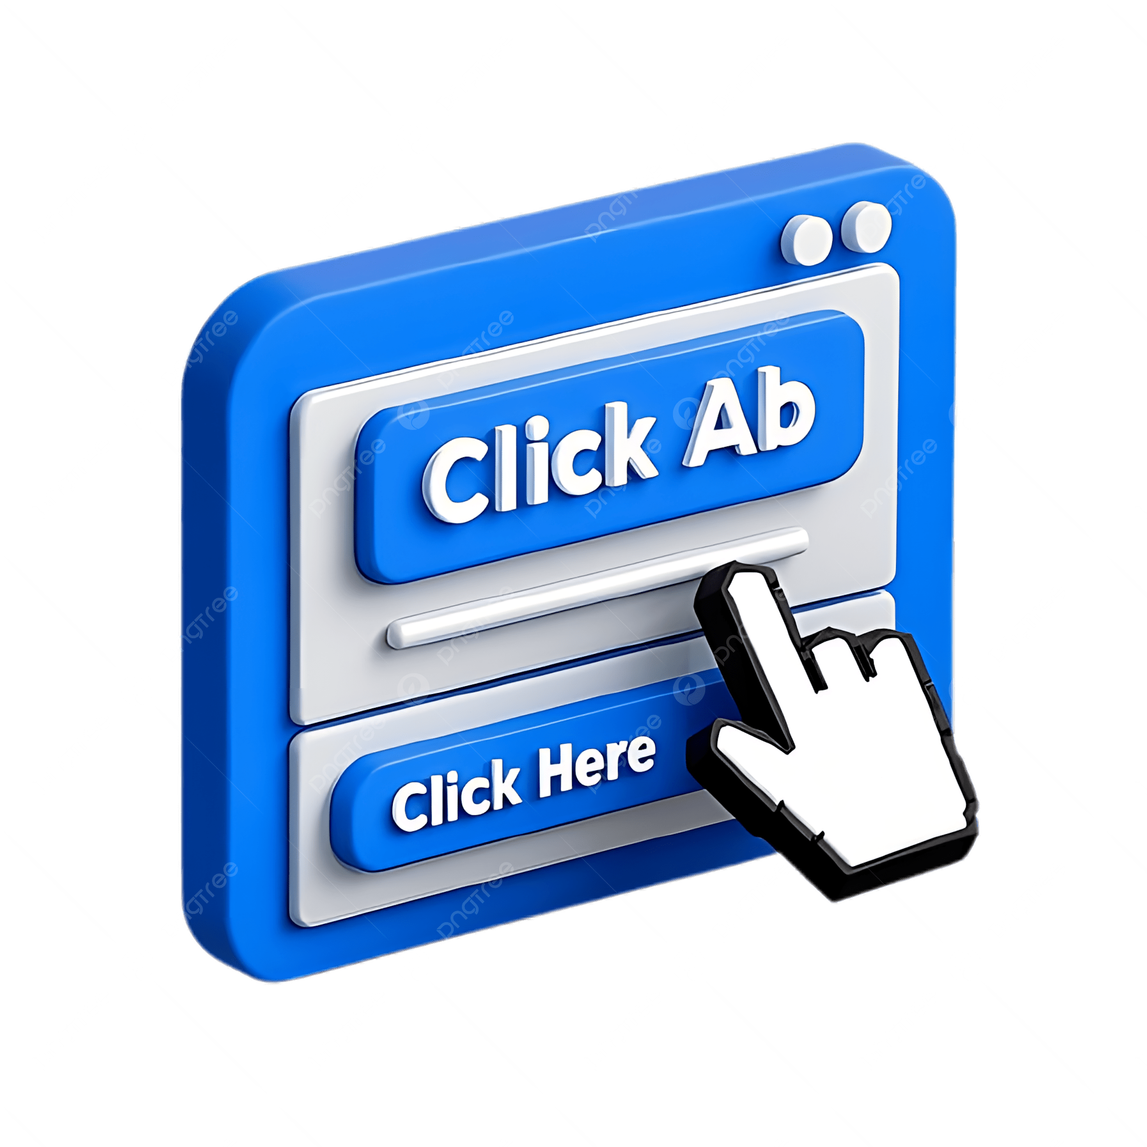
Buying Models: Cost Per Click (CPC) (Continue…)
Steps
  User Clicks: When a user clicks on the ad, they are taken to the advertiser’s website or landing page.

Slide 50
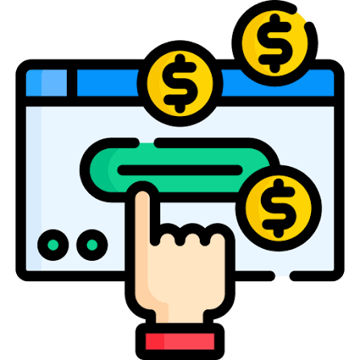
Buying Models: Cost Per Click (CPC) (Continue…)
Steps
  Payment: The advertiser is charged for each click. The cost per click can vary based on competition and ad relevance.
    Example: If a Flipkart ad on Google gets 100 clicks and the cost per click is ₹5, the total cost is ₹500.

Slide 51
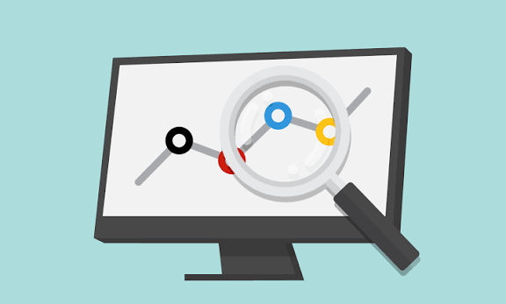
Buying Models: Cost Per Click (CPC) (Continue…)
Steps
  Campaign Monitoring: Advertisers monitor the campaign performance using analytics tools to measure ROI and optimize targeting or bids as needed.

Slide 52
Buying Models: Cost per Mille (CPM)
Cost per Mille (CPM)
Advertisers pay for every 1,000 impressions (views) of their ad, regardless of whether anyone clicks. It is used primarily for raising brand awareness.
Example: If an advertiser's CPM is ₹100, they pay ₹100 for every 1,000 people who see the ad.
Objective: Increase brand visibility by paying for every thousand impressions.

Slide 53
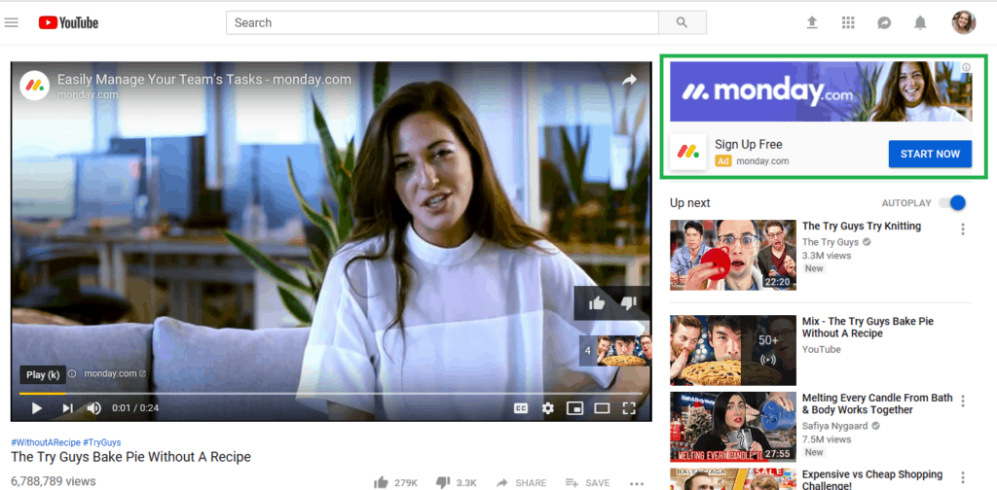
Buying Models: Cost per Mille (CPM) (Continue…)
Steps:
  Ad Creation: The advertiser designs ads, which can be banners, videos, or display ads suited for platforms like YouTube or display networks.

Slide 54

Buying Models: Cost per Mille (CPM) (Continue…)
Steps:
  Bidding/Setting CPM: The advertiser sets a CPM bid (cost per 1,000 impressions). This bid represents how much the advertiser is willing to pay for every 1,000 people who view their ad.

Slide 55
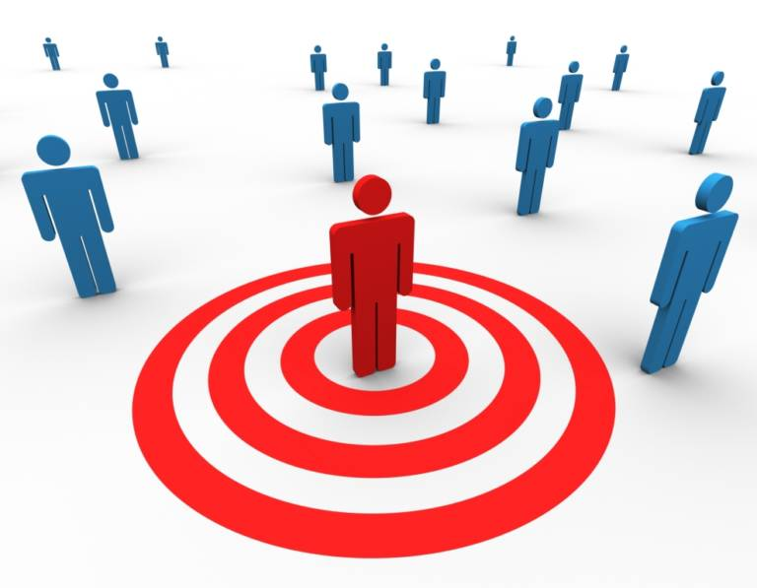
Buying Models: Cost per Mille (CPM) (Continue…)
Steps:
  Targeting: The advertiser defines the audience using factors like age, interests, behavior, or location.

Slide 56
Buying Models: Cost per Mille (CPM) (Continue…)
Steps:
  Ad Display: The ad is displayed across various platforms (social media, video streaming, or display networks) within the target audience.

Slide 57
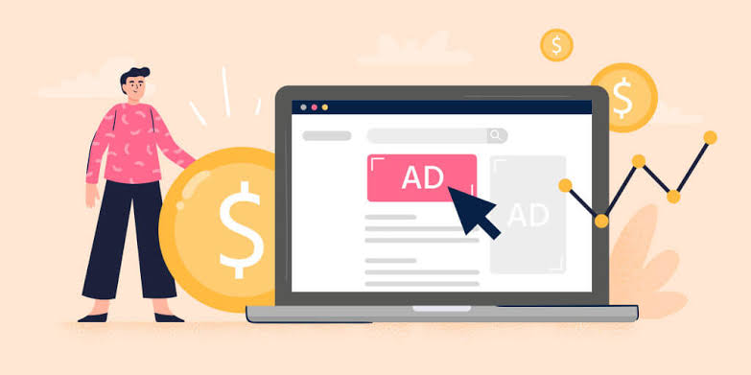
Buying Models: Cost per Mille (CPM) (Continue…)
Steps:
  Payment for Impressions: The advertiser is charged for every 1,000 views (impressions) of the ad, regardless of whether the audience interacts with it.
    Example: If Tata Motors pays ₹100 CPM and their ad is shown 10,000 times, they would pay ₹1,00 (10,000/1,000) = 10 * ₹100).

Slide 58
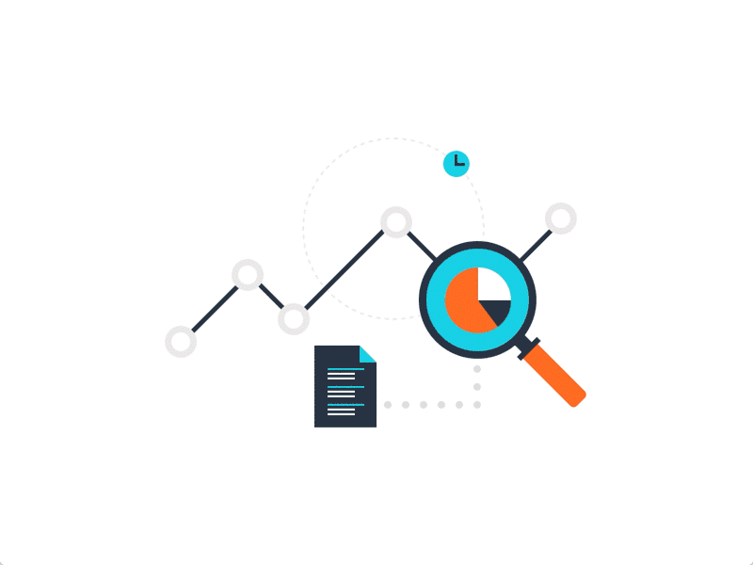
Buying Models: Cost per Mille (CPM) (Continue…)
Steps:
  Campaign Monitoring: Advertisers review impression data to understand reach and adjust their ad creatives or budget if necessary.

Slide 59
Buying Models: Cost Per Lead (CPL)
Cost per Lead (CPL)
Advertisers pay when they generate a lead, such as when a user submits their contact information (e.g., via a form).
This model focuses on lead generation.
Example: If an advertiser pays ₹200 per lead and receives 10 leads, they pay ₹2,000.
Objective: Generate leads by paying for each lead captured through a form or inquiry.

Slide 60
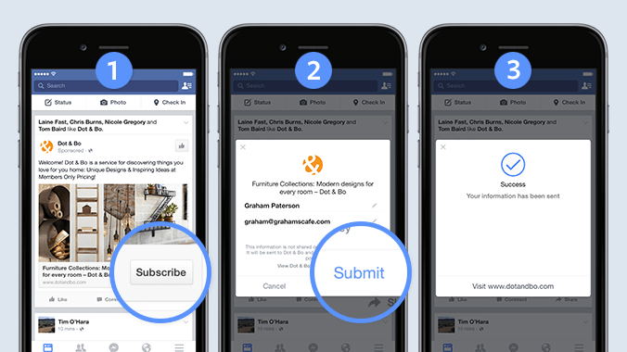
Buying Models: Cost Per Lead (CPL) (Continue…)
Steps:
  Ad Creation: The advertiser creates an ad that offers value (such as free consultations, product demos, etc.) to encourage users to provide their contact details.

Slide 61
Buying Models: Cost Per Lead (CPL) (Continue…)
Steps:
  Bidding: The advertiser sets the amount they are willing to pay per lead (CPL bid).

Slide 62
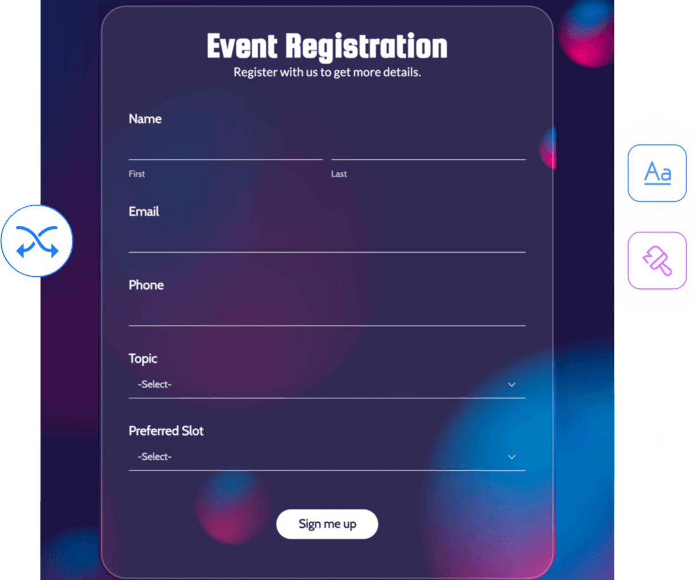
Buying Models: Cost Per Lead (CPL) (Continue…)
Steps:
  Lead Form Setup: A form is integrated with the ad (on platforms like Facebook Lead Ads or Google Ads), where users can submit their information (name, email, phone number, etc.).

Slide 63
Buying Models: Cost Per Lead (CPL) (Continue…)
Steps:
  Targeting: The advertiser targets the audience, focusing on users who are likely to be interested in the offer.

Slide 64
Buying Models: Cost Per Lead (CPL) (Continue…)
Steps:
  Ad Display: The ad is shown to the target audience across various platforms.

Slide 65
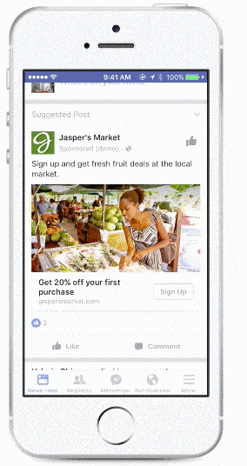
Buying Models: Cost Per Lead (CPL) (Continue…)
Steps:
  Lead Submission: Users see the ad, and if they are interested, they fill out the form, providing their contact details.

Slide 66

Buying Models: Cost Per Lead (CPL) (Continue…)
Steps:
  Payment: The advertiser is charged when a lead is captured.
    Example: If ICICI Bank runs a campaign for credit card sign-ups and generates 50 leads at ₹200 per lead, they would pay ₹10,000 (₹200 * 50 leads).

Slide 67
Buying Models: Cost Per Lead (CPL) (Continue…)
Steps:
  Lead Management: The captured leads are handed over to the sales team for follow-up and conversion into customers.
Hot Lead
Mild Lead
Cold Lead

Slide 68
Buying Models: Cost per Acquisition (CPA)
Cost per Acquisition (CPA)
Advertisers pay when a specific action, like a purchase or sign-up, is completed.
This model ensures that advertisers only pay for tangible results.
Also Know as Cost per Action.
Example: If an advertiser pays ₹500 for each purchase and 5 purchases are made, they pay ₹2,500.
Objective: Drive specific actions (purchases, sign-ups) by paying for each completed conversion.

Slide 69
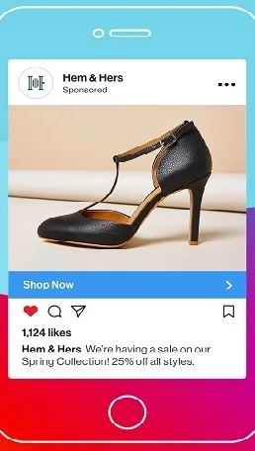
Buying Models: Cost per Acquisition (CPA) (Continue…)
Steps:
  Ad Creation: The advertiser creates an ad with a strong call-to-action (e.g., “Buy Now,” “Sign Up,” or “Download Now”).

Slide 70
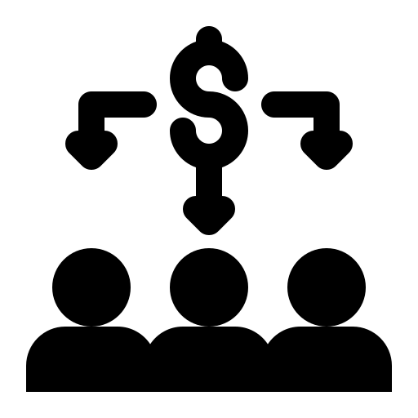
Buying Models: Cost per Acquisition (CPA) (Continue…)
Steps:
  Setting CPA Goal: The advertiser sets a CPA target (the maximum amount they are willing to pay for each completed action, like a sale or registration).

Slide 71
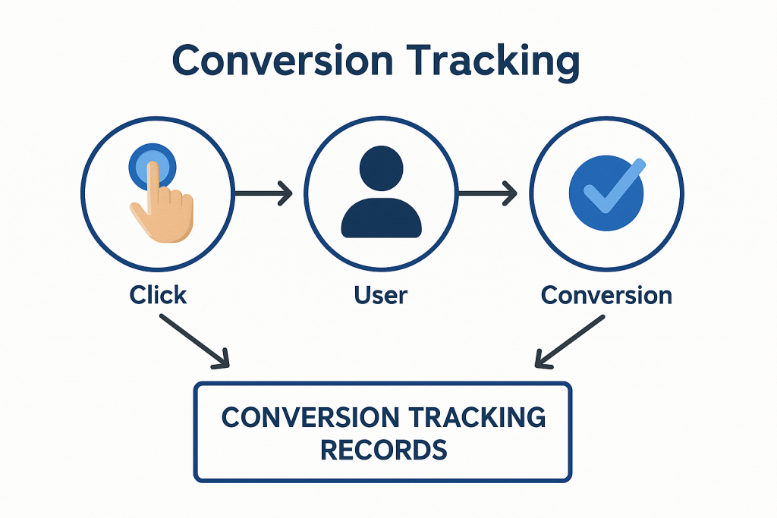
Buying Models: Cost per Acquisition (CPA) (Continue…)
Steps:
  Conversion Tracking Setup: The advertiser installs conversion tracking tools (e.g., Google Analytics or Facebook Pixel) to track the actions users take after clicking the ad.

Slide 72
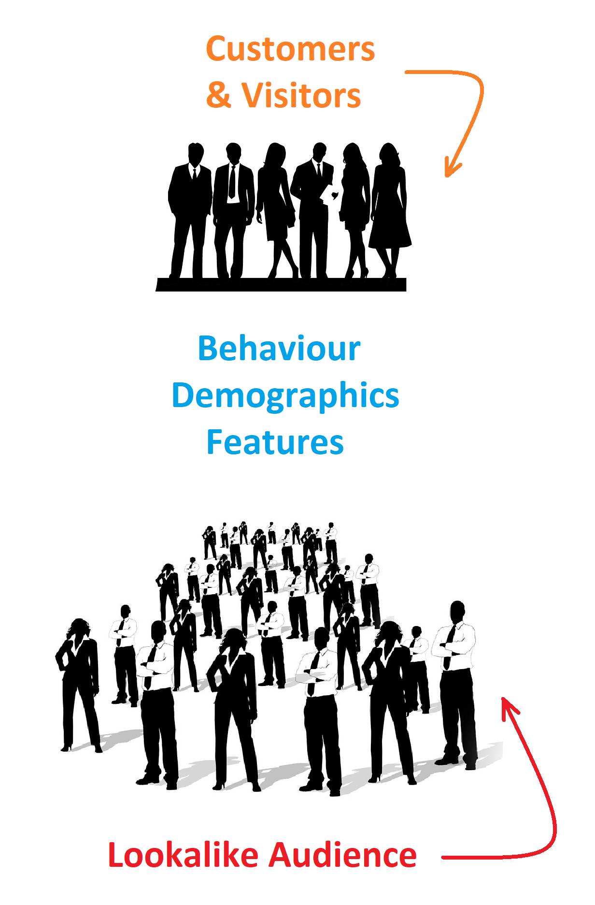
Buying Models: Cost per Acquisition (CPA) (Continue…)
Steps:
  Targeting: The advertiser defines the audience using advanced targeting options such as remarketing, lookalike audiences, or behavioral targeting.

Slide 73
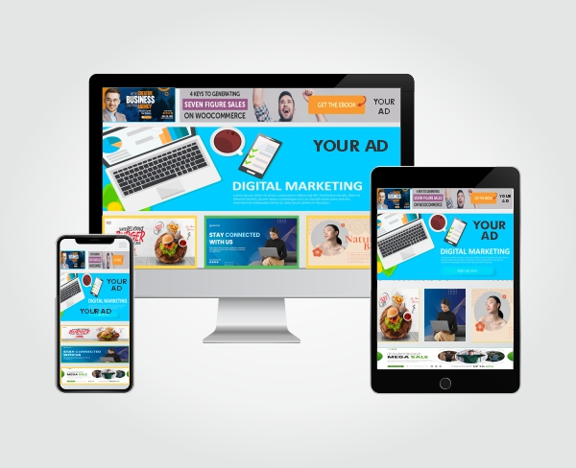
Buying Models: Cost per Acquisition (CPA) (Continue…)
Steps:
  Ad Display: The ad is shown to the target audience across different platforms (search engines, social media, affiliate websites).

Slide 74

Buying Models: Cost per Acquisition (CPA) (Continue…)
Steps:
  Action Completion: A user clicks the ad and completes the desired action (purchase, sign-up, download).

Slide 75

Buying Models: Cost per Acquisition (CPA) (Continue…)
Steps:
  Payment: The advertiser is charged based on the number of completed actions, not clicks or impressions.
    Example: Amazon India uses CPA in affiliate marketing. If an affiliate generates 10 sales for Amazon products and the agreed CPA is ₹300 per sale, Amazon would pay ₹3,000 (₹300 * 10 sales).

Slide 76
Buying Models: Cost per Acquisition (CPA) (Continue…)
Steps:
  Campaign Monitoring: Advertisers use conversion data to evaluate performance and make adjustments to improve ROI.

Slide 77
Buying Models: Current Rates – Platform Wise
The rates of online advertising models
CPC (Cost per Click),
CPM (Cost per Mille),
CPL (Cost per Lead), and
CPA (Cost per Acquisition)
Vary across social media platforms and depend on factors like audience targeting, industry competition, and ad relevance.

Slide 78
Buying Models: Current Rates – Platform Wise (Continue…)
Below are some average rates for 2026 across major platforms in India:
  Facebook & Instagram:
    CPC (Cost per Click): ₹3.00 to ₹15.00 on Instagram, and ₹0.50 to ₹8.00 on Facebook.
    CPM (Cost per 1000 Impressions): ₹30 to ₹120 on Instagram, and ₹50 to ₹130 on Facebook.
    CPL (Cost per Lead): ₹80 to ₹2,000, varying drastically by industry.
    CPA (Cost per Acquisition / Purchase): ₹100 to ₹2,500+, heavily dependent on product cost (AOV) and industry.

Slide 79
Buying Models: Current Rates – Platform Wise (Continue…)
Below are some average rates for 2026 across major platforms in India:
  LinkedIn:
    CPC (Cost per Click): ₹150 to ₹650, as LinkedIn's highly premium, verified professional audience commands the highest ad rates in the market.
    CPM (Cost per 1000 Impressions): ₹500 to ₹3,500, reflecting the platform's hyper-focus on highly valued B2B professional data rather than casual consumer browsing.
    CPL (Cost per Lead): ₹850 to ₹5,500+ for high-quality leads, particularly when using native LinkedIn Lead Gen Forms in competitive verticals like SaaS, FinTech, and Enterprise Consulting.
    CPA (Cost per Acquisition / SQL): Typically much higher than other platforms, frequently crossing ₹5,000 to ₹25,000+, especially for professional services and high-ACV (Average Contract Value) enterprise deals.

Slide 80
Buying Models: Current Rates – Platform Wise (Continue…)
Below are some average rates for 2026 across major platforms in India:
  Twitter (Now X):
    CPC (Cost per Click): ₹15 to ₹65
    CPM (Cost per 1000 Impressions): ₹170 to ₹500
    CPA (Cost per Acquisition): ₹400 to ₹1,800
  E-commerce Websites (Amazon, Flipkart, etc.):
    CPC (Cost per Click):
      Flipkart: ₹4 to ₹15
      Amazon India: ₹25 to ₹120+
    CPM (Cost per 1000 Impressions): ₹80 to ₹450
    CPA / ACoS (Cost per Acquisition): Highly variable based on your organic rank and listing conversion rates, but average purchase acquisition costs generally range from ₹150 to ₹1,200 depending entirely on your product’s Average Order Value (AOV).

Slide 81
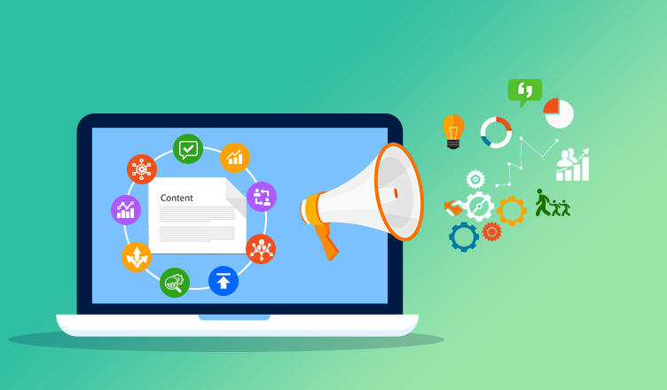
Types of
Digital Marketing Channels

Slide 82
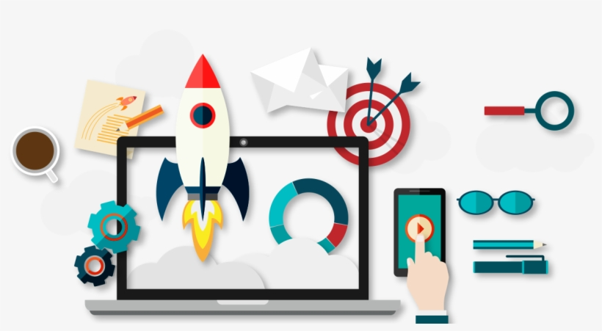
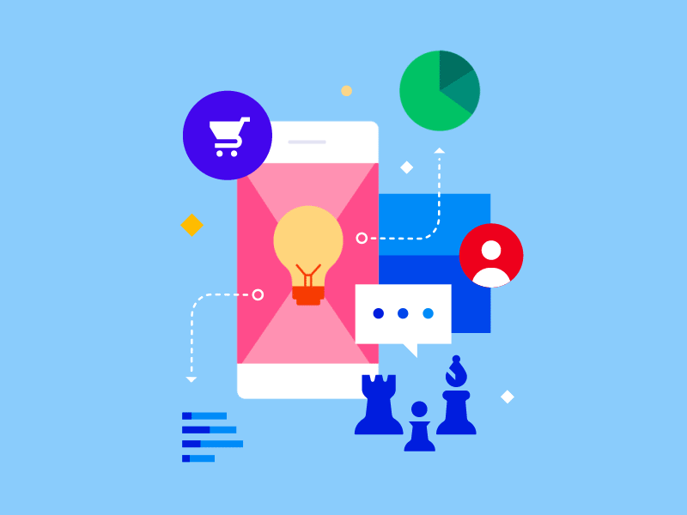
Types of Digital Marketing Channels
Website
Content Marketing
Search Engine Optimization
Email Marketing
Affiliate Marketing
Referral Marketing
InfluencerMarketing
Online Public Relation
Conversational AI
“Digital marketing channels are online platforms and tools that businesses use to communicate with their target audiences, promote their brand, and sell products.”

Slide 83
Types of Digital Marketing Channels: Website
A website serves as the digital home of a business, providing
product information
services
customer interaction channels.
It helps build trust, generate leads, and offers 24/7 accessibility.
A well-designed website supports other digital marketing efforts like SEO and content marketing.
Example: Tata Motors uses its website to showcase vehicle models, offer online booking, and provide customer support.

Slide 84
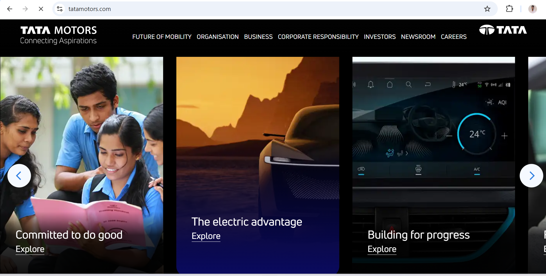
Types of Digital Marketing Channels: Website (Continue…)

Slide 85
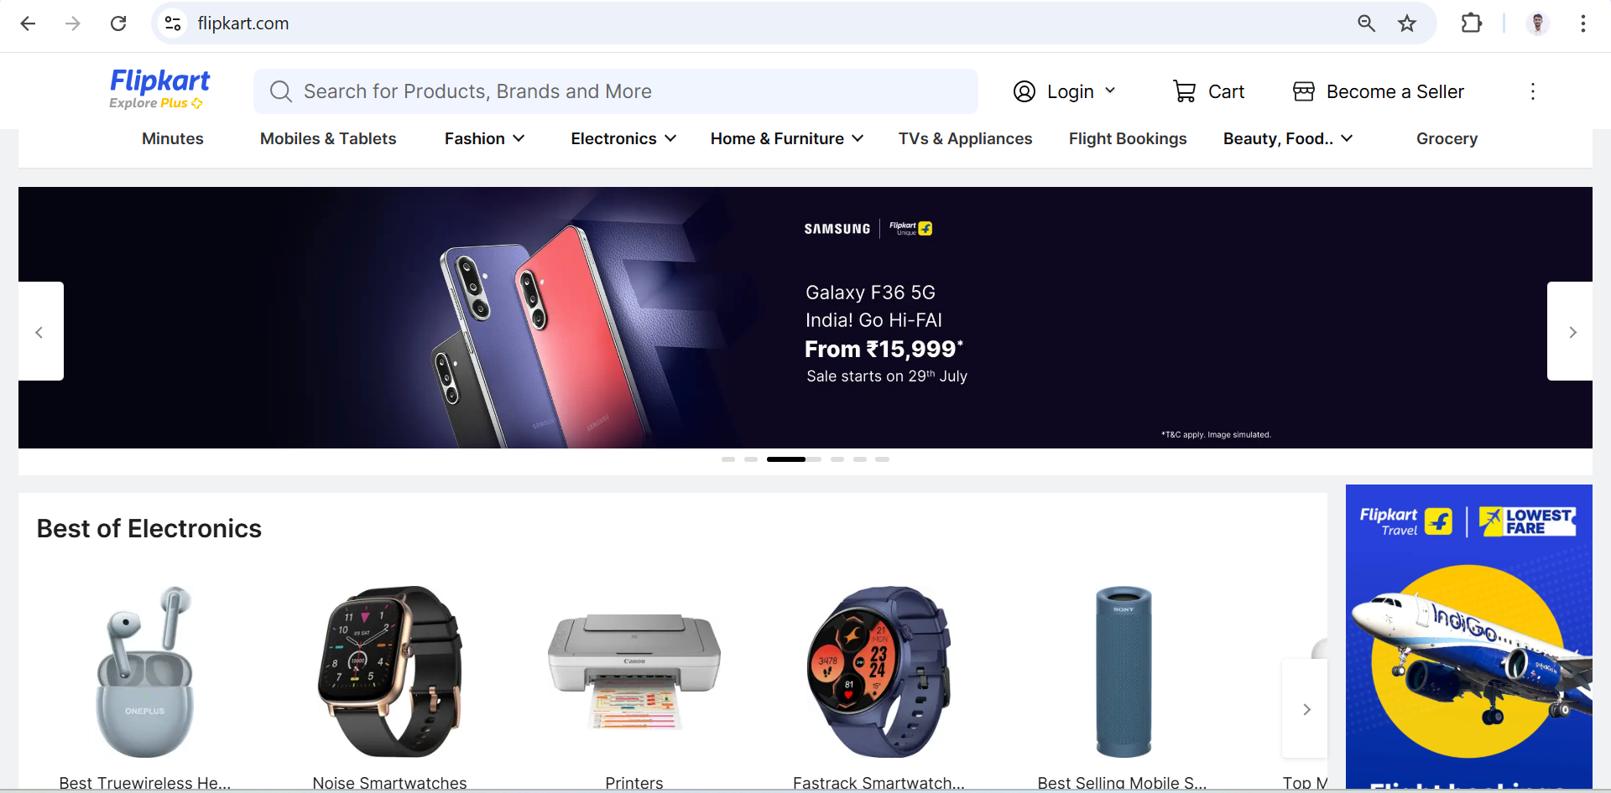
Types of Digital Marketing Channels: Website (Continue…)

Slide 86
Types of Digital Marketing Channels: Website (Continue…)
Key Components:
  User Experience (UX): Ensures smooth navigation, fast loading times, and mobile compatibility.
  SEO Optimized Content: Helps the website rank higher in search results.
  Calls to Action (CTAs): Prompts users to take desired actions (e.g., purchase, contact).
  Analytics Tools: Tools like Google Analytics to measure website traffic and user behavior.
  Security: HTTPS protocol and data privacy compliance build trust with users.

Slide 87
Types of Digital Marketing Channels: Website (Continue…)
Benefits:
  Brand Credibility: A professional website builds trust with customers.
  24/7 Accessibility: Available to users at any time and from any location.
  Lead Generation: Collects leads through forms, CTAs, and newsletters.
  Analytics Integration: Track user behavior and optimize for better performance.
  Marketing Hub: Centralizes other digital marketing efforts such as SEO and content marketing.

Slide 88
Types of Digital Marketing Channels: Website (Continue…)
Limitations:
  High Development Costs: Building and maintaining a quality website can be expensive.
  Technical Complexity: Requires expertise to maintain and optimize performance.
  Slow Load Times Impact SEO: Heavy sites can affect ranking and engagement.
  Security Risks: At risk to hacking if not maintained properly.
  Requires Continuous Updates: Content and design need regular updates to stay relevant.

Slide 89
Types of Digital Marketing Channels: Content Marketing
Content marketing involves creating and sharing valuable content such as
  blogs
  videos
  images
  infographics
  to engage audiences and nurture leads
It establishes brand authority, builds trust, and influences buying decisions.
The content can also improve SEO and social media engagement.
Example: Amul publishes engaging content through memes and infographics on current events across social media.

Slide 90
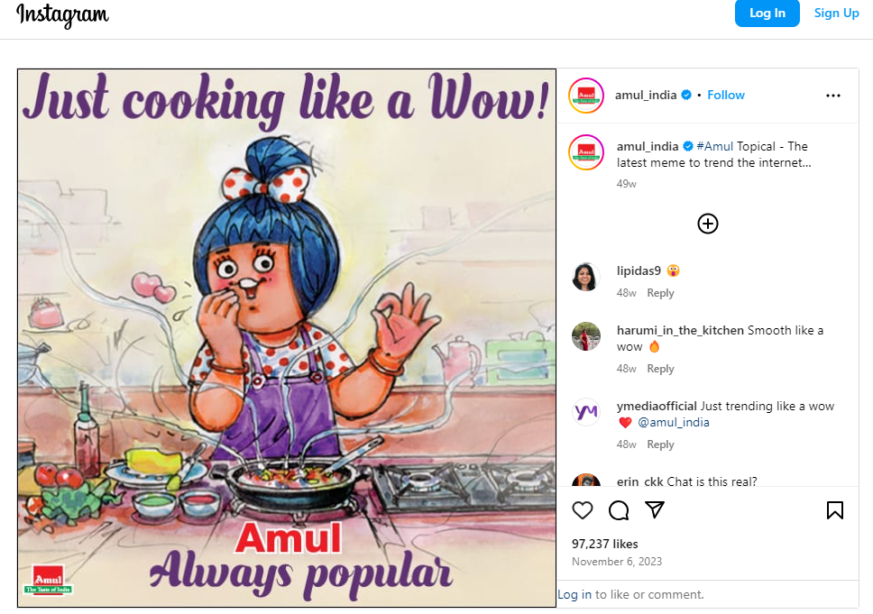


Types of Digital Marketing Channels: Content Marketing (Continue…)

Slide 91
Types of Digital Marketing Channels: Content Marketing (Continue…)
Key Components:
  Blog Articles & Case Studies: Inform and educate readers.
  Videos & Infographics: Simplify complex concepts visually.
  Social Media Posts: Drive engagement and brand awareness.
  Email Newsletters: Provide personalized updates to subscribers.
  E-Books/White Papers: Establish authority in the industry.

Slide 92
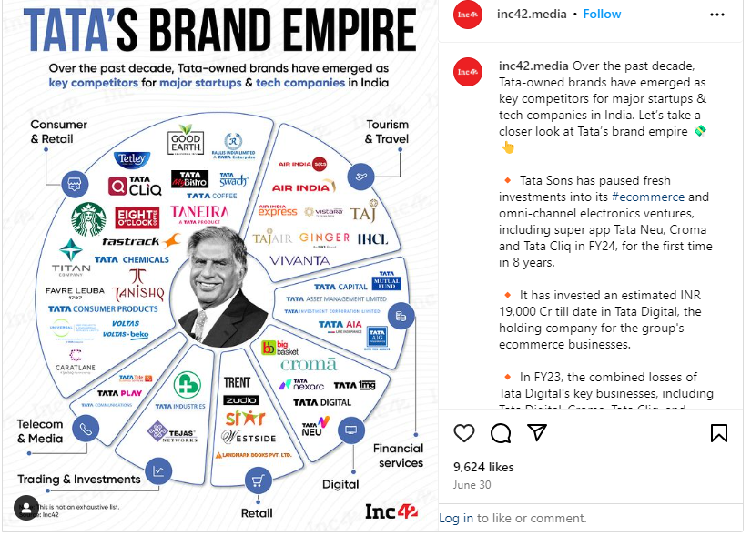
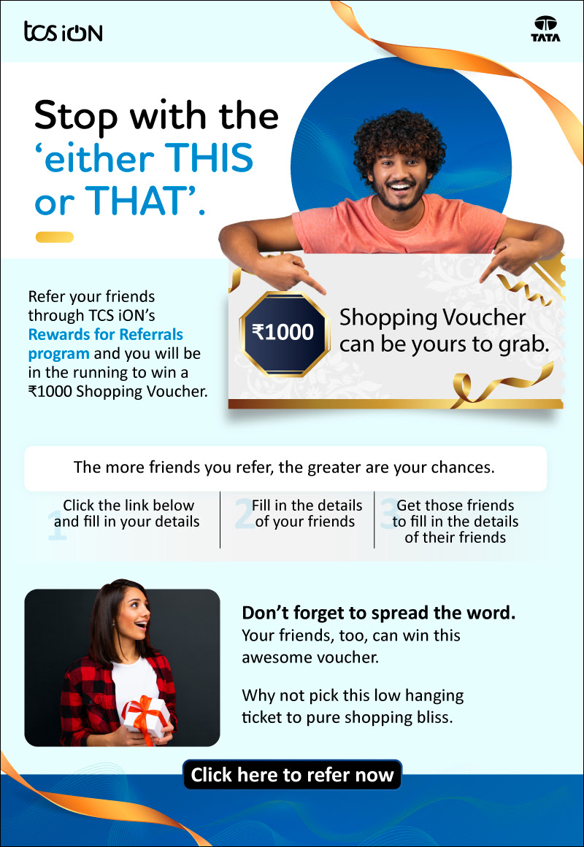
Types of Digital Marketing Channels: Content Marketing (Continue…)

Slide 93
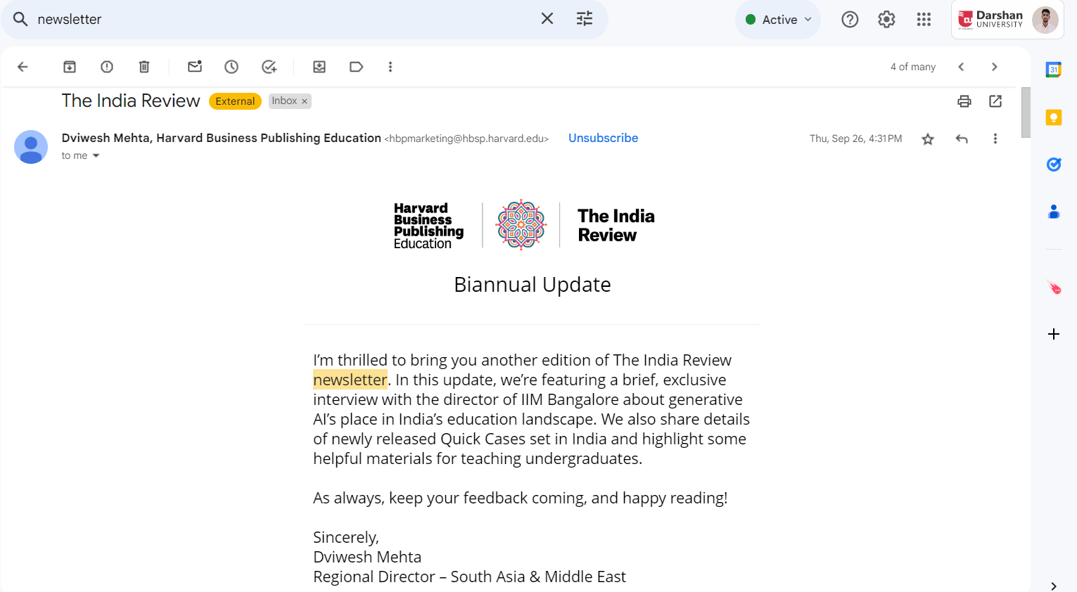
Types of Digital Marketing Channels: Content Marketing (Continue…)

Slide 94
Types of Digital Marketing Channels: Content Marketing (Continue…)
Benefits:
  Builds Brand Authority: Positions the company as a thought leader.
  Increases Organic Traffic: SEO-optimized content attracts visitors.
  Enhances Customer Engagement: Provides value and encourages interaction.
  Supports Lead Generation: Gated content collects user information.
  Drives Conversion: Educational content influences purchase decisions.

Slide 95
Types of Digital Marketing Channels: Content Marketing (Continue…)
Limitations:
  Time-Consuming: Requires regular creation and management.
  Results are Delayed: Benefits are seen over the long term.
  Content Saturation: Standing out in a competitive market is difficult.
  Costly for High-Quality Production: Videos and infographics may require significant resources.
  Continuous Optimization Needed: Trends change, requiring constant updates.

Slide 96
Types of Digital Marketing Channels: SEO
SEO is the strategy of creating content in such a way that search engines like Google will rank your page high on the search engine results page (SERP).
Google uses algorithms to decide how relevant your page is to the keywords that the user is searching for.
These algorithms update frequently, and SEO strategies must be adjusted just as regularly to remain effective.
When done properly, SEO efforts will put your page at the top of the SERP and bring in more organic traffic.
Example: Amazon optimizes its product pages to rank higher on Google for specific product-related keywords.

Slide 97
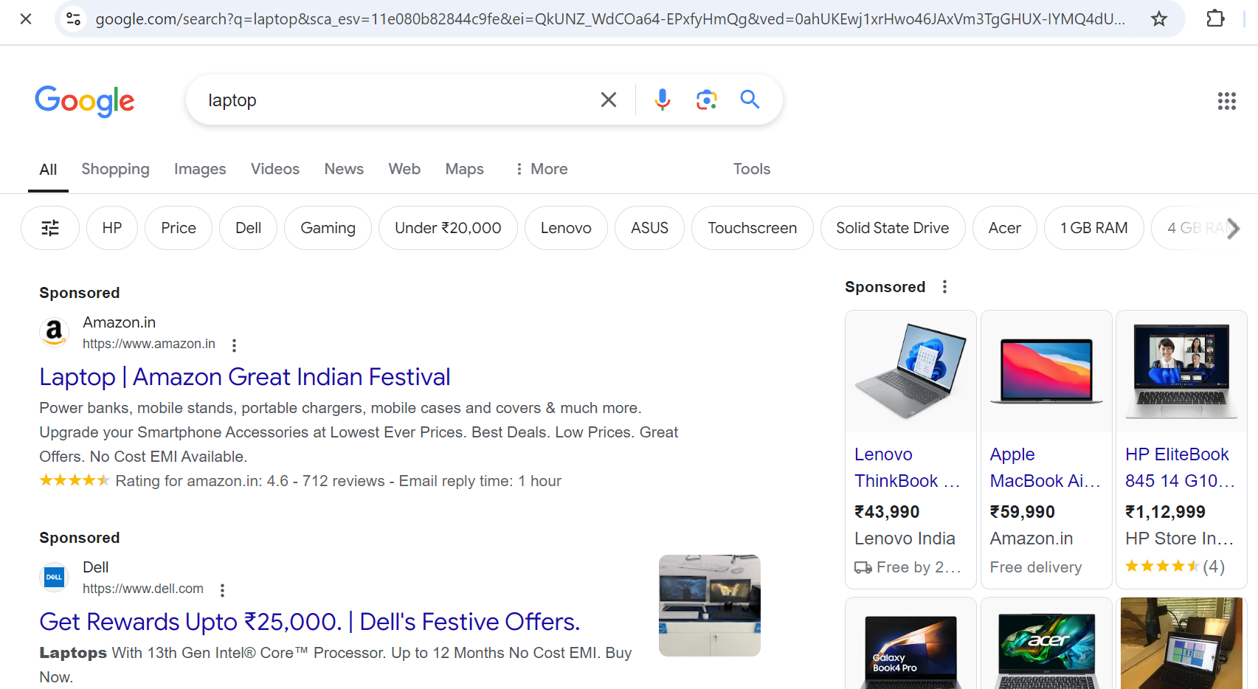
Types of Digital Marketing Channels: SEO (Continue…)

Slide 98
Types of Digital Marketing Channels: SEO (Continue…)
Key Components:
  On-Page SEO: Keywords, meta descriptions, and internal linking.
  Off-Page SEO: Backlinks from high-authority sites.
  Technical SEO: Website speed, mobile-friendliness, and structured data.
  Keyword Research: Identifying relevant search terms.
  Analytics Tools: Tools to monitor performance, such as Google Search Console.

Slide 99
Types of Digital Marketing Channels: SEO (Continue…)
Benefits:
  Increases Organic Traffic: Attracts visitors without paid ads.
  Improves Brand Visibility: Higher ranking leads to more visibility.
  Long-Term ROI: Once optimized, SEO drives sustained traffic.
  Boosts Credibility: Users trust high-ranking sites more.
  Supports Other Channels: Enhances the effectiveness of blogs and websites.

Slide 100
Types of Digital Marketing Channels: SEO (Continue…)
Limitations:
  Requires Expertise: Needs SEO specialists for implementation.
  Constant Updates: SEO algorithms frequently change.
  Results Take Time: Rankings improve over months, not days.
  Competitive: Difficult to rank for high-competition keywords.
  Technical Challenges: Requires maintaining site performance and speed.

Slide 101
Types of Digital Marketing Channels: Email Marketing
Email marketing is a direct communication channel where personalized messages, offers, and updates are sent to subscribers.
It helps businesses maintain relationships, nurture leads, and drive conversions.
Automated campaigns improve efficiency.
Example: Zomato sends personalized restaurant recommendations and discounts to users via email.

Slide 102
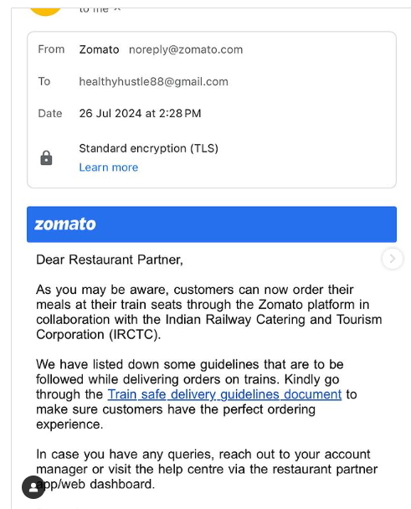

Types of Digital Marketing Channels: Email Marketing (Continue…)

Slide 103
Types of Digital Marketing Channels: Email Marketing (Continue…)
Key Components:
  Segmentation: Grouping users based on behavior or demographics.
  Personalization: Customized emails with user-specific content.
  Automated Campaigns: Drip campaigns to nurture leads.
  CTAs: Encourage users to take specific actions.
  Analytics: Track open rates, click-through rates, and conversions.

Slide 104
Types of Digital Marketing Channels: Email Marketing (Continue…)
Benefits:
  High ROI: Email marketing offers one of the highest returns among digital channels.
  Personalized Communication: Tailored content improves engagement.
  Automated Workflows: Saves time and nurtures leads.
  Direct Channel to Users: Messages reach customers instantly.
  Retargeting Capability: Follow up with abandoned cart emails or offers.

Slide 105
Types of Digital Marketing Channels: Email Marketing (Continue…)
Limitations:
  Email Fatigue: Overwhelming inboxes reduce engagement.
  Spam Filters: Poorly designed emails may end up in spam.
  Privacy Concerns: Users are wary of sharing email addresses.
  Unsubscribe Rates: Irrelevant emails can cause users to opt out.
  Requires Strong Content: Bland emails reduce effectiveness.

Slide 106
Types of Digital Marketing Channels: Affiliate Marketing
In affiliate marketing, businesses collaborate with partners who promote their products and earn a commission for every sale made through their referral.
It is
  performance-based,
  driving traffic and
  conversions through external channels.
Example: Flipkart runs an affiliate program where bloggers and influencers earn commissions by promoting Flipkart products.

Slide 107
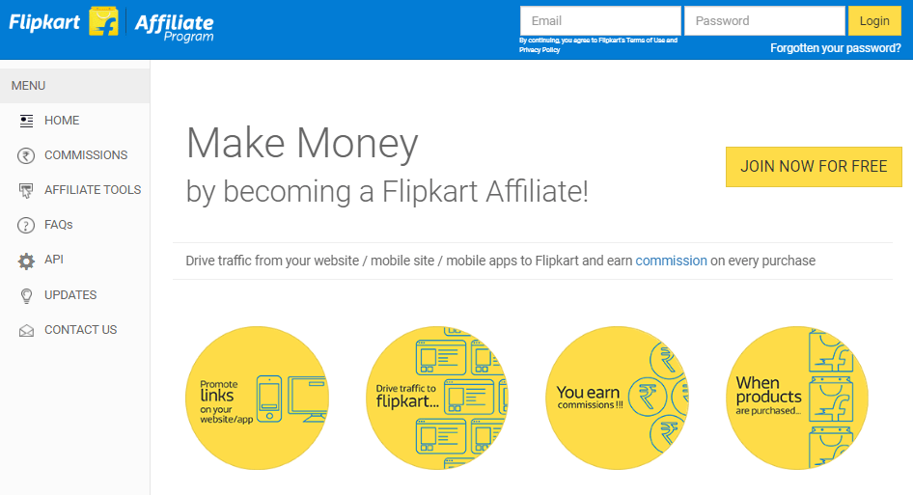
Types of Digital Marketing Channels: Affiliate Marketing (Continue…)

Slide 108
Types of Digital Marketing Channels: Affiliate Marketing (Continue…)
Key Components:
  Affiliate Networks: Platforms that connect businesses with affiliates.
  Commission Models: Pay-per-sale, pay-per-click, or pay-per-lead.
  Tracking Tools: Monitor affiliate performance.
  Product Links: Customized links to track conversions.
  Payment Structures: Clear policies for paying affiliates.

Slide 109
Types of Digital Marketing Channels: Affiliate Marketing (Continue…)
Benefits:
  Low-Risk Investment: Pay only for successful conversions.
  Broad Reach: Affiliates promote products to new audiences.
  Performance-Based: Easy to measure ROI.
  Scalable: Add more affiliates to expand efforts.
  Enhances Brand Awareness: Affiliates promote through various channels.

Slide 110
Types of Digital Marketing Channels: Affiliate Marketing (Continue…)
Limitations:
  Fraud Risk: Affiliates may engage in unethical practices.
  Commission Costs: Can add up with multiple affiliates.
  Limited Control: Affiliates control messaging and promotion.
  Brand Dilution: Poorly selected affiliates may harm brand image.
  Compliance Issues: Ensuring all affiliates follow advertising rules.

Slide 111
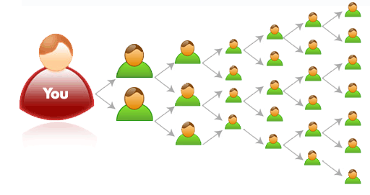
Types of Digital Marketing Channels: Referral Marketing
Referral marketing encourages existing customers to recommend products or services to others, typically incentivizing them with discounts, rewards, or cashback.
It leverages trust in personal networks to acquire new customers at a low cost.
Example: Paytm offers cashback to both referrers and referees for inviting new users to its platform.

Slide 112
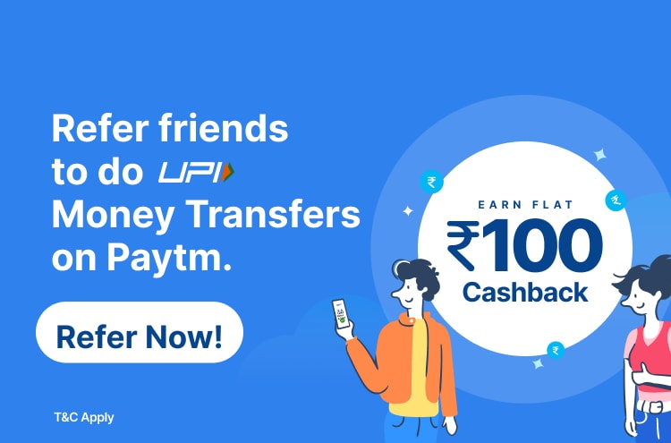
Types of Digital Marketing Channels: Referral Marketing (Continue…)

Slide 113
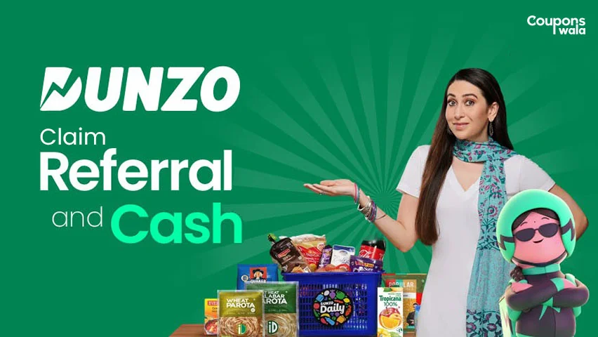
Types of Digital Marketing Channels: Referral Marketing (Continue…)

Slide 114
Types of Digital Marketing Channels: Referral Marketing (Continue…)
Key Components:
  Incentives: Rewards for both referrer and referee (e.g., discount codes).
  Tracking System: Tracks successful referrals through unique links or codes.
  Loyalty Programs: Integrates with customer loyalty programs for additional benefits.
  Social Sharing Tools: Makes it easy for customers to share referral links.
  Automation: Automatically sends rewards upon successful referrals.

Slide 115
Types of Digital Marketing Channels: Referral Marketing (Continue…)
Benefits:
  Cost-Effective: Lower acquisition cost than traditional ads.
  High Conversion Rates: Referred customers are more likely to convert.
  Trust Factor: Recommendations from friends are highly trusted.
  Expands Customer Base: Each customer can bring multiple new leads.
  Brand Loyalty: Encourages customer retention through rewards.

Slide 116
Types of Digital Marketing Channels: Referral Marketing (Continue…)
Limitations:
  Limited Control: Customers may not promote as expected.
  Fraud Risk: Potential abuse of referral rewards.
  Incentive Costs: Offering rewards can increase expenses.
  Requires Existing Customers: Effectiveness depends on having loyal customers.
  Tracking Issues: Difficulty in accurately tracking every referral.

Slide 117
Types of Digital Marketing Channels: Influencer Marketing
Influencer marketing involves collaborating with individuals who have a large social media following to promote products or services.
Influencers help brands reach niche audiences and build credibility through authentic content.
Example: Mamaearth partners with beauty and wellness influencers to promote its personal care products.

Slide 118


Types of Digital Marketing Channels: Influencer Marketing (Continue…)

Slide 119



Types of Digital Marketing Channels: Influencer Marketing (Continue…)

Slide 120
Types of Digital Marketing Channels: Influencer Marketing (Continue…)
Key Components:
  Choosing the Right Influencers: Based on relevance, engagement, and audience.
  Campaign Goals: Define objectives (awareness, engagement, sales).
  Content Strategy: Co-create engaging content with influencers.
  Platform Selection: Use appropriate platforms (e.g., Instagram, YouTube).
  Performance Tracking: Measure reach, engagement, and ROI.

Slide 121
Types of Digital Marketing Channels: Influencer Marketing (Continue…)
Benefits:
  Increases Brand Awareness: Reach large audiences quickly.
  Builds Trust: Followers trust recommendations from influencers.
  Engages Niche Audiences: Access specific demographics.
  Boosts Sales: Influencer promotions drive purchasing decisions.
  Improves SEO: Influencer content often generates backlinks.

Slide 122
Types of Digital Marketing Channels: Influencer Marketing (Continue…)
Limitations:
  High Costs: Top influencers charge significant fees.
  Authenticity Concerns: Over-promoting can reduce credibility.
  Limited Control: Content creation lies in the hands of the influencer.
  Short-Term Impact: Results may decline once the campaign ends.
  Brand Reputation Risk: Influencers’ actions may reflect negatively on the brand.

Slide 123
Types of Digital Marketing Channels: Online Public Relation
Online PR involves managing a brand’s reputation, relationships, and public perception through digital platforms like social media, blogs, and news websites.
It helps businesses build positive public perception and handle crises efficiently.
Example: Ola Cabs engages with customers on Twitter to resolve complaints and share service updates.

Slide 124


Types of Digital Marketing Channels: Online Public Relation (Continue.)

Slide 125
Types of Digital Marketing Channels: Online Public Relation (Continue.)
Key Components:
  Media Outreach: Sending press releases to online media.
  Social Media Engagement: Responding to customer feedback and queries.
  Influencer Collaboration: Using trusted voices to build credibility.
  Reputation Management: Handling online reviews and complaints.
  Crisis Management: Proactively addressing negative publicity.

Slide 126
Types of Digital Marketing Channels: Online Public Relation (Continue.)
Benefits:
  Builds Trust: Positive online reputation boosts brand trust.
  Enhances Visibility: Coverage on news sites improves reach.
  Cost-Effective: PR campaigns are cheaper than paid advertising.
  Manages Crises: Effective online PR mitigates damage during crises.
  Strengthens SEO: Positive media coverage improves search rankings.

Slide 127
Types of Digital Marketing Channels: Online Public Relation (Continue.)
Limitations:
  Lack of Control: Media narratives can shift unpredictably.
  Slow Impact: Results take time to materialize.
  Requires Continuous Monitoring: Online presence must be constantly managed.
  Risk of Negative Publicity: Backlash from negative reviews or posts.
  Dependency on Media: Coverage relies on media interest and availability.

Slide 128
Types of Digital Marketing Channels: Conversational AI
Conversational AI uses chatbots and voice assistants to interact with customers in real-time, providing support and recommendations.
It offers personalized service, reduces response time, and is available 24/7.
Example: HDFC Bank's EVA chatbot assists customers with queries about loans, account balances, and more.

Slide 129


Types of Digital Marketing Channels: Conversational AI (Continue…)

Slide 130
Types of Digital Marketing Channels: Conversational AI (Continue…)
Key Components:
  Chatbots: Automated chat systems on websites and apps for customer service.
  Voice Assistants: Devices like Amazon Alexa or Google Assistant.
  Natural Language Processing (NLP): Understands and responds to user queries.
  Personalization: Customizes interactions based on user data.
  Integration with CRM: Syncs with customer management tools for seamless service.

Slide 131
Types of Digital Marketing Channels: Conversational AI (Continue…)
Benefits:
  24/7 Availability: AI tools offer uninterrupted customer support.
  Reduces Response Time: Instant responses improve user experience.
  Cost-Effective: Reduces the need for large customer service teams.
  Personalized Experience: AI recommends products based on past behavior.
  Scalable: Easily handles increasing numbers of users.

Slide 132
Types of Digital Marketing Channels: Conversational AI (Continue…)
Limitations:
  Limited Understanding: AI struggles with complex queries.
  Lack of Human Touch: May not deliver empathetic responses.
  Initial Setup Cost: High cost to implement advanced AI systems.
  Privacy Concerns: Users may hesitate to share personal information.
  Maintenance Required: AI models need regular updates to stay relevant.

Slide 133
Web Logs

Slide 134
Web logs
Weblogs, or blogs are online journals or informational websites.
It display content in reverse chronological order, with the most recent posts appearing first.
They are often used by individuals or businesses to share
  opinions
  information
  updates
  stories
It Target broader audience.

Slide 135
Web logs
Content:
  Blogs can cover a wide range of topics, from
  personal experiences
  professional insights
  industry trends
  how-to guides.

Slide 136



Web logs
Engagement:
  Readers can often comment on blog posts, creating opportunities for interaction and community building.
SEO:
  Blogs are valuable for search engine optimization (SEO) as they can drive traffic to a website through regularly updated, keyword-rich content.
Example:
Blogger
Medium
Mashable

Slide 137
Page tagging

Slide 138
Page tagging
Page tagging is a method used in web analytics to track user behavior on a website.
Tags are code added to web pages that allow the collection of data
Data such as pageviews, clicks, and other interactions is then visible to dashboard.
Core Uses
  Data Collection: Gathers stats on page views, clicks, and user paths.
  Content Labeling: Groups similar web pages or app screens into distinct categories.
  User Tracking: Helps segment visitors based on what they view.

Slide 139
Page tagging (Continue…)
Functionality:
  Help in understanding how users interact with different elements of a website, providing insights into user preferences and behavior.
Analytics Tools:
  Tools like Google Analytics to collect and analyze data, helping businesses optimize their websites for better user experience and performance.
Applications:
  Used for tracking conversions, measuring the effectiveness of marketing campaigns, and personalizing content for visitors.

Slide 140
Google Analytics 4

Slide 141

Setup and Configuration
Step 1: Create a GA4 Property
  Open Google Analytics and go to Admin.
  Click Create Property under the Property section.
  Enter the Property Name (Website, Company, or Brand Name).
  Select your Country, Time Zone, and Currency.
  Click Next to continue.

Slide 142


Setup and Configuration (Continue…)
Step 2: Business Details
  Answer the required business information questions.
  Select Get Baseline Reports as the business objective.
  Click Create to finish property creation.

Slide 143

Setup and Configuration (Continue…)
Step 3: Create a Data Stream
  Click Add Data Stream and choose Web.
  A Data Stream collects website or app data.
  One Web Data Stream is enough for most websites.

Slide 144
Setup and Configuration (Continue…)
Step 4: Enter Website Details
Enter your Website URL.
Type your Website Name.
Keep Enhanced Measurement enabled for automatic tracking.

Slide 145

Setup and Configuration (Continue…)
Step 5: Enable Enhanced Measurement
  Automatically tracks Page Views, Scrolls, Clicks, File Downloads, and Video Engagement.
  No coding is required for these basic events.

Slide 146

Setup and Configuration (Continue…)
Step 6: Get the Measurement ID
  After creating the data stream, GA4 generates a Measurement ID.
  The ID format is G-XXXXXXXXXX.
  Copy the Measurement ID for future use.
Step 7: Use the Measurement ID
  Add the Measurement ID in Google Tag Manager (GTM).
  It tells GTM where to send your website data.
  Use the same Measurement ID for all GA4 tracking tags.

Slide 147
Goal Setting & Conversion tracking
What is Goal Setting?
  Goal setting defines the actions you want users to complete.
  In GA4, goals are tracked as Conversions.
  Goals help measure business success.
Types of Business Goals
  Increase product sales.
  Generate quality leads.
  Increase website registrations.
  Grow newsletter subscribers.
  Increase file downloads.
  Improve customer engagement.

Slide 148
Goal Setting & Conversion tracking (Continue...)
What is a Conversion?
A conversion is a valuable action completed by a user.
It represents the achievement of a business goal.
Every business can define its own conversions.
Examples:
  Product Purchase,
  User Registration,
  Contact Form Submission,
  Newsletter Subscription,
  File Download

Slide 149
Goal Setting & Conversion tracking (Continue...)
What is Conversion Tracking?
Conversion tracking measures important user actions on a website.
It helps check whether marketing campaigns are successful.
It shows how visitors achieve business objectives.

Slide 150


Goal Setting & Conversion tracking (Continue...)
How Conversion Tracking Works?
  User visits the website.
  User performs an important action.
  GA4 records the action as an event.
  The event is marked as a conversion.
  Conversion data appears in GA4 reports.
Steps to Set Up Conversion Tracking
  Create or identify an event.
  Open Admin → Events.

Slide 151


Goal Setting & Conversion tracking (Continue...)
Steps to Set Up Conversion Tracking
  Create event
  Name the event e.g. Page_View
  Enter the URL that need to be track.
  Click on create.

Slide 152
Goal Setting & Conversion tracking (Continue...)
Benefits of Conversion Tracking
Measures marketing performance.
Tracks business goals accurately.
Identifies successful campaigns.
Improves website performance.
Helps increase ROI.

Slide 153
Key Metrics

Slide 154

Key Metrics
These metrics are essential for understanding website performance and user behaviour.
  Unique visitors
  Pageviews
  Pages/visit
  Avg Visit Duration
  Bounce rate
  New visits

Slide 155


Key Metrics: Unique Visitors
This represents the total number of unique individuals who visited your website during a specific time period.
It’s a measure of how many different people interacted with your site.

Slide 156

Key Metrics: Pageviews
Pageviews indicate the total number of times any page on your website was viewed.
If a user reloads a page or visits it multiple times, each view counts as a separate pageview.

Slide 157

Key Metrics: Pages/Visit
This metric reveals the average number of pages a visitor views during a single session.
Higher values suggest better engagement and exploration of your content.

Slide 158

Key Metrics: Average Visit Duration
This measures the average time visitors spend on your site during a session.
Longer durations often indicate more engaging content.

Slide 159

Key Metrics: Bounce Rate
Bounce rate represents the percentage of visitors who leave your site after viewing only one page.
Lower bounce rates are generally desirable.

Slide 160

Key Metrics: New Visits
The percentage or number of visitors who are accessing your site for the first time.
It’s useful for understanding how effective your site is at attracting new audiences.

Slide 161
Digital Marketing & SEO
2504MN313
Mr. Prashant Parmar
Darshan Institute of Management
prashant.parmar@darshan.ac.in
9586371604

