Slide 1

Unit-3
Meta Advertising – Facebook & Instagram Ads
CO3 perform and optimize targeted advertising campaigns across the Meta (Facebook/Instagram) ecosystem.
Digital Marketing & SEO
2505CS313
Mr. Prashant Parmar
Darshan Institute of Management
prashant.parmar@darshan.ac.in
9586371604

Slide 2
Outline
  Introduction to Social Media Marketing, Importance and benefits of SMM
  Types of Social Media Marketing
  Building a better Social Media Marketing Strategy (Facebook)
  Introduction to Facebook Marketing
  Understanding the Facebook Algorithm for delivery of Ads
  Facebook Marketing Assets Facebook Page, Facebook Ads, Facebook Groups, Facebook Events, Facebook Ads Manager
  Facebook Ads
  Creating & Optimizing Advertising Campaigns Facebook Insights
  Introduction of digital marketing Strategies through Instagram
  Types of Instagram Content
  Instagram Ads
  Instagram Insights.


Slide 3
Introduction to Social Media Marketing

Slide 4
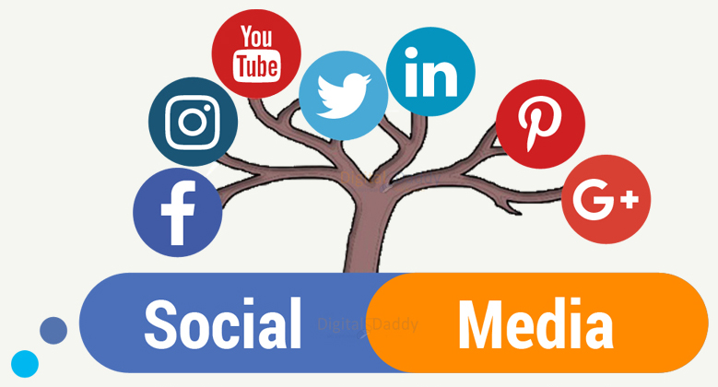
Introduction to Social Media Marketing
Social Media Marketing (SMM) is a digital marketing strategy that uses social media platforms to reach and engage with your target audience.
By creating and sharing valuable content to promote
  Products
  Services
  Brands
Engage with target audiences.

Slide 5

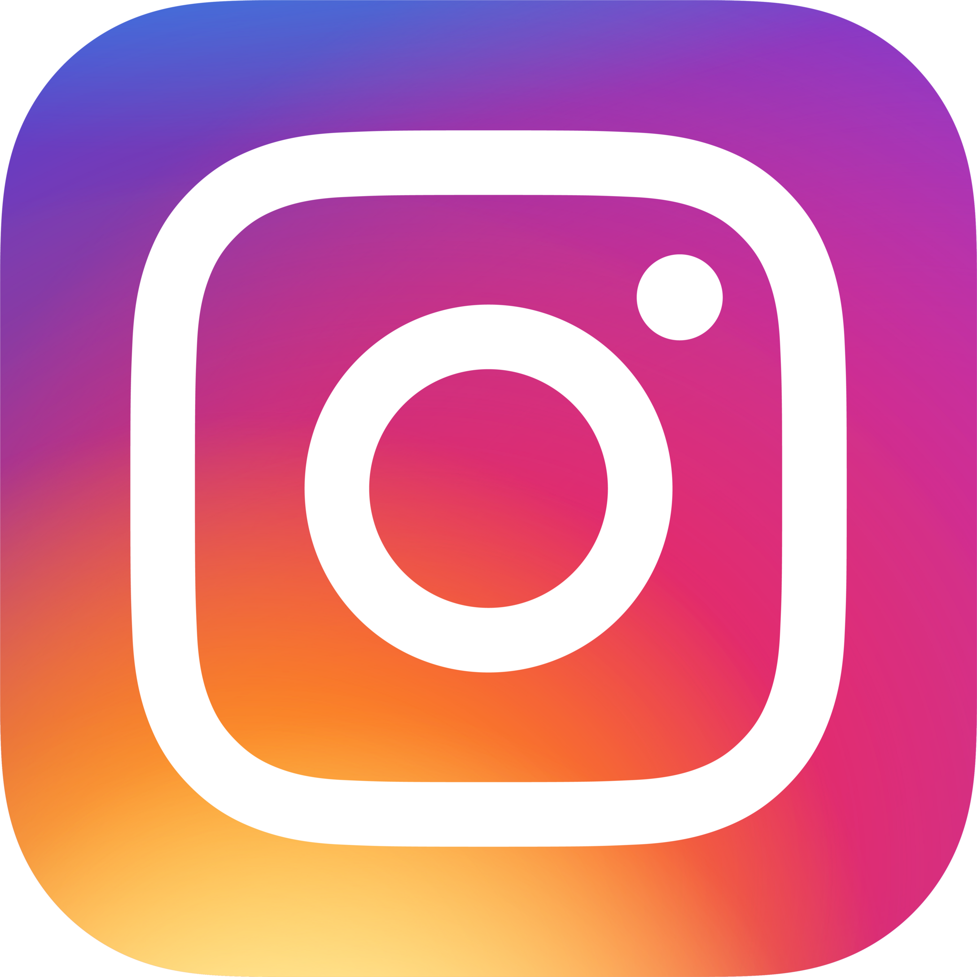


Key Social Media Platforms
Facebook:
  The largest social network, offering a variety of features like Pages, Groups, and advertising.
Instagram:
  Primarily a photo and video sharing platform, popular for its visual content and influencer marketing.
X (Formally Twitter):
  A microblogging platform where users can share short, 280-character messages known as tweets.
LinkedIn:
  A professional networking platform, ideal for B2B marketing and industry connections.

Slide 6
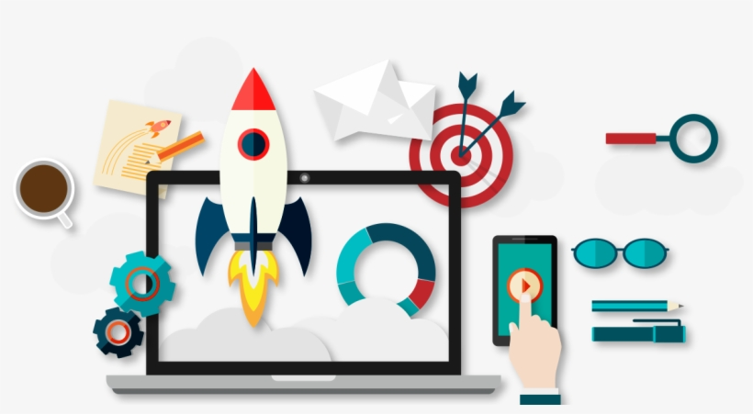

Key Social Media Platforms
Platform | Main Purpose | Best For
Facebook | Share Posts, Photos, Videos, And Ads | Brand Awareness, Community Building, Advertising
Instagram | Share Images, Reels, and Stories | Visual Marketing, Influencers, Fashion, Lifestyle
X (formerly Twitter) | Share Short Updates and News (280-character Messages known as tweets) | Real-time Communication, Customer Engagement
LinkedIn | Professional Networking | B2B Marketing, Recruitment, Business Branding
YouTube | Video Sharing Platform | Video Marketing, Tutorials, Product Demonstrations

Slide 7
Benefits of Social Media Marketing
Increased Brand Awareness
Reach a wider audience and build brand recognition
Improved Customer Engagement
Foster relationships with your customers and build loyalty
Enhanced Website Traffic
Drive traffic to your website and generate leads
Improved SEO
Social media signals can positively impact your search engine rankings.
Cost-Effective Marketing
Social media marketing can be a relatively affordable way to reach your target audience.

Slide 8
Limitation of Social Media Marketing
Time Consuming
Developing and maintaining Social media marketing strategies takes time.
Negative Feedback
Amplification of negative feedback and criticism can hurt brand reputation.
Algorithmic Change
Algorithm of social media platform can change which affect visibility.
Limited Reach
Organic reach on social media is limited, business need to invest in advertising.
Platform Dependency
Business can not rely on a single platform, they need to invest in multiple social media platform.

Slide 9
Types of Social Media Marketing

Slide 10
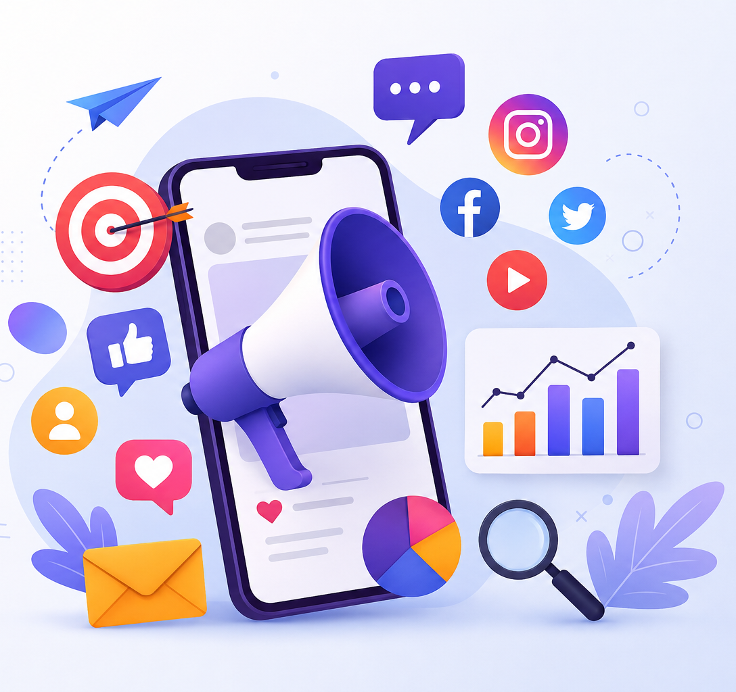
Types of Social Media Marketing
Content Marketing
Paid Advertising
Influencer Marketing
Social Media Optimization (SMO)
Social Media Stories
Social Media Polls and Surveys
Social Media Groups and Communities
Live Streaming
Social Media Analytics and Reporting

Slide 11
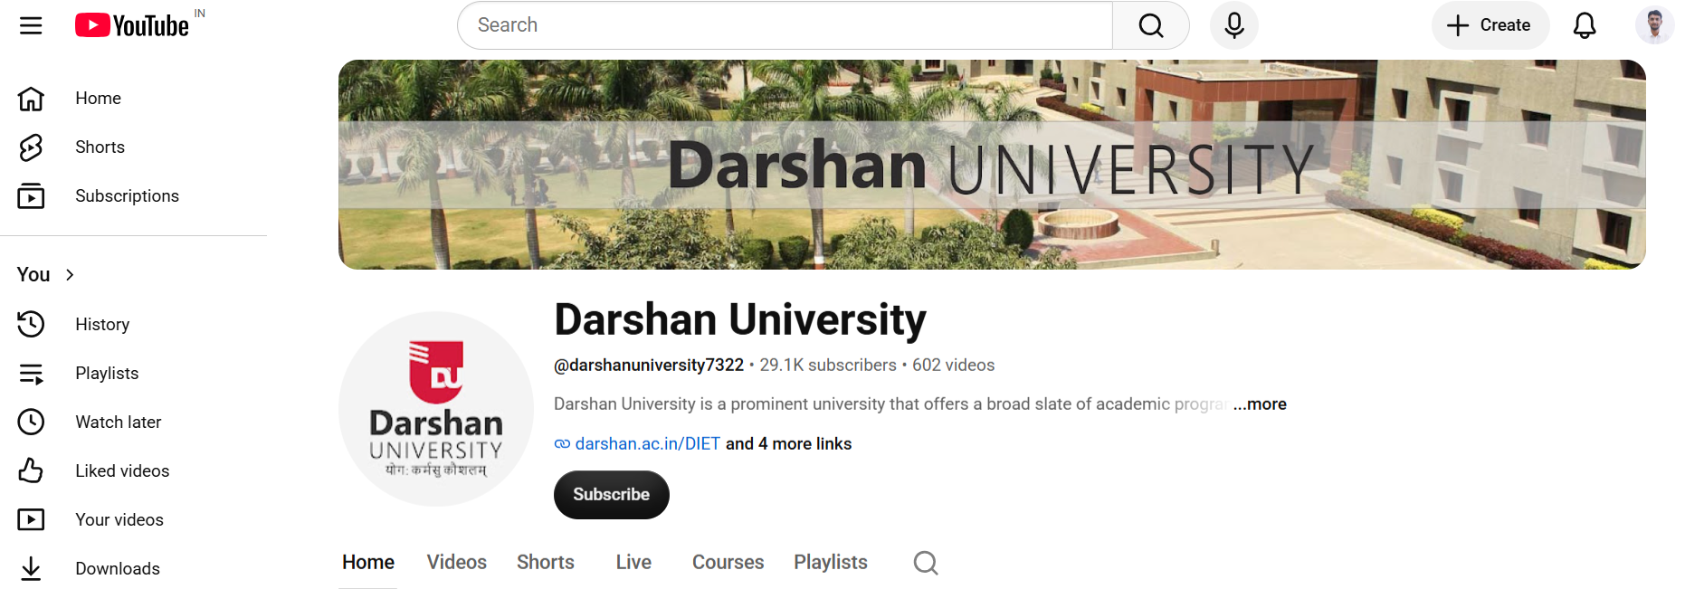
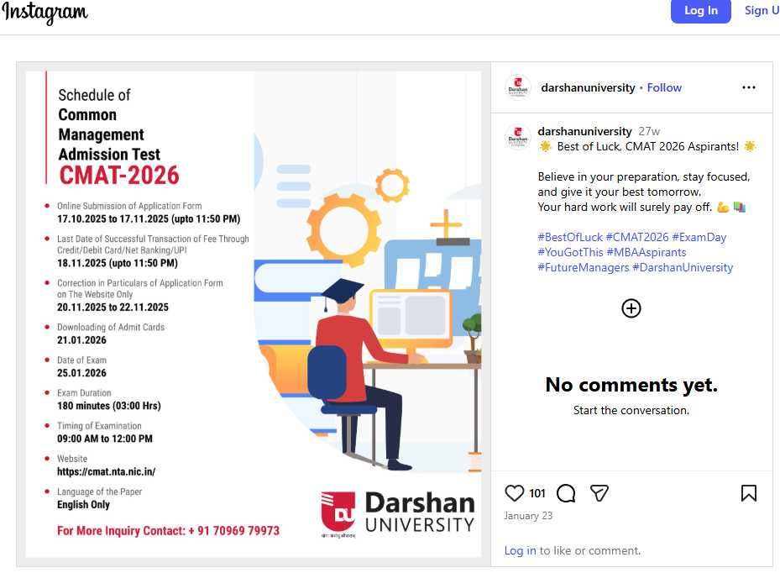
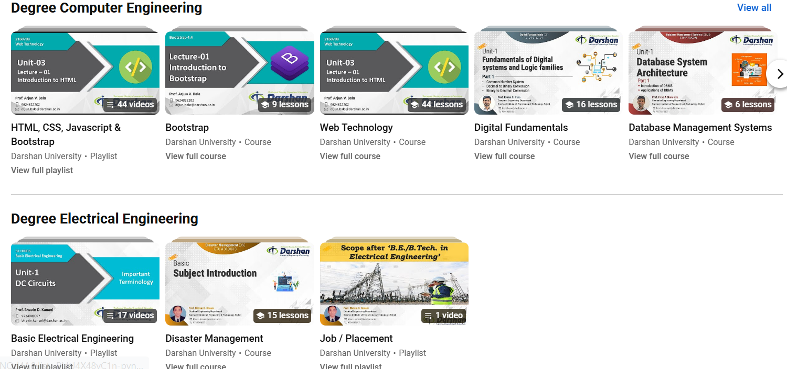
Types of Social Media Marketing: Content Marketing
Creating and sharing valuable content that resonates with your target audience.
Examples: blog posts, articles, infographics, videos, podcasts.

Slide 12
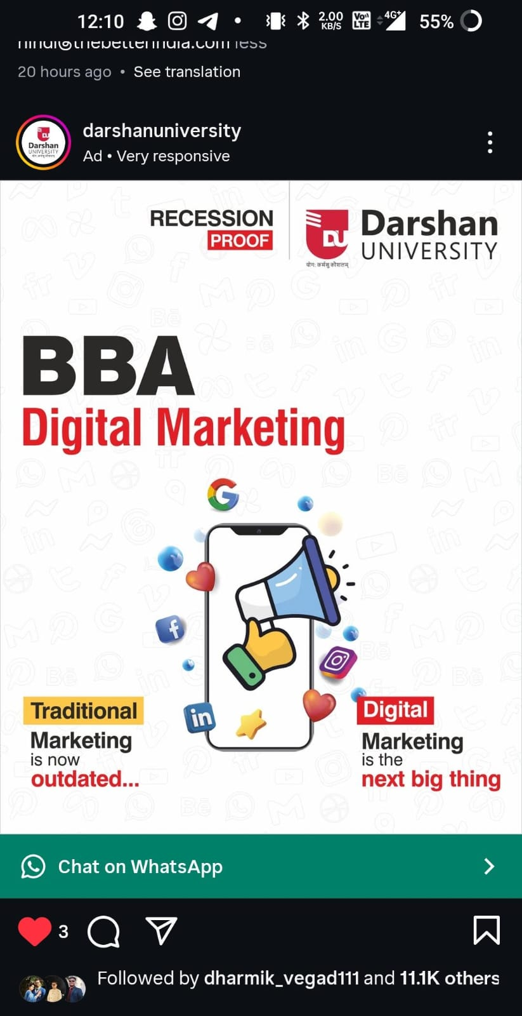
Types of Social Media Marketing: Paid Advertising
Using paid platforms to reach a wider audience and target specific demographics.
Examples: Facebook Ads, Instagram Ads, Twitter Ads, LinkedIn Ads.

Slide 13
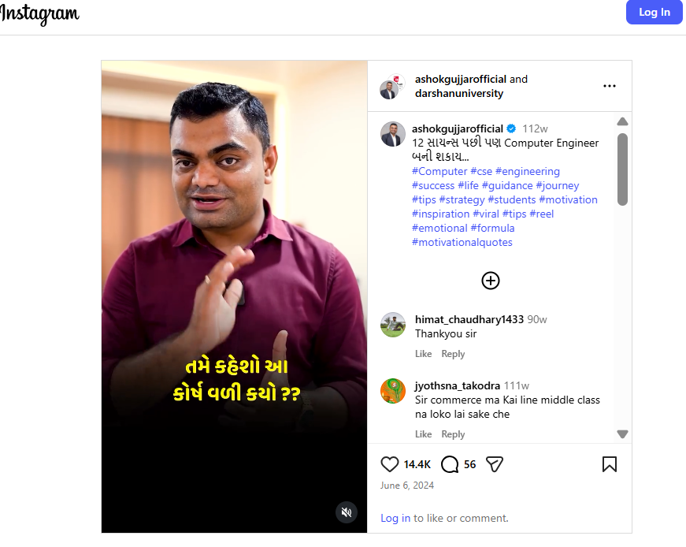
Types of Social Media Marketing: Influencer Marketing
Collaborating with influencers in your industry to promote your brand and reach their followers.
Examples: sponsored posts, product reviews, giveaways.
  Darshan University-1
  Darshan University-2
  Darshan University-3

Slide 14
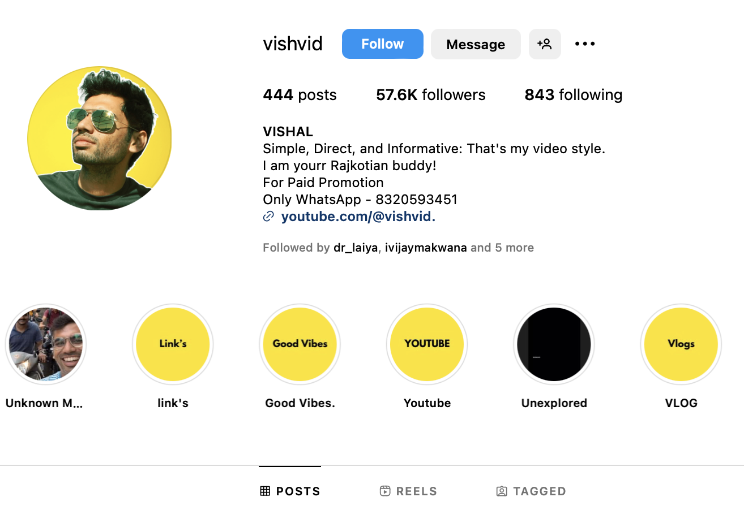
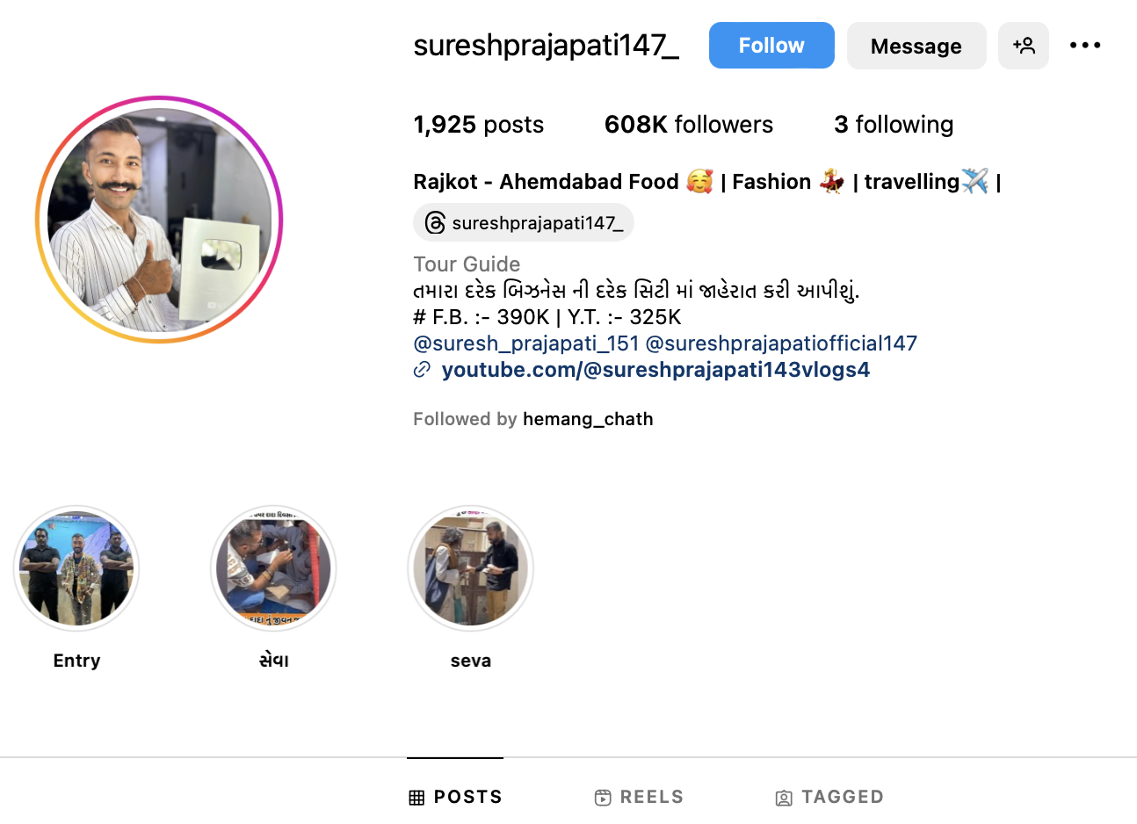
Types of Social Media Marketing: Social Media Optimization (SMO)
Optimizing your social media profiles to improve visibility and engagement.
Examples: using relevant keywords, creating visually appealing profiles, sharing content consistently.

Slide 15
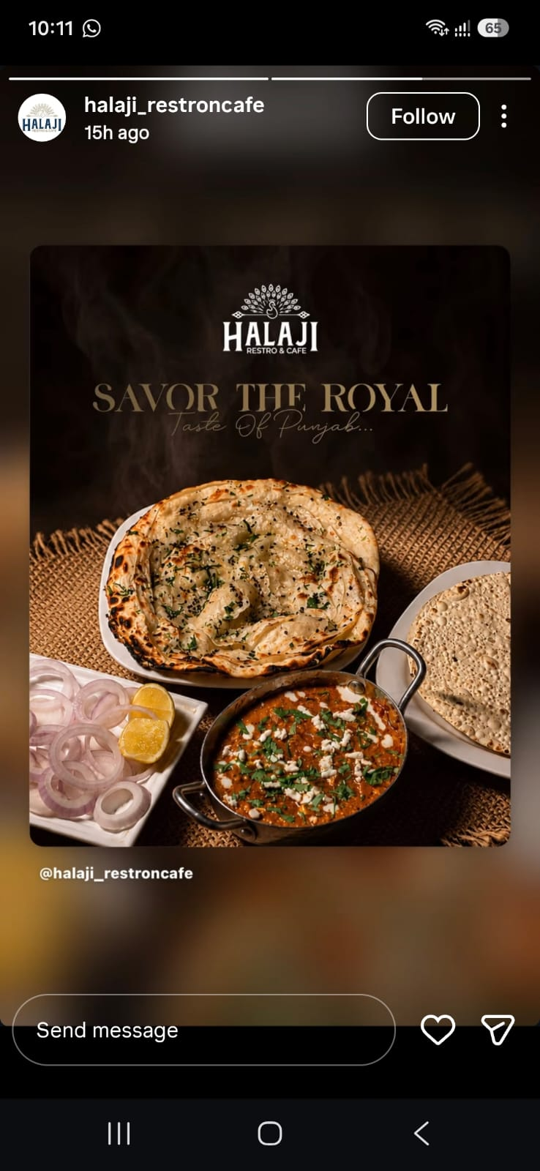
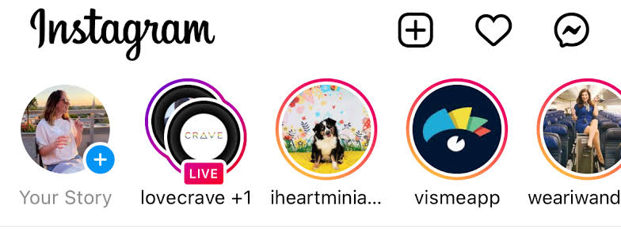
Types of Social Media Marketing: Social Media Stories
Short, temporary content that disappears after 24 hours.
Stories are ideal for sharing behind-the-scenes content, announcements, or daily updates.
Examples: Instagram Stories, Facebook Stories, Snapchat Stories, and LinkedIn Stories.

Slide 16
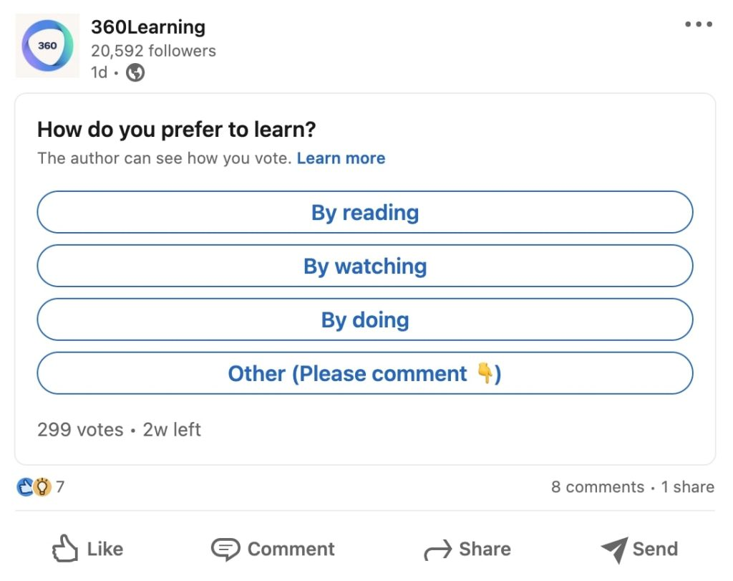
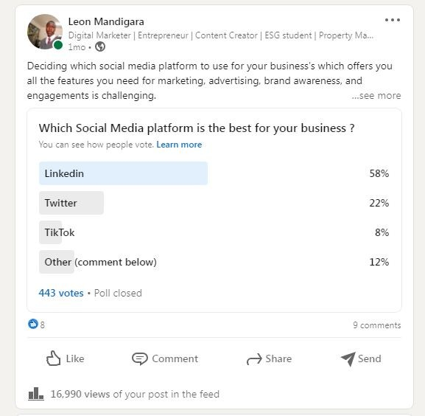
Types of Social Media Marketing: Social Media Polls and Surveys
Using built-in features on social platforms to gather
Opinions
Feedback
Insights from your audience.
Examples: Instagram Polls, Twitter Polls, and LinkedIn Polls to getting interest, preferences, or opinions on various topics.

Slide 17
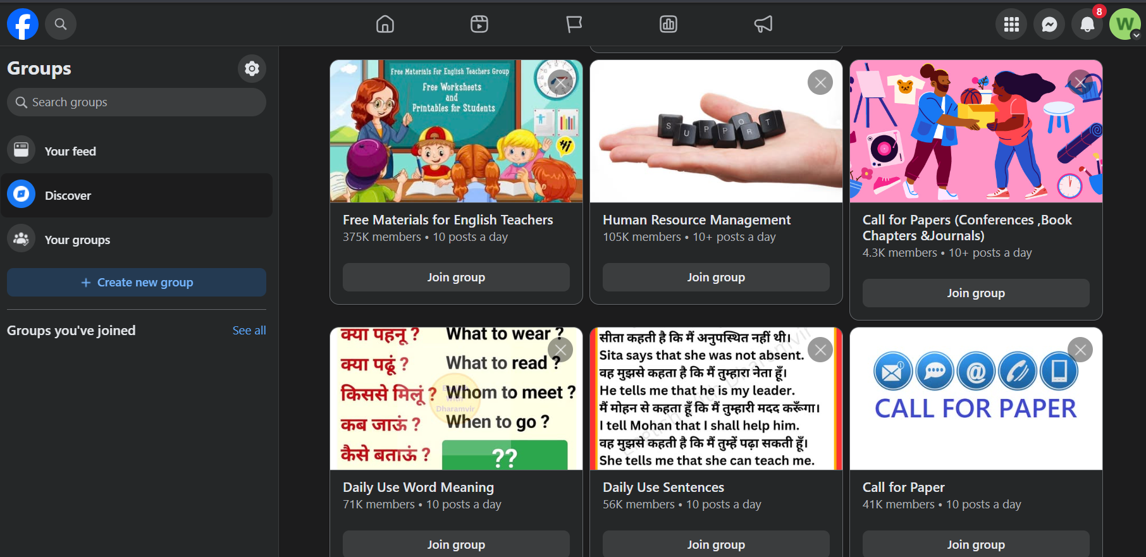
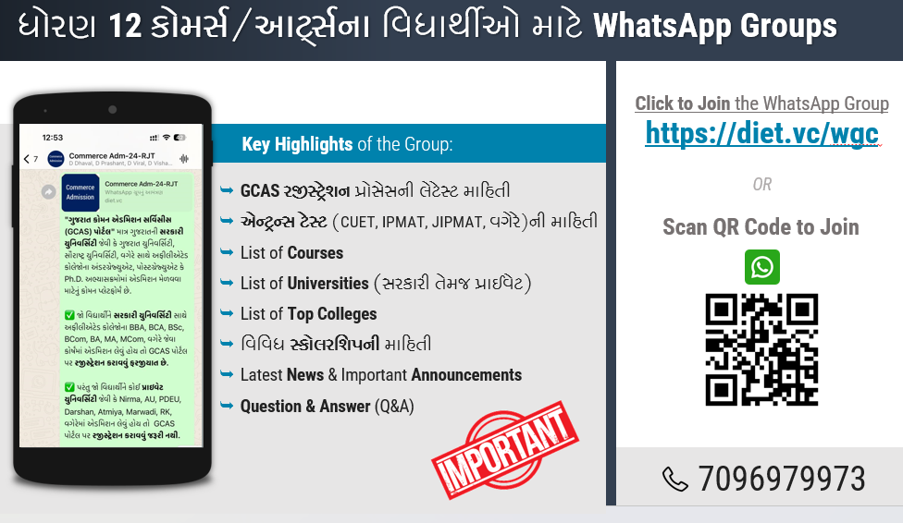
Types of Social Media Marketing: Groups and Communities
Creating or participating in groups or communities centered around your brand, industry, or topics of interest.
Examples: Facebook Groups, LinkedIn Groups, Reddit communities, and niche forums where users share and discuss relevant content.

Slide 18
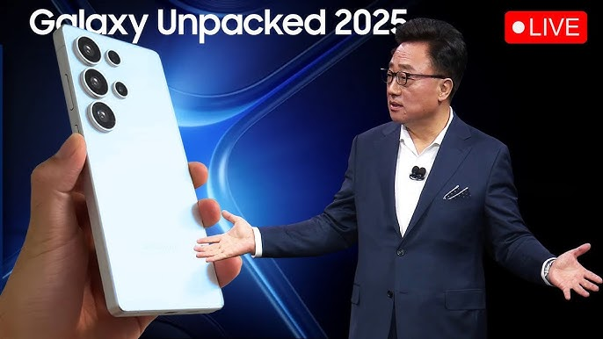
Types of Social Media Marketing: Live Streaming
Broadcasting live video content to connect with your audience in real-time.
Examples: Using YouTube, Facebook Live, and Instagram Live to broadcast
Events
Product launches
Q&A sessions in real-time.

Slide 19
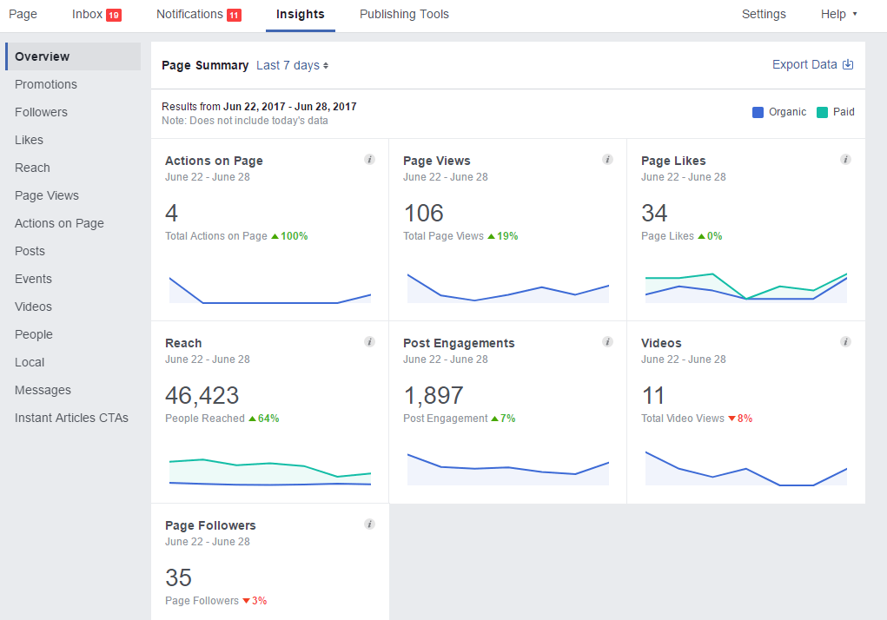
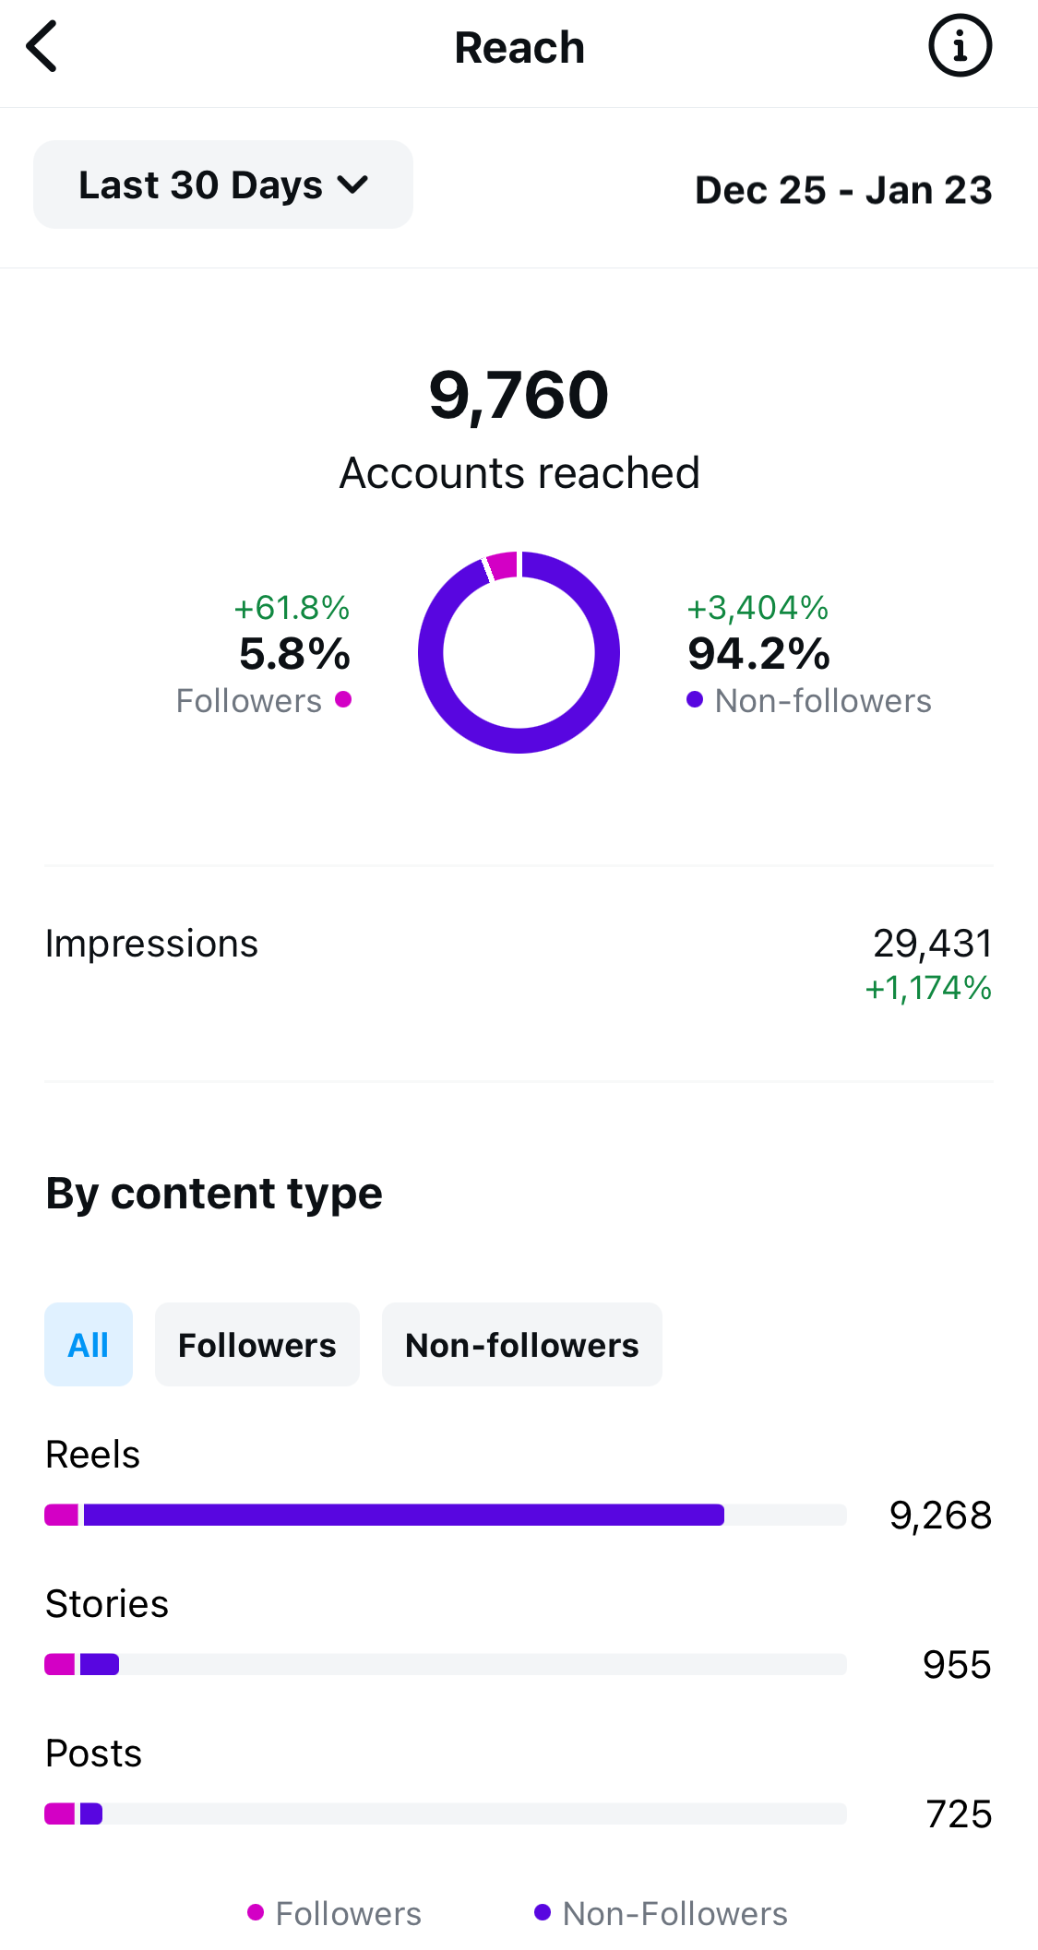
Types of Social Media Marketing: Analytics and Reporting
Regularly analyzing social media performance to track key metrics, understand audience behavior, and optimize strategies.
Examples: Using tools like Facebook Insights, Twitter Analytics, Instagram Analytics, and third-party platforms to measure engagement, reach, conversions, and ROI.

Slide 20
Building Social Media Marketing Strategies

Slide 21
Social Media Marketing Strategy
Building a successful social media marketing strategy involves several key steps.
Set Clear Goals
Understand Your Audience
Conduct a Competitive Analysis
Create Engaging Content
Leverage Influencers
Utilize Paid Advertising
Engage with Your Audience
Analyze and Adjust
Stay Updated with Trends
Maintain Consistency

Slide 22
Set Clear Goals
Specific
Define what you want to achieve (e.g., increase brand awareness, drive website traffic, generate leads).
Measurable
Ensure your goals can be tracked and measured.
Achievable
Set realistic and attainable goals.
Relevant
Align your goals with your overall business objectives.
Time-bound
Set deadlines for achieving your goals.

Slide 23
Understand Your Audience
Demographics
Age, gender, location, income, etc.
Interests
Hobbies, preferences, and behaviors.
Pain Points
Challenges and problems your audience faces.
Platforms
Identify which social media platforms your audience uses most.

Slide 24
Conduct a Competitive Analysis
Identify Competitors
Look at who your competitors are on social media.
Analyse Their Strategies
Examine their content, engagement, and tactics.
Find Gaps
Identify opportunities where you can differentiate yourself.

Slide 25
Create Engaging Content
Content Types
Use a mix of content types (e.g., blog posts, videos, infographics, stories).
Content Calendar
Plan and schedule your content in advance.
Quality Over Quantity
Focus on creating high-quality, valuable content.

Slide 26
Leverage Influencers
Identify Relevant Influencers
Find influencers who align with your brand and audience.
Build Relationships
Engage with influencers and build long-term partnerships.
Track Performance
Measure the impact of influencer collaborations.

Slide 27
6. Utilize Paid Advertising
Targeted Ads
Use social media ads to reach specific demographics.
Budgeting
Allocate a budget for paid campaigns.
A/B Testing
Test different ad creatives and strategies to see what works best.

Slide 28
Engage with Your Audience
Respond to Comments and Messages
Show that you value your audience’s input.
Host Live Sessions
Engage in real-time with your followers through live videos.
User-Generated Content
Encourage your audience to create and share content related to your brand.

Slide 29
Analyze and Adjust
Track Metrics
Monitor key performance indicators (KPIs) like engagement, reach, and conversions.
Analyse Data
Use analytics tools to understand what’s working and what’s not.
Adjust Strategy
Continuously refine your strategy based on data insights.

Slide 30
Stay Updated with Trends
Industry News
Keep up with the latest trends and changes in social media.
Platform Updates
Stay informed about new features and algorithm changes on social media platforms.

Slide 31
Maintain Consistency
Brand Voice
Ensure your content reflects your brand’s voice and values.
Posting Schedule
Maintain a consistent posting schedule to keep your audience engaged.

Slide 32
Activity
Form agencies of three to four.
Your challenge is to rapidly build a mini social media strategy for your assigned brand scenario focusing on goals, audience, content, and paid reach.
You have twelve minutes to collaborate using only rough notes or a whiteboard—no slides are allowed.
Keep your points concise, defend your strategic choices under tight constraints, and prepare for rapid cross-examination.
Topics:
  Artisan Handicrafts (Global E-Commerce Instagram Growth)
  EdTech Bootcamp (LinkedIn Lead Gen & Retargeting)
  Quick-Commerce App (Hyper-Local Push & Influencer Loops)
  Luxury Organic Skincare (Unboxing & Micro-Influencer Strategy)
  EV Two-Wheeler Startup (Launch Campaign & Community Building)

Slide 33
Introduction to Facebook Marketing

Slide 34
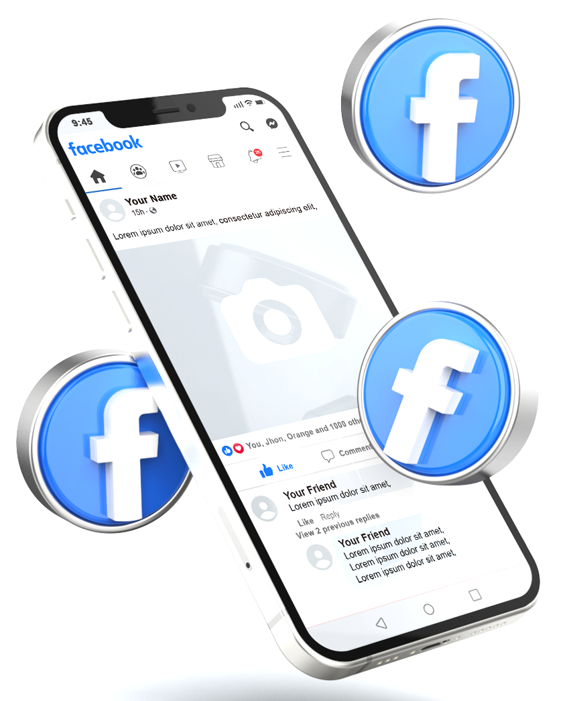
What is Facebook Marketing?
Facebook marketing involves promoting your company or brand on the Facebook platform.
This can include both organic content and paid advertisements.
The goal is to build brand awareness, generate leads, and drive sales.

Slide 35
Why Facebook Marketing?
Massive Audience:
  3.07 billion monthly active users.
  Prime platform for reaching global audience.
Targeted Advertising:
  To reach specific demographics, interests, behaviors, and even custom audiences based on past interactions.
Multiple Ad Formats:
  From image and video ads to carousel and slideshow formats.
  Offers a variety of ad types to showcase products and engage users.

Slide 36
Why Facebook Marketing?(Continue…)
Engagement Opportunities:
  Likes, comments, shares, reactions and other interactive features help brands communicate with customers.
  Engagement can help businesses build brand awareness, relationships and customer communities.
Data-Driven Insights:
  Meta Ads Manager provides campaign performance information to help marketers evaluate results.
  Businesses can use performance data to optimize campaigns, audiences, creatives and budgets. Meta's advertising system also optimizes delivery according to selected campaign objectives.

Slide 37
Facebook Algorithm for delivery of Ads

Slide 38
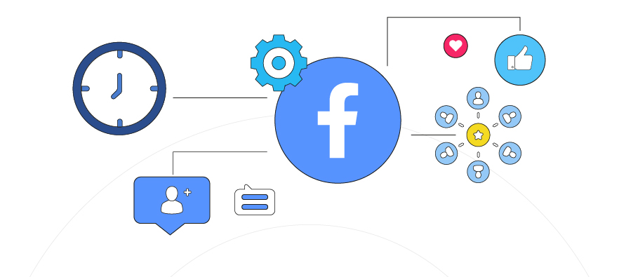
Facebook Algorithm for delivery of Ads
The Facebook algorithm for ad delivery is a sophisticated system.
It is designed to show the most relevant ads to users.
It uses user interests, behaviours, and interactions to determine which ads are most relevant to each user.

Slide 39
Key Components of the Facebook Ads Algorithm
Component | Easy Explanation | One-Line Example
1. Inventory | The system first identifies all ads that are eligible to be shown to a particular user. | Example: A user interested in fitness may be eligible to see ads for shoes, gym memberships, and fitness apps.
2. Signals | The system looks at information about the user and the ad to decide which ad is more suitable. | Example: If a user often watches fashion videos, fashion-related ads may be considered relevant.
• User Behaviour | It considers what users have previously clicked, watched, liked, or interacted with. | Example: A user who frequently clicks on smartphone ads may see more smartphone offers.
• Ad Performance | It considers how well an ad has performed with similar audiences. | Example: An ad receiving many clicks and purchases may be considered a strong-performing ad.
• Ad Relevance / Quality | It considers whether the ad is useful and appropriate for the people seeing it. | Example: A relevant running-shoe ad is more suitable for a person interested in running.
3. Predictions | The system predicts how likely a user is to take the desired action on an ad. | Example: If a user often clicks shopping ads, the system may predict a higher chance of clicking a new product ad.
4. Ad Quality / Relevance | Ads that provide a better experience and are more likely to achieve the advertiser's objective can have an advantage in the auction. | Example: A clear, useful product ad with positive user feedback may perform better than a misleading or low-quality ad.

Slide 40
How the Algorithm Works?
Bidding
  Advertisers bid for ad placements.
  The bid amount, combined with the relevance score, determines the ad’s overall value in the auction.
  Example: A clothing brand may bid ₹50 to reach potential customers.
Auction
  The algorithm runs an auction to decide which ads to show.
  It considers both the bid and the relevance score to select the most valuable ads for the user.
  Example: Even if Brand A bids higher, Brand B may win if its ad is more relevant and likely to get customer action.

Slide 41
How the Algorithm Works?
Ad Delivery
  The winning ads are then delivered to the user.
  The algorithm continuously monitors ad performance and user interactions to optimize delivery.
  Example: If users frequently click a shoes ad, Facebook may show it more often to similar interested users.
  Relevance: How well an ad matches the interests and needs of the target audience.

Slide 42
Facebook Marketing Assets

Slide 43
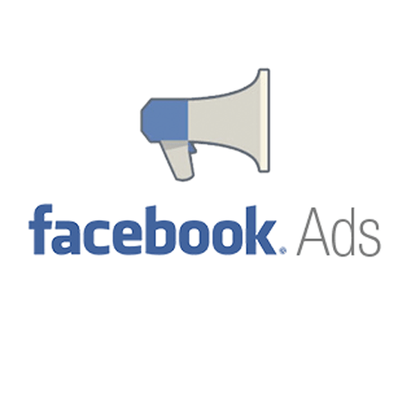





Assets of Facebook Marketing
Facebook Pages
Facebook Ads
Facebook Groups
Facebook Events
Facebook Ads Manager
Facebook Insights

Slide 44
Facebook Pages
A Facebook Page works like a digital storefront where a business can present its brand and communicate with customers.
Business Pages:
  A Facebook Page acts as a digital storefront where businesses can share content, interact with followers, and provide information about their brand.
Content Posting:
  Regularly sharing posts, images, videos, and updates helps keep your audience engaged and informed.
Customer Interaction:
  Pages allow businesses to respond to messages, comments, and reviews, fostering direct communication with customers.

Slide 45
Facebook Ads
Ad Manager:
  It is a powerful tool for creating and managing ad campaigns.
  It offers detailed targeting options and budget control.
Ad Formats:
  Image Ads: Simple yet effective, these ads use a single image to capture attention.
  Video Ads: Engaging and dynamic, video ads can tell a story or showcase a product in action.
  Carousel Ads: Allow users to swipe through multiple images or videos in a single ad.
  Slideshow Ads: Lightweight videos that combine multiple images with text and sound.
  Collection Ads: Feature a cover image or video, followed by several product images, ideal for e-commerce.

Slide 46
Facebook Ads (Continue…)
Targeting Options:
  Facebook allows precise targeting based on location, age, gender, interests, behavior, and more.
  Custom audiences can be created from customer lists, website visitors, or engagement data.
A/B Testing:
  Test different ad creatives, copy, and audiences to find the most effective combinations.

Slide 47
Facebook Groups
Community Building:
  Facebook Groups offer a space for users to connect over shared interests.
  Brands can create or participate in groups to engage with niche communities.
Exclusive Content:
  Groups can be used to offer exclusive content, deals, or support, fostering a sense of community and loyalty.

Slide 48
Facebook Events
Event Promotion:
  Facebook Events allow businesses to promote events, both online and offline.
  Users can RSVP, share, and engage with event-related content.
Live Events:
  Facebook Live allows real-time broadcasting, making it ideal for webinars, product launches, and interactive sessions.

Slide 49
Facebook Ads Manager
Facebook Ads Manager is a comprehensive tool that allows you to
  Create,
  Manage, and
  Analyze your ad campaigns
Facebook, Instagram, Messenger, and Audience Network.

Slide 50
Facebook Insights
Facebook Insights provides performance information about a Page and its content,
It helps businesses understand their audience and improve their marketing strategy.
Example: A business checks which posts received the most reach and engagement and creates more similar content.

Slide 51
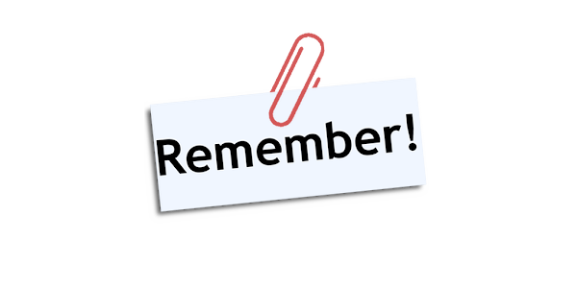
Assets of Facebook Marketing
Pages = Presence
Ads = Promotion
Groups = Community
Events = Interaction
Ads Manager = Control
Insights = Measurement
“Facebook Marketing is not just about reaching people; it is about reaching the right people, building relationships, and turning engagement into action.”

Slide 52
Key Features of Facebook Ads Manager
Ad Creation
  Ad Formats:
    Choose from various ad formats like image, video, carousel, slideshow, and collection ads.
  Creative Tools:
    Use tools like Creative Hub to design and preview your ads before they go live.
Campaign Management
  Campaign Structure:
    Organize your ads into campaigns, ad sets, and individual ads.
  Budgeting:
    Set daily or lifetime budgets for your campaigns.
  Scheduling:
    qChoose specific dates and times for your ads to run.

Slide 53
Key Features of Facebook Ads Manager (Continue…)
Targeting Options
  Demographics:
    Target based on age, gender, location, and more.
  Interests and Behaviors:
    Reach people based on their interests, activities, and behaviors.
  Custom Audiences:
    Upload your customer list or target people who have interacted with your business.
  Lookalike Audiences:
    Find new people similar to your existing customers.

Slide 54
Key Features of Facebook Ads Manager (Continue…)
Performance Tracking
  Analytics:
    Monitor key metrics like impressions, clicks, conversions, and return on ad spend (ROAS).
  Reports:
    Generate detailed reports to analyze the performance of your campaigns.
  A/B Testing:
    Test different versions of your ads to see which performs best.

Slide 55
Key Features of Facebook Ads Manager (Continue…)
Optimization Tools
  Automatic Placements:
    Let Facebook decide where to show your ads for the best results.
  Bid Strategies:
    Choose from different bidding strategies like cost per click (CPC), cost per thousand impressions (CPM), and cost per action (CPA).
  Ad Relevance Diagnostics:
    Get insights into how relevant your ads are to your target audience.

Slide 56
Creating & Optimizing Advertising Campaigns

Slide 57
How to Use Facebook Ads Manager
Access Ads Manager
  Go to Facebook Ads Manager and log in with your Facebook account.
Create a Campaign
  Click on the “Create” button and choose your campaign objective (e.g., brand awareness, traffic, conversions).
Set Up Ad Sets
  Define your target audience, budget, and schedule for each ad set within your campaign.
Optimize and Scale
  Use the data from your campaigns to optimize your ads.
  Scale successful campaigns by increasing the budget or expanding your target audience.

Slide 58
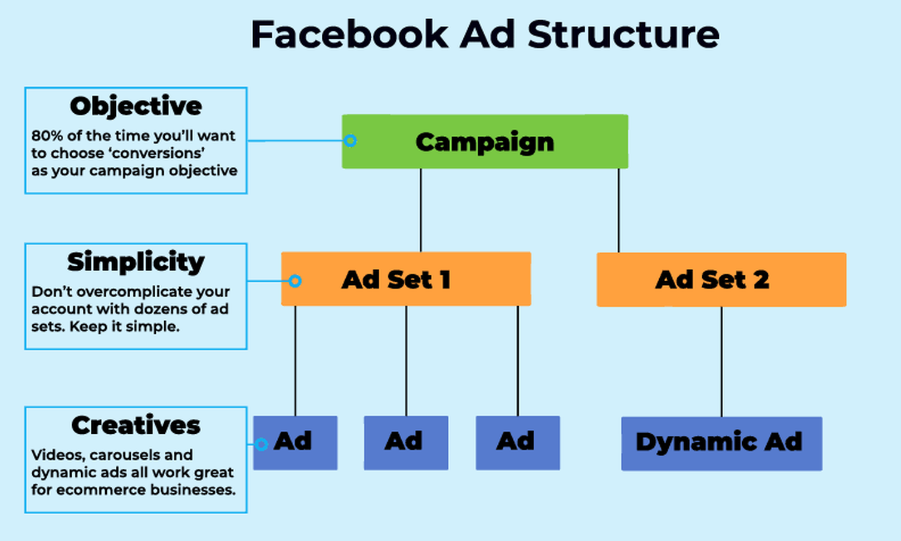
How to Use Facebook Ads Manager (Continue…)

Slide 59
Facebook Insights

Slide 60
Facebook Insights
Facebook Insights is a powerful analytics tool that helps track and analyze the performance of Facebook business page.
Key aspects to understand:
Page Views and Likes
  Track the number of views and likes your page receives over time.
Post Reach and Engagement
  Measure how many people see your posts and how they interact with them (likes, comments, shares).
Audience Demographics
  Get insights into the age, gender, location, and other demographics of your audience.

Slide 61
Facebook Insights (Continue…)
Post Performance
  Analyze which posts are performing well and why, helping you to optimize your content strategy.
Competitor Analysis
  Monitor and compare your page’s performance with similar pages.

Slide 62
Introduction of digital marketing Strategies through Instagram

Slide 63
Introduction of digital marketing Strategies through Instagram
Instagram marketing is the use of the platform to promote a brand, product, or service.
It combines creative content, strategic planning, community engagement, and data analysis to build brand awareness, foster authentic relationships, and drive sales.
Account Setup and Optimization
  Switch to a Professional Account: Convert your personal account to an Instagram Business or Creator account to unlock powerful tools like Meta Ads Manager, detailed analytics (Instagram Insights), and Instagram Shopping.
  Optimize Your Profile: Your bio must clearly state who you serve, how you help them, and include a clear Call-To-Action (CTA) with a link. Use a recognizable profile picture, like a brand logo or professional headshot.

Slide 64
Types of Instagram Content

Slide 65
Reels (Short-Form Video)
Best for: Massive reach, brand awareness, and discovering new audiences.
How to use: Create entertaining skits, quick tutorials, step-by-step guides, or highly relatable "problem-aware" videos showcasing how your product solves a common pain point.

Slide 66
Carousels (Multiple Images or Short Videos)
Best for: Deep-dive education, step-by-step guides, case studies, and saving for later.
How to use: Swipe able multi-slide posts allow you to provide massive value by breaking down complex topics. Perfect for sharing "Dos and Don'ts," myth-busting, or before-and-after transformations.

Slide 67
Stories (Ephemeral Content)
Best for: Daily connection, driving immediate action, and building community.
How to use: Use interactive stickers (polls, sliders, and Q&As) to directly engage your audience and run market research. Share behind-the-scenes moments, time-limited flash sales, and product teasers.
Save the best ones to your profile Highlights so new visitors can learn about your business immediately.

Slide 68
User-Generated Content (UGC) & Testimonials
Best for: Trust-building and social proof.
How to use: Reshare posts and reviews from real customers who love your product. Authentic UGC makes a brand highly relatable and provides unvarnished validation of your service or product quality.

Slide 69
Single Photo Posts
Best for: Aesthetic branding, quick announcements, and quotes.
How to use: High-quality, high-resolution product photography, motivational/industry quote graphics, or clear, simple images highlighting a major brand announcement.

Slide 70
Instagram Live
Best for: Real-time engagement, Q&A sessions, and product launches.
How to use: Host an "Ask Me Anything" (AMA), give a live tour of your workspace, or do a live demonstration of how your product works.

Slide 71
Instagram Shop
Best for: Seamless purchasing directly from the app.
How to use: Tag products directly in your Posts, Stories, and Reels. This shortens the buyer's journey by allowing users to tap and purchase without leaving Instagram.

Slide 72
Instagram Broadcast Channels (One-to-Many Messaging)
Best for: Direct DM inbox reach, VIP engagement, and customer retention.
How to use: Send text updates, raw voice notes, interactive polls, or exclusive sneak peeks directly to your most loyal followers to bypass the feed algorithm entirely.

Slide 73
Instagram Ads

Slide 74
Instagram Ads
Instagram Ads are paid posts that businesses use to promote products or services to specific target audiences across the platform.
Managed primarily through Meta Ads Manager, these ads allow brands to bypass the organic algorithm by directly funding guaranteed visibility in user feeds, stories, and reels.

Slide 75
Instagram Ads (Summary)
Instagram Ad Type | Description / Purpose
Photo Ads | Photo ads are simple image-based advertisements used to create strong visual impact. Businesses use them for product promotion, brand awareness, announcements, discounts, and promotional campaigns. They are effective because users can quickly understand the message through a single attractive image.
Video Ads | Video ads help businesses explain products and services in a more engaging way. They are commonly used for storytelling, product demonstrations, tutorials, customer testimonials, and brand awareness campaigns. Videos attract more attention and improve audience engagement compared to static images.
Carousel Ads | Carousel ads allow businesses to display multiple images or videos in a single advertisement. Users can swipe through different cards. These ads are ideal for showcasing multiple products, explaining step-by-step processes, or showing products from different angles.
Stories Ads | Story ads appear in full-screen vertical format between users’ Instagram stories. They are highly immersive and interactive. Businesses use them for limited-time offers, flash sales, event promotions, and interactive campaigns using stickers, polls, or links.
Reels Ads | Reels ads are short vertical video advertisements shown between Instagram reels. These ads are designed to be entertaining, fast-paced, and attention-grabbing. Businesses use reels ads to increase reach, engage younger audiences, and create viral marketing campaigns.
Collection Ads | Collection ads are designed mainly for e-commerce businesses. They combine a primary video or image with multiple product images displayed below it. When users tap the ad, they are taken to an Instant Experience landing page for a seamless shopping experience.

Slide 76
Campaign Setup Structure
Campaign Level: You establish your overarching business goal. This includes Awareness (reach), Traffic (link clicks), Engagement (video views/messages), Leads (forms), or Sales (conversions).
Ad Set Level: You define your conversion location, set a daily or lifetime budget, and configure ad placement settings.
Ad Level: You upload your physical assets (images/videos), write the text copy, input the destination landing page URL, and attach the Call-to-Action (CTA) button.

Slide 77
Instagram Insights.

Slide 78
Delivery & Visibility Insights (Top Funnel)
These metrics show how effectively your budget is pushing your visual content onto user feeds, stories, and reels.
  Impressions: The total number of times your ad was displayed on screen, even if clicked multiple times by the same profile.
  Reach: The exact number of unique individual user accounts that saw your ad at least once.
  Frequency: The average number of times each unique person has seen your ad over a specific period (Impressions ÷ Reach). Keep this number below 3 for cold audiences to avoid ad fatigue.
  CPM (Cost Per Mille): The financial cost to buy exactly 1,000 impressions on the platform. It measures how expensive it is to compete for your chosen target audience's attention.

Slide 79
Attention & Engagement Insights (Middle Funnel)
These metrics reveal whether your ad's creative hook successfully stopped a user from scrolling.
  CTR (Click-Through Rate): The percentage of people who saw your ad and actually clicked it (Clicks ÷ Impressions × 100). A low CTR usually indicates a mismatch between your creative and target audience.
  CPC (Cost Per Click): The average amount you pay each time a user taps your ad's link destination.
  Video Hook Rate (3-Sec View Rate): The percentage of viewers who watched the first 3 seconds of a video ad out of total impressions. This measures the strength of your video's opening hook.
  Video Hold Rate (ThruPlay): The number of times your video ad was watched to completion, or for at least 15 seconds.

Slide 80
Conversion & Action Insights (Bottom Funnel)
These metrics tie your Instagram ad spend directly to tangible business outcomes and revenue.
  Conversions / Results: The total number of times your target goal was achieved, such as purchases completed, leads collected, or app installs triggered.
  CPA / CPL (Cost Per Action / Lead): The exact amount of ad budget spent to acquire one conversion or lead.
  ROAS (Return on Ad Spend): The financial efficiency ratio calculated by dividing gross ad revenue by total ad spend. For example, a 4x ROAS means you earned $4 for every $1 spent on ads.

Slide 81
Digital Marketing & SEO
2504MN313
Mr. Prashant Parmar
Darshan Institute of Management
prashant.parmar@darshan.ac.in
9586371604

